Slide 1
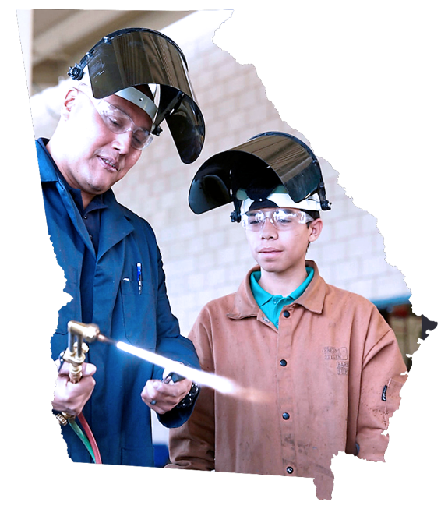

RURAL WORKFORCE
DEVELOPMENT
IDEAS AND PROMISING PRACTICES
from the State of Georgia
GREG WILSON
Carl Vinson Institute of Government
Workforce Development & Economic Analysis Manager

Slide 2
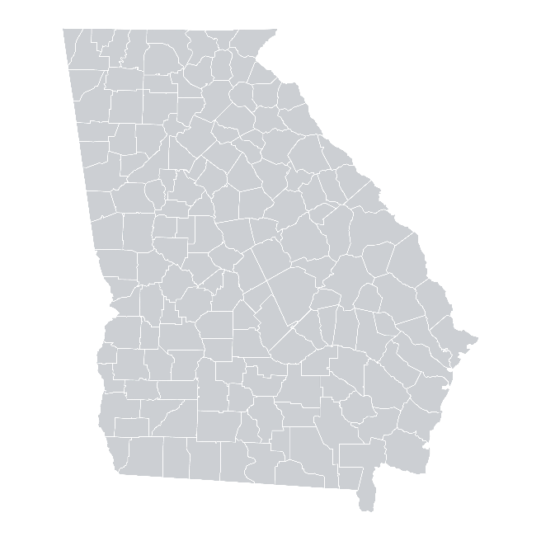


1
Showing Opportunity in
Rural Georgia to Young Adults
Promising Practices
from the
State of Georgia
2
Collaborating Across a Region for Key Industries
3
Building Talent-Driven Economic Development Strategies

Slide 3
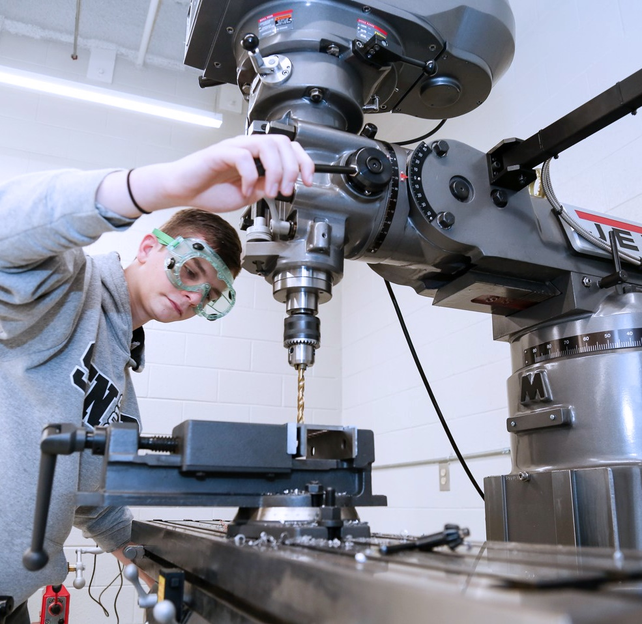
1
Showing
Opportunity
in Rural Georgia
to Young Adults

Slide 4


Slide 5

Creating More
Hands-on-Learning
Opportunities
for Young Adults
Free resources available at www.gaworkforce.com/explearning

Slide 6

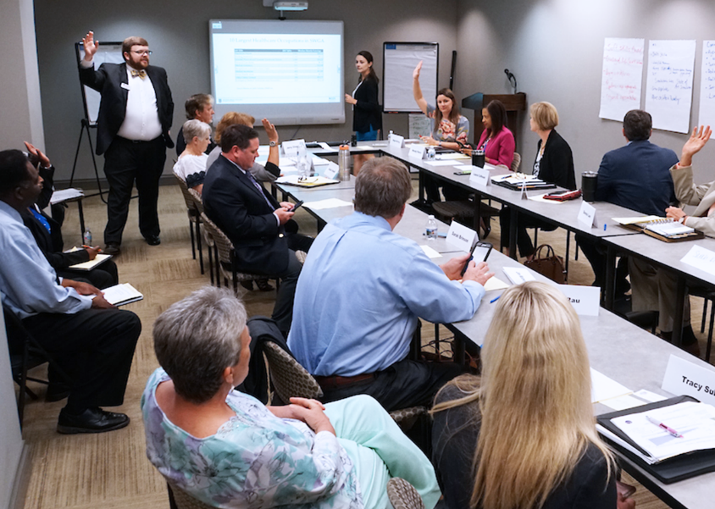
2
Collaborating
Across a Region
for Key Industries
Terrell
Lee
Calhoun
Dougherty
Worth
Early
Baker
Miller
Mitchell
Colquitt
Seminole
Decatur
Grady
Thomas
Building healthcare workforce in
Southwest Georgia

Slide 7
3
Building Talent-Driven
Economic Development Strategies

Slide 8
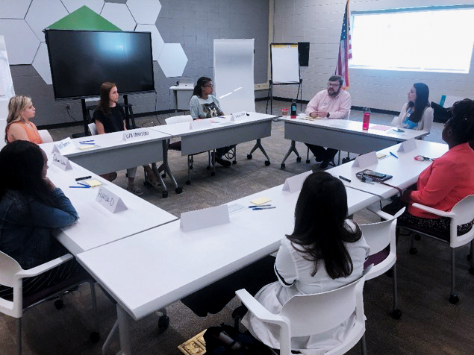
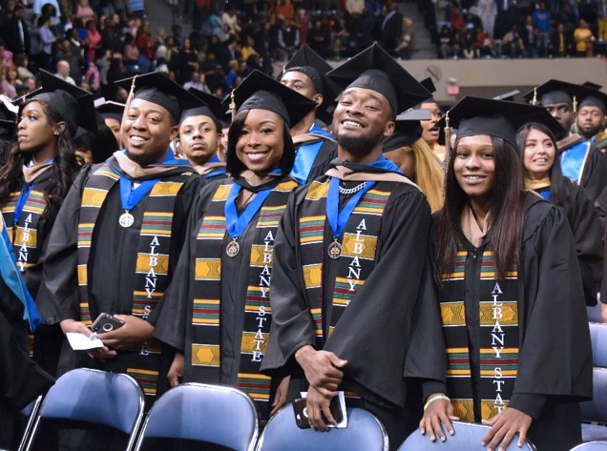
3
Building
Talent-Driven
Economic Development Strategies
Designing and Implementing
Local Workforce
Development Strategies

Slide 9
3
Building Talent Driven
Economic Development Strategies
Aligning
Educational Efforts
to In-Demand Jobs
Available at
www.gaworkforce.org/alignment

Slide 10
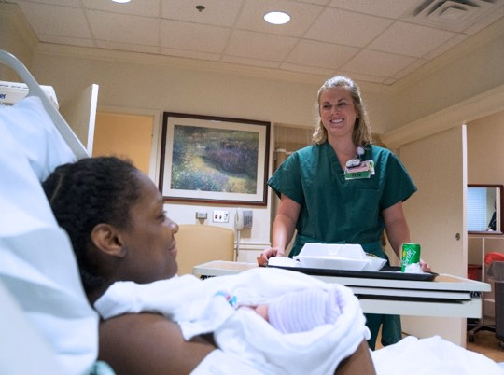
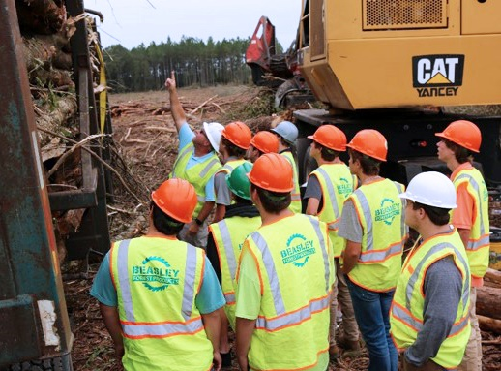
3
Building
Talent-Driven
Economic Development Strategies
Aligning
Educational Efforts
to In-Demand Jobs
Notes:
1) Pathways to Nursing Careers—Multiple Exit Points
2) Timber Harvesting Program

Slide 11
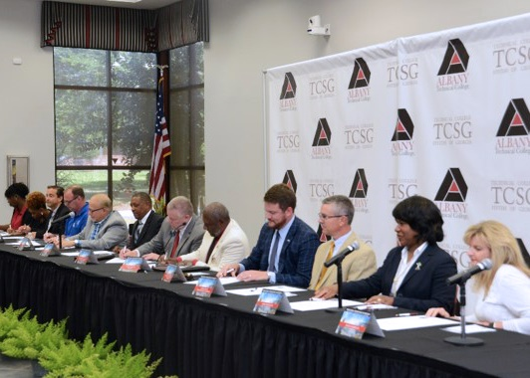
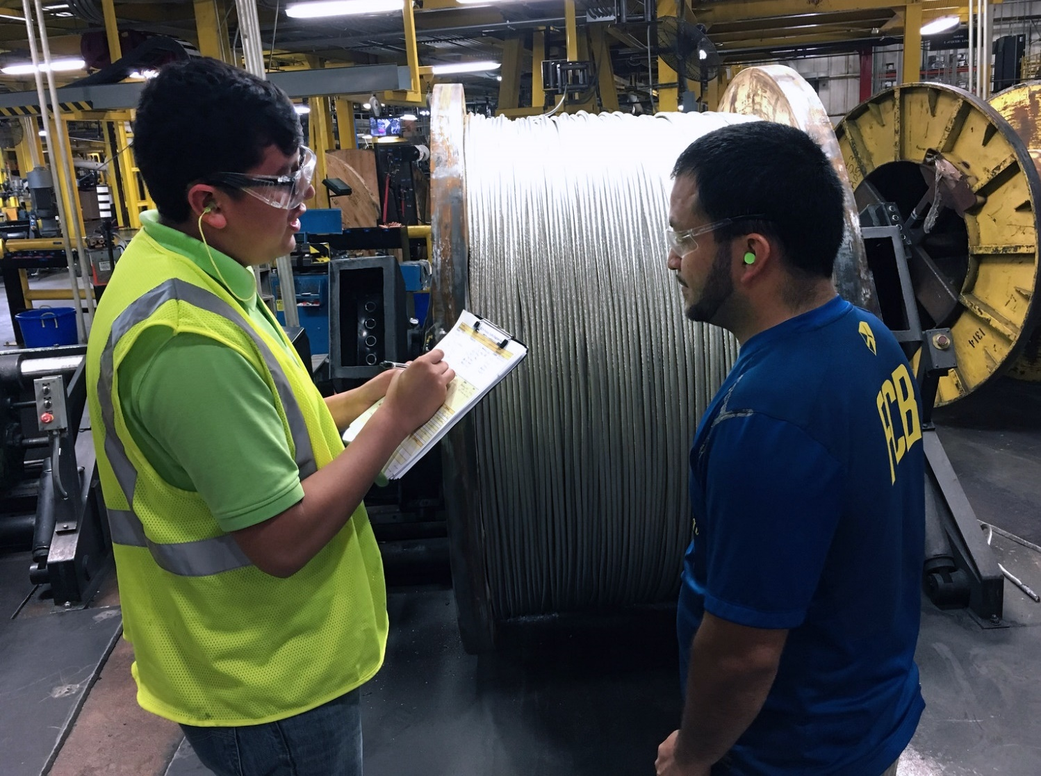
3
Building
Talent-Driven
Economic Development Strategies
Aligning
Educational Efforts
to In-Demand Jobs
Notes:
Customized Programs to Adults into High Demand Careers
Pre-Apprenticeship Programs

Slide 12

THANK YOU!
GREG WILSON . gjwilson@uga.edu . (706) 542-6271

