Slide 1
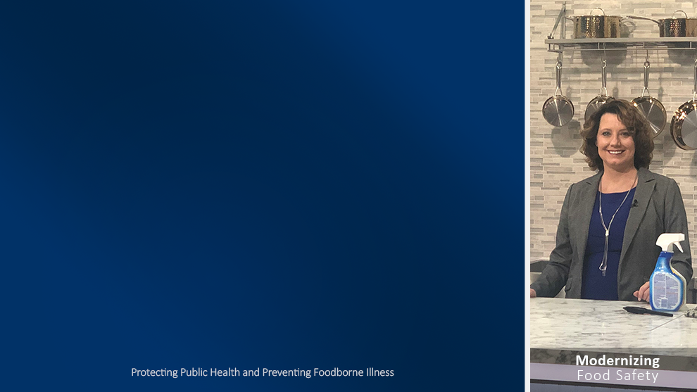
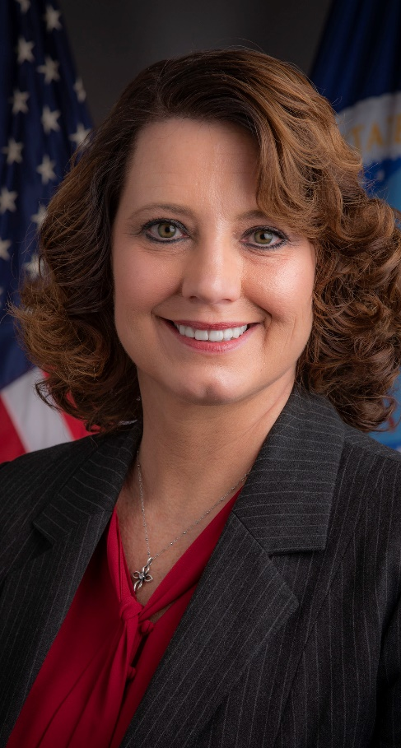

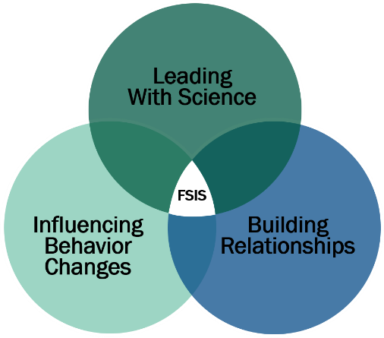
2020 Vision: Focus on the Future
Agricultural Outlook Forum
Arlington, Virginia
February 21, 2020
Mindy Brashears, Ph.D.
Deputy Under Secretary for Food Safety
U.S. Department of Agriculture
Protecting
Public Health

Slide 2


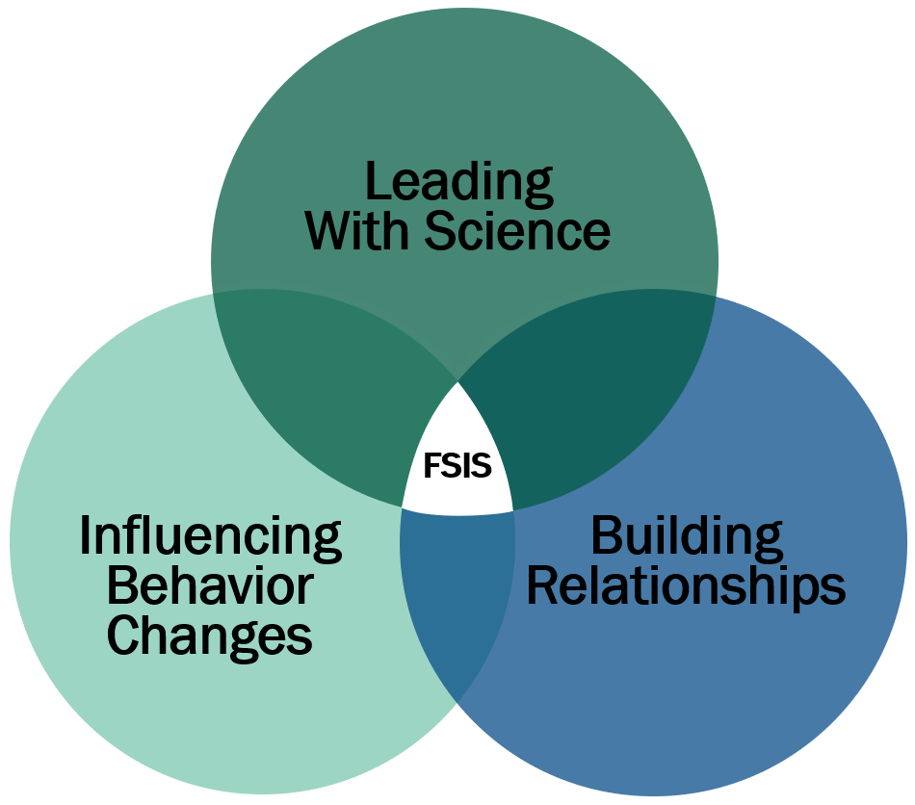
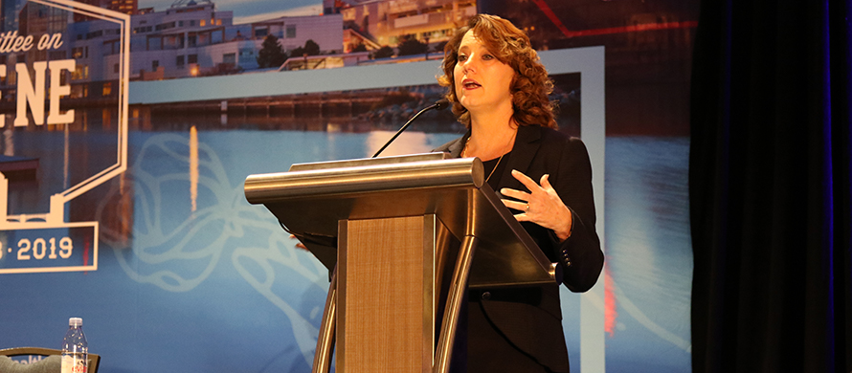
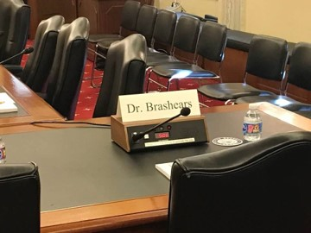
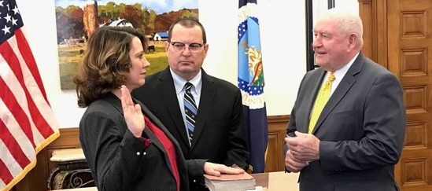
The Path to Washington
Notes:
The commitment to ensure food safety is what started my path to Washington.

Slide 3
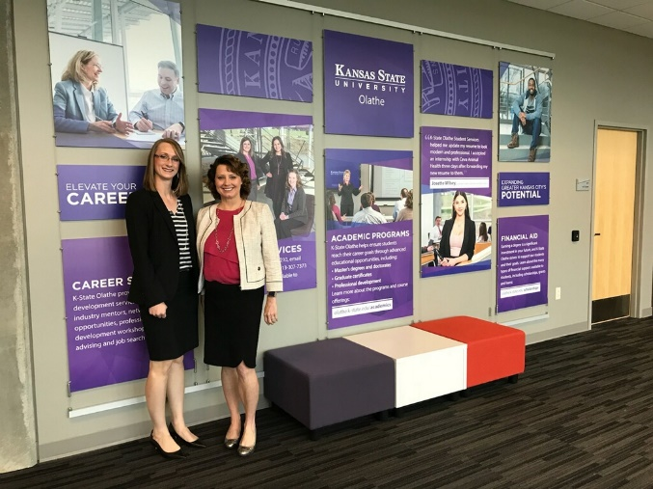
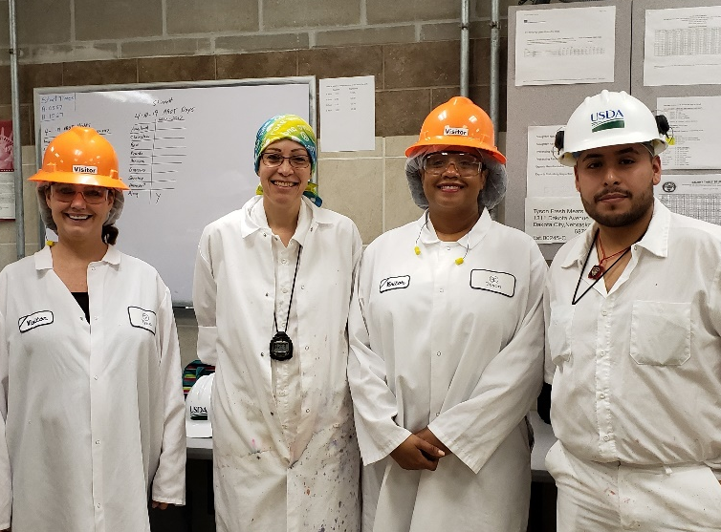

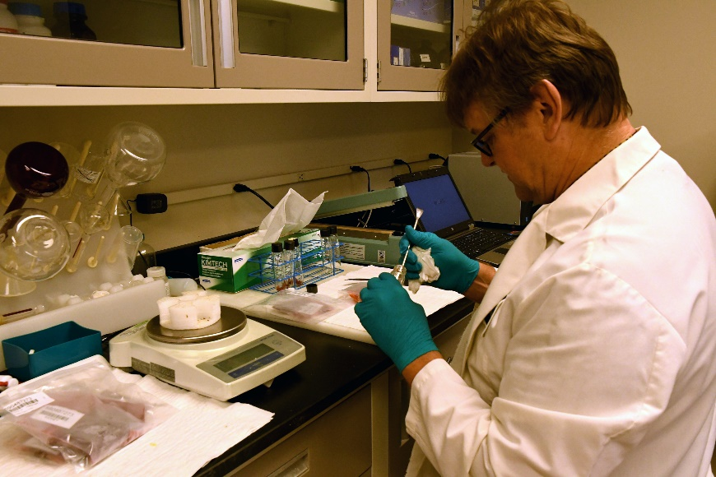
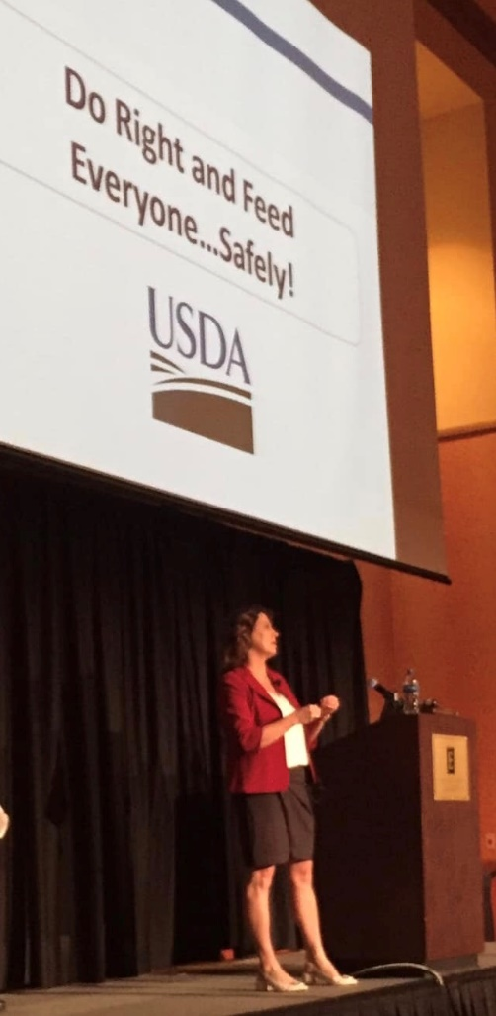
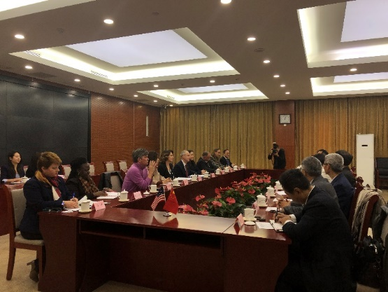
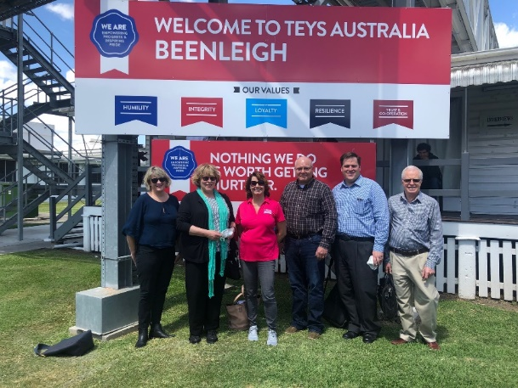
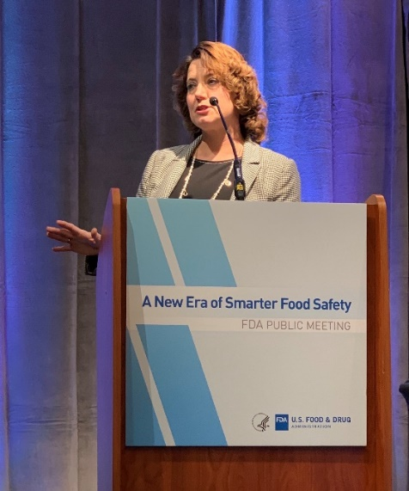

Notes:
As a true scientist, I have been gathering data in the “field” to gain a strong understanding of FSIS and the policies of the agency.
From these interactions and learning experiences, I have set forth a “2020 Vision.”

Slide 4
2020 Vision:
Focus on the Future
Notes:
Three overlapping and inter-related objectives

Slide 5

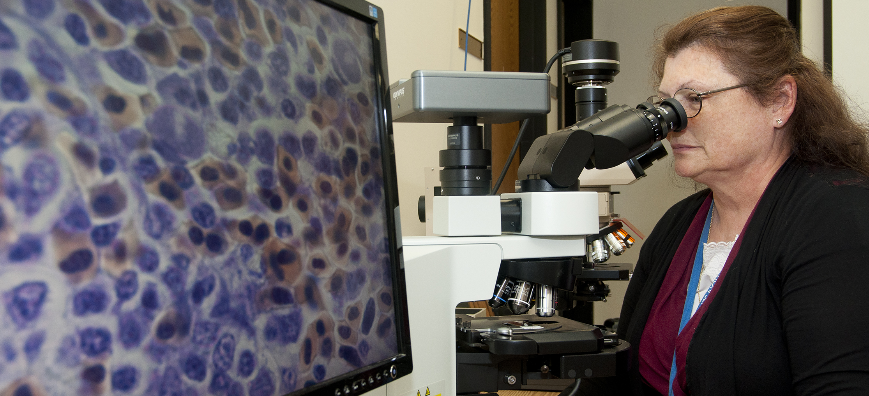

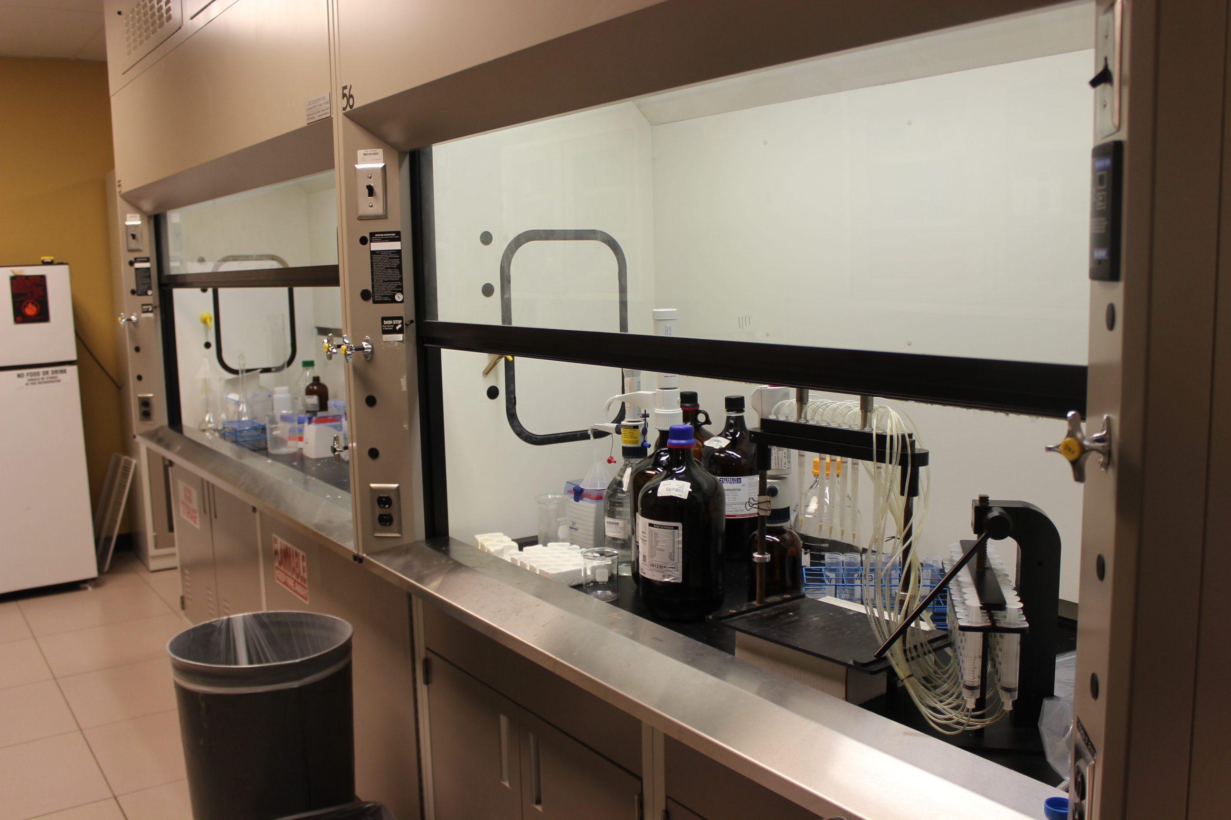
Notes:
While my foundation as a scientist has remained strong, I have learned to view food safety through a regulatory lens.
Now, I have the responsibility to protect the health of the American people through food safety.
In this role, I am intensely focused on finding solutions with genuine applications to prevent foodborne illness and save lives.
Numerous times over the past year, outside organizations have presented me with documents that are characterized as “research studies” that are simply collections of emotional anecdotes.
Theses anecdotes frequently come from biased populations or are taken completely out of context; they are twisted and manipulated to support an agenda.
We will make data-driven and science-based decisions.
One of the most surprising things I have experienced in this role is the request to make substantial decisions based on anecdotes and hearsay.
We will NOT do that.

Slide 6
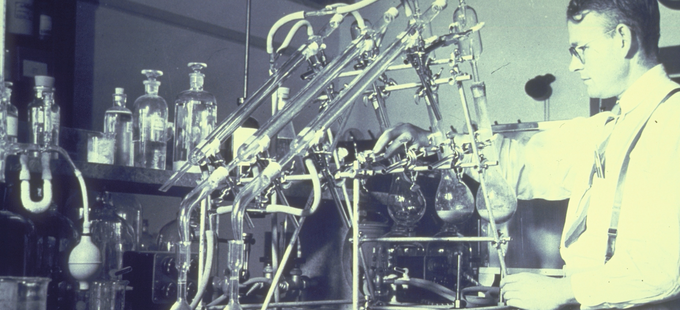
Leading
With Science
Past

Slide 7
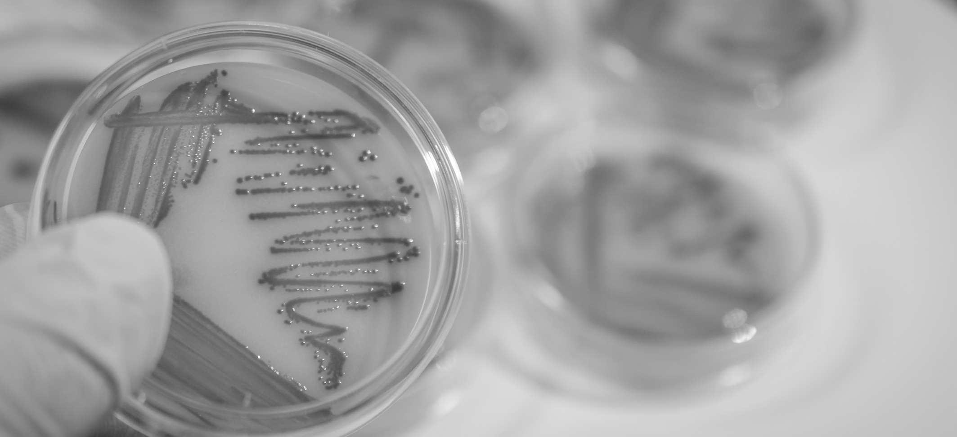
HACCP Rule — 1998
Development of first interventions
E. coli O157:H7 an adulterant
Additional interest
Pre-harvest research
Irradiation
Sampling and testing methods
Leading
With Science
Innovation Driven by Policy
Notes:
In the past, food safety policies from the 1990’s sparked innovation in several areas.
In 1998, FSIS introduced the Hazard Analysis and Critical Control Point, or HACCP, principles into inspection systems.
HACCP represented a paradigm shift for food safety and prompted the development of some of the first food safety interventions.
Around this time, FSIS also moved to classify E. coli O157:H7 as an adulterant in raw ground product.
This spurred additional interest in processing interventions, including pre-harvest research and new sampling and testing methodology.
Research into the application of irradiation as a food safety intervention was also advanced and we first saw what a powerful tool irradiation could be for ensuring safety of raw food products.

Slide 8
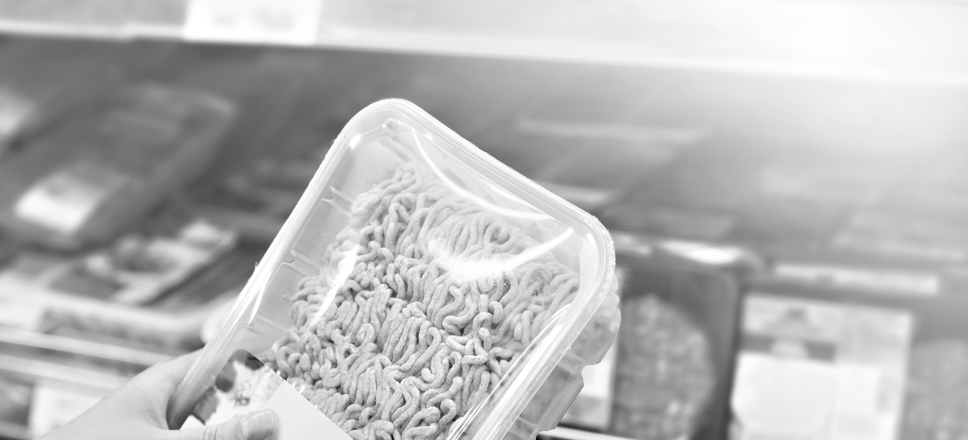
Lack of Implementation of Pre-Harvest Interventions
Irradiation Labeling
Slowing of Irradiation Research
Leading
With Science
Innovation Stifled by Policy
Notes:
Although progressive policies have paved the way for innovation, we can also find examples of policies that have hindered innovation and widespread industry adoption of technologies validated in laboratories.
There was a lack of implementation of pre-harvest interventions in the earlier stages of production.
Another example is low-dose irradiation — one of the most promising interventions to reduce pathogens in raw product, both historically and now.
Irradiation can extend shelf life and improve the quality and safety of foods.
National and international organizations and regulatory agencies have concluded that irradiated food is safe and wholesome.
Yet we have seen that irradiation has not been widely adopted due to labeling requirements and consumer perceptions surrounding that labeling.
We need to be taking a close look at when it’s appropriate to classify an intervention as a processing aid and when it’s appropriate to classify an intervention as a food additive, because these decisions can have far reaching consequences for public health.

Slide 9
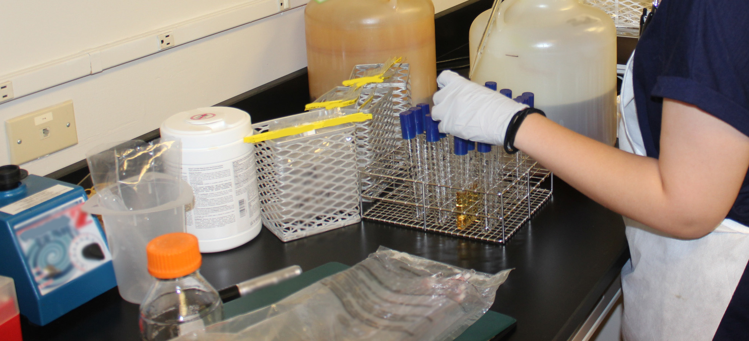
Leading
With Science
Present

Slide 10
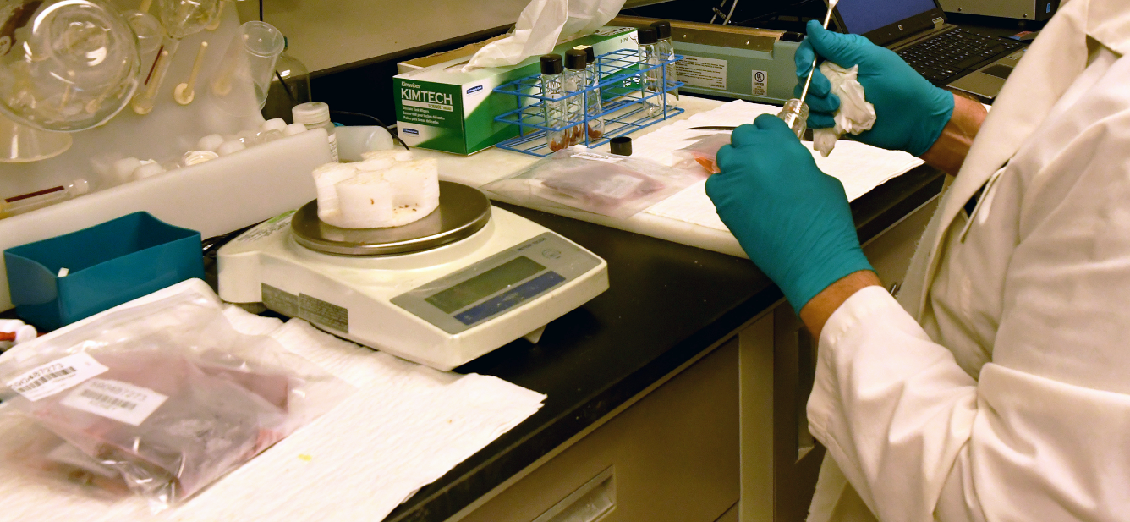
Pathogen Reduction Performance Standards for Salmonella and Campylobacter
Intervention research
Pre-harvest interventions in poultry
Lymph nodes in beef
Quantification methods
Leading
With Science
Performance Standards
Notes:
Currently, one of the main tools that we use to drive down pathogens such as Salmonella and Campylobacter are performance standards.
Performance standards are targets for industry to meet that are tied to public health goals.
FSIS uses the federal government’s Healthy People goals when developing performance standards.
Establishments are categorized according to how well they meet performance standards, creating market-based incentives for companies to reduce foodborne pathogens and meet public health goals.
These standards can also serve as a springboard for innovation and research into new pre-harvest and in-plant interventions that help producers meet and exceed performance standards.
In recent years, we have seen new research into sources of Salmonella in ground beef that has highlighted the role of lymph nodes.
We’ve also seen research into new laboratory methods, such as quantitative and semi-quantitative methods for enumeration of Salmonella.
Collectively, we will need to innovate on multiple fronts to address these leading causes of foodborne illness.

Slide 11
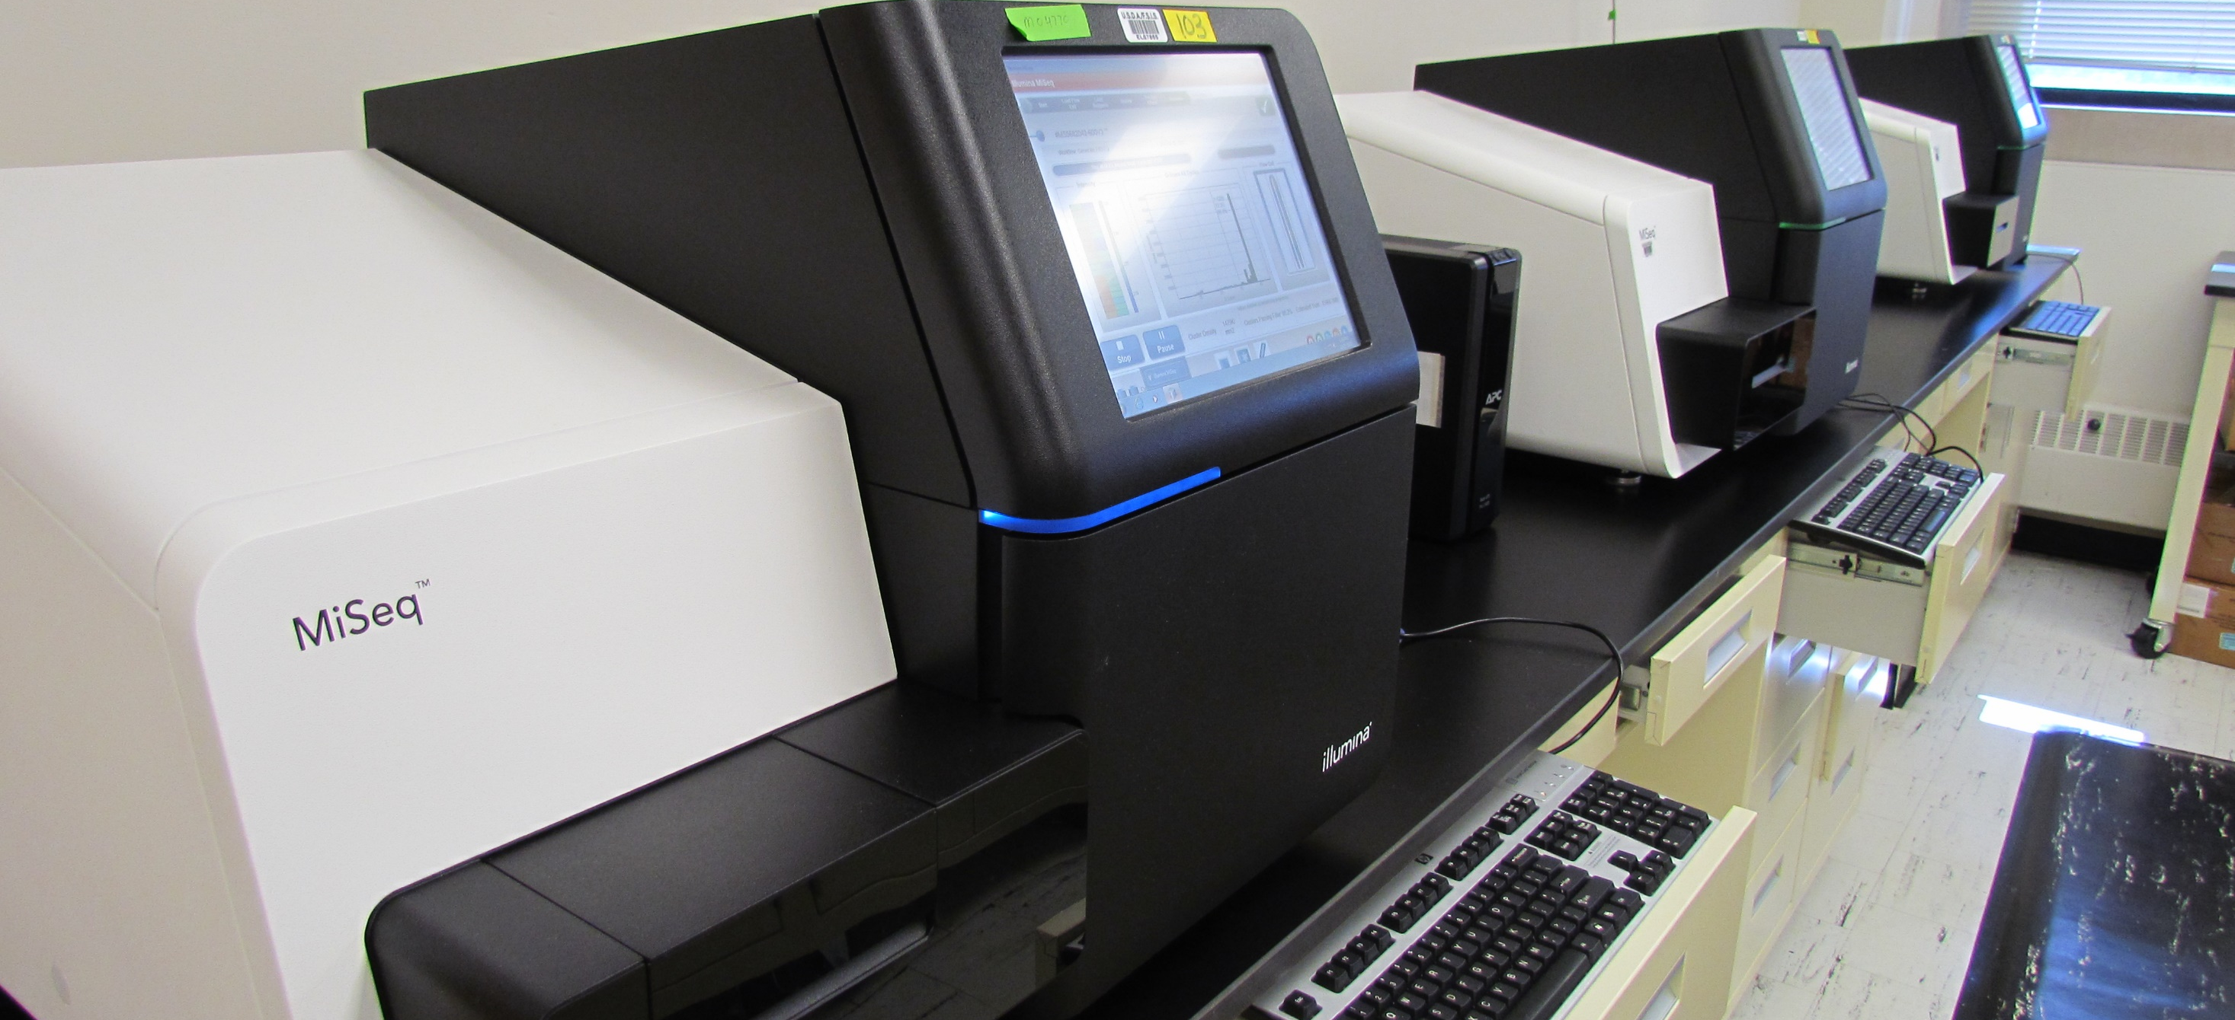
Screening and detection methods for foodborne pathogens
Whole Genome Sequencing
New methodology for environmental and chemical hazards
Leading
With Science
Modernizing Laboratory Methodology
Notes:
In the same way that we’ve been seeing innovation in food safety interventions, we’ve also seen advances in laboratory technology and methodology.
Last year, USDA’s Food Safety and Inspection Service began using new screening methodologies for key foodborne pathogens — Salmonella, Shiga toxin-producing E. coli, and Listeria monocytogenes.
These new systems are faster, more accurate, and more efficient than previous methods.
We’ve also seen increased adoption of Whole Genome Sequencing in federal and state public health laboratories.
Whole Genome Sequencing provides a very high level of detail about unique characteristics of foodborne bacteria and how closely related they are to one another.
I want to highlight that new laboratory methodologies are also frequently closely tied to policies.
For example, FSIS has proposed to incorporate a new laboratory methodology into Campylobacter performance standards for poultry.
The new enrichment method is more sensitive and allows for increased recovery of Campylobacter from samples.
New laboratory methodologies are also needed to address emerging environmental and chemical hazards.
In response to concerns about a class of substances known as per- and polyfluroalkyl substances, commonly referred to as PFAS, FSIS developed a laboratory methodology to screen for these chemicals in beef muscle and is currently working to extend that methodology to blood samples.

Slide 12
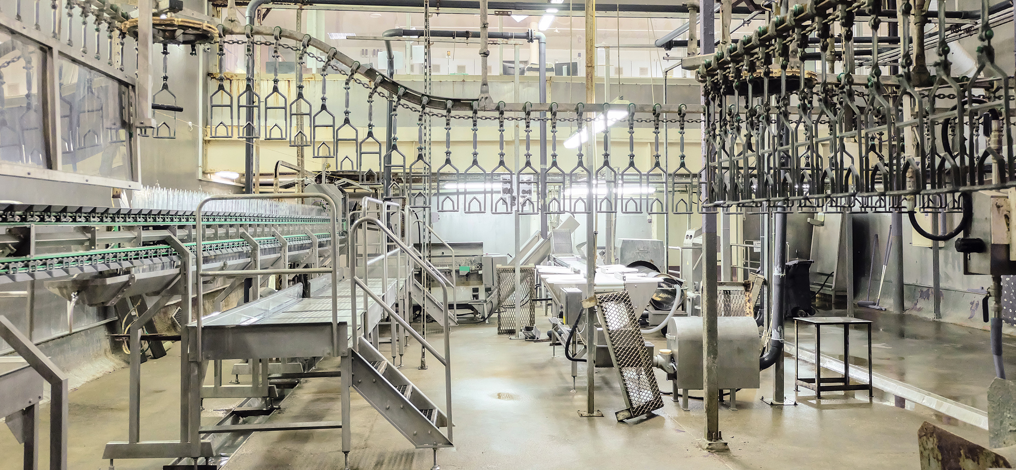
Address regulatory barriers to innovative technology
Expedited approval process for technology
Consider labeling needs
Encourage in-plant testing
Leading
With Science
Innovation and Policy
Notes:
In my current role, I’m intensely focused on finding solutions with genuine applications to prevent foodborne illness and save lives.
To realize the full potential of these solutions, we will need to collaboratively address regulations that are serving as a barrier to implementation of innovative technologies.
We cannot afford to let validated technologies sit on the shelves of laboratories.
It is critical that we provide a means for these validated technologies to be available to industry for use.
I intend to explore options to expedite the approval process for new technology.
This includes a careful consideration of the need for labeling and whether labeling could become a barrier to adoption.
It will be important to include input from both industry and consumers in this process.
We will also work with industry to facilitate testing of new technologies in a production setting.
This is a key step for a new technology to move from the laboratory to widespread adoption, and we need to think creatively about how to test new technologies while still ensuring food safety.

Slide 13
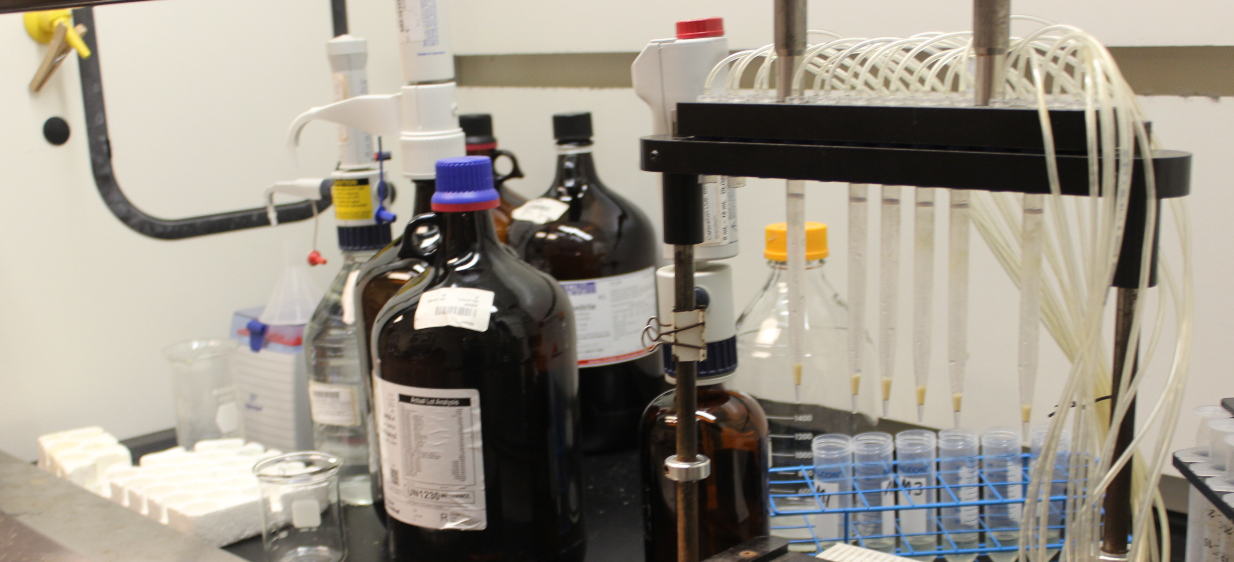
What are the phases of the review process?
    Submission
    Technical review
    No objection letter
    Directive 7120.1.
Leading
With Science
New Technology Review Process
Notes:
With these goals in mind, I’d like to talk a little more about the current process for review of new technologies.
After a new technology is submitted for review, it goes onto a technical review.
During technical review, a multidisciplinary team with expertise in microbiology, toxicology, chemistry, laboratory science, pathology, epidemiology, economics, and statistics reviews the provided information.
The technology is evaluated to determine if it:
affects product safety;
violates any FSIS regulation;
interferes with inspection procedures;
jeopardizes the safety of inspection program personnel; and
is deemed suitable for use in meat, poultry, or egg products.
If it is approved, FSIS will issue a no objection letter and will go on to publish the technology as “approved” in the next monthly revision of Directive 7120.1.
Companies would need to check the directive to determine if a technology has been approved for use by FSIS.
The timeline for approval will vary based on the type of submission, but submissions for technologies such as antimicrobials that are Generally Recognized As Safe (GRAS) by FDA will move through the process in 60 days.

Slide 14
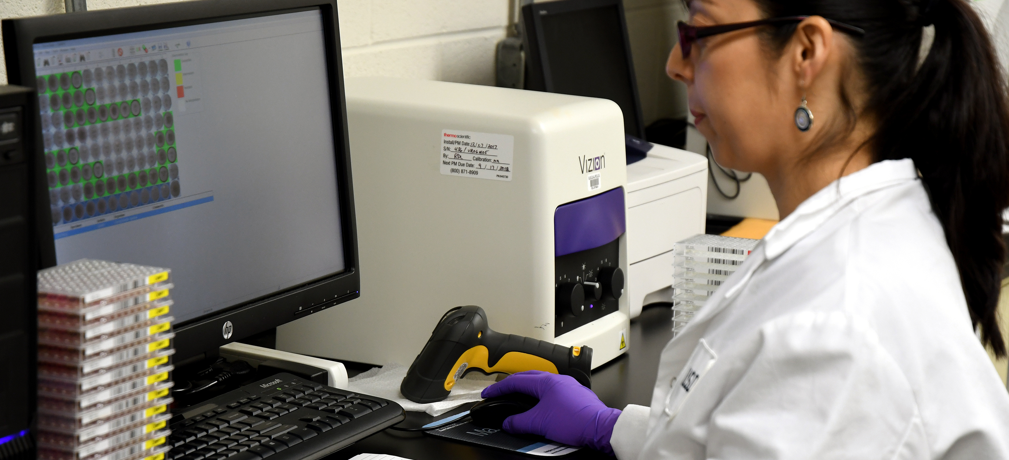
Leading
With Science
Submission = Suitability Data/Support + Protocol
  Operational Protocols
  In-Plant Trial Protocol
Submission
Notes:
The submission for a new technology should include two key pieces — data to support suitability of the intervention and a protocol for use of the intervention.
Suitability means that the substance or process is effective in performing the intended purpose.
It also includes assurance that the conditions of use in an FSIS-regulated establishment will not result in an adulterated product or one that misleads consumers.
The protocol can be an operational protocol that describes in detail how the proposed new technology will be implemented and evaluated on an ongoing basis.
Operational protocols are most appropriate for new ingredients and reprocessing procedures, including on-line and off-line reprocessing systems that use an antimicrobial in a very well-defined manner.
For newer technologies with limited data, an in-plant protocol might be most appropriate.
In this case, the protocol should include detail on how the proposed new technology will be tested in commercial conditions.
In some cases, testing might need to be performed under a waiver, which requires approval by the FSIS Administrator.
I cannot emphasize enough that science will always lead in the technology review and approval process.
Decisions to approve new technologies will be based on sound science.
I encourage all stakeholders to come to us with ideas and data.
We’re committed to working together to bring life-saving technologies to our food production systems.

Slide 15

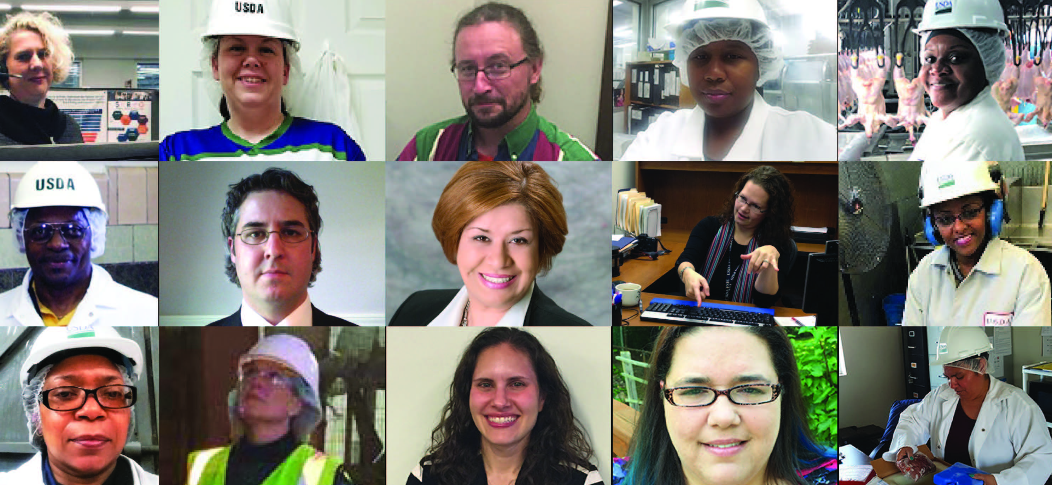
Notes:
At the core of every successful organization is a network of strong internal and external relationships.
The past year, I have invested in building these relationships and intend to strengthen them in 2020.
I am committed to building relationships within USDA, across other Departments, and with Congress and stakeholders.

Slide 16
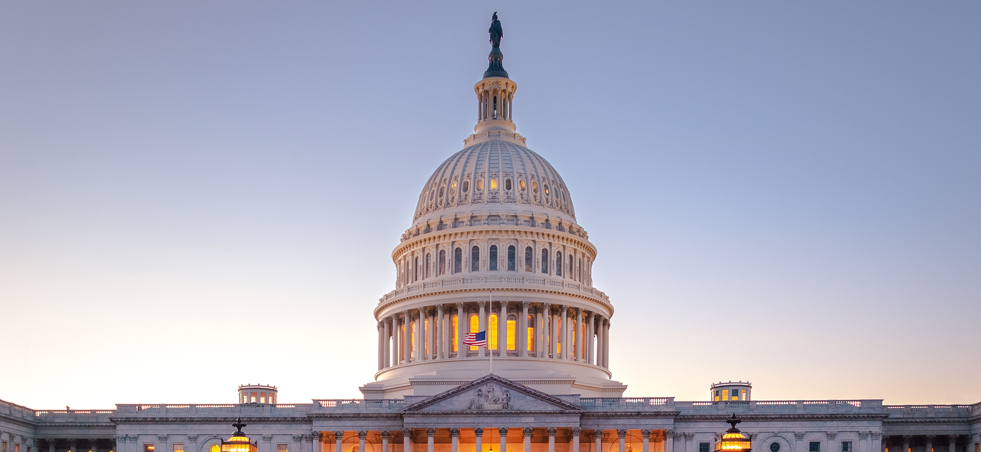
  Employees
  Congress
  Government Agencies
  Universities
  Stakeholders
  Industry
  Consumers
Building
Relationships
Notes:
EMPLOYEES
I am committed to continuing to visit establishments and to interacting with our inspectors in the field to fully understand their needs and challenges.
CONGRESS
In 2020, our relationship with Congress will continue to be a priority.
We will be proactive in reaching out to members of Congress and committees to brief them on our upcoming policies.
GOVERNMENT AGENCIES
I am committed to continuing to strengthen the “One USDA” model across the department.
I also intend to strengthen our relationships with FDA and CDC in 2020 and will meet with FDA and CDC to lay out our public health goals for the coming years.
UNIVERSITIES
A strong relationship with universities will keep us abreast of cutting-edge research that could inform policy.
Relationships with food science, meat science and animal science programs will also help with recruitment of individuals holding B.S. degrees into our CSI workforce.
We also want to build relationships with schools of veterinary medicine across the country to make students aware of FSIS internships, scholarships, and career opportunities,
STAKEHOLDERS
We will continue meeting and engaging with our consumer and industry stakeholders, as their input assists in identifying priorities.
We will also be building new relationships by reaching out to non-traditional partners and other stakeholders that have not engaged or disengaged from policy discussions.
I encourage the stakeholder groups to lead with scientific data and to work cooperatively with us on common goals.
INDUSTRY
We will partner with industry in areas such as consumer education and in searching for solutions to ensure food safety.
CONSUMERS
I have observed firsthand that FSIS is committed to consumer education.
We have invested in consumer research studies to inform decisions and help us identify areas where we still need to work to influence consumer food handling behaviors.

Slide 17
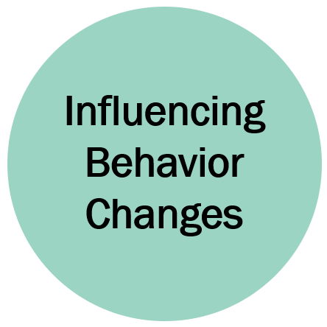
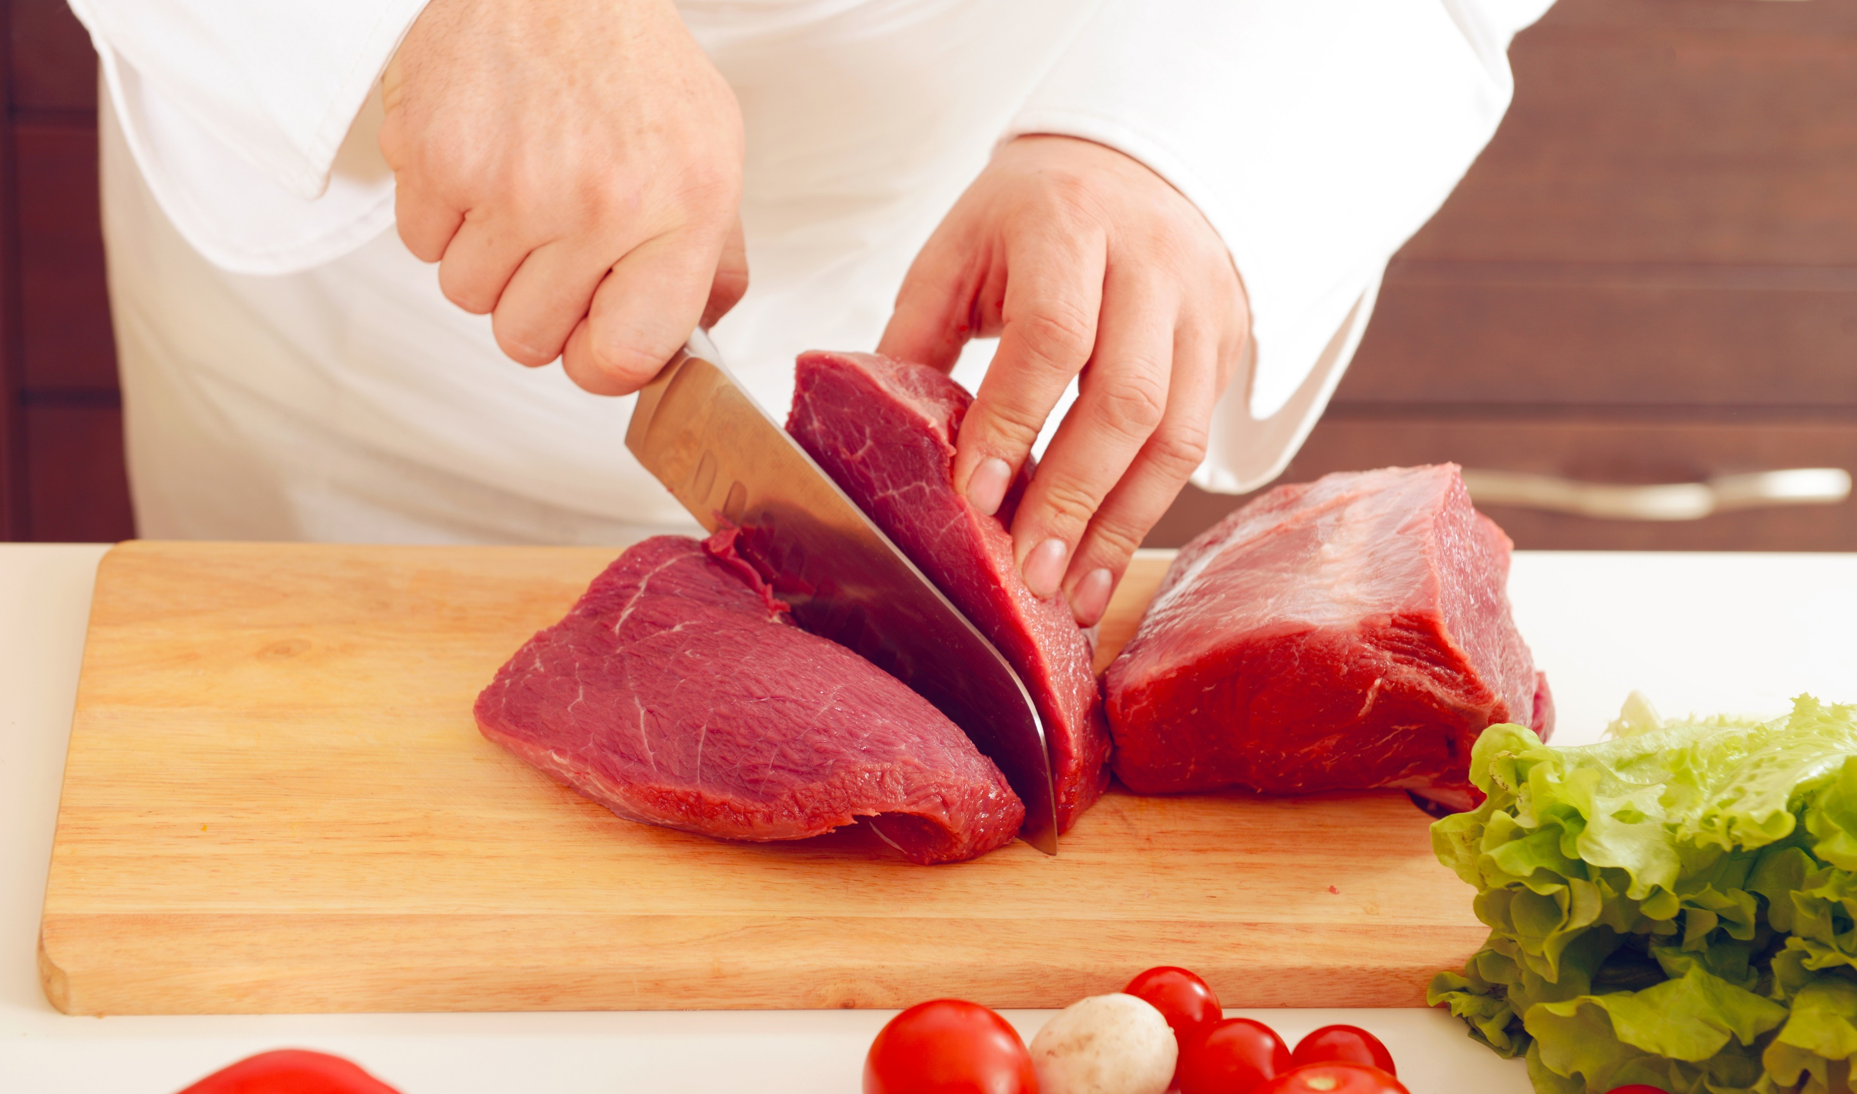
Notes:
Changing habits can be difficult and putting knowledge into action is a challenge for any organization.
However, within FSIS, the expectation is that we change when new information becomes available.
Additionally, FSIS employees are expected to influence behavior changes in our partners, stakeholders, and the public.

Slide 18
  Employees
  Consumers
  Industry
Influencing
Behavior
Changes
Notes:
EMPLOYEES
Within FSIS, I want to nurture a culture where our employees feel valued for their ideas.
I want them to have the freedom to be creative and to present new ideas in a safe environment.
I do not want employees to wait to be told what to do; I want them to think about solutions.
CONSUMERS
Consumer stakeholder groups provide input from a diverse population of individuals who can help us improve food safety and public health.
They have submitted petitions and made requests throughout the year that are worthy of consideration.
I want these stakeholders to engage with us on the common goal of protecting public health.
One of the greatest transformations I would like to see as we move forward into 2020 is a better relationship with stakeholders based on the foundations of science to reduce foodborne illnesses.
INDUSTRY
The meat, poultry and processed egg products industries are our partners and share a common goal of protecting consumers from foodborne illness.
We currently interact with industry associations during regular stakeholder meetings and with individual companies in establishments daily and during outbreak investigations.
We are committed to making data driven decisions that span the breadth of the industry, including our small and very small processors, to implement the best technologies to protect products from foodborne pathogens.

Slide 19
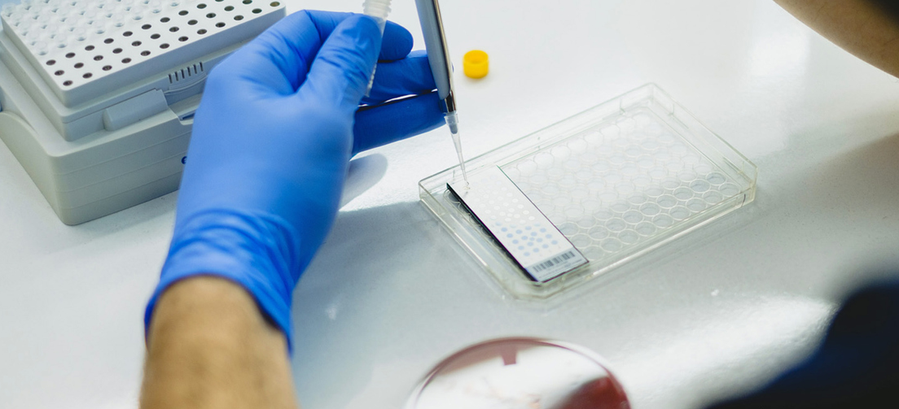
FSIS Quarterly Tracking
of Industry Performance
Percentage of establishments that meet pathogen reduction performance standards
  87% for FY20 Q1 Target
  85% for FY20 Q1 Actual
Percentage of establishments whose non-compliance rate decreased
  74% for FY20 Q1 Target
  74% for FY20 Q1 Actual
Influencing
Behavior
Changes
Performance Metrics
Notes:
Our commitment to influencing behavior change is so deep that it’s something we track as part of our performance metrics.
For example, FSIS puts performance standards in place to encourage industry to reduce foodborne pathogens.
But we are profoundly invested in how well industry is meeting those standards — so much so that we track what percentage of establishments are meeting performance standards as a measure of our own success.
Similarly, we track the percentage of establishments that reduce their rate of non-compliance reports in the four months following an early warning alert.
When a policy helps to drive change that positively impacts consumers — that’s a picture of success.

Slide 20
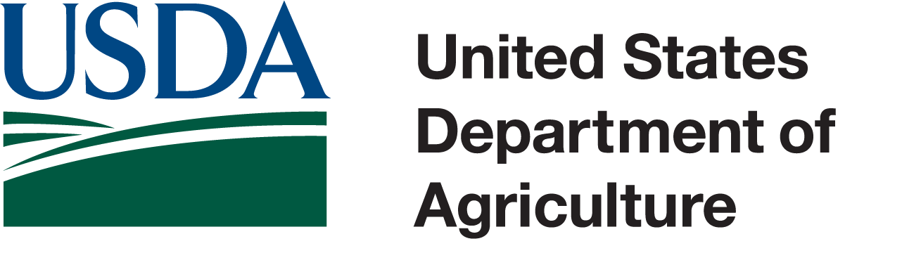
Do Right and Feed Everyone…Safely!
Notes:
In 2020, I am committed to working cooperatively within the agency and with stakeholders to advance a vision that reduces foodborne pathogens in the meat, poultry and processed egg supply and improves public health.
I will work closely with FSIS leadership as we Lead with Science, Build Relationships and Influence Behavior Changes for the good of the American public.
We will be bold in our decisions and steadfast in implementing data and science-based decisions to “Do Right and Feed Everyone…. SAFELY.”

