Slide 1


United States Department of Agriculture
National Agricultural Statistics Service
2019 Crop Season
Highlights
Principal Crops, Corn, & Soybeans
January 2020 v3

Slide 2
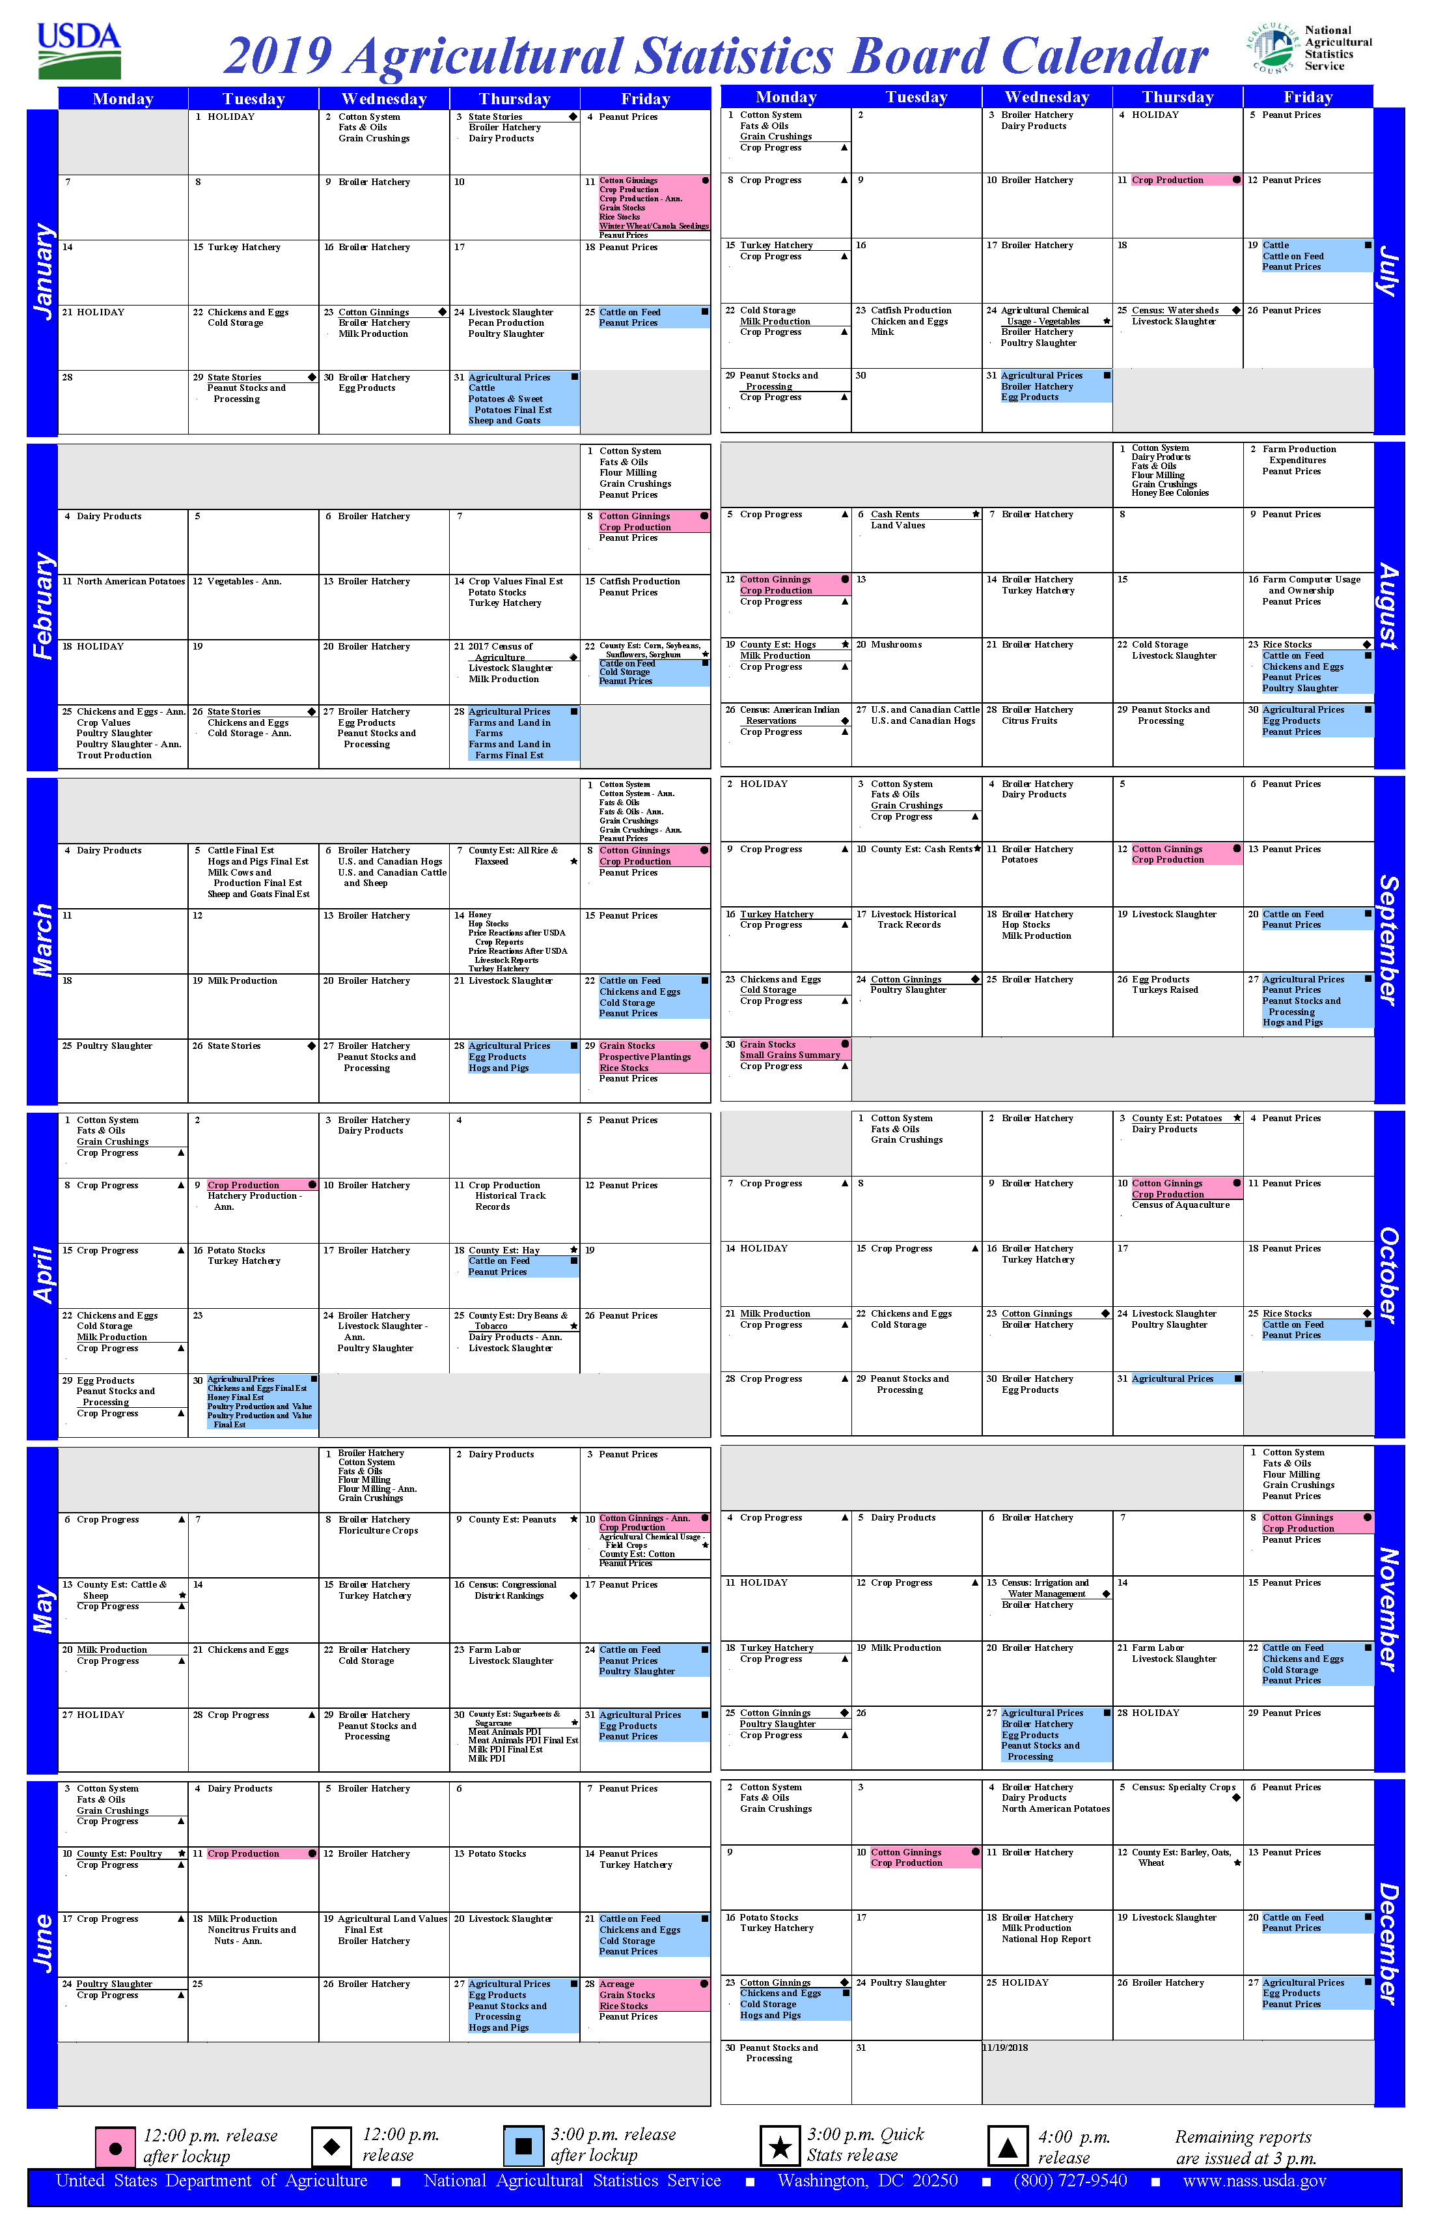
NASS Mission
To provide timely, accurate, and useful statistics in service to U.S. agriculture.
~120 Crop Commodities
~40 Livestock Commodities
~500 National Reports Annually
> 9,000 State-Level Reports Annually
Census of Agriculture
All
Scheduled in
Advance

Slide 3
NASS Reports
Principal Federal Economic Indicator (PFEI) Reports
The major statistical series that describe the current condition of the economy -- are compiled, released, and periodically evaluated in accordance with procedures established in OMB Statistical Policy Directive No. 3.
Prospective Plantings
Acreage
Crop Production
Grain Stocks
Agricultural Prices
Cattle on Feed
Hogs and Pigs
OMB Statistical Policy Directive No. 3 states:
The interval between the period to which the data or estimates refer and the date when the data or estimates are released to the public shall be as short as practicable. Agencies should compile and release series that are issued quarterly or more frequently within 22 working days of the end of the reference period.

Slide 4
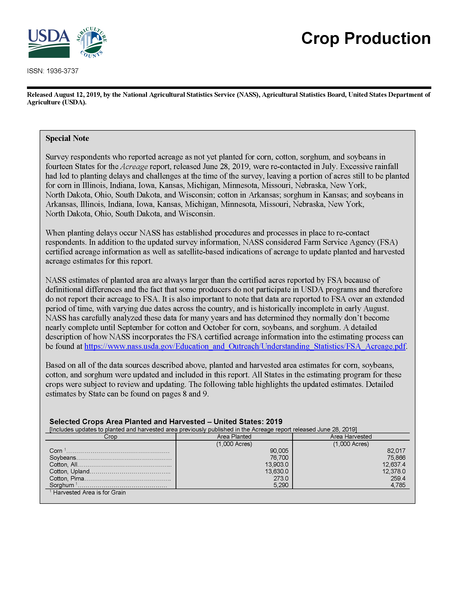
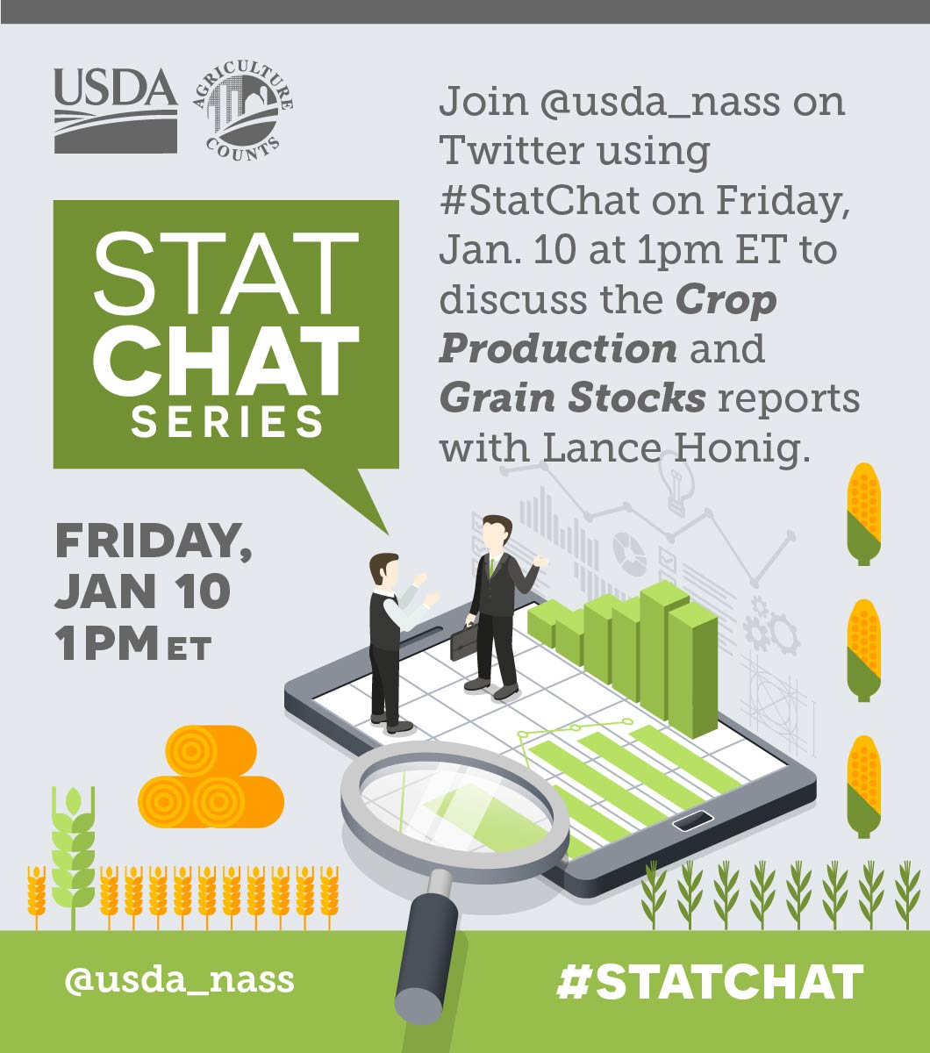
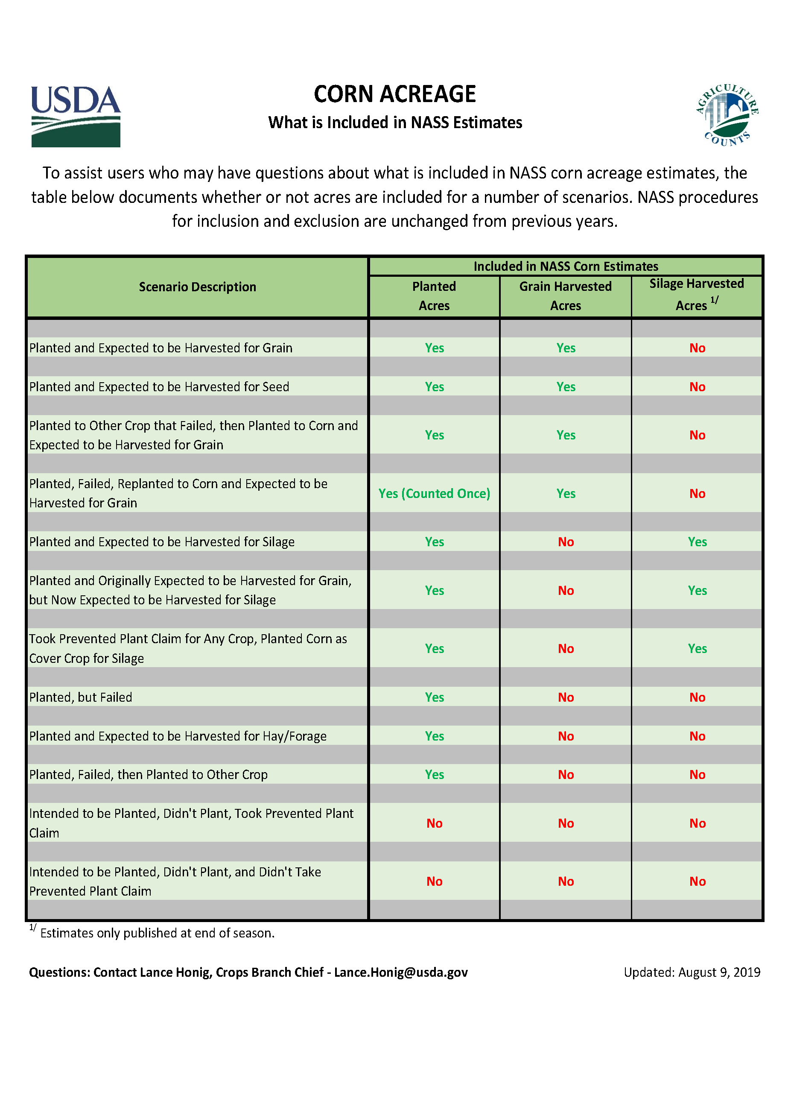
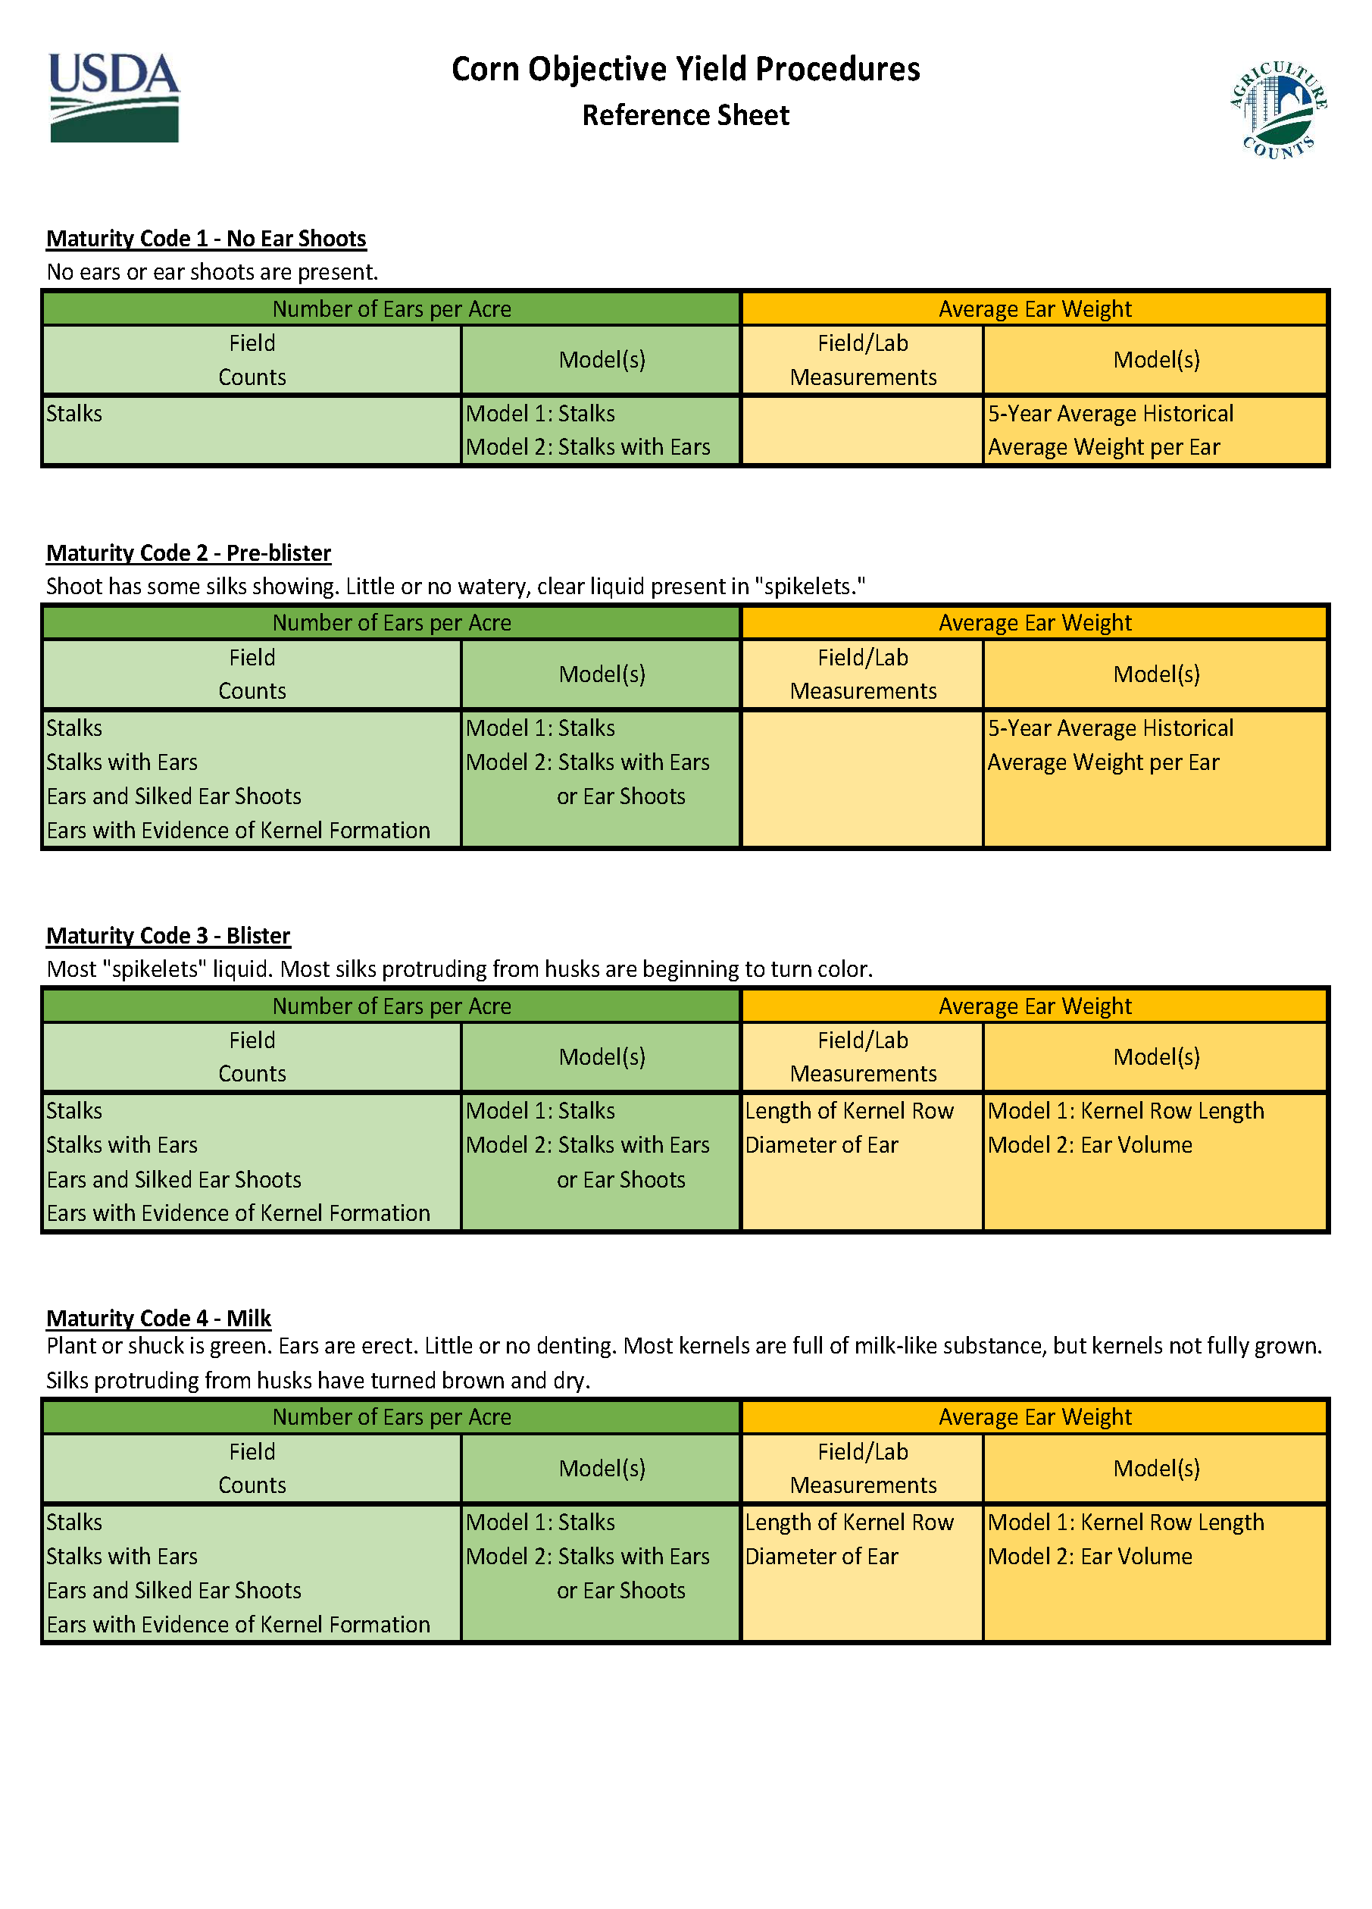
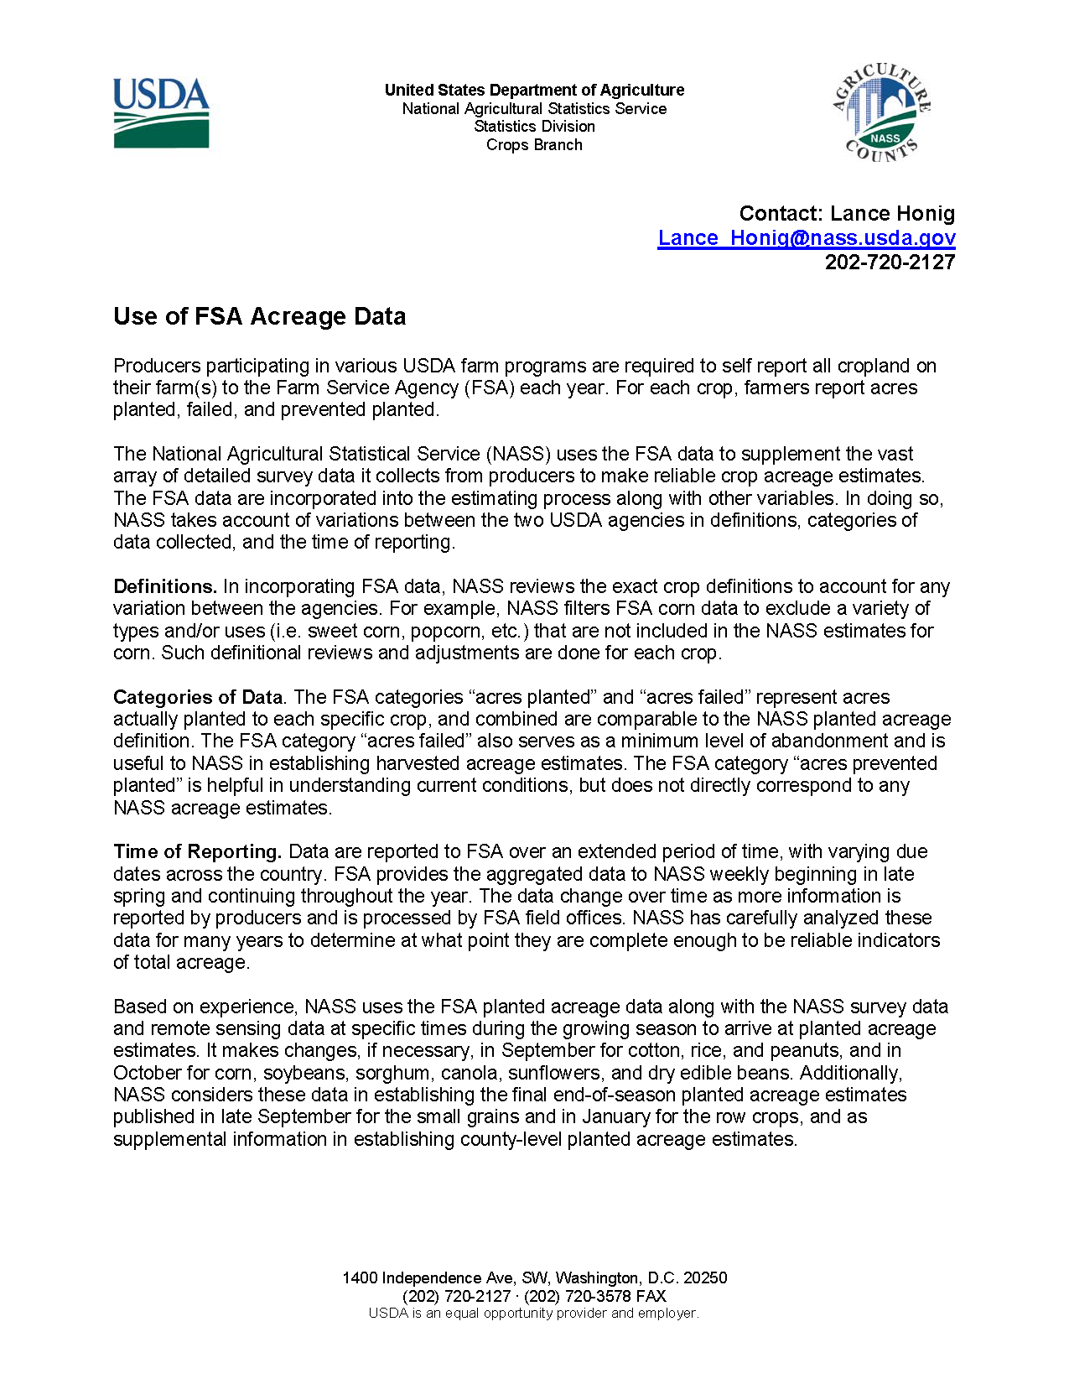
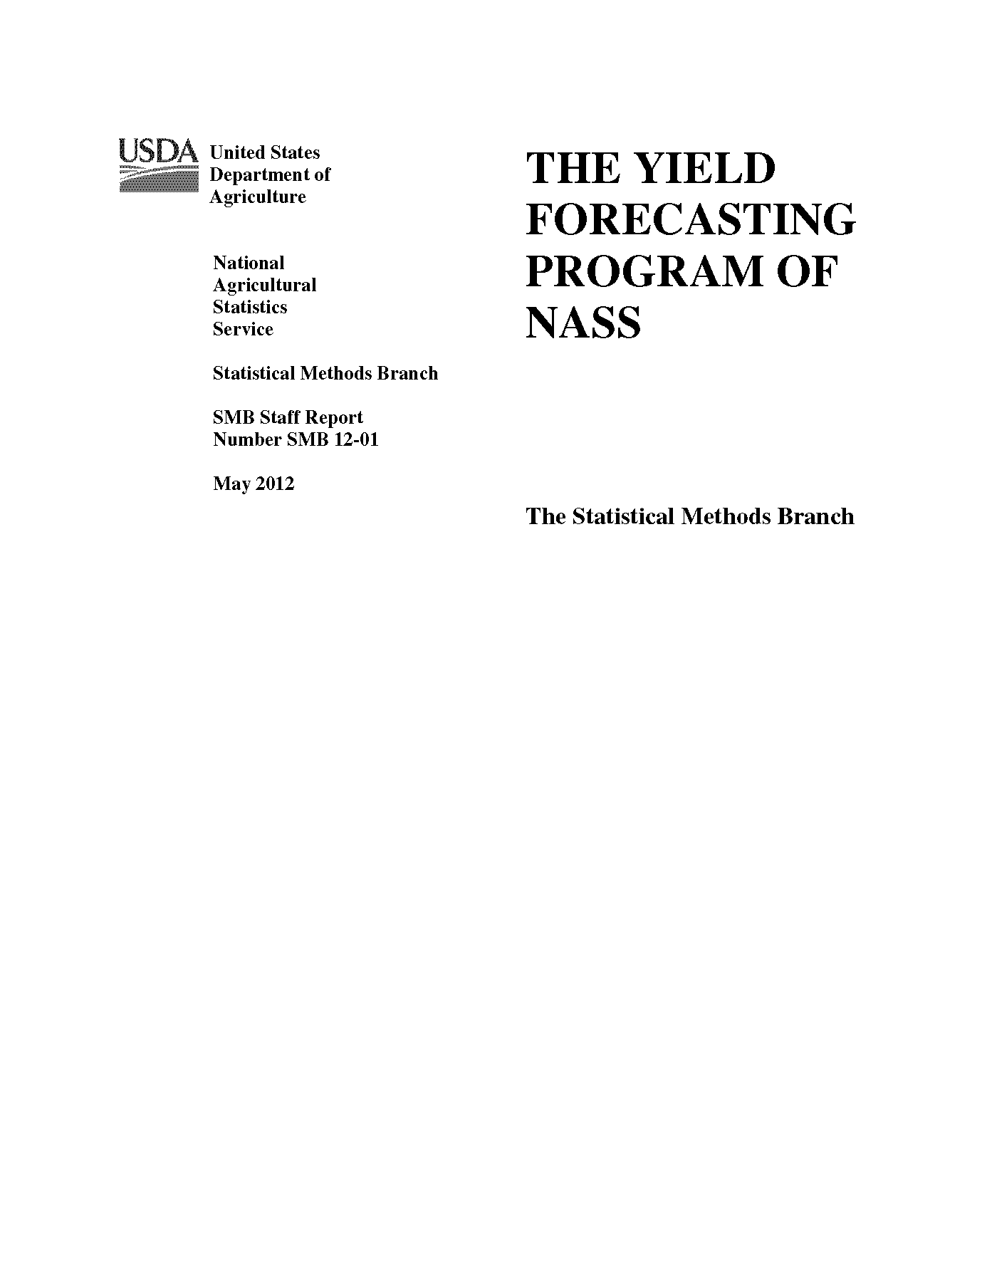
Communication and Documentation
Enhanced release time information and communication.
Both quick reference and in-depth documentation of procedures.
https://www.nass.usda.gov/Education_and_Outreach/Understanding_Statistics/index.php

Slide 5
Corn and Soybean Acreage Data Sources
Farmer Reported Surveys
FSA
Certified Acres
Remotely Sensed (Satellite)
FSA and RMA Failed Acres
Resurveys
March (82,352)
June (~100,000)
December (78,637)
August
October
Annual
August
October
Annual
Annual
June (7,683 Fields)
Annual (~1,500 producers)

Slide 6
Corn and Soybean Yield Data Sources
Farmer Reported Surveys
Field Measurement Surveys
Corn = 1,015
Soybeans = 1,050
Remotely Sensed (Satellite)
August (20,837)
September (9,624)
October (10,861)
September
Annual
August
September
Annual
November (8,346)
Annual (78,637)
October
November
October
November

Slide 7
Principal Crops Planted Acreage
United States
Year | Principal Crops | Change From Previous Year
 | Million Acres
2010 | 315.4 | -3.6
2011 | 314.3 | -1.1
2012 | 324.3 | +10.0
2013 | 324.9 | +0.6
2014 | 326.7 | +1.7
2015 | 319.1 | -7.6
2016 | 319.0 | -0.1
2017 | 318.3 | -0.6
2018 | 319.3 | +1.0
2019 | 302.6 | -16.7
Crops included in area planted are corn, sorghum, oats, barley, rye, winter wheat, Durum wheat, other spring wheat, rice, soybeans, peanuts, sunflower, cotton, dry edible beans, chickpeas, potatoes, sugarbeets, canola, and proso millet. Harvested acreage is used for all hay, tobacco, and sugarcane in computing total area planted.

Slide 9
2019 Final FSA value as of January 1, 2020 and includes barley, corn, cotton, oats, rice, sorghum, soybeans, sugarbeets, sugarcane, & wheat.

Slide 10
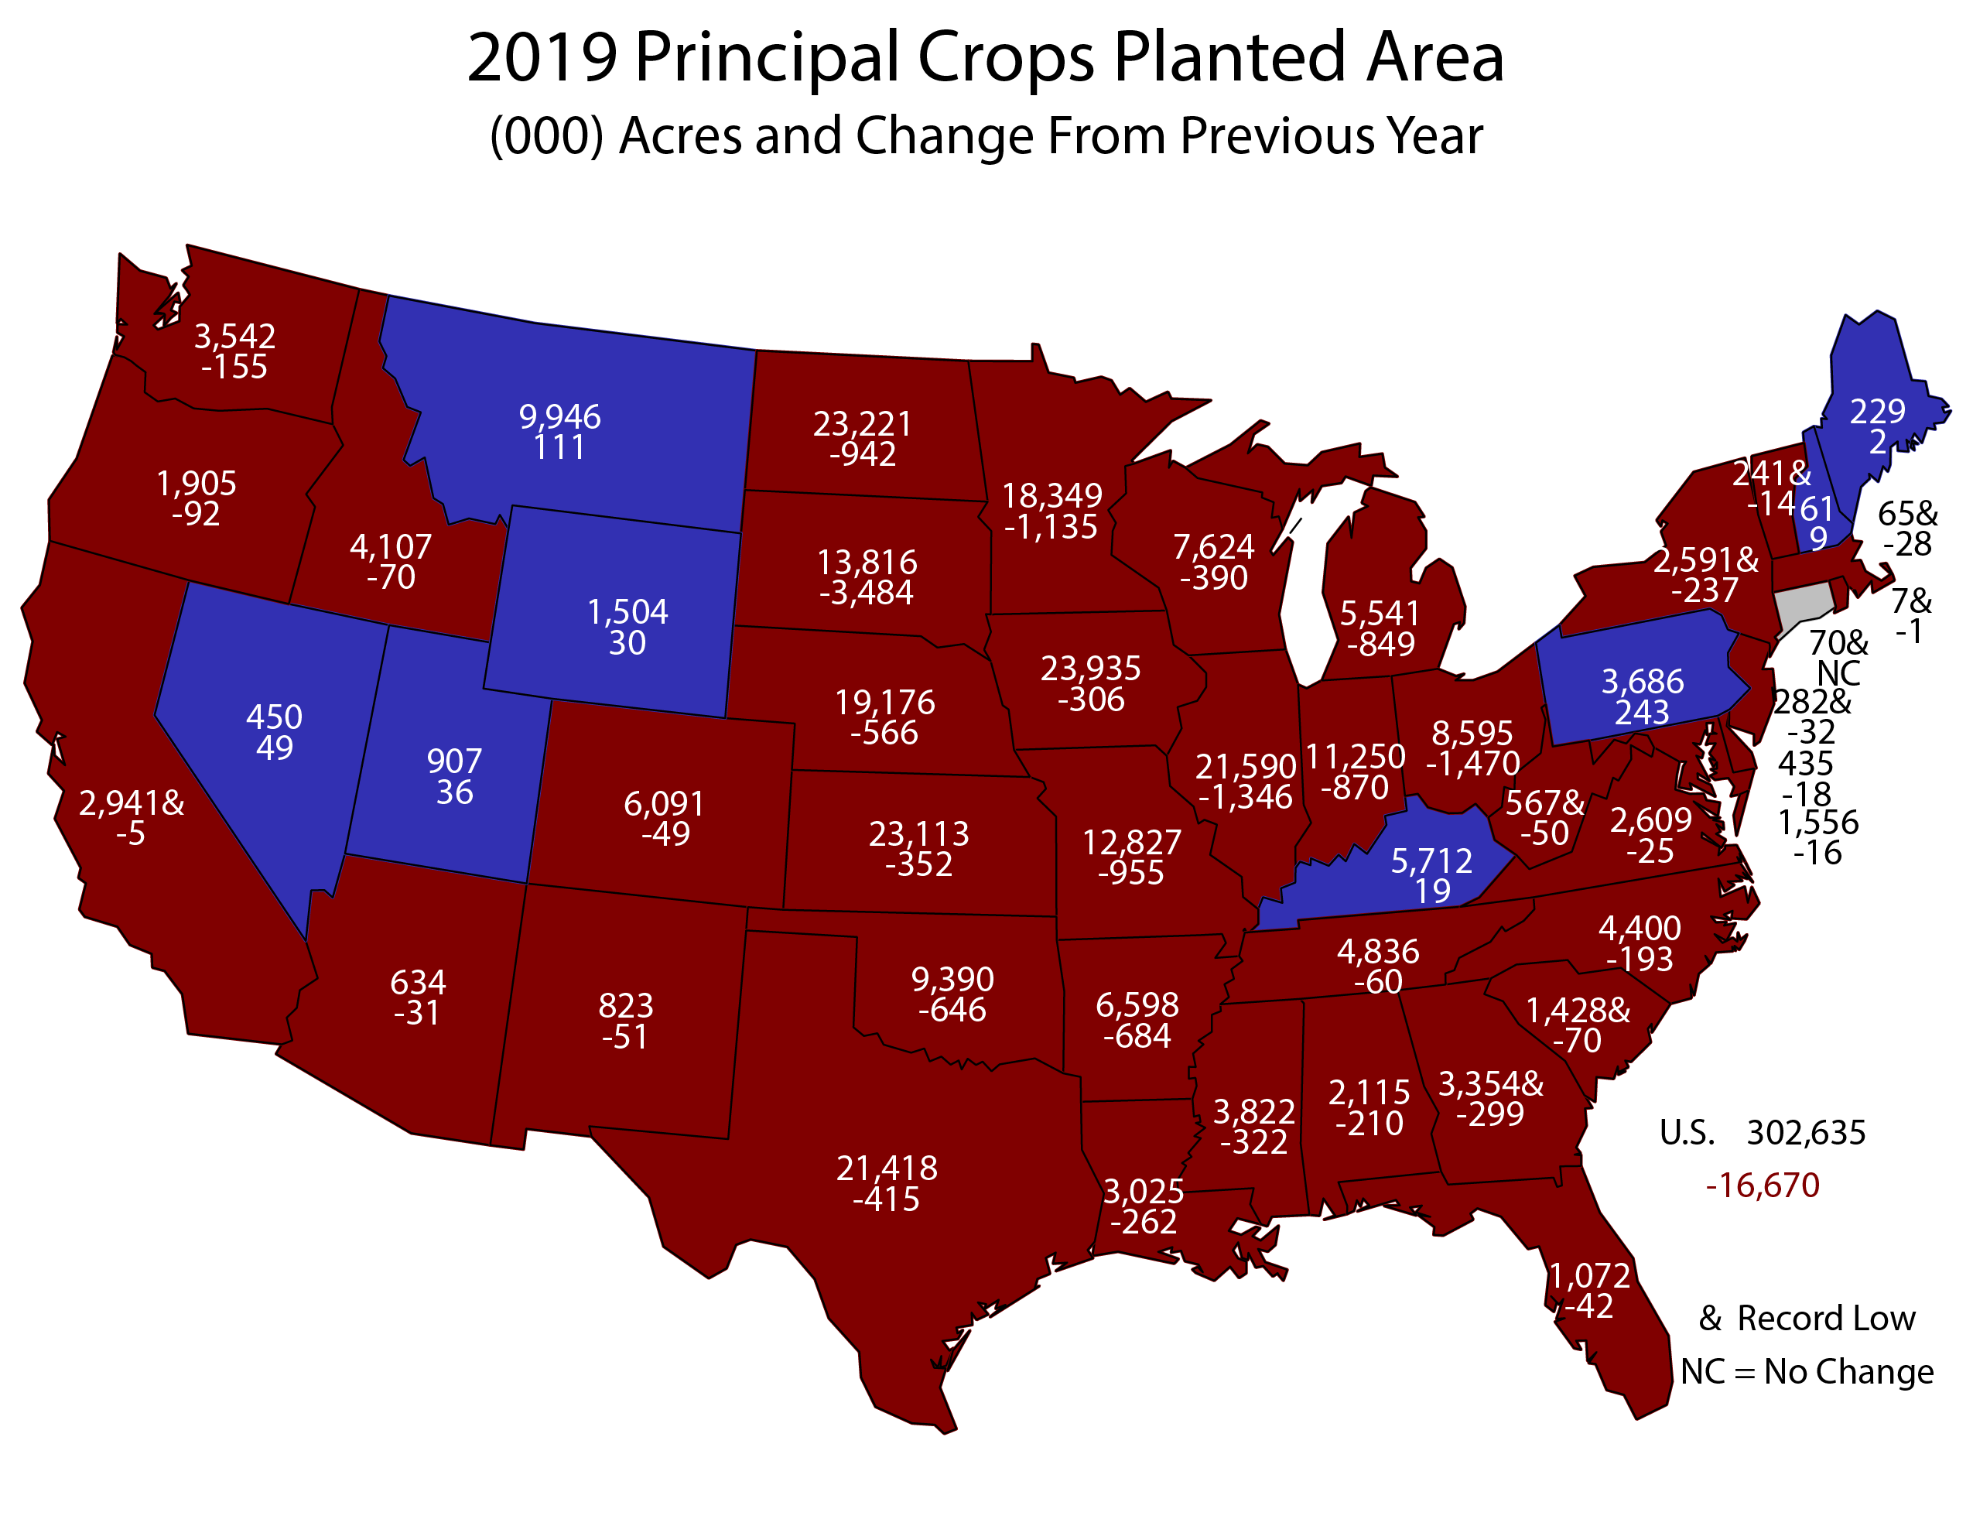

Slide 11
2019 Principal Crops
Planted Acre (000) Change from 2018
United States
Harvested acre change for hay, sugarcane, and tobacco.

Slide 12
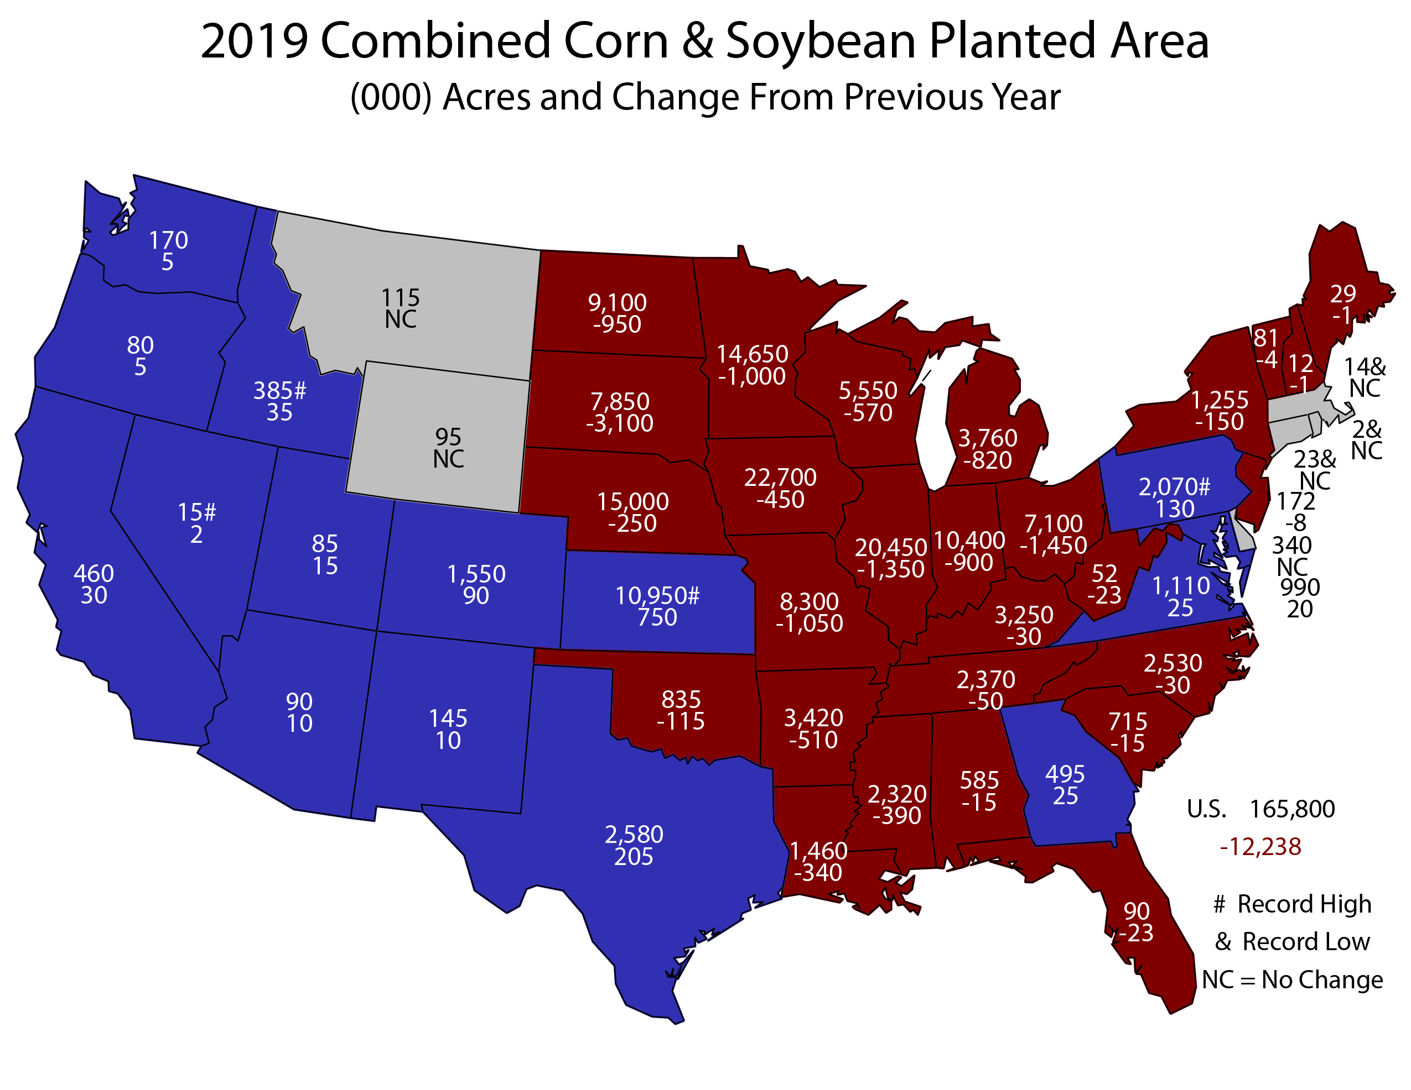

Slide 13
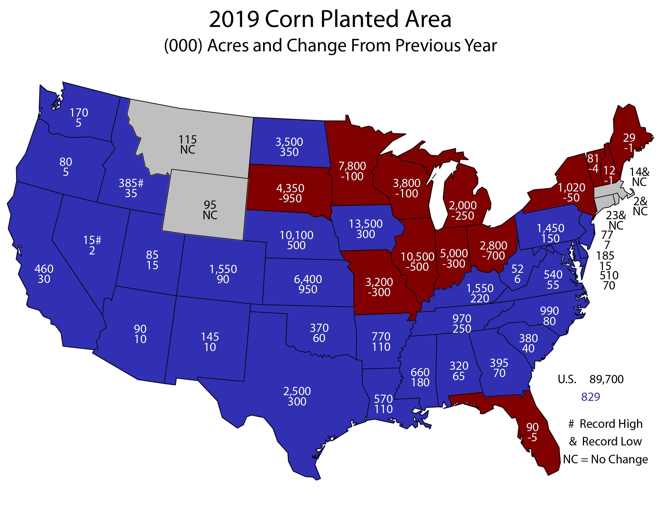
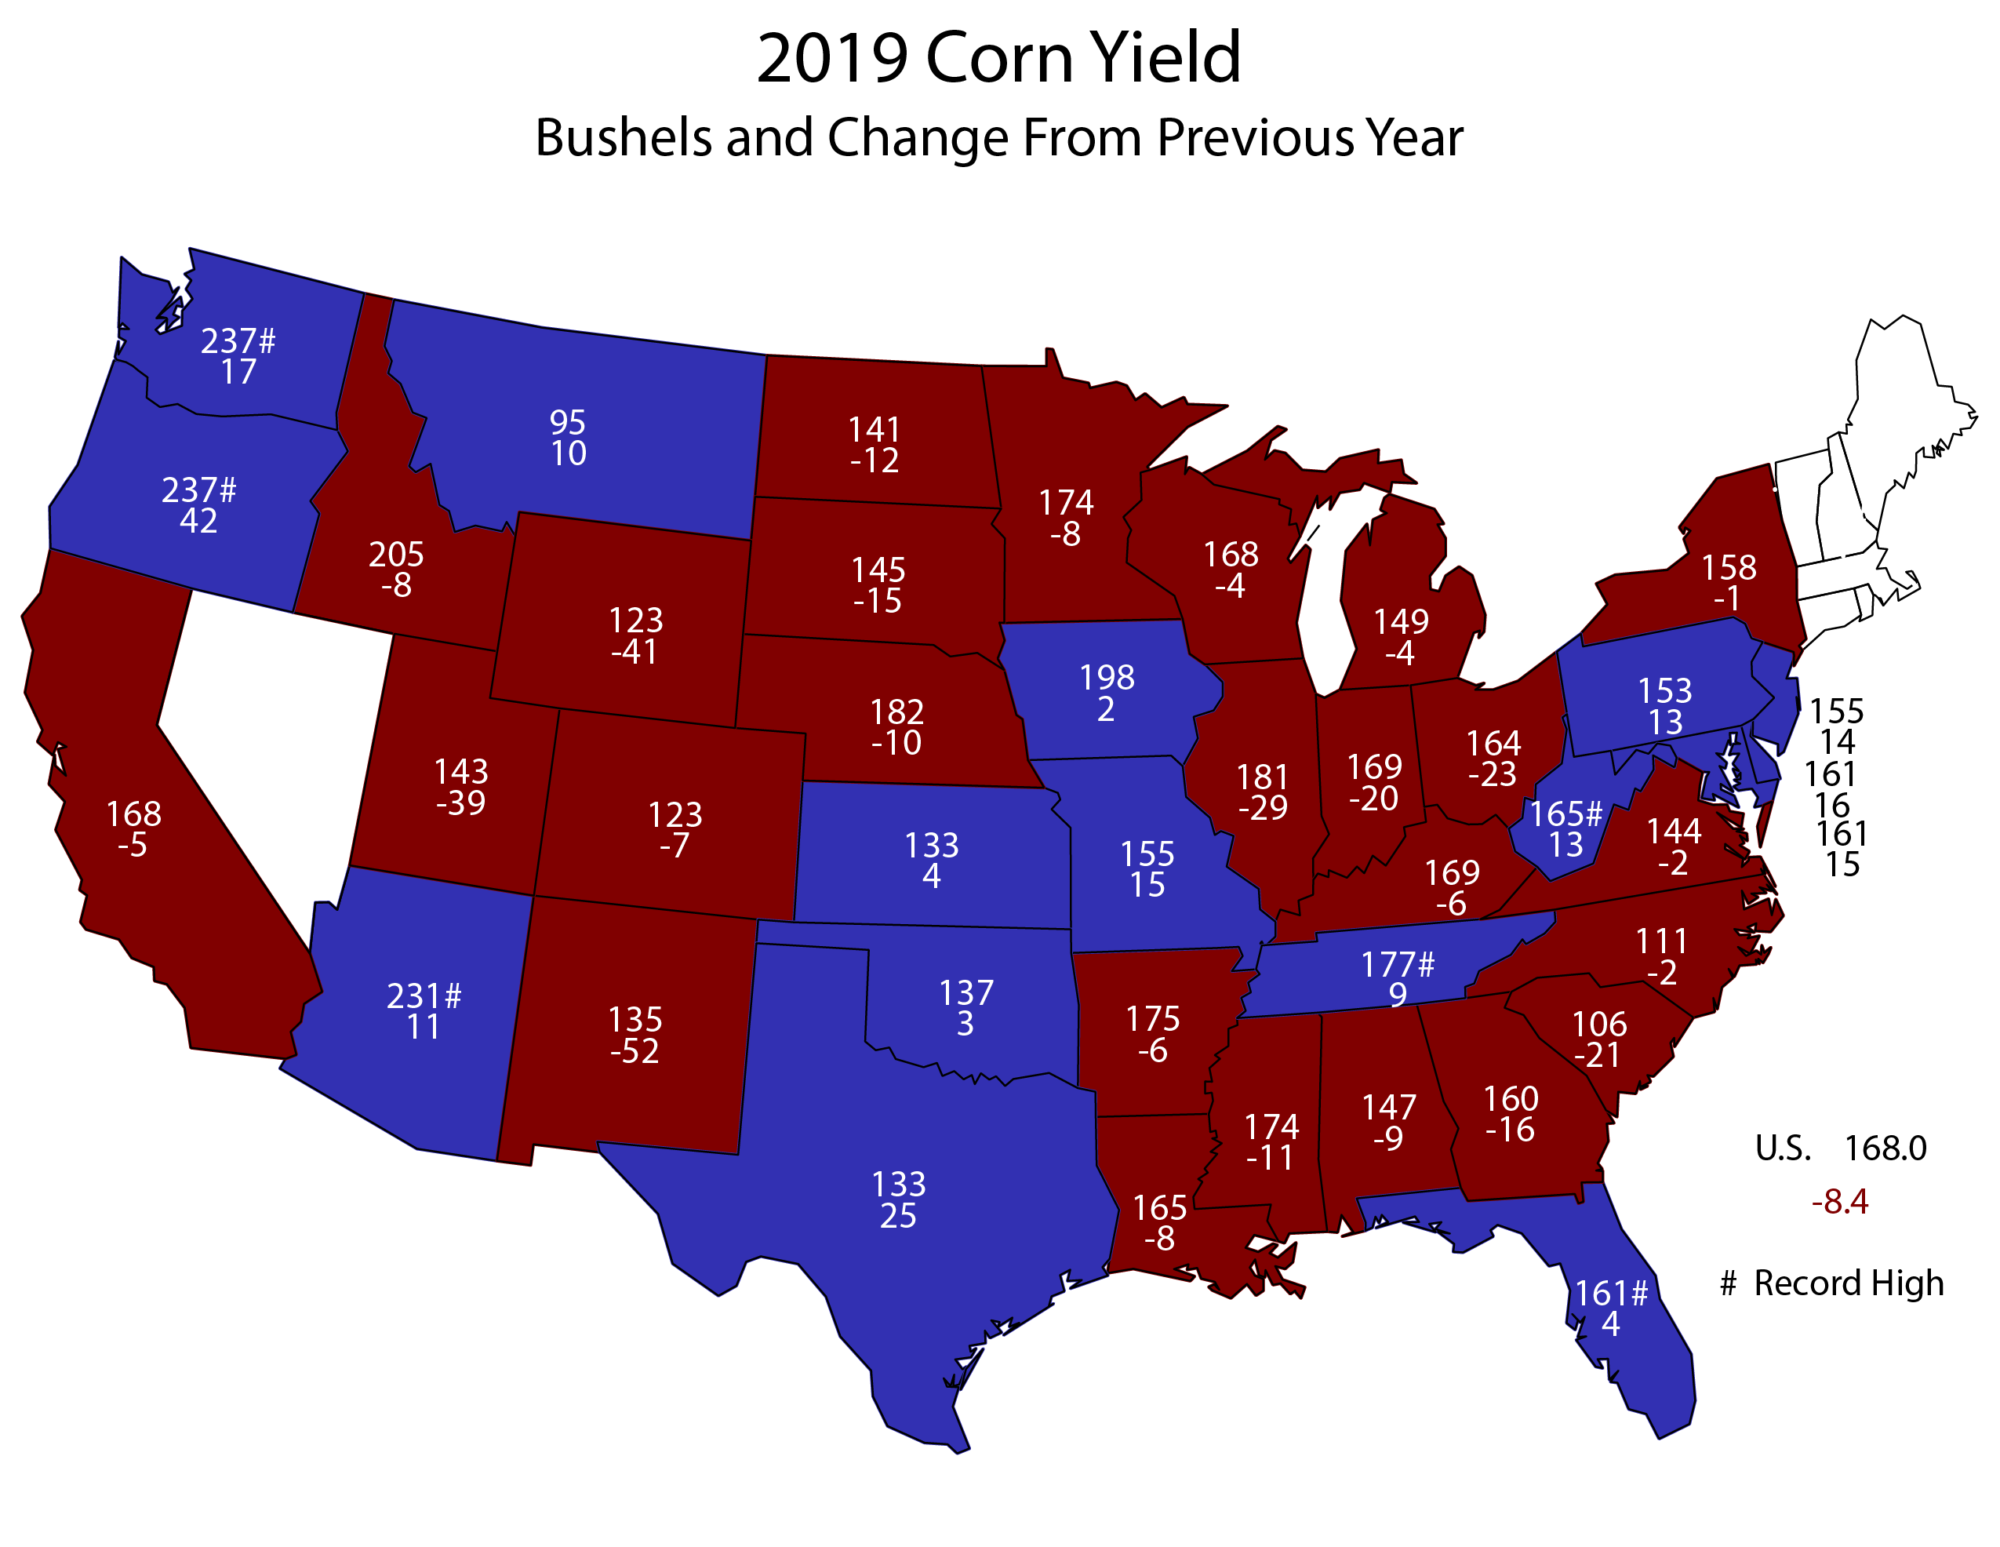
2019 Corn Forecasts and Final Estimates – United States
March - Final
 |  | March | June | August | September | October | November | Final
Planted | Mil Ac | 92.8 | 91.7 | 90.0 | 90.0 | 89.9 | 89.9 | 89.7
Harvested | Mil Ac | N/A | 83.6 | 82.0 | 82.0 | 81.8 | 81.8 | 81.5
Yield | Bu/Ac | N/A | N/A | 169.5 | 168.2 | 168.4 | 167.0 | 168.0
Production | Bil Bu | N/A | N/A | 13.9 | 13.8 | 13.8 | 13.7 | 13.7

Slide 14
2019 Corn – United States
August Forecast and Final Estimates with Comparisons
 |  | August | Final | Change | Percent Change
Planted | Mil Ac | 90.0 | 89.7 | -0.305 | -0.3
Harvested | Mil Ac | 82.0 | 81.5 | -0.535 | -0.7
Yield | Bu/Ac | 169.5 | 168.0 | -1.5 | -0.9
Production | Bil Bu | 13.9 | 13.7 | -0.209 | -1.5

Slide 15
2019 Final FSA value is as of January 1, 2020

Slide 16
No published industry expectations after August.

Slide 17
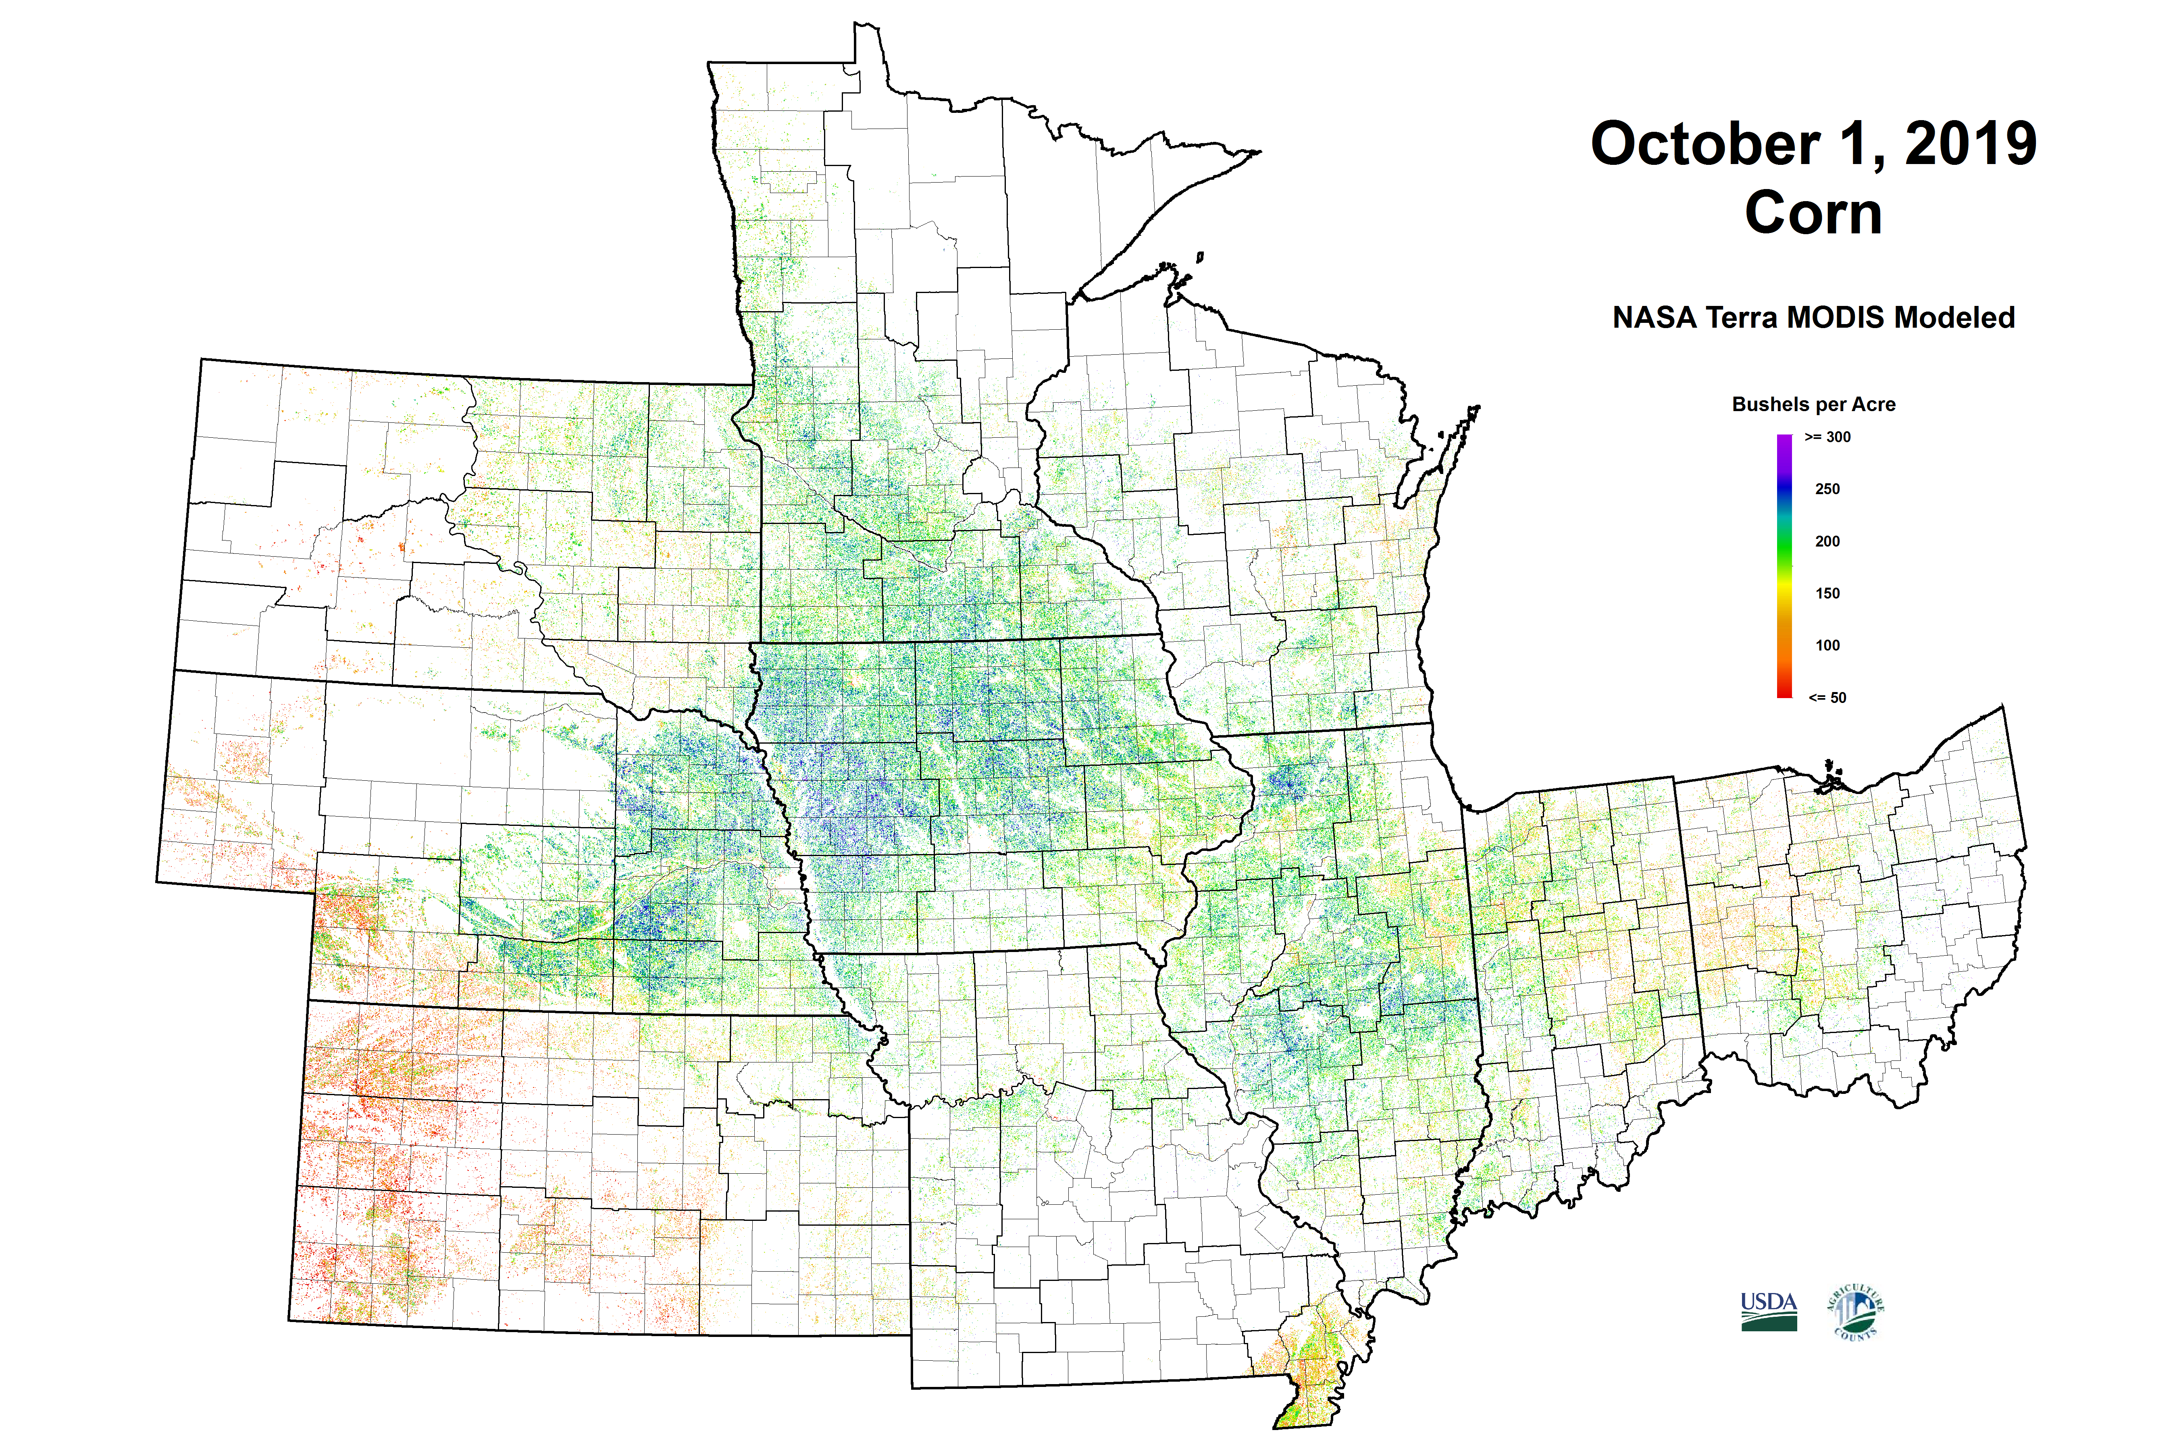

Slide 18
Corn Production Forecasts Percent Difference From Final Production Estimate 2012-2019
Year | August | September | October | November | Final Prod (bil bu)
2012 | 0.2% | -0.3% | -0.5% | -0.3% | 10.8
2013 | -0.5% | 0.1% | N/A | 1.1% | 13.8
2014 | -1.3% | 1.3% | 1.8% | 1.3% | 14.2
2015 | 0.6% | -0.1% | -0.3% | 0.4% | 13.6
2016 | 0.0% | -0.4% | -0.6% | 0.5% | 15.1
2017 | -3.1% | -2.9% | -2.3% | -0.2% | 14.6
2018 | 1.7% | 3.4% | 3.1% | 2.0% | 14.3
2019 | 1.5% | 0.8% | 0.6% | -0.2% | 13.7

Slide 20
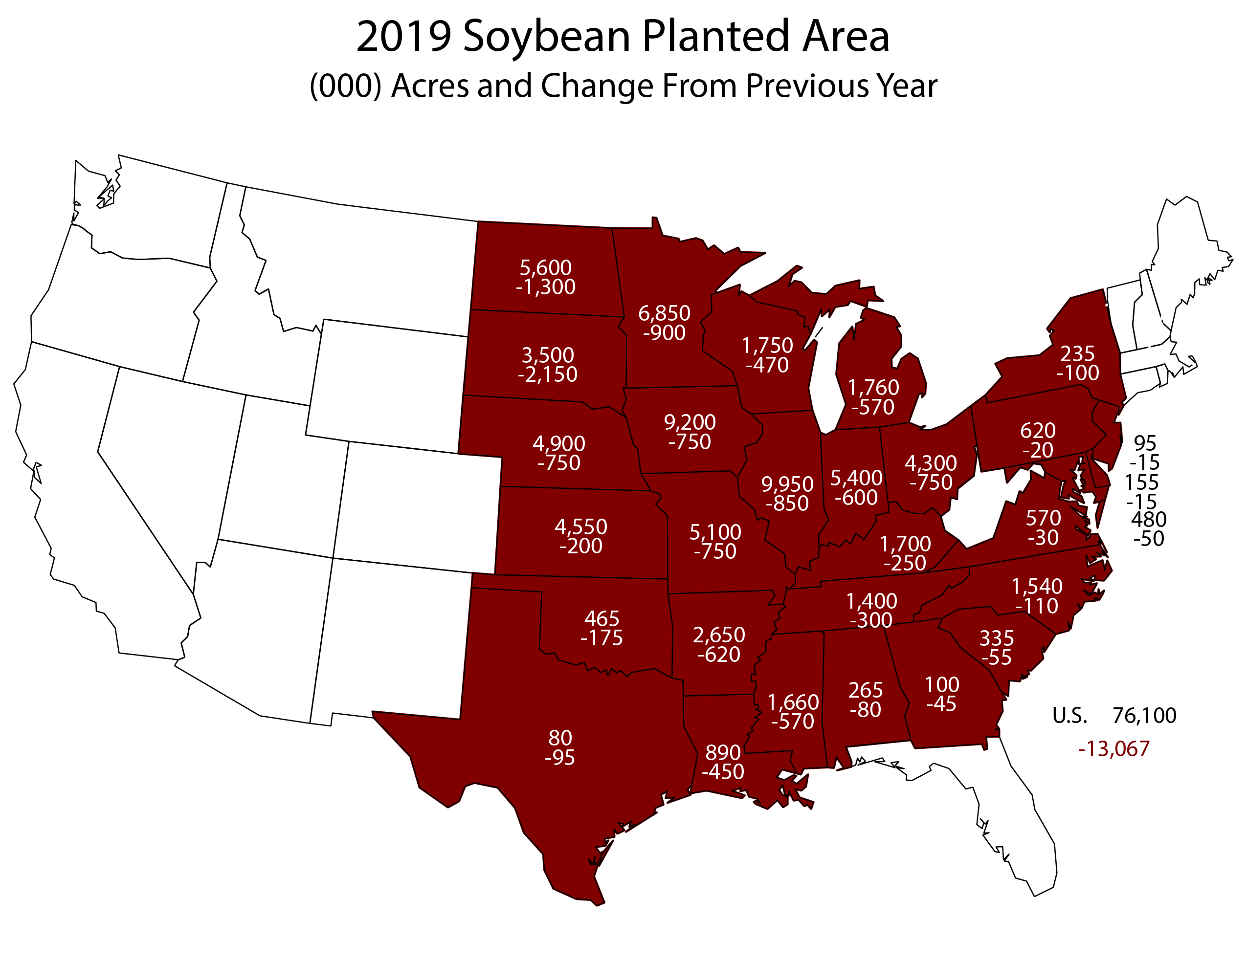
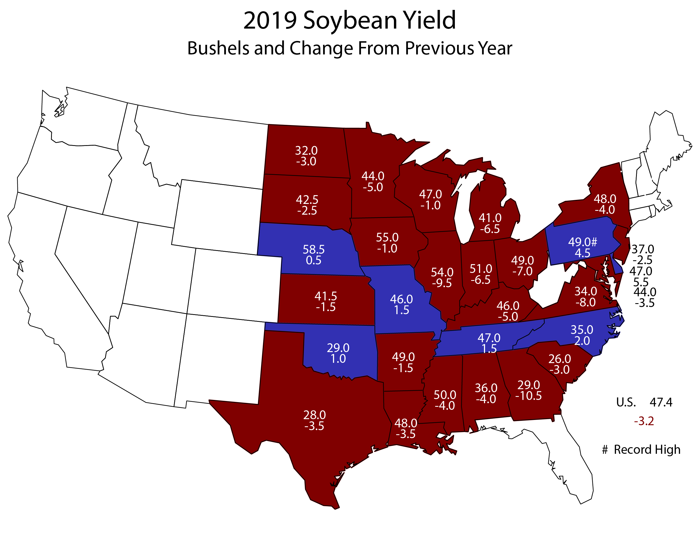
2019 Soybean Forecasts and Final Estimates – United States
March - Final
 |  | March | June | August | September | October | November | Final
Planted | Mil Ac | 84.6 | 80.0 | 76.7 | 76.7 | 76.5 | 76.5 | 76.1
Harvested | Mil Ac | N/A | 79.3 | 75.9 | 75.9 | 75.6 | 75.6 | 75.0
Yield | Bu/Ac | N/A | N/A | 48.5 | 47.9 | 46.9 | 46.9 | 47.4
Production | Bil Bu | N/A | N/A | 3.68 | 3.63 | 3.55 | 3.55 | 3.56

Slide 21
2019 Soybean Forecasts – United States
August and Final with Comparisons
 |  | August | Final | Change | Percent Change
Planted | Mil Ac | 76.7 | 76.1 | -0.600 | -0.8
Harvested | Mil Ac | 75.9 | 75.0 | -0.845 | -1.1
Yield | Bu/Ac | 48.5 | 47.4 | -1.1 | -2.3
Production | Bil Bu | 3.68 | 3.56 | -0.122 | -3.3

Slide 22
2019 Final FSA value is as of January 1, 2020

Slide 23
No published industry expectations after August.

Slide 24
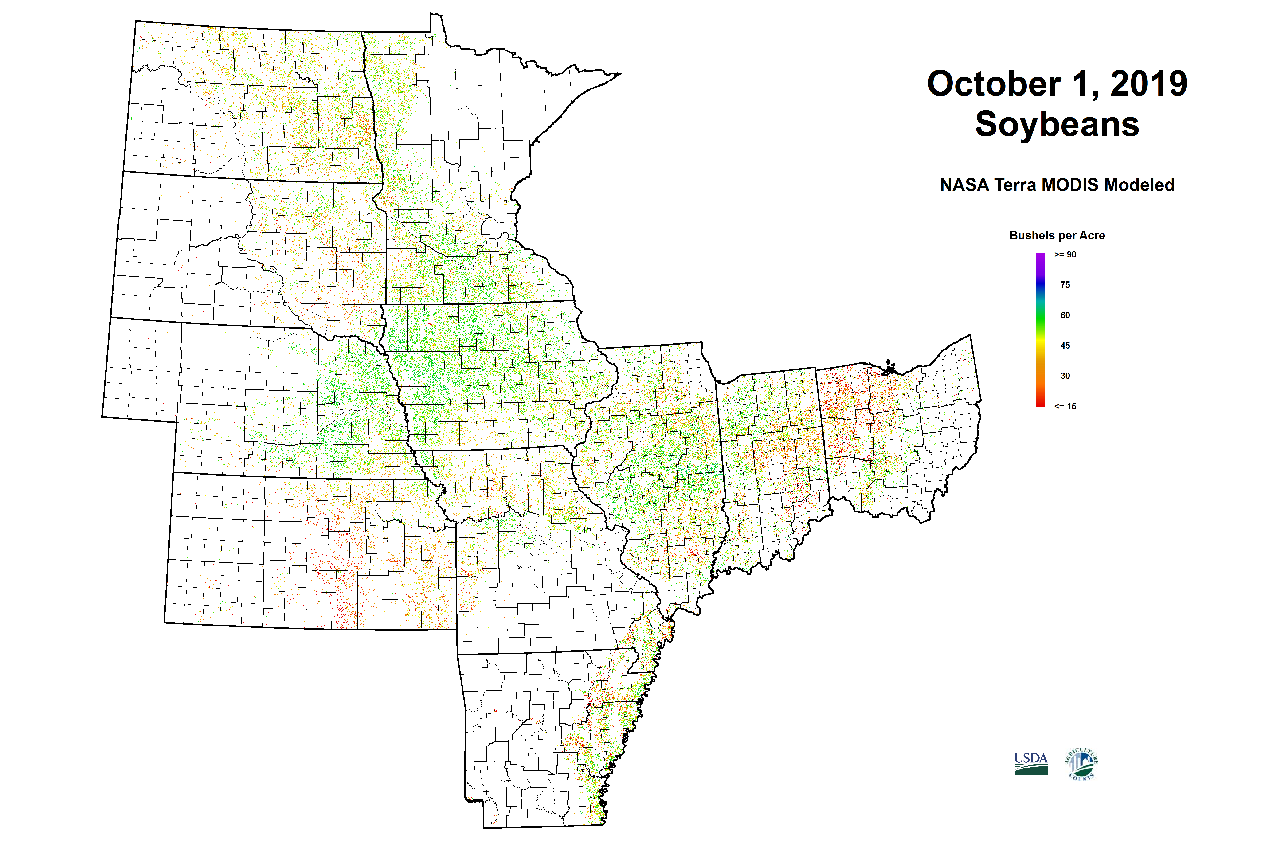

Slide 25
Soybean Production Forecasts as a Percent of Final Production Estimate 2012-2019
Year | August | September | October | November | Final Prod (bil bu)
2012 | -11.5% | -13.4% | -6.0% | -2.3% | 3.04
2013 | -3.0% | -6.2% | NA | -3.0% | 3.36
2014 | -2.9% | -0.4% | -0.0% | 0.8% | 3.93
2015 | -0.3% | 0.2% | -1.0% | 1.4% | 3.93
2016 | -5.5% | -2.2% | -0.6% | 1.5% | 4.30
2017 | -0.7% | 0.4% | 0.4% | 0.3% | 4.41
2018 | 3.6% | 6.0% | 5.9% | 3.9% | 4.43
2019 | 3.4% | 2.1% | -0.2% | -0.2% | 3.56

Slide 26
NASS
Estimate
Low
Of Expectations
Average
Of Expectations
High
Of Expectations

Slide 27

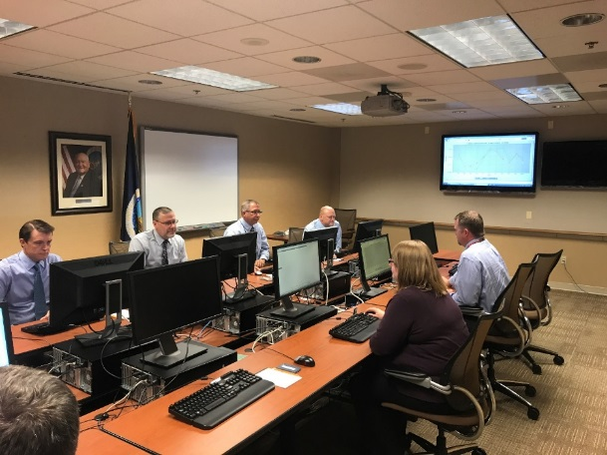

United States Department of Agriculture
National Agricultural Statistics Service
Join Us for Lockup
Contact
Lance.Honig@usda.gov

Slide 28
United States Department of Agriculture
National Agricultural Statistics Service
All Reports Available At
www.nass.usda.gov
Executive Summaries Available At
www.nass.usda.gov/Newsroom/Executive_Briefings

