Slide 1

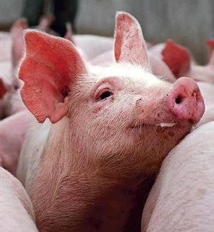
African Swine Fever (ASF)
USDA Prevention, planning,
Response and outreach
in the United states
Alan Huddleston, vmd
Director
Aquaculture, Swine, Equine & Poultry Health
U.S. Department of Agriculture
Animal and Plant Health Inspection Service
Veterinary Services
Agricultural outlook forum – Arlington, VA
February 21, 2020

Slide 2
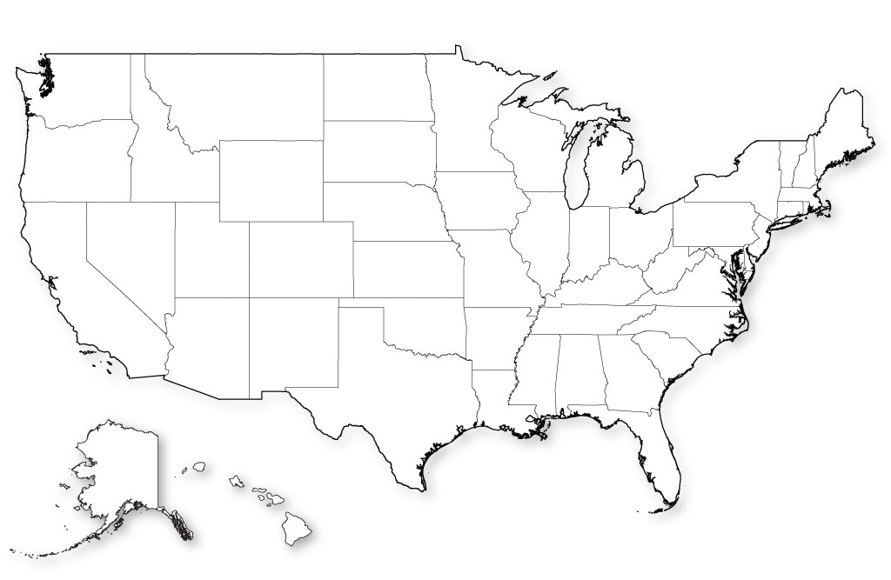
USDA and African Swine Fever
Protecting Our National Herd
Prevention
Planning
Response
Outreach

Slide 3

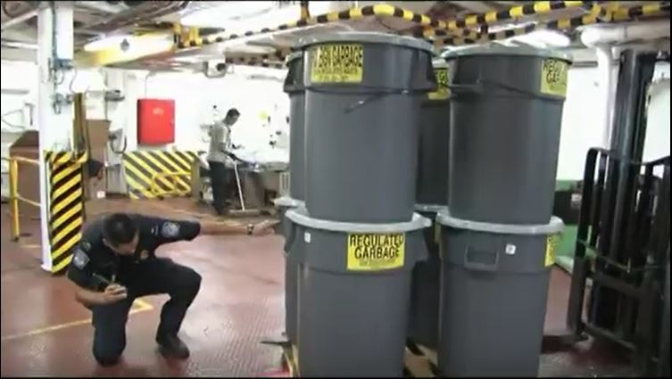
ASF Prevention
Barriers to Entry to the US
Import Restrictions
  Live swine
  Products derived from swine
International garbage restrictions

Slide 4
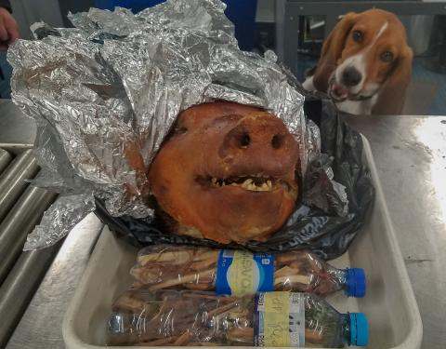
ASF Prevention
Barriers to Entry to the US
Passenger and commercial screening, confiscation/fines
  Partnering with U.S Customs & Border Protection (CBP)

Slide 5
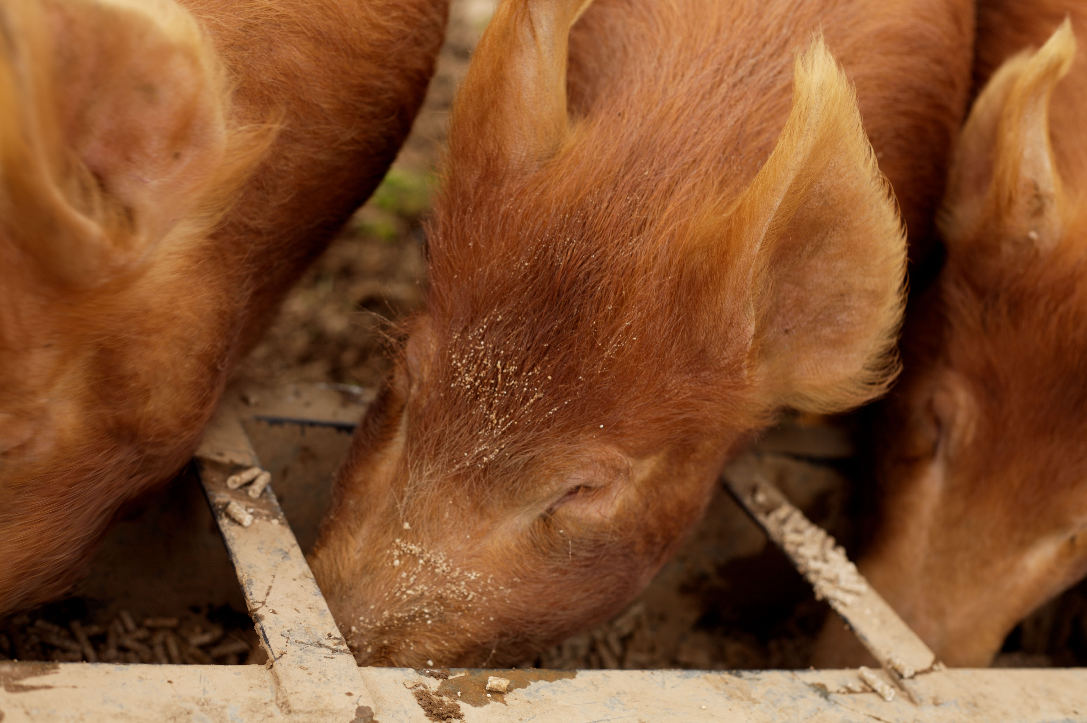
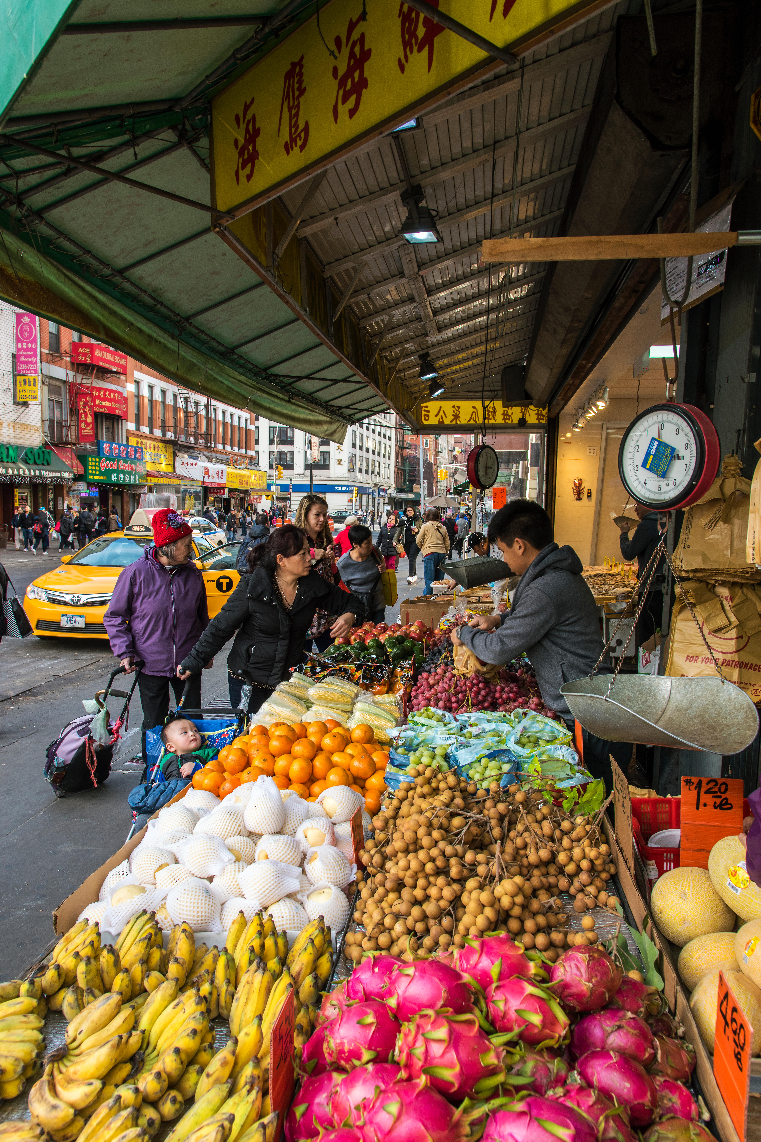
ASF Prevention
Interior Barriers Protecting U.S. Swine
Swine Health Protection Act/Garbage-Feeding Restrictions
Ethnic markets
  APHIS PPQ SITC outreach and enforcement

Slide 6
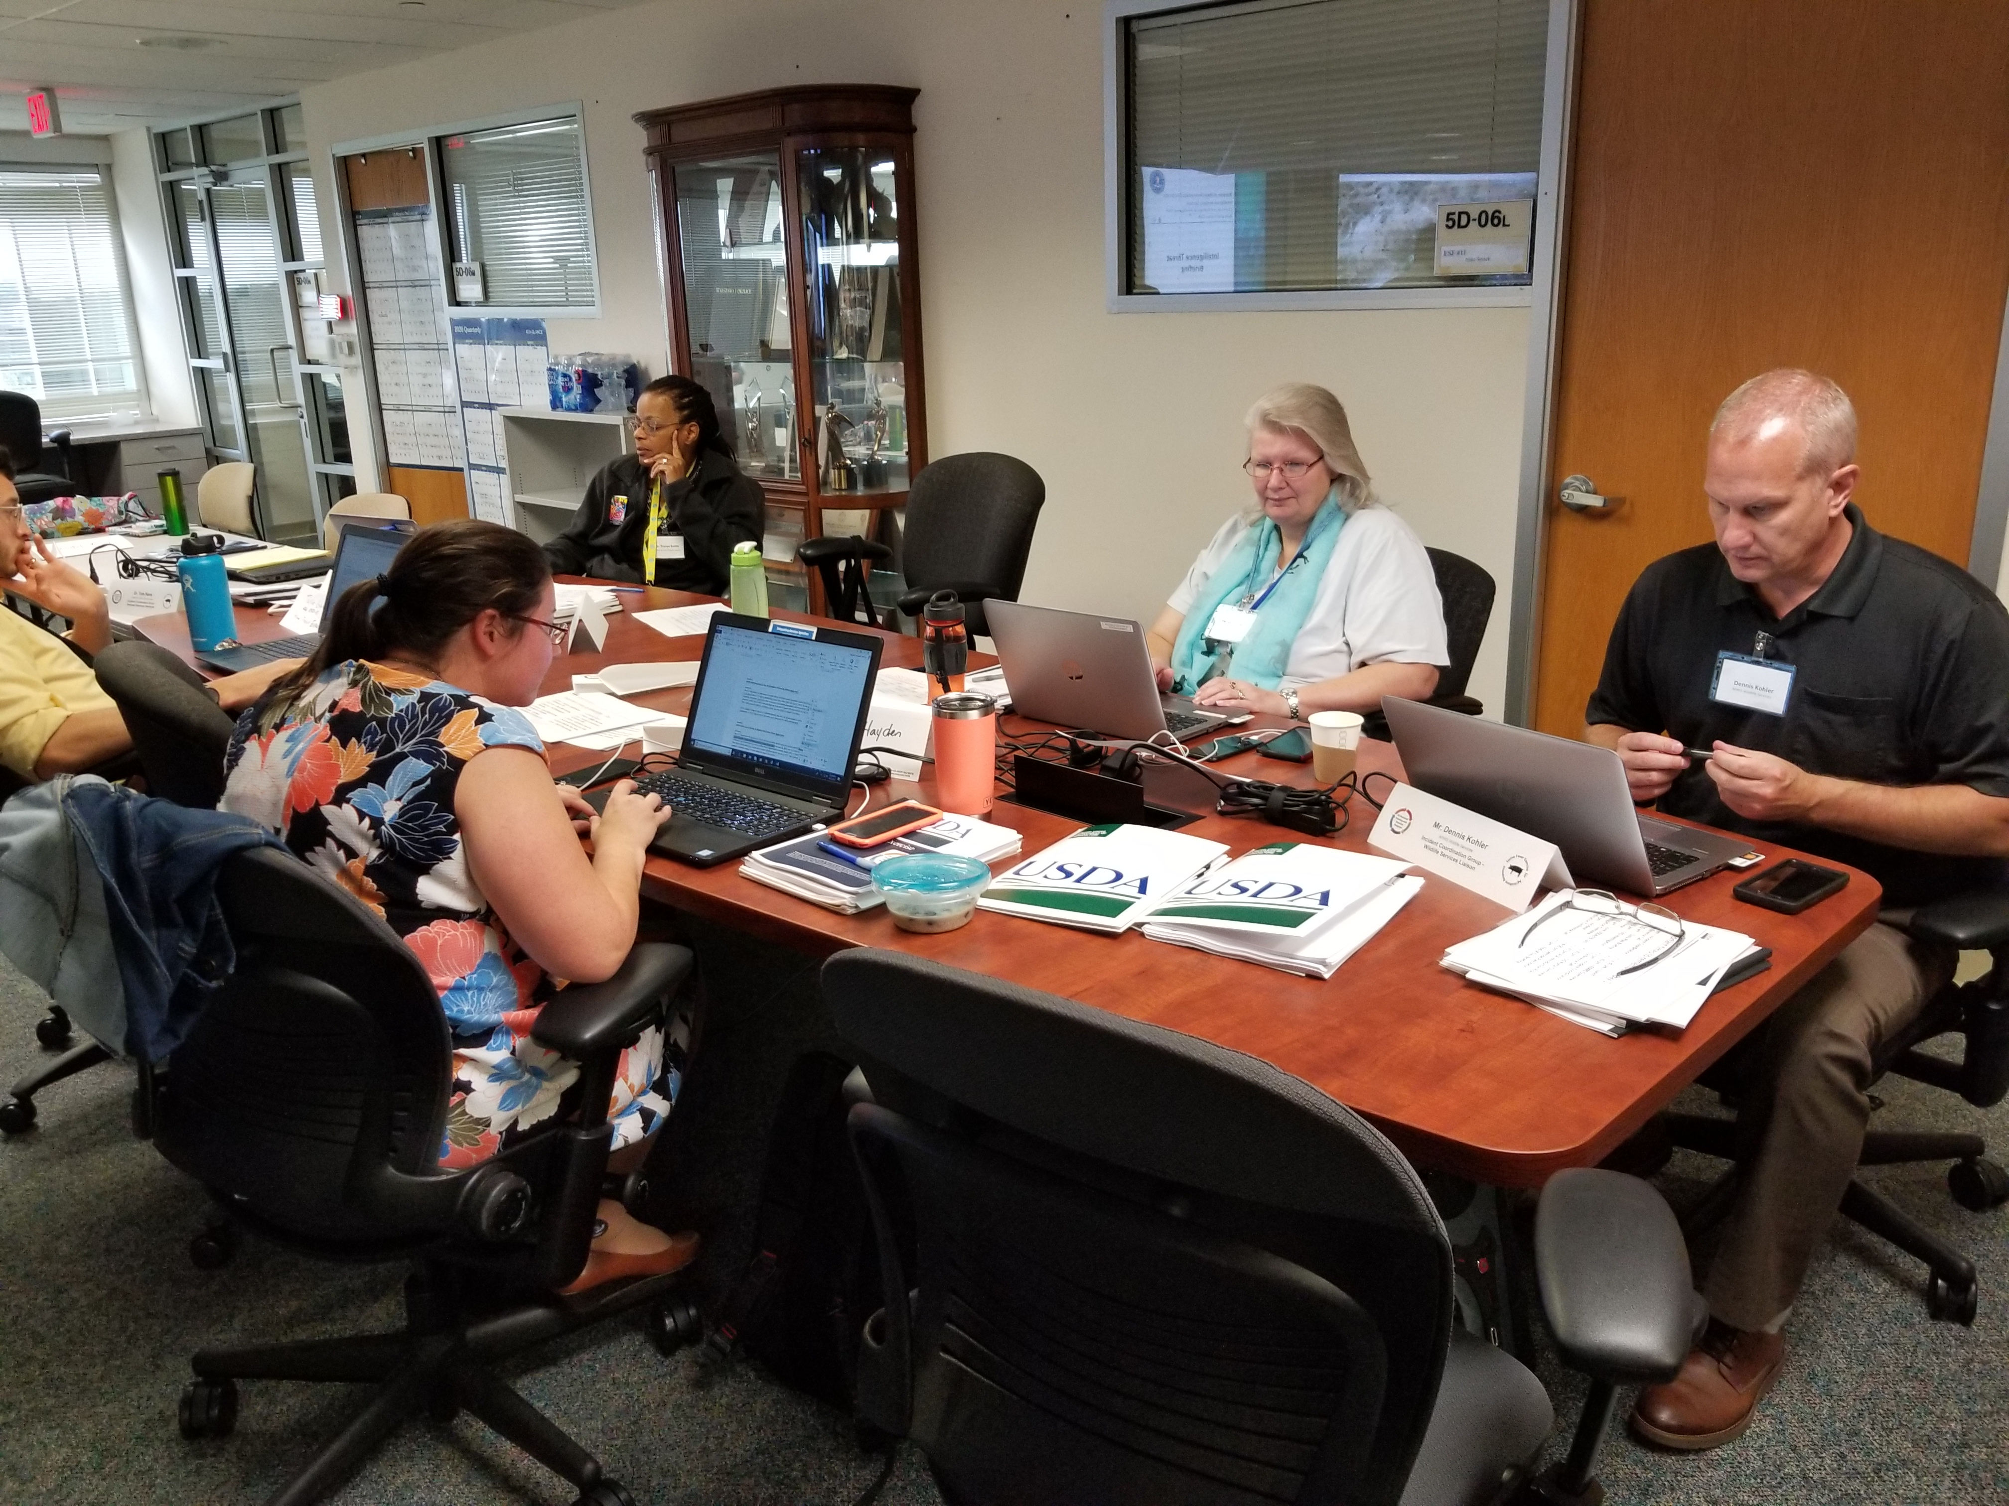
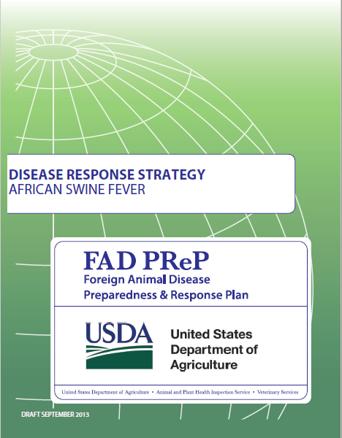
ASF Planning & Response
Strategic Plans & Exercises
ASF FAD PReP Response Strategy
(Dec 2019)
ASF response exercises
2018-2019
State ASF response plans

Slide 7
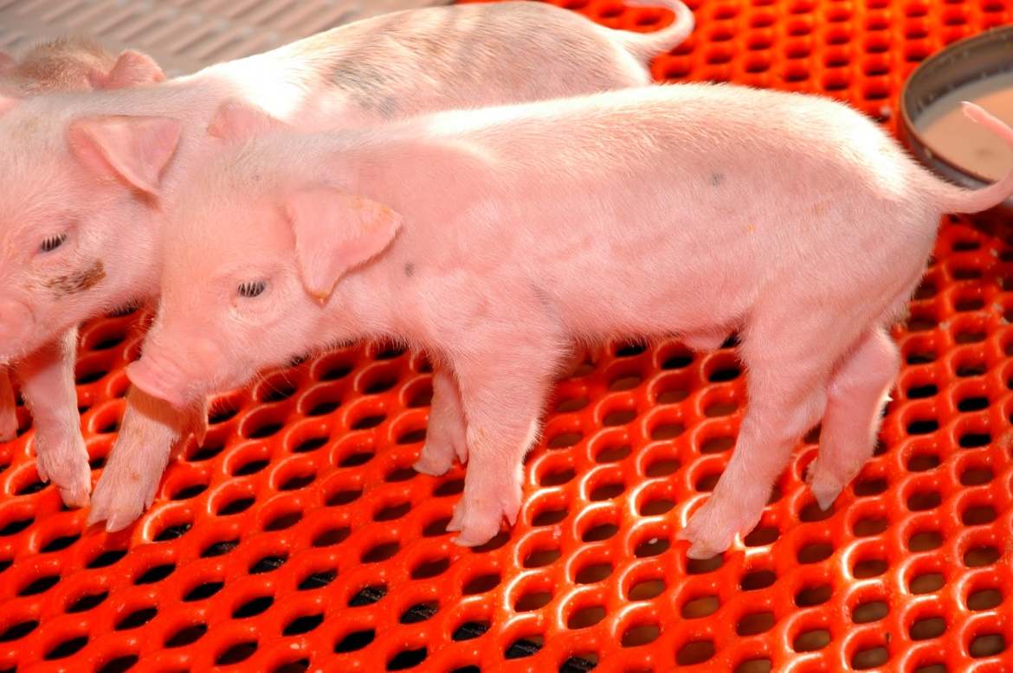
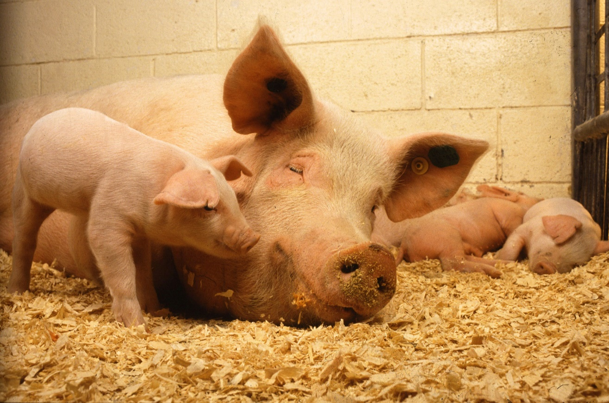
ASF Planning & Response
Increased Diagnostic Capacity
Expanded list of approved tissues for ASF testing
Increased number of approved NAHLN labs

Slide 8
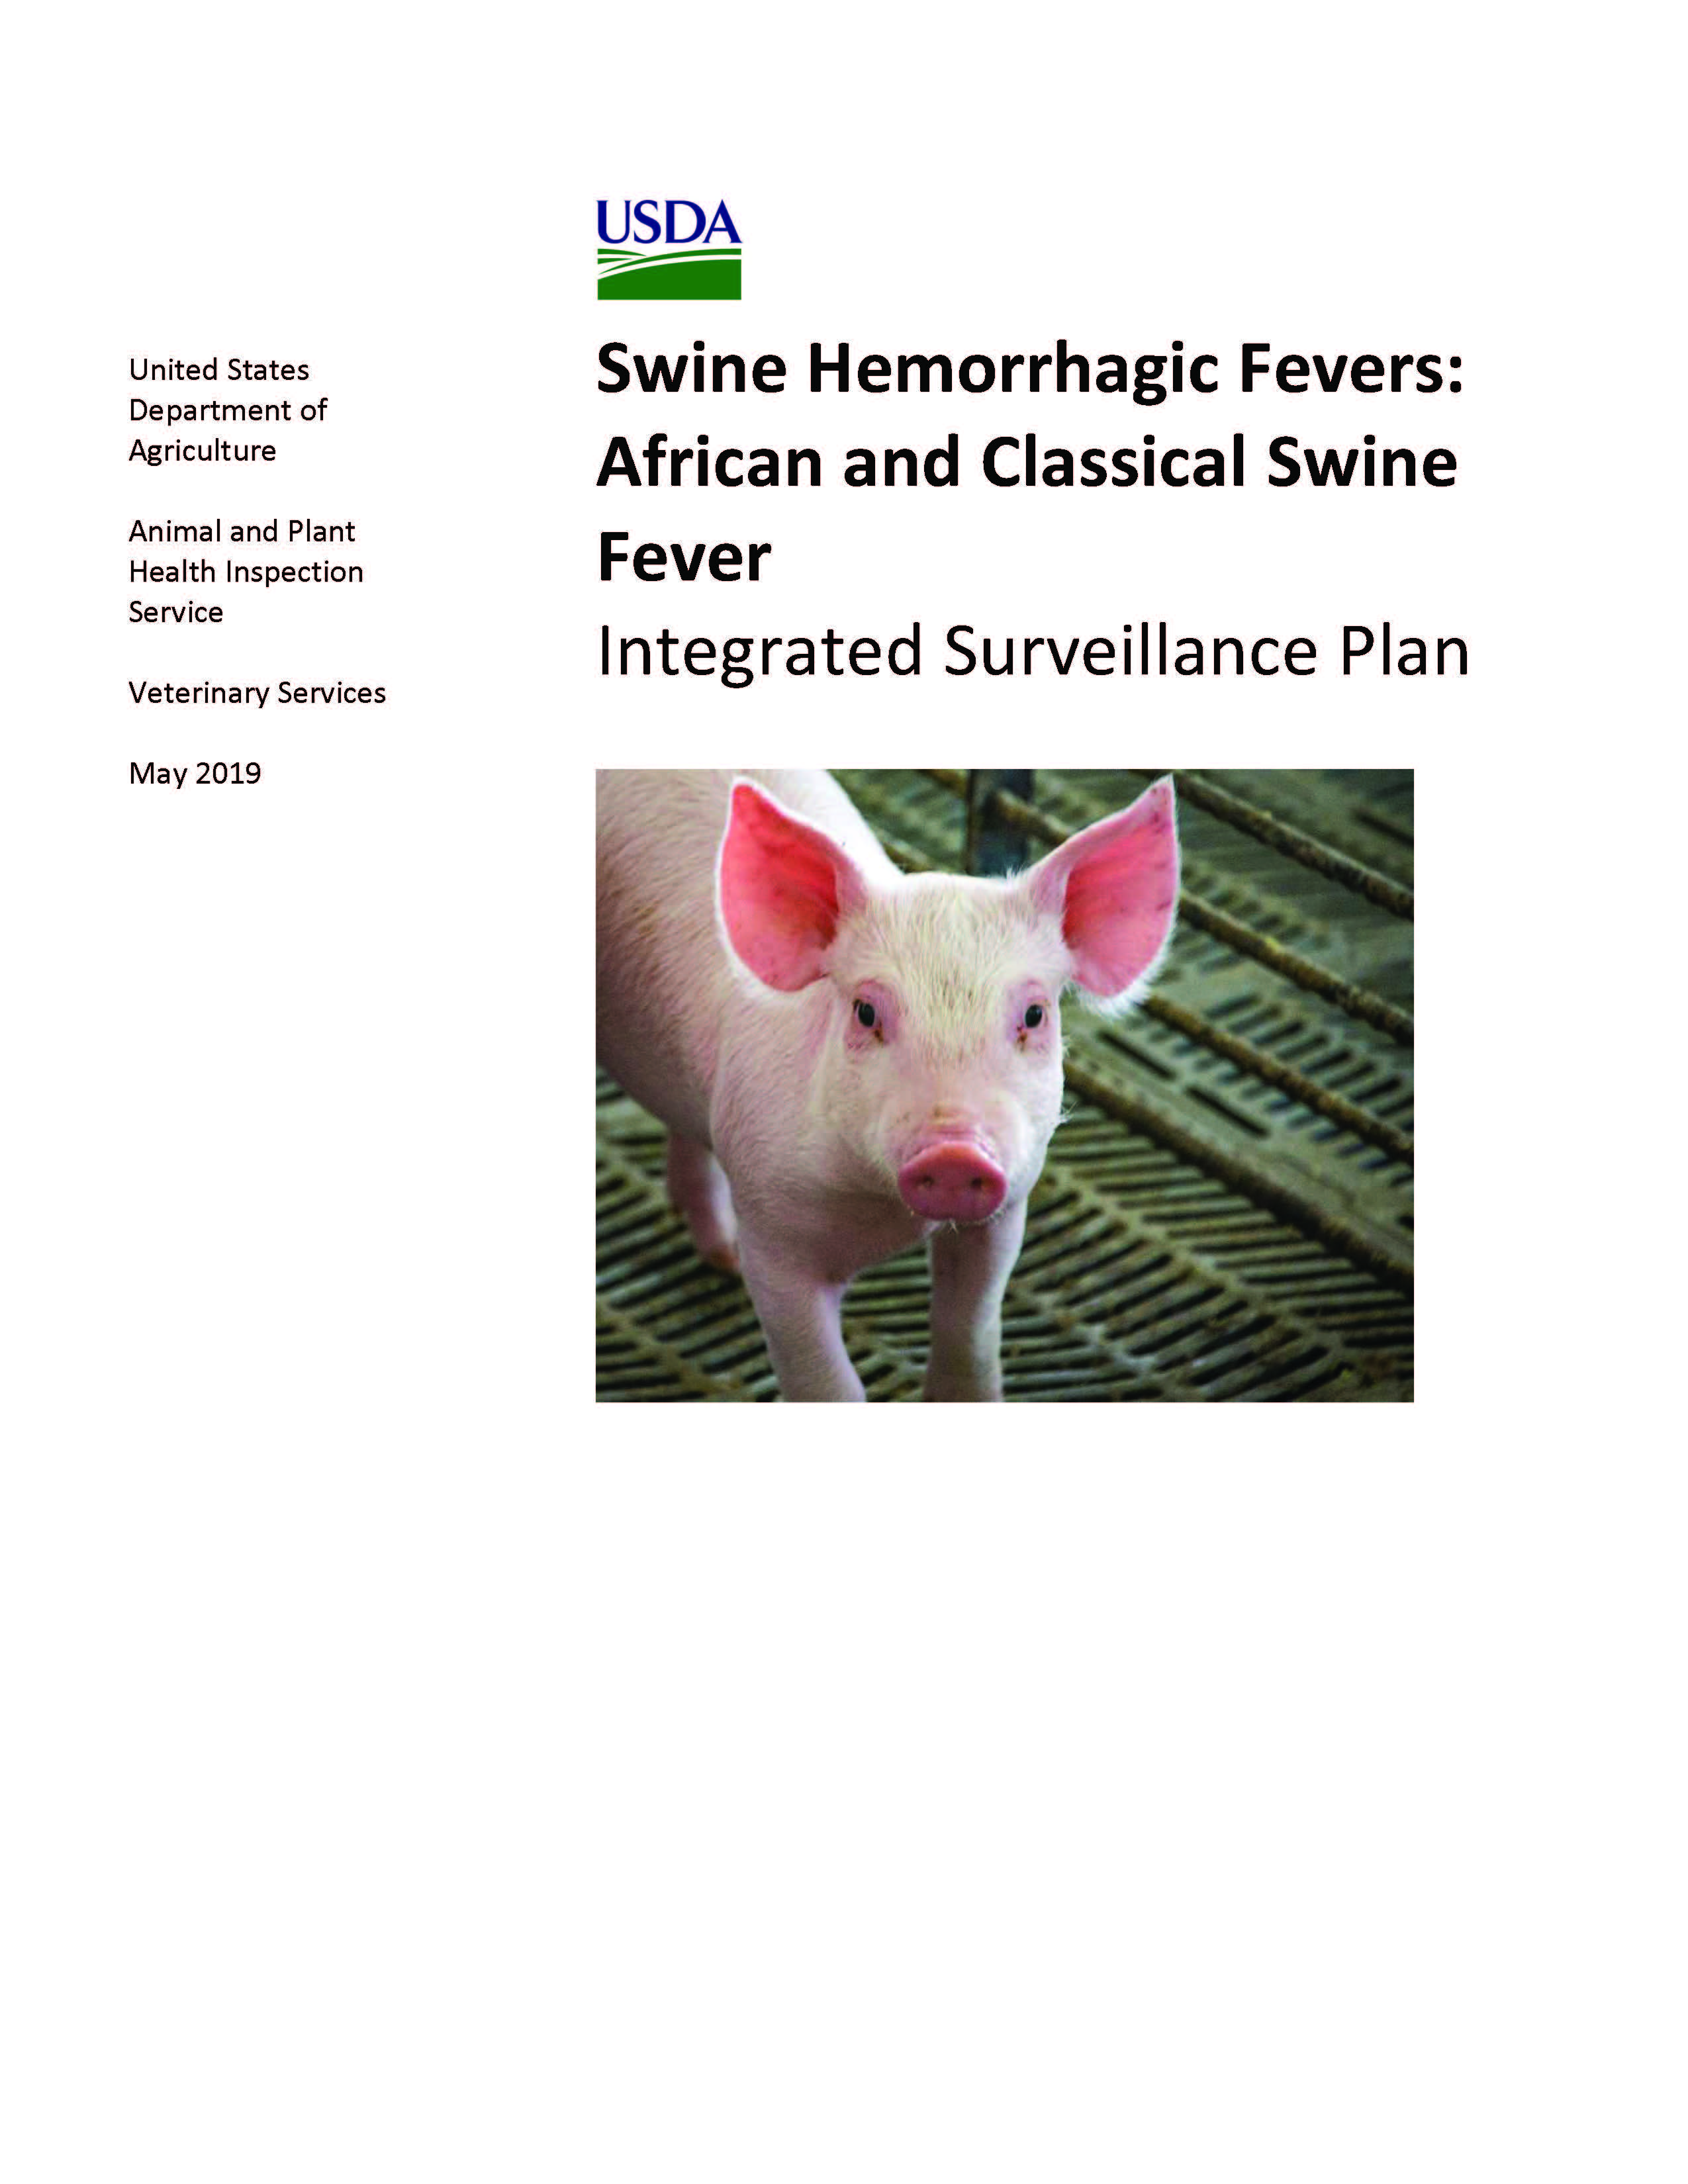
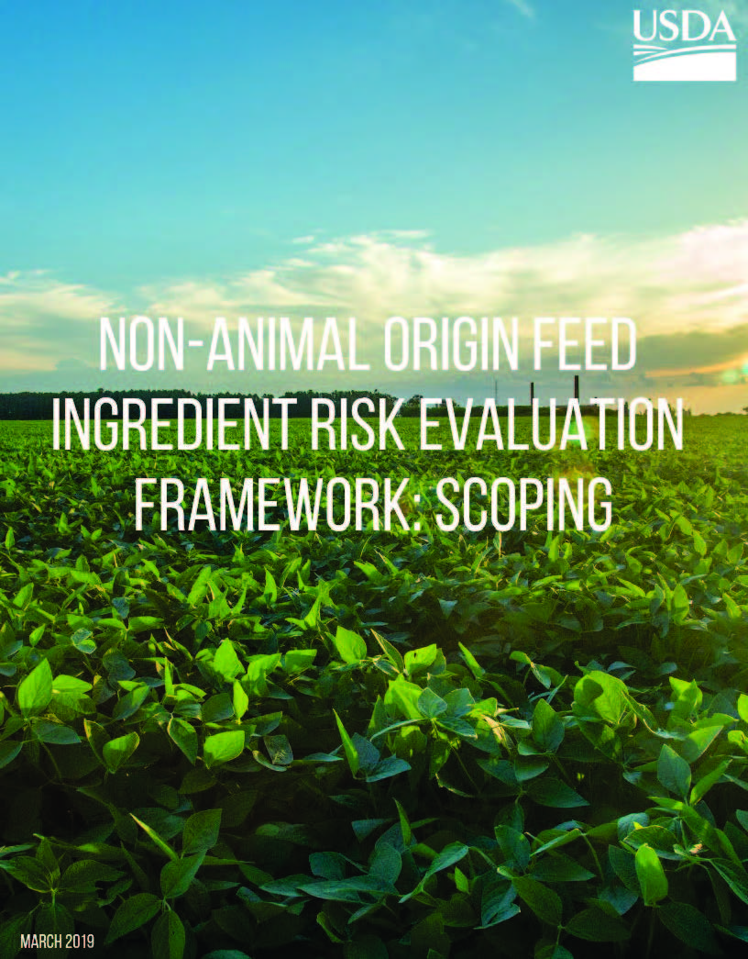
ASF Planning & Response
Surveillance & Analysis
Swine Hemorrhagic Diseases Targeted Surveillance
(June 2019)
Global monitoring
Scientific analysis at USDA’s
Center for Epidemiology & Animal Health (CEAH)

Slide 9
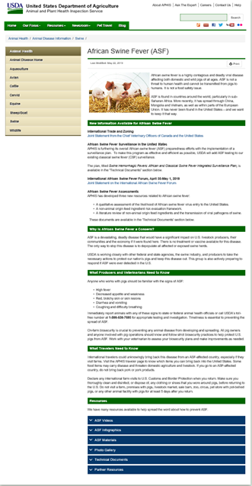
ASF Outreach
Informed Partners = Key to Success
Raising awareness of ASF: how to prevent it from entering the U.S. and encouraging reporting
Sharing information and communicating priorities and activities with key partners
Preparing communications materials to respond in the event of a detection

Slide 10
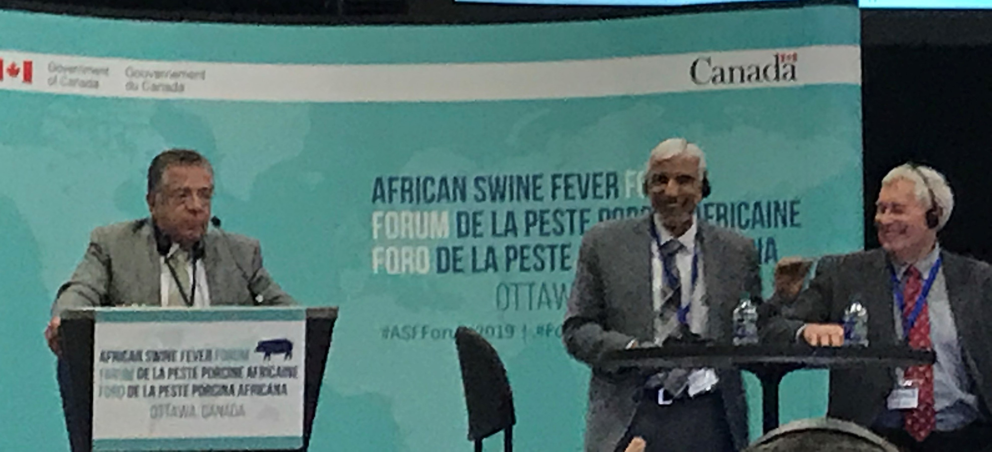
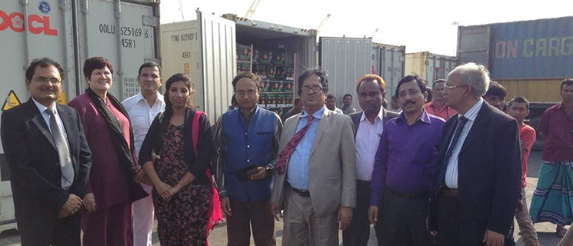
ASF Outreach
International Coordination
North American ASF Symposia
APHIS International Services Reporting & Coordination
USDA ASF Exercises – Mexico & Canada participation

Slide 11
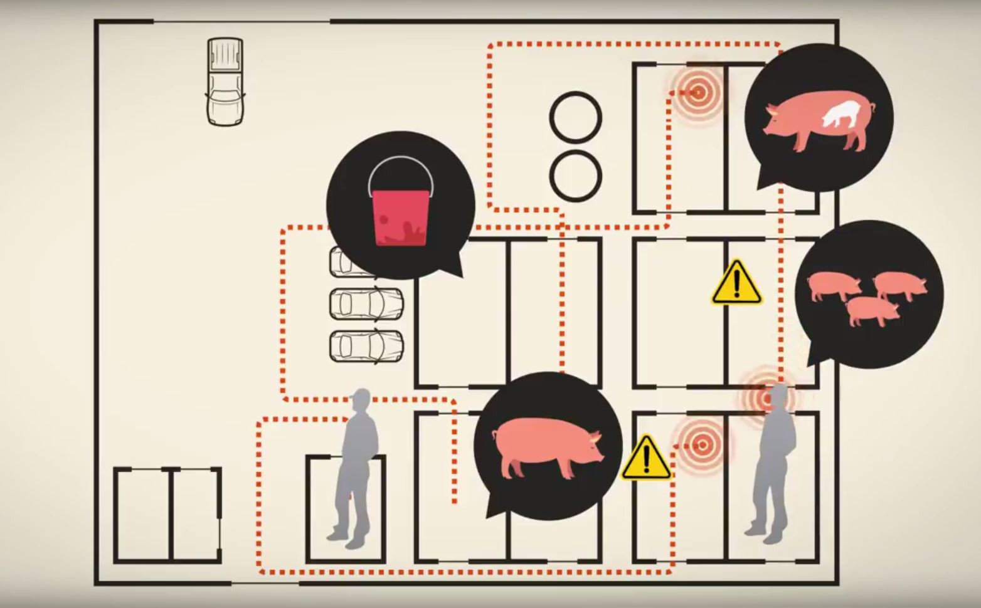

What Can You Do?
Report suspect cases
Practice Good Biosecurity
  On the farm
  Returning from international travel
1-866-536-7593

Slide 12
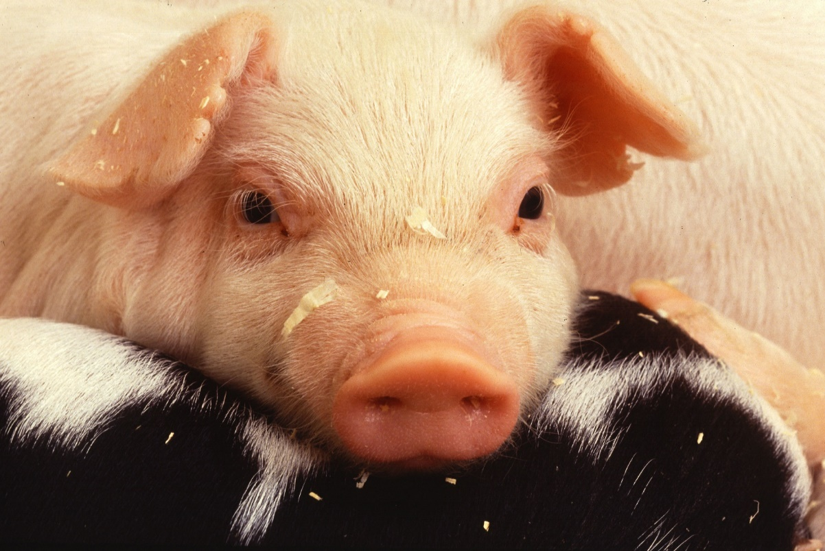
Alan Huddleston, VMD
Director
Aquaculture, Swine, Equine & Poultry Health
U.S. Department of Agriculture
Animal and Plan Health Inspection Service
Veterinary Services

