Slide 1
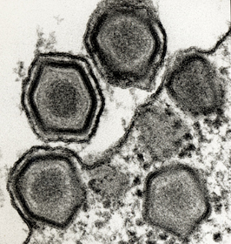
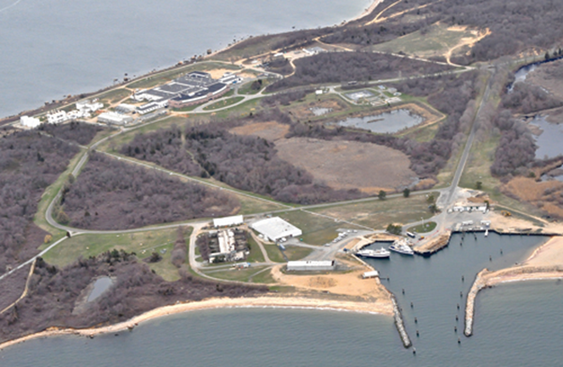


Rational development of
African swine fever vaccine candidates
ASFV Research Program at
Plum Island Animal Disease Center
Manuel V. Borca DVM, PhD

Slide 2
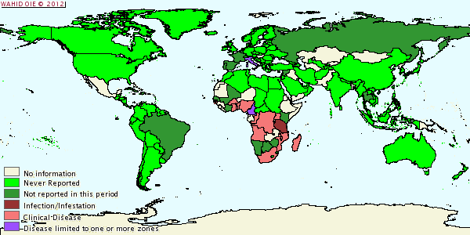
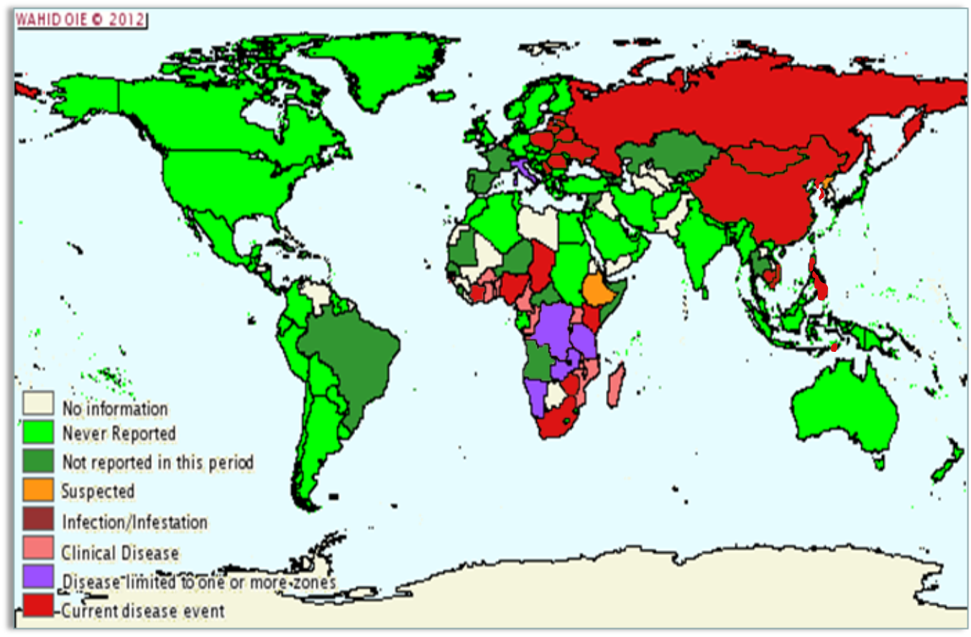
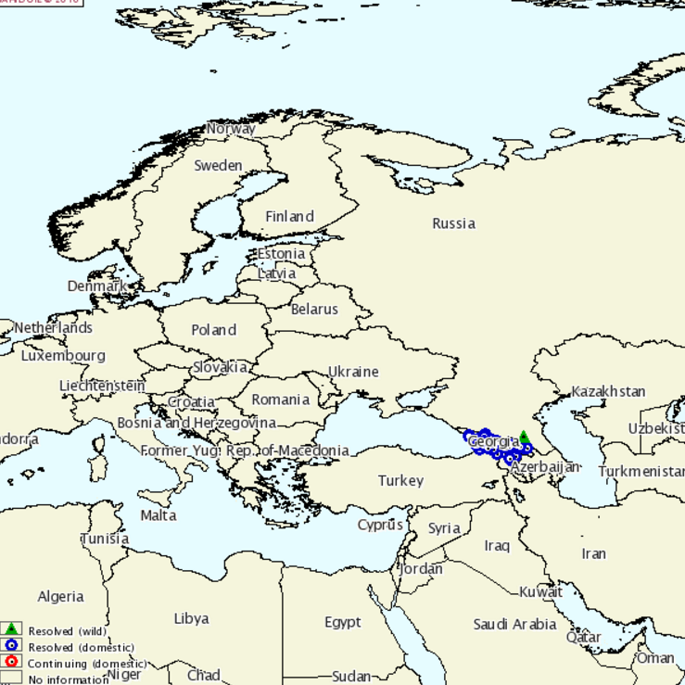
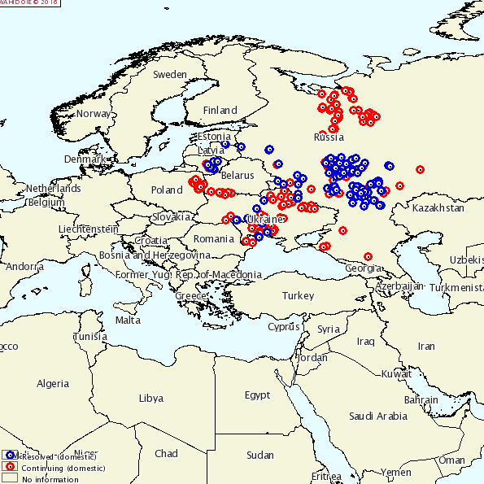
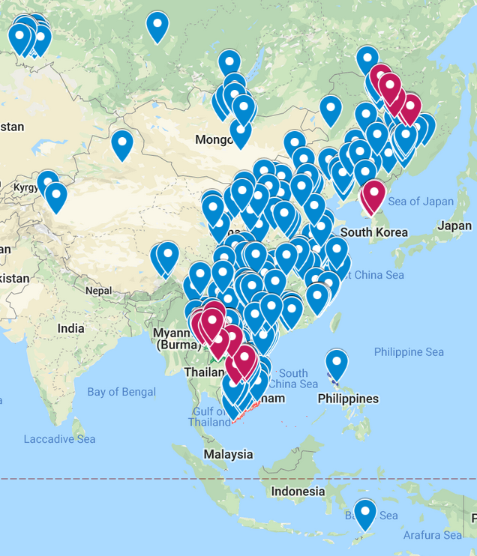
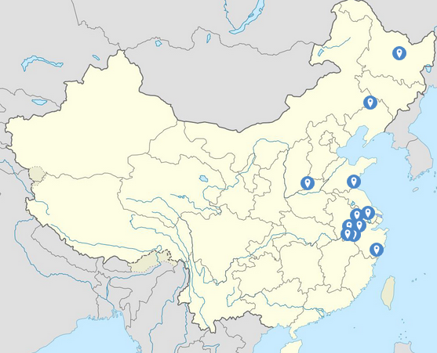
ASFV from single Georgia outbreak
2005
2019
2018-2019 : African swine fever spreads to
China, Mongolia, Vietnam, Cambodia, Philippines,
Timor, Laos, Myanmar, South Korea, North Korea
2007
2016
2018 : Introduction of African swine fever in China
Aug 3 :
Aug 16
Aug 19
Aug 22
Aug 30
Sep 2-3

Slide 3
African Swine Fever Virus
Causes a lethal hemorrhagic disease in domestic
pigs
Large, icosahedral, large double-stranded DNA
genome encoding more than 150 genes
Wild Boar, Warthogs, domestic pigs and soft ticks
Virus/Host factors responsible for different
outcomes remain poorly understood
Rapid and efficient transmission among pigs /
human factor
Long-term persistent/latent infection
Unknown role for most of the genes
Unknown protective immune mechanisms
Unknown protective virus antigens
No commercial vaccine

Slide 4
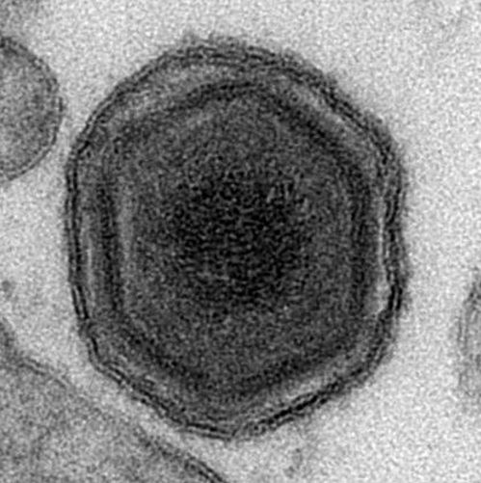
ASF Vaccine
Strategic Targeting for Development
Live attenuated viruses are effective inducing protection against infection
Only 8 genes associated with virulence
Notes:
Live attenuated viruses are effective to protect pigs against homologous challenge.
Attenuated isolates were produced by:
Low virulence isolates: residual virulence
Viruses attenuated by tissue culture passages: huge genetic modifications
Viruses with genetically engineered deletions: rationally designed and genetically stable
Only 8 genes associated with virulence: 9GL, NL, UK, MGF, DP148R, TK, CD2, I177L.
All of them but DP148R discovered at PIADC

Slide 5
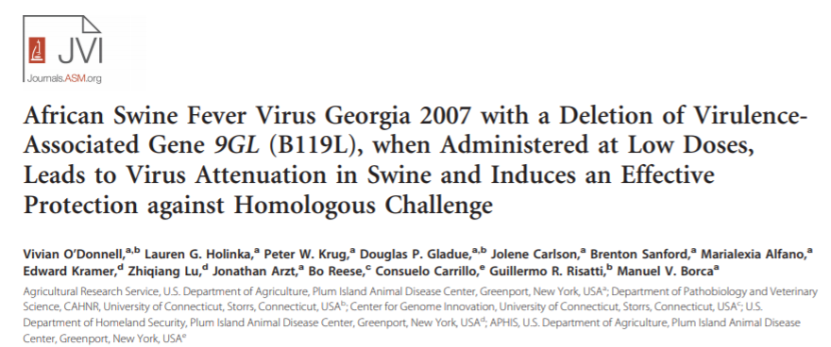
ASF Vaccine
Development of ASFV-G-Δ9GL
Sub-lethal doses of ASFV-G Δ9GL induces protection against clinical disease and death caused by ASF Georgia strain
Journal of Virology (2015) 89:8556-8566
US Patent No. 9,463,234 B2 (2016)

Slide 6
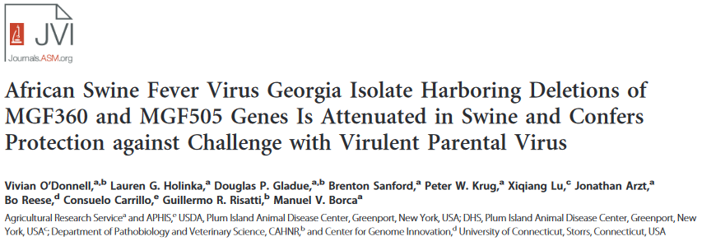
ASF Vaccine
Development of ASFV-G-ΔMGF
The MGF360/MGF505 area: virus attenuation and induction of protection against death caused by ASF Georgia strain
Journal of Virology (2015) 89:6048-6056
US Patent No. 9,528,094 (2016)

Slide 7

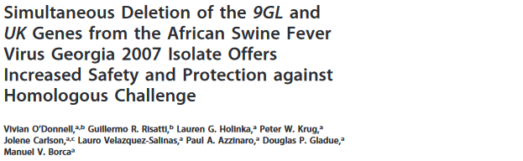
ASF Vaccine
Development of ASFV-G-Δ9GL/ΔUK
Deletion of UK in the ASFV-G-Δ9GL genome increases virus attenuation at least hundred times
ASFV-G-Δ9GL/ΔUK induces protection when administered once at 10⁴ HAD50
Onset of protection starts at 14 days post ASFV-G-Δ9GL/ΔUK infection
Journal of Virology (2017) 91:e01760-16
US Patent No. 9,808,520 (2017)

Slide 8
ASF Vaccine
Development of ASFV-G-ΔI177L
Deletion of I177L gene produces virus attenuation and induction of protection against death caused by ASF Georgia strain
It is effective even at low doses (10² HAD)
It is attenuated even at high doses (10⁶ HAD)
It does not shed
Induces sterile immunity
Journal of Virology (2020) 10.1128/JVI.02017-19 USA Patent Application Serial No. 16/580.058 (2019)

Slide 9
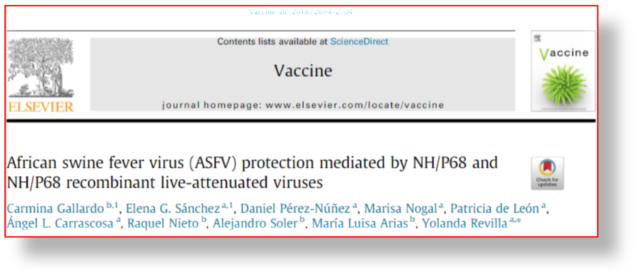
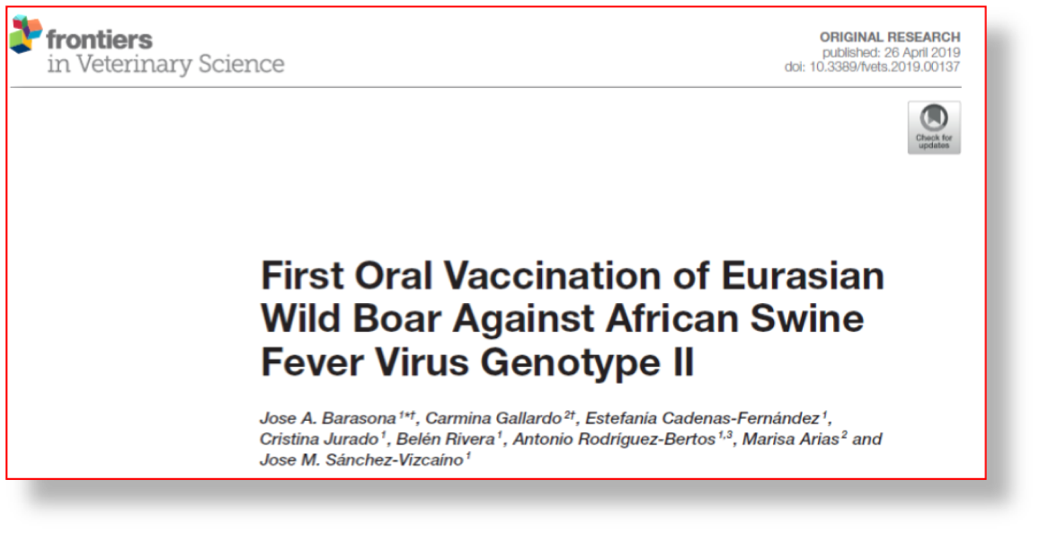
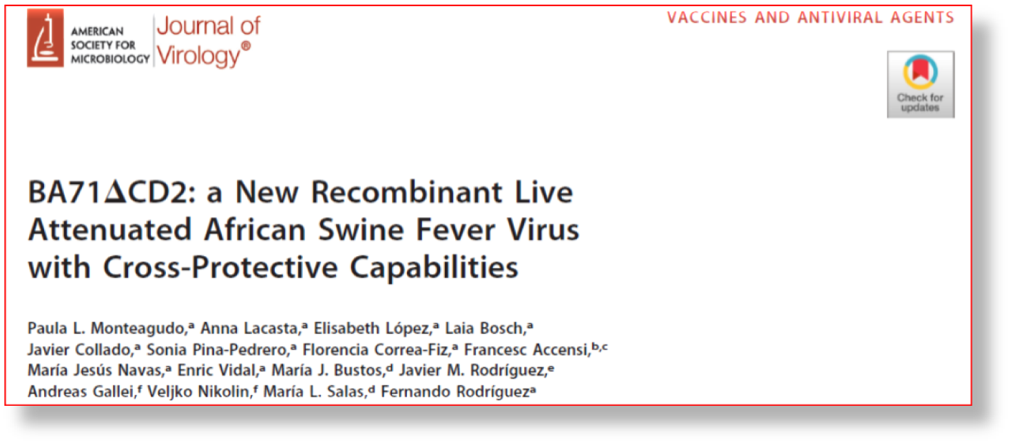
ASF Vaccine
What else is out there besides the ARS vaccine candidates?

Slide 10

.
Contributors
Lauro Velazquez
Elizabeth
Ramirez
Sarah Pruit
Ediane Silva
James Zhu
Liz Vuono
Ayushi Rai

