Slide 1



Thriving with
ADHD at Work
Dr. Theresa Haskins | Presentation for the USDA TARGET Center

Slide 2

Advancing Access & Equity

Slide 3

About the Session
Appreciate neurodiversity and why it is a growing area of focus in the workplace
Understand more about ADHD
Support individuals with ADHD and and their different approaches at work
Find resources if you need support
@ Theresa Haskins, LLC 2023
Notes:
Today we are going to talk about the importance of Mental Health and overall well-being in the workplace. In the first of many neurodiversity session to come, we want to address the most common mental health issues in our workplace – and help you recognize and develop strategies to better support your colleagues.

Slide 4
Session Disclaimer
This presentation is for education and informational purposes only and should not be considered medical advice or mental health services.
If you or someone you know needs assistance or is facing a mental health emergency, please seek guidance from an appropriate healthcare provider.
Any actions taken based on the information presented are at your own risk.
Notes:
As we begin – I want to remind everyone that this presentation…

Slide 5
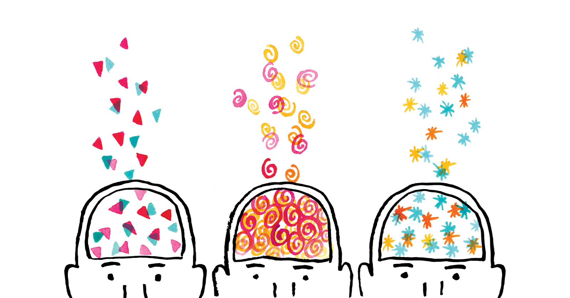
Neurodiversity Defined
Neurodiversity is the diversity of human brains and minds – and recognizes the infinite variation in neurocognitive functioning within our species.
Focused on strengths-based approaches and the concept of multiple intelligences.
(Armstrong, 2011)
@ Theresa Haskins, LLC 2023

Slide 6
Neurodiversity Includes
Neurodivergent
having a brain that functions in ways that results in behaviors that diverge significantly from the societal standards of “normal.”
Neurotypical
having a style of neurocognitive functioning and behaviors that fall within the dominant societal standards of “normal.”
@ Theresa Haskins, LLC 2023

Slide 7
More About Neurodivergence
Autism
ADHD
Dyslexia
Dyscalculia
Dyspraxia
Tourette's Syndrome
Giftedness
Mental Health Conditions
Intellectual Disabilities
@ Theresa Haskins, LLC 2023
Notes:
Neurodevelopmental conditions arise as a result of atypical development of the nervous system during the early stages of life due to the interaction of genetic, neurobiological and environmental influences.
There are many criteria that are considered when someone expects they may be neurodivergent – the primary factor isn’t that you have a characteristic of one of these conditions but more so that the characteristic significantly worsens your ability to engage at work, school, or has some other unwanted or negative impact to an individual’s quality of life.

Slide 8

What is ADHD?
Atypical development resulting in persistent and developmentally (age) inappropriate levels of
inattention,
hyperactivity, and
impulsivity.
ADHD is the persistence of behavior that diverges from typical cognitive milestones.
ADHD worldwide impacts
6 in 100 children
3 in 100 adults
@ Theresa Haskins, LLC 2023
Notes:
Theresa Haskins Consulting does not provide medical advice, diagnosis, or treatment. The material shared during this session is provided for educational purposes only.
Atypical development during ADHD results in persistent and developmentally inappropriate levels of:
inattention
hyperactivity
impulsivity.
(APA, 2000)
Of course, individuals without ADHD can still be inattentive, hyperactive and impulsive to some degree but with ADHD, as with other neurodevelopmental conditions such as autism, these behaviors are persistent and represent a divergence from typical cognitive milestones.
Prevalence data (the number of new and continuing cases) indicate that ADHD is the most common of the neurodevelopmental conditions (Hansen et al., 2018).
Estimates of the worldwide prevalence of ADHD are around 6 in 100 children and adolescents and 3 in 100 adults (Spencer et al., 2002; Moffitt et al., 2015).

Slide 9
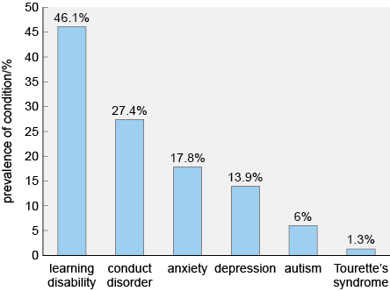
ADHD + Other Conditions
@ Theresa Haskins, LLC 2023
Notes:
Figure 2 Prevalence of several comorbid conditions in children and adolescents with ADHD (based on Larson et al., 2011). *Spencer et al., 2002; Moffitt et al., 2015).
Atypical development during ADHD results in persistent and developmentally inappropriate levels of:
inattention
hyperactivity
impulsivity.
(APA, 2000)
Of course, individuals without ADHD can still be inattentive, hyperactive and impulsive to some degree but with ADHD, as with other neurodevelopmental conditions such as autism, these behaviors are persistent and represent a divergence from typical cognitive milestones.
Prevalence data (the number of new and continuing cases) indicate that ADHD is the most common of the neurodevelopmental conditions (Hansen et al., 2018).
Estimates of the worldwide prevalence of ADHD are around 6 in 100 children and adolescents and 3 in 100 adults (Spencer et al., 2002; Moffitt et al., 2015).

Slide 10
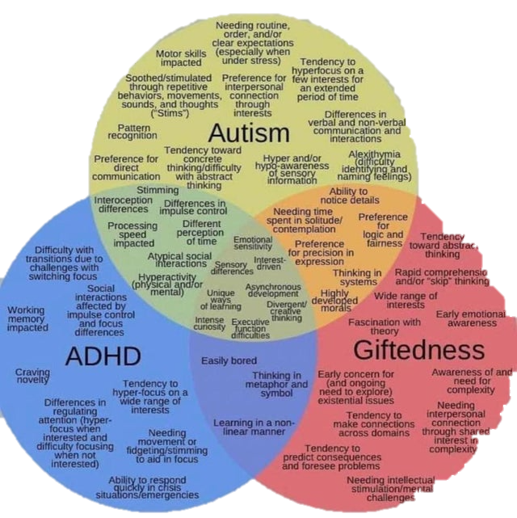
What’s your perception of ADHD
@ Theresa Haskins, LLC 2023

Slide 11
Impacts of ADHD
Executive Functioning
Impulsivity
Restlessness and Hyperactivity
Memory Difficulties
Patterns of Procrastination
Disorganized
@ Theresa Haskins, LLC 2023

Slide 12
ADHD @ Work Without Support
interpersonal conflict
tardiness
absenteeism
errors
slow to change
lack of dependability
Negative Impacts on Performance
@ Theresa Haskins, LLC 2023
Notes:
Figure 2 Prevalence of several comorbid conditions in children and adolescents with ADHD (based on Larson et al., 2011). *Spencer et al., 2002; Moffitt et al., 2015).
Atypical development during ADHD results in persistent and developmentally inappropriate levels of:
inattention
hyperactivity
impulsivity.
(APA, 2000)
Of course, individuals without ADHD can still be inattentive, hyperactive and impulsive to some degree but with ADHD, as with other neurodevelopmental conditions such as autism, these behaviors are persistent and represent a divergence from typical cognitive milestones.
Prevalence data (the number of new and continuing cases) indicate that ADHD is the most common of the neurodevelopmental conditions (Hansen et al., 2018).
Estimates of the worldwide prevalence of ADHD are around 6 in 100 children and adolescents and 3 in 100 adults (Spencer et al., 2002; Moffitt et al., 2015).

Slide 13
Impact of ADHD Unsupported at Work
3x more likely to be terminated from a job
52% more likely to change jobs
Absent more frequently than typical colleagues
@ Theresa Haskins, LLC 2023

Slide 14
ADHD @ Work With Support
quieter work area
more time for completing work
quality check or peer review of detailed work
flex hours to support peak hours of focus and attention
clear directions and expectations
instructions and training in writing for reference
Effective Supports for Top Performance
@ Theresa Haskins, LLC 2023
Notes:
Figure 2 Prevalence of several comorbid conditions in children and adolescents with ADHD (based on Larson et al., 2011). *Spencer et al., 2002; Moffitt et al., 2015).
Atypical development during ADHD results in persistent and developmentally inappropriate levels of:
inattention
hyperactivity
impulsivity.
(APA, 2000)
Of course, individuals without ADHD can still be inattentive, hyperactive and impulsive to some degree but with ADHD, as with other neurodevelopmental conditions such as autism, these behaviors are persistent and represent a divergence from typical cognitive milestones.
Prevalence data (the number of new and continuing cases) indicate that ADHD is the most common of the neurodevelopmental conditions (Hansen et al., 2018).
Estimates of the worldwide prevalence of ADHD are around 6 in 100 children and adolescents and 3 in 100 adults (Spencer et al., 2002; Moffitt et al., 2015).

Slide 15
Strategies If You Have ADHD
Impulsivity
Anticipate problems that trigger impulsive reactions and develop routines for coping with these situations
Ask for feedback as a way of becoming more aware of your actions at work
Restless and Hyperactivity
Take notes in meetings to prevent restlessness
Use objects to redirect energy to focus
Set a timer to stay on task
Memory
Write checklists for tasks
Use a note board, planner, or computer reminders
Write notes on a sticky pad and put them in a highly visible place
Procrastination
Break tasks into small pieces
Ask the manager to set task checkpoints and deadlines
Work with a co-worker who excels at time management
@ Theresa Haskins, LLC 2023

Slide 16

How You Can Help Others
Schedule regular check-ins
Make short-term goals clear to the team
Support time management of tasks and projects
Provide helpful techniques to meet deadlines
Encourage and support unique approaches to work
Assign task partners to help get work done
Provide ideas on how to get started on a project
Assist by offering to switch tasks sometimes
Set realistic timelines for everyone
@ Theresa Haskins, LLC 2023

Slide 17
Finding Resources and Support
Explore resources online to learn more about neurodivergent conditions
Leverage online discovery assessments to inform your decision to pursue a formal diagnosis
Talk to your general practitioner, therapist, or psychologist about your experiences and findings
Find a qualified professional to formally assess and diagnose adulthood autism and ADHD
Connect with local autism networks, advocates, and neurodivergent groups for community support
@ Theresa Haskins, LLC 2023

Slide 18

Promote Neurodiversity
Educate yourself
Respect individual differences
Focus on accessibility
Be open to new approaches
Implement universal practices
Advocate proactively for inclusion
@ Theresa Haskins, LLC 2023

Slide 19

Contact Information
TARGET Center Website
https://www.usda.gov/target-center
TARGET Center Email
target-center@usda.gov
TARGET Center Phone Number
(202) 720-2600

Slide 20

Current and Upcoming Meetings, cont.
OCTOBER
MONDAY WEDNESDAY
THURSDAY
TUESDAY
10/16/2023
11:00 AM – 12:00 PM
USDA TARGET Center
Accessible Communications
Program
Nancy Frohman
Accessible
Communications
Program Manager
1:00 PM – 2:00 PM
USDA TARGET Center
Education Program
Michelle Sherbondy
Education Program Manager
10/17/2023
11:00 AM – 12:00 PM
Unmasking Hidden Challenges: Chronic Conditions in the Workplace
Dr. Theresa Haskins Haskins Consulting
1:00 PM – 2:00 PM
Equity, Accessibility, and Inclusion in the Workplace (Part 1 of 2)
Dr. Theresa Haskins Haskins Consulting
10/18/2023
10:00 AM – 11:00 AM
Ergonomic Equity: Addressing Risk Factors Through Job Analysis and Prevention
Sandra Miller
Britroix
12:00 PM – 1:00 PM
Digital Accessibility Fundamentals for Websites, Documents, and Video
Mike Caprara
The Viscardi Center
10/23/2023
11:00 AM – 12:00 PM
Emotional Intelligence (Part 1 of 2)
Carolyn Owens,
MCC, SPHR
1:00 PM – 2:00 PM
Proper Posture in the Workplace to Prevent Posture-Related Problems (Part 1 of 2)
Dr. Krista Burns
American Posture Institute
10/24/2023
11:00 AM – 12:00 PM
Thriving with ADHD at Work
Dr. Theresa Haskins Haskins Consulting
1:00 PM – 2:00 PM
Equity, Accessibility, and Inclusion in the Workplace (Part 2 of 2)
Dr. Theresa Haskins Haskins Consulting
10/25/2023
10/26/2023
10:00 AM – 11:00 AM
Assistive Technology at New Heights
Dr. Wayne Crolley
Novare Products, LLC
10/25/2023
10:00 AM - 12:00 PM
USDA TARGET Center
Accessible Communications Demonstrations
(Virtual/Onsite)
Nancy Frohman
Accessible Communications
Program Manager
1:00 PM - 3:00 PM
USDA TARGET Center
Education Demonstrations
(Virtual/Onsite)
Michelle Sherbondy
Education Program Manager

