Slide 1

accessibility at new heights
fully accessible wall storage products
National Disability Employment Awareness Month Symposium | 2023 USDA TARGET Center

Slide 2
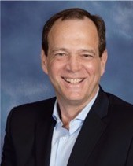
about me
With over 30 years experience in leadership positions, Wayne brings his technical leadership experience and product vision to the consortium. During his 20 years at AT&T, Wayne successfully led several initiatives that had executive visibility and were concluded successfully by meeting strategic objectives, target objectives, and were completed on time and under budget. He is skilled at building and leading highly-diverse teams to higher productivity and effectiveness levels to achieve targeted outcomes while maintaining a focus on quality and an innovative culture.
Wayne Crolley, MBA
His technical leadership experience includes large-scale digital transformation and collaboration platform development,
marketing, and planning.
Founder and Managing Member
Novare Products LLC
Wayne has been awarded 22 patents for various technologies including IoT devices, encryption methods, and a novel method for geolocation. Wayne has an undergraduate degree in Information Technology – Summa Cum Laude, and a Masters in Business Administration with an emphasis in management and strategy.
Copyright 2023 – Novare Products LLC All Rights Reserved

Slide 3

Advancing Access & Equity

Slide 4
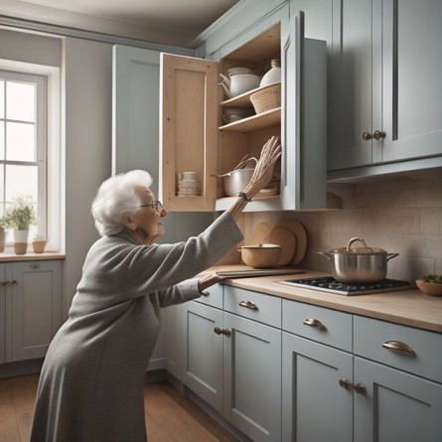
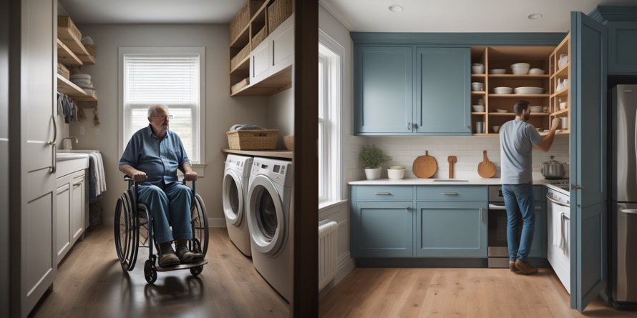
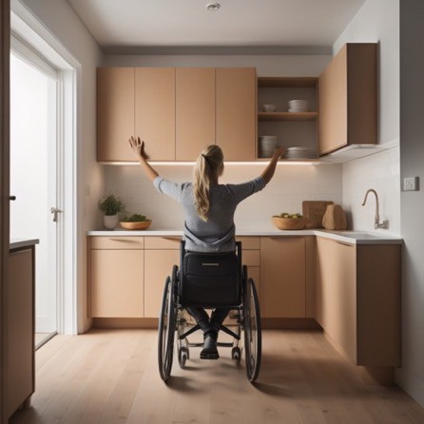
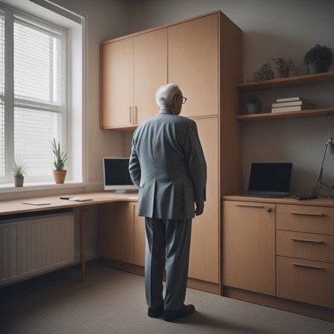
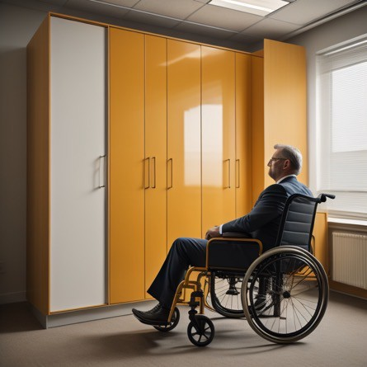
the problem
a pervasive and largely unaddressed accessibility barrier
kitchen wall cabinets are 52” high closet shelves are 84” high laundry area shelves are 60+” high
a wheelchair user’s reach is 48”
study: shoulder range of motion ~<120 degrees ages 65+
homes, workplaces, transportation, assisted living, government facilities, recreational areas
Copyright 2023 – Novare Products LLC All Rights Reserved

Slide 5
impact
250,000
American Veterans use a wheelchair
3.6 million
Americans use wheelchairs
>3 million
Americans have upper limb disabilities
66%
of Americans 55 and older in 2021 said they plan to age in place
73 million
Americans will be 65 and older by 2030
Copyright 2023 – Novare Products LLC All Rights Reserved

Slide 6
the (other) problem(s)
conventional options:
  footstool or stepladder: creating a risk of fall and injury
  asking for assistance: potentially negatively affecting dignity
  moving all objects from a wall cabinet to a countertop or lower shelves, not feasible
lowering cabinet products that (claim to) provide this type of accessibility:
  require manual operation to lower the cabinet contents: not feasible, unsafe
  only lower ~1’ and only vertically: provide only partial access
  prices start at $2,500: basically, the price of an appliance
no major marketing or distribution channels: no product awareness
result: MORE barriers of safety, usability, efficacy, and affordability!
Copyright 2023 – Novare Products LLC All Rights Reserved

Slide 7
the solution
ideally? remove ALL barriers
remove the complexity barrier
  provide FULL accessibility
  appliance-like, easy and inexpensive to install
  industry standard cabinet dimensions
  replaceable exterior panels
remove the usability barrier
  a single button, universal remote control, or app
remove the efficacy barrier
  robotic technology
    minimal size -> more space for storage
  move in front of objects that are underneath
  lower 3 feet or more
remove the affordability barrier
  low complexity = lowest possible cost
✓ = must have feature
Copyright 2023 – Novare Products LLC All Rights Reserved

Slide 8
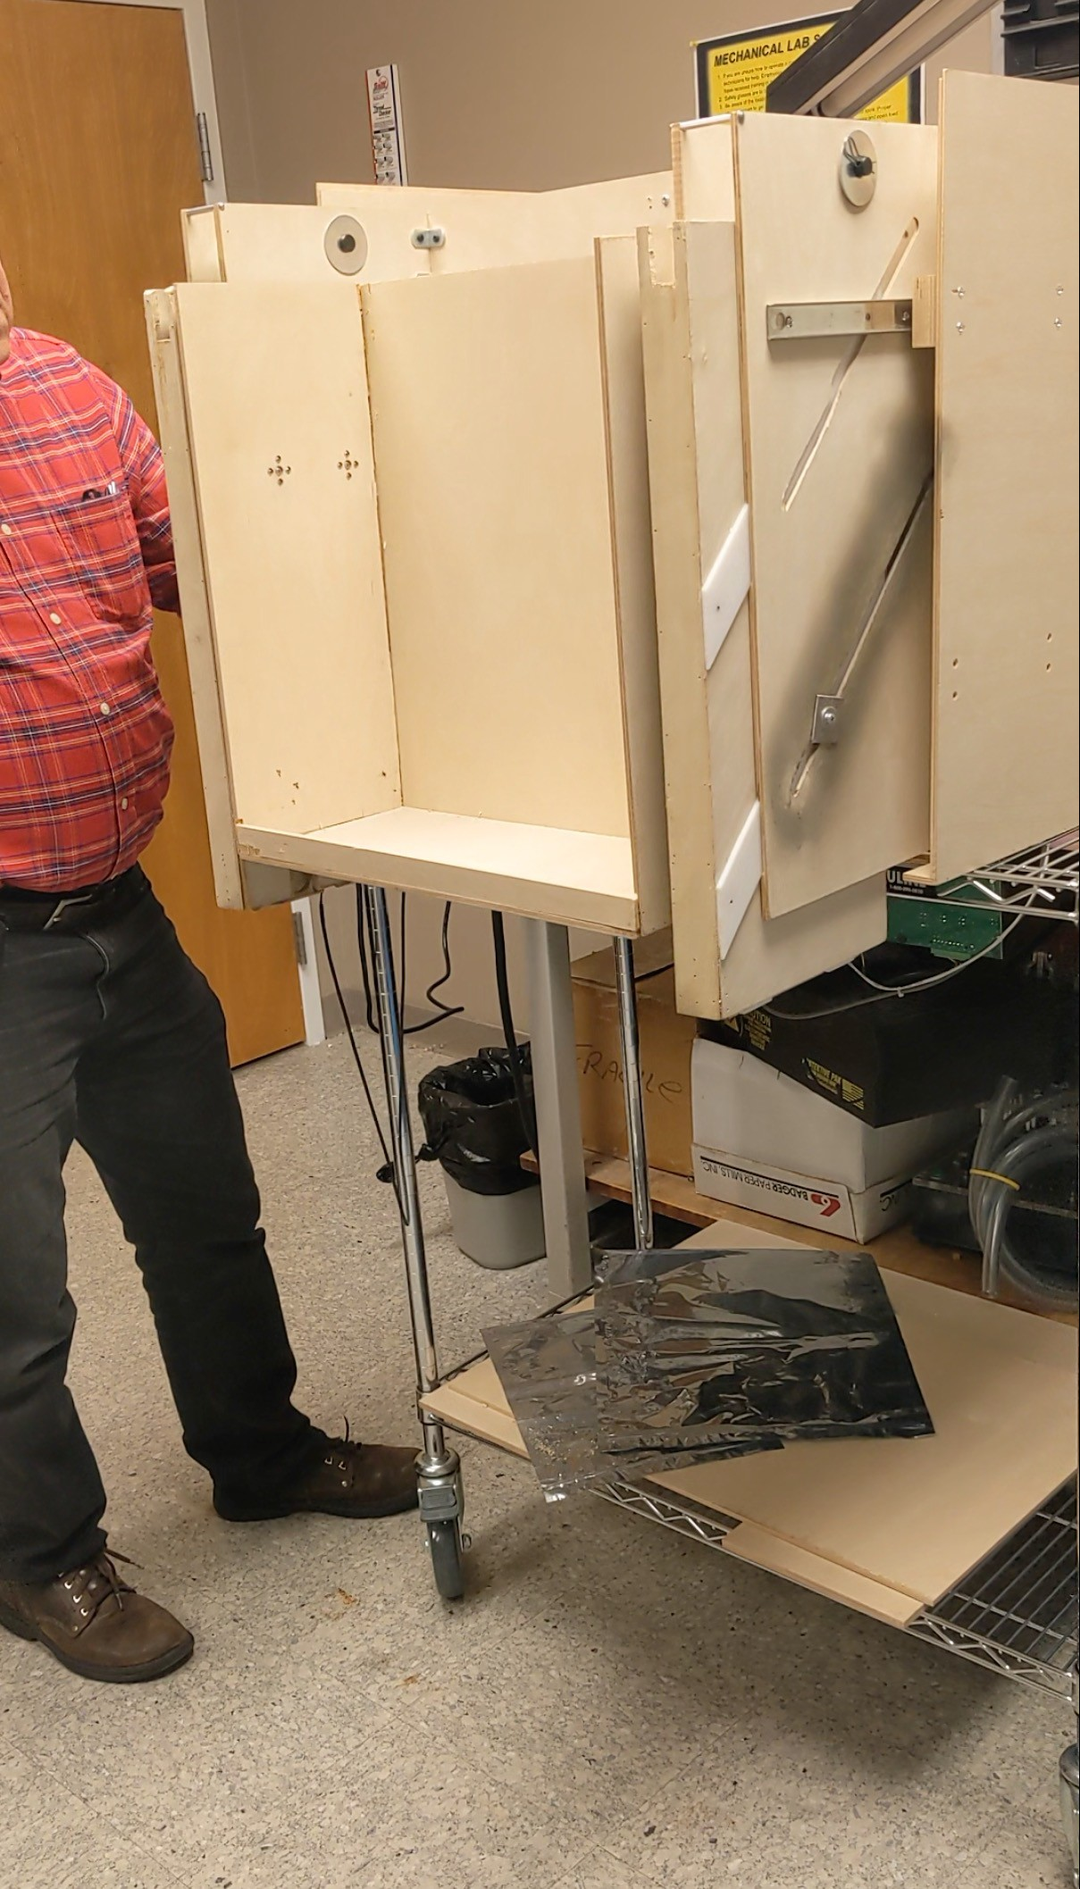
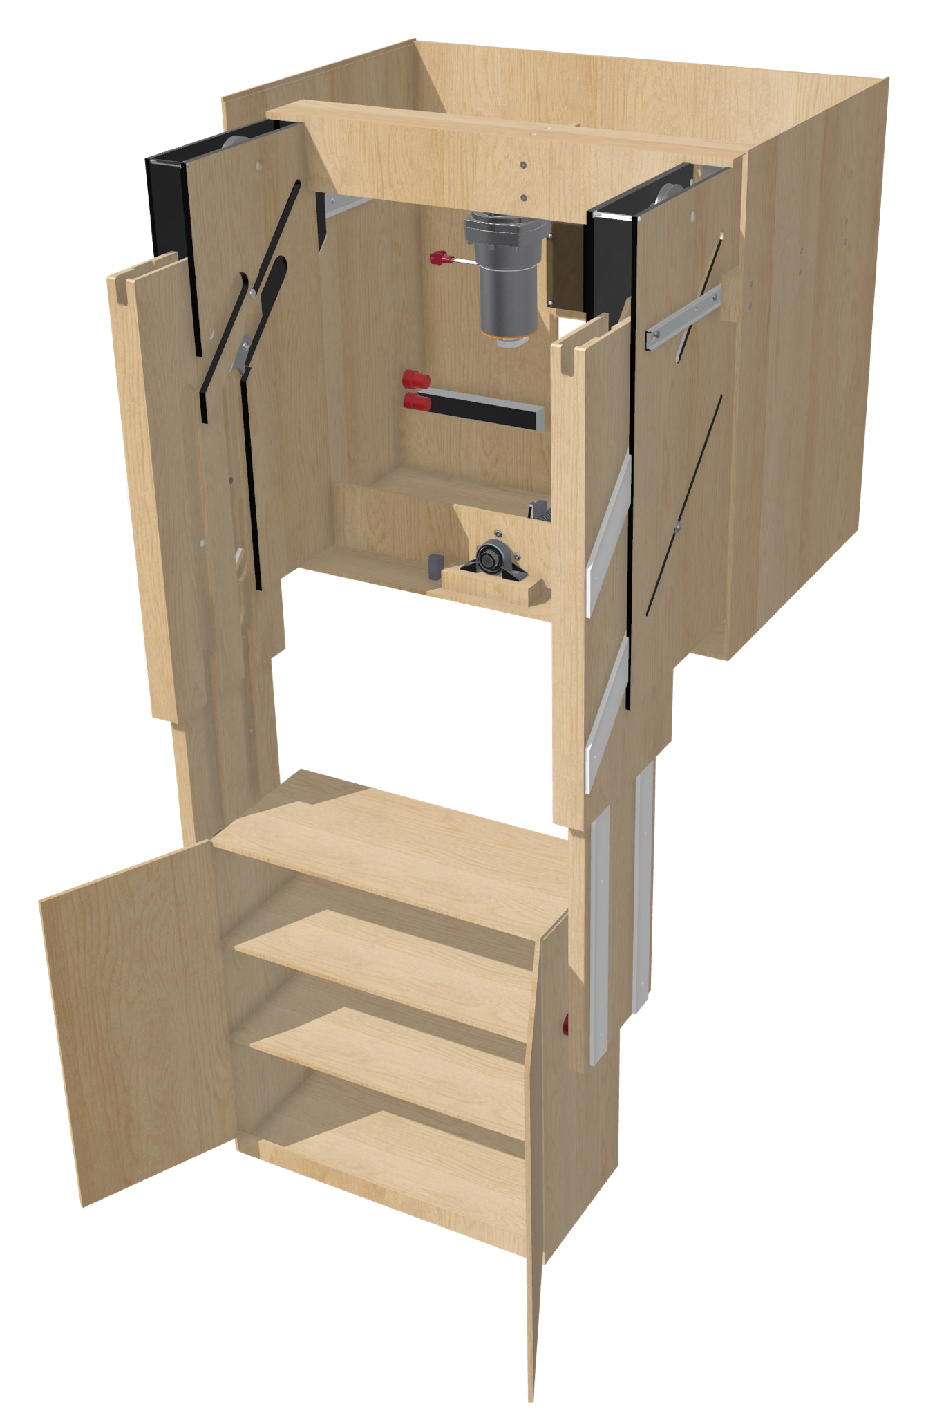
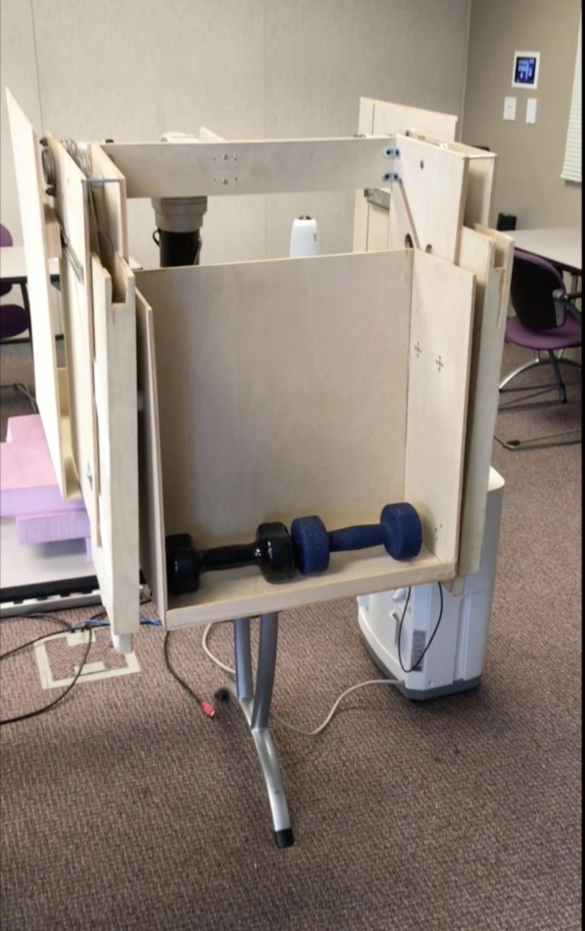
the solution
prototyped in 2019

Slide 9
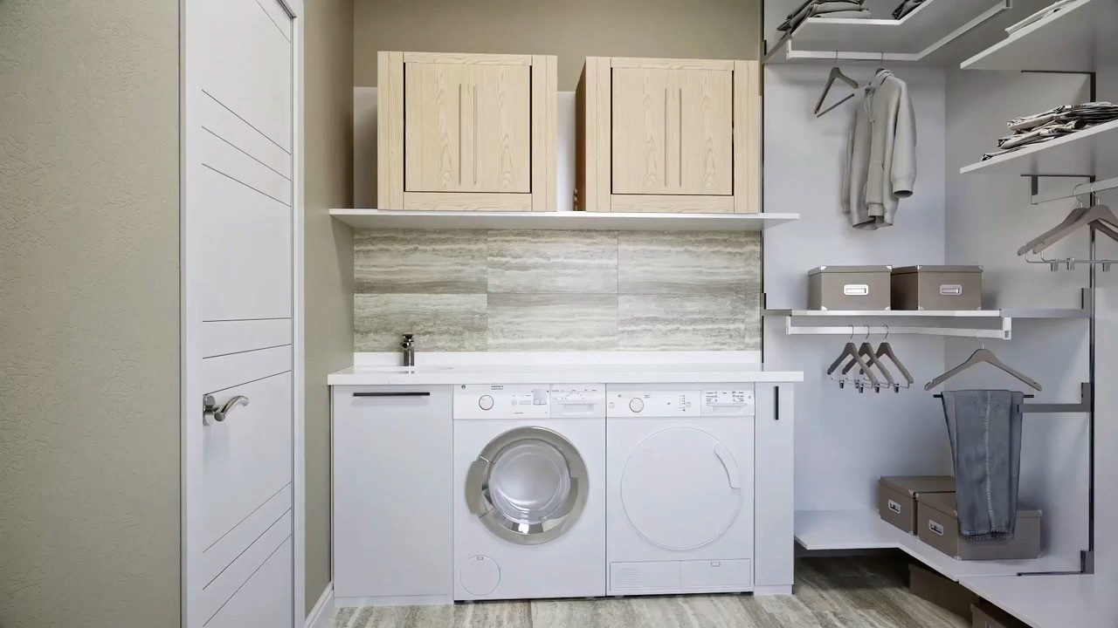
No Slide Title
Copyright 2023 – Novare Products LLC All Rights Reserved

Slide 10
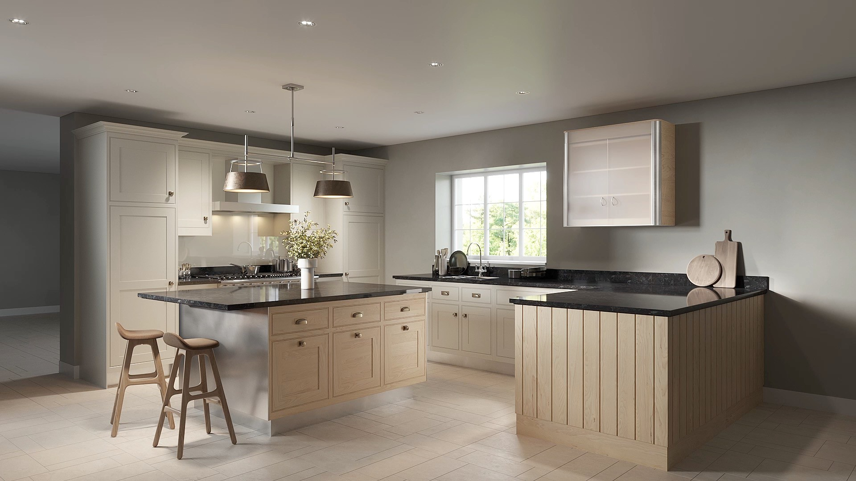
No Slide Title #2
Copyright 2023 – Novare Products LLC All Rights Reserved

Slide 11
the solution
Plide™ robotic technology
removing the efficacy barrier
  lowers a wall mounted cabinet 3 feet or greater
  moves in front of objects that are underneath to maintain that as usable space and to achieve further lowering distances
removing the affordability barrier
  reduced complexity, lower cost
adaptable for multiple configurations, multiple uses, multiple products
“energy smart” design uses gravity for a controlled lowering of the storage cabinet
minimal volume = more space for storage
Fully Accessible Wall Storage products
home and workplace products
removing the complexity barrier
  designed to be an appliance
  lowers and raises with the push of a button
  operate with remote control or app
  low-cost installation like conventional wall cabinets
industry standard cabinet dimensions for convenient replacement
customer can select exterior panels
assistive technology, consumer, and commercial market products
•
✓
✓ = unique feature
Copyright 2023 – Novare Products LLC All Rights Reserved

Slide 12
the solution
broad market availability
by creating products that also appeals to a wide range of consumers, we can:
make the products available in the broad market
leverage those revenues to subsidize AT customers
raise awareness of accessibility issues
markets
assistive technology
kitchen wall cabinet
smart furniture
$5.8 billion by 2030 (U.S.)
18.5% CAGR
$199 billion by 2027
8% CAGR
$4.2 billion by 2030 (U.S.)
4.6% CAGR
Copyright 2023 – Novare Products LLC All Rights Reserved

Slide 13


recognition
2023 caregiver friendly product award from caregiver.com
2023 innovation award from the 2023 TechConnect World Innovation Conference
a survey of 1,000 Americans aged 55 to 85 resulted in a 2.75 out of 5 sentiment score of our fully accessible wall storage products
Copyright 2023 – Novare Products LLC All Rights Reserved

Slide 14
the dignity of independent living
perhaps the most important aspect of well being…

Slide 15

join us on our journey info@novare.biz
www.novare.biz

Slide 16

Contact Information
TARGET Center Website
https://www.usda.gov/target-center
TARGET Center Email
target-center@usda.gov
TARGET Center Phone Number
(202) 720-2600

Slide 17

Current and Upcoming Meetings, cont.
OCTOBER
MONDAY WEDNESDAY
THURSDAY
TUESDAY
10/30/2023
11:00 AM – 12:00 PM Emotional Intelligence (Part 2 of 2)
Carolyn Owens,
MCC, SPHR
1:00 pm- 2:00 pm
Bridging Gaps: Generations and Disabilities
Mayor Neil McDevitt
10/31/2023
11:00 AM – 12:00 PM
Identifying Obstacles to Neurodiversity and Inclusion
Dr. Theresa Haskins
Haskins Consulting
1:00PM – 2:00 PM
Overcoming Barriers to Neurodiversity and Inclusion
Dr. Theresa Haskins
Haskins Consulting
11:00 AM – 12:00 PM
Navigating Temporary Disabilities: Resilience and Coping Strategies (Part 2 of 2)
Dr. Theresa Haskins
Haskins Consulting
10/31/2023
11:00 AM – 12:00 PM
Postural Ergonomics in
the Workplace (Part 2 of 2)
Dr. Krista Burns
American Posture Institute
1:00 PM – 2:00 PM
Working Group: MS Teams Is Accessible for All
Michelle Sherbondy Education Program Manager
11/1/2023
11/2/2023
10/19/2023
10/19/2023

