Slide 1

Assistive Technology Program Technology Demonstration
United States Department of Agriculture
TARGET Center
​

Slide 2

Advancing Access & Equity

Slide 3


Today’s Presenter

Slide 4
Learning Objectives
Assistive Technology Area’s of Need
Assistive Technology Tools & Devices
Technology Demonstration

Slide 5
Assistive Technology Area’s of Need
Vision
Hearing
Communication
Learning, Cognitive, & Developmental
Mobility, Seating, and Positioning
Computers & Peripherals
Executive Functioning

Slide 6
Assistive Technology Devices
The term “assistive technology device” means any item, piece of equipment, or product system, whether acquired commercially off the shelf, modified, or customized, that is used to increase, maintain, or improve functional capabilities of individuals with a disabilities
Assistive technology tools and devices can range from no-tech and low-tech solutions to high-tech solutions
Assistive Technology tools include hardware and software

Slide 7
Technology Demonstration

Slide 8

Fusion Software

Slide 9

Dragon Professional Dictation Software

Slide 10

Read & Write Literacy Tool

Slide 11
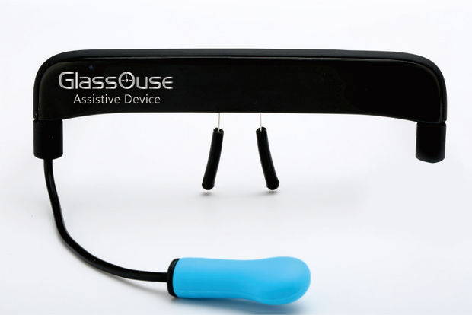
Glasouse Assistive Device

Slide 12
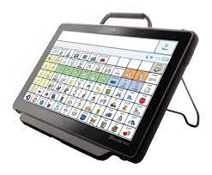
Accent 1000 Communication Device

Slide 13
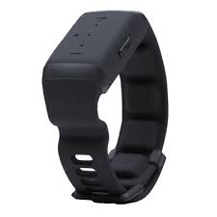
NeoSensory Wristband for Hearing Loss

Slide 14
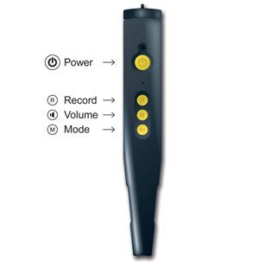
PenFriend 3 Audio Labeler

Slide 15

Rocketbook Smart Notebook

Slide 16
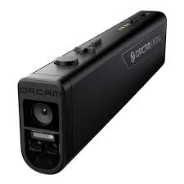
Orcam Read All in One Reading Solution

Slide 17
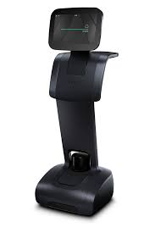
Temi Robot AI in Motion

Slide 18
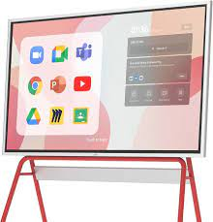
Vibe Interactive Whiteboard

Slide 19

Questions

Slide 20
Thank you
Access Webinars
Collaborate with TARGET Center!
Share in Your Networks
Sign Up for Email List
Request AT Evaluation
Follow on Twitter
Request Training

Slide 21
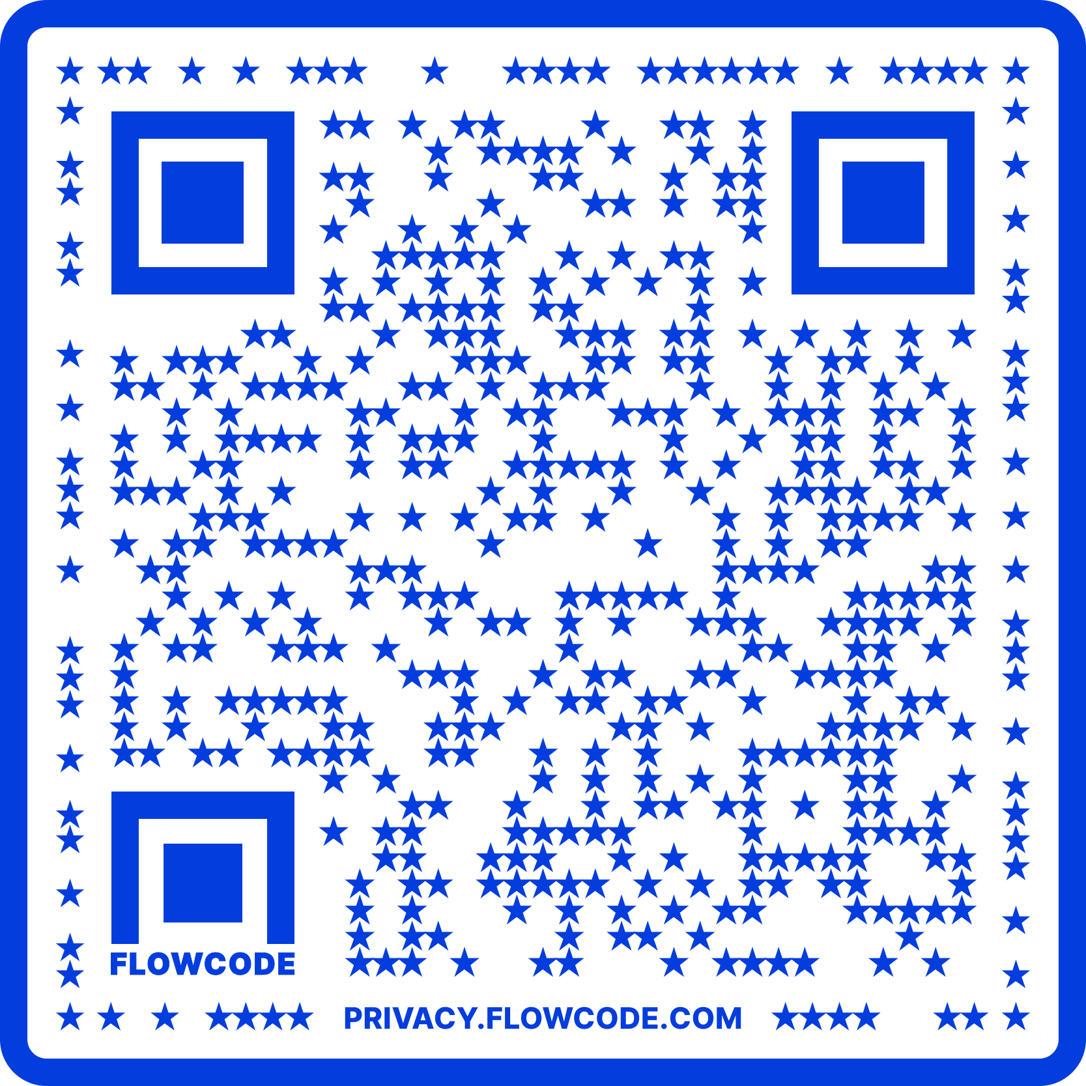
Contact Information
TARGET Center Website
https://www.usda.gov/target-center
TARGET Center Email
target-center@usda.gov
TARGET Center Phone Number
(202) 720-2600

Slide 22

Current and Upcoming Meetings, cont.
OCTOBER
MONDAY WEDNESDAY
THURSDAY
TUESDAY
10/16/2023
11:00 AM – 12:00 PM
USDA TARGET Center
Accessible Communications
Program
Nancy Frohman
Accessible
Communications
Program Manager
1:00 PM – 2:00 PM
USDA TARGET Center
Education Program
Michelle Sherbondy
Education Program Manager
10/17/2023
11:00 AM – 12:00 PM
Unmasking Hidden Challenges: Chronic Conditions in the Workplace
Dr. Theresa Haskins Haskins Consulting
1:00 PM – 2:00 PM
Equity, Accessibility, and Inclusion in the Workplace (Part 1 of 2)
Dr. Theresa Haskins Haskins Consulting
10/18/2023
10:00 AM – 11:00 AM
Ergonomic Equity: Addressing Risk Factors Through Job Analysis and Prevention
Sandra Miller
Britroix
12:00 PM – 1:00 PM
Digital Accessibility Fundamentals for Websites, Documents, and Video
Mike Caprara
The Viscardi Center
10/17/2023
10/23/2023
11:00 AM – 12:00 PM
Emotional Intelligence (Part 1 of 2)
Carolyn Owens,
MCC, SPHR
1:00 PM – 2:00 PM
Proper Posture in the Workplace to Prevent Posture-Related Problems (Part 1 of 2)
Dr. Krista Burns
American Posture Institute
10/24/2023
11:00 AM – 12:00 PM
Thriving with ADHD at Work
Dr. Theresa Haskins Haskins Consulting
1:00 PM – 2:00 PM
Equity, Accessibility, and Inclusion in the Workplace (Part 2 of 2)
Dr. Theresa Haskins Haskins Consulting
10/25/2023
10/26/2023
10:00 AM – 11:00 AM
Assistive Technology at New Heights
Dr. Wayne Crolley
Novare Products, LLC
10/25/2023
10:00 AM - 12:00 PM
USDA TARGET Center
Accessible Communications Demonstrations
(Virtual/Onsite)
Nancy Frohman
Accessible Communications
Program Manager
1:00 PM - 3:00 PM
USDA TARGET Center
Education Demonstrations
(Virtual/Onsite)
Michelle Sherbondy
Education Program Manager

