Slide 1



Autism Inclusion and the Pathway to Neurodiversity
Dr. Theresa Haskins | Presentation for the USDA TARGET Center

Slide 2

Advancing Access & Equity

Slide 3
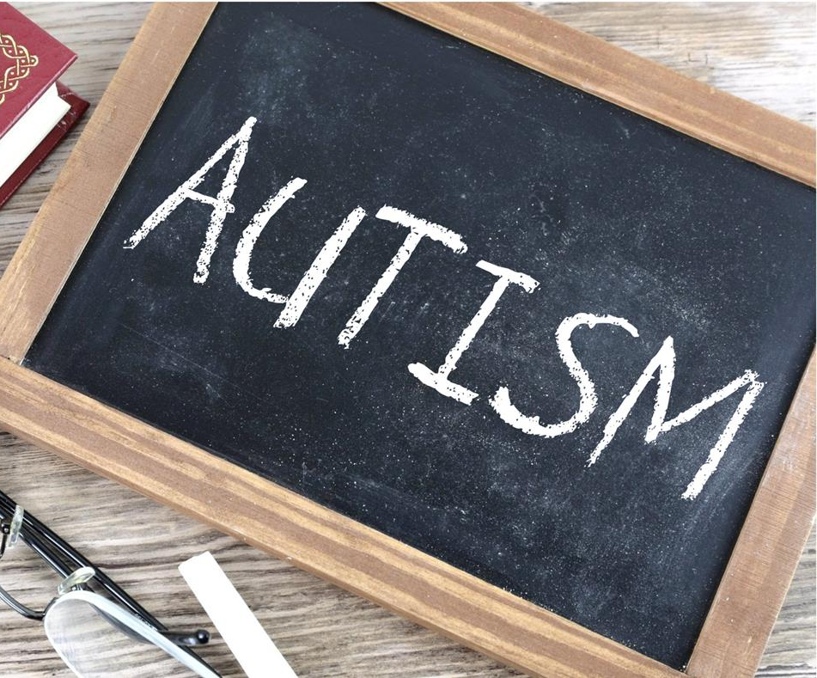
About the Session
Appreciate why autism is a growing area of focus in the workplace
Understand more about autism and how to support individuals with different learning, communication, and working styles
Recognize how equal approaches do not always result in equitable outcomes
This Photo by Unknown Author is licensed under CC BY-SA
Notes:
Today we are going to talk about the importance of Mental Health and overall well-being in the workplace. In the first of many neurodiversity session to come, we want to address the most common mental health issues in our workplace – and help you recognize and develop strategies to better support your colleagues.

Slide 4


What is your perception of autism
?
Notes:
it is helpful to reflect on any pre-existing perceptions and beliefs you may have about ADHD. These may come from personal experiences, previous study, or even media coverage. Spend a few minutes now noting down any thoughts that come to mind when you think about a person with ADHD. For example, are they male, female, young or old, and how do they behave? You may wish to use the box provided.

Slide 5
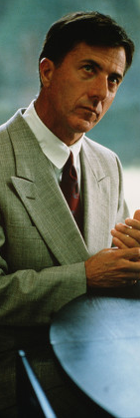
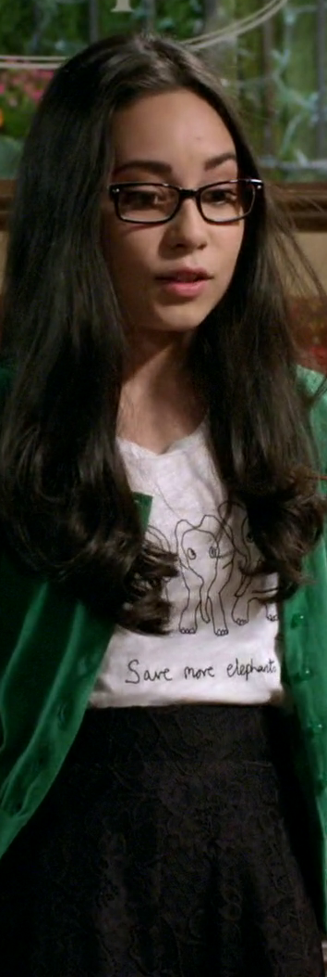


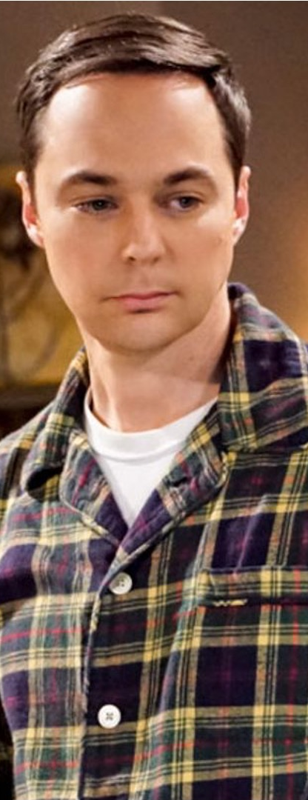
Autism in the Media

Slide 6
What is Autism?
Autism spectrum disorder (ASD) is a developmental disability that constitutes a diverse group of conditions caused by differences in the brain
People with ASD often have problems with
  Social Interactions
  Verbal and nonverbal communication
  Repetitive or ritualistic behaviors
2.21% of adults in the US have autism
The abilities and needs of autistic people vary and can evolve over time.
While some people with autism can live independently, others have severe disabilities and require life-long care and support.

Slide 7
Potential Signs of Autism
difficulty interpreting what others are thinking or feeling
Trouble interpreting facial expressions
body language, or social cues
Difficulty regulating emotion
Trouble keeping up a conversation
Inflection that does not reflect feelings
Theresa Haskins Consulting does not provide medical advice, diagnosis, or treatment. The material shared during this session is provided for educational purposes only.

Slide 8
Potential Signs of Autism.
Difficulty maintaining the natural give-and-take of a conversation
prone to monologues on a favorite subject
Tendency to engage in repetitive or routine behaviors
Only participates in a restricted range of activities
Strict consistency to daily routines
Exhibiting strong, special interests
Theresa Haskins Consulting does not provide medical advice, diagnosis, or treatment. The material shared during this session is provided for educational purposes only.

Slide 9


Autism Across the Lifespan
Challenge Stereotypes

Slide 10


Why Focus on Autism Inclusion?
CALL TO ACTION
U.N. urges businesses to employ people on the autism spectrum
85%
of Autistic Adults are
Unemployed
Despite targeted efforts, there is a lack of progress in diversifying the workforce and equalizing the pay gap for disabled workers
Traditional Vocational Rehabilitation Services DO NOT improve outcomes
Autistics have difficulty understanding social norms and reciprocal communication
54%
Over
of businesses
Diagnosis of Autism Spectrum Disorder
continues to rise
reported skill shortages
and difficulty attracting top talent
Rate of Diagnosis is now 1 in 36
(Baldwin et al., 2014; Haskins, 2019; Maenner et al., 2023; Roux et al., 2017; Stevens, 2020; U.S. Dept. of Ed., 2011; U.S. Dept. of Labor, 2016)

Slide 11
Common Experiences of Autistics at Work
Doesn’t make eye contact.
Speaks in a monotone voice or monologues on topics for too long.
Doesn’t like when the cleaning company rearranges it to dust.
May make involuntary noises or movements, like clearing her throat over and over or snapping their hands.
Difficulty telling if a colleague is happy or mad at them.
Follows the same schedule every day of the week and doesn’t like unexpected events.
Often bumps into things and trips over their own feet.

Slide 12
Overcoming Stigmas and Barriers to Autism Inclusion
Social Isolation
Stereotypes
Perceived Dependency
Over Sensitivity
Lack of Empathy
Low Expectations
Notes:
Social Isolation: Some individuals with autism may face social isolation due to difficulties with social interactions and communication.
Stereotypes: Autistic individuals are often stereotyped based on media and parental reports; little is reported about autistic adult capabilities and experiences.
Perceived Dependency: Some people believe that individuals with autism are entirely dependent on others. Needing support in some areas does not mean dependency and lack of ability in all areas.
Over Sensitivity: Public spaces and services are often inaccessible to individuals with sensory sensitivities or other autism-related needs. Overcoming this stigma involves making accommodations and modifications to ensure that public spaces, transportation, and services are inclusive and welcoming to all.
Lack of Empathy: Some people mistakenly assume that autistic individuals lack empathy and feelings. Autistic people are as empathetic as neurotypical people – it is their differences in interpersonal communication that lead to this perception.
Low Expectations: People often set low expectations for autistic individuals based on misconceptions, bias, and misinformation.

Slide 13
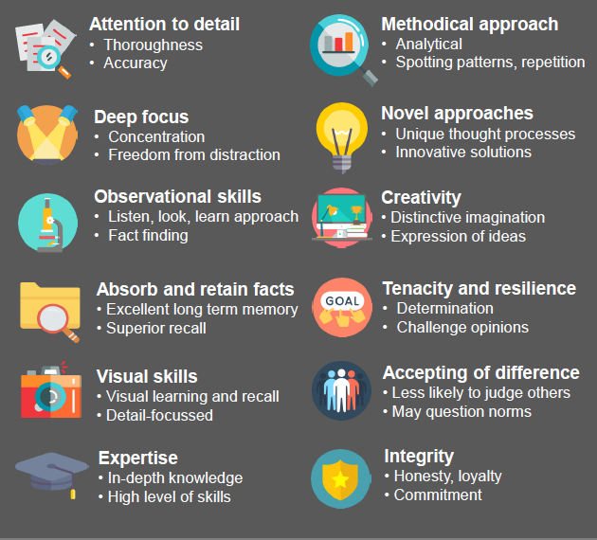

Appreciating Autism
(Cannon, 2018)

Slide 14
Common Accommodations
quieter work area
more time for completing work
peer review or Quality Checks of more-detailed work
Flexible work time to better accommodate peak periods of focus and attention
Write down instructions, deliverables, and training materials
Theresa Haskins Consulting does not provide medical advice, diagnosis, or treatment. The material shared during this session is provided for educational purposes only.

Slide 15
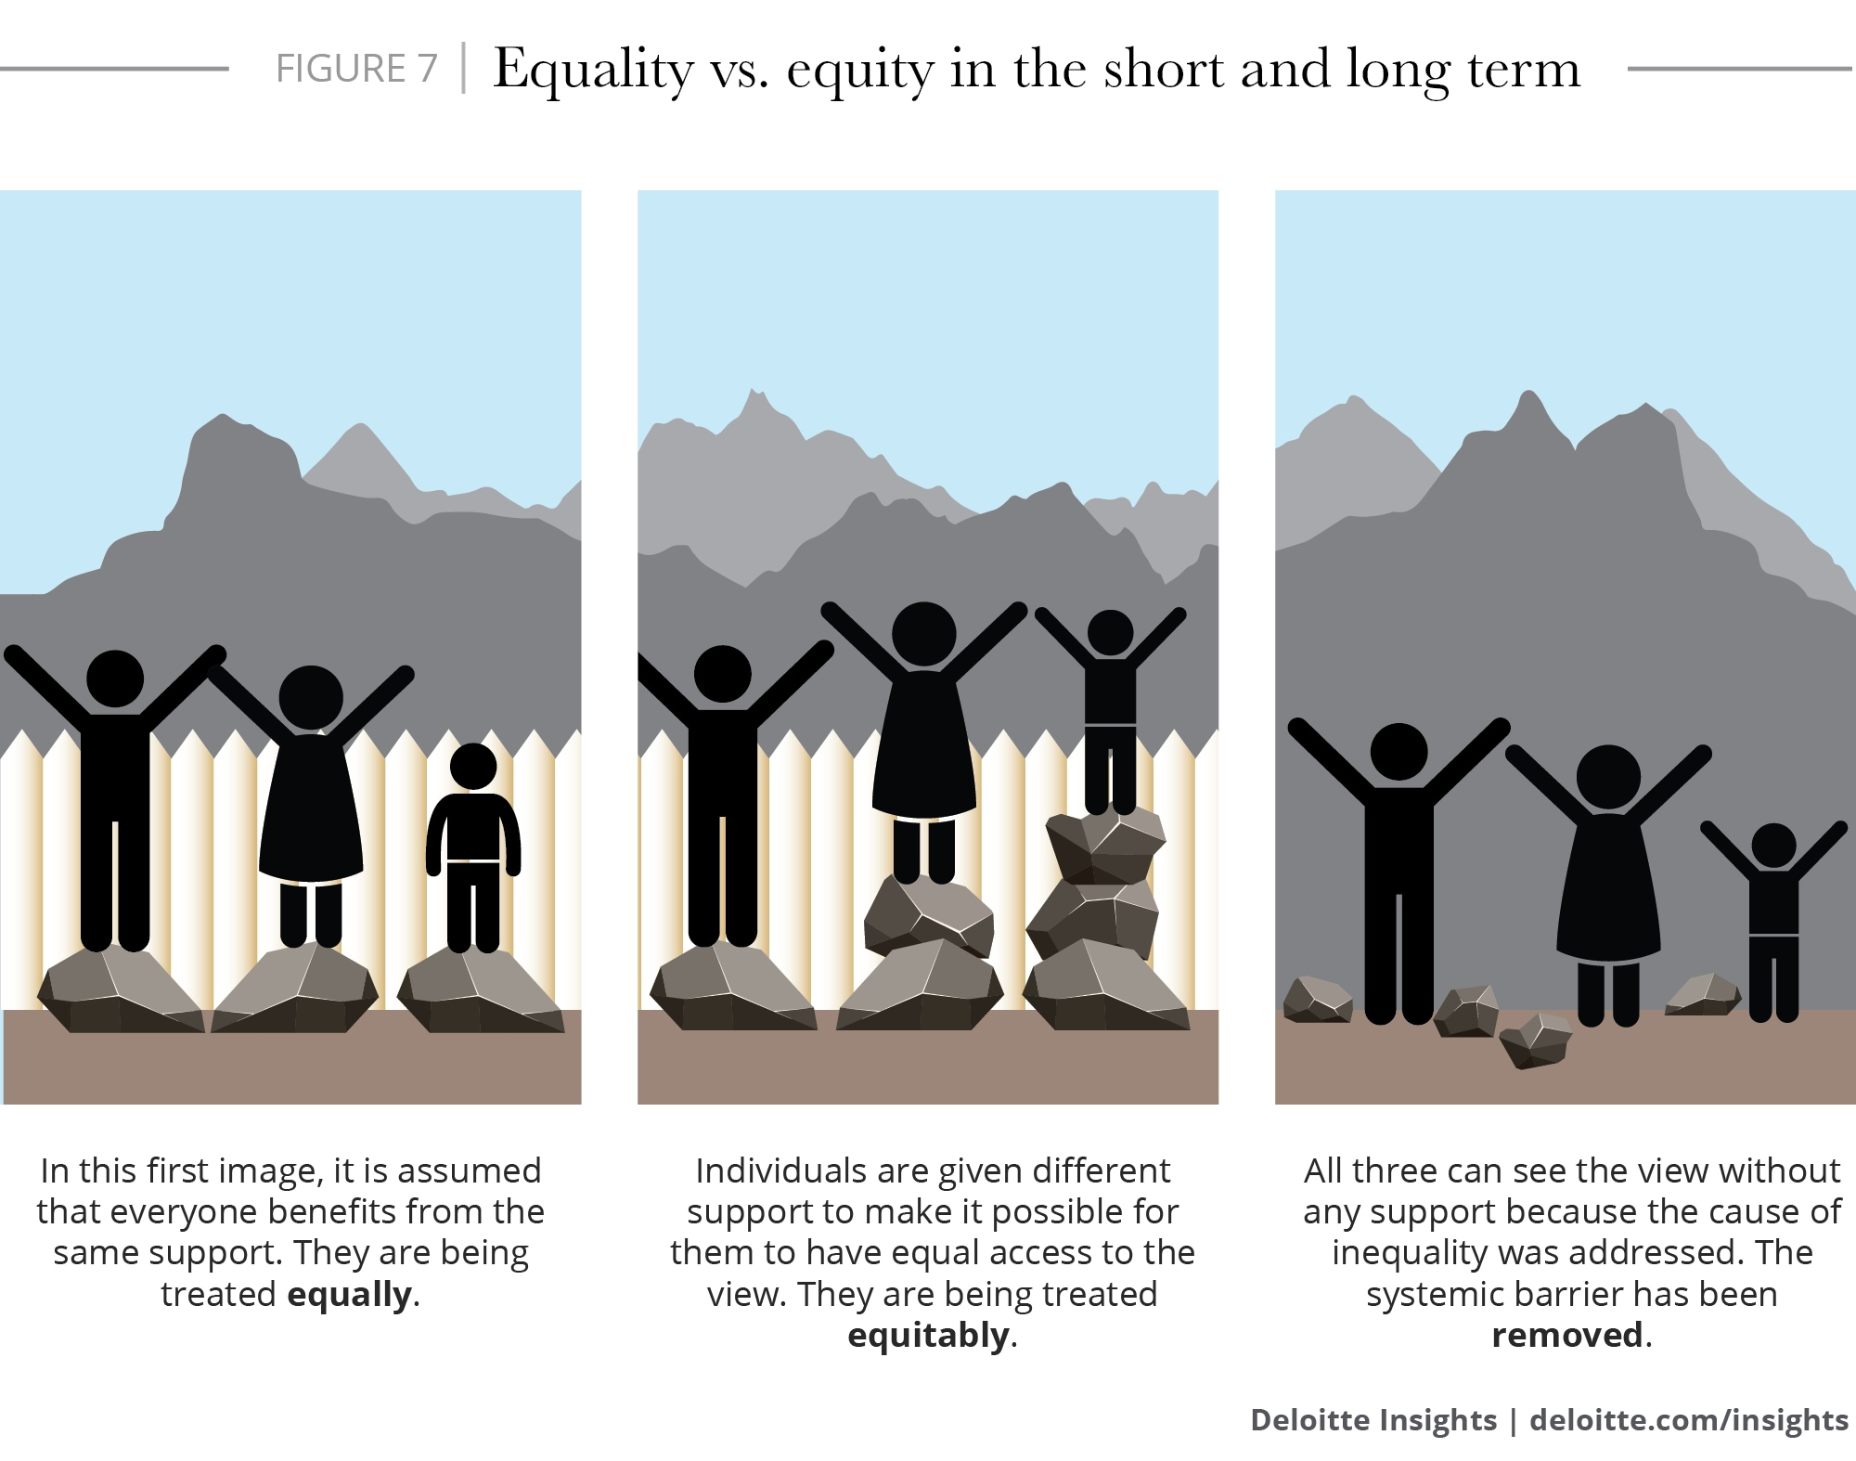
Equality, Equity, Accessibility

Slide 16

Universal Design
Making the workplace accessible to everyone

Slide 17






Why Universal Design Works
=
Equitable
Flexible
Simple &
Intuitive
Perceptible
Information
Tolerance
for Error
Low Physical
Effort
Size & Shape

Slide 18
Support Autism @Work
Focus on strengths and creating diversified teams
1
Be clear in communications, performance expectations, and task assignments
2
Be open to reasonable accommodations and novel approaches to work
3
Educate yourself, advocate proactively, and celebrate differences
5
Create psychological safety with kindness and respect
4

Slide 19


Continue Learning with
Dr. Theresa Haskins
USDA TARGET Center
NDEAM 2023 Upcoming Sessions
See e-mailed schedule for details.
Find resources, podcasts, newsletters and more at
www.theresahaskins.com
@ Theresa Haskins, LLC 2023

Slide 20
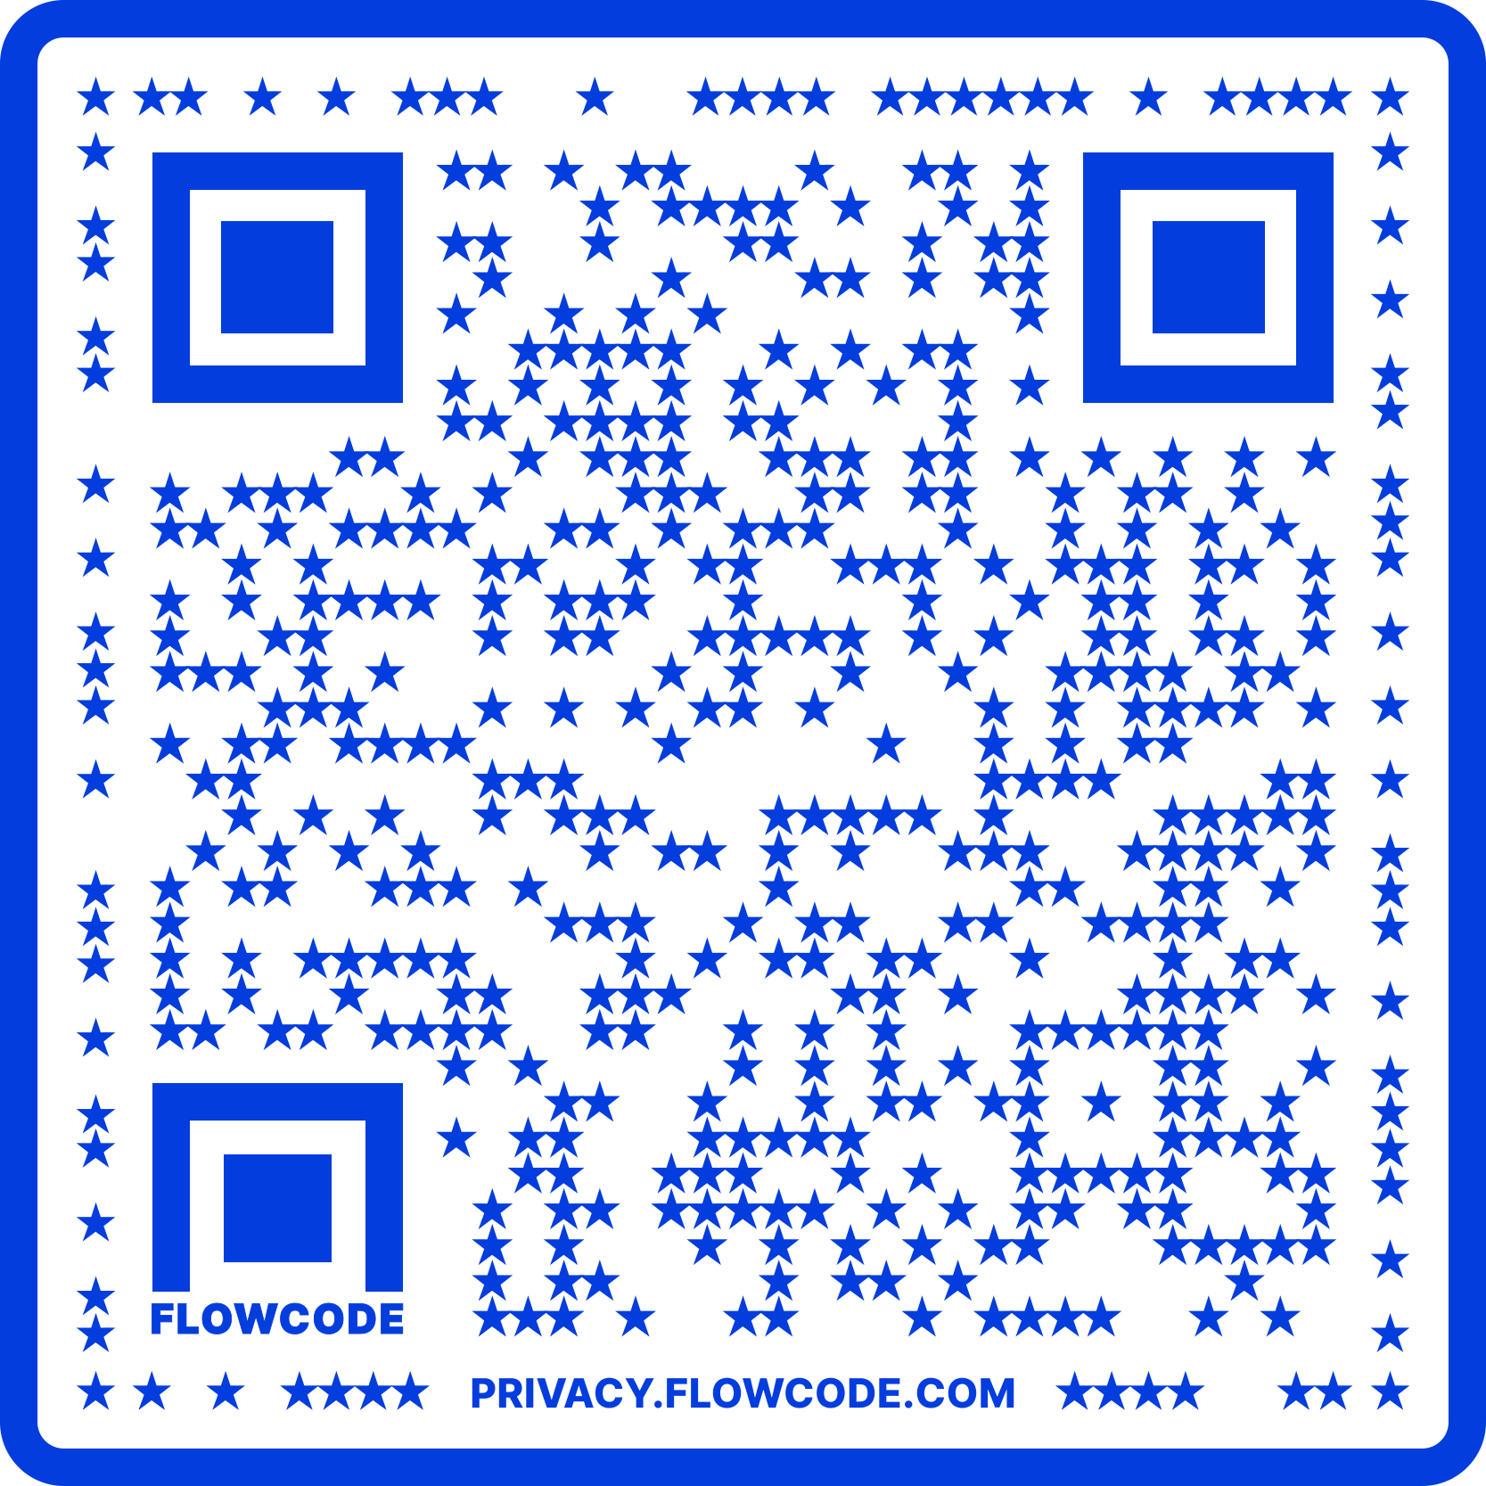
Contact Information
TARGET Center Website
https://www.usda.gov/target-center
TARGET Center Email
target-center@usda.gov
TARGET Center Phone Number
(202) 720-2600

Slide 21

Current and Upcoming Meetings
OCTOBER
MONDAY WEDNESDAY
THURSDAY
TUESDAY
10/2/2023
10/3/223
11:00 AM – 12:00 PM
Rethinking Disability and What It Means to Be Disabled
Dr. Theresa Haskins Haskins Consulting
1:00 PM – 2:00 PM
(Neuro) Diversity Includes You
Dr. Theresa Haskins Haskins Consulting
10/4/2023
11:00 AM – 12:00 PM
Nurturing Workplace Well-Being and Supporting Mental Health (Part 1 of 2)
Dr. Theresa Haskins Haskins Consulting
1:00 PM – 2:00 PM
PTSD Is More Common Than You Think
Alla Weinberg
Spoke & Wheel
10/5/2023
10:00 AM – 11:00 AM
Empowering Lives Through Assistive Technology Solutions
Donny Osborn
Boundless AT
12:00 PM – 1:00 PM
Department of Defense Computer/Electronic Accommodations Program (CAP)
Erin Sanderson
CAP
10/3/2023
10:00 AM – 11:00 AM
USDA TARGET Center Assistive Technology Program
Rashida Owens
Assistive Technology Program Manager
12:00 PM – 1:00 PM
USDA TARGET Center
Ergonomics Program
Stephanie Bradley
Ergonomics Program Manager
HOLIDAY
10/10/2023
11:00 AM – 12:00 PM
Autism Inclusion and the Pathway to Neurodiversity
Dr. Theresa Haskins Haskins Consulting
1:00 PM – 2:00 PM
Lessons from Unpredictable Journeys: Insights from Temporary and Situational Disabilities (Part 1 of 2)
Dr. Theresa Haskins Haskins Consulting
10/11/2023
11:00 AM – 12:00 PM
Creating a
Trauma-Informed Workplace
Alla Weinberg
Spoke & Wheel
1:00 PM – 2:00 PM
Nurturing Workplace Well-Being and Supporting Mental Health (Part 2 of 2)
Dr. Theresa Haskins Haskins Consulting
10/12/2023
10:00 AM - 12:00 PM
USDA TARGET Center
Ergonomics Demonstrations
(Virtual/Onsite)
Stephanie Bradley
Ergonomics Program Manager
Howard Flowers
BodyBilt
Stephen DiCarlo
Humanscale
1:00 PM - 3:00 PM
USDA TARGET Center Assistive Technology Demonstrations
(Virtual/Onsite)
Rashida Owens
Assistive Technology Program Manager

