Slide 1
The Impact of Generations in Disabilities
Neil McDevitt
Mayor, North Wales Borough (PA)
Executive Director, Deaf-Hearing Communication Centre, Inc.
National Disability Employment Awareness Symposium | 2023 USDA TARGET Center

Slide 2

Advancing Access & Equity

Slide 3
A little about me
Proudly Generation X - born 1973 in North New Jersey. I’ve been to most of the places that you see in the opening shots of The Sopranos
Before my current positions, I had a chance to work with The Leadership Foundry, an organization of retired military leaders presenting about leadership particularly for Department of Defense Reserve Units.
One of the most critical elements of management that they identified was the critical skill of understanding how to manage across generations.
After years of working in the field, I saw distinct differences in how different generations of people with disabilities look at advocacy.

Slide 4
This presentation will focus on:
Even though the Rehabilitation Act of 1973 is 50 years old this year, it is still a relatively young set of civil rights. There are quite a few people in the workplace who represent distinct generational differences, not just in their age, but also in how the Rehabilitation Act of 1973 affects them. This workshop will explore some of those key distinctions and discuss how they can affect workplace dynamics.
Learning Objectives:
1. Highlight the general history of the Rehabilitation Act’s passage.
2. Explore the broader demographics of generations as they are commonly understood.
3. Understand how generational differences can often fuel challenges in the workplace.
4. Review the differences in how generations experience the Rehabilitation Act.

Slide 5
What is the Rehabilitation Act?
The most influential Civil Rights Act for People with Disabilities to date when it was passed in 1973.
In addition to ensuring public service accommodations from anything funded with federal dollars, it also required federal employers to become more welcoming to people with disabilities.
It also set the stage for Judy Heumann’s Section 504 Sit In in 1977 in San Francisco which was vitally important for the law’s regulations to be enacted.

Slide 6
Wait, what IS a generation?
Wikipedia defines it as:
“A generation refers to all of the people born and living at about the same time, regarded collectively. It can also be described as, “the average period, generally considered to be about 20–⁠30 years, during which children are born and grow up, become adults, and begin to have children.””

Slide 7
Why is this important?
Generations will typically have very similar social experiences (that are “normal”) that others in the same age group will share.
Examples:
  Rolodex
  AIM message
  Picture in a post office
  A family living in a one bedroom apartment

Slide 8

No Slide Title

Slide 9
What did you recognize from that clip?
If you said “I know Billy Joel and the song, but not many of the things he’s singing about.” You’re in good company.
Released in September 1989, “its fast-paced lyrics include brief references to 118 significant political, cultural, scientific, and sporting events between 1948 (the year before Billy Joel's birth) and 1989, in mainly chronological order.”

Slide 10
Joel conceived the idea for the song when he had just turned 40. He was in a recording studio and met a 21-year-old friend of Sean Lennon who said "It's a terrible time to be 21!".
Joel replied: "Yeah, I remember when I was 21 – I thought it was an awful time and we had Vietnam, and y'know, drug problems, and civil rights problems and everything seemed to be awful".
The friend replied: "Yeah, yeah, yeah, but it's different for you. You were a kid in the fifties and everybody knows that nothing happened in the fifties". Joel retorted: "Wait a minute, didn't you hear of the Korean War or the Suez Canal Crisis?" Joel later said those headlines formed the basic framework for the song.
-Wikipedia

Slide 11
How generations tend to treat each other…
Generally speaking, people in different generations tend to dismiss or discount the experiences of other generations.
How many times have you heard someone say, “Ok Boomer!” or “Stupid millennial, go eat a tide pod!”
These are NOT new! When our baby boomer parents were younger, their elder generations complained about them!

Slide 12
We live in a bizarre time!
Thanks to improvements in medical treatment and life expectancy, we live in a time where there are 5 generations in a workplace!
Traditionalists: 2% (1925-1945)
Baby Boomers: 25% (1946-1964)
Generation X: 33% (1965-1980)
Generation Y: 35% (1981-2000)
Generation Z: 5% (2001-2020)
Source: Purdue Global

Slide 13
But…
Generations are just one layer of a person’s identity and personality. So many others, including disability, gender, race, socioeconomic status, LGBTIQA and many more also play a significant role.

Slide 14
Traditionalist (or Greatest) Generation - 1925-1945
Dependable, straightforward, tactful, loyal
Shaped by: The Great Depression, World War II, radio and movies
Motivated by: Respect, recognition, providing long-term value to the company
Communication style: Personal touch, handwritten notes instead of email
Worldview: Obedience over individualism; age equals seniority; advancing through the hierarchy
Employers should: Provide satisfying work and opportunities to contribute; emphasize stability
Source: Purdue Global

Slide 15
Baby Boomers - 1946-1964
Optimistic, competitive, workaholic, team-oriented
Shaped by: The Vietnam War, civil rights movement, Watergate
Motivated by: Company loyalty, teamwork, duty
Communication style: Whatever is most efficient, including phone calls and face to face
Worldview: Achievement comes after paying one’s dues; sacrifice for success
Employers should: Provide them with specific goals and deadlines; put them in mentor roles; offer coaching-style feedback
Source: Purdue Global

Slide 16
Generation X - 1965-1980
Flexible, informal, skeptical, independent
Shaped by: The AIDS epidemic, the fall of the Berlin Wall, the dot-com boom
Motivated by: Diversity, work-life balance, their personal-professional interests rather than the company's interests
Communication style: Whatever is most efficient, including phone calls and face to face
Worldview: Favoring diversity; quick to move on if their employer fails to meet their needs; resistant to change at work if it affects their personal lives
Employers should: Give them immediate feedback; provide flexible work arrangements and work-life balance; extend opportunities for personal development
Source: Purdue Global

Slide 17
Millennial Generation - 1981-2000
Competitive, civic-minded, open-minded on diversity, achievement-oriented
Shaped by: Columbine, 9/11, the internet
Motivated by: Responsibility, the quality of their manager, unique work experiences
Communication style: IMs, texts, and email
Worldview: Seeking challenge, growth, and development; a fun work life and work-life balance; likely to leave an organization if they don't like change
Employers should: Get to know them personally; manage by results; be flexible on their schedule and work assignments; provide immediate feedback
Source: Purdue Global

Slide 18
Generation Z - 2001-2020
Global, entrepreneurial, progressive, less focused
Shaped by: Life after 9/11, the Great Recession, access to technology from a young age
Motivated by: Diversity, personalization, individuality, creativity
Communication style: IMs, texts, social media
Worldview: Self-identifying as digital device addicts; valuing independence and individuality; preferring to work with millennial managers, innovative coworkers, and new technologies
Employers should: Offer opportunities to work on multiple projects at the same time; provide work-life balance; allow them to be self-directed and independent
Source: Purdue Global

Slide 19
How many of you saw yourself in your generation’s description?

Slide 20
How many of you DIDN’T see yourself in your generation’s description?

Slide 21
BE HONEST: How many of you reacted negatively to ANOTHER generation’s description?

Slide 22
How does this apply in disability community?

Slide 23
Older Generations
Younger Generations
Person first language became the norm (eg - Americans with Disabilities Act, not Disabled Americans Act)
Focused on fighting for the laws and systemic changes that our rights depend upon
Direct Action by teams of people with disabilities (ADAPT)
Identify Disability as a culture, not as a condition.
Focus has been on increasing access by increasing representation - The Nyle DiMarco / Alli Stroker effect
Individuals have as much effect as team do. They often work in partnership to bring attention to issues.

Slide 24
What about the Rehab Act?
For older people - the Rehabilitation Act came on the heels of a decade-long fight for civil rights for a wide spectrum of people, not just people with disabilities. The Rehabilitation Act was one of the last major civil rights bills during the “Second Revolution” that lasted from 1964 to 1980. This was done in the backdrop of Black Power, LGBTQIA Rights, Chicano Rights, Native American Rights, and more.
For many younger people - they only understood the Americans with Disabilities Act. With the original act and it’s updates in 2010 - this has been the common “language” and they often forget that the Rehabilitation Act is not only older, but can be more powerful.

Slide 25
How do you think these two groups view each other?

Slide 26
How do we move forward?
Be aware of your reactions and your biases. We tend to think of younger generations as lazy and older generations as inflexible but these are not true.
Figure out ways to bridge those differences.
Become a mentor. An older person can help a younger person become more confident in interpersonal conversations. A younger person can help an older person understand a new concept or technology.

Slide 27
Questions?

Slide 28

Current and Upcoming Meetings
OCTOBER
MONDAY WEDNESDAY
THURSDAY
TUESDAY
10/30/2023
11:00 AM – 12:00 PM Emotional Intelligence (Part 2 of 2)
Carolyn Owens,
MCC, SPHR
1:00 pm- 2:00 pm
Bridging Gaps: Generations and Disabilities
Mayor Neil McDevitt
10/31/2023
11:00 AM – 12:00 PM
Identifying Obstacles to Neurodiversity and Inclusion
Dr. Theresa Haskins
Haskins Consulting
1:00PM – 2:00 PM
Overcoming Barriers to Neurodiversity and Inclusion
Dr. Theresa Haskins
Haskins Consulting
11:00 AM – 12:00 PM
Navigating Temporary Disabilities: Resilience and Coping Strategies (Part 2 of 2)
Dr. Theresa Haskins
Haskins Consulting
10/31/2023
11:00 AM – 12:00 PM
Postural Ergonomics in
the Workplace (Part 2 of 2)
Dr. Krista Burns
American Posture Institute
1:00 PM – 2:00 PM
Working Group: MS Teams Is Accessible for All
Michelle Sherbondy Education Program Manager
11/1/2023
11/2/2023
10/19/2023
10/19/2023

Slide 29
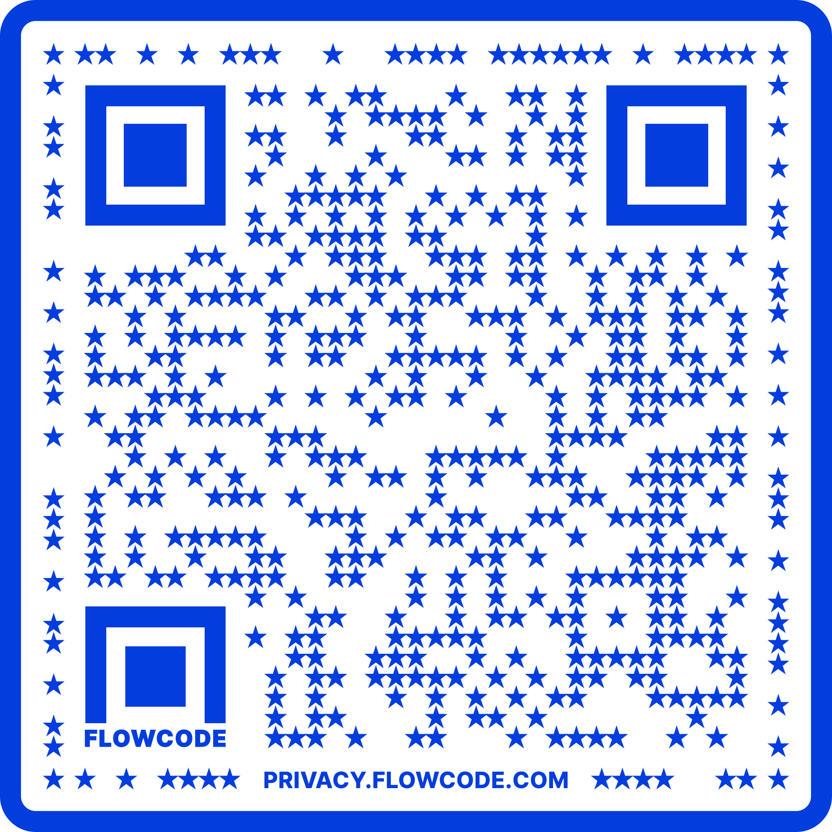
Contact Information
TARGET Center Website
https://www.usda.gov/target-center
TARGET Center Email
target-center@usda.gov
TARGET Center Phone Number
(202) 720-2600

