Slide 1

Utilizing Emotional Intelligence to Develop a Diverse and Inclusive Team
Facilitated by: Carolyn Owens, MCC
October 30, 2023
National Disability Employment Awareness Symposium | 2023 USDA TARGET Center

Slide 2

Advancing Access & Equity

Slide 3
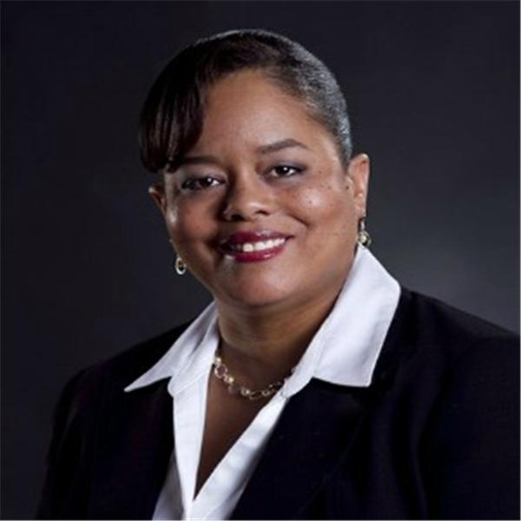

Carolyn R Owens, MCC
Infinity Coaching, Inc.
Executive and Leadership Coach/Trainer

Slide 4
Last Time…
Emotional intelligence and why it matters for the workplace.
Raising individual self-awareness.
Identifying skills that empower you, colleagues, and team members reach their greatest potential.

Slide 5
Today…
Gain an understanding of how emotional intelligence can impact connecting with team members and customers, both external and internal.
Gain of understanding how emotional intelligence impacts our judgment, bias, and ultimately decision making.
Learn strategies to use emotional intelligence to avoid unconscious bias and micro aggressive behaviors.

Slide 6
Executive Order 14035
The Executive Order to Advance Diversity, Equity, Inclusion, and Accessibility (DEIA) in the Federal Workforce.
Cultivate a workforce that draws from the full diversity of the Nation.

Slide 7
The Federal Government must:
Be a model for diversity, equity, inclusion and accessibility (DEIA).
Strengthen its ability to recruit, hire, develop, promote and retain our Nation’s talent.
Remove barriers to equal opportunity.

Slide 8

USDA Diversity, Equity, Inclusion and Accessibility (DEIA) Strategic Plan
FY 2022 – 2026
Published March 2022

Slide 9
National Disability Employment Awareness Month (NDEAM)
2023 Theme:
Advancing Access & Equity

Slide 10

What is
emotional intelligence?

Slide 11
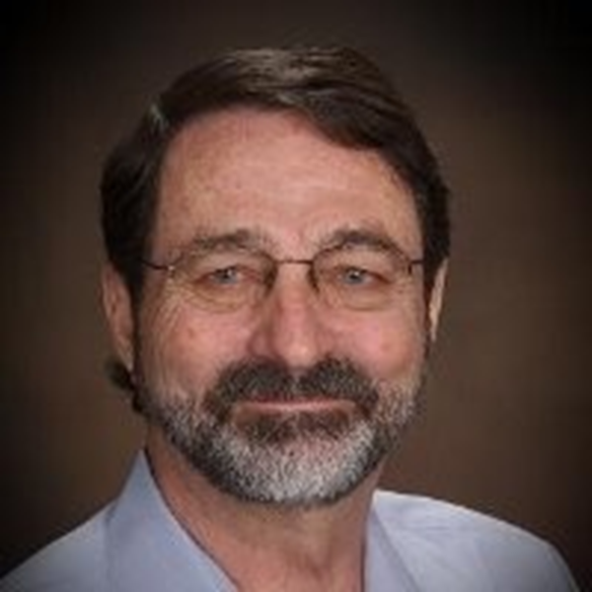

Reuven Bar-On
Emotional Quotient (EQ) -
An array of non-cognitive capabilities, competencies, and skills that influence one’s ability to succeed in coping with environmental demands.

Slide 12
Emotional Intelligence
Emotional intelligence is a set of emotional and social skills that collectively establish how we perceive and express ourselves, develop and maintain relationships, cope with challenges, and how we use emotions in an effective and meaningful way.

Slide 13

What are some of the main derailers of careers?
Photo by Pixabay

Slide 14
Advancing Access & Equity

Slide 15
What is Equity?

Slide 16
“Equality is about having the same opportunity. Equity is about being able to have access to the necessary tools and resources to be successful.”
~
Carolyn Owens, MCC

Slide 17
Can we always tell if someone has a disability ?

Slide 18

Photo by Tima Miroshnichenko
Invisible vs. Visible

Slide 19
Permanent
vs.
Temporary

Slide 20

No Slide Title
Photo by: Photo by Alexandre Saraiva Carniato -
https://www.pexels.com/photo/man-sits-on-wheelchair-3057504

Slide 21
What do you believe?

Slide 22

Fear
Boundaries
The unknown
Judgement
Lack of understanding
Lack of acceptance
Micro-aggressive behavior
Photo by Mart Production

Slide 23
Personal Awareness
“Awareness proceeds choice.”
~
John E Jones

Slide 24
What, if anything,
can YOU do?
Start by raising your EQ.

Slide 25
All disabilities are not created equal.
Be aware of your bias and judgement.
Identify what makes you uncomfortable and why.
Refrain from asking unnecessary, intrusive, personal questions but…

Slide 26
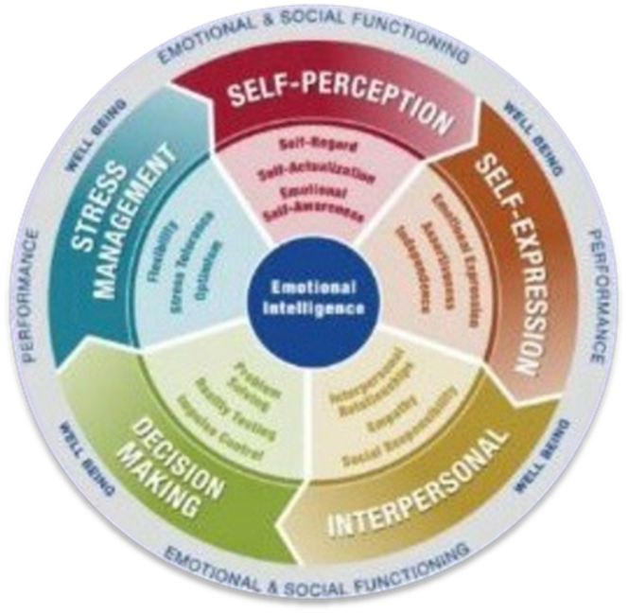
Be curious.
Educate yourself.
Have empathy.
Raise your emotional intelligence.

Slide 27

High EQi in the workplace:
A leader with a positive mood and attitude tends to interact with others in a way that results in a positive, helpful, and cooperative workgroup, thereby increasing workplace efficiency.

Slide 28
What, if any, barriers exist in your agency to creating an accessible work environment?

Slide 29

What barriers are YOU creating for those who have unique physical abilities?
Photo by John Guccione

Slide 30

No Slide Title #2

Slide 31

Questions

Slide 32
Recommended Reading
The Body is Not An Apology;
  Sonya Renee Taylor
Emotional Intelligence for Managing Results in a Diverse World;
  Leo Gardenswartz, Jorge Cherbosque, and Anita Rowe
Emotional Intelligence 2.0;
  Travis Bradberry and Jean Graves

Slide 33
“To know the true reality of yourself, you must be aware not only of your conscious thoughts, but also of your unconscious prejudices, bias and habits.”
~
Unknown

Slide 34
THANK YOU

Slide 35
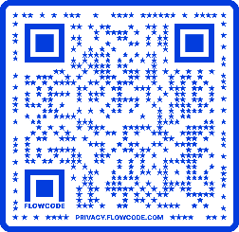
Contact Information
TARGET Center Website
https://www.usda.gov/target-center
TARGET Center Email
target-center@usda.gov
TARGET Center Phone Number
(202) 720-2600

Slide 36

Current and Upcoming Meetings
OCTOBER
MONDAY WEDNESDAY
THURSDAY
TUESDAY
10/30/2023
11:00 AM – 12:00 PM Emotional Intelligence (Part 2 of 2)
Carolyn Owens,
MCC, SPHR
1:00 pm- 2:00 pm
Bridging Gaps: Generations and Disabilities
Mayor Neil McDevitt
10/31/2023
11:00 AM – 12:00 PM
Identifying Obstacles to Neurodiversity and Inclusion
Dr. Theresa Haskins
Haskins Consulting
1:00PM – 2:00 PM
Overcoming Barriers to Neurodiversity and Inclusion
Dr. Theresa Haskins
Haskins Consulting
11:00 AM – 12:00 PM
Navigating Temporary Disabilities: Resilience and Coping Strategies (Part 2 of 2)
Dr. Theresa Haskins
Haskins Consulting
10/31/2023
11:00 AM – 12:00 PM
Postural Ergonomics in
the Workplace (Part 2 of 2)
Dr. Krista Burns
American Posture Institute
1:00 PM – 2:00 PM
Working Group: MS Teams Is Accessible for All
Michelle Sherbondy Education Program Manager
11/1/2023
11/2/2023
10/19/2023
10/19/2023

