Slide 1

Creating An
Emotionally Intelligent Team
Facilitated by: Carolyn Owens, MCC
October 23, 2023
National Disability Employment Awareness Symposium | 2023 USDA TARGET Center

Slide 2
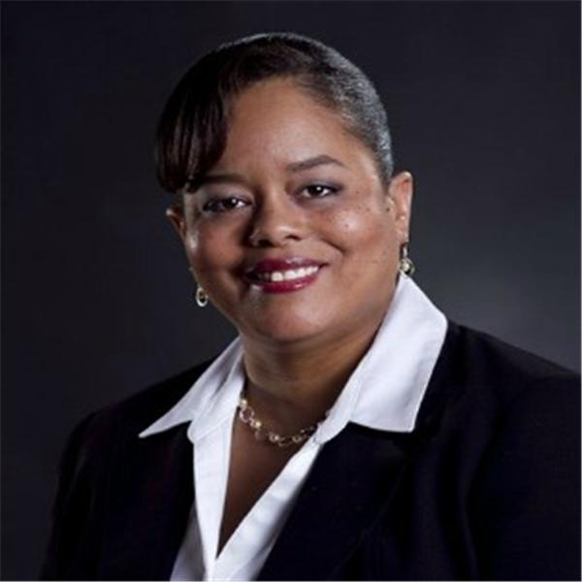

Carolyn R Owens, MCC
Infinity Coaching, Inc.
Executive and Leadership Coach/Trainer

Slide 3
Why discuss
emotional intelligence
in the workplace?

Slide 4

Advancing Access & Equity

Slide 5
Objectives
Gain an understanding of emotional intelligence and why it matters for the workplace.
Raise individual self-awareness.
Identify skills that empower you, colleagues, and team members reach their greatest potential.
Includes discussion to inspire in-depth dialogue and application to the federal workforce.

Slide 6

Laying the Foundation

Slide 7
Laying the foundation to begin to “create and advance a diverse, inclusive culture that champions dignity and respect, and where employees feel welcomed and motivated to do their best”.

Slide 8
Executive Order 14035
June 25, 2021

Slide 9
Executive Order 14035
The Executive Order to Advance Diversity, Equity, Inclusion, and Accessibility (DEIA) in the Federal Workforce.
Cultivate a workforce that draws from the full diversity of the Nation.

Slide 10
The Federal Government must:
Be a model for diversity, equity, inclusion and accessibility (DEIA).
Strengthen its ability to recruit, hire, develop, promote and retain our Nation’s talent.
Remove barriers to equal opportunity.

Slide 11

USDA Diversity, Equity, Inclusion and Accessibility (DEIA) Strategic Plan
FY 2022 – 2026
Published March 2022

Slide 12

Personal Awareness
What’s Your…
  guiding world view or paradigm?
  communication challenges?
  cultural influences?
Learning about ourselves through interactions with others...
  How they respond to you?
  How they perceive & evaluate you?

Slide 13
Personality
Intelligence
Emotional Intelligence

Slide 14
Personality
The complex of characteristics that distinguishes an individual or a nation or group; especially the totality of an individual's behavioral and emotional characteristics
Merriam-Webster Dictionary

Slide 15
Personality, cont.
A characteristic way of thinking, feeling, and behaving. Personality embraces moods, attitudes, and opinions and is most clearly expressed in interactions with other people.
https://www.britannica.com/topic/personality

Slide 16
Personality, cont. (Part 3)
Emotions: A natural instinctive state of mind deriving from one’s own circumstances, mood or relationship with others
Behaviors: The way in which one acts or conducts oneself; in response to a particular stimuli

Slide 17
Personality, cont. (Part 4)
Enduring patterns of thoughts, emotions and behaviors
Behaviors refer to a person’s actions or reactions in response to internal or external stimuli
Behavior is an expression of
our personality

Slide 18
Behavior
Observable
Situationally-based
Flexible
Dynamic
Impacted by one’s culture

Slide 19
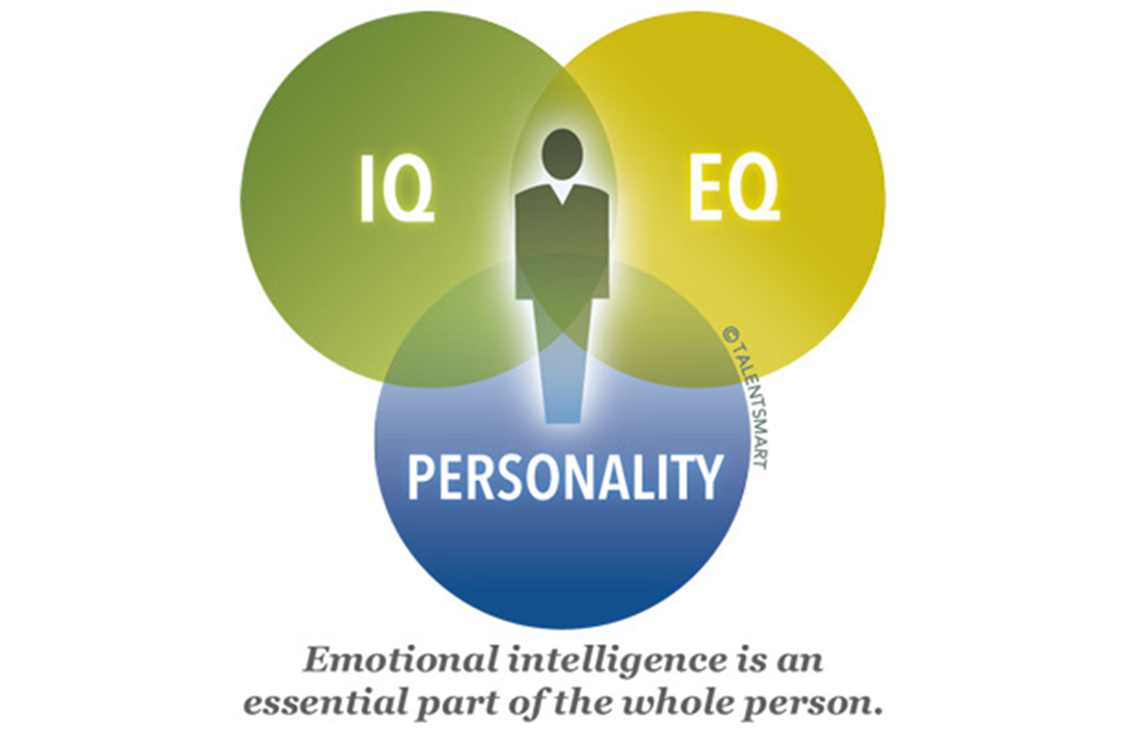
No Slide Title

Slide 20

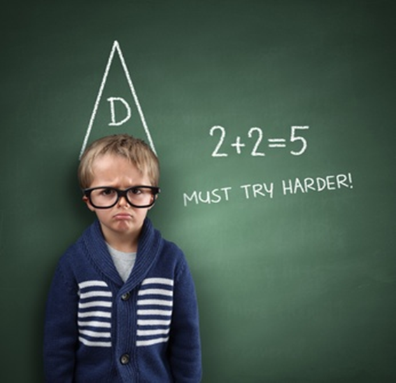
What’s the difference?
IQ
EQ

Slide 21
Intelligence Quotient (IQ) -
A score determined by one's performance on a standardized intelligence test relative to the average performance of others of the same age
Merriam-Webster dictionary

Slide 22

Intelligence Quotient (IQ), cont.
How smart you are compared to your peers.
Used to assess career fields and how well you will succeed in life.

Slide 23
Emotional Quotient (EQ) -
The level of a person's emotional intelligence, often as represented by a score on a standardized test.

Slide 24

Reuven Bar-On
Emotional Quotient (EQ) -
An array of non-cognitive capabilities, competencies, and skills that influence one’s ability to succeed in coping with environmental demands.

Slide 25
No Slide Title #2
Is emotional intelligence something that should be discussed?
Why discuss emotional intelligence in the workplace?
Can your level of emotional intelligence change?

Slide 26
No Slide Title #3
Emotional intelligence is being determined as an important job skill to have even more so…
then technical skills.

Slide 27

Emotional Intelligence improves
Emotional Intelligence improves:
Communication
Decision Making
Problem-solving
Management
Conflict resolution
Relationships

Slide 28
There is a strong correlation between how well an individual handled personal emotions and the willingness of others to work with that individual.
A team member with a positive mood and attitude tends to interact with others in a way that results in a positive, helpful, and cooperative workgroup, thereby increasing workplace efficiency.

Slide 29

What if there is an overall low level of emotional intelligence in the work environment?

Slide 30
Low EQi in the workplace:
Victim mentality
Don’t take responsibility
Passive or aggressive communication styles
Don’t support or work with the team
Poor, uninformed decisions
Confrontational
Critical of others/judgmental
Not open to viewpoints of others

Slide 31

What if there is an overall high level of emotional intelligence in the work environment?

Slide 32
High EQi in the workplace:
Make better decisions
Proactive vice reactive
Resolve conflicts
Better listener
Handle Pressure
High stress situations
Feedback and criticism
Empathetic

Slide 33
High EQi in the workplace: cont.
Research at the Center for Creative Leadership has shown that the primary cause of executive turnover was individual deficiency in the area of emotional competence.
In another study that involved 130 executives, results showed that there is a strong correlation between how well an individual handled personal emotions and the willingness of others to work with that individual.

Slide 34

High EQi in the workplace: cont. (Part 2)
A leader with a positive mood and attitude tends to interact with others in a way that results in a positive, helpful, and cooperative workgroup, thereby increasing workplace efficiency.

Slide 35
No Slide Title #4

Slide 36
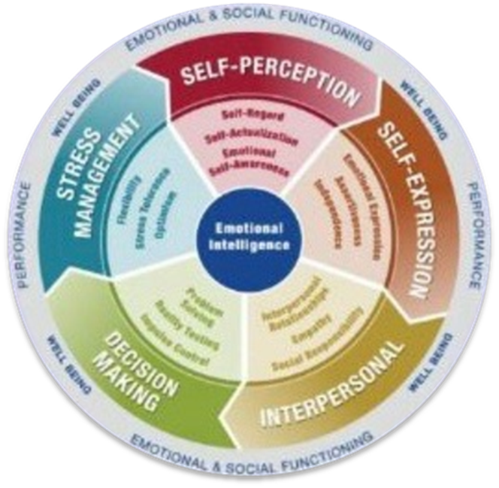
EQ-i 2.0 Model of Emotional Intelligence

Slide 37
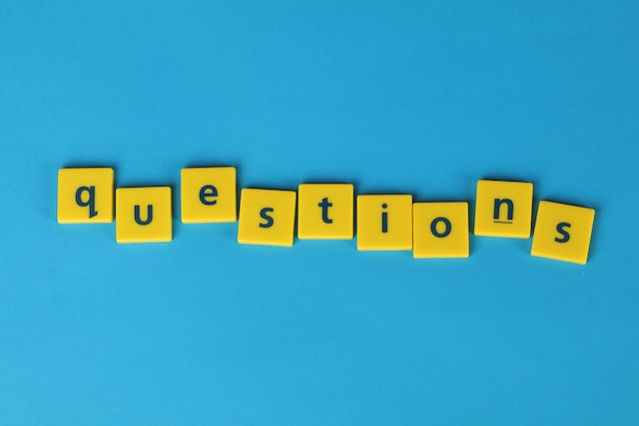
Questions

Slide 38
No Slide Title #5
Part Two:
Utilizing Emotional Intelligence to Develop a Diverse and Inclusive Team
October 30, 2023

Slide 39
“The journey to an inclusive, empowering environment will come with learning, discovery, and with hard truths.”
Message from Secretary Thomas J. Vilsack and
Deputy Secretary Jewel Bronaugh

Slide 40
THANK YOU

Slide 41
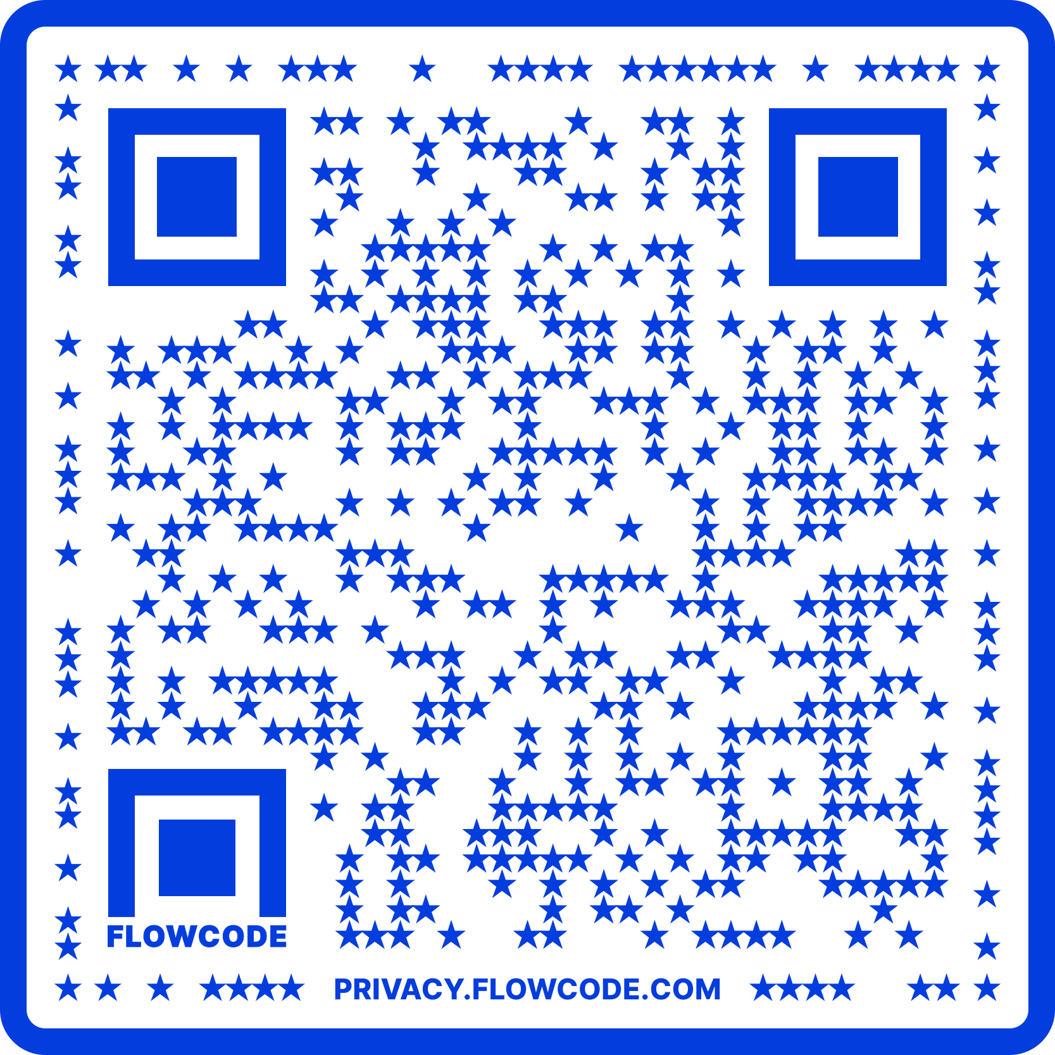
Contact Information
TARGET Center Website
https://www.usda.gov/target-center
TARGET Center Email
target-center@usda.gov
TARGET Center Phone Number
(202) 720-2600

Slide 42

Current and Upcoming Meetings.
OCTOBER
MONDAY WEDNESDAY
THURSDAY
TUESDAY
10/16/2023
11:00 AM – 12:00 PM
USDA TARGET Center
Accessible Communications
Program
Nancy Frohman
Accessible
Communications
Program Manager
1:00 PM – 2:00 PM
USDA TARGET Center
Education Program
Michelle Sherbondy
Education Program Manager
10/17/2023
11:00 AM – 12:00 PM
Unmasking Hidden Challenges: Chronic Conditions in the Workplace
Dr. Theresa Haskins Haskins Consulting
1:00 PM – 2:00 PM
Equity, Accessibility, and Inclusion in the Workplace (Part 1 of 2)
Dr. Theresa Haskins Haskins Consulting
10/18/2023
10:00 AM – 11:00 AM
Ergonomic Equity: Addressing Risk Factors Through Job Analysis and Prevention
Sandra Miller
Britroix
12:00 PM – 1:00 PM
Digital Accessibility Fundamentals for Websites, Documents, and Video
Mike Caprara
The Viscardi Center
10/23/2023
11:00 AM – 12:00 PM
Emotional Intelligence (Part 1 of 2)
Carolyn Owens,
MCC, SPHR
1:00 PM – 2:00 PM
Proper Posture in the Workplace to Prevent Posture-Related Problems (Part 1 of 2)
Dr. Krista Burns
American Posture Institute
10/24/2023
11:00 AM – 12:00 PM
Thriving with ADHD at Work
Dr. Theresa Haskins Haskins Consulting
1:00 PM – 2:00 PM
Equity, Accessibility, and Inclusion in the Workplace (Part 2 of 2)
Dr. Theresa Haskins Haskins Consulting
10/25/2023
10/26/2023
10:00 AM – 11:00 AM
Assistive Technology at New Heights
Dr. Wayne Crolley
Novare Products, LLC
10/25/2023
10:00 AM - 12:00 PM
USDA TARGET Center
Accessible Communications Demonstrations
(Virtual/Onsite)
Nancy Frohman
Accessible Communications
Program Manager
1:00 PM - 3:00 PM
USDA TARGET Center
Education Demonstrations
(Virtual/Onsite)
Michelle Sherbondy
Education Program Manager

