Slide 1



Equity, Accessibility, and Inclusion in the workplace
Part 1
Dr. Theresa Haskins | Presentation for the USDA TARGET Center

Slide 2

Advancing Access & Equity
Notes:
NDEAM's roots go back to 1945 when Congress enacted a law declaring the first week in October each year "National Employ the Physically Handicapped Week." In 1962, the word "physically" was removed to acknowledge the employment needs and contributions of individuals with all types of disabilities.

Slide 3

About the Session
Understand equity in fostering workplace inclusion and ensuring accessibility for all.
Identify and address systemic barriers in the workplace.
Learning practical strategies to effectively support neurodivergent individuals effectively.

Slide 4

National Disability Employment Awareness Month
Notes:
What is NDEAM?
Significance and history
The role of NDEAM in promoting equity, accessibility, and inclusion
NDEAM's roots go back to 1945 when Congress enacted a law declaring the first week in October each year "National Employ the Physically Handicapped Week." In 1962, the word "physically" was removed to acknowledge the employment needs and contributions of individuals with all types of disabilities.

Slide 5

Understanding Disabilities
Notes:
Physical and Mobility Issues
Hearing loss
Low and no vision
Mental heath and neurocogntivie issues
Point in time disabilities
And chronic conditions

Slide 6
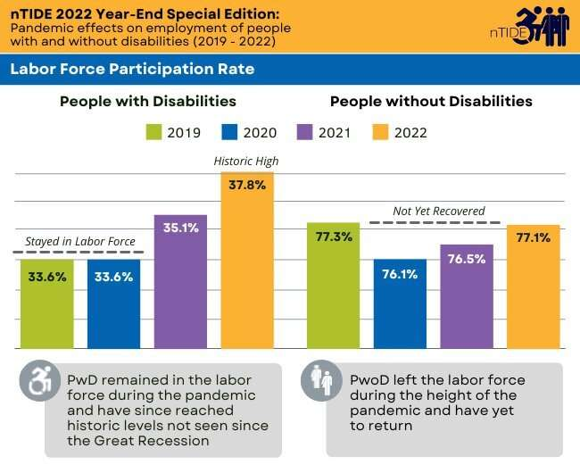
No Slide Title
Notes:
We saw an increase in disabled workers in the workforce – more than the PwoD groups –
And while researcher are still debating cause – one area that continue to resurface is the equalization of access to work – due to remote structures and more accessible tech-based work arrangements. Manual labor jobs were impacted the most – and knowledge workers received the greatest gains – another benefit is virtual interviews – which allowed disabled applicants more discretion in the interview process – as many didn’t have to disclose their disability because they didn’t need accommodations in a virtual interview process. This allowed more disabled applicants to apply with jobs without stigma. This also helped neurodivergent and introverted applicants. As eye contact – external environment stimuli stress, and physical contact were removed from the interviewing equation.

Slide 7
Achieve Equity through Accessibility
Physical
Technological
Communication
Attitude

Slide 8

Overcome Physical Barrier
Steps/curbs that enable a person from entering a building or using a sidewalk
Elevators
Accessible bathrooms
Larger cubicles and movable desks and workspaces
Improved lighting
Reduced high-noise and quieter work areas to avoid high-traffic

Slide 9

Technology Access
Expanded or mini-keyboards
Left- and right-handed keyboards
Track balls and specialized input devices to replace a mouse.
Screen readers
Scanners
Text to speech
Larger print
Captioning

Slide 10

Accessible Communication
Braille
American Sign Language (ASL)
Audio and Visual Presentation of Information
Plain Language Materials
Direct Communication (brief and detailed)

Slide 11

Barriers to Employment & Retention

Slide 12

Attitudinal Barriers
Assuming co-workers with disabilities have a poor quality of life or are unhealthy
Seeing disability as a personal tragedy, as something that needs to be cured or prevented
Thinking that people with disabilities are inferior
Assuming that a person with a disability is affected in their ability to understand you

Slide 13
Bias in the Hiring Process
Unconscious bias
Inaccessible interview processes
Judging communication style and not assessing required job skills

Slide 14

Neurodiversity
Informs the Solution to
Disability Inclusion at Work

Slide 15

What is Neurodiversity?
Neuro·diversity | is the diversity of human brains and minds – and recognizes the infinite variation in neurocognitive functioning within our species.
Focused on strengths-based approaches and the concept of multiple intelligences.
(Armstrong, 2011)
Neuro·divergent
having a brain that functions in ways that result in behaviors that diverge from the societal standards of “normal.”
Neuro·typical
having a style of neurocognitive functioning and behaviors that fall within the dominant societal standards of “normal.”

Slide 16
Common Accommodations
quieter work area
more time for completing work
peer review or Quality Checks of more-detailed work
Flexible work time to better accommodate peak periods of focus and attention
Written instructions, deliverables, and training materials

Slide 17
Unwillingness to Provide Accommodations
Managers Fear Unknown
Concerned about favoritism
Belief capable people don't need help
Providing Supports are too costly
Notes:
Managerial reluctance for accommodations
Fear of appearing biased
Misbelief in self-sufficiency
"Managers often hesitate to provide accommodations and workplace modifications due to concerns such as:
Worrying that offering support may be perceived as preferential treatment.
Holding the mistaken belief that capable individuals do not require assistance."

Slide 18
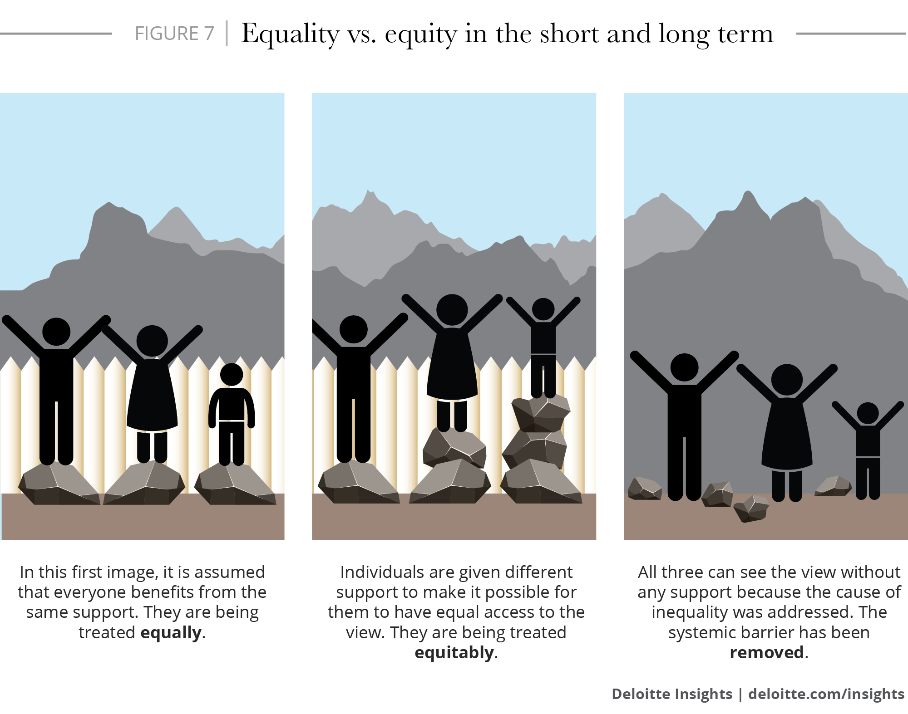
Equality, Equity, Accessibility

Slide 19

Support Neurodiversity@Work
Focus on strengths and creating diversified teams
1
Be clear and direct in communications, performance expectations, and task assignments
2
Follow-up with employees with meeting notes and key reminders e-mails
3
Be open to reasonable accommodations and novel approaches to work
4
Promote kindness and celebrate differences
5

Slide 20

Current and Upcoming Meetings, cont.
OCTOBER
MONDAY WEDNESDAY
THURSDAY
TUESDAY
10/16/2023
11:00 AM – 12:00 PM
USDA TARGET Center
Accessible Communications
Program
Nancy Frohman
Accessible
Communications
Program Manager
1:00 PM – 2:00 PM
USDA TARGET Center
Education Program
Michelle Sherbondy
Education Program Manager
10/17/2023
11:00 AM – 12:00 PM
Unmasking Hidden Challenges: Chronic Conditions in the Workplace
Dr. Theresa Haskins Haskins Consulting
1:00 PM – 2:00 PM
Equity, Accessibility, and Inclusion in the Workplace (Part 1 of 2)
Dr. Theresa Haskins Haskins Consulting
10/18/2023
10:00 AM – 11:00 AM
Ergonomic Equity: Addressing Risk Factors Through Job Analysis and Prevention
Sandra Miller
Britroix
12:00 PM – 1:00 PM
Digital Accessibility Fundamentals for Websites, Documents, and Video
Mike Caprara
The Viscardi Center
10/23/2023
11:00 AM – 12:00 PM
Emotional Intelligence (Part 1 of 2)
Carolyn Owens,
MCC, SPHR
1:00 PM – 2:00 PM
Proper Posture in the Workplace to Prevent Posture-Related Problems (Part 1 of 2)
Dr. Krista Burns
American Posture Institute
10/24/2023
11:00 AM – 12:00 PM
Thriving with ADHD at Work
Dr. Theresa Haskins Haskins Consulting
1:00 PM – 2:00 PM
Equity, Accessibility, and Inclusion in the Workplace (Part 2 of 2)
Dr. Theresa Haskins Haskins Consulting
10/25/2023
10/26/2023
10:00 AM – 11:00 AM
Assistive Technology at New Heights
Dr. Wayne Crolley
Novare Products, LLC
10/25/2023
10:00 AM - 12:00 PM
USDA TARGET Center
Accessible Communications Demonstrations
(Virtual/Onsite)
Nancy Frohman
Accessible Communications
Program Manager
1:00 PM - 3:00 PM
USDA TARGET Center
Education Demonstrations
(Virtual/Onsite)
Michelle Sherbondy
Education Program Manager

Slide 21

Contact Information
TARGET Center Website
https://www.usda.gov/target-center
TARGET Center Email
target-center@usda.gov
TARGET Center Phone Number
(202) 720-2600

Slide 22


Continue Learning with
Dr. Theresa Haskins
USDA TARGET Center
NDEAM 2023 Upcoming Sessions
See e-mailed schedule for details.
Find resources, podcasts, newsletters and more at
www.theresahaskins.com
@ Theresa Haskins, LLC 2023

