Slide 1



Nurturing Workplace
Well-being and Supporting Mental Health
Part 1
Dr. Theresa Haskins | Presentation for the USDA TARGET Center

Slide 2

Advancing Access & Equity

Slide 3

About the Session
Increase understanding of common mental health issues and the impact of stigma in the workplace.
Develop practical skills that will help you better support the well-being of others.
Learn strategies to create a culture of support, understanding, and open communication.
Notes:
Today we are going to talk about the importance of Mental Health and overall well-being in the workplace. In the first of many neurodiversity session to come, we want to address the most common mental health issues in our workplace – and help you recognize and develop strategies to better support your colleagues.

Slide 4
Session Disclaimer
This presentation is for education and informational purposes only and should not be considered medical advice or mental health services.
If you or someone you know needs assistance or is facing a mental health emergency, please seek guidance from an appropriate healthcare provider.
Any actions taken based on the information presented are at your own risk.
@ Theresa Haskins, LLC 2023
Notes:
As we begin – I want to remind everyone that this presentation…

Slide 5
Why We Need to Focus on Mental Health at Work
1 in 5
Americans experience a diagnosable mental disorder annually
#1Disability
Mental health conditions are the leading cause of disability in the United States
$105 billion
Untreated mental illness costs businesses over $105 billion annually
@ Theresa Haskins, LLC 2023
Notes:
And it’s not just in our personal lives that we can experience distress – mental health impacts wellness has significant impacts in the workplace from motivation to overall productivity.
Today… [read through slide]

Slide 6
The Importance of Mental Health
Mental health is as important as physical health.
Employees' well-being impacts productivity, engagement, and job satisfaction.
Poor mental health can lead to absenteeism, presenteeism, and higher turnover rates.
Addressing mental health positively impacts the organization's bottom line
Notes:
So what we all need to appreciate - is that mental health is as important as physical health – and, if left untreated, can impact our physical wellness. Employees’ well-being impacts productivity and overall job satisfaction, and if left unaddressed can lead to absenteeism, presenteeism, and higher turnover rates. With 105billion dollars annually at stake, it’s clear that we need to support mental health as it doesn’t just impact individual productivity and happiness– it affects the organizations bottom line.

Slide 7
Common Mental Health Issues
Depression
Persistent feelings of sadness, loss of interest in activities, and changes in sleep and appetite.
Anxiety
Excessive worry, fear, or panic that can interfere with daily life and tasks.
Stress
Emotional and physical strain due to excessive demands or pressures.
Burnout
Prolonged exposure to work-related stress, leading to exhaustion and reduced effectiveness.
Post-Traumatic Stress Disorder (PTSD)
Caused by experiencing traumatic events, leading to flashbacks, nightmares, and heightened arousal.
Notes:
When people think of mental health – they usually flip quickly to mental illnesses and disorders that they learned about in psychology 101. And while mental illness can impact employees, the stereotypical view of mental health and what causes the most disabilities isn’t what people think. The most common mental health issues that result in lack of wellness and issues in the workplace are areas that every single one of us has experienced at one point or another – at work and in our personal lives. The first is stress – we’ve all encountered stress – especially when we are under pressure at work – then there is anxiety – where we begin to worry, have fear, or panic that begins to impact our ability to function and complete tasks. Depression is when we have a persists feeling of sadness, there is loss of interest and stop engaging in activities. When people push through stress and anxiety for long periods of time – they may burn-out – where they just become exhausted and no longer willing to continue to engage with work and peers – and while PTSD is often associated with significantly traumatic events – long term stress, anxiety, and pushing beyond comfort zones can also result in workplace PTSD, which can lead to heightened arousal, anxiety, and nightmares related to work.

Slide 8
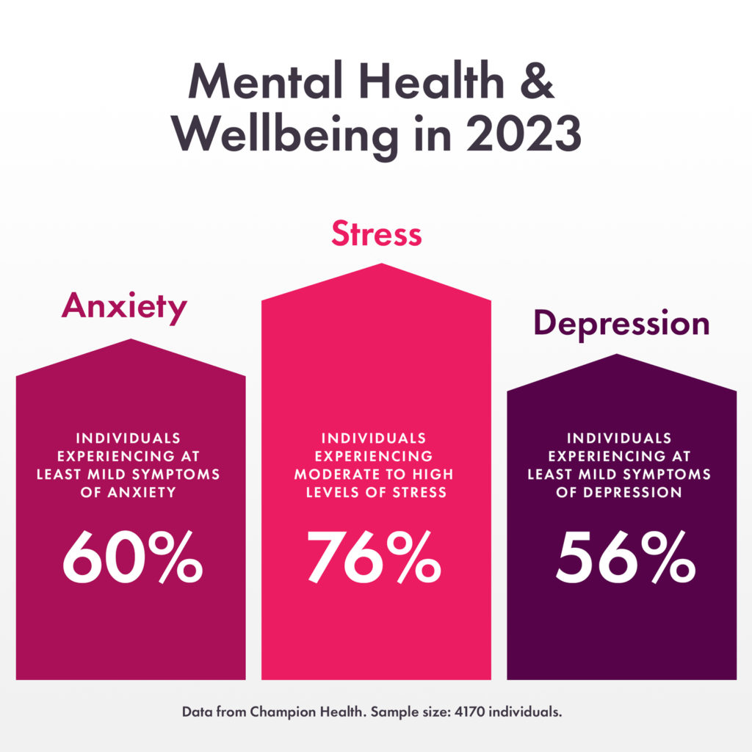
Mental Health
& Wellbeing in 2023
@ Theresa Haskins, LLC 2023
Notes:
What we all need to acknowledge is there is usually an entry point to larger wellness issues – and if we are aware of the most common triggers – we can be proactive to mitigate the stress and anxiety and lead to more significant disabilities. Today , 76% of individuals report they are experiencing high levels of stress, and 60% say they are experiencing anxiety. That leads to no surprise that 56% of people would indicate that they are feeling depressed. These are three areas whose presence are directly connected to the work environment, culture, work load, and expectations set for each other and employees. That also means that they can be mitigated – because for the majority – these issue are caused with the inability to deal with external factors, not an innate problem of the individual.

Slide 9

Recognizing Signs of Workplace Stress
Changes in behavior, mood, or attitude
Increased irritability and impatience
Frequent complaints of physical ailments
Withdrawal from social interactions
Reduced enthusiasm for work tasks
@ Theresa Haskins, LLC 2023
Notes:
While these can be signs – you can also listen for cues about how someone feels “stressed out”, the deadlines are unreasonable, I don’t’ know if I can do it. This is too hard.
If someone tells you they feel stressed out – believe them – even if it is momentary- often people have other issues in their lives – that little work place stress could be added to a personal stress you cannot see – and could be one thing too many.

Slide 10

Recognizing Signs of Anxiety
Excessive worry or preoccupation about work-related matters
Physical symptoms like headaches, muscle tension, or digestive issues
Avoidance of work-related situations or tasks
Feeling overwhelmed and emotionally drained
Lack of sleep and restlessness
@ Theresa Haskins, LLC 2023
Notes:
When people are anxious, they will amp up the atmosphere around them. There is an energy and they will be preoccupied about failure – and obsessively worry about work related outcoems.
They will be overwhelmed – seem emotionally drained – they may avoid meetings and hard tasks – to preserve themselves.
Because Anxiety is aligned with worry and fear –you may hear people talking in ways that imply they are concerned about outcomes, not confident in their abilities, or always focused on the worst
If anxiety and stress go unchecked – or if their fears manifest into reality – that they can’t meet deadlines, they don’t feel they are meeting expectations, if they are criticized and their doubts come to life (or they perceive that people are unhappy with them( all of this anxiety can turn – and stress or anxiety can turn into depression.

Slide 11
Depression
More than 300 million people are depressed.
Depression is the leading cause of disability worldwide
@ Theresa Haskins, LLC 2023
Notes:
Depression at work is a feeling of sadness, lack of self-worth, and negative thinking – or negative self-talk toward a person’s value, interactions, or worth with others. It leads people to fold within themselves – and inner dialogue is controlling actions and thinking more than a balanced and objective interaction with others.
Depression impacts over 400 million people and is the leading cause of disability worldwide. It is definitely something we all need to talk about more – and collectively invest in preventing – and reducing its impacts.

Slide 12

Recognizing Depression
What Depression Feels Like
How it Looks to Co-Workers
Deep Feelings of sadness
Loss of interest in work or social activities
Difficulty concentrating, slowed thoughts
Forgetfulness and trouble remembering
Trouble making decisions
Trouble sleeping or sleeping too much
Feelings of worthlessness
Energy loss or increased fatigue
Irritability, anger, or tearfulness
Weight of appetite changes
Withdrawal from team, isolates oneself
Indifference
Putting things off, missed deadlines, mistakes
Seems “scattered” or absent-minded
Procrastination, indecisiveness, slowed productivity
Late to work, afternoon fatigue, accidents
Unsure of abilities, lack of confidence
Low motivation, detached
Inappropriate reactions, strained relationships
Change in appearance
@ Theresa Haskins, LLC 2023
Notes:
Intentionally or not – feelings manifest into observable behaviors – if you are around a person who becomes depressed – you will notice a change – and it is this observation that needs to lead to action. Because helping people is the right thing to do – and it’s a good investment for an team at work too.

Slide 13
The Value of Treating Depression
$1
Investment in treatment for depression
60%
Reduction in absenteeism and presenteeism
$4
Return in productivity at work
=
+
@ Theresa Haskins, LLC 2023
Notes:
Treatment of depression results in up to a 60% reduction in absenteeism and presenteeism.
$1 of investment in treatment for depression leads to a $4 return in productivity at work.

Slide 14
Societal Stigma Toward
Mental Health
Prevents people from seeking help
Leads to workplace discrimination
Creates an environment of fear and isolation
@ Theresa Haskins, LLC 2023
Notes:
Many companies are focused on the positive side of mental health – wellness – and focus on activities that promote physical activity and mindfulness – and while this is all important and helps elevate and reduce stress and anxiety – it doesn’t provide a pathway of acceptance for when people find that exercise and meditation are not enough to get them through a situation.
This is because there is a societal stigma towards mental health. Some people believe it is a sign of weakness – of not having enough tenacity and fortitude to overcome obstacles.
But what people don’t understand is that continuous stress and anxiety can rewire the brain and cause chemical imbalances – that depression is as much physical as it is mental – and that will alone may not be enough to get to wellness again. If more people accepted that being unwell warranted care whether it is your heart, lungs, or mind, than more people would seek the help the need. Because there are prejudices and myths around what causes depression and other mental issues – it create an environment of fear and isolation – the misconceptions and incorrect assumptions lead to discrimination – and ultimately prevents people from seeking the help they need.

Slide 15

You don’t need to be a therapist to help!
You can support someone by
Listening
Withholding Judgment
Assist in Finding Help
@ Theresa Haskins, LLC 2023
Notes:
You can support someone by
Listening
Withholding judgment
Connecting the person with to appropriate resources

Slide 16

How You Can Help Others
1. Be Available
Maintain an open dialogue with your team around mental health and that you want to support them.
2. Make Confidentiality Clear
Make it clear to your team that any discussions with you will be kept as private as possible.
3. Start the Conversation
Regularly check the wellness of your team. Do this in a one-to-one setting.
4. Involve Others
Encourage your team to speak openly about mental health and to look out for each other.
5. Ask Twice
Three in four people will say they’re fine even if they are struggling.
Simply asking again, with interest, might lead to your employee disclosing a need for help
Follow-up after the meeting can have more meaning than the first interaction..
7. Lead by Example
Your team will be more open if you express your own vulnerabilities and concerns at work.
6 Show Compassion and Empathy
Demonstrate compassion and empathy throughout the conversation.
@ Theresa Haskins, LLC 2023

Slide 17
Things to say (and not say)
Don’t Say
There’s always someone worse off than you.
No one ever said life was fair.
Stop feeling sorry for yourself.
You need to snap out of it.
Have you tried just being happy?
I know how you feel.
Say Instead
I’m here for you.
You’re important to me.
Let me know if you need to talk.
Come talk to me anytime.
How can I help you?
@ Theresa Haskins, LLC 2023

Slide 18
Suicide is Preventable
Suicide rates are climbing
Early intervention is key
Increase psychological safety
Listen and Support Others
@ Theresa Haskins, LLC 2023
Notes:
I can’t do this anymore, I can’t handle this anymore, or blatantly say I’m going to kill myself, you need to believe them, you need to listen – and you need to act.
While only 3.7% of adults have had thoughts about suicide and less than a percent attempted suicide – we don’t want anyone to spiral to the point of no return. And you need to know that suicide is in the top 10 causes of death across demographics. And while most depressed people are not suicidal, you need to be prepared with what to do when you feel that a colleague or loved one has hit the point of crisis and is heading toward the point of no return.
Know that early intervention is key. And that workplace culture and management and colleagues can play a part in the health or illness of their employees – if we increase psychological safety – we will increase the likelihood that people can talk about their troubles before they manifest into clinical issues – and if we listen and support others –we can prevent illness and promote wellness.
But sometimes – even with our best attempts – things do not improve. There are more factors and more needs than a quick conversation can solve for.
1Learn about mental health CDC. Accessed December 2020.
2Suicide National Institute of Mental Health. Accessed December 2020.
3Symptoms matter-Leading causes of disability Accessed December 2020.
4Untreated Mental Health Disorders Result in Exorbitant Costs for Individuals, Businesses. Accessed December 2020

Slide 19
In a Crisis? HELP IS AVAILABLE
Encourage
Encourage the person to seek professional help.
Do Not Leave
If you think the person is in immediate danger, do not leave them alone.
Seek
Seek help using these crisis resources.
Check-In
Continue to check-in with the person after the event.
VISIT
A hospital near you.
CALL
Suicide & Crisis Lifeline
988
Emergency Services
911
TEXT
The Crisis Text Line
741-741
@ Theresa Haskins, LLC 2023
Notes:
If you are a colleague has hit a point of crisis – know that help is available.
Encourage the person to seek professional help – make a commitment and check-in – if you believe they will act – do not leave them alone – under any circumstances.
And most importantly continue to check-in with the person after the event. If someone feels unloved, unvalued, unwanted –the best thing we can do is show them they are remembered, we do care, and we proactively support them – our actions need to mitigate their self-talk and perception – and help them develop a new reality.
I can’t do this anymore, I can’t handle this anymore, or blatantly say I’m going to kill myself, you need to listen – and you need to act.
While only 3.7% of adults had thought about suicide and only about ½ a percent attempted – we don’t’ want anyone to spiral to the point of no return. And while most depressed people are not suicidal, you need to be prepared with what to do when you feel that a colleague or loved one has hit the point of crisis.

Slide 20

Supporting Self-Care
Seek wellness and professional support
Maintain and enhance your social networks
Engage in regular exercise and leisure activities
Talk about your feelings with a trusted person
Ask for help when you need it
Be realistic about what you can (and cannot) do
Take time for you.
@ Theresa Haskins, LLC 2023
Notes:
As I said, most people will not spiral out of control – yet don’t underestimate how debilitating depression can be.
What’s good news is that Employees can avoid burnout and improve their mental wellness in the workplace. Here are some tips:

Slide 21


Continue Learning with
Dr. Theresa Haskins
USDA TARGET Center
NDEAM 2023 Upcoming Sessions
See e-mailed schedule for details.
Find resources, podcasts, newsletters and more at
www.theresahaskins.com
@ Theresa Haskins, LLC 2023

Slide 22
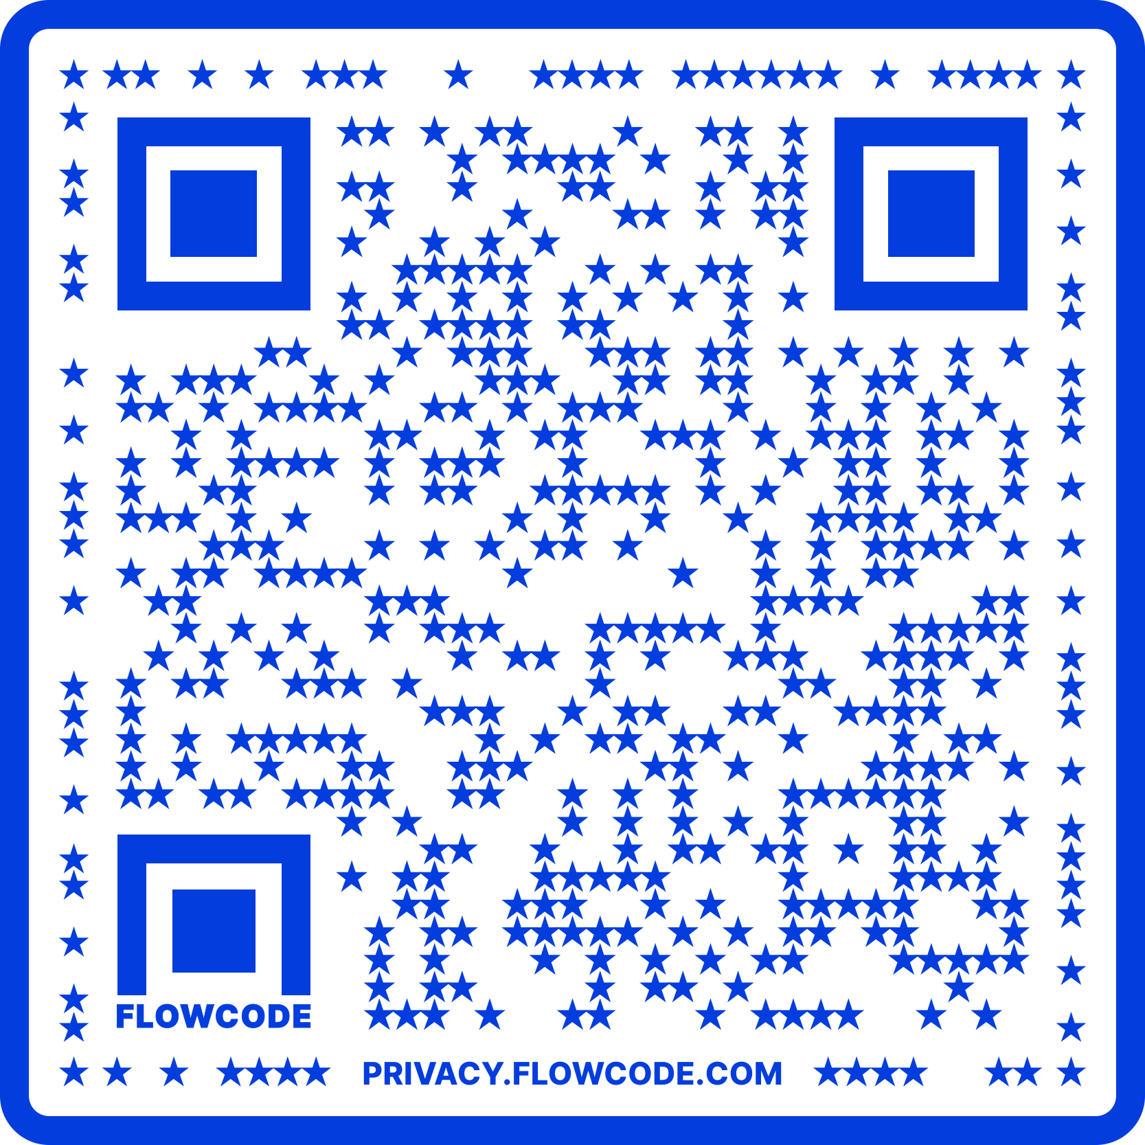
Contact Information
TARGET Center Website
https://www.usda.gov/target-center
TARGET Center Email
target-center@usda.gov
TARGET Center Phone Number
(202) 720-2600

Slide 23

Current and Upcoming Meetings
OCTOBER
MONDAY
TUESDAY
WEDNESDAY
THURSDAY
10/2/2023
10/3/223
11:00 AM – 12:00 PM
Rethinking Disability and What It Means to Be Disabled
Dr. Theresa Haskins Haskins Consulting
1:00 PM – 2:00 PM
(Neuro) Diversity Includes You
Dr. Theresa Haskins Haskins Consulting
10/3/2023
10/4/2023
10/5/2023
10:00 AM – 11:00 AM
USDA TARGET Center Assistive Technology Program
Rashida Owens
Assistive Technology Program Manager
12:00 PM – 1:00 PM
USDA TARGET Center
Ergonomics Program
Stephanie Bradley
CEAS, CAE
Ergonomics Program Manager
11:00 AM – 12:00 PM
Nurturing Workplace Well-Being and Supporting Mental Health (Part 1 of 2)
Dr. Theresa Haskins
Haskins Consulting
1:00 PM – 2:00 PM
PTSD Is More Common Than You Think
Alla Weinberg
Spoke & Wheel
10:00 AM – 11:00 AM
Empowering Lives Through Assistive Technology Solutions
Donny Osborn
Boundless AT
12:00 PM – 1:00 PM
Department of Defense Computer/Electronic Accommodations Program (CAP)
Erin Sanderson
CAP
HOLIDAY
10/10/2023
10/11/2023
10/12/2023
11:00 AM – 12:00 PM
Autism Inclusion and the Pathway to Neurodiversity
Dr. Theresa Haskins Haskins Consulting
1:00 PM – 2:00 PM
Lessons from Unpredictable Journeys: Insights from Temporary and Situational Disabilities (Part 1 of 2)
Dr. Theresa Haskins Haskins Consulting
11:00 AM – 12:00 PM
Creating a
Trauma-Informed Workplace
Alla Weinberg
Spoke & Wheel
1:00 PM – 2:00 PM
Nurturing Workplace Well-Being and Supporting Mental Health (Part 2 of 2)
Dr. Theresa Haskins Haskins Consulting
10:00 AM - 12:00 PM
USDA TARGET Center
Ergonomics Demonstrations
(Virtual/Onsite)
Stephanie Bradley
CEAS, CAE
Ergonomics Program Manager
Stephen DiCarlo
Humanscale
Howard Flowers
BodyBilt
1:00 PM - 3:00 PM
USDA TARGET Center Assistive Technology Demonstrations
(Virtual/Onsite)
Rashida Owens
Assistive Technology Program Manager

