Slide 1



Identifying Obstacles to Neurodiversity and Inclusion
Dr. Theresa Haskins | Presentation for the USDA TARGET Center

Slide 2

Advancing Access

Slide 3

About the Session
Understand neurodiversity and its significance in the workplace.
Identify challenges faced by neurodivergent individuals.
Recognize barriers to inclusion, including stereotypes, biases, and misconceptions.

Slide 4

Defining Neurodiversity
Neurodiversity is the diversity of human brains and minds – and recognizes the infinite variation in neurocognitive functioning within our species. Focused on strengths-based approaches and the concept of multiple intelligences.

Slide 5
Neurodiversity Includes
You
Neurodivergent
having a brain that functions in ways that results in behaviors that diverge significantly from the societal standards of “normal.”
Neurotypical
having a style of neurocognitive functioning and behaviors that fall within the dominant societal standards of “normal.”

Slide 6
Types of Neurodivergence
Autism
ADHD
Dyslexia
Dyscalculia
Dyspraxia
Tourette's Syndrome
Giftedness
Mental Health Conditions
Intellectual Disabilities

Slide 7
(Neuro)Distinct
Thinking
Processes
Experiences
Interactions

Slide 8
Work Environment Issues
Sensory Sensitivities
Heightened sensitivity to sensory stimuli in the workplace.
May be distracted or negatively affected by bright lighting, loud noises, strong scents, etc.
Routine and Change
Thrive on routine and predictability.
Difficulty adapting to sudden changes in work tasks, schedule, or environment.
Task Management
Difficulties with time management and prioritization
Can have issues with organizing work and predictive planning

Slide 9
Challenging Social Dynamics
Communication Difficulties
Distinct verbal and non-verbal communication.
Difficulty in maintaining eye contact and interpreting social cues
Workplace Culture
Difficulty following complex and unclear rules of engagement and office politics
Challenges in forming and maintaining relationships with colleagues or supervisors
Sigma and Discrimination
Experience negative attitudes and stereo types
Bias results in limited in job opportunities and fewer promotions

Slide 10

Stereotypes about Abilities
Example Scenario
Emma is a highly talented software developer with autism.
She consistently delivers high-quality code and innovative solutions.
Some colleagues and her supervisors assume that her autism affects her competency.
She receives fewer challenging projects and opportunities for career advancement.

Slide 11
Stereotypes about autism lead to
Less challenges and opportunities.
Hindered career advancement.

Slide 12

Misconceptions about Communication
Example Scenario
John, who has ADHD, is known for his enthusiasm and creative thinking in brainstorming sessions.
His colleagues sometimes struggle to follow his fast-paced speech and unconventional presentation style.
They mistakenly assume that John's communication style hinders his effectiveness because they have difficulty following his thinking, leading to missed opportunities for collaboration.
John is a highly productive innovator and is often left to work on his own projects.

Slide 13
Misconceptions about communication lead to
Difficulty in collaborating effectively with colleagues.
Missed opportunities for creative contributions due to unconventional communication.

Slide 14

Bias in Hiring and Promotion
Example Scenario
Maria, who is on the autism spectrum, recently applied for a managerial position within her company.
Despite her strong qualifications and excellent performance record, she is passed over for a neurotypical candidate.
The team didn’t feel like they connected with her in the interview and believed the other candidate was more "socially skilled."
Marie received this feedback and is confused. She thought the interview went well. She has all the skills for the job and doesn’t know how to overcome this obstacle.

Slide 15
Bias in the hiring process leads to
Unfair treatment
Feelings of exclusion
Lack of employment

Slide 16

Assumptions about Limitations
Example Scenario
Michael is an autistic employee with a strong analytical mind.
He is pigeonholed into a narrow range of tasks at work.
His supervisors are concerned about him engaging in client interactions, so they continuously assign him to back-office projects.
He wants to be promoted, but his supervisor doesn’t believe he's suited for leadership roles.
Michael's potential for growth within the company is restricted, even though he possesses valuable skills and insights.

Slide 17
Negative assumptions about social skills leads to
Exclusion from team projects and collaboration.
Underutilization of valuable problem-solving skills and contributions.

Slide 18


Identifying Obstacles is the First Step

Slide 19
Overcome Obstacles to Neurodiversity
Come back this afternoon to learn practical strategies for promoting understanding, dispelling misconceptions, and fostering a more inclusive workplace.

Slide 20


Continue Learning with
Dr. Theresa Haskins
USDA TARGET Center
NDEAM 2023 Upcoming Sessions
See e-mailed schedule for details.
Find resources, podcasts, newsletters and more at
www.theresahaskins.com
@ Theresa Haskins, LLC 2023

Slide 21

Current and Upcoming Meetings
OCTOBER
MONDAY WEDNESDAY
THURSDAY
TUESDAY
10/30/2023
11:00 AM – 12:00 PM Emotional Intelligence (Part 2 of 2)
Carolyn Owens,
MCC, SPHR
1:00 pm- 2:00 pm
Bridging Gaps: Generations and Disabilities
Mayor Neil McDevitt
10/31/2023
11:00 AM – 12:00 PM
Identifying Obstacles to Neurodiversity and Inclusion
Dr. Theresa Haskins
Haskins Consulting
1:00PM – 2:00 PM
Overcoming Barriers to Neurodiversity and Inclusion
Dr. Theresa Haskins
Haskins Consulting
11:00 AM – 12:00 PM
Navigating Temporary Disabilities: Resilience and Coping Strategies (Part 2 of 2)
Dr. Theresa Haskins
Haskins Consulting
10/31/2023
11:00 AM – 12:00 PM
Postural Ergonomics in
the Workplace (Part 2 of 2)
Dr. Krista Burns
American Posture Institute
1:00 PM – 2:00 PM
Working Group: MS Teams Is Accessible for All
Michelle Sherbondy Education Program Manager
11/1/2023
11/2/2023
10/19/2023
10/19/2023

Slide 22
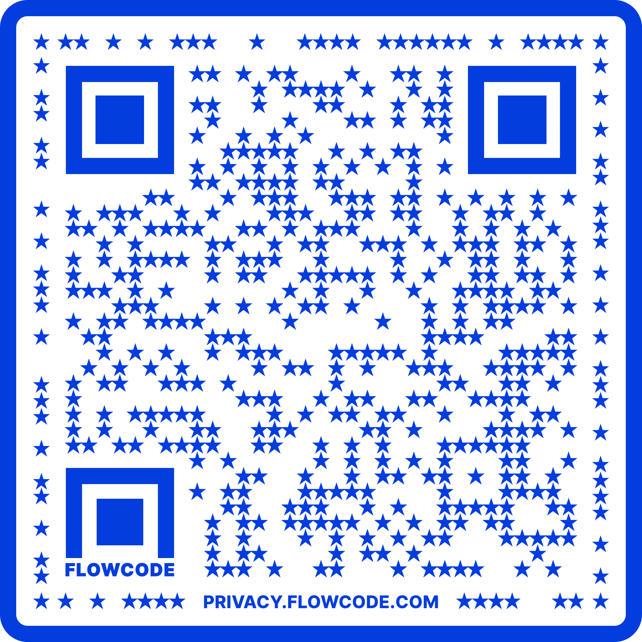
Contact Information
TARGET Center Website
https://www.usda.gov/target-center
TARGET Center Email
target-center@usda.gov
TARGET Center Phone Number
(202) 720-2600

