Slide 1



NAVIGATING TEMPORARY DISABILITIES
RESILIENCE AND COPING STRATEGIES
Dr. Theresa Haskins | Presentation for the USDA TARGET Center

Slide 2

Advancing Access & Equity

Slide 3

About the Session
Recognize the significance of resilience in navigating temporary disabilities
Utilize practical coping strategies and resilience-building techniques to manage challenges
Promote inclusion by fostering resilience and well-being in the workplace
This Photo by Unknown Author is licensed under CC BY-NC-ND
Notes:
Today we are going to talk about the importance of Mental Health and overall well-being in the workplace. In the first of many neurodiversity session to come, we want to address the most common mental health issues in our workplace – and help you recognize and develop strategies to better support your colleagues.

Slide 4
Session Disclaimer
This presentation is for education and informational purposes only and should not be considered medical advice or mental health services.
If you or someone you know needs assistance or is facing a mental health emergency, please seek guidance from an appropriate healthcare provider.
Any actions taken based on the information presented are at your own risk.
@ Theresa Haskins, LLC 2023
Notes:
As we begin – I want to remind everyone that this presentation…

Slide 5




What are Situational Disabilities
ACCIDENTS
ENVIRONMENT
ILLNESS
SURGERY

Slide 6
Occupational Disabilities
Physical Disabilities
Chronic Health Conditions
Mental Health Disorders
Sensory Disabilities
Neurological Conditions
Notes:
Physical Disabilities: Conditions that affect mobility or physical functioning, such as paralysis, limb loss, or mobility disabilities.
Chronic Health Conditions: Conditions like diabetes, asthma, or epilepsy that may require ongoing management and accommodation.
Mental Health Disorders: Conditions such as depression, anxiety, bipolar disorder, or post-traumatic stress disorder (PTSD) that can affect cognitive and emotional functioning at work.
Sensory Disabilities: Hearing loss or visual disabilities that can impact communication and job performance.
Neurological Conditions: Conditions like multiple sclerosis or Parkinson's disease that can affect coordination and cognitive function.

Slide 7



Impact of Temporary Disabilities
Physical Health and Well-Being
Pain and Discomfort
Limited Mobility
Rehabilitation and Medical Treatments
Notes:
Pain and Discomfort: Depending on the nature of the disability, employees may experience pain and discomfort, which can affect their ability to perform daily tasks and work-related activities.
Limited Mobility: Mobility limitations may require employees to use assistive devices (e.g., crutches or wheelchairs) or modify their daily routines.
Rehabilitation and Medical Treatments: Employees with temporary disabilities often require rehabilitation, physical therapy, or medical treatments, which can be time-consuming and physically demanding.

Slide 8



Impact of Temporary Disabilities
Emotional and Psychological Impact
Emotional Distress
Loss of Independence
Social Isolation
Notes:
Pain and Discomfort: Depending on the nature of the disability, employees may experience pain and discomfort, which can affect their ability to perform daily tasks and work-related activities.
Limited Mobility: Mobility limitations may require employees to use assistive devices (e.g., crutches or wheelchairs) or modify their daily routines.
Rehabilitation and Medical Treatments: Employees with temporary disabilities often require rehabilitation, physical therapy, or medical treatments, which can be time-consuming and physically demanding.

Slide 9
Impacts at Work
Work Absence
Reduced Productivity
Job Modifications
Financial Strain
  may need to take time off work to recover or attend medical appointments.
  may experience reduced productivity due to physical limitations or fatigue.
  job tasks may need to be modified to accommodate the employee's temporary disability.
  loss of income during disability leave and medical expenses can lead to financial strain.
Notes:
Work Absence: Employees with temporary disabilities may need to take time off work to recover, which can result in a loss of income and impact their career progression.
Reduced Productivity: While at work, employees with temporary disabilities may experience reduced productivity due to physical limitations or fatigue.
Job Modifications: In some cases, job tasks may need to be modified to accommodate the employee's temporary disability.
Financial Strain: Medical expenses, coupled with potential loss of income during disability leave, can lead to financial strain for employees.

Slide 10

Understanding Resilience
Ability to adapt positively to challenges.
The strength to navigate difficulties
A skill that can be developed over time.

Slide 11

How People Define
Resilience
Bouncing back or being "buoyant."
"Rolling with" or "dancing with" a disability.
Taking things one day at a time
Finding a "new normal" as life changes.
Trusting that stressful times will pass, like the weather.

Slide 12

Why Develop Resilience?
Crucial in coping with temporary disabilities.
Empowers individuals to maintain a positive outlook, set goals, and improve quality of life.
Helps individuals grow through adversity.

Slide 13



Positive Thinking
Embracing Optimism
See challenges as opportunities for learning and growth rather than insurmountable obstacles.
Self-Affirmation
Positive self-talk and affirms capabilities, boosts self-esteem, and resilience.
Goal Setting
Setting realistic, achievable goals fosters a sense of purpose and helps increase motivation during a temporary disability.
Notes:
Positive Thinking: Encouraging positive thinking involves maintaining an optimistic mindset, even in the face of adversity. This approach enables individuals to focus on their strengths and the potential for personal growth. Key points to cover may include:
Embracing Optimism: Encourage participants to see challenges as opportunities for learning and growth rather than insurmountable obstacles.
Self-Affirmation: Discuss the power of positive self-talk and how affirming one's capabilities can boost self-esteem and resilience.
Goal Setting: Explain the importance of setting realistic, achievable goals that foster a sense of purpose and motivation during a temporary disability.

Slide 14
Reframing
Change
Changing Perspectives
Discuss how shifting the focus from what can't be done to what can be achieved can enhance resilience.
Find
Finding Silver Linings
Encourage participants to identify positive aspects or opportunities that might emerge from their temporary disability.
Practice
Practicing Gratitude
Share the benefits of recognizing and appreciating the positive aspects of life, which can improve overall well-being.
Notes:
Reframing: Reframing involves looking at a situation from a different perspective. It can help individuals alter their perceptions and emotions regarding their disability.
Changing Perspectives: Discuss how shifting the focus from what can't be done to what can be achieved can enhance resilience.
Finding Silver Linings: Encourage participants to identify positive aspects or opportunities that might emerge from their temporary disability.
Practicing Gratitude: Share the benefits of recognizing and appreciating the positive aspects of life, which can improve overall well-being.

Slide 15




Stress Management
BREATHING EXERCIES
MINDFULNESS AND MEDITATION
TIME MANAGEMENT
PHYSICAL ACTIVITY
Notes:
Stress Management Techniques:
Breathing Exercises: Teach deep breathing exercises as a fundamental stress management technique. Discuss how deep, mindful breaths can calm the nervous system and reduce stress.
Diaphragmatic Breathing: Explain the process of diaphragmatic breathing and its effectiveness in reducing stress and anxiety.
Practical Exercise: Lead participants in a brief breathing exercise they can incorporate into their daily routines.
Mindfulness and Meditation: Discuss the role of mindfulness and meditation in reducing stress and promoting emotional well-being.
Benefits of Mindfulness: Explain how mindfulness practices help individuals stay present and reduce rumination on stressors.
Guided Meditation: Offer a brief guided meditation or recommend resources for participants to explore mindfulness and meditation techniques.
Time Management: Managing time efficiently can reduce stress by preventing overwhelming situations.
Setting Priorities: Teach participants how to identify and prioritize tasks and responsibilities.
Effective Planning: Discuss the benefits of creating schedules and to-do lists to reduce stress caused by disorganization.
Physical Activity: Explain the importance of regular exercise in stress management. Physical activity releases endorphins and improves overall well-being.
Types of Exercise: Encourage various forms of exercise, from low-impact to high-intensity, based on individual abilities.
Adaptive Exercise: Provide information on adaptive exercise options for those with temporary disabilities.

Slide 16

Helping Others Helps Ourselves
Notes:
If you don’t have a disability now, that doesn’t mean you can’t be impacted in the future. Eventually, most all of us will have have diminished eyesight, hearing, mobility, cognitive abilities, memory, etc. But it’s not just age that shapes a certain or uncertain future. For instance, you may unexpectedly face a situational disability on any given day. And now you know how assistive technology can help you when this happens.
From a business and personal standpoint, supporting digital accessibility can simultaneously support altruism and self-preservation. As such, future codified standards may help with cognitive disabilities. For example, end users could theoretically click a “simplify” button showing only the most critical content on a webpage. That’s accessible technology we can all get behind for the future good of everyone.

Slide 17





Supporting Colleagues at Work
Open Communication
Flexible Work Arrangements
Empowerment and Autonomy
Education and Awareness
Provide Clear Instructions and Expectations

Slide 18
Create an Inclusive Work Environment
Offer Assistance and Accommodations
Regular
Check-Ins
Encourage
Self-Care
Celebrate Achievements

Slide 19


CONTINUE LEARNING
WITH
Dr. Theresa Haskins
USDA TARGET Center
NDEAM 2023 Upcoming Sessions
See e-mailed schedule for details.
Find resources, podcasts, newsletters and more at
www.theresahaskins.com
@ Theresa Haskins, LLC 2023

Slide 20
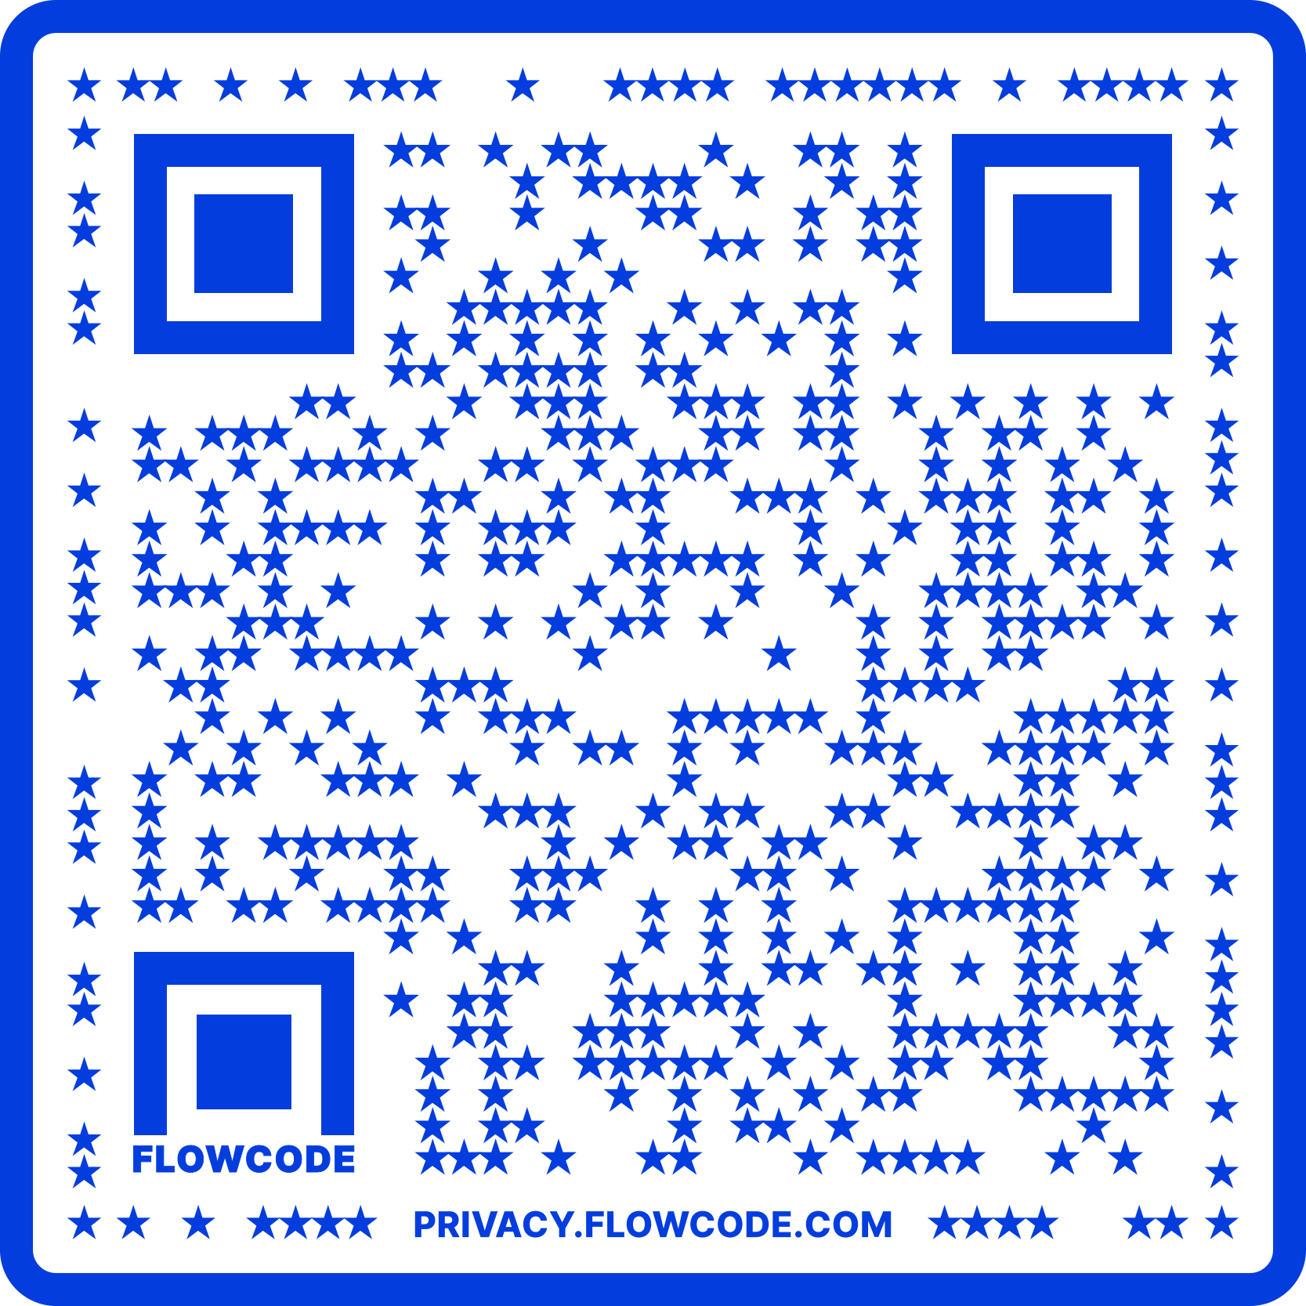
Contact Information
TARGET Center Website
https://www.usda.gov/target-center
TARGET Center Email
target-center@usda.gov
TARGET Center Phone Number
(202) 720-2600

Slide 21

Current and Upcoming Meetings
OCTOBER
MONDAY WEDNESDAY
THURSDAY
TUESDAY
10/30/2023
11:00 AM – 12:00 PM Emotional Intelligence (Part 2 of 2)
Carolyn Owens,
MCC, SPHR
1:00 pm- 2:00 pm
Bridging Gaps: Generations and Disabilities
Mayor Neil McDevitt
10/31/2023
11:00 AM – 12:00 PM
Identifying Obstacles to Neurodiversity and Inclusion
Dr. Theresa Haskins
Haskins Consulting
1:00PM – 2:00 PM
Overcoming Barriers to Neurodiversity and Inclusion
Dr. Theresa Haskins
Haskins Consulting
11:00 AM – 12:00 PM
Navigating Temporary Disabilities: Resilience and Coping Strategies (Part 2 of 2)
Dr. Theresa Haskins
Haskins Consulting
10/31/2023
11:00 AM – 12:00 PM
Postural Ergonomics in
the Workplace (Part 2 of 2)
Dr. Krista Burns
American Posture Institute
1:00 PM – 2:00 PM
Working Group: MS Teams Is Accessible for All
Michelle Sherbondy Education Program Manager
11/1/2023
11/2/2023
10/19/2023
10/19/2023

