Slide 1



Lessons from
Unpredictable Journeys:
Insights from Temporary and Situational Disabilities
Dr. Theresa Haskins | Presentation for the USDA TARGET Center

Slide 2

Advancing Access & Equity

Slide 3

About the Session
Understanding of temporary and situational disabilities
Recognize challenges faced by temporary disabled workers
Acquire strategies to support and accommodate colleagues with situational and temporary disabilities.
This Photo by Unknown Author is licensed under CC BY-NC-ND
Notes:
Today we are going to talk about the importance of Mental Health and overall well-being in the workplace. In the first of many neurodiversity session to coimme, we want to address the most common mental health issues in our workplace – and help you recognize and develop strategies to better support your colleagues.

Slide 4
Session Disclaimer
This presentation is for education and informational purposes only and should not be considered medical advice or mental health services.
If you or someone you know needs assistance or is facing a mental health emergency, please seek guidance from an appropriate healthcare provider.
Any actions taken based on the information presented are at your own risk.
@ Theresa Haskins, LLC 2023
Notes:
As we begin – I want to remind everyone that this presentation…

Slide 5
What are Situational Disabilities
Accidents
Environment
Illness
Surgery

Slide 6
Occupational Disabilities
Physical Disabilities
Chronic Health Conditions
Mental Health Disorders
Sensory Disabilities
Neurological Conditions
Notes:
Physical Disabilities: Conditions that affect mobility or physical functioning, such as paralysis, limb loss, or mobility disabilities.
Chronic Health Conditions: Conditions like diabetes, asthma, or epilepsy that may require ongoing management and accommodation.
Mental Health Disorders: Conditions such as depression, anxiety, bipolar disorder, or post-traumatic stress disorder (PTSD) that can affect cognitive and emotional functioning at work.
Sensory Disabilities: Hearing loss or visual disabilities that can impact communication and job performance.
Neurological Conditions: Conditions like multiple sclerosis or Parkinson's disease that can affect coordination and cognitive function.

Slide 7
Temporary vs. Permanent Disability
Temporary Disability
Injuries or medical conditions that affect an individual's ability to work or perform certain activities for a limited period.
Permanent/Long-Term Disability
Long-lasting or permanent disabilities that affect an individual's ability to work or perform certain activities for the rest of their life.
These disabilities often have a defined recovery period, and the individual is expected to regain their functional capacity over time.
These disabilities are not expected to improve with time.
Notes:
Temporary Disability refers to illnesses or injuries that temporarily prevent people from partaking in everyday things like walking, using a computer, or carrying groceries without help.
Permanent/Long-Term Disability refers to conditions that may permanently disabilities normal activities like seeking employment. They can be hereditary (e.g., disease-related) or caused by accidental circumstances like a car crash.

Slide 8
Impact of Temporary Disabilities
Physical Health and Well-Being
Pain and Discomfort
Limited Mobility
Rehabilitation and Medical Treatments
Notes:
Pain and Discomfort: Depending on the nature of the disability, employees may experience pain and discomfort, which can affect their ability to perform daily tasks and work-related activities.
Limited Mobility: Mobility limitations may require employees to use assistive devices (e.g., crutches or wheelchairs) or modify their daily routines.
Rehabilitation and Medical Treatments: Employees with temporary disabilities often require rehabilitation, physical therapy, or medical treatments, which can be time-consuming and physically demanding.

Slide 9
Impact of Temporary Disabilities
Emotional and Psychological Impact
Emotional Distress
Loss of Independence
Social Isolation
Notes:
Pain and Discomfort: Depending on the nature of the disability, employees may experience pain and discomfort, which can affect their ability to perform daily tasks and work-related activities.
Limited Mobility: Mobility limitations may require employees to use assistive devices (e.g., crutches or wheelchairs) or modify their daily routines.
Rehabilitation and Medical Treatments: Employees with temporary disabilities often require rehabilitation, physical therapy, or medical treatments, which can be time-consuming and physically demanding.

Slide 10
Work-Related Impacts
Work Absence
may need to take time off work to recover or attend medical appointments.
Reduced Productivity
may experience reduced productivity due to physical limitations or fatigue.
Job Modifications
job tasks may need to be modified to accommodate the employee's temporary disability.
Financial Strain
loss of income during disability leave and medical expenses can lead to financial strain.
Notes:
Work Absence: Employees with temporary disabilities may need to take time off work to recover, which can result in a loss of income and impact their career progression.
Reduced Productivity: While at work, employees with temporary disabilities may experience reduced productivity due to physical limitations or fatigue.
Job Modifications: In some cases, job tasks may need to be modified to accommodate the employee's temporary disability.
Financial Strain: Medical expenses, coupled with potential loss of income during disability leave, can lead to financial strain for employees.

Slide 11
Appreciating
Situational Disabilities
Scenario 1
Situational Disability
You accidentally break your arm on an ice-skating adventure.
Workplace Issue
You use a mouse and trackpad to operate your computer at work.
Typical Advice
“Just use your other hand”
Appreciate the Problem
Use your non-dominant hand to open a new tab in your browser and type an email.
Assistive Technology Solutions
Keyboard navigation assistance such as tab, space, and arrow keys; speech-directed navigation
Notes:
Ice skating can be challenging. Even the pros fall, break arms, and wear unsightly casts, making it difficult or impossible to use their fingers until everything heals.
, you’ll quickly learn that the mouse and trackpad require fine motor skills you no longer have.
Scenario 1: You accidentally break your arm on an ice-skating adventure.
Work Problem: You have a job where you currently use a mouse and trackpad to operate your computer.
Typical advice: “just use your other hand”.
One way to relate: Use your non-dominant hand to open a new tab in your browser and type an email with one.
Assistive Technology Solution: Keyboard navigation such as tab, space, and arrow keys enables computer users to access content when a touchpad, touch screen, or mouse isn’t available.

Slide 12
Appreciating
Situational Disabilities
Scenario 2
Situational Disability
You end up with a double ear-infection that leads to significant swelling and hearing loss.
Workplace Issue
You are the notetaker at conference meetings where there is distance between speakers and people talk over each other.
Typical Advice
“Follow-up with others after the meeting”
“Try to pay attention”.
Appreciate the Problem
Take notes with a recording - missing information. Wait 1-hour before you can ask a clarifying question.
Assistive Technology Solutions
Subtitles, captions, and transcripts help support audio-based interactions for the deaf and hard of hearing individuals.
Notes:
Ice skating can be challenging. Even the pros fall, break arms, and wear unsightly casts, making it difficult or impossible to use their fingers until everything heals.
, you’ll quickly learn that the mouse and trackpad require fine motor skills you no longer have.
Scenario 1: You accidentally break your arm on an ice-skating adventure.
Work Problem: You have a job where you currently use a mouse and trackpad to operate your computer.
Typical advice: “just use your other hand”.
One way to relate: Use your non-dominant hand to open a new tab in your browser and type an email with one.
Assistive Technology Solution: Keyboard navigation such as tab, space, and arrow keys enables computer users to access content when a touchpad, touch screen, or mouse isn’t available.

Slide 13
Appreciating
Situational Disabilities
Scenario 3
Scenario 3
Your doctor dilates your eyes during a routine exam, and you’re highly light-sensitive, and your vision is blurry.
Workplace Issue
You drive a delivery truck, and you need to be able to read the computer maps and navigate roadways safely.
Typical Advice
”Just wear sunglasses”
“Squint – it will pass in a few hours”.
Appreciate the Problem
There is not a way to replicate this issue safely – but imagine it being painful to open your eyes and look at lit-up objects.
Assistive Technology and Alternative Solutions
Contrast and display brightness options make a device readable. Another should operate the vehicle.
Notes:
Ice skating can be challenging. Even the pros fall, break arms, and wear unsightly casts, making it difficult or impossible to use their fingers until everything heals.
, you’ll quickly learn that the mouse and trackpad require fine motor skills you no longer have.
Scenario 1: You accidentally break your arm on an ice-skating adventure.
Work Problem: You have a job where you currently use a mouse and trackpad to operate your computer.
Typical advice: “just use your other hand”.
One way to relate: Use your non-dominant hand to open a new tab in your browser and type an email with one.
Assistive Technology Solution: Keyboard navigation such as tab, space, and arrow keys enables computer users to access content when a touchpad, touch screen, or mouse isn’t available.

Slide 14

Better Accessibility
Equals
Better Business

Slide 15

Employer Supports
Provide Accommodations and Resources
Have Clear Policies and Procedures:
Flexible Work Arrangements:
Communication:
Return-to-Work Plan
Monitor Progress
Lead by Example
Notes:
Provide Accommodations:.
Have Clear Policies and Procedures:
Ensure that your workplace has clear policies and procedures in place for requesting accommodations and addressing temporary disabilities.
Training and Education:
Provide training and education to employees on disability awareness, so they understand how to interact with colleagues who have temporary disabilities respectfully.
Flexible Work Arrangements:
Consider offering flexible work arrangements, such as remote work or modified hours, to accommodate your employee's recovery.
Communication:
Maintain open and supportive communication with the employee throughout their recovery process. Ask how they are doing and what they need to be successful at work.
Return-to-Work Plan:
Develop a return-to-work plan in collaboration with the employee. Discuss any necessary job modifications, expectations, and timelines.
Provide Resources:
Offer information about resources available to assist employees during their recovery, such as employee assistance programs (EAPs) or support groups.
Anti-Discrimination Policies:
Ensure that your workplace has policies in place to prevent discrimination based on disability and that employees are aware of these policies.
Monitor Progress:
Keep track of your employee's progress and well-being during their recovery period. Check in regularly to see if any adjustments are needed.
Lead by Example:
Demonstrate a commitment to inclusivity and support for employees with disabilities, setting a positive tone for the entire workplace.

Slide 16

How We Can Help Our Future Selves
Notes:
If you don’t have a disability now, that doesn’t mean you can’t be impacted in the future. Eventually, most all of us will have have diminished eyesight, hearing, mobility, cognitive abilities, memory, etc. But it’s not just age that shapes a certain or uncertain future. For instance, you may unexpectedly face a situational disability on any given day. And now you know how assistive technology can help you when this happens.
From a business and personal standpoint, supporting digital accessibility can simultaneously support altruism and self-preservation. As such, future codified standards may help with cognitive disabilities. For example, end users could theoretically click a “simplify” button showing only the most critical content on a webpage. That’s accessible technology we can all get behind for the future good of everyone.

Slide 17

Help Others Today
Show Empathy and Understanding
Respect Privacy
Offer Assistance
Flexible Work Environment:
Communication
Respect Boundaries
Inclusive Social Activities
This Photo by Unknown Author is licensed under CC BY
Notes:
Show Empathy and Understanding:
Be empathetic and understanding about your colleague's situation. Show concern and ask how you can assist without being intrusive.
Respect Privacy:
Respect your colleague's privacy. Don't pry into their medical condition unless they choose to share it with you.
Offer Assistance:
Offer assistance with tasks or projects that may be difficult for your colleague due to their disability. Be specific in your offers to help, and ensure they feel comfortable accepting or declining assistance.
Flexible Work Environment:
Be open to flexible work arrangements, such as adjusting schedules or workload, to accommodate your colleague's needs during their recovery.
Communication:
Maintain open communication with your colleague. Ask them how they are feeling and if they have any special requirements or preferences regarding work tasks.
Respect Boundaries:
Respect your colleague's boundaries. If they need some space or time alone, give them the opportunity to recharge.
Inclusive Social Activities:
If your workplace has social events, consider inclusive activities that can be enjoyed by all, even those with disabilities.

Slide 18


Continue Learning with
Dr. Theresa Haskins
USDA TARGET Center
NDEAM 2023 Upcoming Sessions
See e-mailed schedule for details.
Find resources, podcasts, newsletters and more at
www.theresahaskins.com
@ Theresa Haskins, LLC 2023

Slide 19
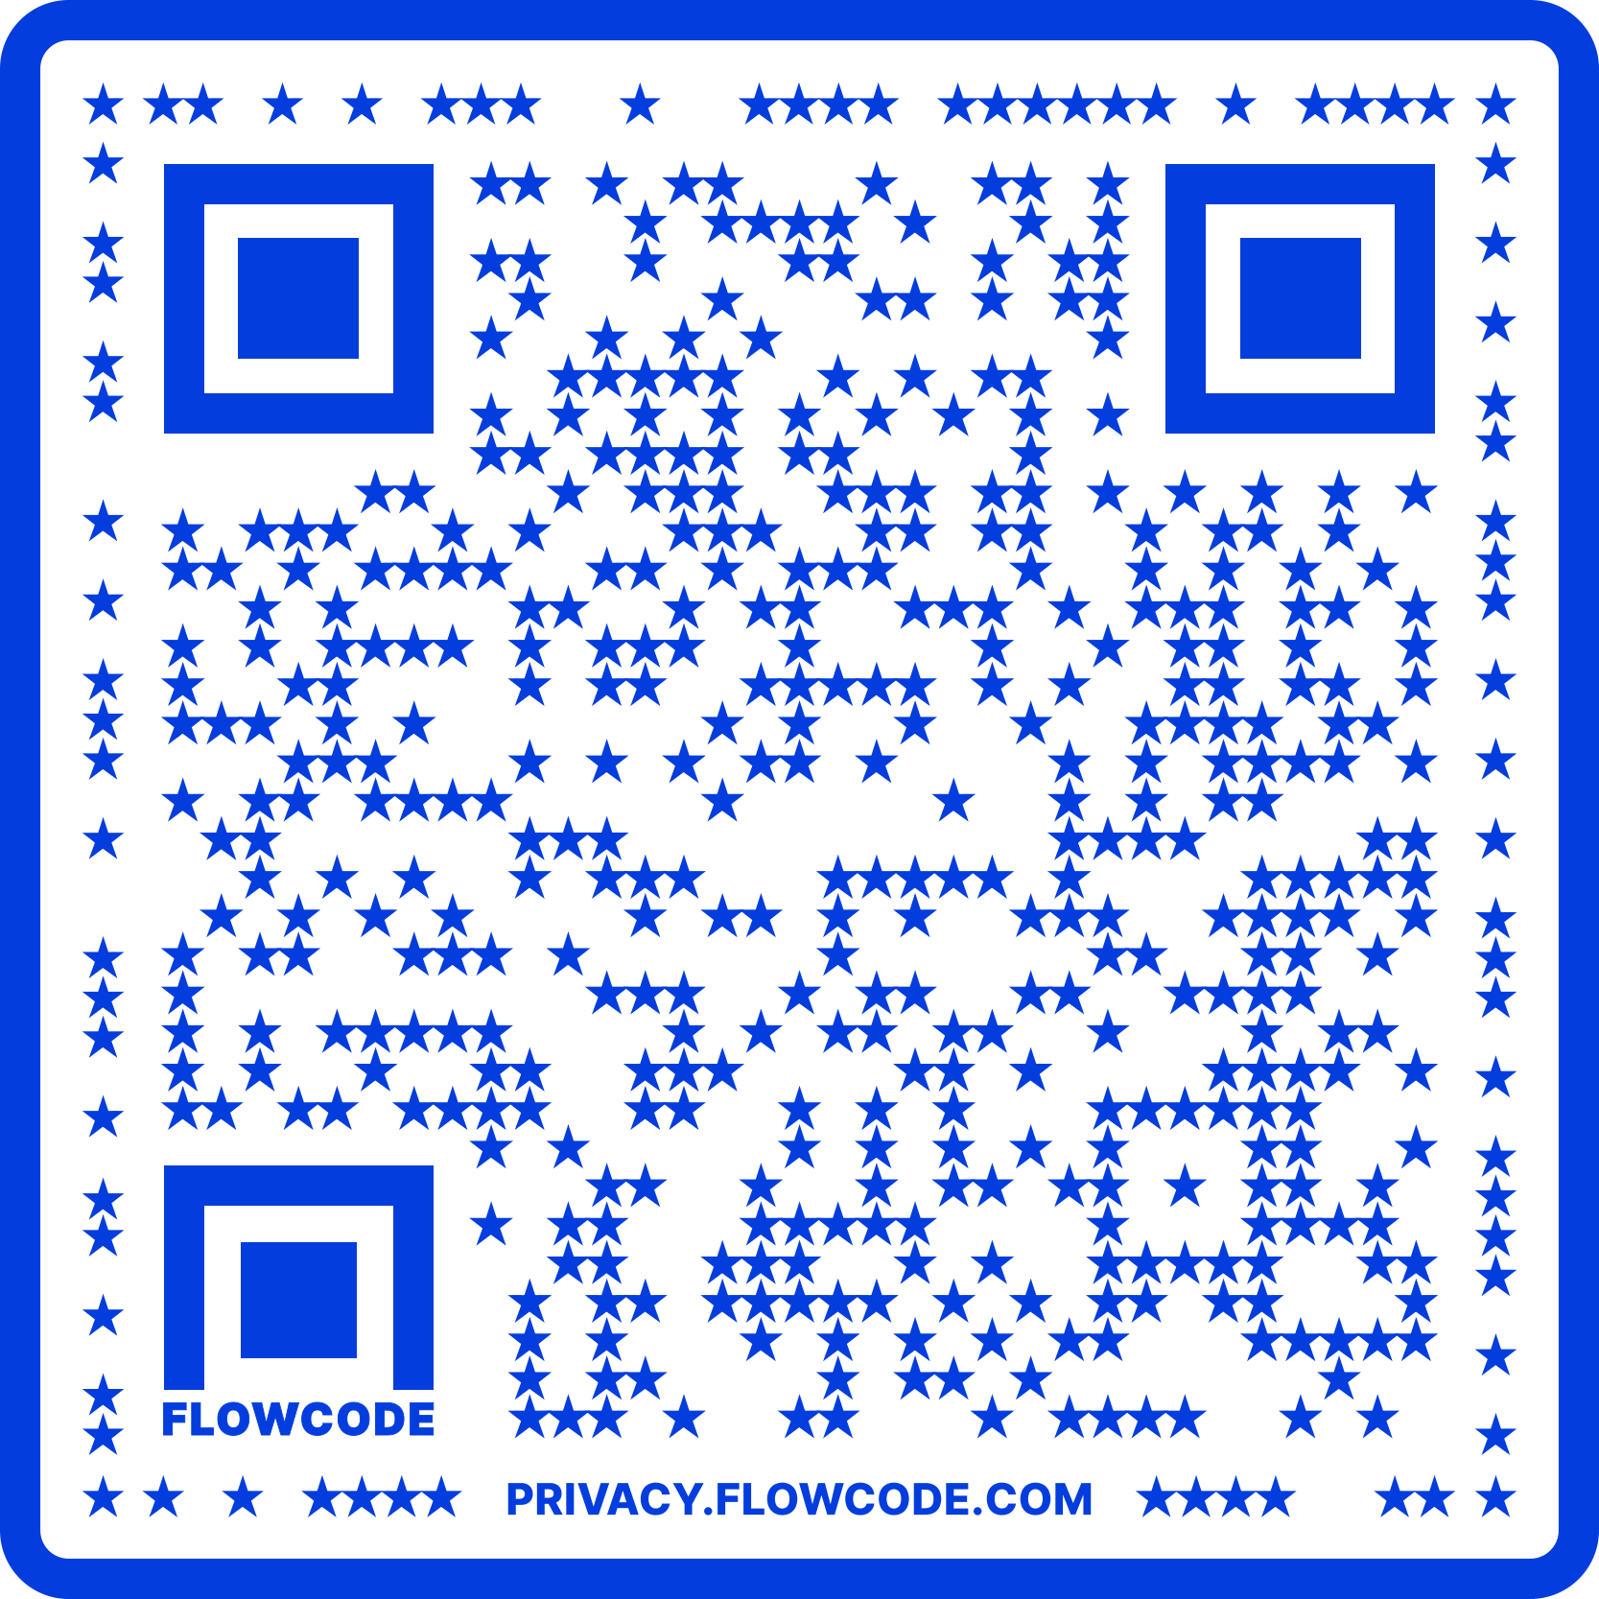
Contact Information
TARGET Center Website
https://www.usda.gov/target-center
TARGET Center Email
target-center@usda.gov
TARGET Center Phone Number
(202) 720-2600

Slide 20

Current and Upcoming Meetings
OCTOBER
MONDAY WEDNESDAY
THURSDAY
TUESDAY
10/2/2023
10/3/223
11:00 AM – 12:00 PM
Rethinking Disability and What It Means to Be Disabled
Dr. Theresa Haskins Haskins Consulting
1:00 PM – 2:00 PM
(Neuro) Diversity Includes You
Dr. Theresa Haskins Haskins Consulting
10/4/2023
11:00 AM – 12:00 PM
Nurturing Workplace Well-Being and Supporting Mental Health (Part 1 of 2)
Dr. Theresa Haskins Haskins Consulting
1:00 PM – 2:00 PM
PTSD Is More Common Than You Think
Alla Weinberg
Spoke & Wheel
10/5/2023
10:00 AM – 11:00 AM
Empowering Lives Through Assistive Technology Solutions
Donny Osborn
Boundless AT
12:00 PM – 1:00 PM
Department of Defense Computer/Electronic Accommodations Program (CAP)
Erin Sanderson
CAP
10/3/2023
10:00 AM – 11:00 AM
USDA TARGET Center Assistive Technology Program
Rashida Owens
Assistive Technology Program Manager
12:00 PM – 1:00 PM
USDA TARGET Center
Ergonomics Program
Stephanie Bradley
Ergonomics Program Manager
HOLIDAY
10/10/2023
11:00 AM – 12:00 PM
Autism Inclusion and the Pathway to Neurodiversity
Dr. Theresa Haskins Haskins Consulting
1:00 PM – 2:00 PM
Lessons from Unpredictable Journeys: Insights from Temporary and Situational Disabilities (Part 1 of 2)
Dr. Theresa Haskins Haskins Consulting
10/11/2023
11:00 AM – 12:00 PM
Creating a
Trauma-Informed Workplace
Alla Weinberg
Spoke & Wheel
1:00 PM – 2:00 PM
Nurturing Workplace Well-Being and Supporting Mental Health (Part 2 of 2)
Dr. Theresa Haskins Haskins Consulting
10/12/2023
10:00 AM - 12:00 PM
USDA TARGET Center
Ergonomics Demonstrations
(Virtual/Onsite)
Stephanie Bradley
Ergonomics Program Manager
Howard Flowers
BodyBilt
Stephen DiCarlo
Humanscale
1:00 PM - 3:00 PM
USDA TARGET Center Assistive Technology Demonstrations
(Virtual/Onsite)
Rashida Owens
Assistive Technology Program Manager

