Slide 1

Creating a Trauma-Informed Workplace
National Disability Employment Awareness Month Symposium | 2023 USDA Target Center

Slide 2

Advancing Access & Equity

Slide 3
What?

Slide 4

70% of the general world population reported at least one traumatic event in their life, and 30.5% experienced four or more traumatic events.
- World Mental Health Survey Consortium

Slide 5

Trauma is not new in our organizations, and it’s not going away
S&W

Slide 6
We have been experiencing: Collective Trauma
S&W

Slide 7
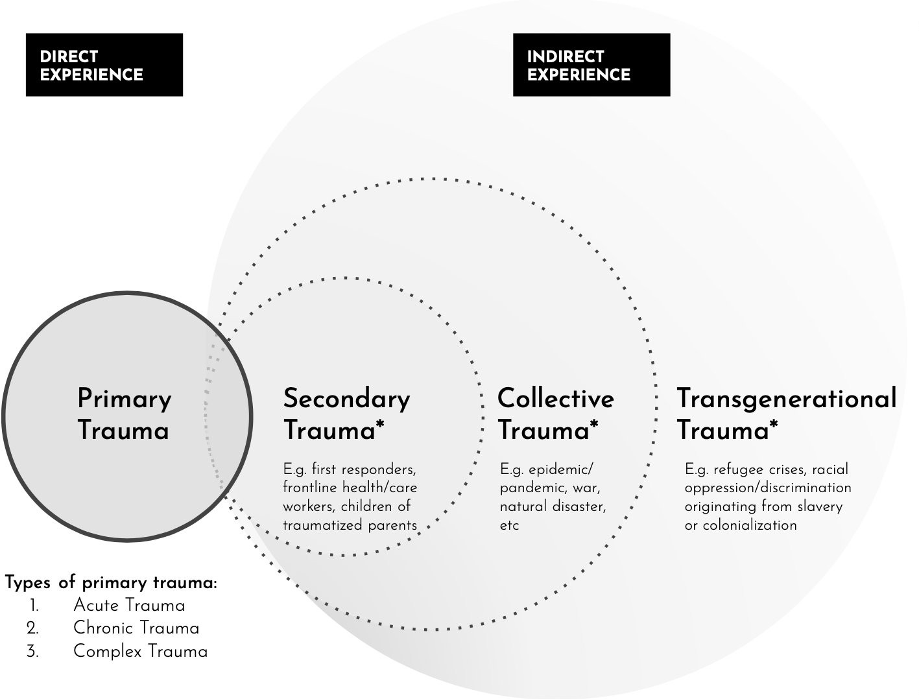
No Slide Title
S&W
Diagram by Melanie Kahl

Slide 8
6 in 10 men will experience at least one trauma
5 in 10 women will experience at least one trauma
6% of the population will develop PTSD at some point in their lives

Slide 9
Common causes of workplace trauma
S&W
Emotional
Harassment, discrimination, verbal abuse, or aggressions
Bullying
Job insecurity or being laid off Toxic workplace culture
Physical
Violence, physical or sexual abuse
Accidents or injuries at work
Serious injury or death of a colleague
Natural disaster on the job

Slide 10
Type into Q&A
S&W
What is your definition of trauma?

Slide 11
No Slide Title #2
“Anything that is too much, too soon, too fast or for too long without being attended to by something reparative or healing.”
- Resmaa Menakem

Slide 12
“Trauma is not what happened to you. Trauma is the internal wound you suffer as a result of what happened to you.”
- Dr. Gabor Mate

Slide 13

Trauma is stored in the body
S&W

Slide 14
Feeling “on edge”
S&W

Slide 15
Trouble sleeping
S&W

Slide 16
Memory issues
S&W

Slide 17
Anxiety-Depression
S&W

Slide 18
Rage
S&W

Slide 19
Low “window of tolerance”
S&W

Slide 20
Chronic Pain
S&W

Slide 21
So What?

Slide 22
Signs of trauma in the workplace
S&W
Absenteeism
Limited ability to build work relationships
Burnout Panic attacks
Feeling undervalued or lost
Unexplained bursts of anger or aggression
Withdrawal or reduced productivity Inability to focus or complete tasks

Slide 23

Type into Q&A
What are some difficult behaviors you have witnessed from people at work?
S&W

Slide 24
From
S&W
What’s wrong with you?
To
What happened to you?

Slide 25
Now What?

Slide 26
Trauma-informed workplaces recognize that trauma is common and work to create environments that are protective, reparative, and healing.

Slide 27

Creating a trauma-informed workplace.
S&W
Phase 1 Phase 2 Phase 3
Phase 4
https://www.traumainformedcare.chcs.org/wp-content/uploads/MO-Model-Working-Document-february-2015.pdf

Slide 28

Six principles for trauma-informed workplaces
S&W
https://www.cdc.gov/cpr/infographics/6_principles_trauma_info.htm

Slide 29
What can I do right now?
Three Cs: Context, Choice, Connection
S&W

Slide 30
Context
Communicate the why, what, and how
S&W

Slide 31
Choice
Discuss choices and options
S&W

Slide 32
Connection
See, hear, and value people
S&W

Slide 33
Type into Q&A.
S&W
What behavior do you commit to start practicing at work?

Slide 34

Thank You!
Alla is the CEO of SPOKE & WHEEL, a culture change and leadership development company that builds safe and trauma-informed cultures.
She is a culture designer & author of A Culture of Safety: Building an Environment for People to Think, Collaborate, and Innovate.
alla@spokeandwheel.co

Slide 35

Current and Upcoming Meetings
OCTOBER
MONDAY WEDNESDAY
THURSDAY
TUESDAY
10/2/2023
10₁/₀3//₃2/0₂23
11:00 AM – 12:00 PM
Rethinking Disability and What It Means to Be Disabled
Dr. Theresa Haskins Haskins Consulting
10/4/2023
11:00 AM – 12:00 PM
Nurturing Workplace Well-Being and Supporting Mental Health (Part 1 of 2)
Dr. Theresa Haskins Haskins Consulting
1:00 PM – 2:00 PM
PTSD Is More Common Than You Think
Alla Weinberg Spoke & Wheel
10/5/2023
10:00 AM – 11:00 AM
Empowering Lives Through Assistive Technology
Solutions Donny Osborn Boundless AT
12:00 PM – 1:00 PM
Department of Defense Computer/Electronic Accommodations Program (CAP)
Erin Sanderson CAP
10:00 AM – 11:00 AM
USDA TARGET Center Assistive Technology Program
Rashida Owens Assistive Technology Program Manager
12:00 PM – 1:00 PM
USDA TARGET Center Ergonomics Program
Stephanie Bradley Ergonomics Program Manager
1:00 PM – 2:00 PM
(Neuro) Diversity
Includes You
Dr. Theresa Haskins Haskins Consulting
HOLIDAY
10/10/2023
11:00 AM – 12:00 PM
Autism Inclusion and the Pathway to Neurodiversity
Dr. Theresa Haskins Haskins Consulting
10/11/2023
11:00 AM – 12:00 PM
Creating a Trauma-Informed Workplace
Alla Weinberg Spoke & Wheel
1:00 PM – 2:00 PM
Nurturing Workplace Well-Being and
Supporting Mental Health (Part 2 of 2)
Dr. Theresa Haskins Haskins Consulting
10/12/2023
10:00 AM - 12:00 PM
USDA TARGET Center Ergonomics Demonstrations (Virtual/Onsite)
Stephanie Bradley
Ergonomics Program Manager
Howard Flowers BodyBilt Stephen DiCarlo Humanscale
1:00 PM – 2:00 PM
Lessons from Unpredictable Journeys: Insights from Temporary and Situational Disabilities (Part 1 of 2) Dr. Theresa Haskins Haskins Consulting
1:00 PM - 3:00 PM
USDA TARGET Center Assistive
Technology Demonstrations (Virtual/Onsite)
Rashida Owens
Assistive Technology Program Manager

Slide 36

Contact Information
TARGET Center Website https://www.usda.gov/target-center
TARGET Center Email target-center@usda.gov
TARGET Center Phone Number
(202) 720-2600

