Slide 1


Slide 2
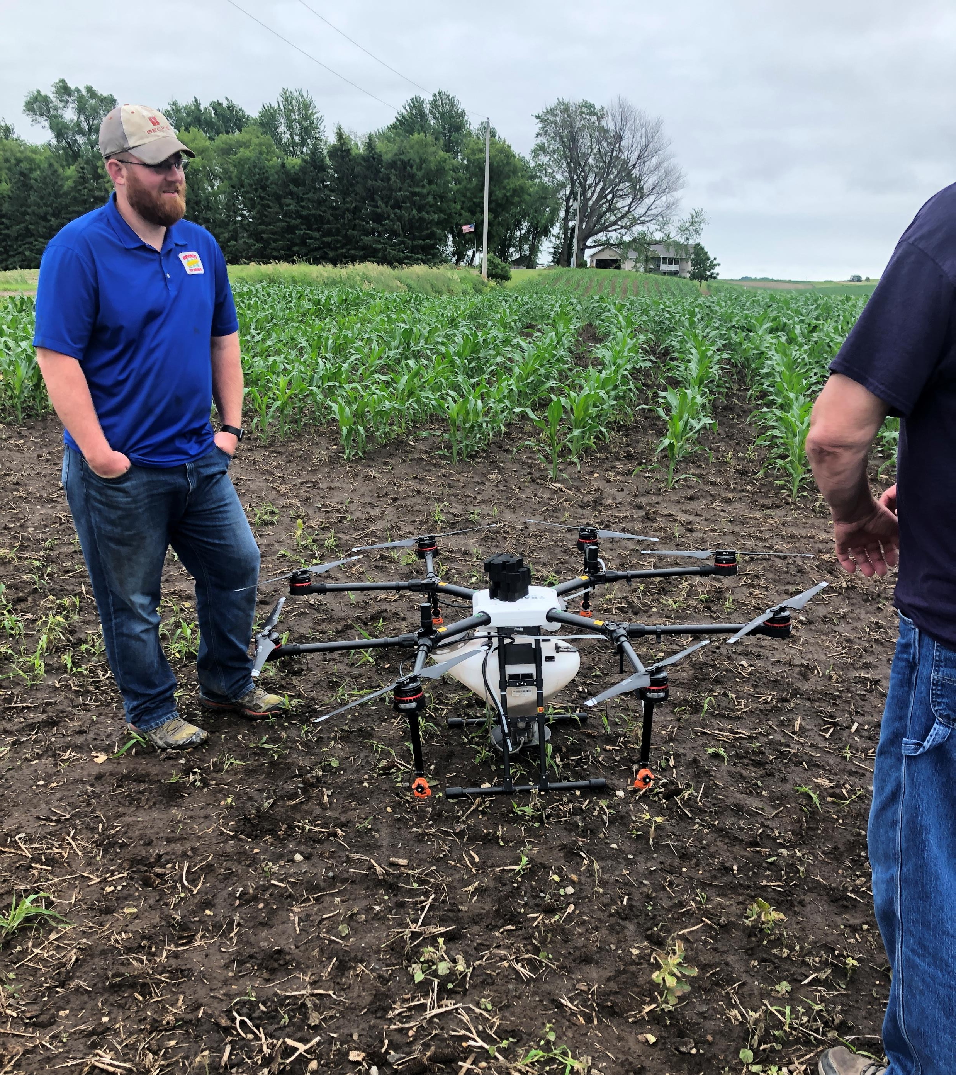
Mission
Increase farm profitability.

Slide 3
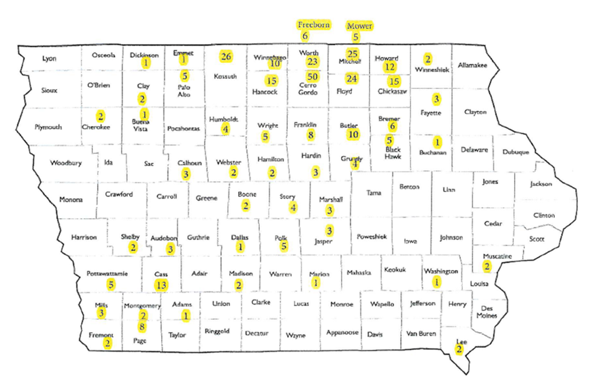
About
  Founded in 1998
  350-member farmer cooperative
  Developed Countryside Angel Network with ISU and EDA
  Implementing Farmer Trial Network with AgLaunch
  20 Active Investments
  6 Exits, 1 IPO
  More than $500 million New Market Tax Credit financing in Rural Locations (RDP)

Slide 4
Technology is Creating New Opportunities in Agriculture
Inputs
  Biologicals
  Genetics
  Fertilizer
Management
  Finance
  Marketing
  Labor
Robotics
Artificial Intelligence
Logistics
Transparency
Aligned Incentives
New Markets
  Crops
  Uses
  Regenerative Ag

Slide 5
What does a VC look for?
Team
Problem
Solution
Traction
Market Size
Competitive Advantage
Impact

Slide 6
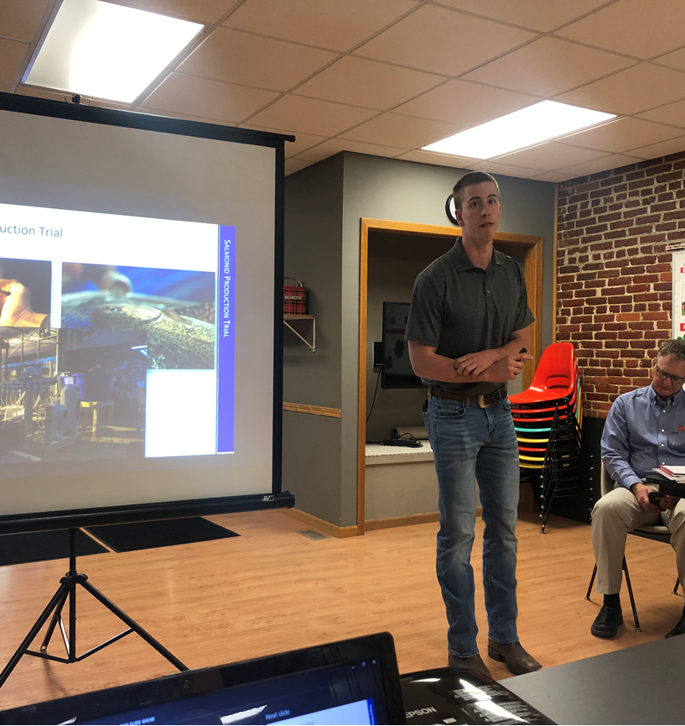
Rural Innovation Initiatives
Direct Investment
Countryside Angels
Farmer Network

Slide 7













Direct Investment
NEW MARKETS
Current Portfolio
RBIC Funds
FINANCE
IMPROVED PRODUCTION
FARM MANAGEMENT
ROBOTS & AUTONOMY

Slide 8
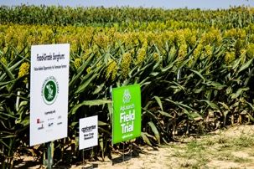
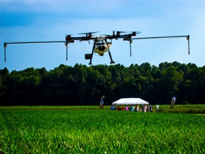
Model Farms
Farmer Network – Model Farms
MODEL FARM PROGRAM
Farmer Trials earn Equity in Startups
Create a group of Model Farms strategically located across the US that serve as the “hub” for the farmer network trial sites
Model Farms serve as:
  Convening locations for field days, workshops, and demonstrations
  Repository of information, data, and knowledge on how to get things done in creating new agricultural ventures
  Rural AgTech Incubators
Our incubator
is the field

Slide 9

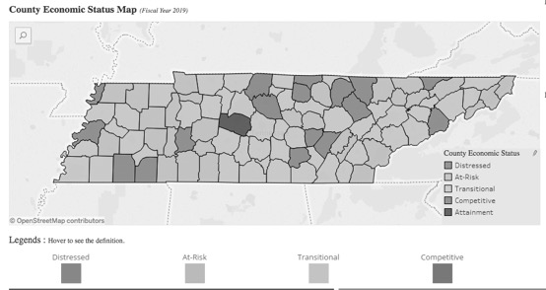
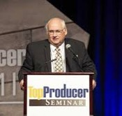
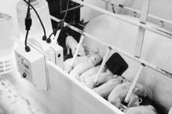
Model Farms
CASE STUDY
Tosh Farms
Iowa-based company
  Using artificial intelligence to eliminate sow and piglet deaths.
  Iowa Farm Bureau Entrepreneur of the Year (2018)
Conducting version 1.0 trial with Tosh Farms
  2019 Top Producer of the Year
  Redesigning key components (adhesive, size of sensor) for new trial in 2019
Trial cost share facilitated through TDA/AgLaunch.
Equity investment from Ag Ventures Alliance & Innova RBIC
Our incubator
is the field

Slide 10

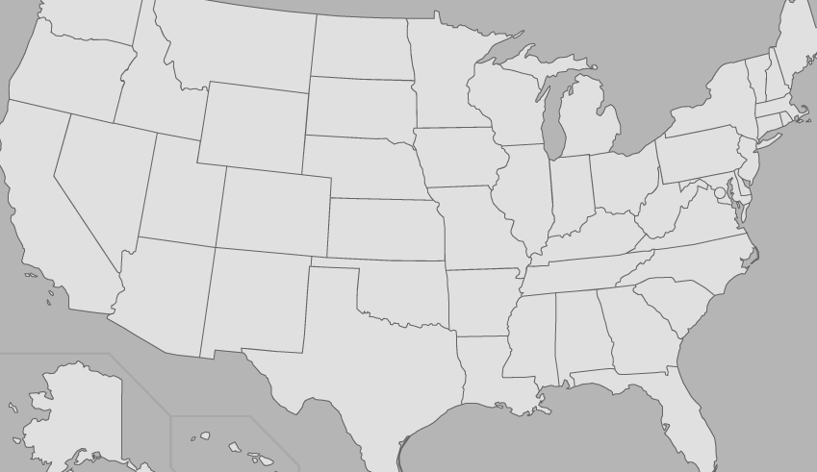


Rural Impact
??
??
??
Regional Innovation Cluster
Small Business Administration

Slide 11
Vision
Create a vibrant, rural economy with farmers at the center of innovation.

Slide 12
How can you participate?
Become a member of AgVa.
Join Countryside Angels.
Join Farmer Trial Network.
  Mentors
  Field Trials
www.agventuresalliance.com

