Slide 1


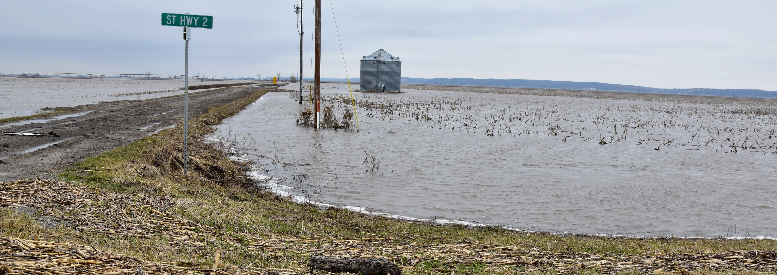
Managing Risk and Ensuring Sustainability
Preparing for Disaster and Drought Resiliency and Recovery
Moderator:
Richard Fordyce, Administrator, USDA Farm Service Agency

Slide 2
Managing Risk and Ensuring Sustainability
Preparing for Disaster and Drought Resiliency and Recovery
In 2019, there were 14 weather and climate disaster events across the United States each with losses exceeding $1 billion according to NOAA.
        There were:
          3 flooding events,
          8 severe storm events,
          2 tropical cyclone events, and
          1 wildfire event.

Slide 3
Managing Risk and Ensuring Sustainability
Preparing for Disaster and Drought Resiliency and Recovery
USDA Helps Farmers Recover
  We helped offset agricultural losses through more than $1 billion in funding from the 2018 Farm Bill and other legislation.
  The Wildfire and Hurricane Indemnity Program Plus (WHIP+), provides $3 billion to agricultural producers who suffered damages in 2018 and 2019.

Slide 4
Managing Risk and Ensuring Sustainability
Preparing for Disaster and Drought Resiliency and Recovery
Looking to the Future
  USDA will continue to help farmers recovery from these weather events.
  We know all agricultural producers are looking at a different future.
  To meet today’s agriculture needs and beyond, we need to understand the challenge of recent extreme weather.

Slide 5
Managing Risk and Ensuring Sustainability
Preparing for Disaster and Drought Resiliency and Recovery
Today is an opportunity for an open the discussion on
  the current state of agricultural production as it relates to extreme weather;
  the adoption of cost-effective solutions to manage farm programs; and
  the opportunities to partner with the private sector for solutions.

Slide 6
Managing Risk and Ensuring Sustainability
Preparing for Disaster and Drought Resiliency and Recovery
Adapting Agricultural Planning and Production to Prepare for Extreme Weather Uncertainties
  Mr. Stephen Nicholson, Rabo AgriFinance Senior Analyst
The Impact of Natural Disasters on Agricultural Economics
  Dr. Keith Coble, Mississippi State University Professor and Department Head
The Path Forward: Growing Resilience in Rural Communities
  Dr. Barb Glenn, National Association of State Departments of Agriculture Chief Executive Officer

