Slide 1
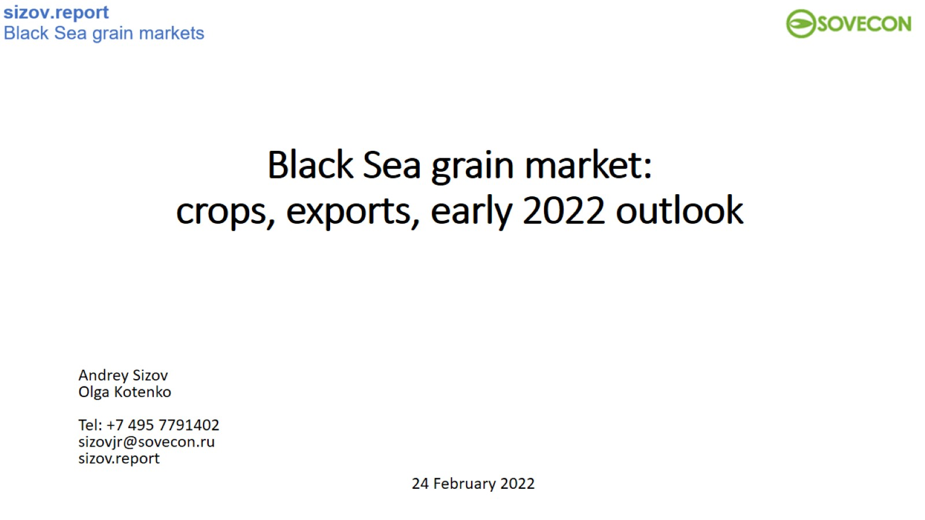
Black Sea grain market: crops, exports, early 2022 outlook

Slide 2
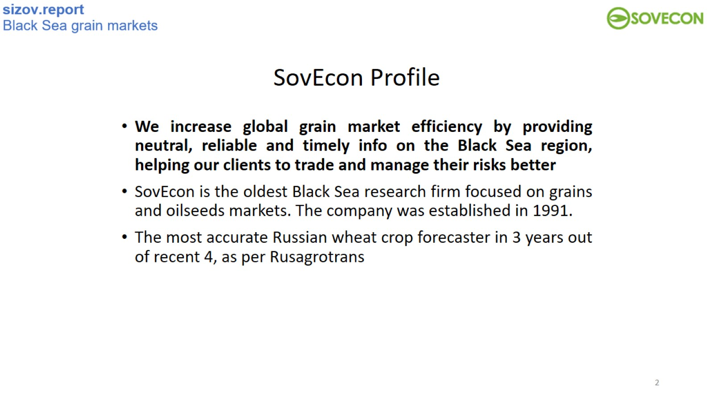

Slide 3
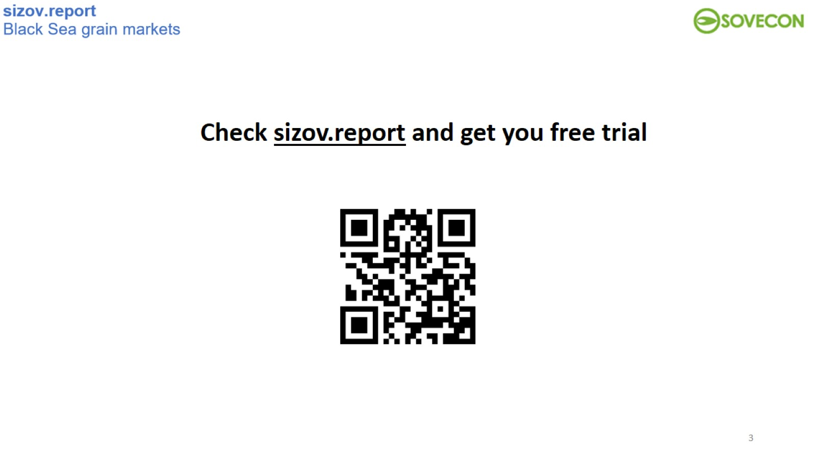

Slide 4
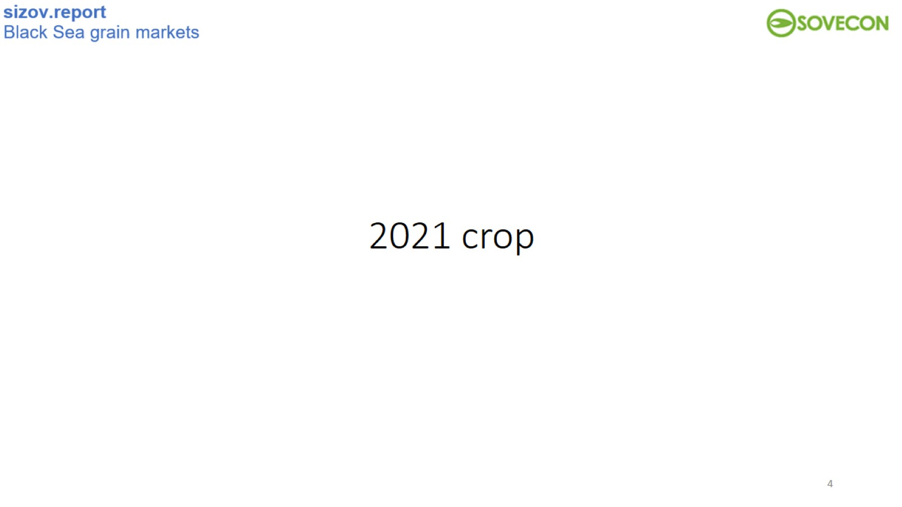
2021 crop

Slide 5
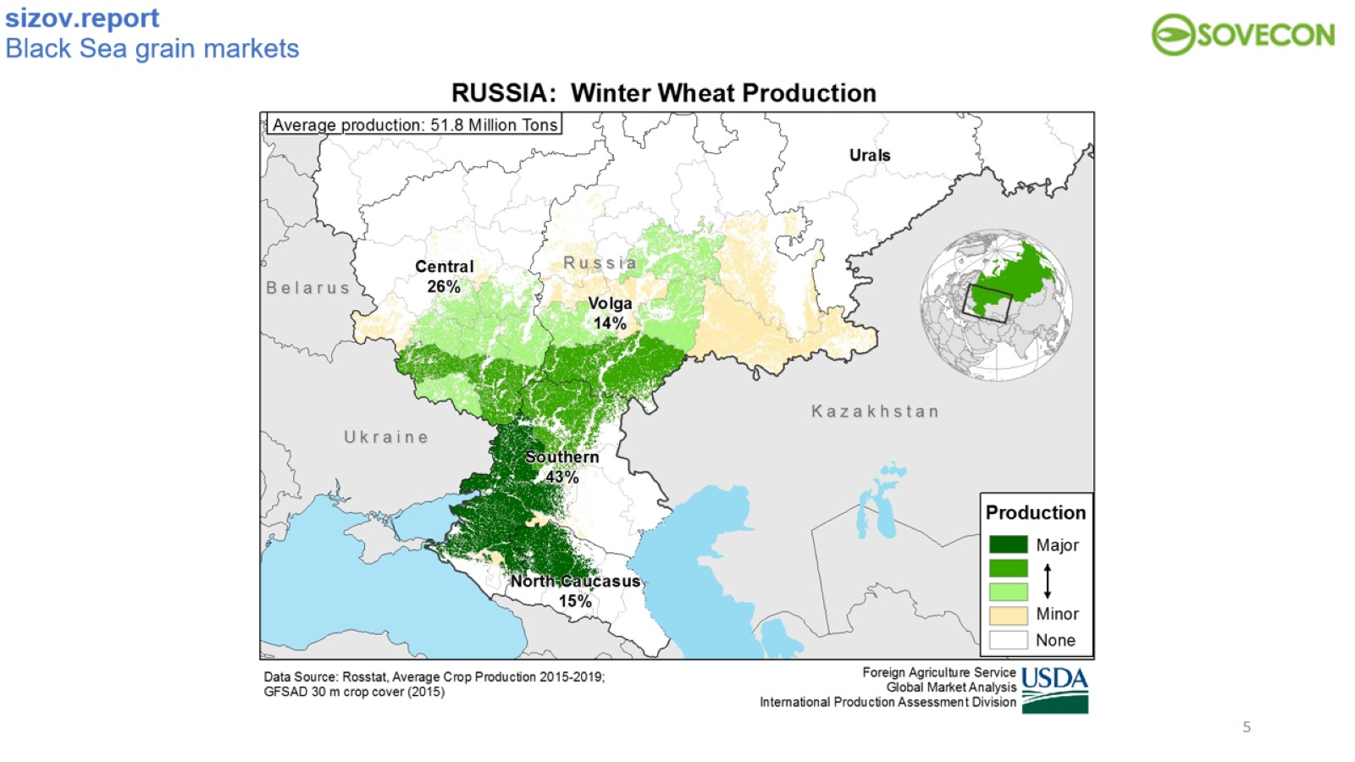

Slide 6
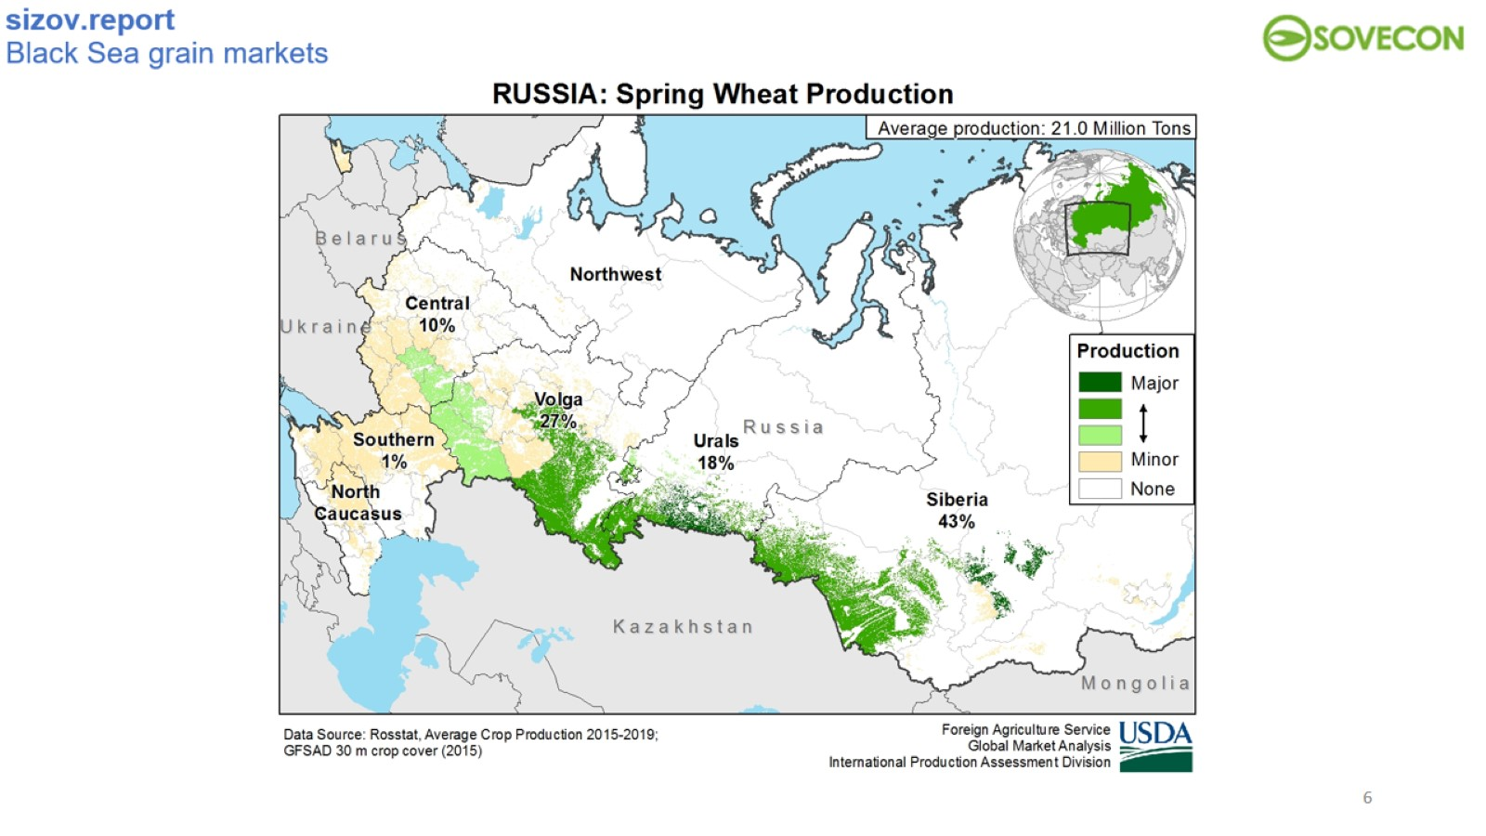

Slide 7
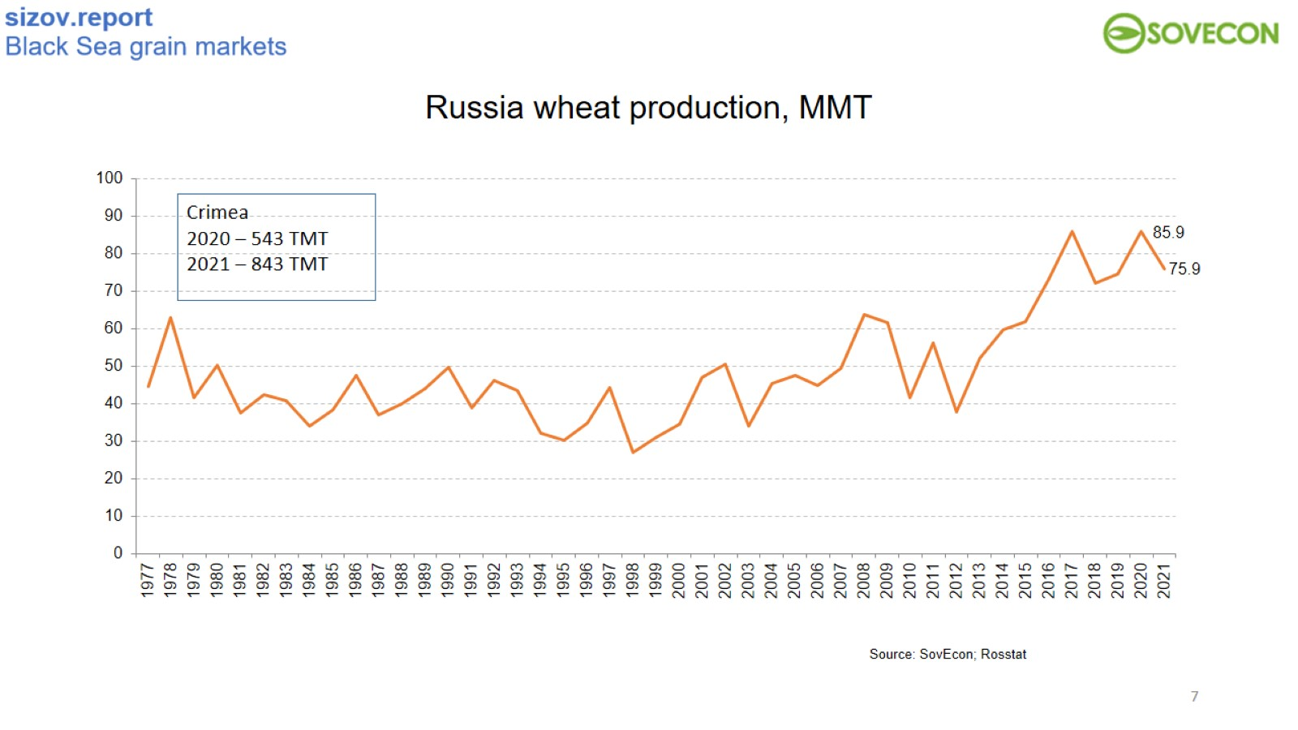
Russia wheat production, MMT

Slide 8
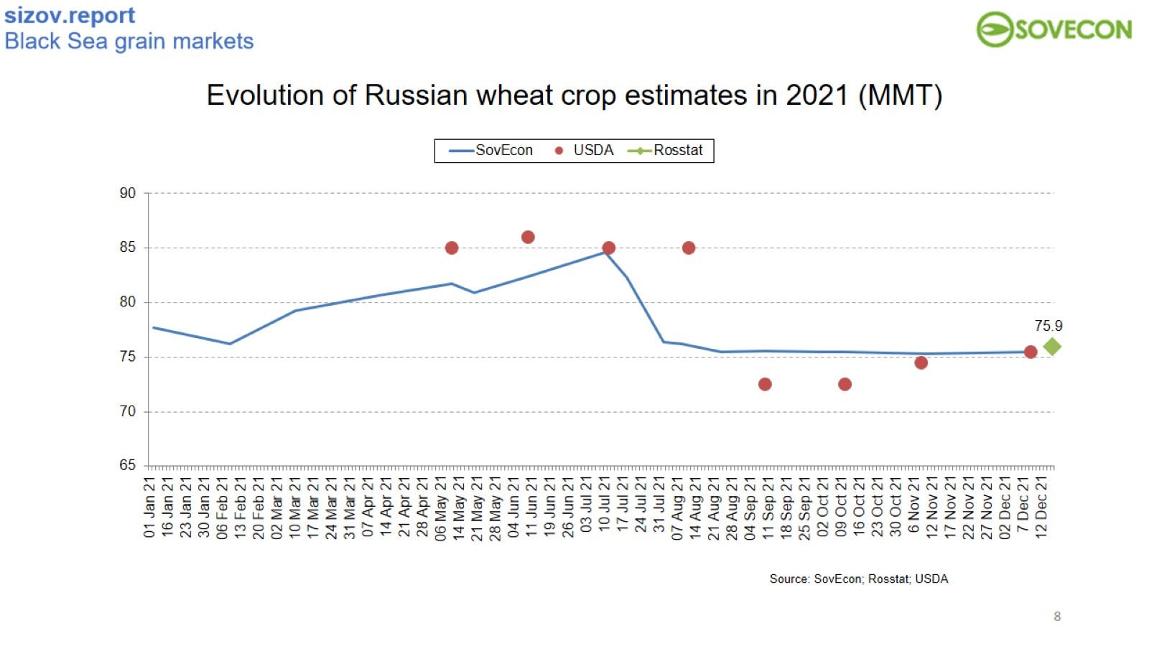
Evolution of Russian wheat crop estimates in 2021 (MMT)

Slide 9
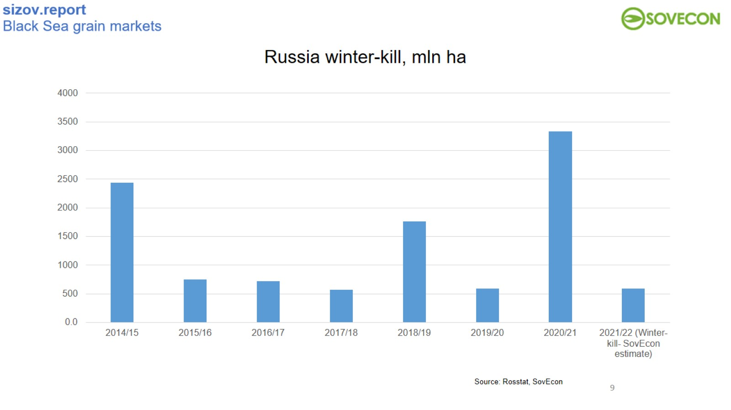

Slide 10
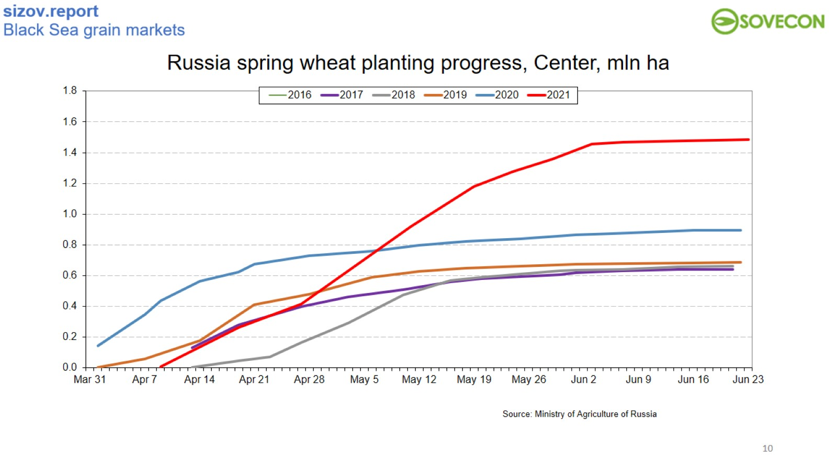
Russia spring wheat planting progress, Center, mln ha

Slide 11
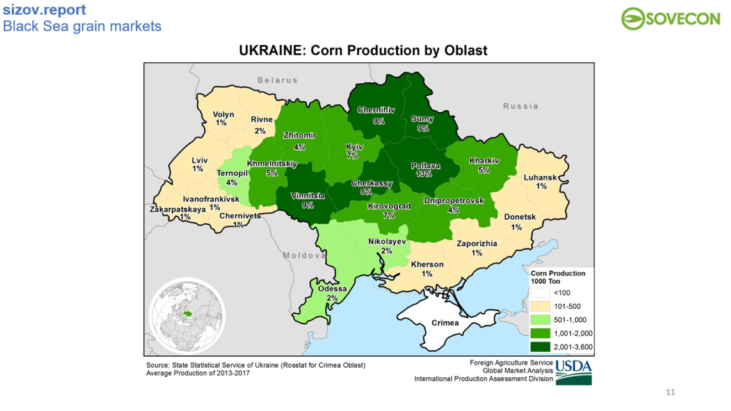

Slide 12
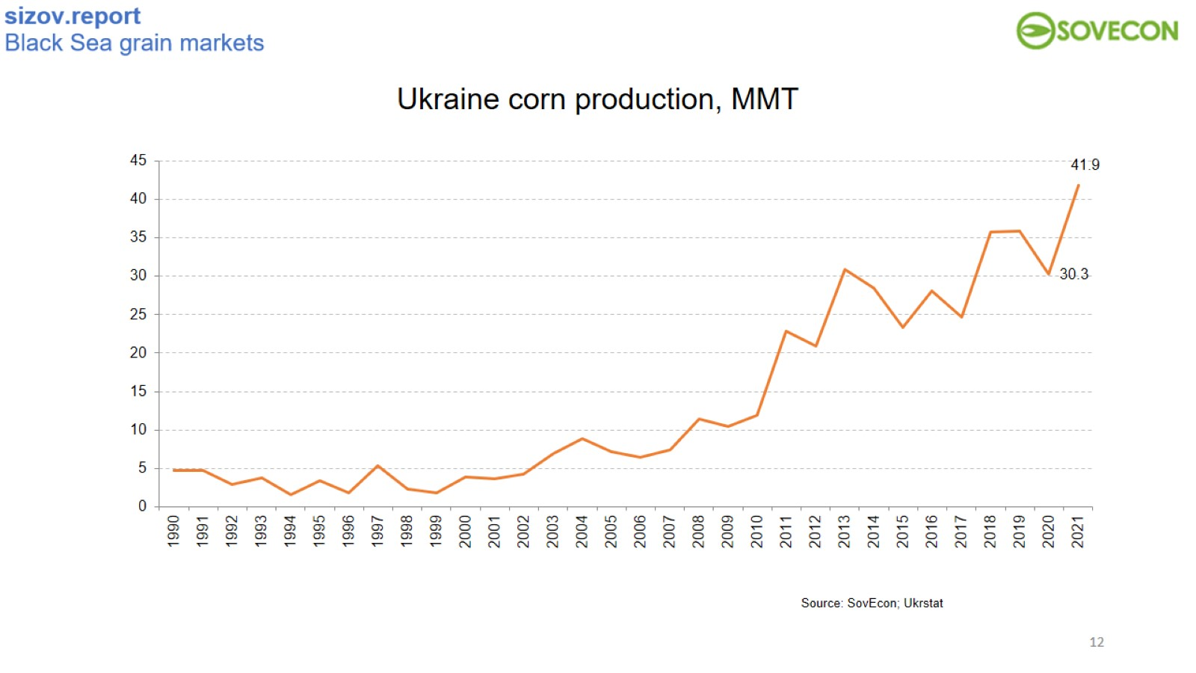
Ukraine corn production, MMT

Slide 13
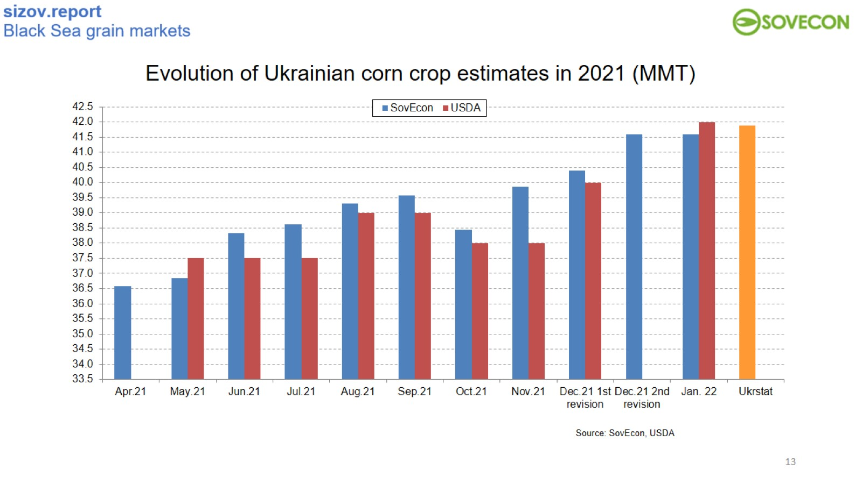
Evolution of Ukrainian corn crop estimates in 2021 (MMT)

Slide 14
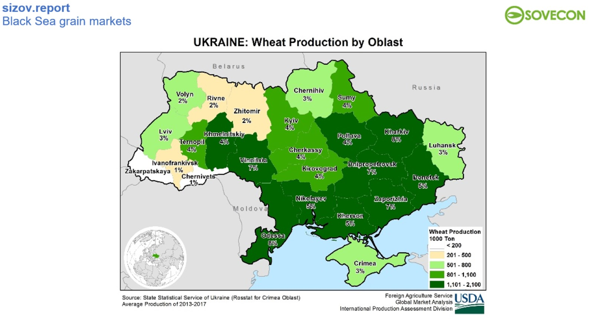

Slide 15
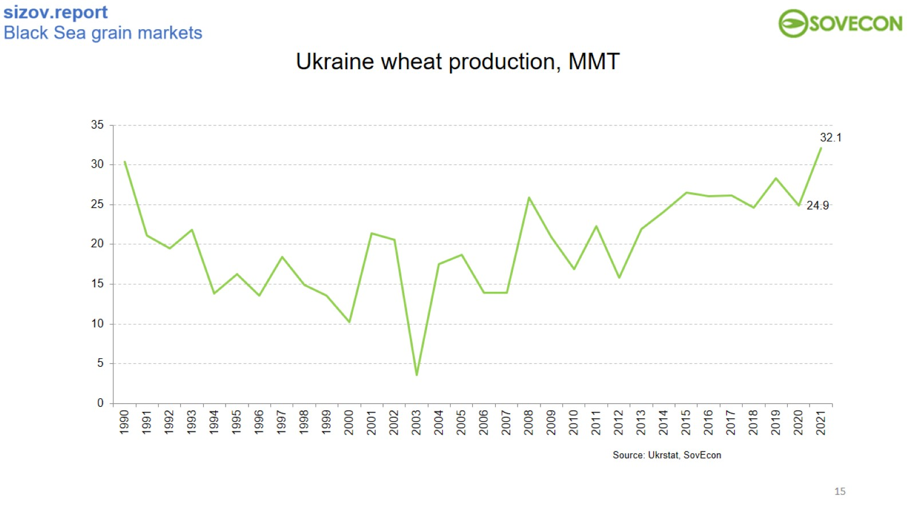
Ukraine wheat production, MMT

Slide 16
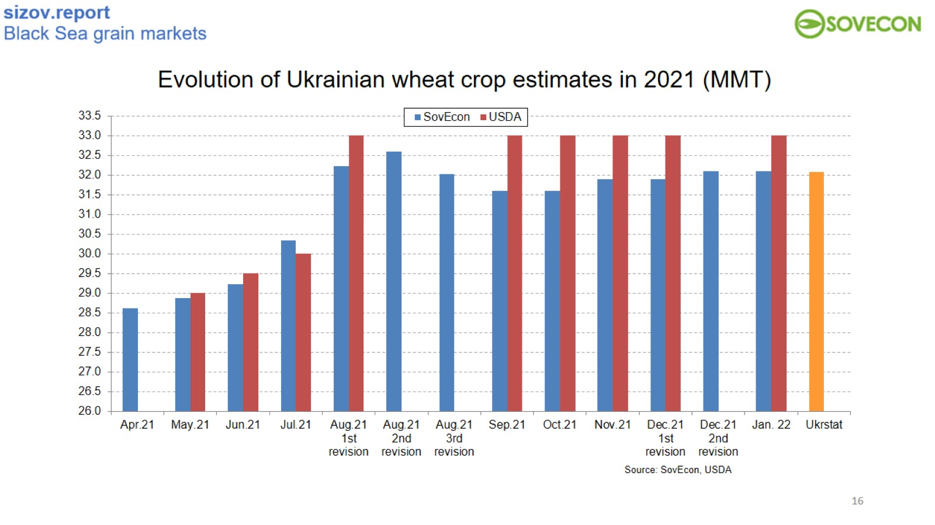
Evolution of Ukrainian wheat crop estimates in 2021 (MMT)

Slide 17
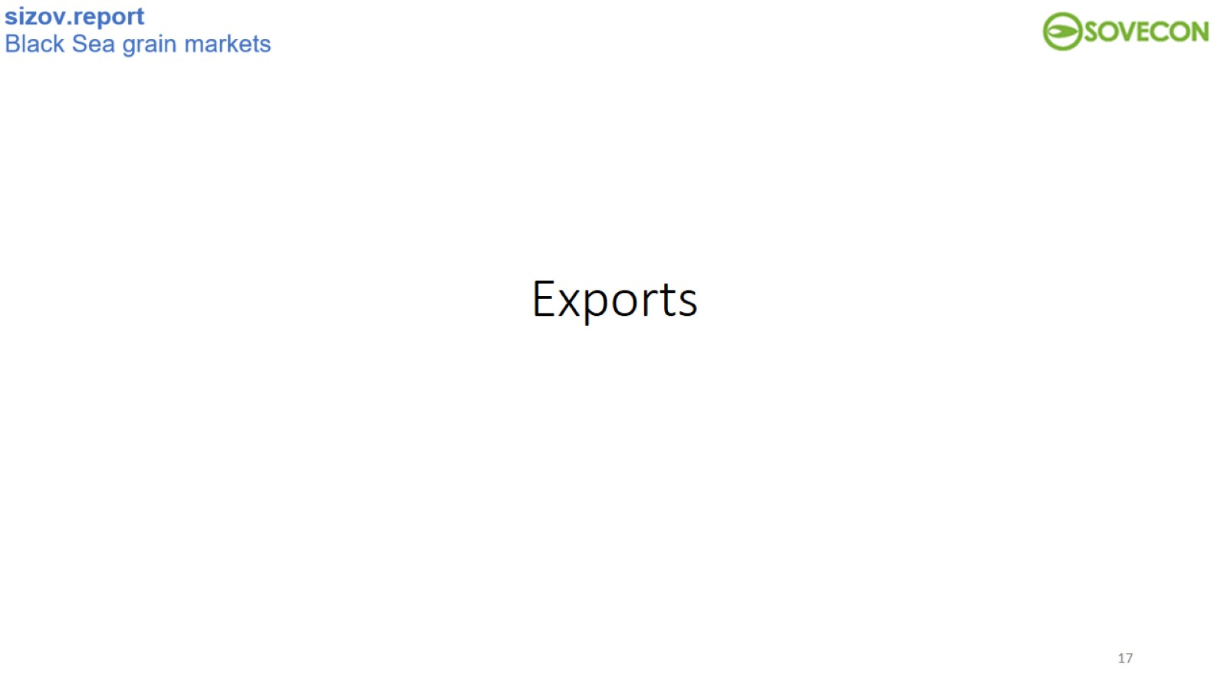
Exports

Slide 18
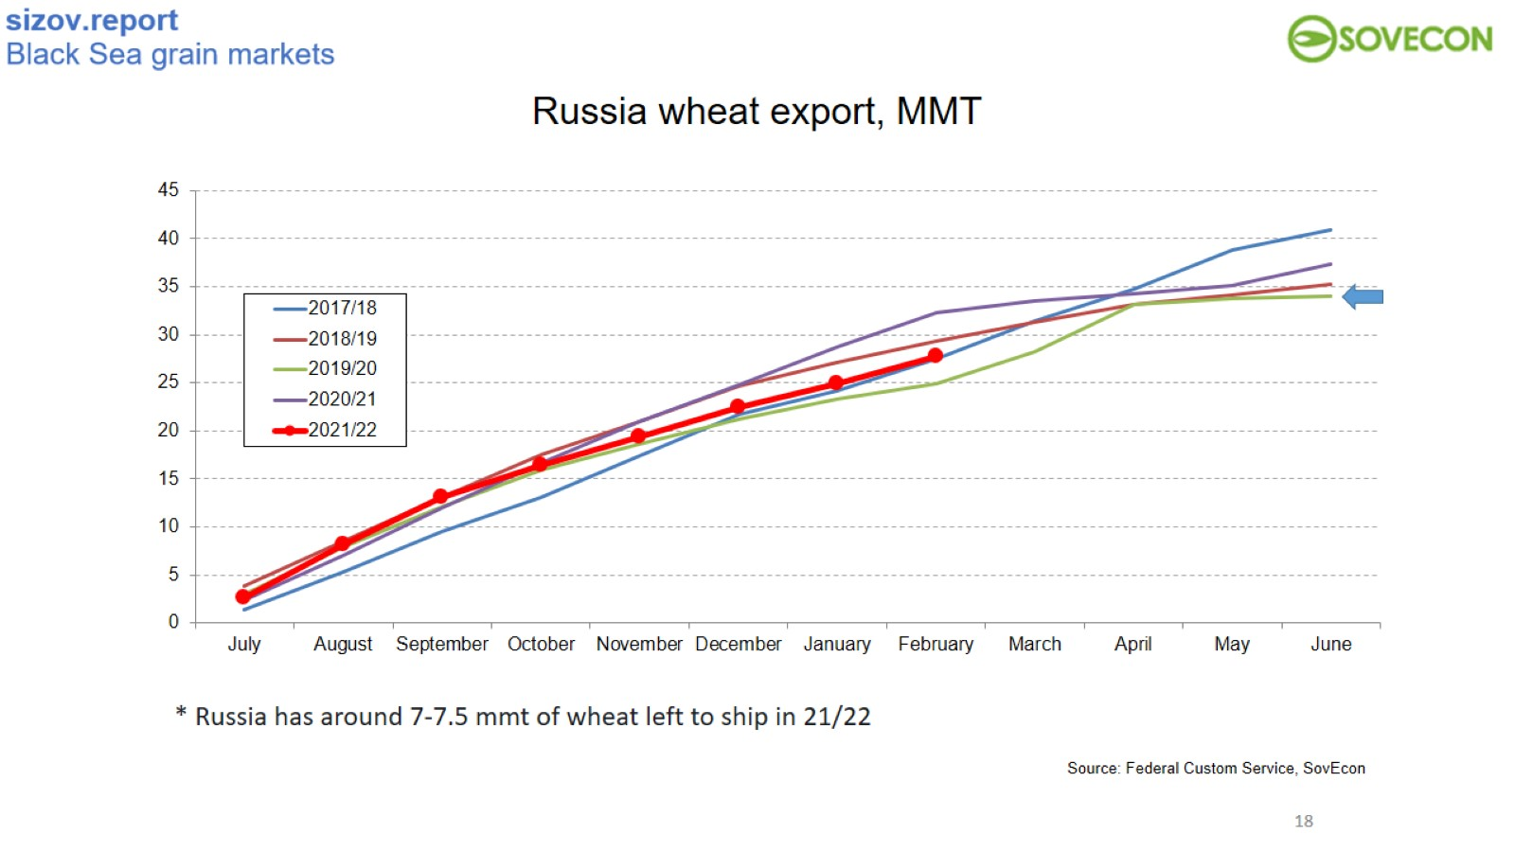
Russia wheat export, MMT

Slide 19
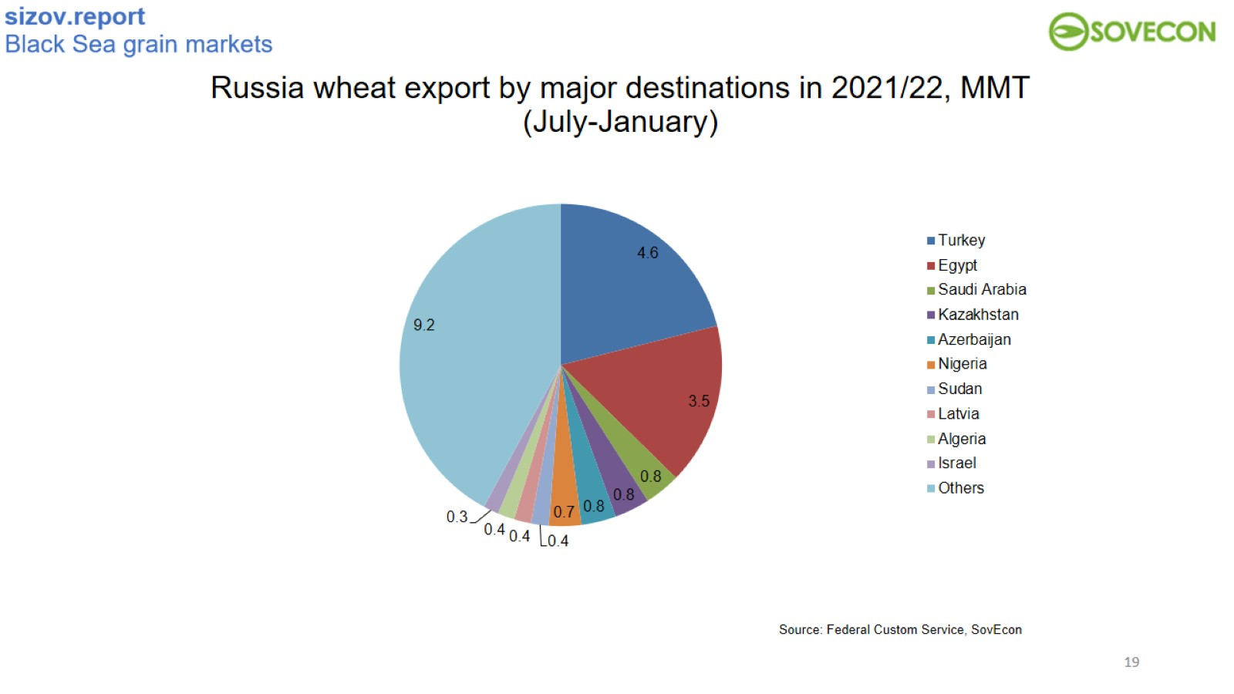
Russia wheat export by major destinations in 2021/22, MMT
(July-January)

Slide 20
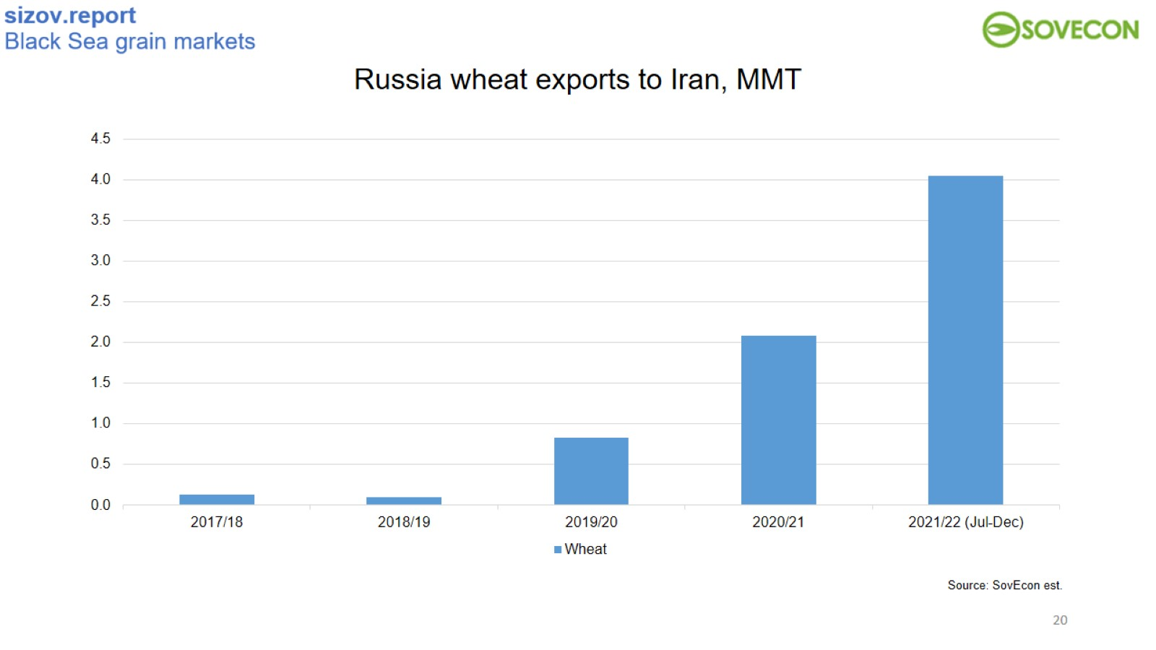
Russia wheat exports to Iran, MMT

Slide 21
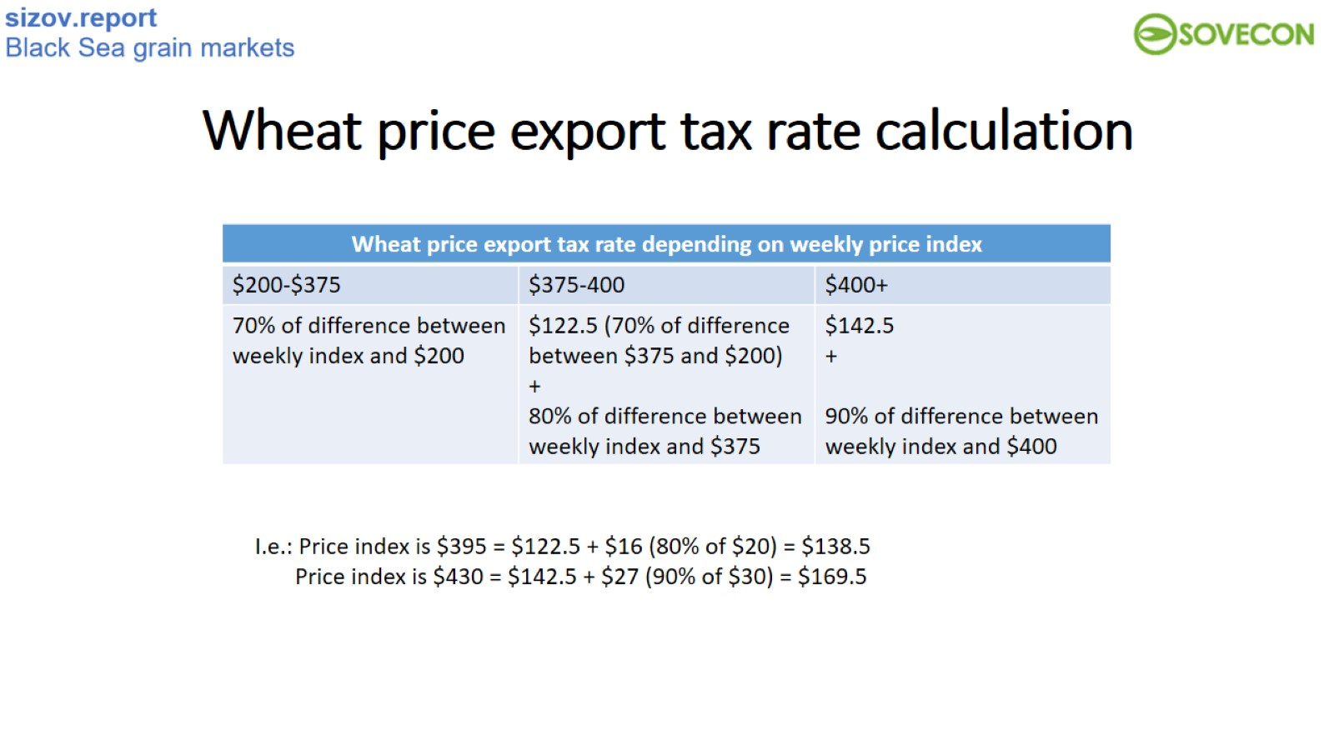
Wheat price export tax rate calculation

Slide 22
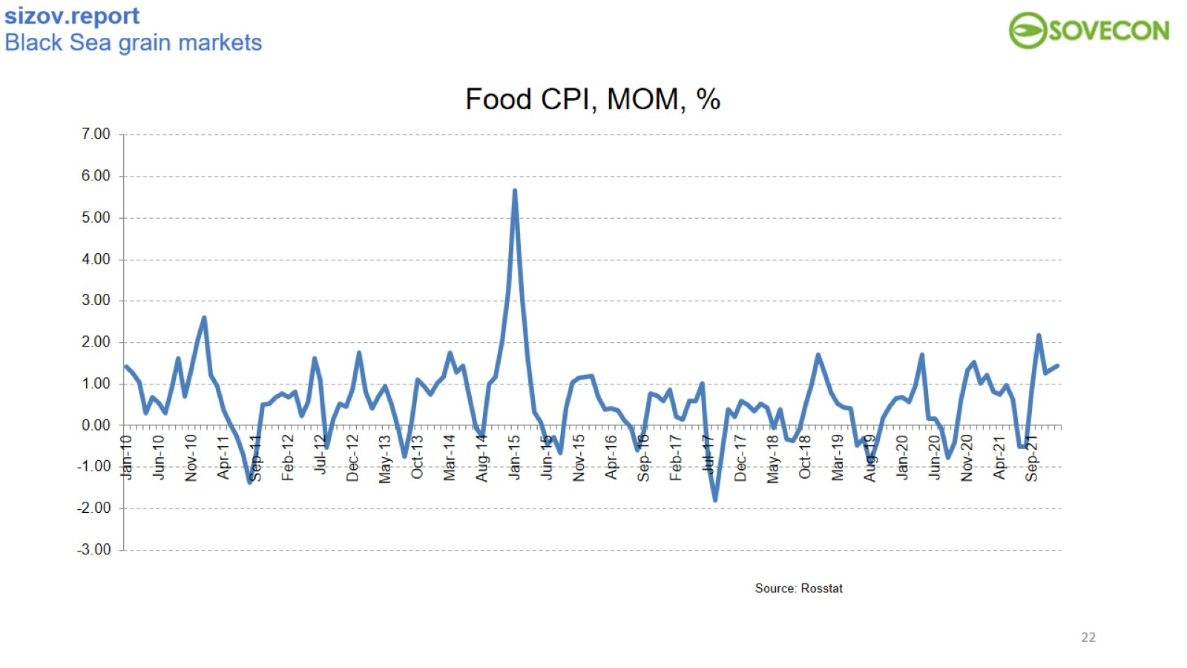
Food CPI, MOM, %

Slide 23
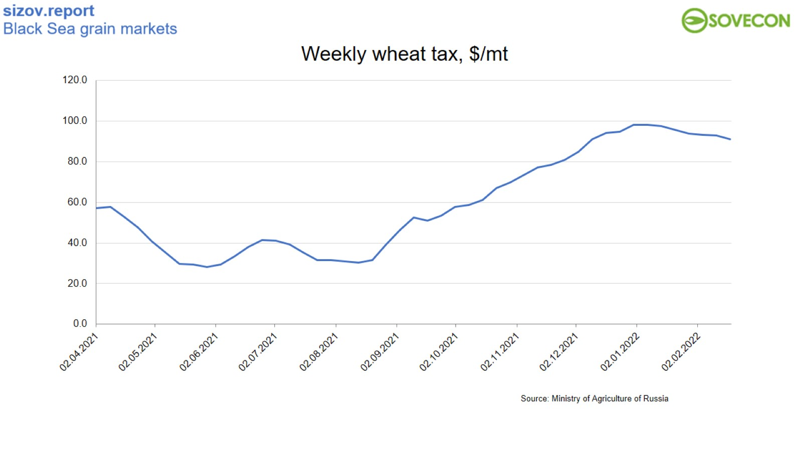
Weekly wheat tax, $/mt

Slide 24
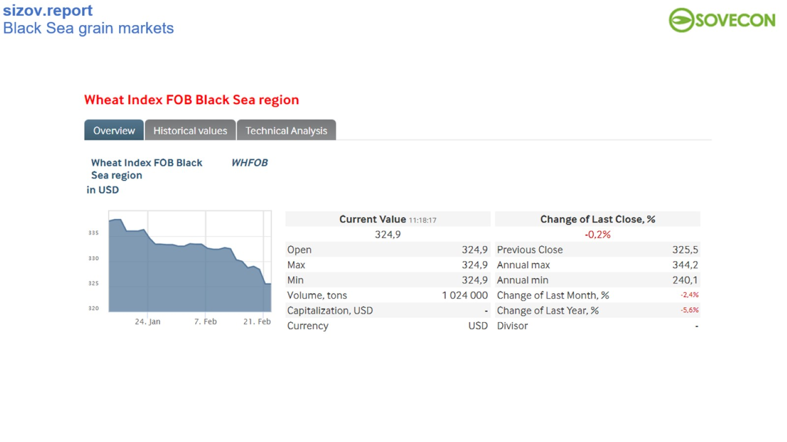

Slide 25
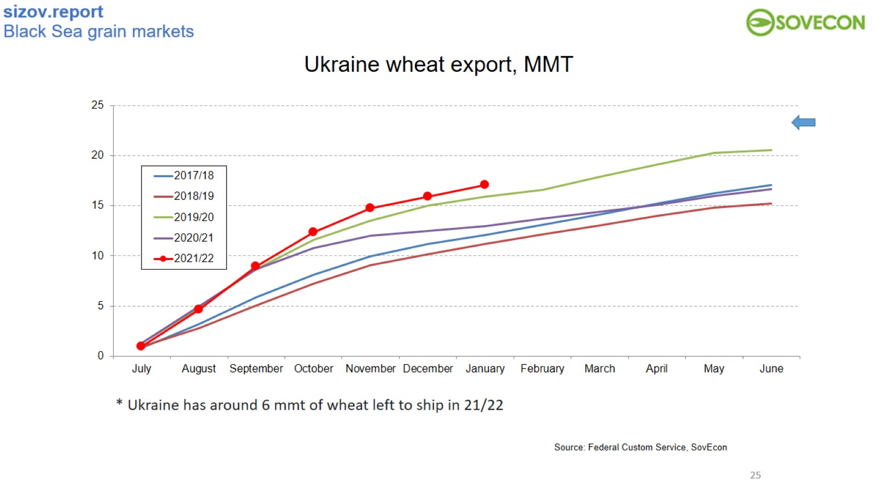
Ukraine wheat export, MMT

Slide 26
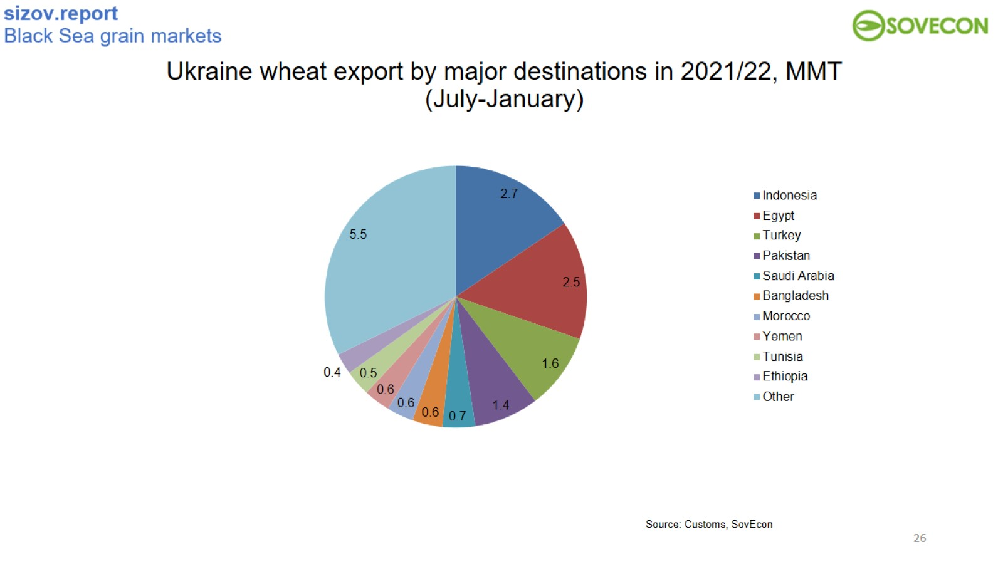
Ukraine wheat export by major destinations in 2021/22, MMT
(July-January)

Slide 27
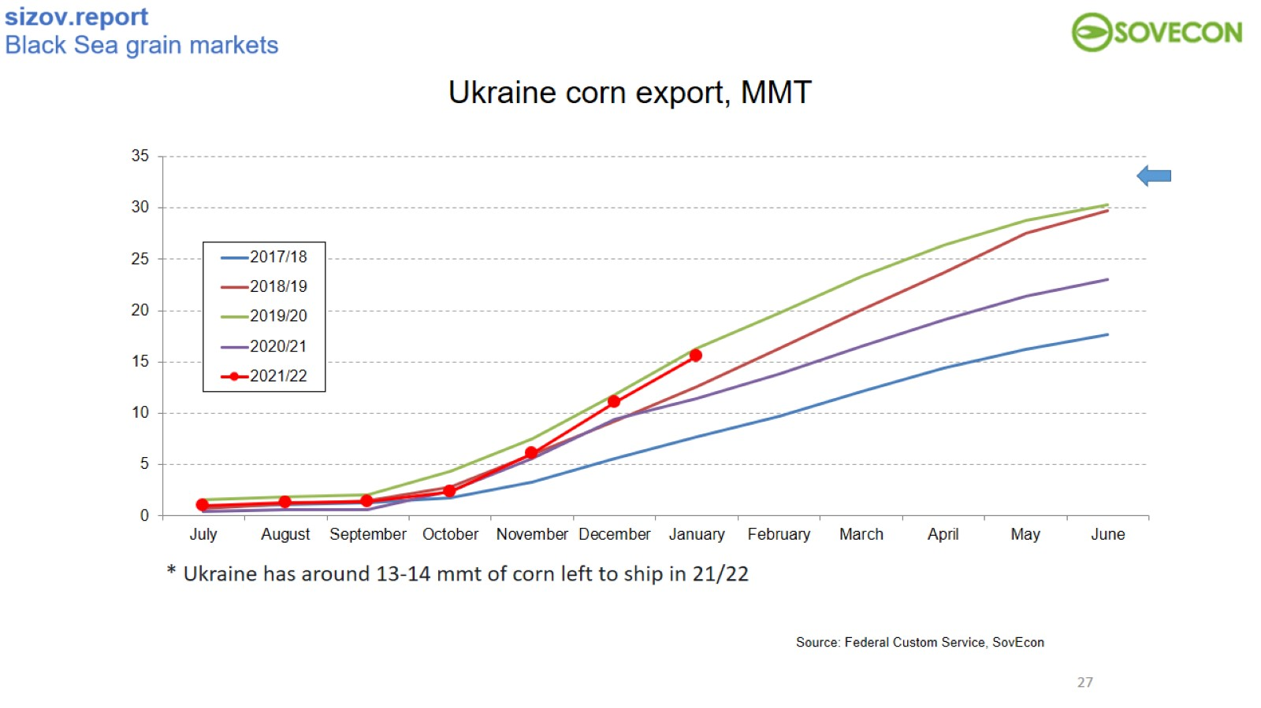
Ukraine corn export, MMT

Slide 28
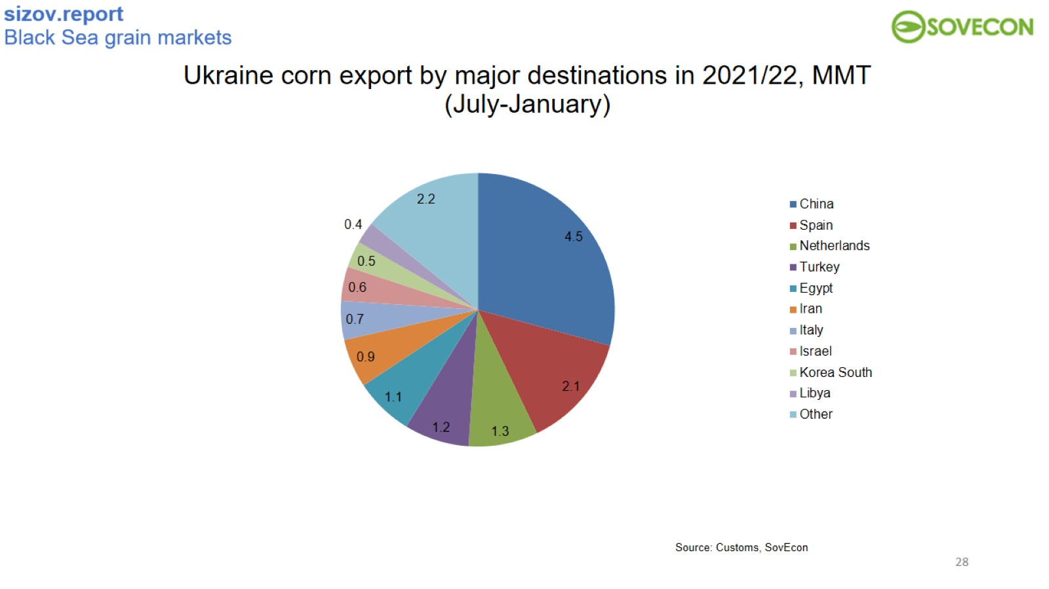
Ukraine corn export by major destinations in 2021/22, MMT
(July-January)

Slide 29
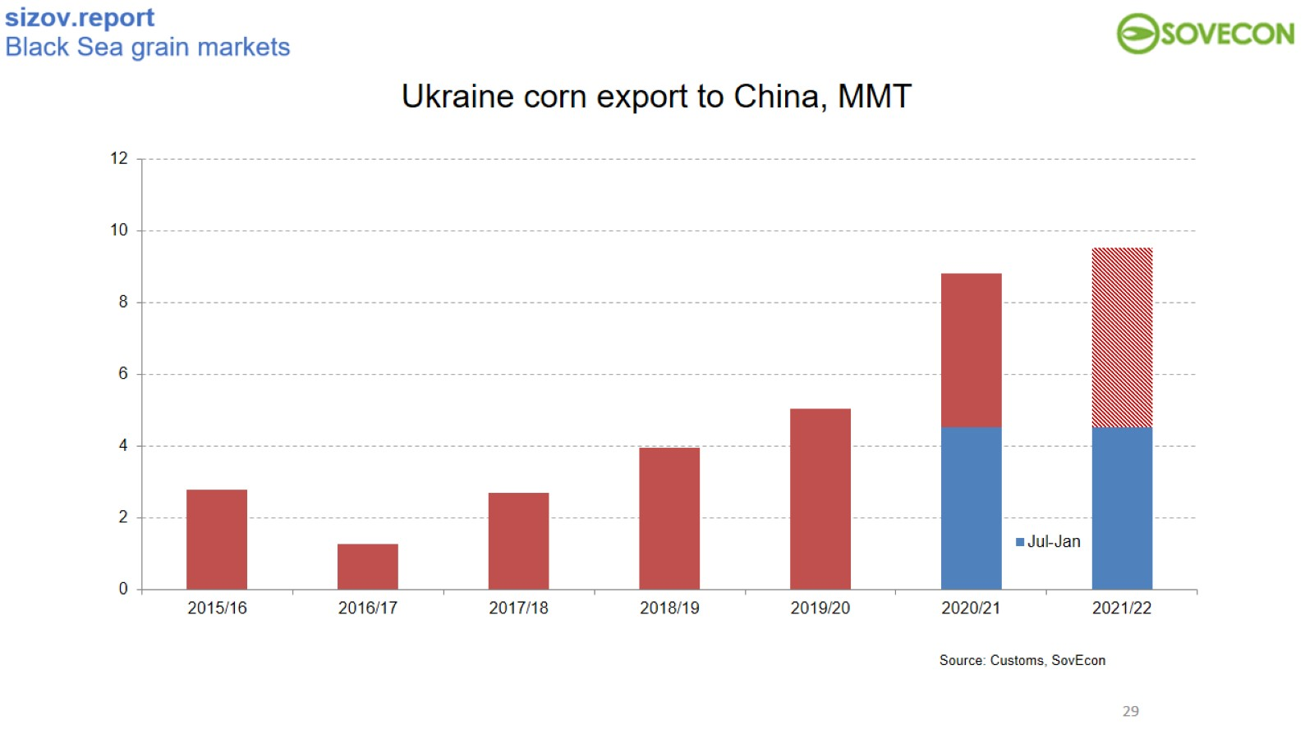
Ukraine corn export to China, MMT

Slide 30
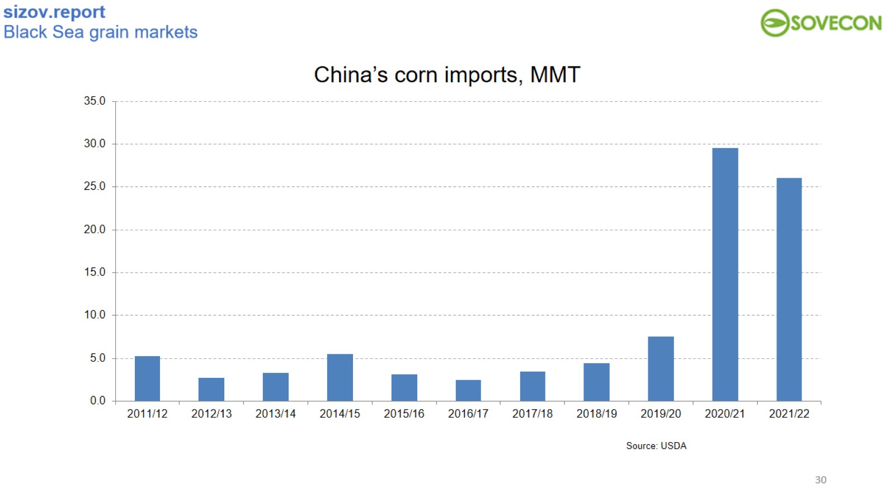
China’s corn imports, MMT

Slide 31
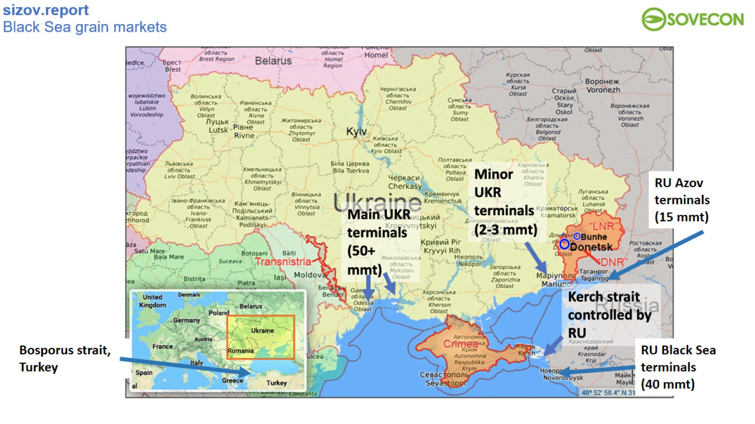

Slide 32
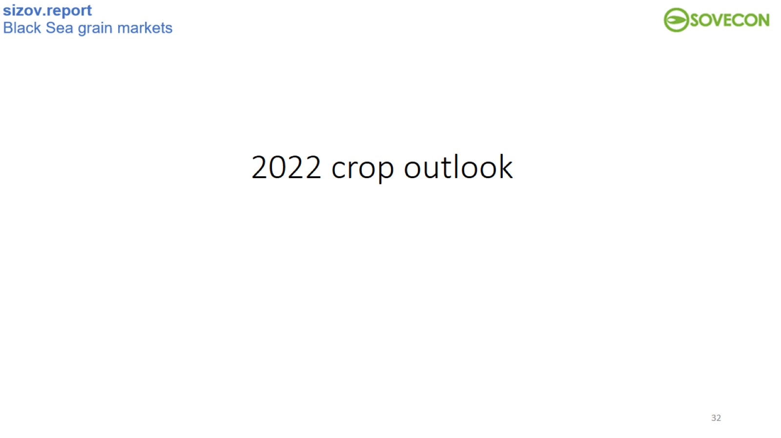
2022 crop outlook

Slide 33
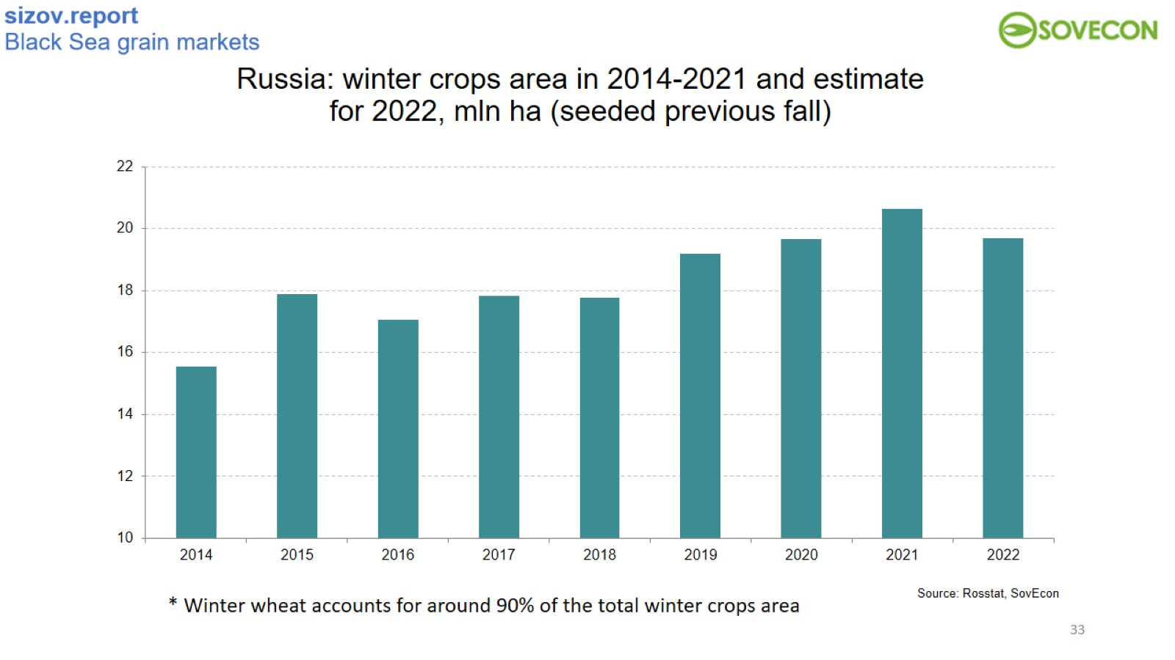
​Russia: winter crops area in 2014-2021 and estimate for 2022, mln ha (seeded previous fall)

Slide 34
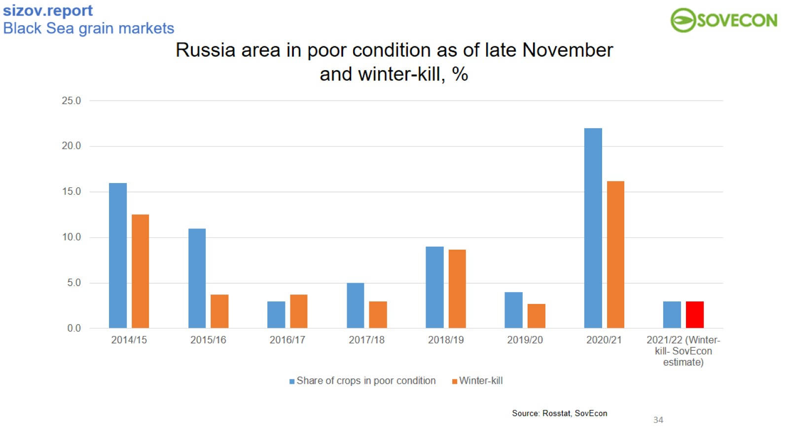

Slide 35
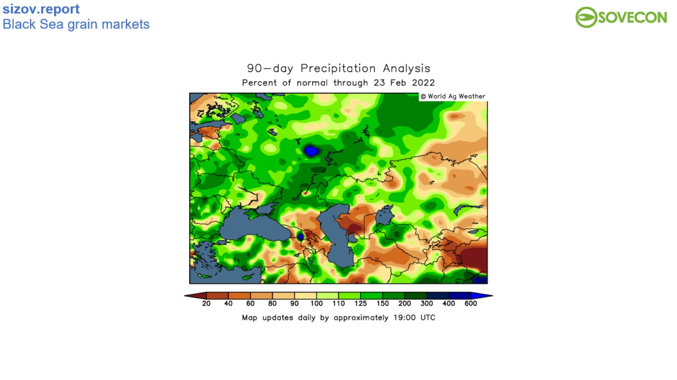

Slide 36
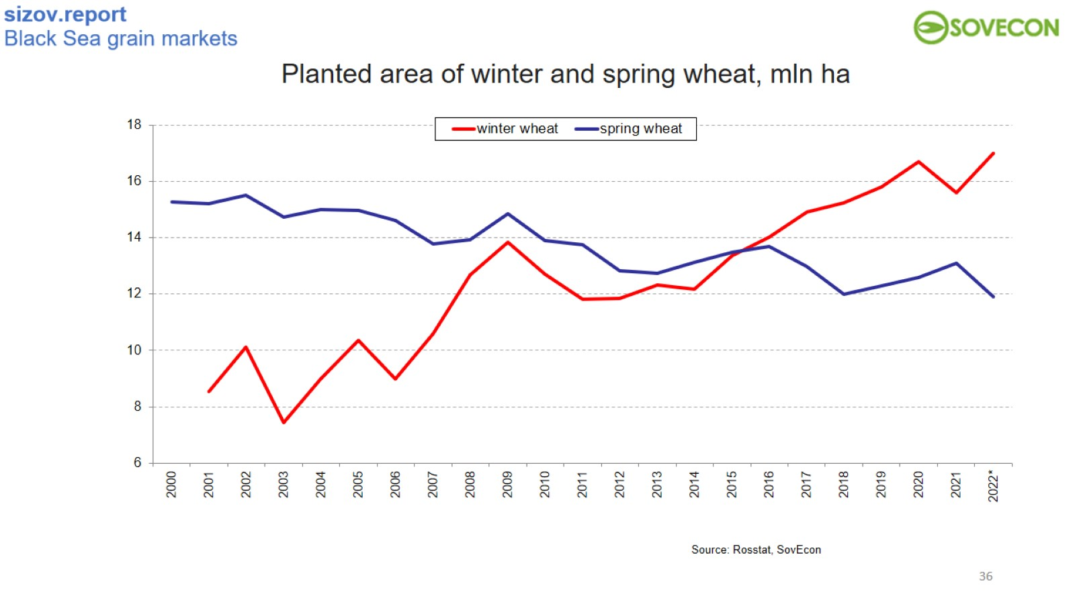

Slide 37
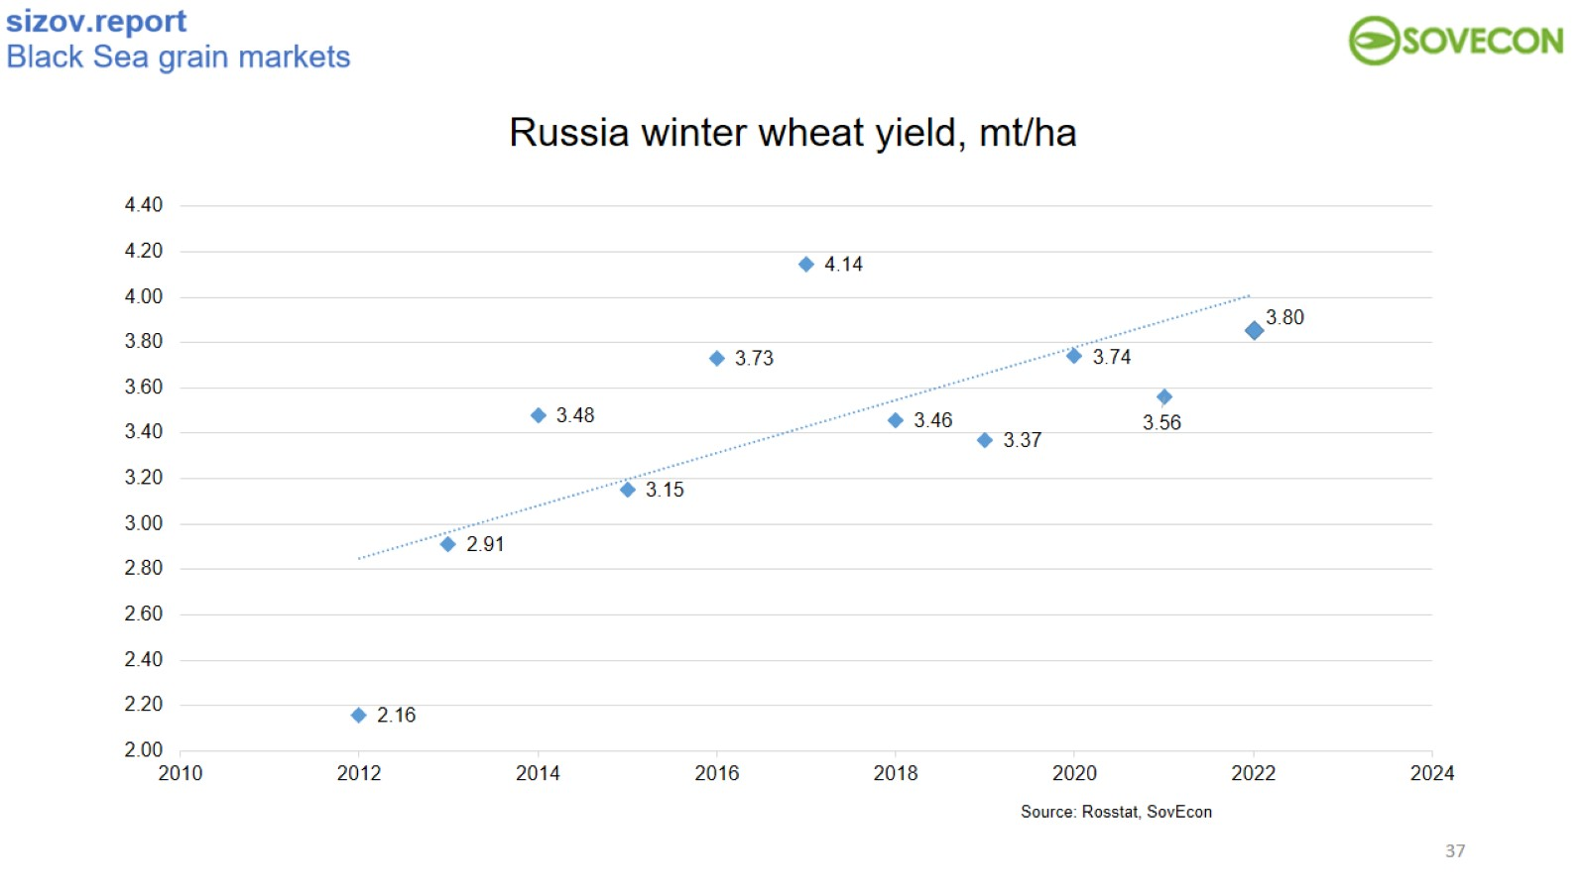
Russia winter wheat yield, mt/ha

Slide 38
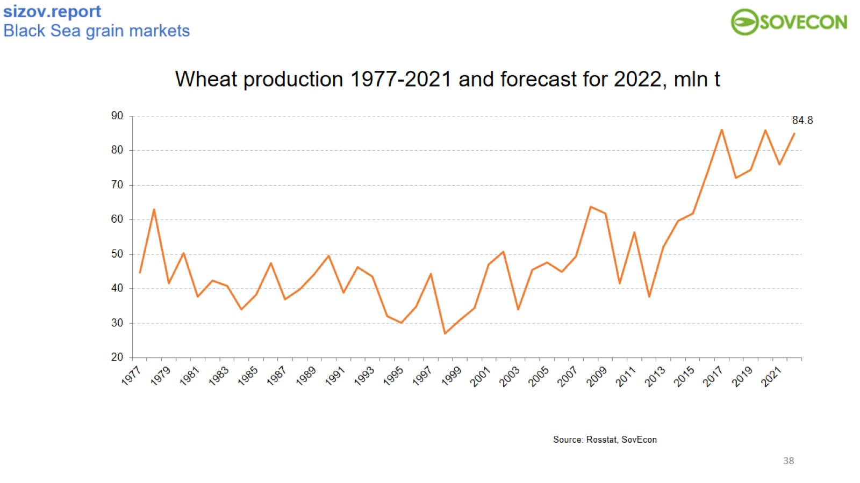

Slide 39
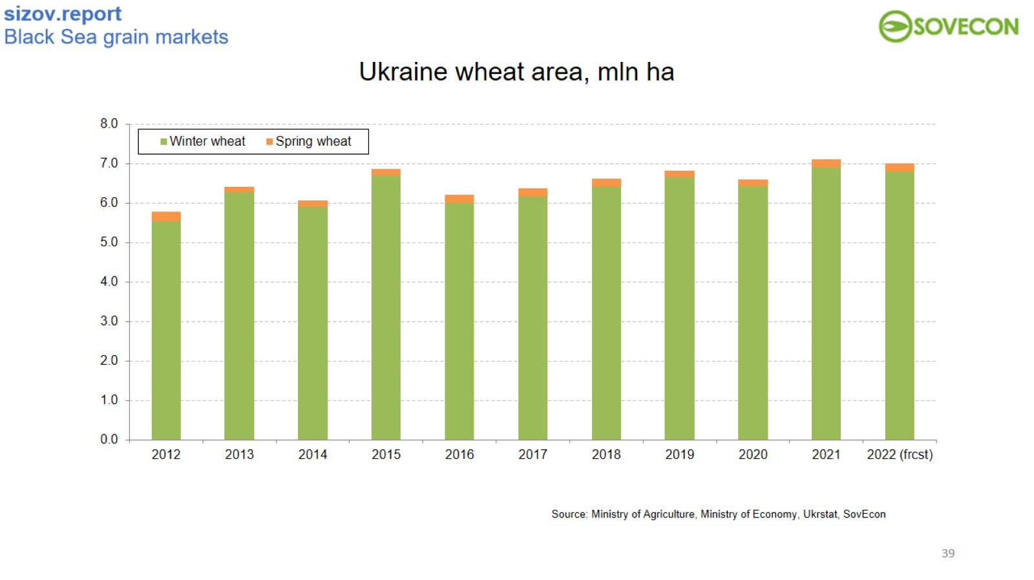

Slide 40
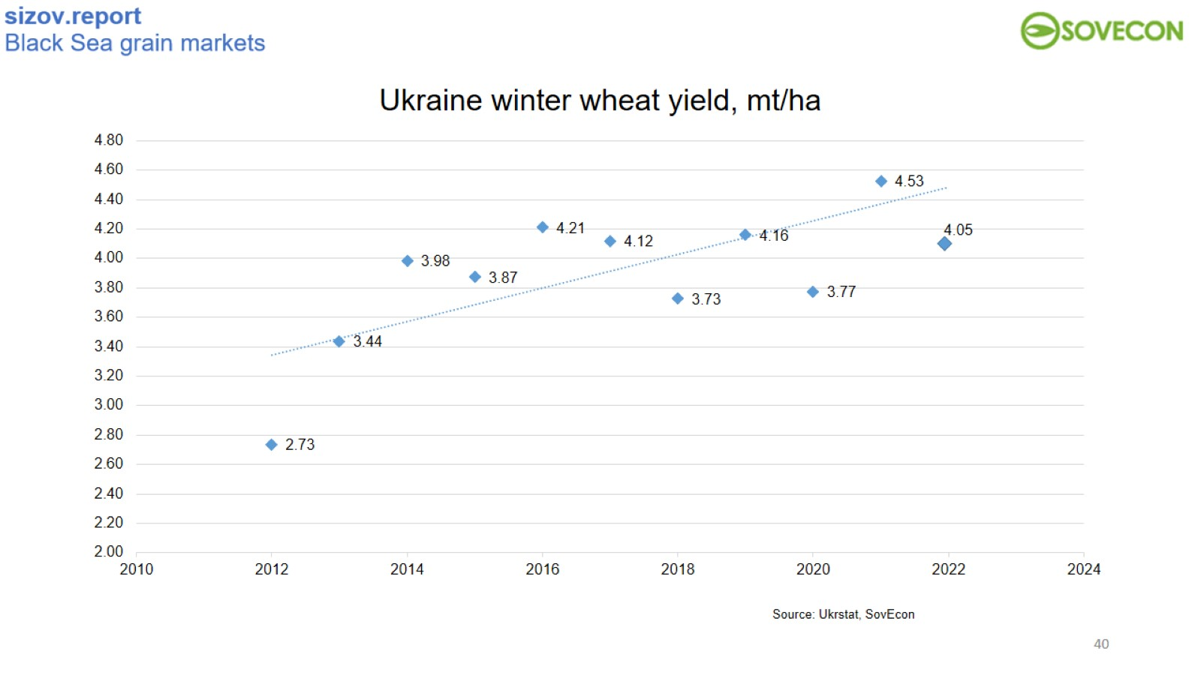
Ukraine winter wheat yield, mt/ha

Slide 41
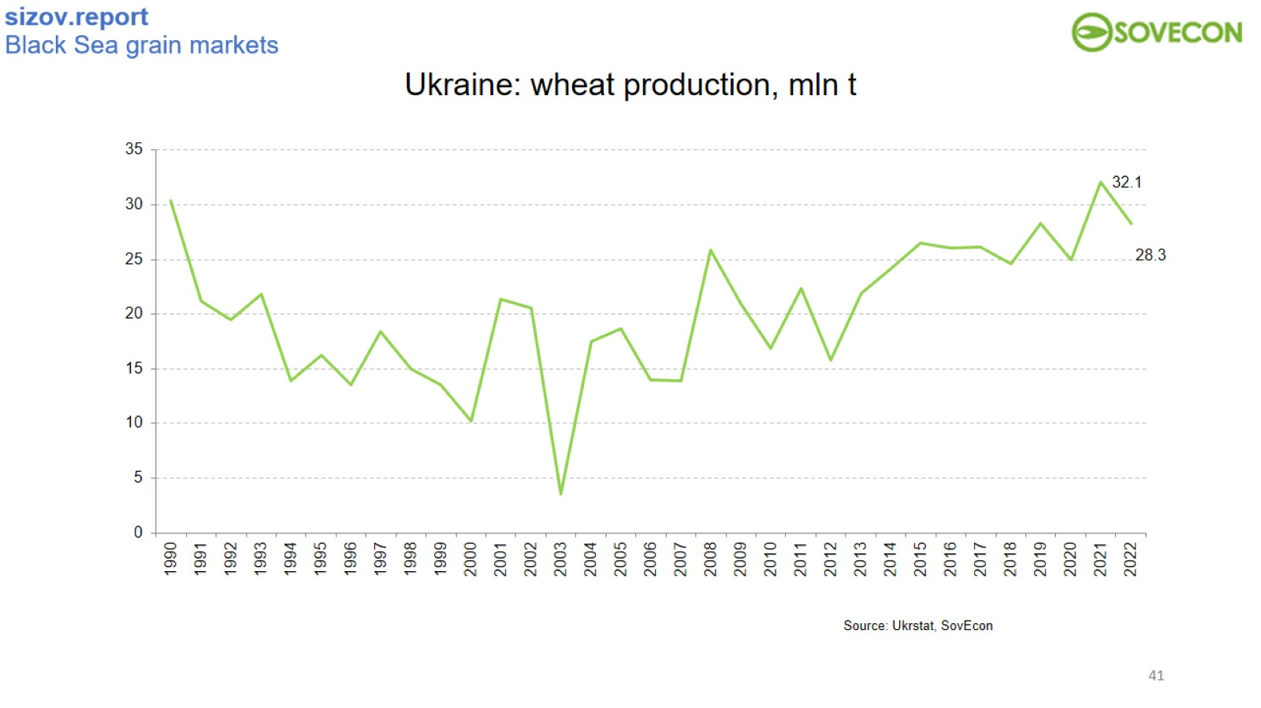
Ukraine: wheat production, mln t

Slide 42
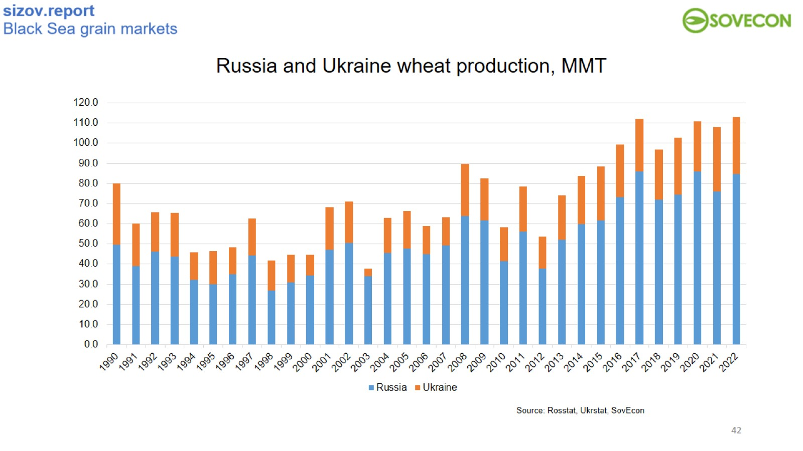

Slide 43
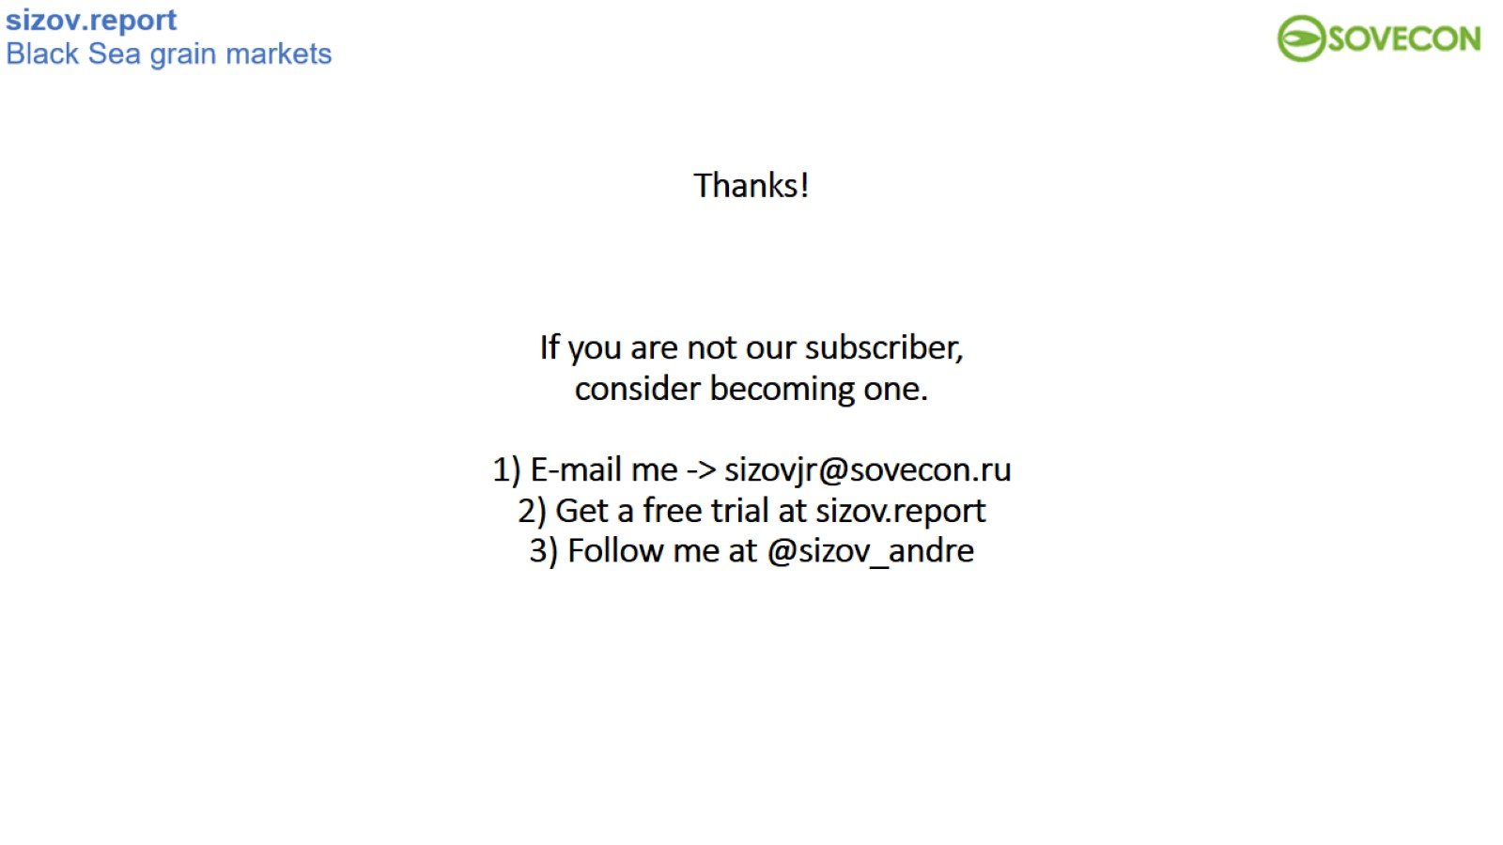
Thanks!
If you are not our subscriber, consider becoming one.
1) E-mail me -> sizovjr@sovecon.ru
2) Get a free trial at sizov.report
3) Follow me at @sizov_andre

