Slide 1
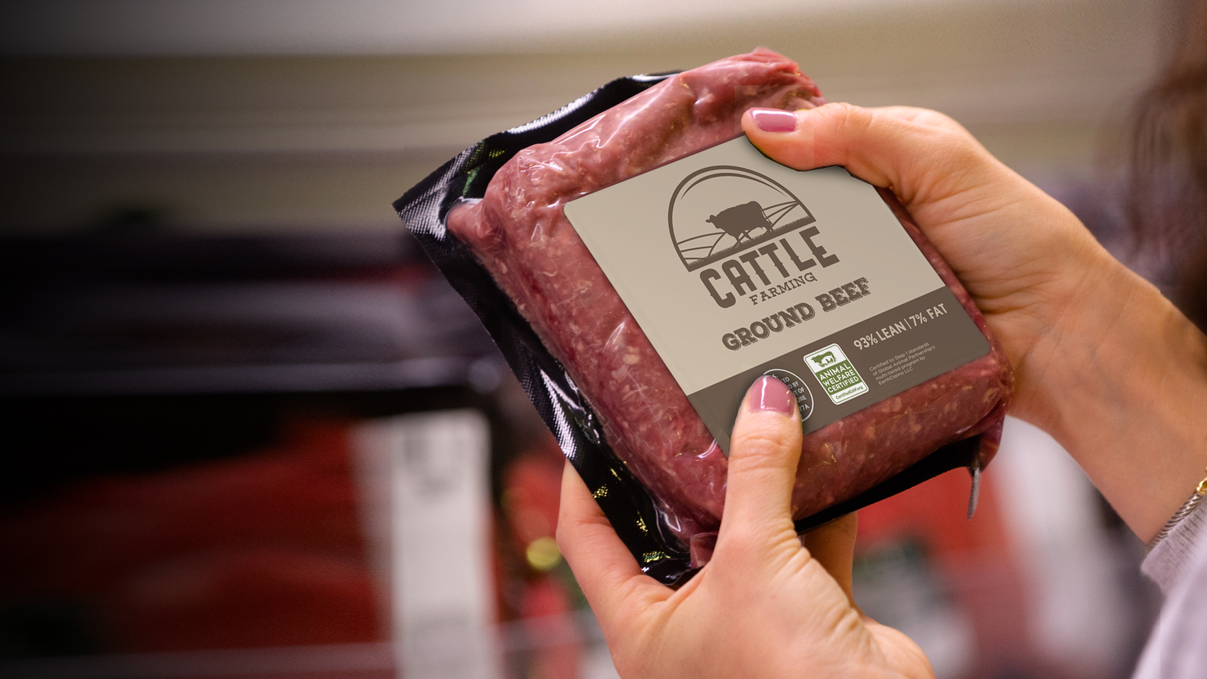

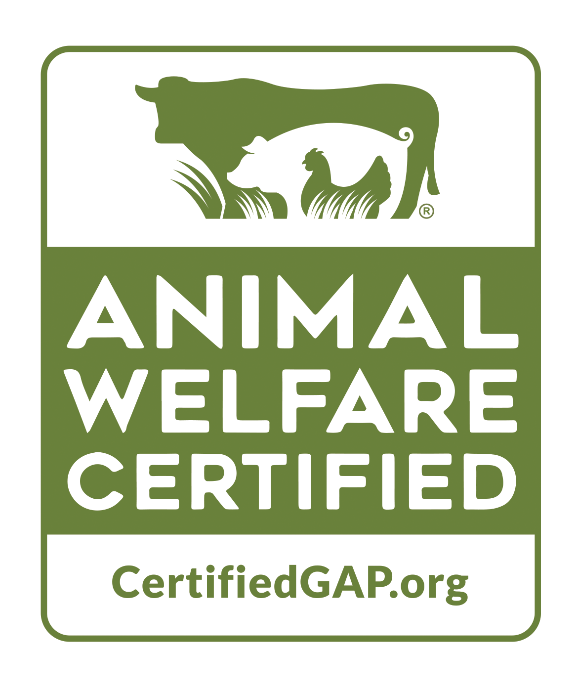
Global Animal Partnership
USDA Presentation | February 25, 2022

Slide 2
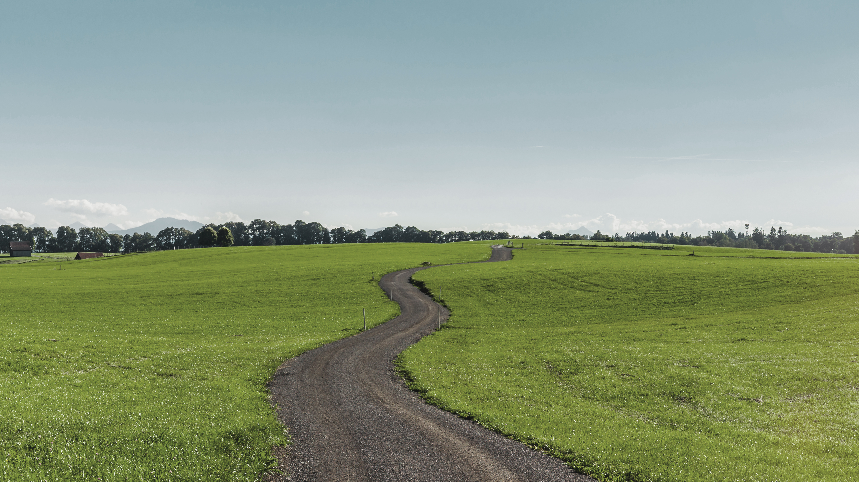
Consumer Trends

Slide 3
Consumers Care about Animal Welfare
75%
80%
77%
68%
of consumers are concerned about how chickens are raised for meat
of US consumers said they were concerned after learning about the treatment of factory-farmed pigs.
of consumers surveyed by the ASPCA said they are concerned about the welfare of animals raised for food.
of Gen-Z pet parents in a recent Chewy study said they care more about where their pet’s food comes from than their own.
A similar
Percentage
said they were concerned about how chickens are bred to optimize meat production.
75%
said supermarkets have a responsibility to source pork from higher welfare farms.
New Research Shows Major Global Supermarket Chains at Risk of Losing Customers over Poor Pig Welfare (news release), Cision PR Newswire, Apr 17, 2018.
New Research Finds Vast Majority of Americans Concerned about Farm Animal Welfare (news release), ASPCA, Jul 7, 2016.
“Chewy, Purina Surveys on Premiumization and Transparency”, PetFood Industry magazine, May 2021.
US Chicken Consumption Report, National Chicken Council, Jul 2018.

Slide 4

Consumer Concerns are Driving Change
  Environmental concerns are fueling initiatives like:
  Regenerative agriculture
  Carbon emissions tracking
  Plant-based food diets
  “Recommerce”
  Electric cars

Slide 5

Consumer Concerns are Driving Change
  According to a recent study from Deloitte, purpose-driven companies witness higher market share gains and grow 3x faster on average than their competitors.

Slide 6

Consumer Concerns are Driving Change
  Food has moved beyond
  “Natural” and Organic
  Consumers are wary of “greenwashing”
  Meat & Dairy are seeing product proliferation
  Gen Z and Millennials are at the forefront,
  looking for products that match their values
  more than ever before

Slide 7

Consumer Concerns are Driving Change
  Animal Welfare is Intrinsically Intertwined with Sustainability
  Flexitarianism is rising
  The pet food industry is investing in third-party certifications
  We’re seeing more claims on clothing and furniture

Slide 8

Consumer Concerns are Driving Change
States are Legislating
Animal Welfare
California Proposition 12 & Massachusetts Question 3 require humane treatment for meat & egg products sold in their states (pigs, laying hens, veal calves)

Slide 9

Consumer Concerns are Driving Change
Brands are drawing consumers in by finding unique ways to tell their stories
Background/history rich with relatable patriarchs and purpose
3rd party claims substantiate these stories so they’re not just “marketing fluff”

Slide 10

Consumer Concerns are Driving Change
Producers are also benefiting from higher attribute products
Producers are receiving premiums for raising meat with added claims and care
The pet food industry helps increase animal utilization and gives premiums for parts of the animal that weren’t possible before

Slide 11
Bottom Line: G.A.P. Animal Welfare Certification aligns with consumers’ values, provides competitive differentiation for brands, and a premium price for producers.

Slide 12
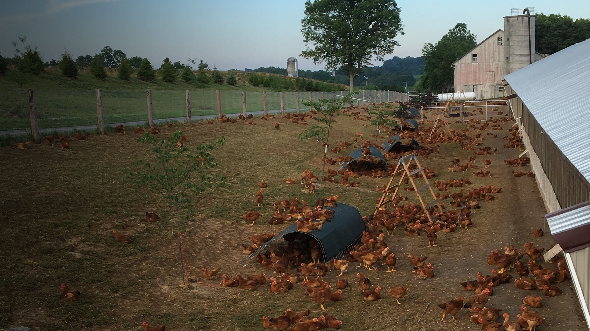
Program Overview

Slide 13



  WHO IS GLOBAL ANIMAL PARTNERSHIP?
Global Animal Partnership (G.A.P.) is one of the largest animal welfare standards and labeling organizations in North America.
G.A.P.’s mission is to drive meaningful, continuous improvement
of farm animal welfare through multi-level standards development, application, and verification across the supply chain.

Slide 14
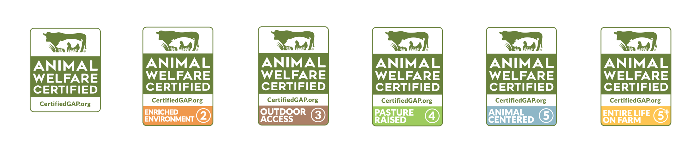

  MULTI-TIERED COMPREHENSIVE STANDARDS
G.A.P. certification is not a "one-size-fits-all" program. G.A.P. has created tiered
animal welfare standards for 11 species that are science-based and 3rd party certified.
Each tier, or Step, includes over 100 animal and farm-based requirements that must be met in order to achieve certification. Our tiered program creates a platform for change for farms
and ranches, as they can achieve higher Steps with welfare improvements.

Slide 15

  EVERY FARM, EVERY 15 MONTHS
*Every 12 Months for
Pigs and Laying Hens
pork

Slide 16
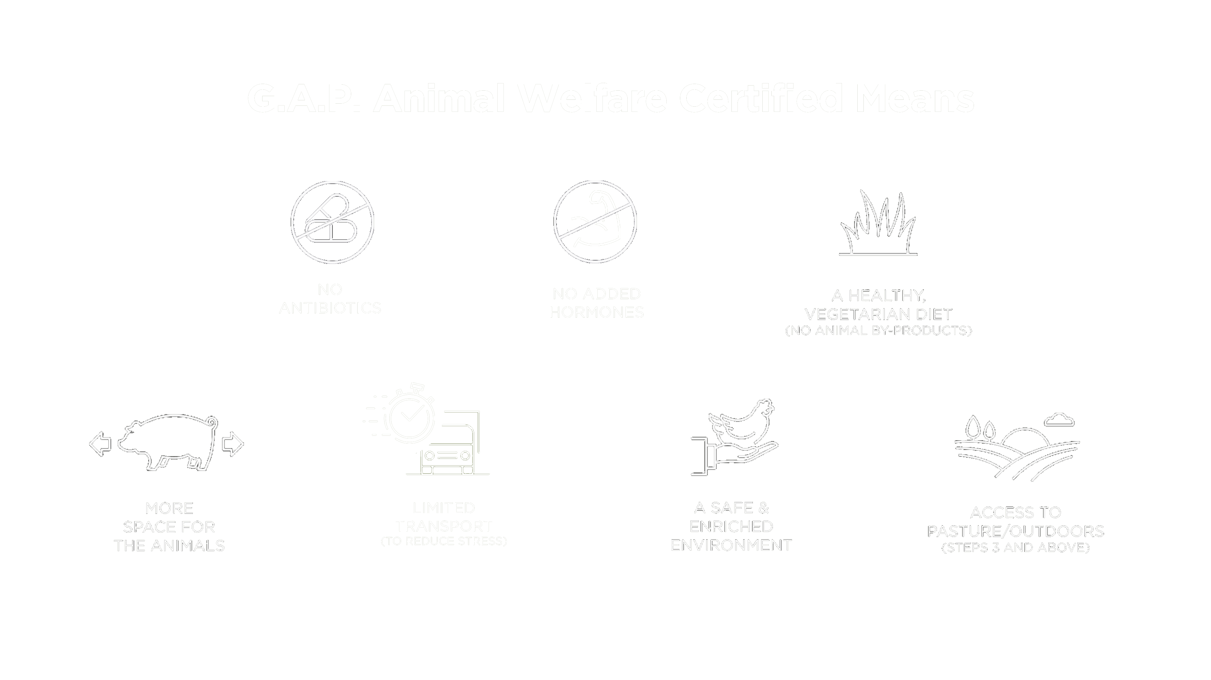
pork

Slide 17




What Makes G.A.P. Special?
Technical
Knowledge
Supply Chain
Connectors
Integrity
Transparency
Farm animal welfare and meat buying experts
  Increased carcass utilization (using the whole animal)
  Every farm audited every 15 months
  Tiered program promotes continuous improvement
pork

Slide 18
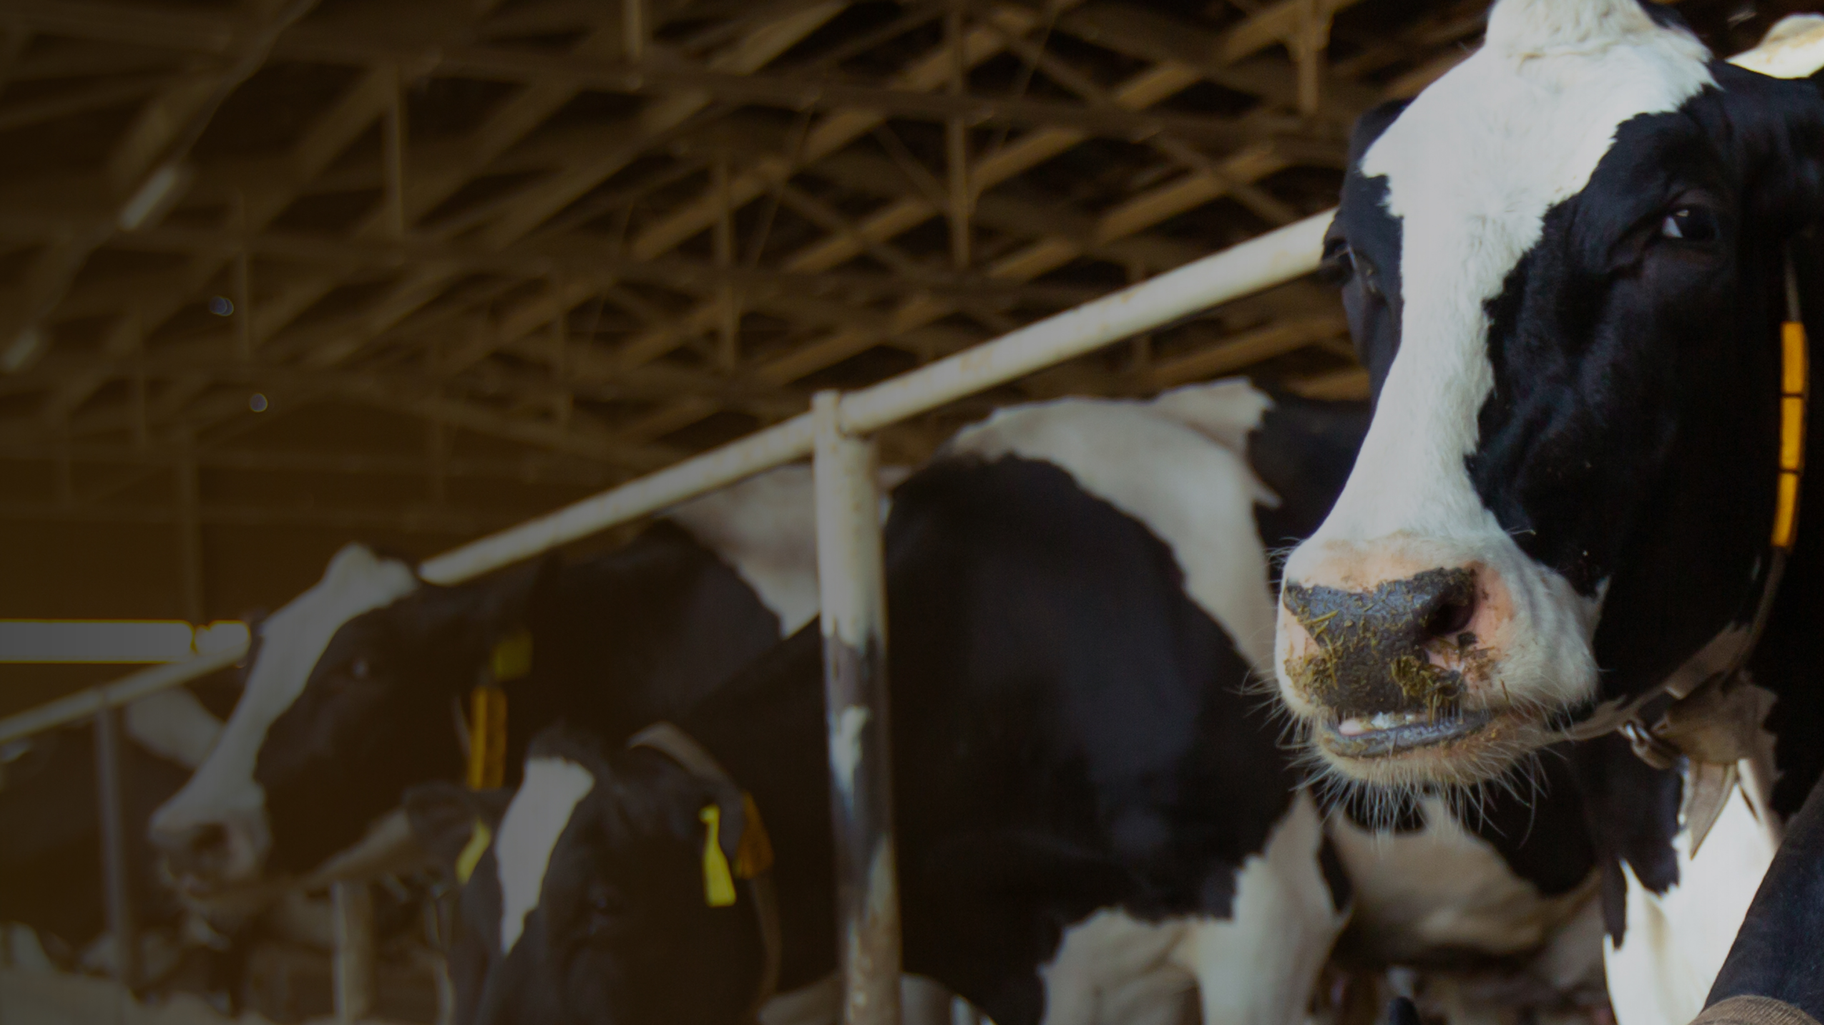
Becoming a
G.A.P. Partner

Slide 19

Procurement
    Connecting suppliers + processors + brands
    Ensuring chain of custody to support the claim
    Supporting international expansion

Slide 20
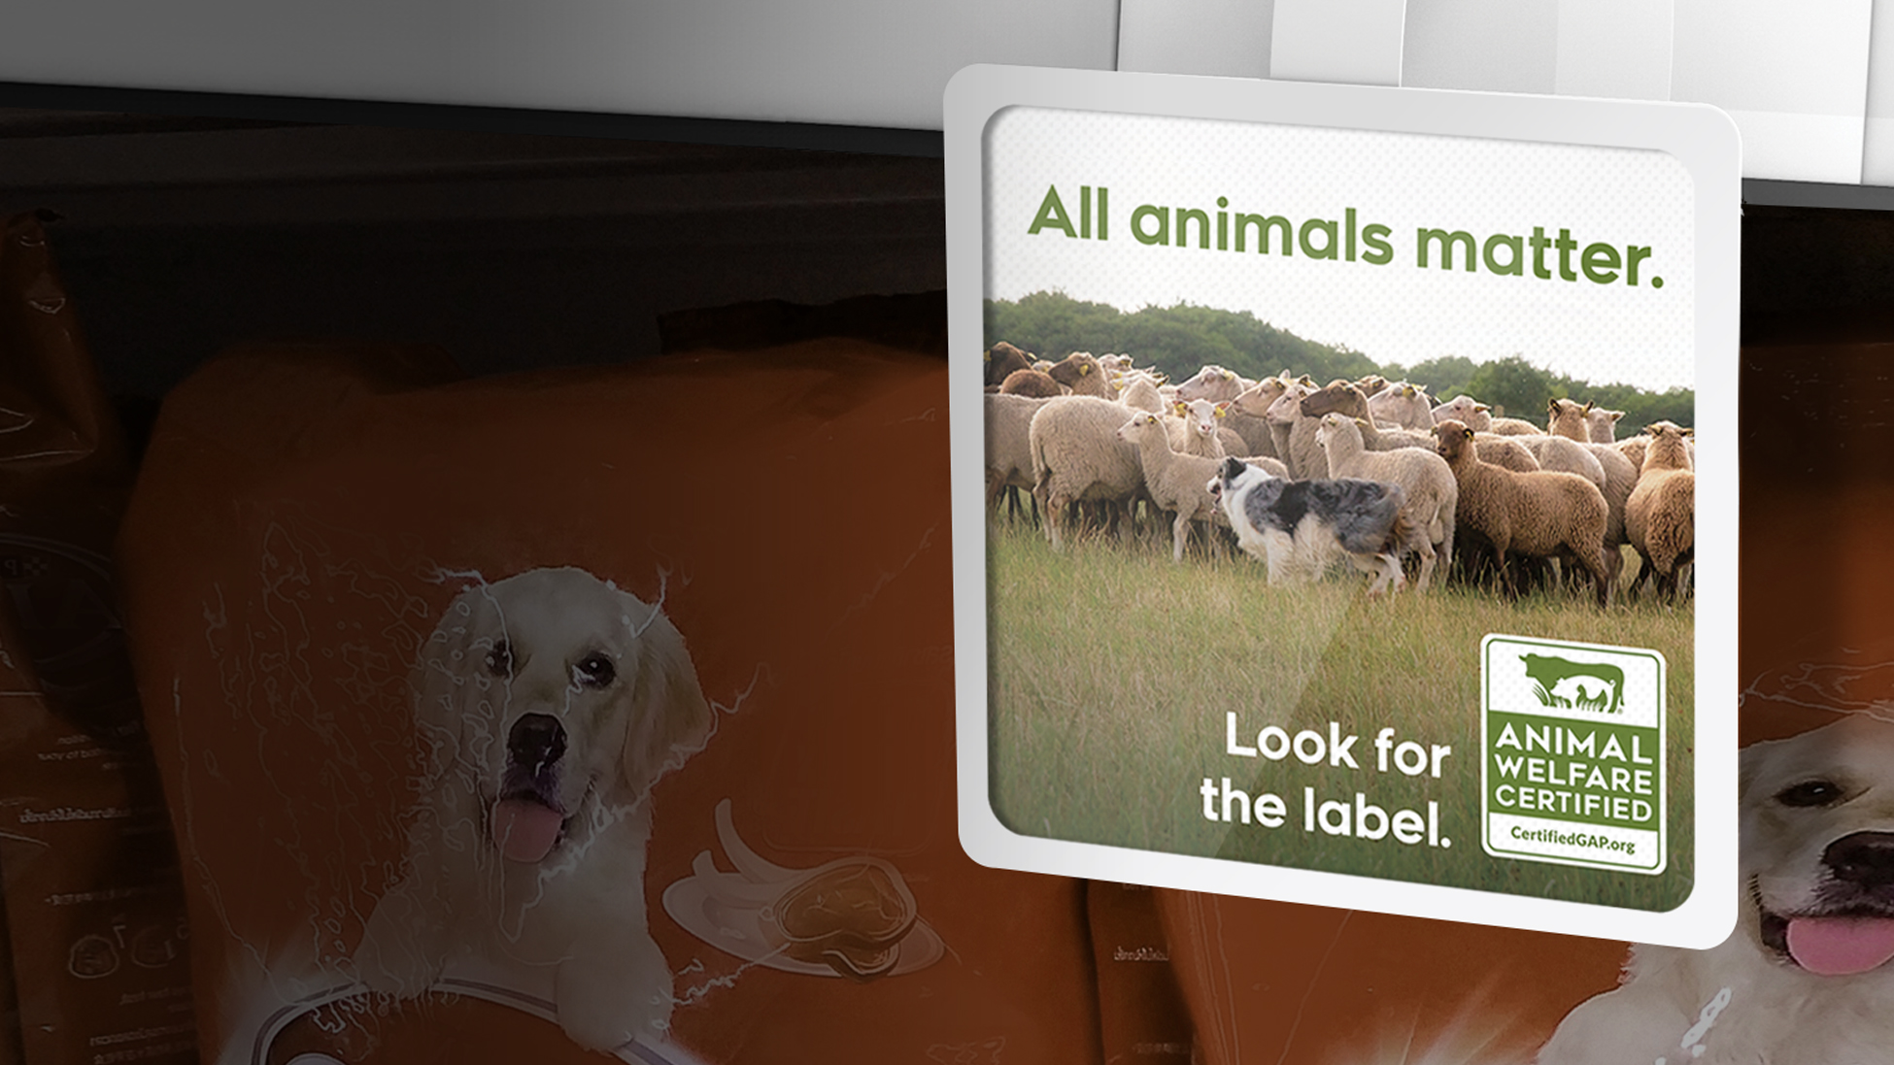
Sales
    Educating sales teams + distributors
    Producing co-branded graphics / sell sheets
    Helping with retail sales support

Slide 21

Marketing
    Ensuring label compliance with USDA-FSIS
    Supporting PR, social, other marketing initiatives
    Assisting with consumer education and research

Slide 22
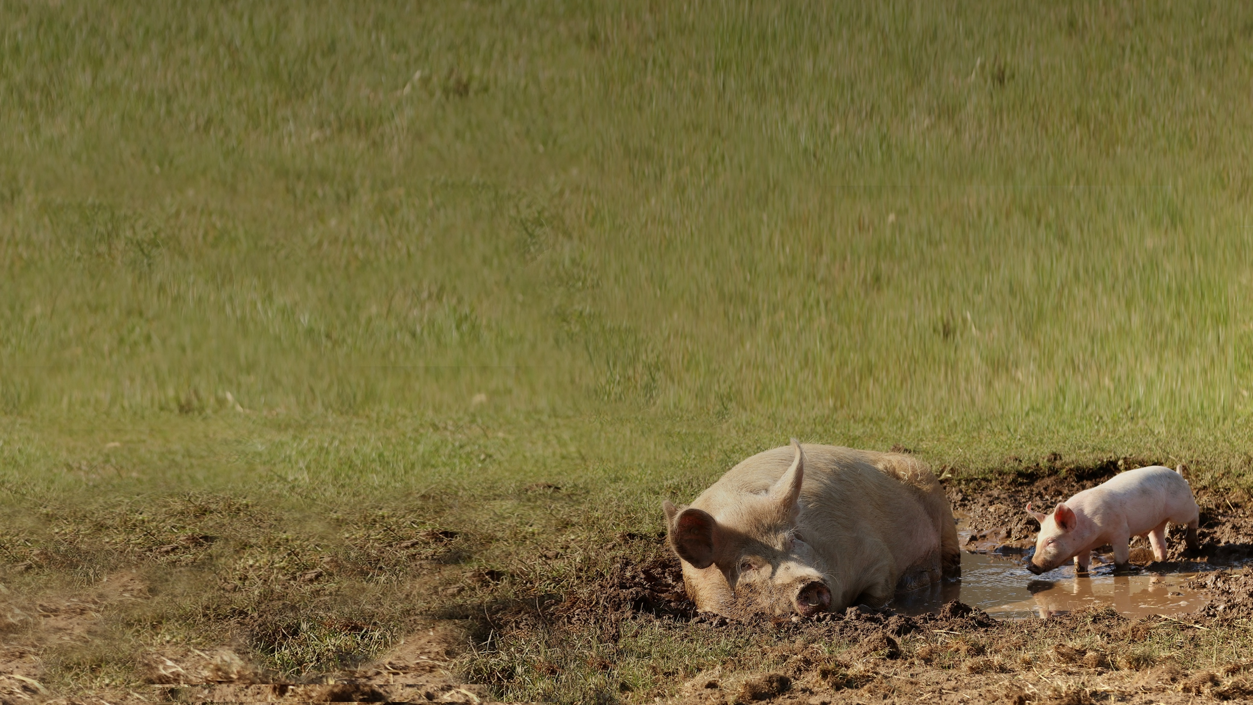
Key Takeaways
1.
    Consumer expectations are rising
2.
  G.A.P. Certification provides many benefits
  - Return on Investment (premiums)
  - Competitive Differentiation
  - Risk management (every farm is audited)
  - Authenticity (delivering on your brand promise)

Slide 23
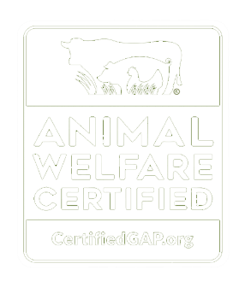
Let’s Talk!
    info@GlobalAnimalPartnership.org

