Slide 1


Slide 2
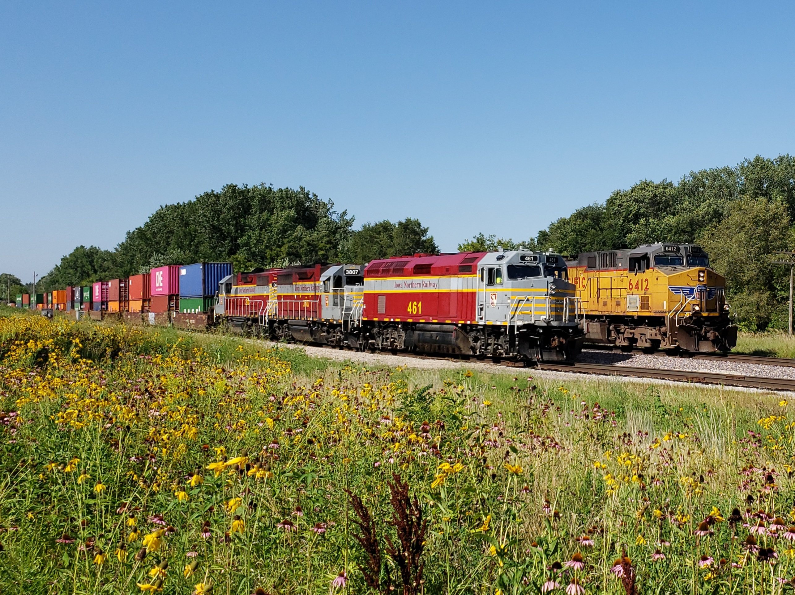
DELIVERING INTERMODAL TO AMERICA’S HEARTLAND

Slide 3
AGENDA
US export dynamics prior to 2020
How the US supply chain became a crisis
US Export data 2020-2021
Valor Victoria outlook on Agri Exports
AGOUTLOOK 2022

Slide 4
LA/LGB Export Market Share
*Statistics provided by the Journal of Commerce

Slide 5
Ag Export Commodities YOY
Commodities Included:
Agricultural
Cotton
Foodstuffs
Forest Products
Hay Animal Feed
Logs & Lumber
*Statistics provided by the Journal of Commerce

Slide 6
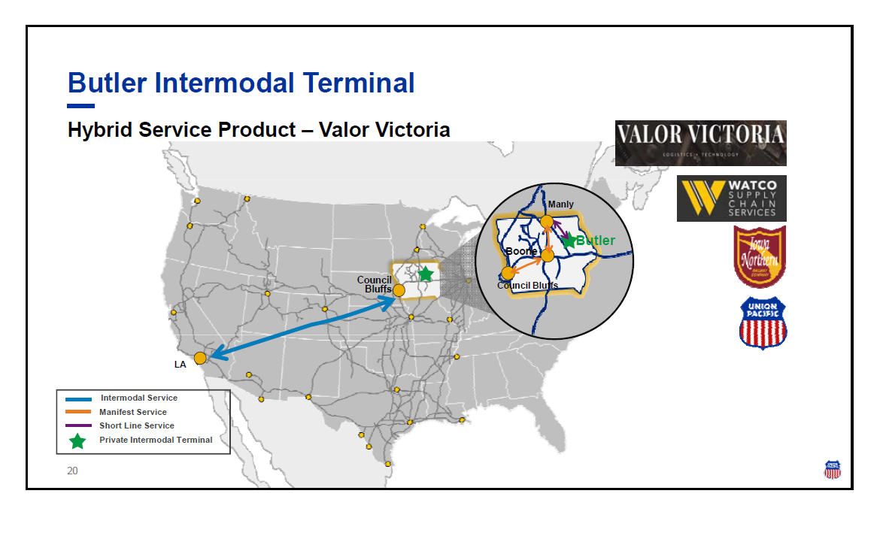
REIMAGENE
INTERMODAL
Union Pacific’s adoption of PSR
Riding the fast train
Access to unique markets without volume minimums

Slide 7

Private Rail Service

Slide 8
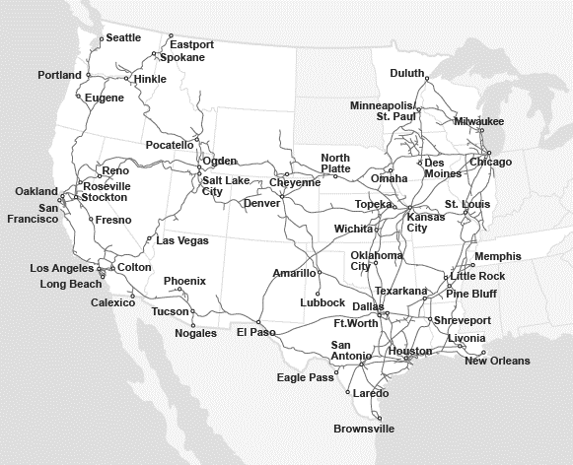
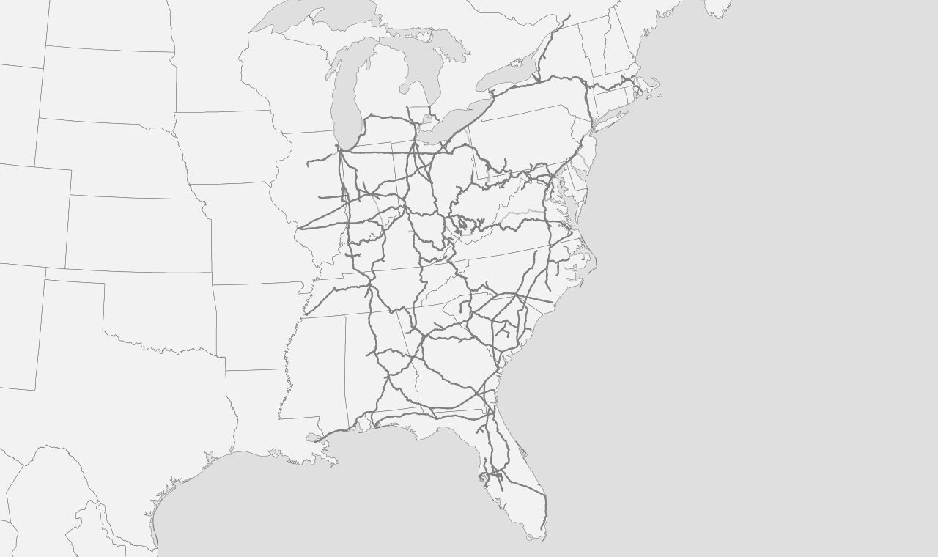


2022 GROWTH
Private
Public
Port Routing

Slide 9

THE FUTURE
Demand of local terminals, close to DC’s and manufacturing
Remove long haul dray
Reduce CO2 emissions
Fewer drivers required on the short haul- happy drivers, home for dinner
Off the train and onto the highway within 1 hour
Improved on-time deliveries through shorter drays
Communities supporting local businesses and jobs
REDUCE DRAY MILES BY 90%

Slide 10
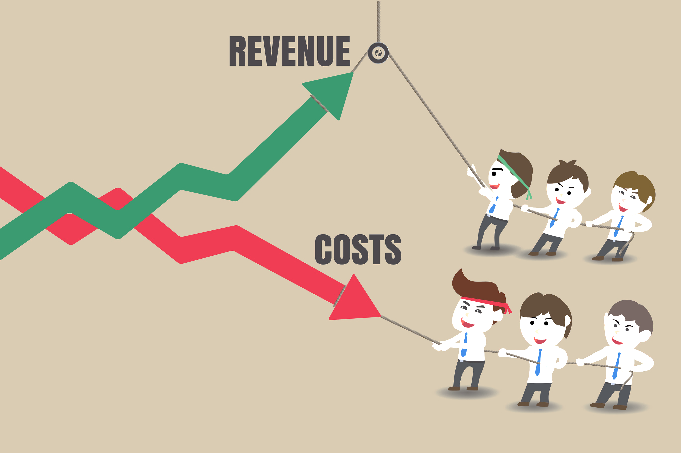
Access unique markets without depot investment
Removing barriers to entry for a new, balanced market
Private chassis fleet owned and operated by Valor Victoria
Eliminate cost of empty repositioning containers
Reducing dray miles = faster turns inland
Export revenue guaranteed (select markets) without the inland risk
Foster longer-term relationships by offer a cost savings solution to BCOs
Valor Victoria funnels new import and export business to participating ocean carriers
OCEAN CARRIERS
10

Slide 11
THANK YOU
ashley@valorvictoria.com

