Slide 1
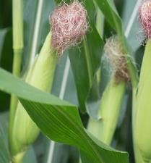
Technology Innovations delivering Data Driven Insights to Farmers
Teddy Bekele
Chief Technology Officer
Land O’Lakes, Inc.
Notes:
Thank you for the opportunity to join you today and thanks to the Larta Institute for the invitation.
AGENDA
Overview of Land O’Lakes.
Focus on three focus areas as we consider how ag tech plays a role that spans the agriculture sector.
First, the lay of the land in agriculture, where technology continues to play a huge role.
Second, our work as a farmer-owned cooperative, with a locally-owned network of retailers across America, to deploy ag tech.
Finally, where are things headed? A look at what might be around the corner and how we are contributing.

Slide 2
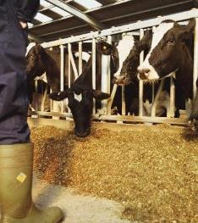
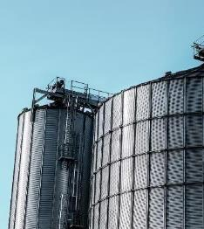
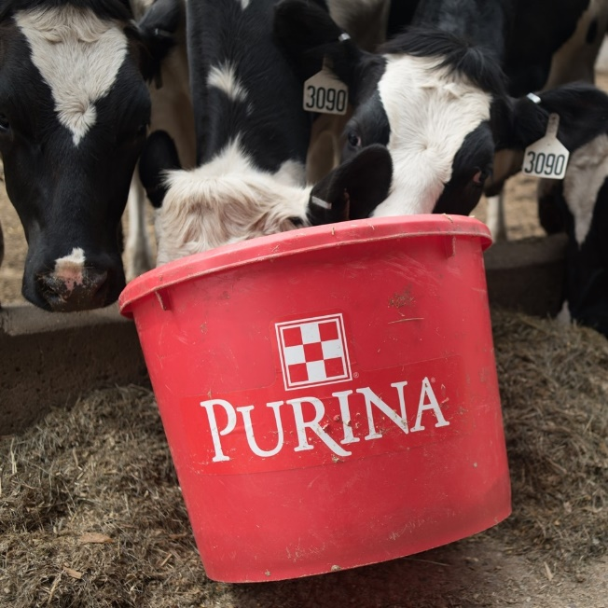
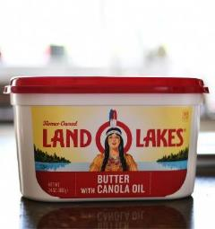
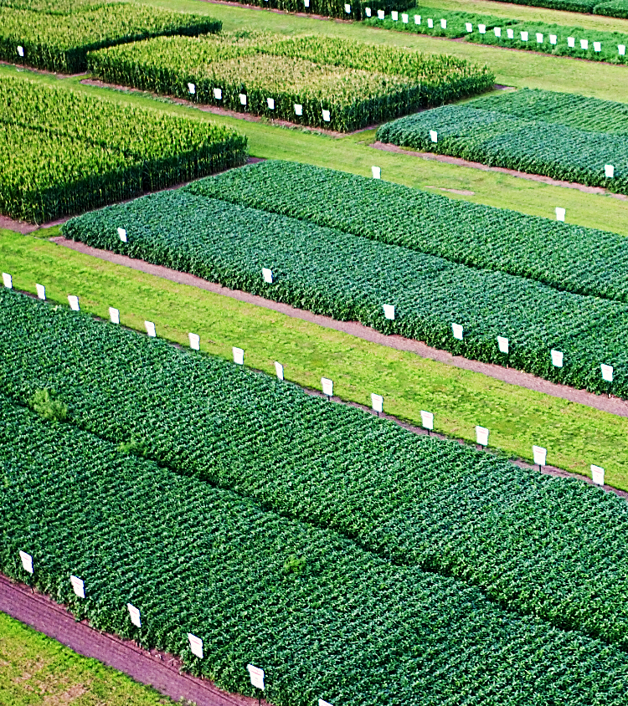
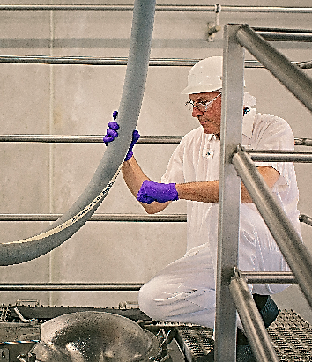

FARMER-OWNED COOPERATIVE
1,851
DAIRY PRODUCERS
Herds range from
50 to 10,000+
UNIQUE
FARMER-TO-FORK VIEW
UNIQUE
FARMER-TO-FORK VIEW
1,116
RETAIL OWNERS
Serving a producer network of 300,000+
Notes:
First, a little about Land O’Lakes.
Nearly 100 years since Land O’Lakes was formed by a group of Minnesota dairy farmers, we remain farmer-owned and we’ve added many capabilities along the way.
Today, we’re far more than a butter company. We’re a “farmer to fork” cooperative.
We operate respected businesses and brands. In addition to our iconic Dairy Foods business many know us for, we deliver crop inputs and insights through WinField United.
We provide animal feed and ingredients through Purina Animal Nutrition.
And through our Land O’Lakes SUSTAIN business, we are also deeply engaged on developing and deploying farmer-led stewardship tools. With ag tech and innovation, we’re focused on helping farmers balance both natural resources, and the economic sustainability of their business.
Across our businesses, we’re present in all 50 states and are active in more than 60 countries, which includes exports as well as markets where we’ve invested in commercial growth through core operations.

Slide 3
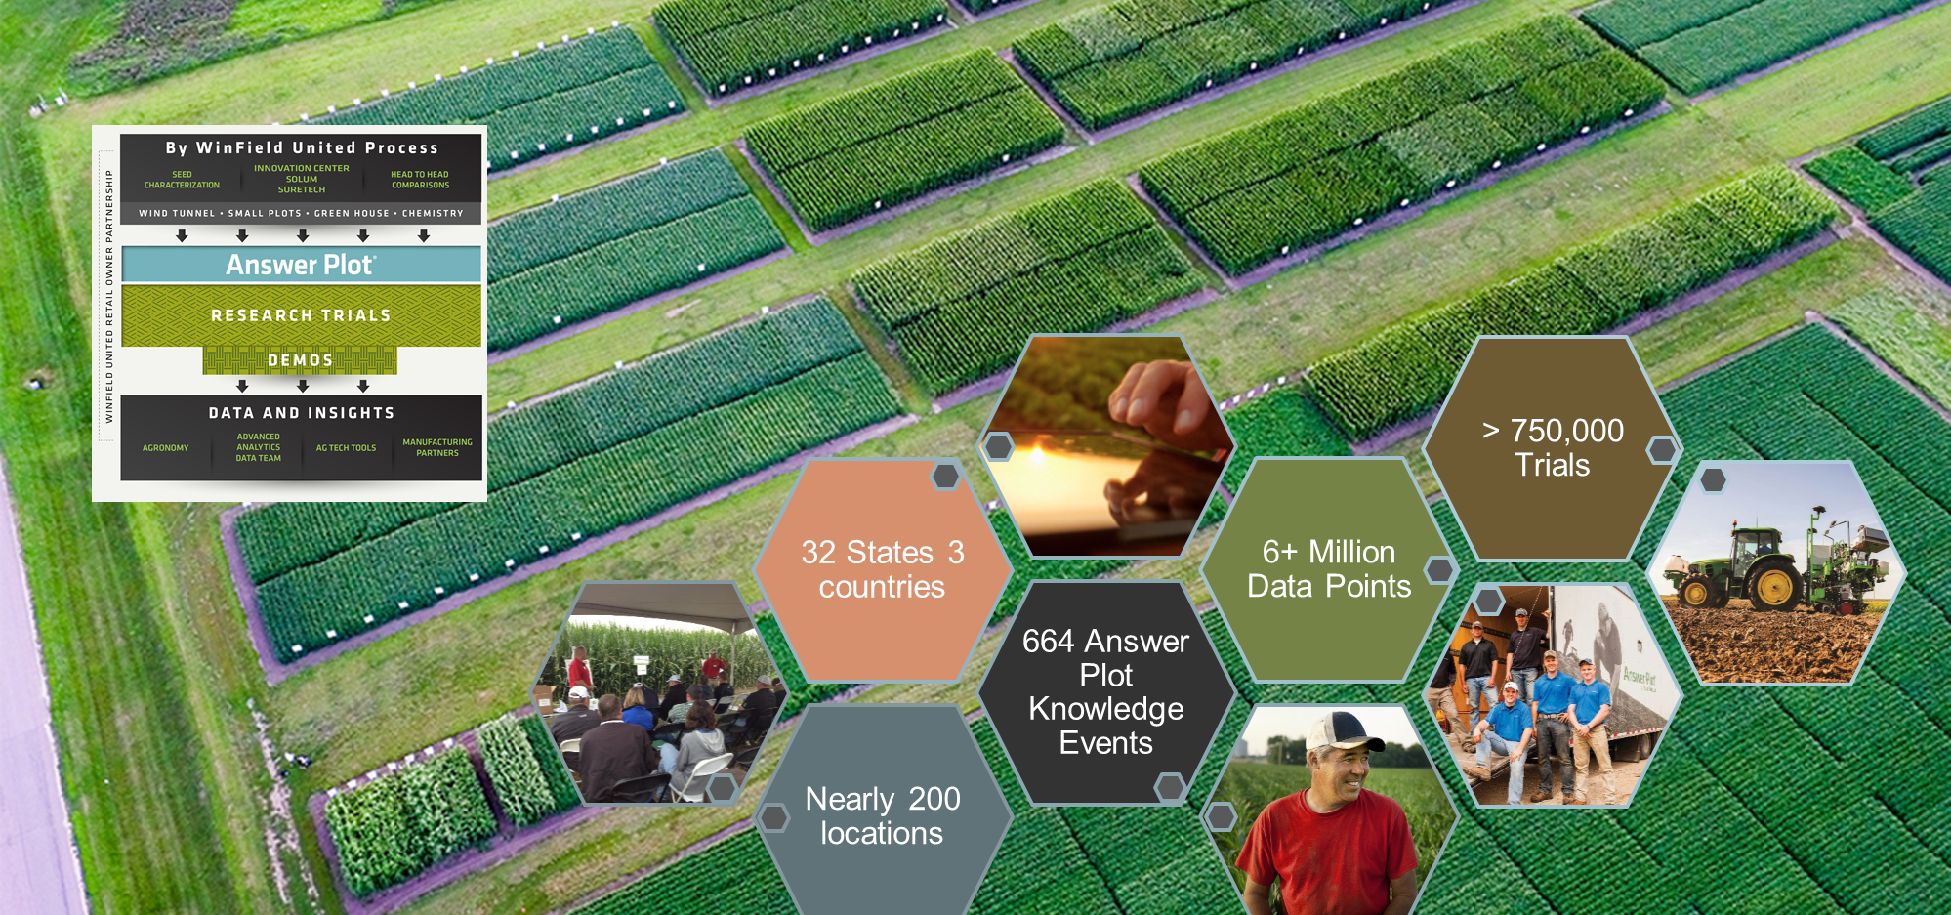
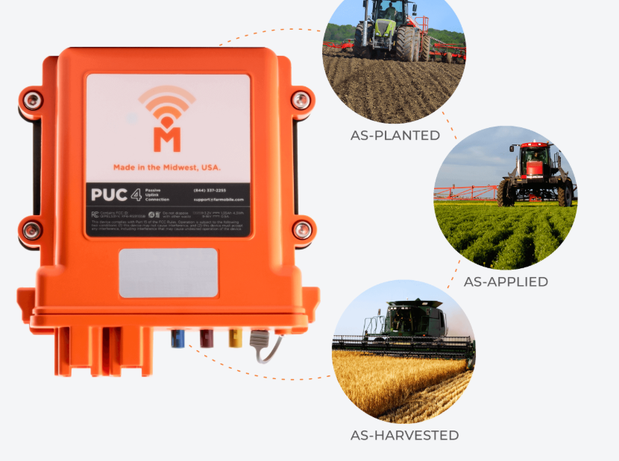
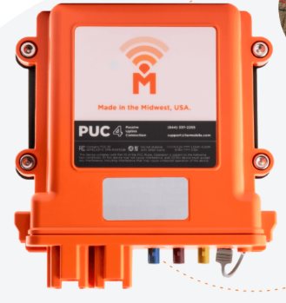
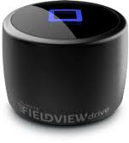
Leveraging Data to Make Informed Decisions…

Slide 4
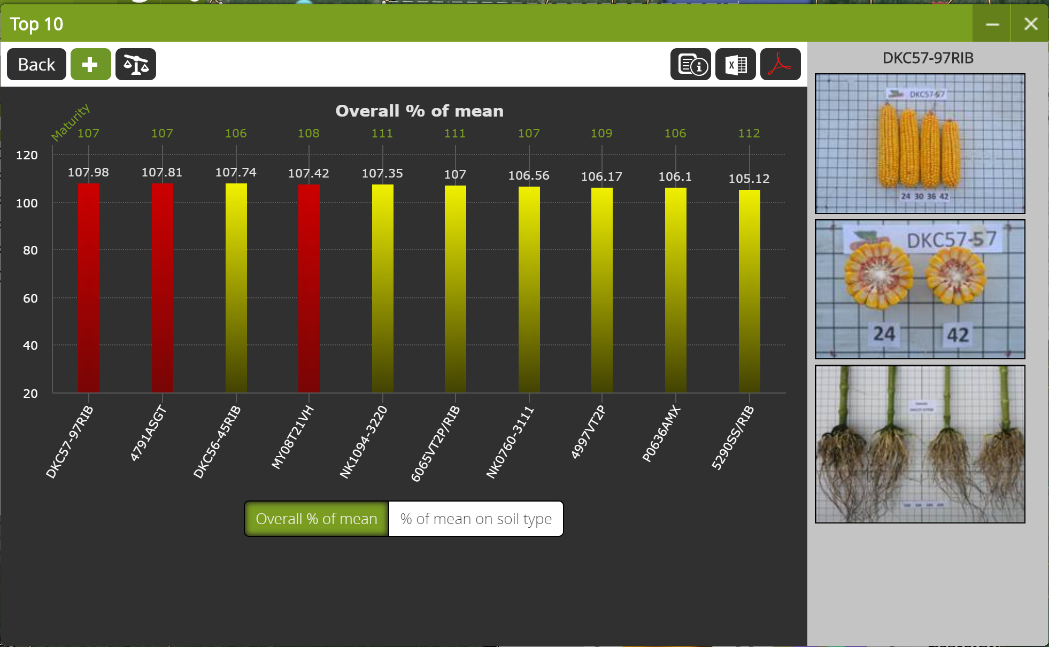
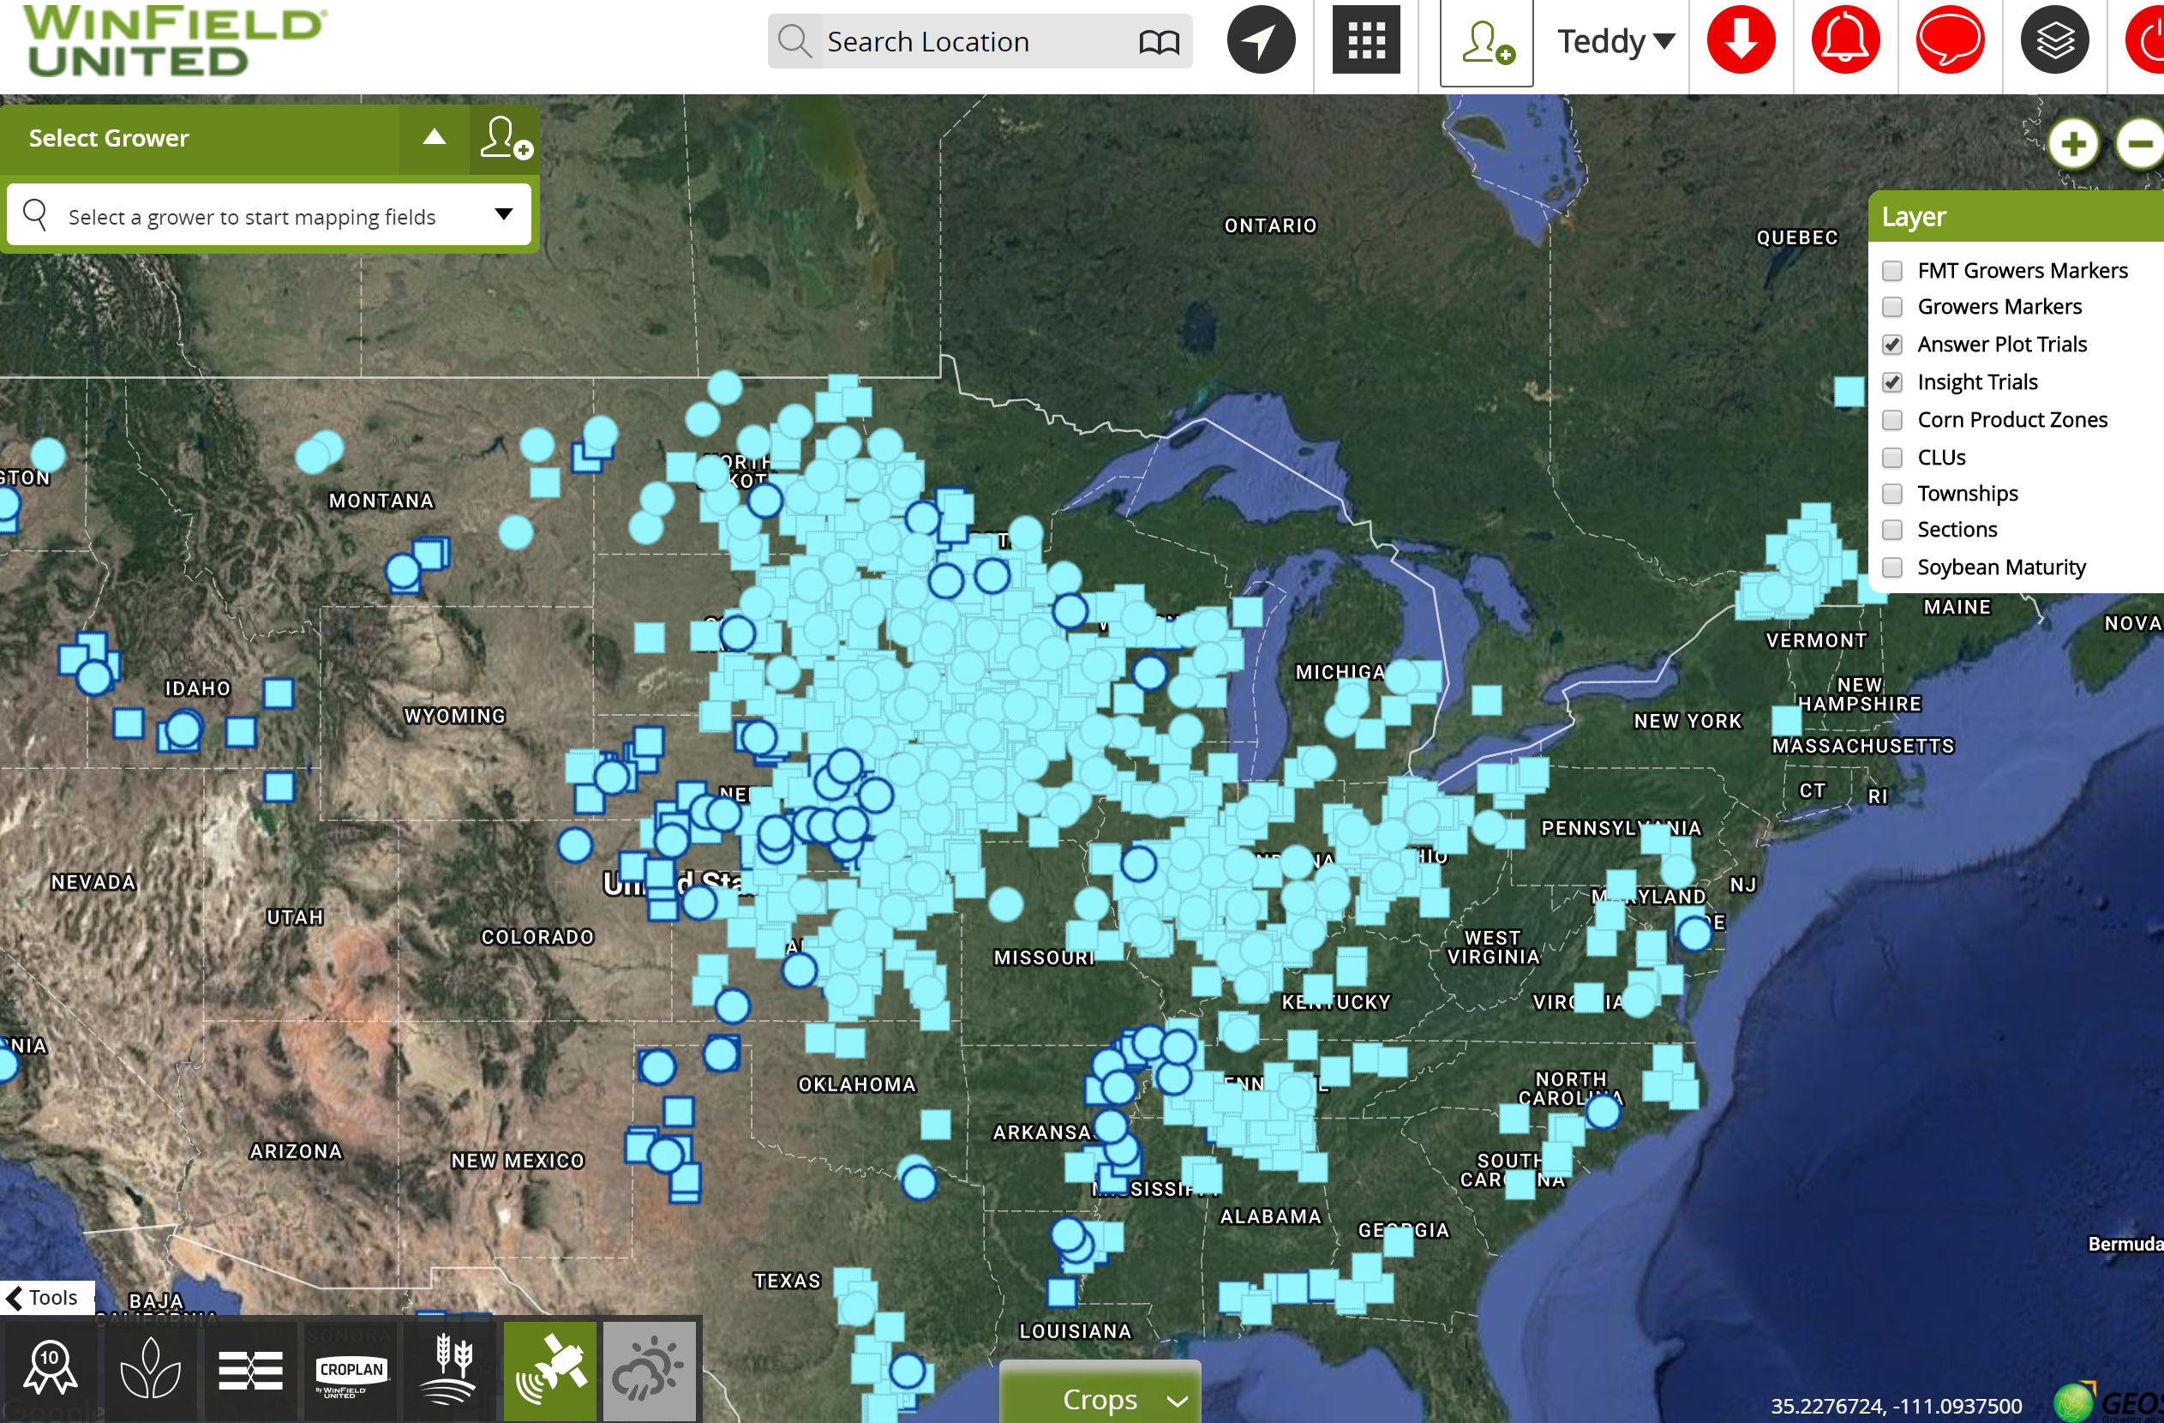
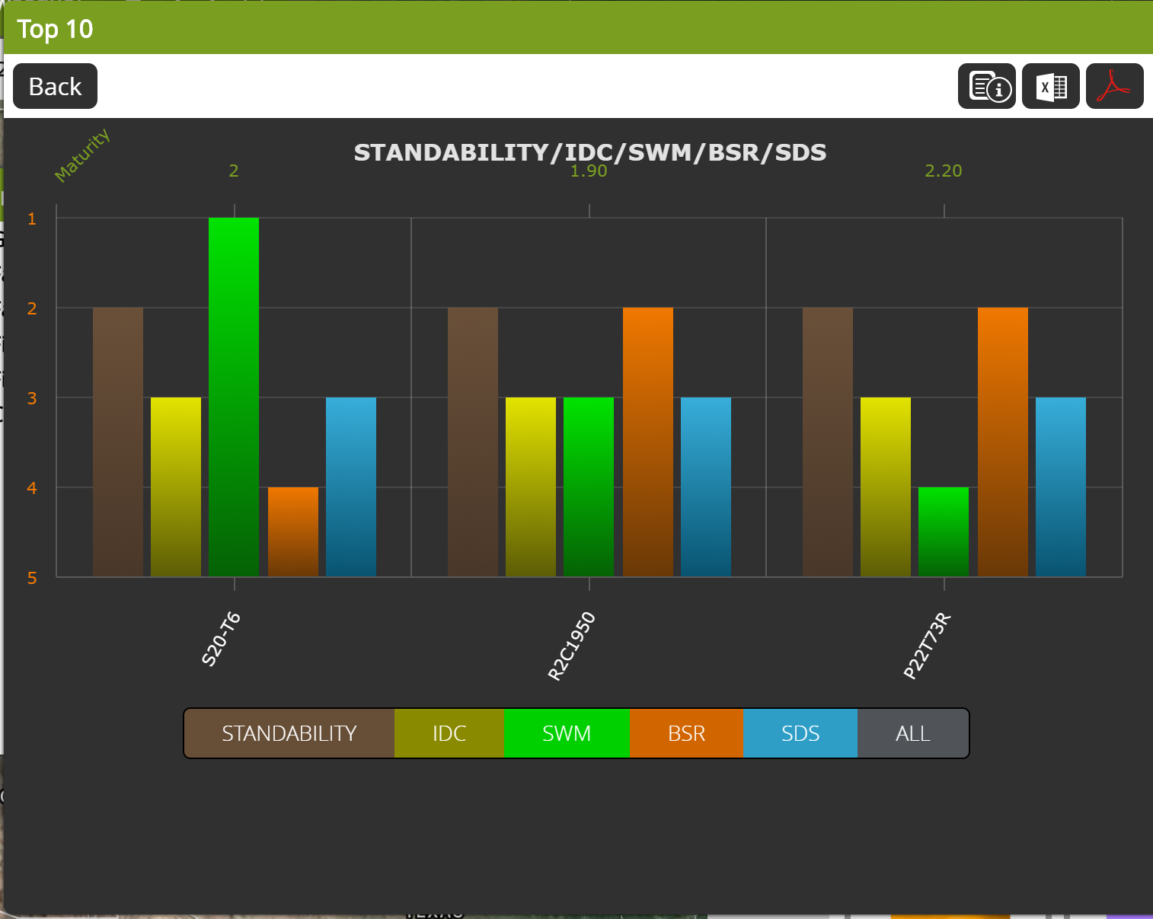
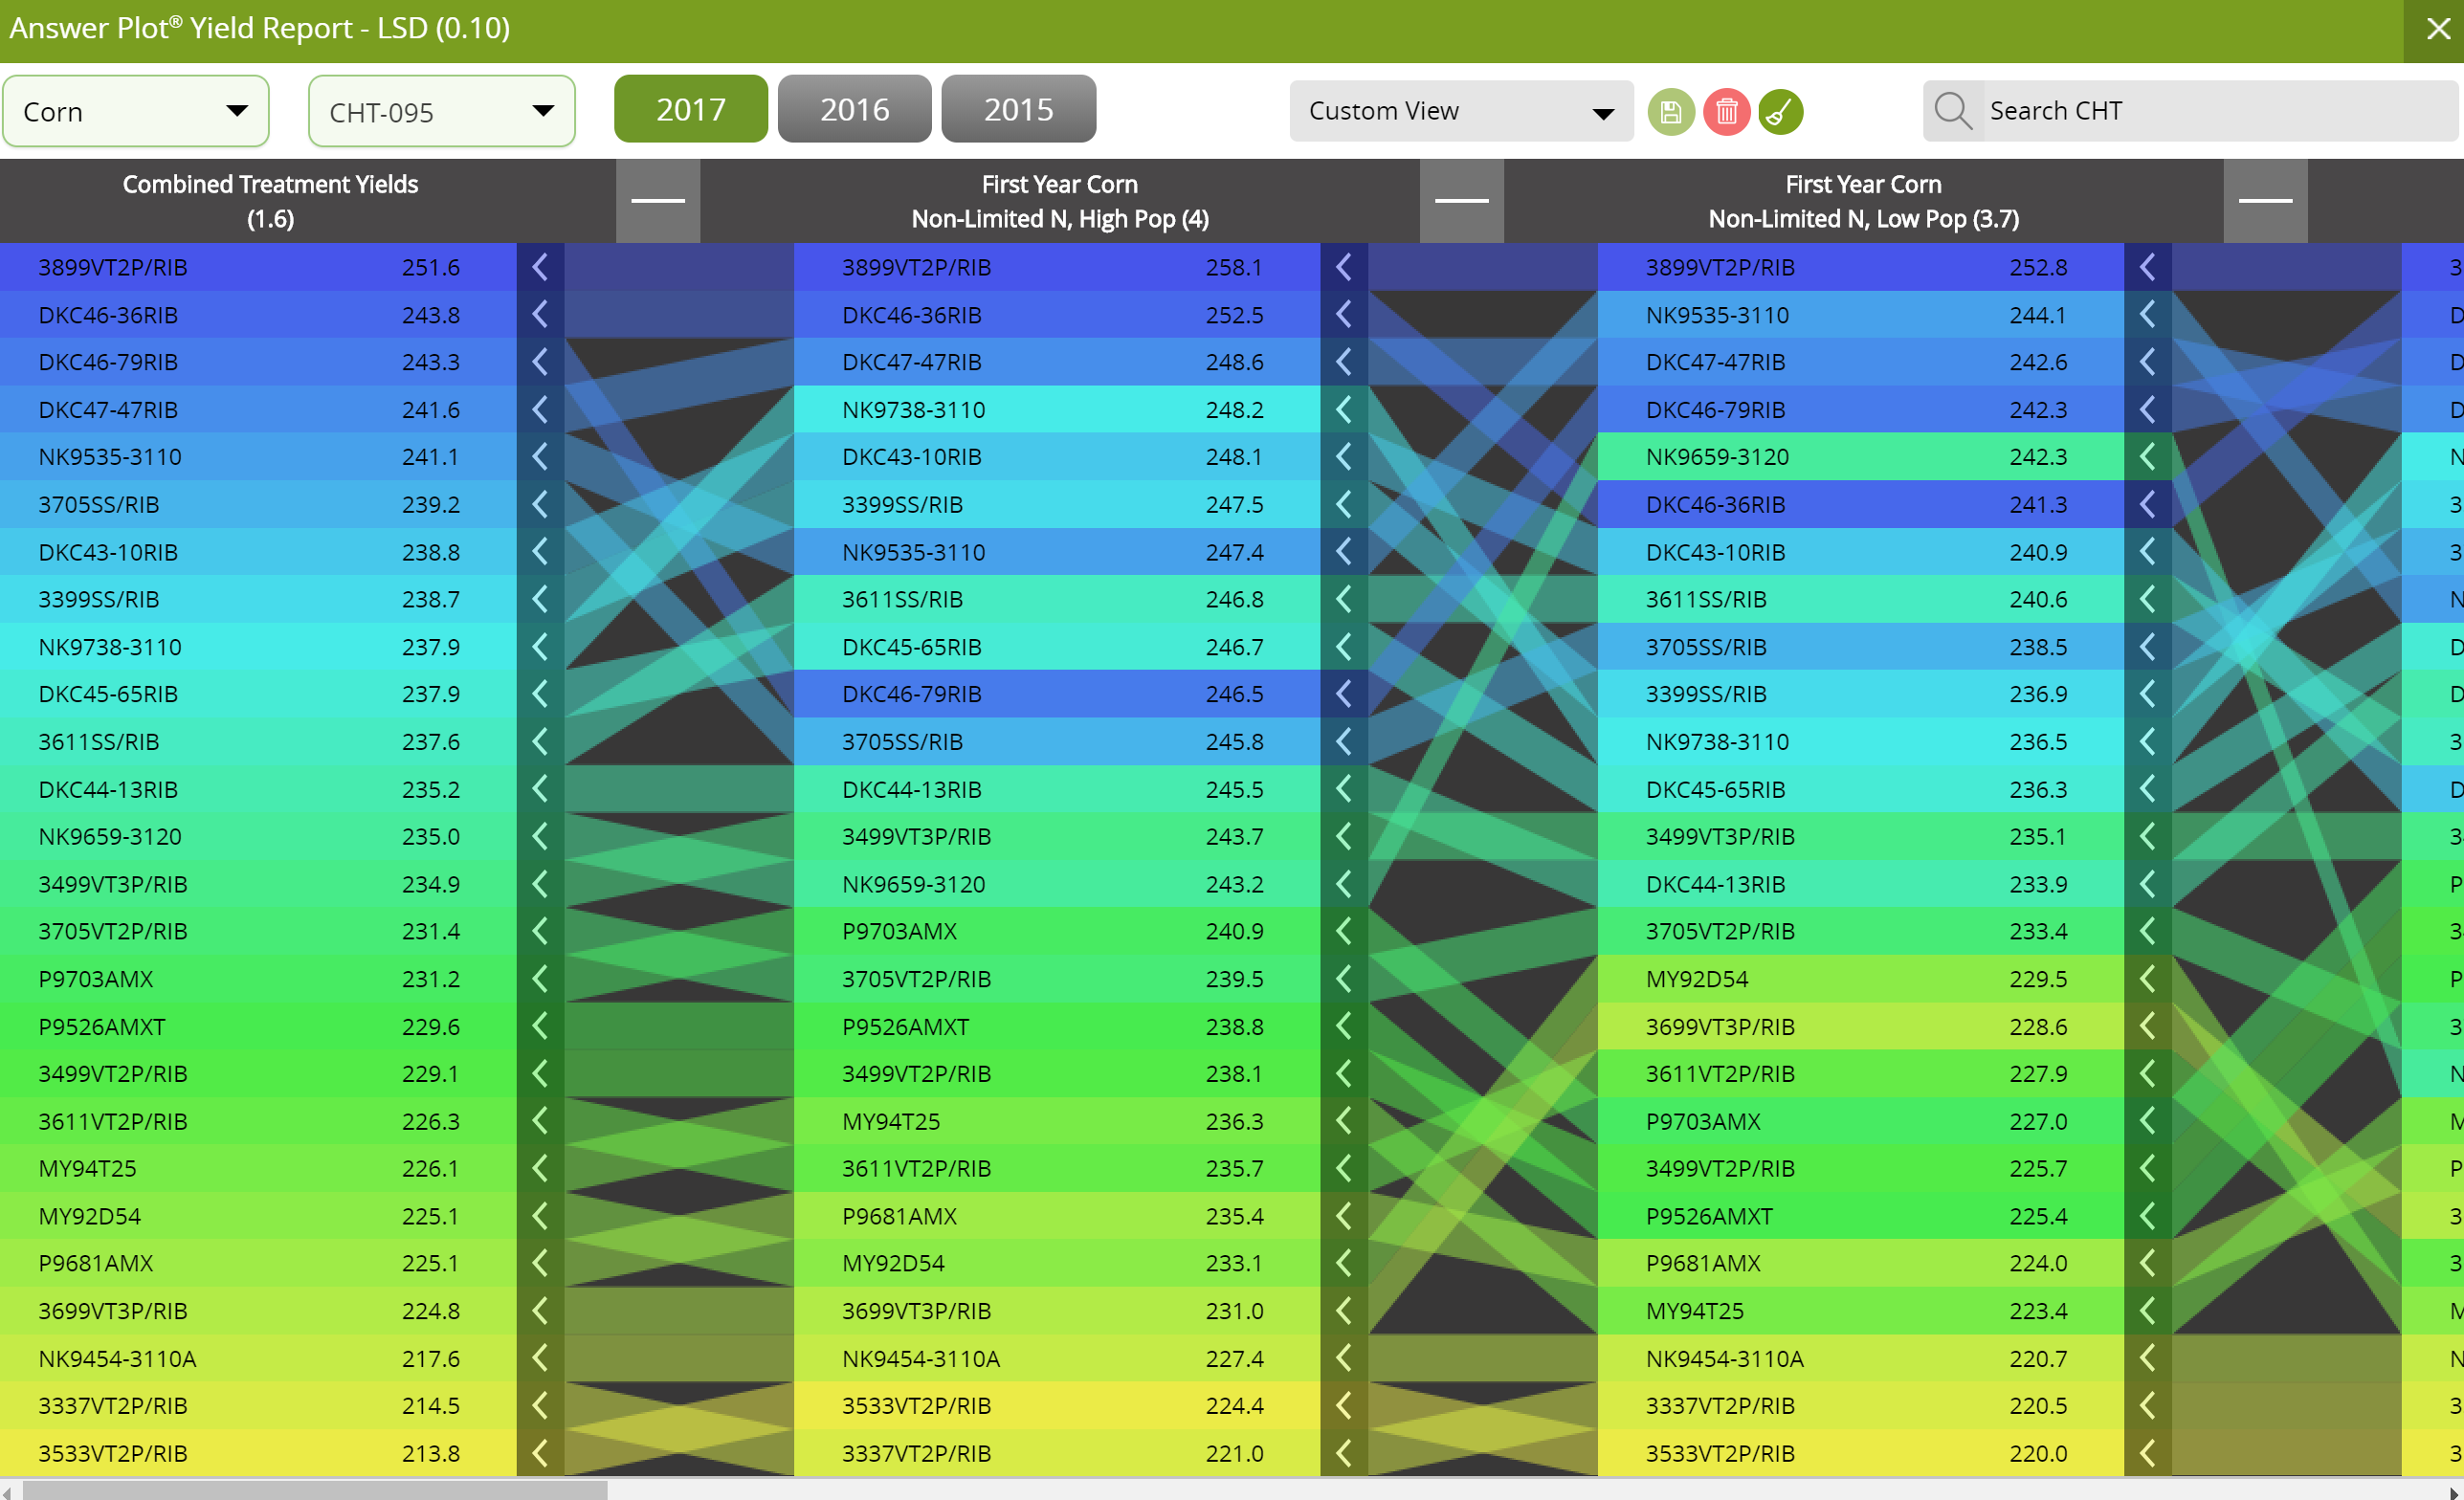
R7 Tool – Rich with Agronomic Insights
Notes:
SDS – Sudden Death Syndrome
BSR – Brown Stem Rot
SWM - Sclerotinia White Mold
IDC - Iron Deficiency Chlorosis
Standability

Slide 5
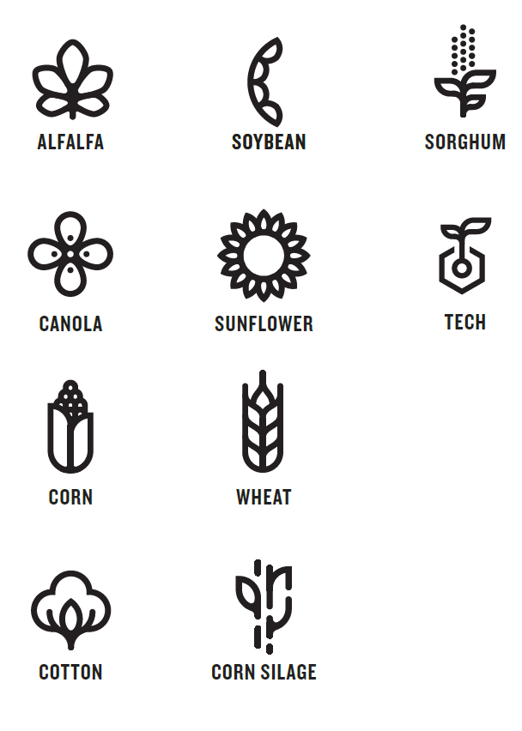

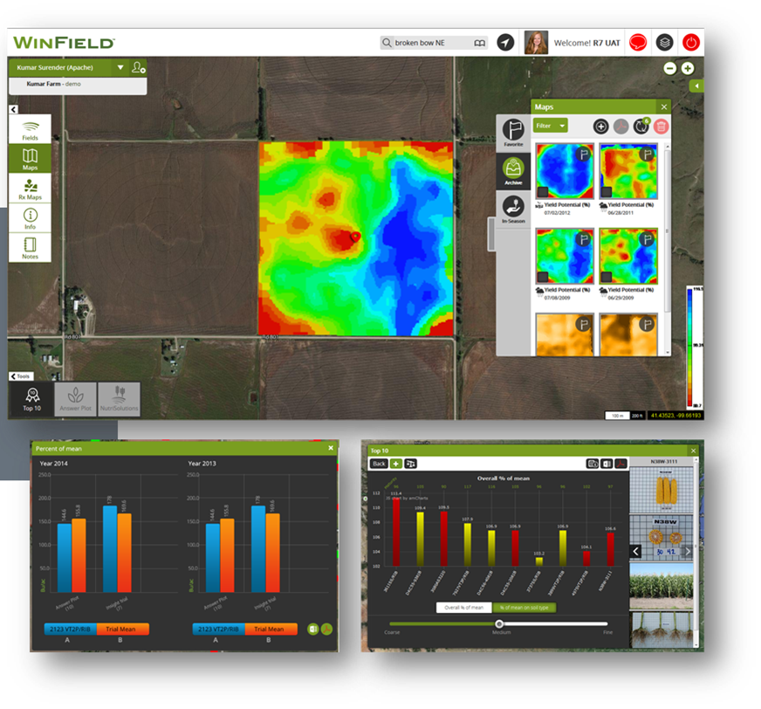
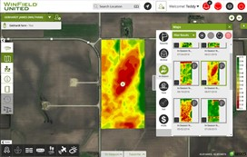
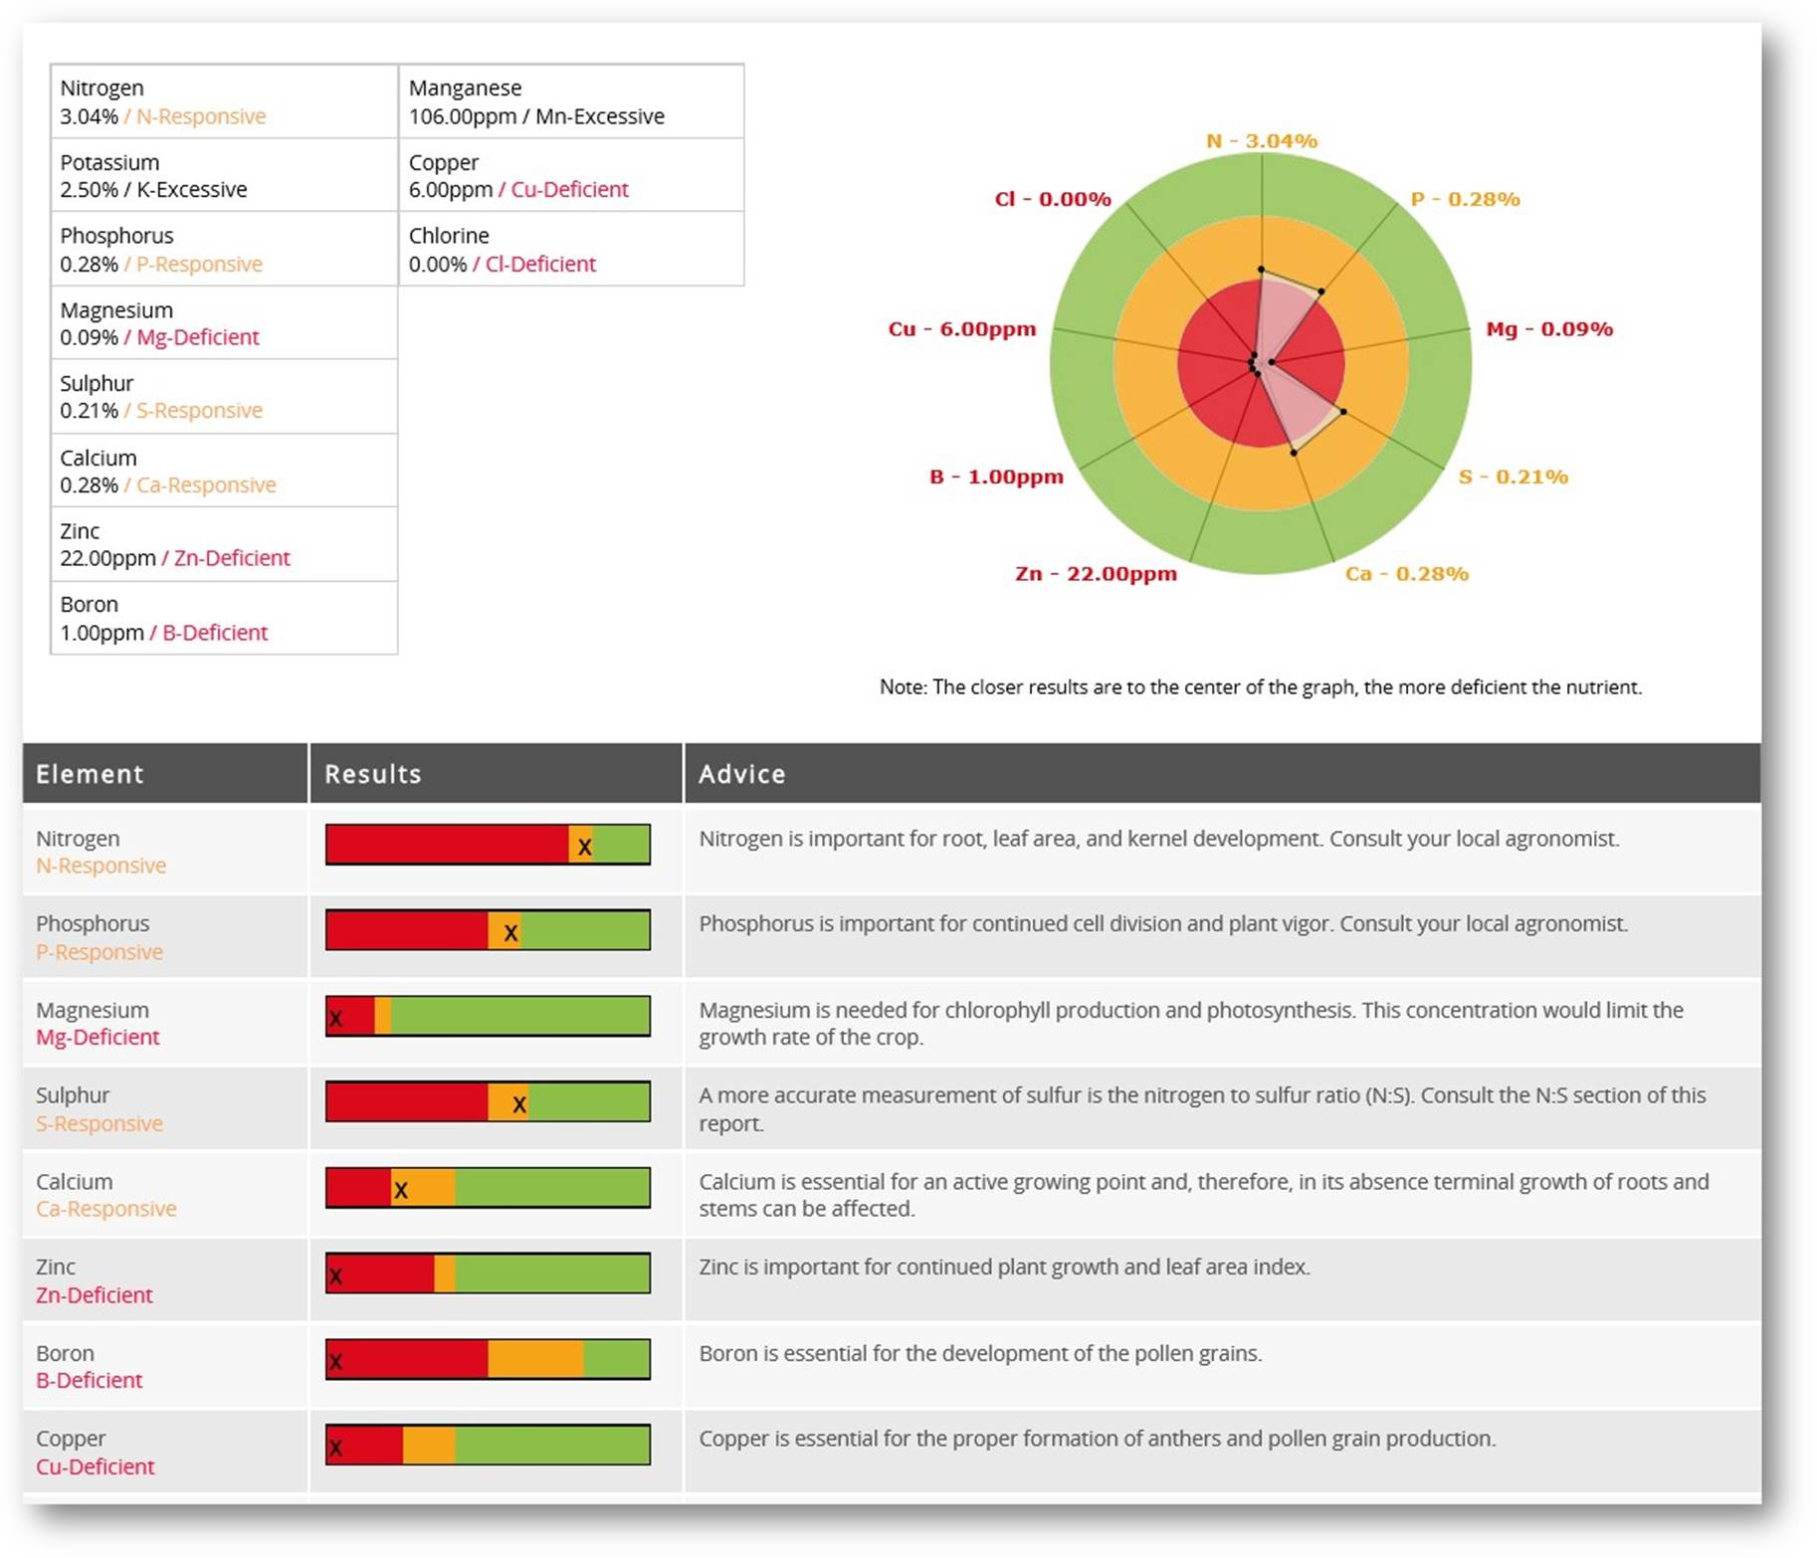
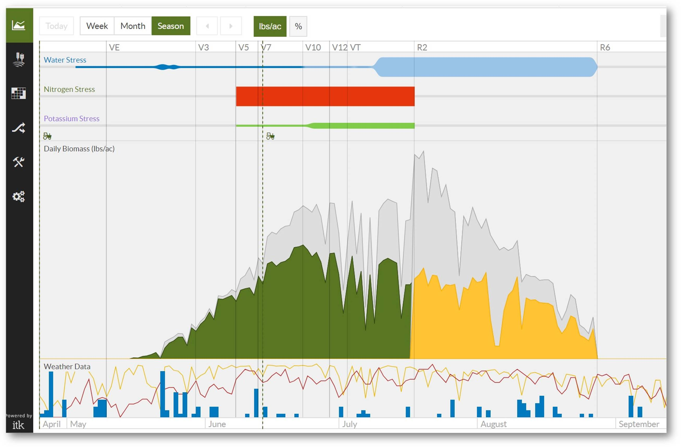
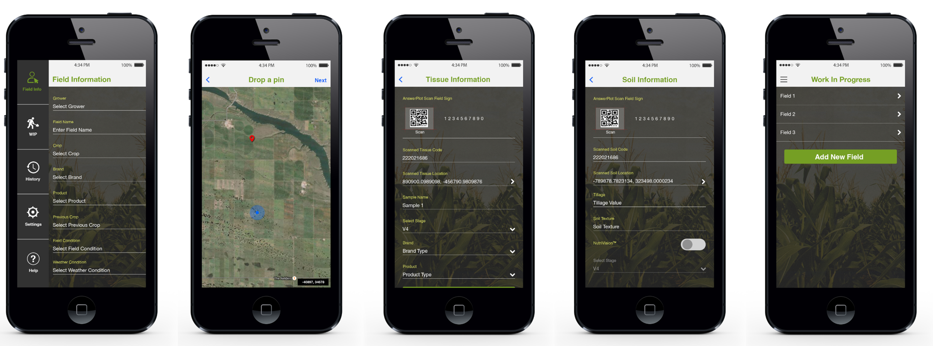
Helping Growers with Key Agronomic Decisions
Right Genetics @
Right Population
In Season
Crop Protection
In Season
Plant Nutrition
In Season
Adjustments
R7® Tool
R7® Field Monitoring
NutriSolutions®
R7® Field Forecasting
Notes:
Focused on providing insights to help growers with key In-Season decisions, the R7® Tool Suite has multiple applications that are backed by Answer Plots, Insight Trial data and remote sensing technologies. Although each tool is strong on its own, using all the tools together, navigated by the local expert, provides a multiplier effect to achieve each field’s potential.
Place the seed correctly based on the crops genetic potential and understanding the field’s variability. Put the right genetics at the right population in the right environment. Match Answer Plot and Insight trial seed characteristics with the field variability identified using the R7® Tools proprietary imagery maps.
Protecting the genetic placement decision with a Warden Brand seed treatment, mitigating early season environmental stress with a bio stimulant, like Ascend, and using balanced starters will increase the probability of achieving the field’s potential.
Benchmark field progress against similar fields beginning at emergence. Get insights on possible issues, like weed escapes, by tracking how the field is trending in biomass accumulation and start investigating the field with either a satellite image or making a trip to the field. Start your day here like “your morning cup of coffee” to be the more efficient with scouting efforts.
To make sure the crop has the right fuel to achieve its potential take a tissue sample through NS360. Use satellite imagery from the R7® Tool to identify the correct parts of the field to pull the samples – “sample with purpose.” Maybe one sample in a good spot and one in a poor spot. The tissue sample results will recommend the right Max-In product. Those results will also calibrate the R7® Field Forecasting Tool which models N, K and water to provide insight to the gap between expected yield and the field’s potential.
Based on the gap identified in R7® Field Forecasting Tool, review crop characteristics, determine the most limiting factor, and consider the forecasted weather to determine the best in season management recommendation. Model how using a stabilizer with an in season nitrogen application can improve the expected yield. Add those nutrient applications to the R7® Field Forecasting Tool to see how they impact the gap between potential and expected yield.
Validate application success in season by continual reference to the R7® Field Monitoring Tool for trend movements compared to like fields, as well as changes in biomass on a satellite image.
The proprietary R7® Tool Suite insights combined with local expertise will guide the selection of the right genetics, the right crop protection products to protect the investment and the right targeted plant nutrition products to increase the probability of achieving each field’s potential and have a more predictable outcome.

Slide 6
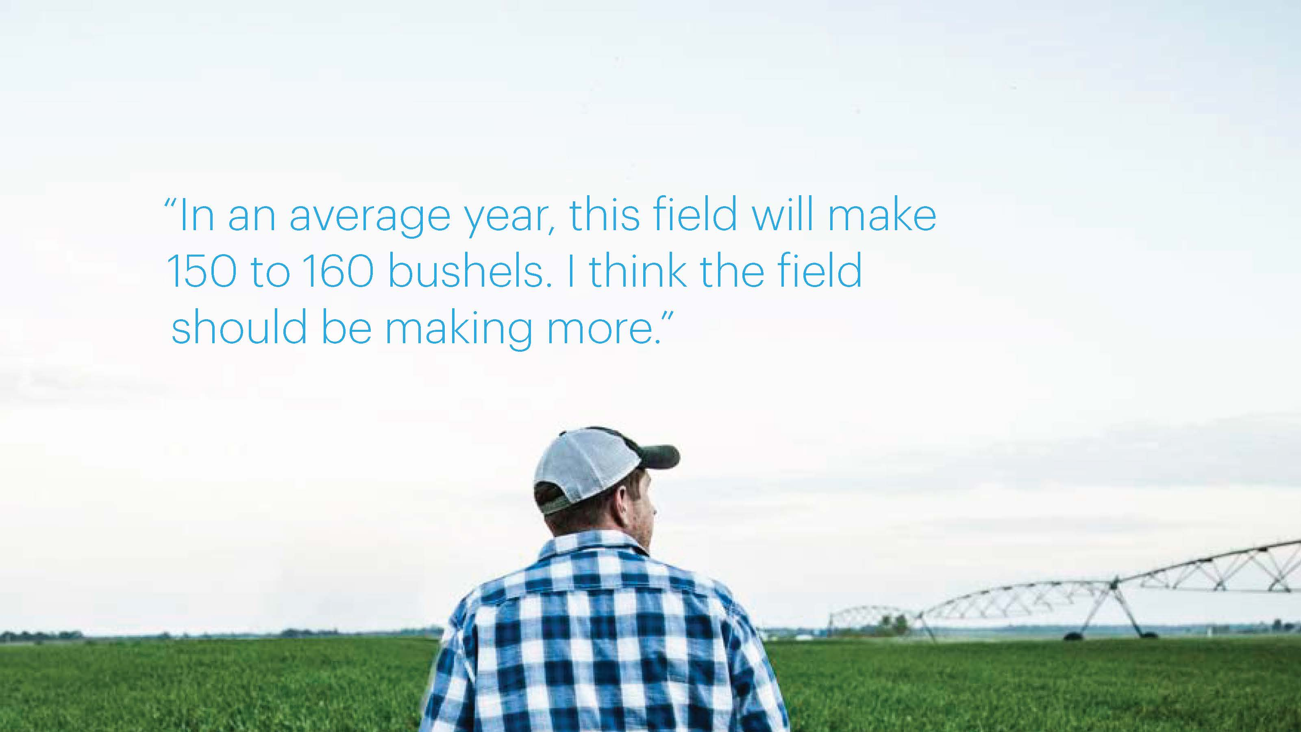

Slide 7
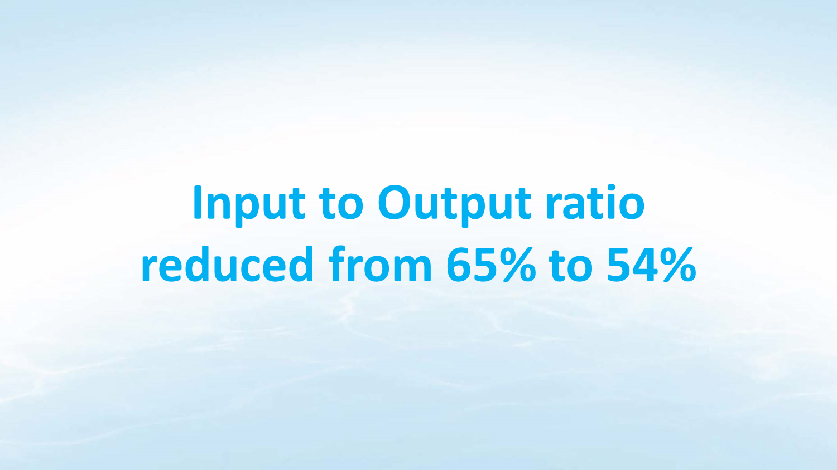
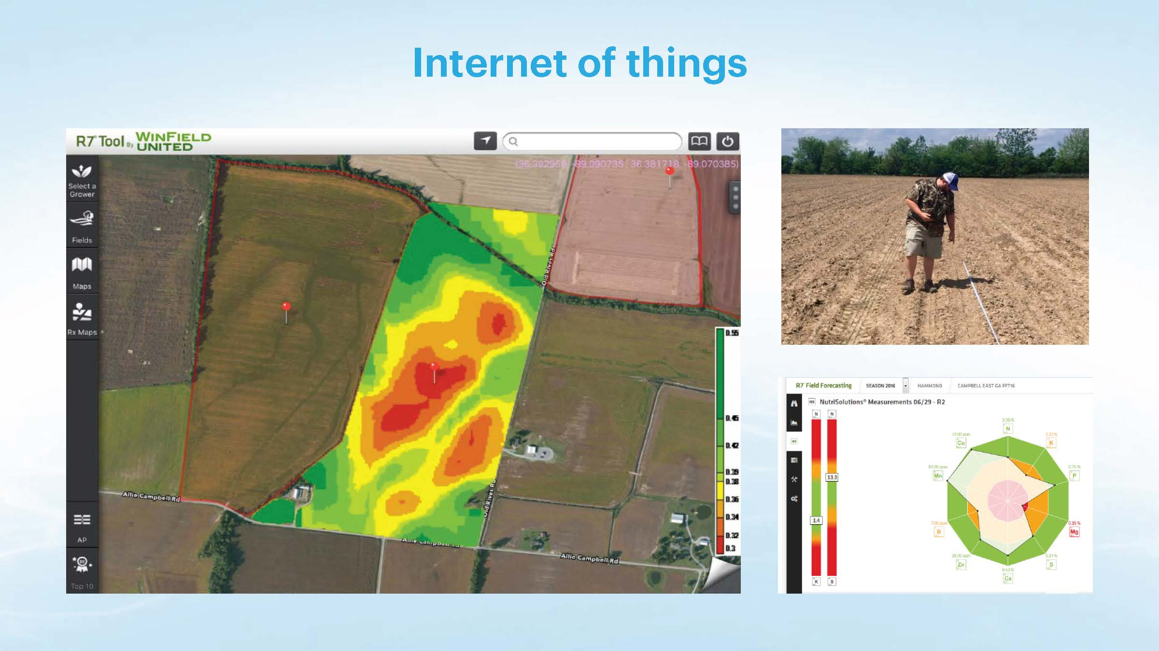
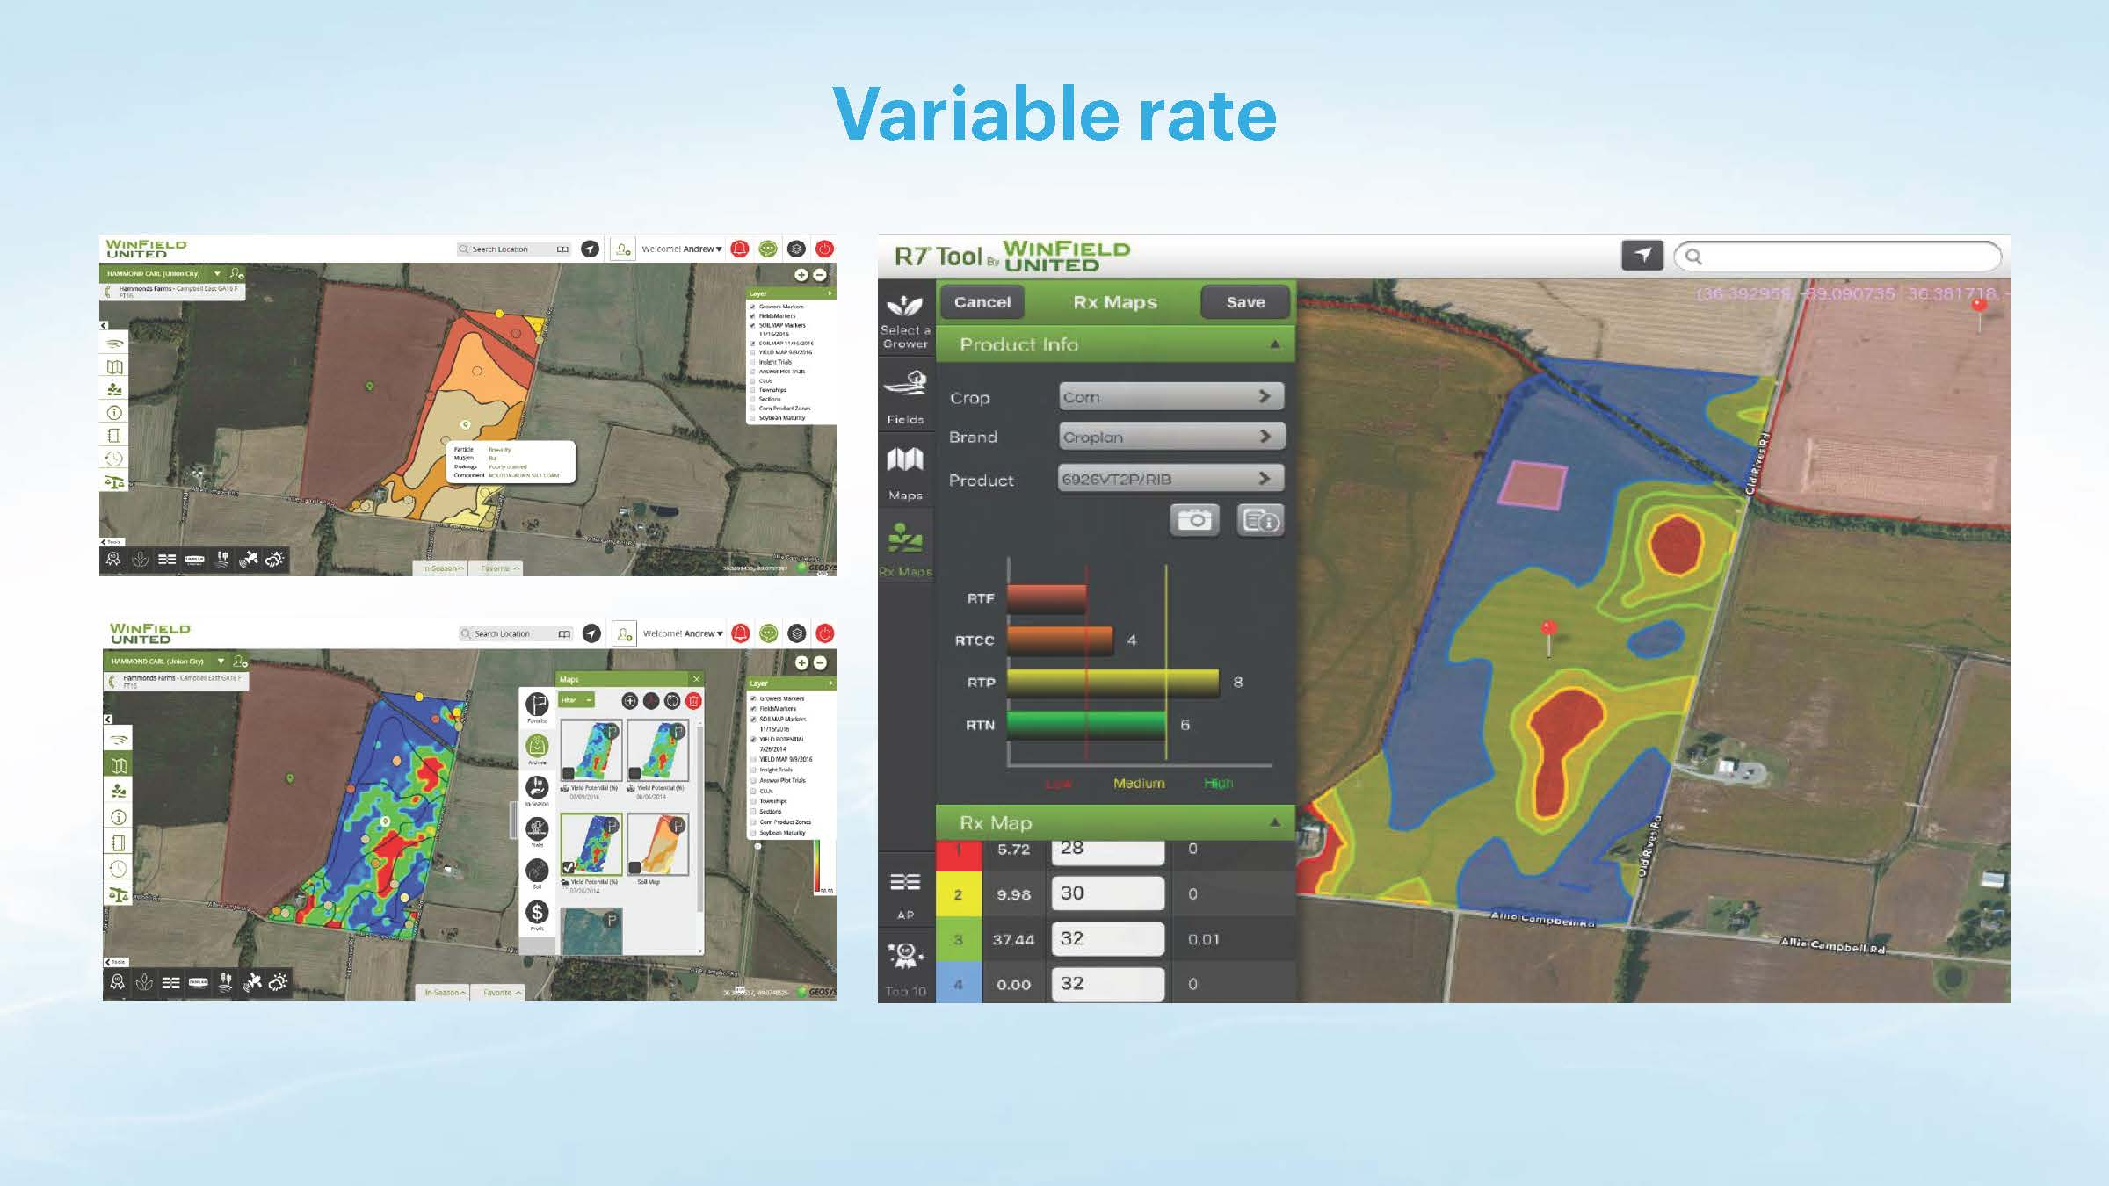

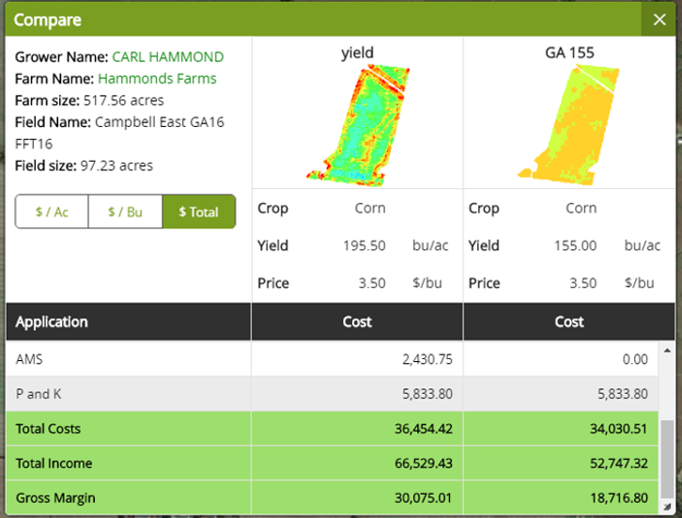
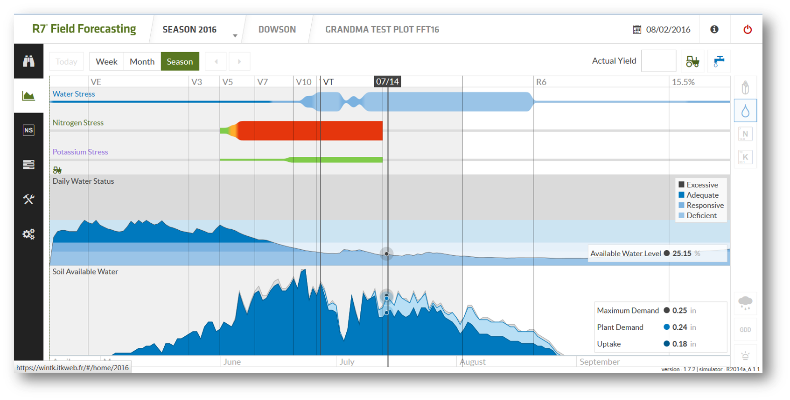
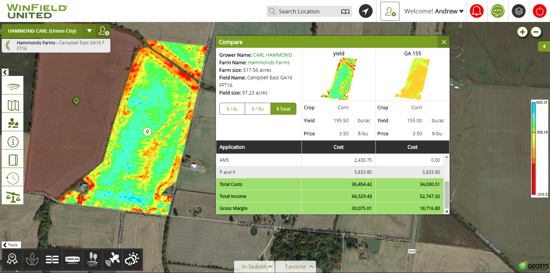
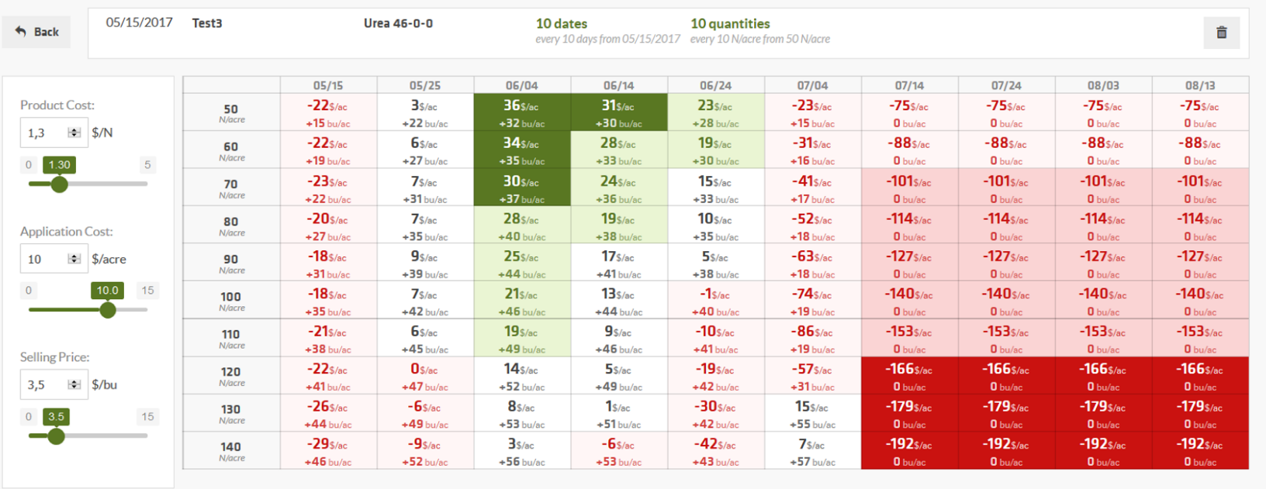
Average yield on the field: 195.26 bushels – up 22%
Economics is NOW driving Sustainability

Slide 8

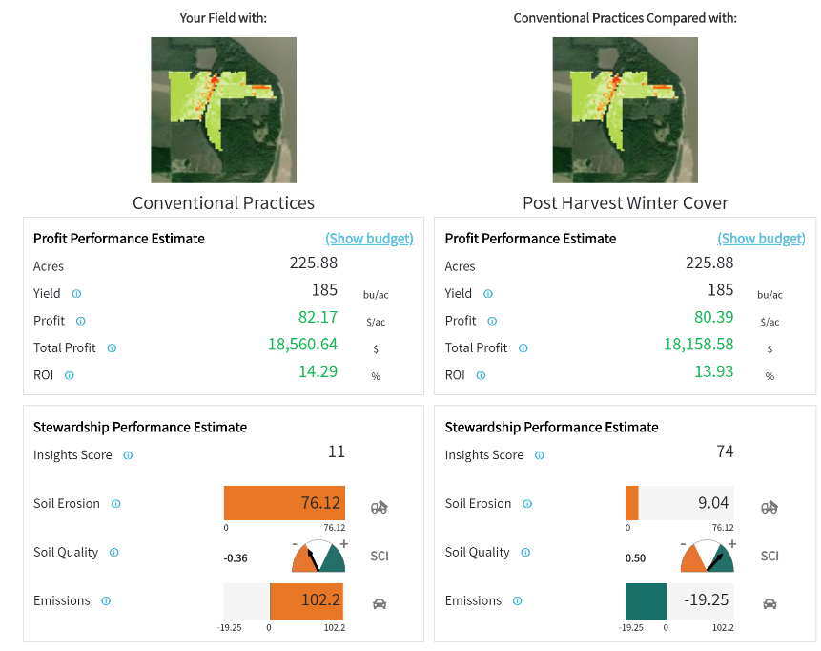
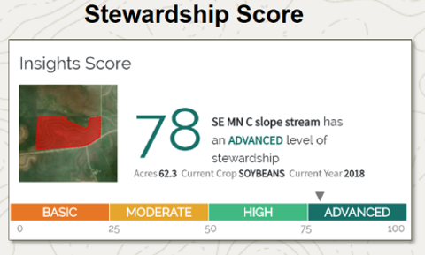
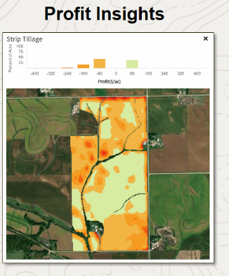

Slide 9
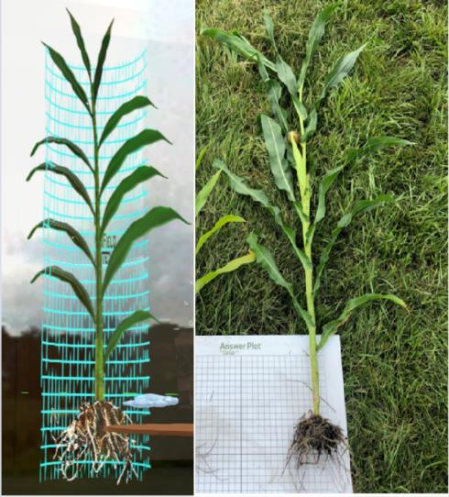
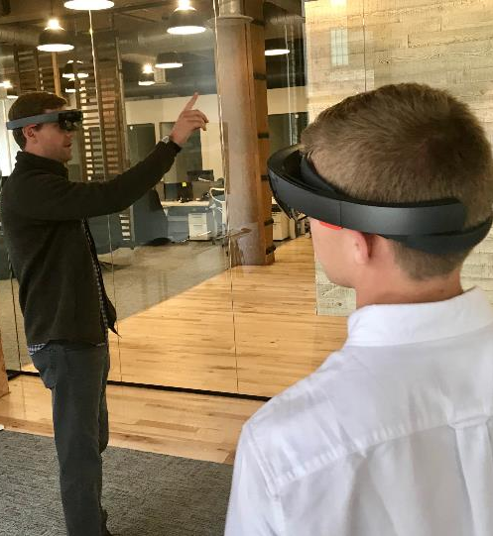
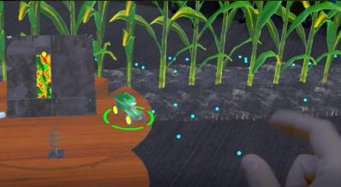
Creating “Digital Twins”
A digital replica of physical assets.
Allows us to leverage our insights and “test” solutions.
Builds on available data and research.
Notes:
Digital twin refers to a digital replica of physical assets (physical twin), processes, people, places, systems and devices that can be used for various purposes. The digital representation provides both the elements and the dynamics of how an Internet of things device operates and lives throughout its life cycle.
The concept of a digital twin allows us to leverage our insights and “test” out solutions before investing and engaging in the in-season activities

Slide 10
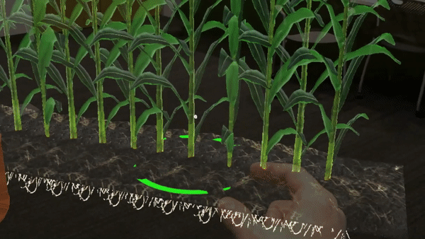

Slide 11
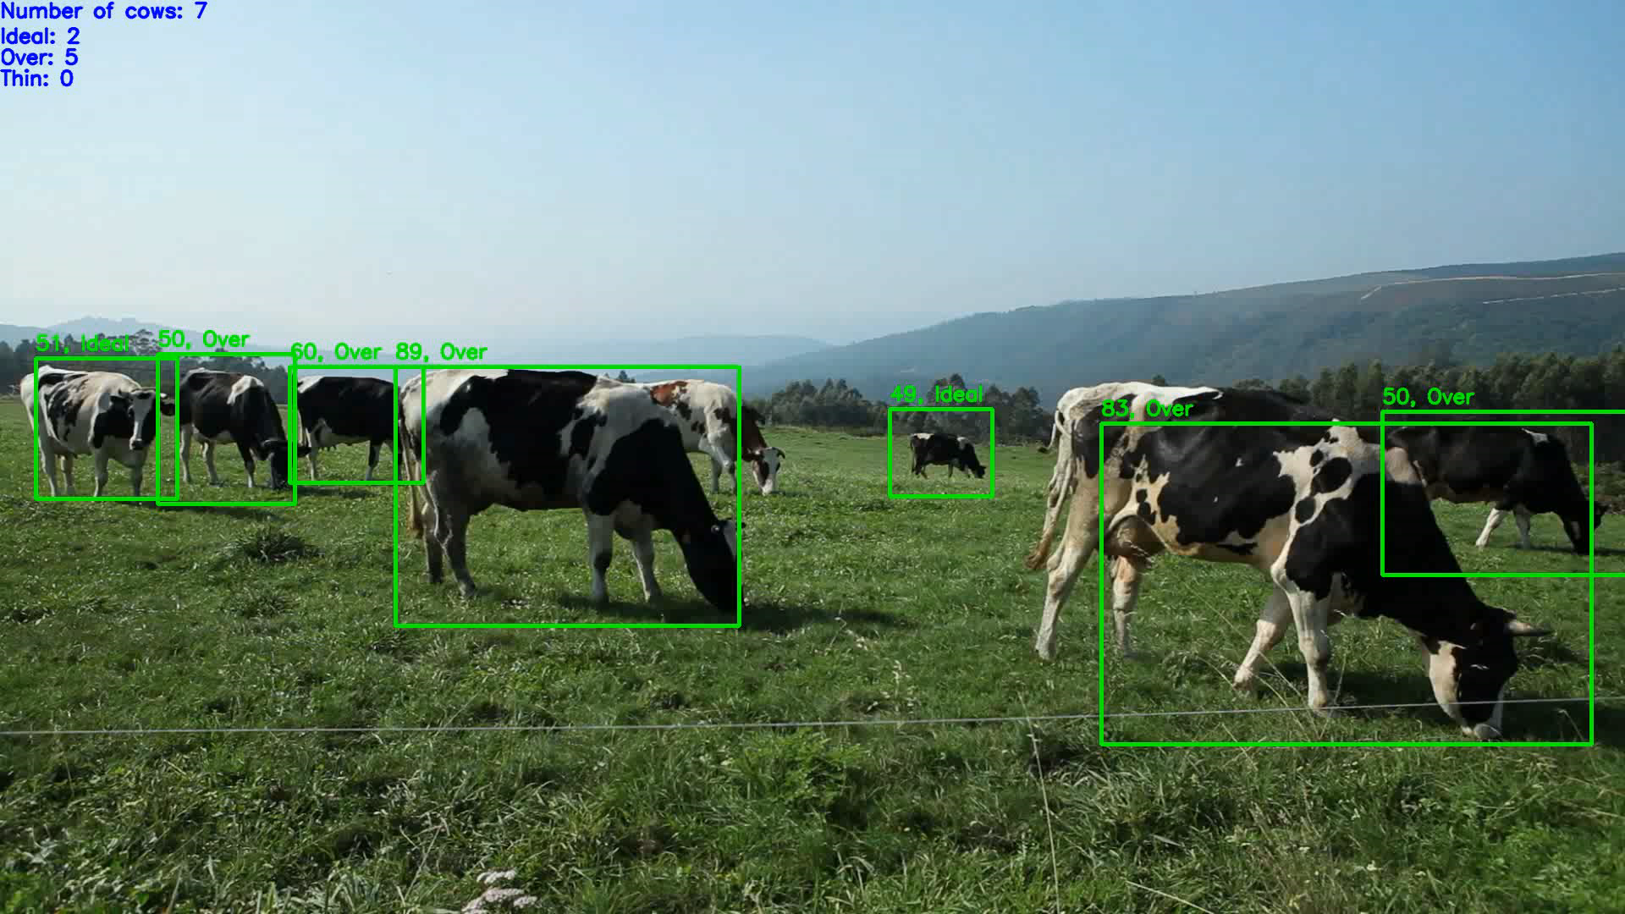

Slide 12
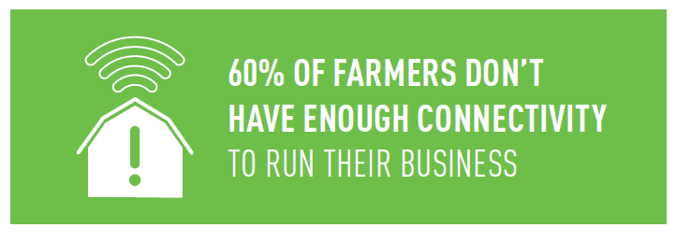
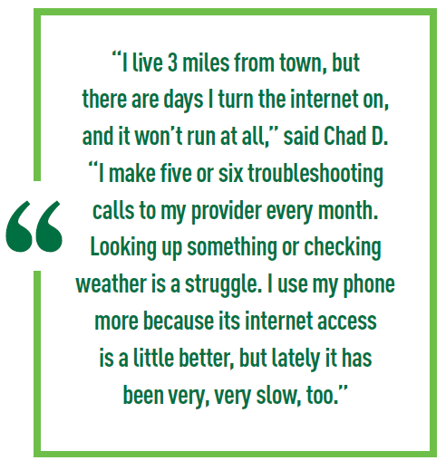

https://api.unitedsoybean.org/uploads/documents/58546-1-ruralbroadband-whitepages-final.pdf
“USDA estimates that rural broadband connectivity is the driver of more than one-third of the value ($18 billion to $23 billion/year) that digital technologies could create for our nation.”
https://www.usda.gov/sites/default/files/documents/case-for-rural-broadband.pdf

Slide 13
Precision Ag Connectivity Task Force Overview
Explore ways to enhance the productivity and efficiency of the nation’s farms and ranches through broadband-based technologies. The Task Force is a federal advisory committee and was created by the Agricultural Improvement Act of 2018, which includes provisions directing the FCC to work with the U.S. Department of Agriculture to develop policy recommendations to promote the rapid, expanded deployment of broadband Internet access service on agricultural land where service is not available.
  Mapping and Analyzing Connectivity on Agricultural Lands
  Examining Current and Future Connectivity Demand for Precision Agriculture
  Encouraging Adoption of Precision Agriculture and Availability of High-Quality Jobs
  Accelerating Broadband Deployment on Unserved Agricultural Lands

