Slide 1
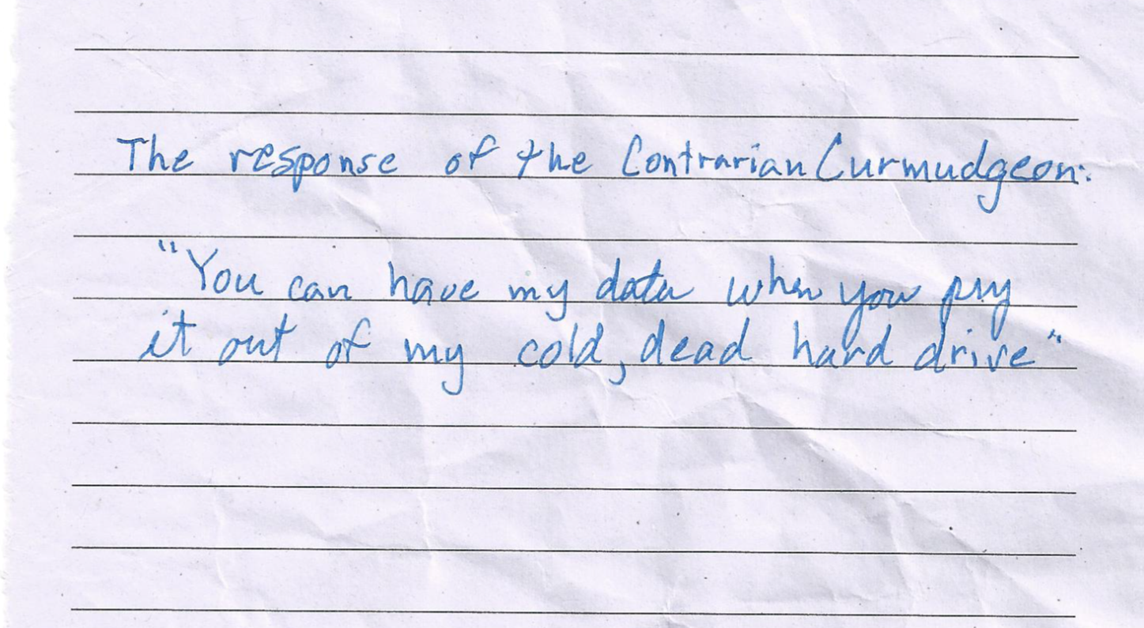
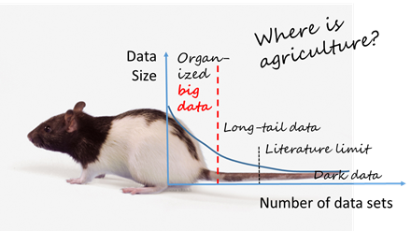
Enabling Open-source Data Networks in Public Agricultural Research
(Realizing the dream of open data in the “long tail” of public agricultural research…)
Sylvie M. Brouder, Purdue Univ.
Ag2020 Forum
Arlington, VA
Feb. 20 – 21, 2020

Slide 2
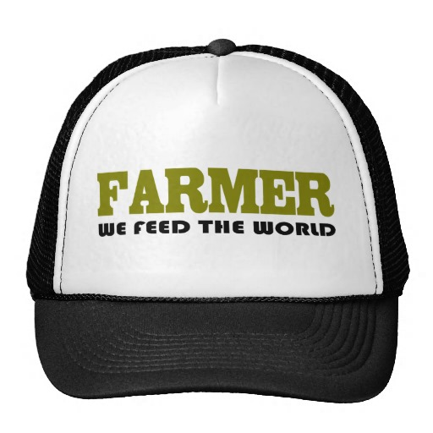
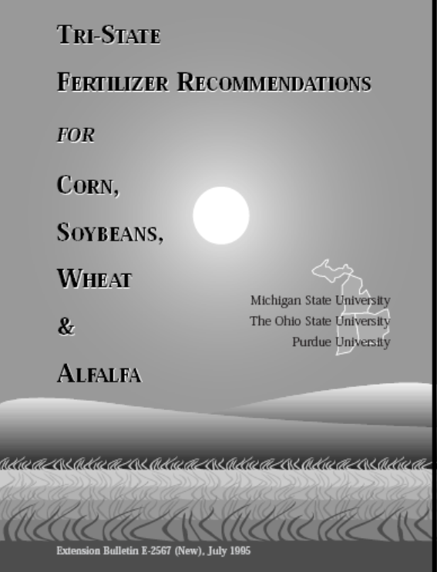
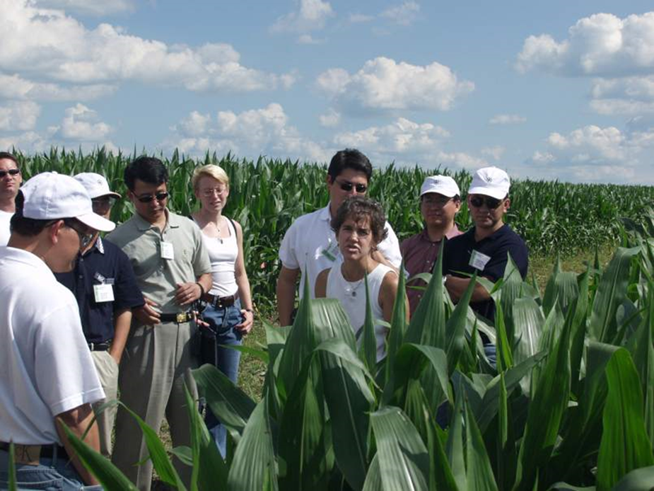
Why data? Other professional “hat”…
The Tri-State Recommendations
… and my 5-yr K experiment lasted 19th years but still not enough data…

Slide 3
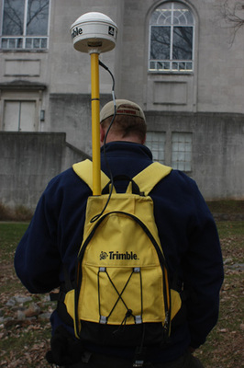
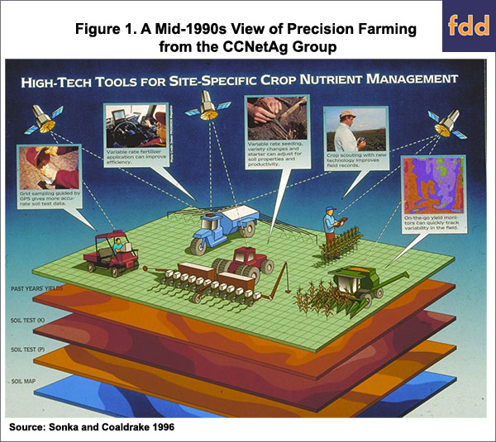
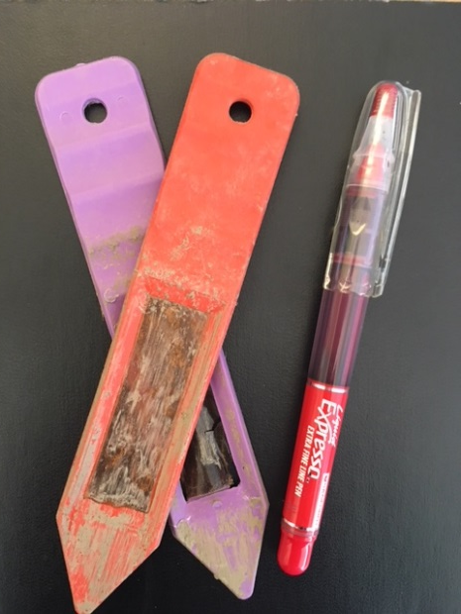
The vision for IT & data-driven ag solutions is not new…
In the beginning… 1996
Soil Map
Soil Test 1
Soil Test 2
GPS
Have we really made progress in using the tools and do we have the science needed to realize the benefits?

Slide 4
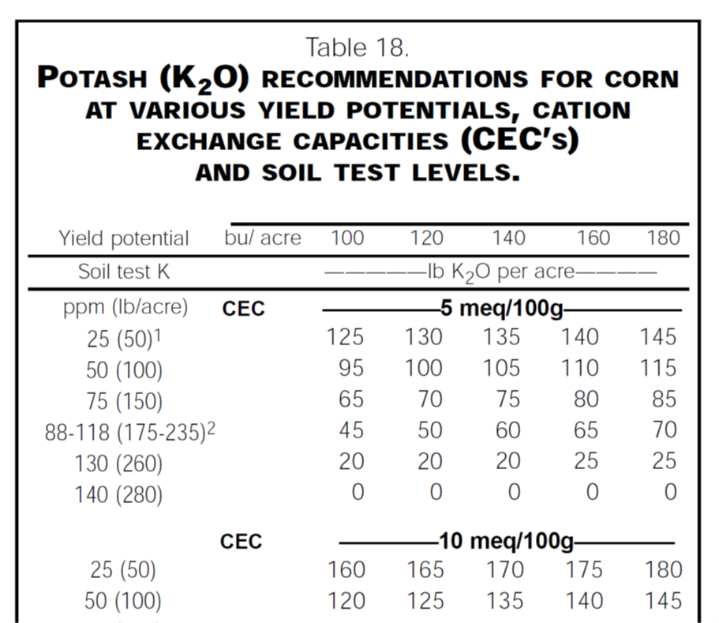
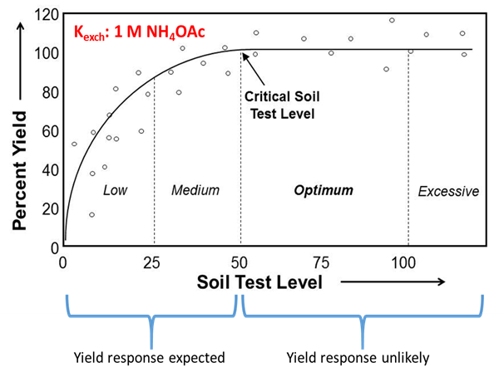
Ex. K research & recommendations: A history of small datasets & simple, “regionalized” recommendations designed for the “average” condition!
Research results: small, discrete data sets, model overfitting, sparse covariate data…
Tabular data  fit a function to the soil-specific recommendation….
Approached as a “small” data problem w/ geopolitical boundaries

Slide 5
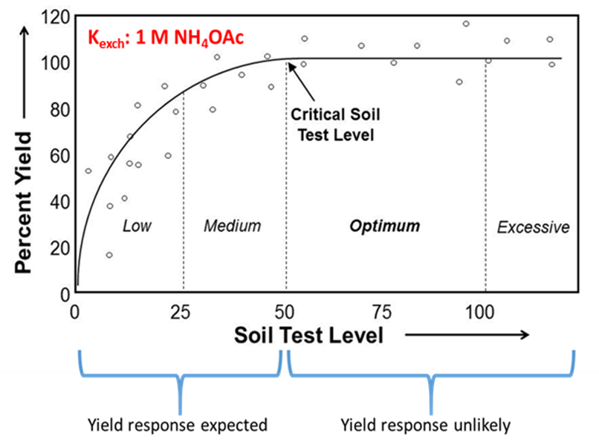
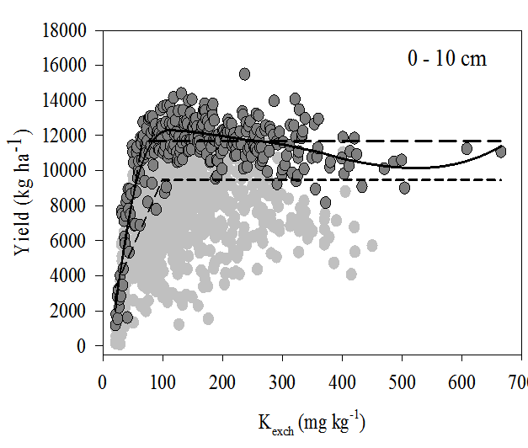
When you can acquire lots of research data…
It does NOT look like this.
It looks like this!
R. Navarrete, 2013
Historically disregarded b/c we did NOT have the computational power & covariates to understand it, synthesize it into actionable knowledge & reliably extend the inference space…

Slide 6
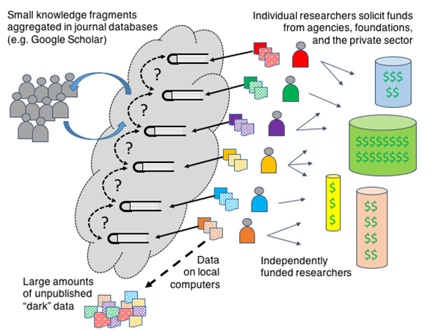
We really have not changed how we do agricultural research…
Environmental Outcomes:
Article data not “open” (subscription paywalls)
No explicit linkages among knowledge fragments
Research not transdisciplinary
Lots of inaccessible and, often, lost data
Data accessed via journals partial and (potentially?) biased
The
“Small”
Science Environment

Slide 7
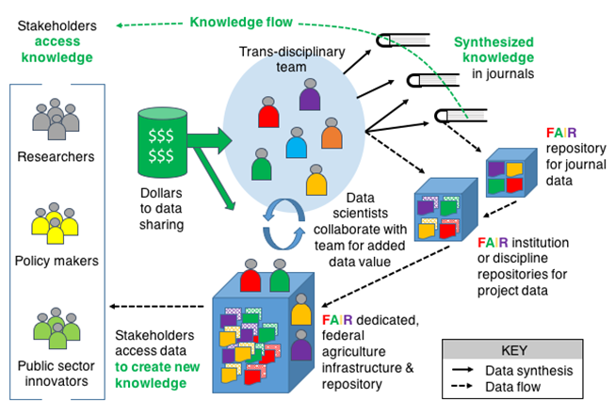
The data ecosystem for team science… (2019 CAST Commentary)
Key attributes:
Data collection a priori anticipating reuse
Article data is published; all project data are FAIR
“Knowledgebases” with expert services enhance data collections and reuse
Dedicated experts collaborate with teams and stakeholders for high-value data products (“fusions”)
Stakeholders access knowledge and data…

Slide 8
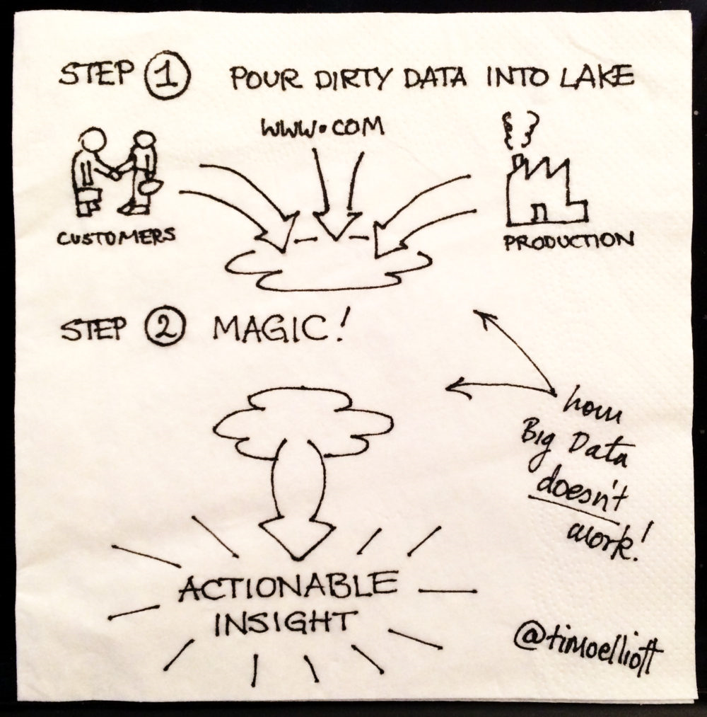
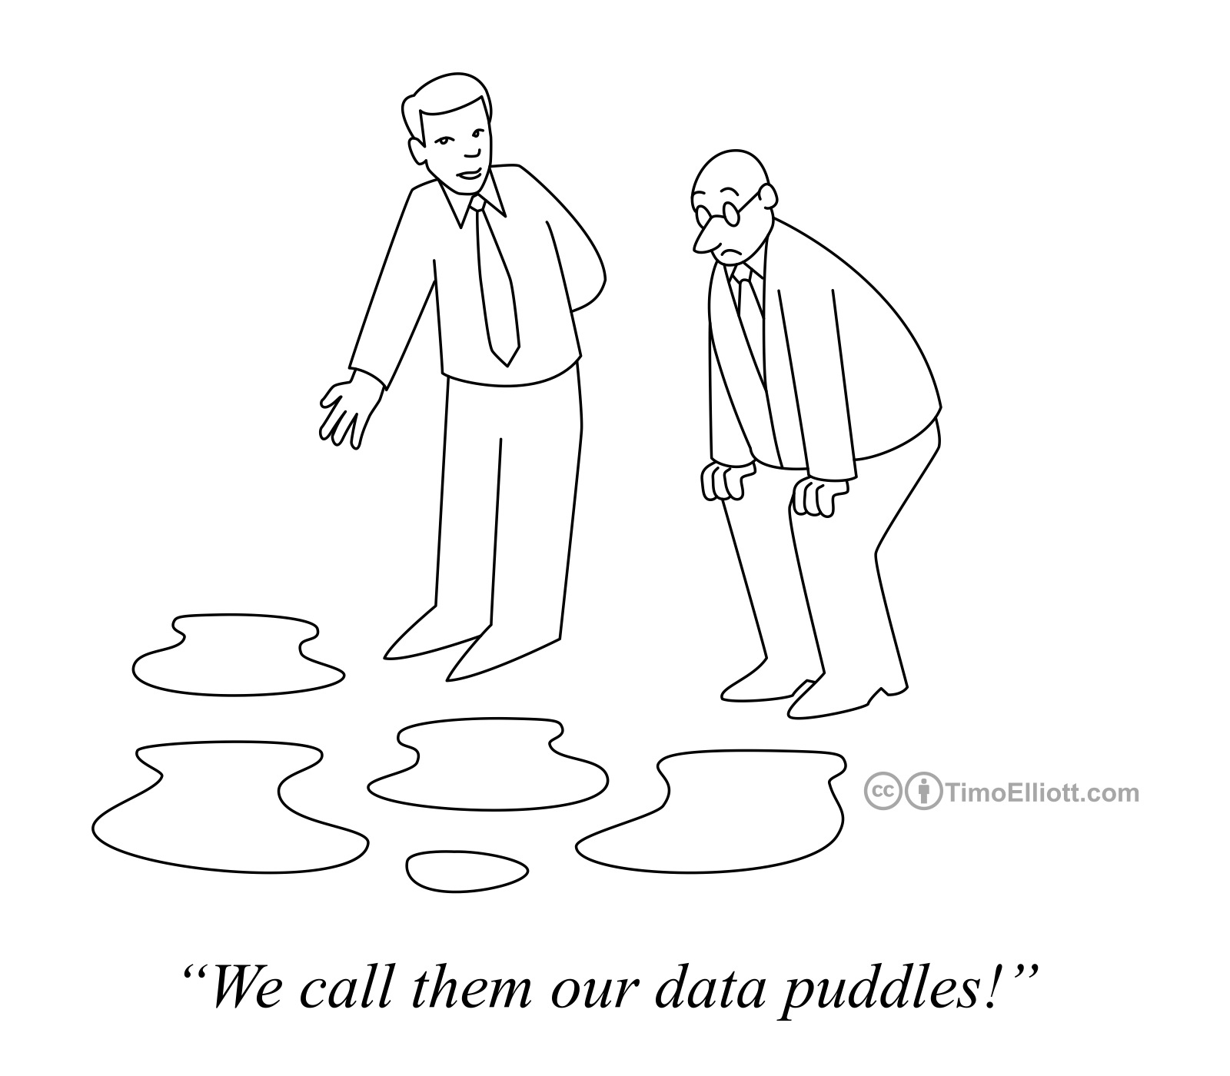
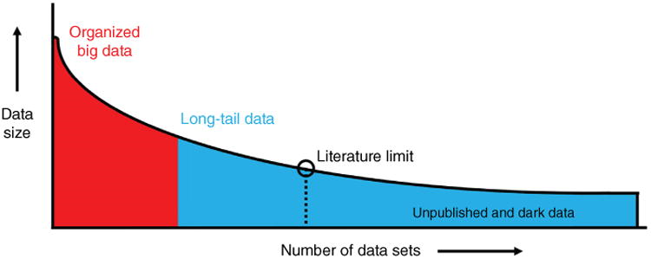


Are we about to realize the dream?
Pile of bodies
(P. Pascuzzi, Purdue Univ. LSIS)
Ferguson et al., 2016
Big data from small data: Data sharing in the ‘long-tail’ of neuroscience
Many Ag researchers inhabit the “long-tail” with lots of small data sets

Slide 9
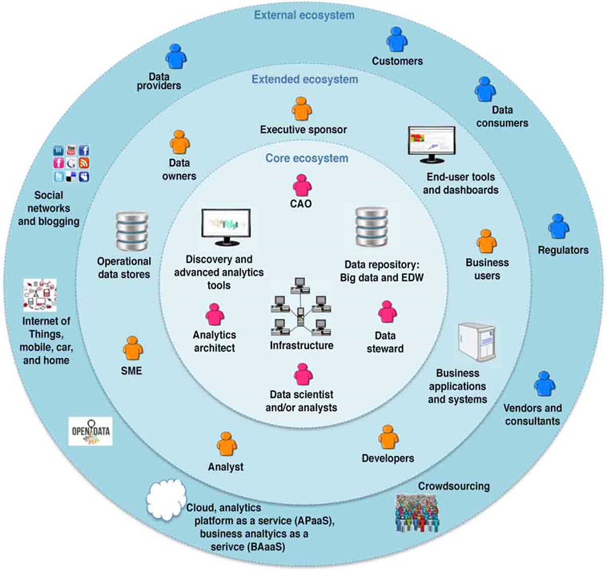
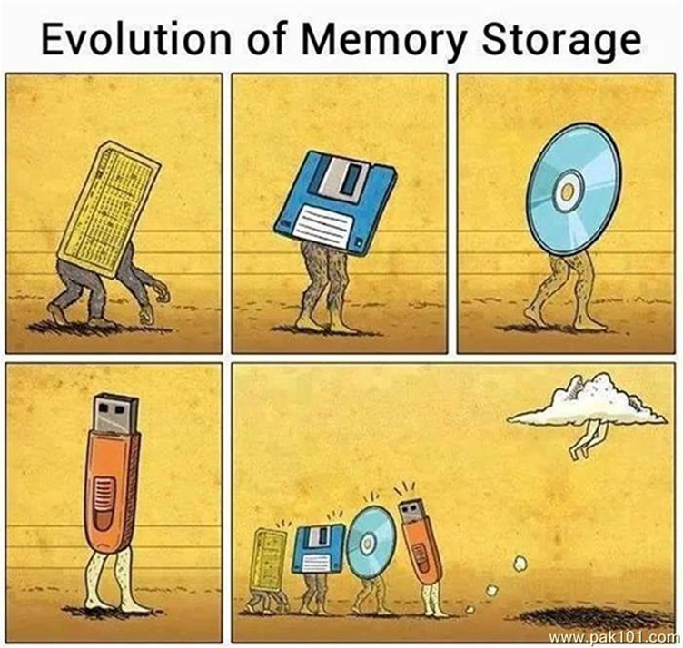
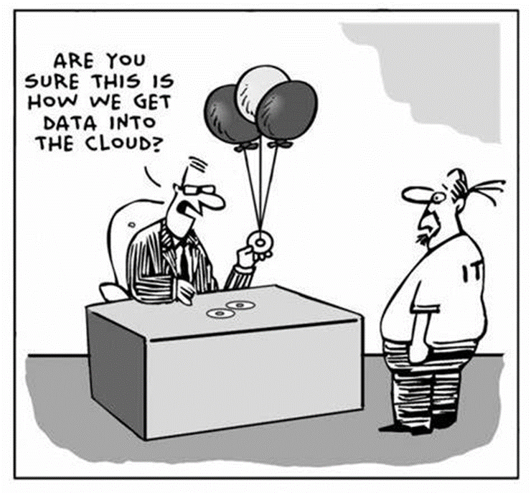
Plethora of vision, dearth of user-friendly solutions

Slide 10

The reality: Why has ag been so slow (comparatively) to enter the BD/Analytics world?
Many answers, most apply to both farmer & researcher, all are opportunities
Convention: culture of eminence-based recommendation development w/in US Land Grant
Privacy concerns (fear of regulation)
Giving away something of “value”
IT and tools/apps not really useful/usable in real world
Lack of ag data model and infrastructure and business model: storage cheap, curation/preservation expensive
General fear of incorrect use of data ~ black box analyses producing non-robust solutions (machine learning vs deliberate hypothesis testing)
By Me!

Slide 11

Why is so much data not shared and/or lost?
Multiple “vocabularies” and cultures of practice among/within disciplines and domains
Yield ?
The “scoop” and other past perceptions of ownership…

Slide 12
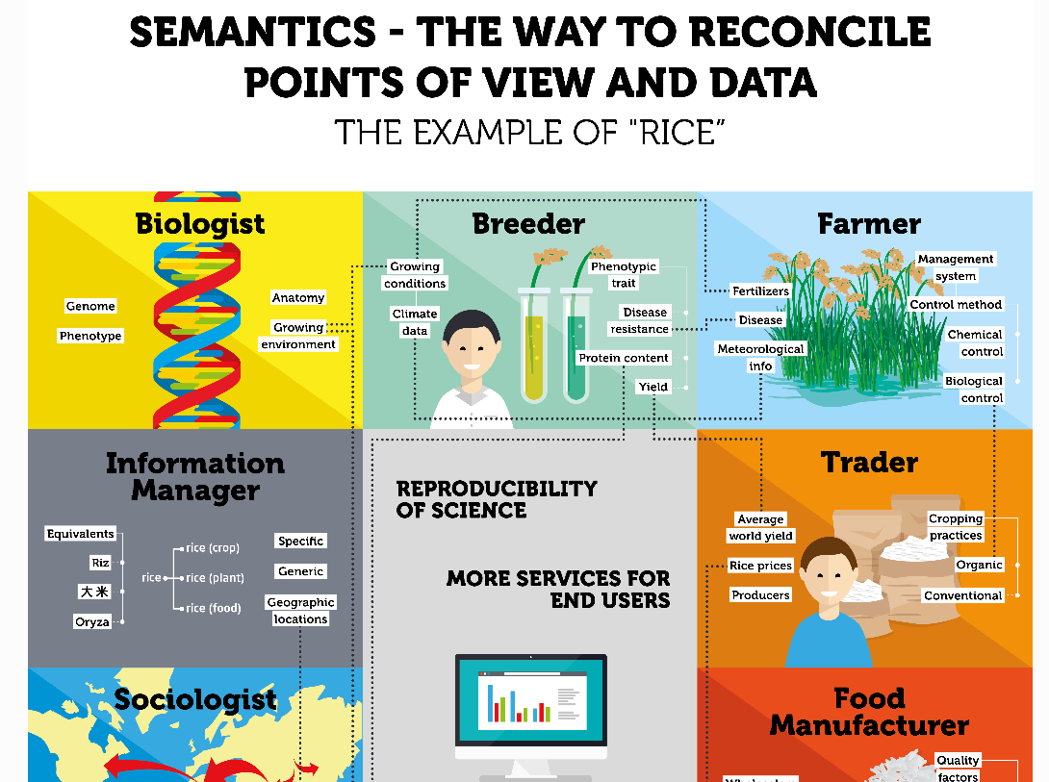
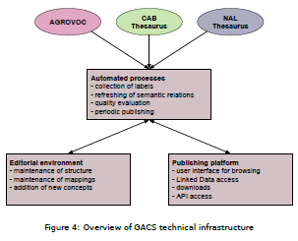
Agricultural multilingual taxonomies and glossaries – are we converging?
Agrisemantics (semantics for the interoperability of agricultural data)
Global multilingual concept scheme for mapping and pruning across ontologies
https://agrisemantics.org/
http://aims.fao.org/global_agricultural_concept_scheme_gacs

Slide 13


Do you speak data? A quick search suggests a complete lack of linguistic discipline….
What “ecosystem” features are not claimed?
Natural Environ.
Built Environ.
Transportation
Cloud, Lake, Stream, Island, Cave, Cat, Kangaroo, Mountain, Swamp, Shrub, Brook, Puddle, Eel, Monkey, Snail, Worm, Barracuda, Pond Scum, Community, Keystone species, …
Rooftop, Depot, Playground, Museum, Putting green, Store, Warehouse, Table, Sofa, Kitchen, Bathroom, Man-cave, She-shack, Garden, Water cooler, Patio, Porch, …
Truck, Boat, Subway, Canoe, Bicycle, Dinghy, Golf cart, Roadmap, Highway, Thruway, Tunnel, Bridge, Raft, Wagon, Surfboard, Sled, Flying Saucer, Toboggan, Skateboard, …

Slide 14
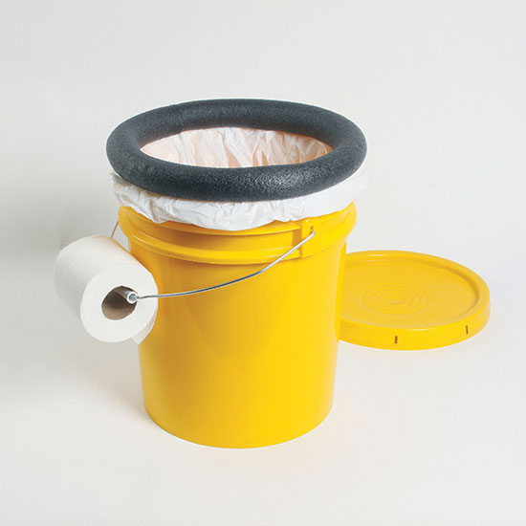
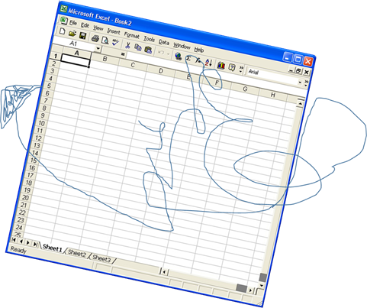
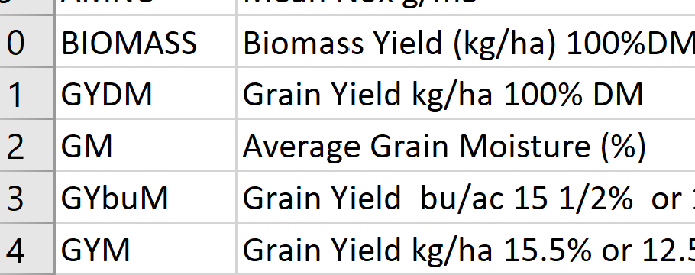

Developing the “Ag data model” for a “data bucket”… (aka “minimum dataset” & metadata)
Collect common, minimum array of relevant data (orderly use of rows & columns)
Annotate w/ sufficient metadata
(Data dictionary)
Soil
Crop
Weather
Researchers collecting what/how they want for narrow purpose
Programming magic CAN happen

Slide 15
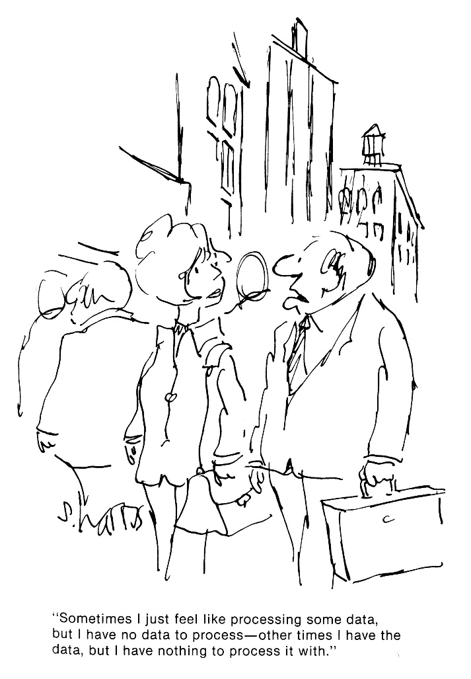
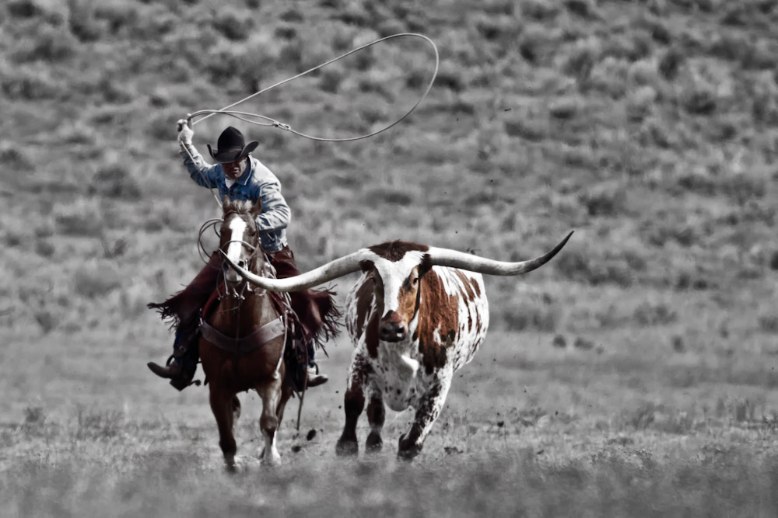
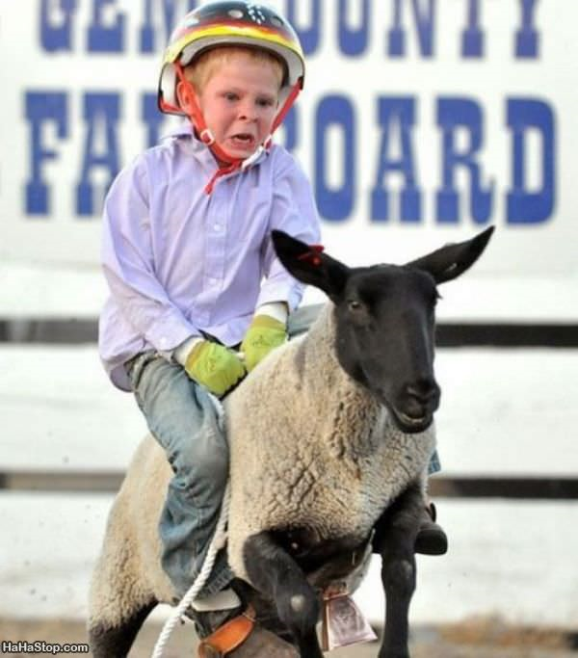
Until recently very little interest in user-friendly tools for data “processing”

Slide 16
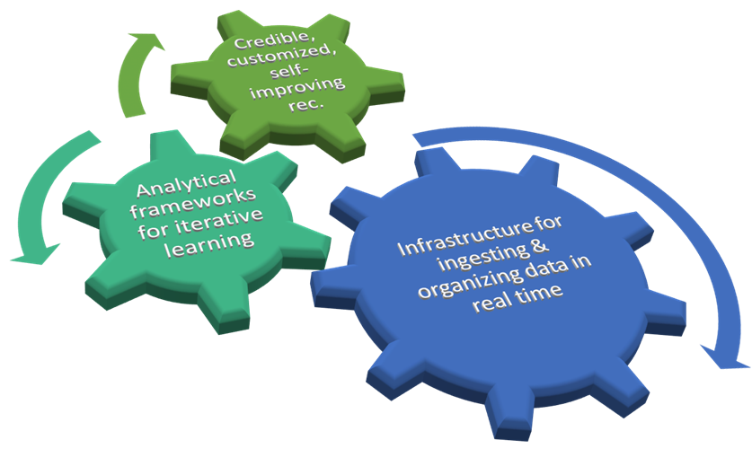
Need for case studies proving research efficiency: USDA NIFA AFRI Grant
FACT: An Innovative Cyber-Framework Integrating Public/Private Data for Evidence-Based Recommendations
Schematic 1. The custom-izeable, self-improving recommendation

Slide 17
Schematic 2.
FACT Project Scope
Data Sources
On-going Public Research
Peer and Grey Literature, Extracted
Future Small Exp.
On-farm Unknown Quality
Legacy Research
High-Qual. On-Farm Data
Model ecosystem for cyber-enabled practice improvement w/ public-private partnering
Future
Scope
T1: Create Ag Data Model for FAIR
T6: On-farm Testing and Business Case
T5: Rec. Deployment and Research Roadmaps
T4: Machine Learning, with On-farm Data
T3: Eval. Rec. Parameters with On-farm Data
T2: Data Synthesis with Systematic Review
T*: Auto Data Ingestion, Self-Improving Rec
FAIR data; Prototype Ag data model
SRs; Proof-of-concept re. value of open data
Proof-of concept re. on-farm data in res.
ML proof-of-concept re. novel insights
Modified apps; POW for ag. rec. imprvmt
Profitability analyses; community testbeds
PRODUCTS
Obj.1: Cochrane-style
Collaborative
Obj. 2: Validation of Rec. Framework,
Evidence-based, site-specific P/K Mgmts.
Obj. 3: New Curriculum:
T7. Graduate Certificate;
Practitioner Programming
MAIN Obj.
FACILITATING Obj.

Slide 18
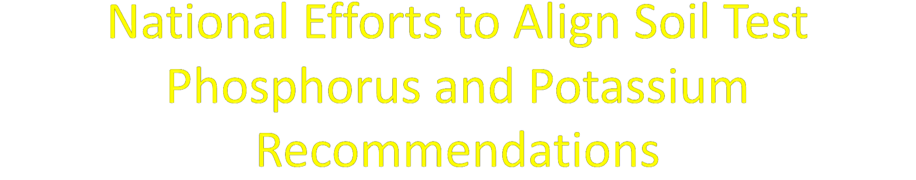
Deanna Osmond and Sarah Lyons (NC State),
Peter Kleinman and Dan Arthur (ARS),
Nathan Slaton (Univ. Arkansas), John Spargo (Penn State),
Josh McGrath (Univ. Kentucky)
Notes:
The intent of this project is to harmonize soil test phosphorus and potassium recommendations across state boundaries through a national effort. Although there are seven principles on this project, there are many more collaborators because without them, this project would not exist.

Slide 19
Team + Contributors
Shannon Alford, Clemson University
Brian Arnall, Oklahoma State University
Dan Arthur, USDA-ARS
Dana Ashford-Kornburger, USDA-NRCS
Doug Beegle, Reitred Penn State
Carl Bolster, USDA-ARS
Sylvie Brouder, Purdue University
Tom Bruulsema, IPNI-Canada
Michael Buser, USDA-ARS
Miguel Cabrera, University of Georgia
Steve Culman, Ohio State University
Joan Davenport, Retired Washington State Univ.
Marlen Eve, USDA-ARS
Bhupinder Farmaha, Clemson University
Robert Florence, University of Tennessee
Luke Gatiboni, North Carolina State University
Bobby Golden, Mississippi State University
John Grove, University of Kentucky
David Hardy, NC Department of Agriculture and Consumer Services
Darren Harmel, USDA-ARS
Joseph Heckman, Rutgers University
Bryan Hopkins, Brigham Young University
Gobena Huluka, Auburn University
Sindhu Jagadamma, University of Tennessee
Edwin Ritchey, University of Kentucky
Amir Sadeghpour, University of Southern Illinois
Hubert Savoy, Retired University of Tennessee
Linda Schott, University of Idaho
Charlie Shapiro, Retired University of Nebraska
Lakesh Sharma, University of Florida
Andrew Sharpley, University of Arkansas
Amy Shober, University of Delaware
Frank Sikora, University of Kentucky
Nathan Slaton, University of Arkansas
John Spargo, Penn State University
Haiying Tao, Washington State University
Gurpal Toor, University of Maryland
Teferi Tsegaye, USDA-ARS
Bruce Vandenberg, USDA-ARS
Jeff Volenec, Perdue University
Forbes Walker, University of Tennessee
Jim Wang, Louisiana State University
Paul Wester, USDA-National Ag Library
Charlie White, Penn State University
Frank Yin, University of Tennessee
Hailin Zhang, Oklahoma State University
John Jones, FAR-The Fertilizer Institute
Quirine Ketterings, Cornell University
Pete Kleinman, USDA-ARS
Jay Lessl, University of Georgia
Sarah Lyons, North Carolina State University
Rory Maguire, Virginia Tech University
Dave Mengel, Retired Kansas State Univ.
Robert Miller, Colorado State University
Amber Moore, Oregon State University
Tom Morris, Retired University of Connecticut
Jake Mowrer, Texas A&M University
Stephanie Myers, Rutgers University
Rao Mylavarapu, University of Florida
Nathan Nelson, Kansas State University
Larry Oldham, Mississippi State University
Deanna Osmond, North Carolina State University
Eugenia Pena-Yewtukhiw, West Virginia University
Rishi Prasad, Auburn University
Tony Provin, Texas A&M University
Ed Rayburn, West Virginia University
Mark Reiter, Virginia Tech University
Notes:
Collaborators include almost 70 land-grant faculty, ARS, NRCS, and not-for-profit personnel.

Slide 20







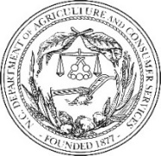



























Thanks to our sponsors:
USDA-NRCS grant
69-3A75-17-45
and
USDA-ARS grant
58-8070-8-016
Canada
Notes:
These collaborators and principles represent 29 land grant universities, 2 federal agencies, 2 not-for-profit organizations, and one state department of agriculture.

Slide 21
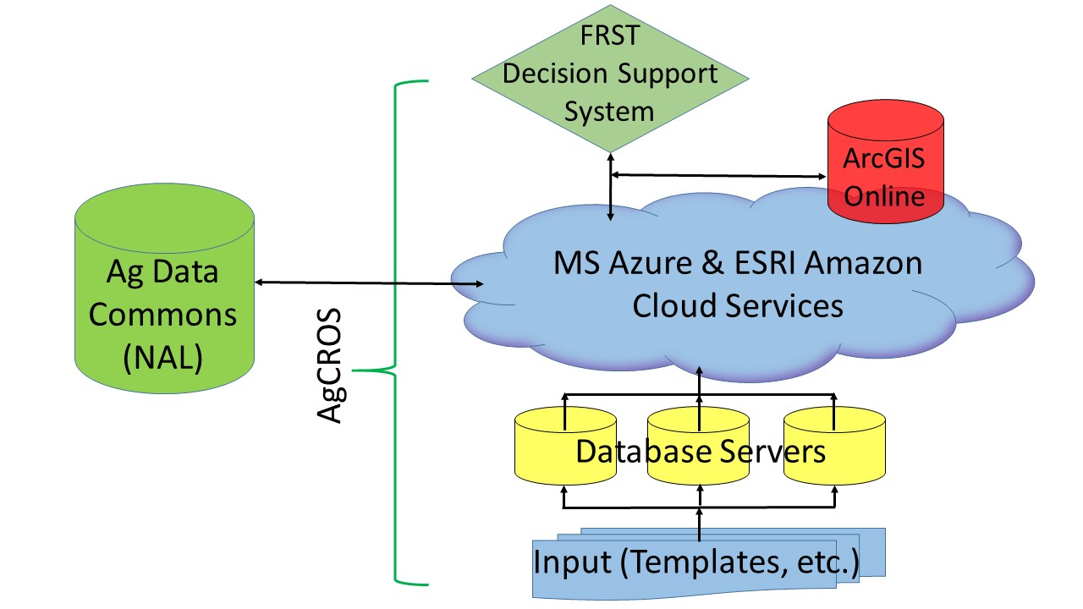
Fertilizer Recommendation Support Tool (FRST): A Foundation for Modernizing Fertilizer Recommendations
Goal of FRST: Advance the accuracy of soil-test-based fertilizer recommendations by developing a database and decision tool from which recommendations can be scientifically developed and defended as best management practices. The FRST tool is based on an Australian soil testing tool.
Database of FRST: collecting current and historic soil fertility data recommendations with over 600 entries representing 20 states and 6 crops. Work is on-going and will continue.
Decision Support System of FRST: funding being sought.
For More Information: contact Deanna Osmond (deanna_osmond@ncsu.edu)
Notes:
The intent of this project, FRST which stands for Fertilizer Support Tool, is to advance soil-test-based fertilizer decisions by developing a database and decision support tool. This tool will help with phosphorus and potassium recommendations that can be scientifically defended; it will also provide transparency. Users will enter the FRST decision support system tool through the USDA National Agricultural Library. Users will then be able to select the crop, nutrient of concern (P or K), and specific geographical area in the United States. Based on these criteria and more, a critical level will be developed from data residing in the database and algorithms. After only six months, our database houses over 600 distinct trials representing over 20 states and six crops. Project collaborators have provided and continue to provide much of these data. We are currently seeking funding to develop the decision support system. For more information, contact Deanna Osmond.

Slide 22
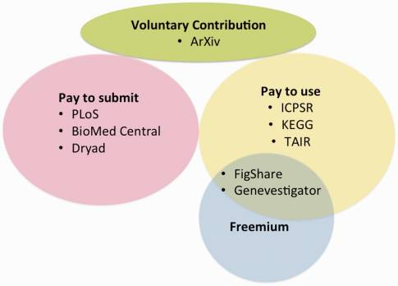
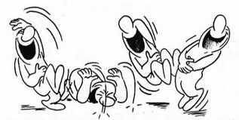
Open access ≠ cost free: Who pays for the ecosystem?
“who’d pay for YOUR data?!”
Subscription fee = open access?
Sustainable funding for biocuration: The Arabidopsis Information Resource (TAIR) as a case study of a subscription-based funding model (Reiser et al. 2016)
“Freemium” → data access is free but premium payments for additional services

Slide 23
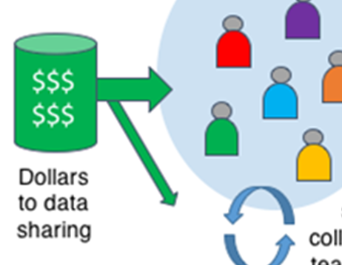
12 funding models for data (knowledgebases) by origin of revenue
Funding knowledgebases: Towards a sustainable funding model for the UniProt use case (Gabella et al. 2017/2018)
“Razors and blades” = We give you the razor, you buy blades
Which are open access compliant / equitable? #1 – 4
Which are stable? #1, 2, maybe 3…

Slide 24
Partners in Big Data for Ag.
Data scientists
Information scientists
Science administrators
Professional societies
Domain scientists
Ag. Res. Funders
Private publishers
Other data stakeholders
Commitment to collaborative, iterative analysis of successes and failures in design, implementation, and utility…
Dollars talk:
Federal Funding Agencies
Private Donors
Public-Private Consortia
Uphold professional standard

Slide 25
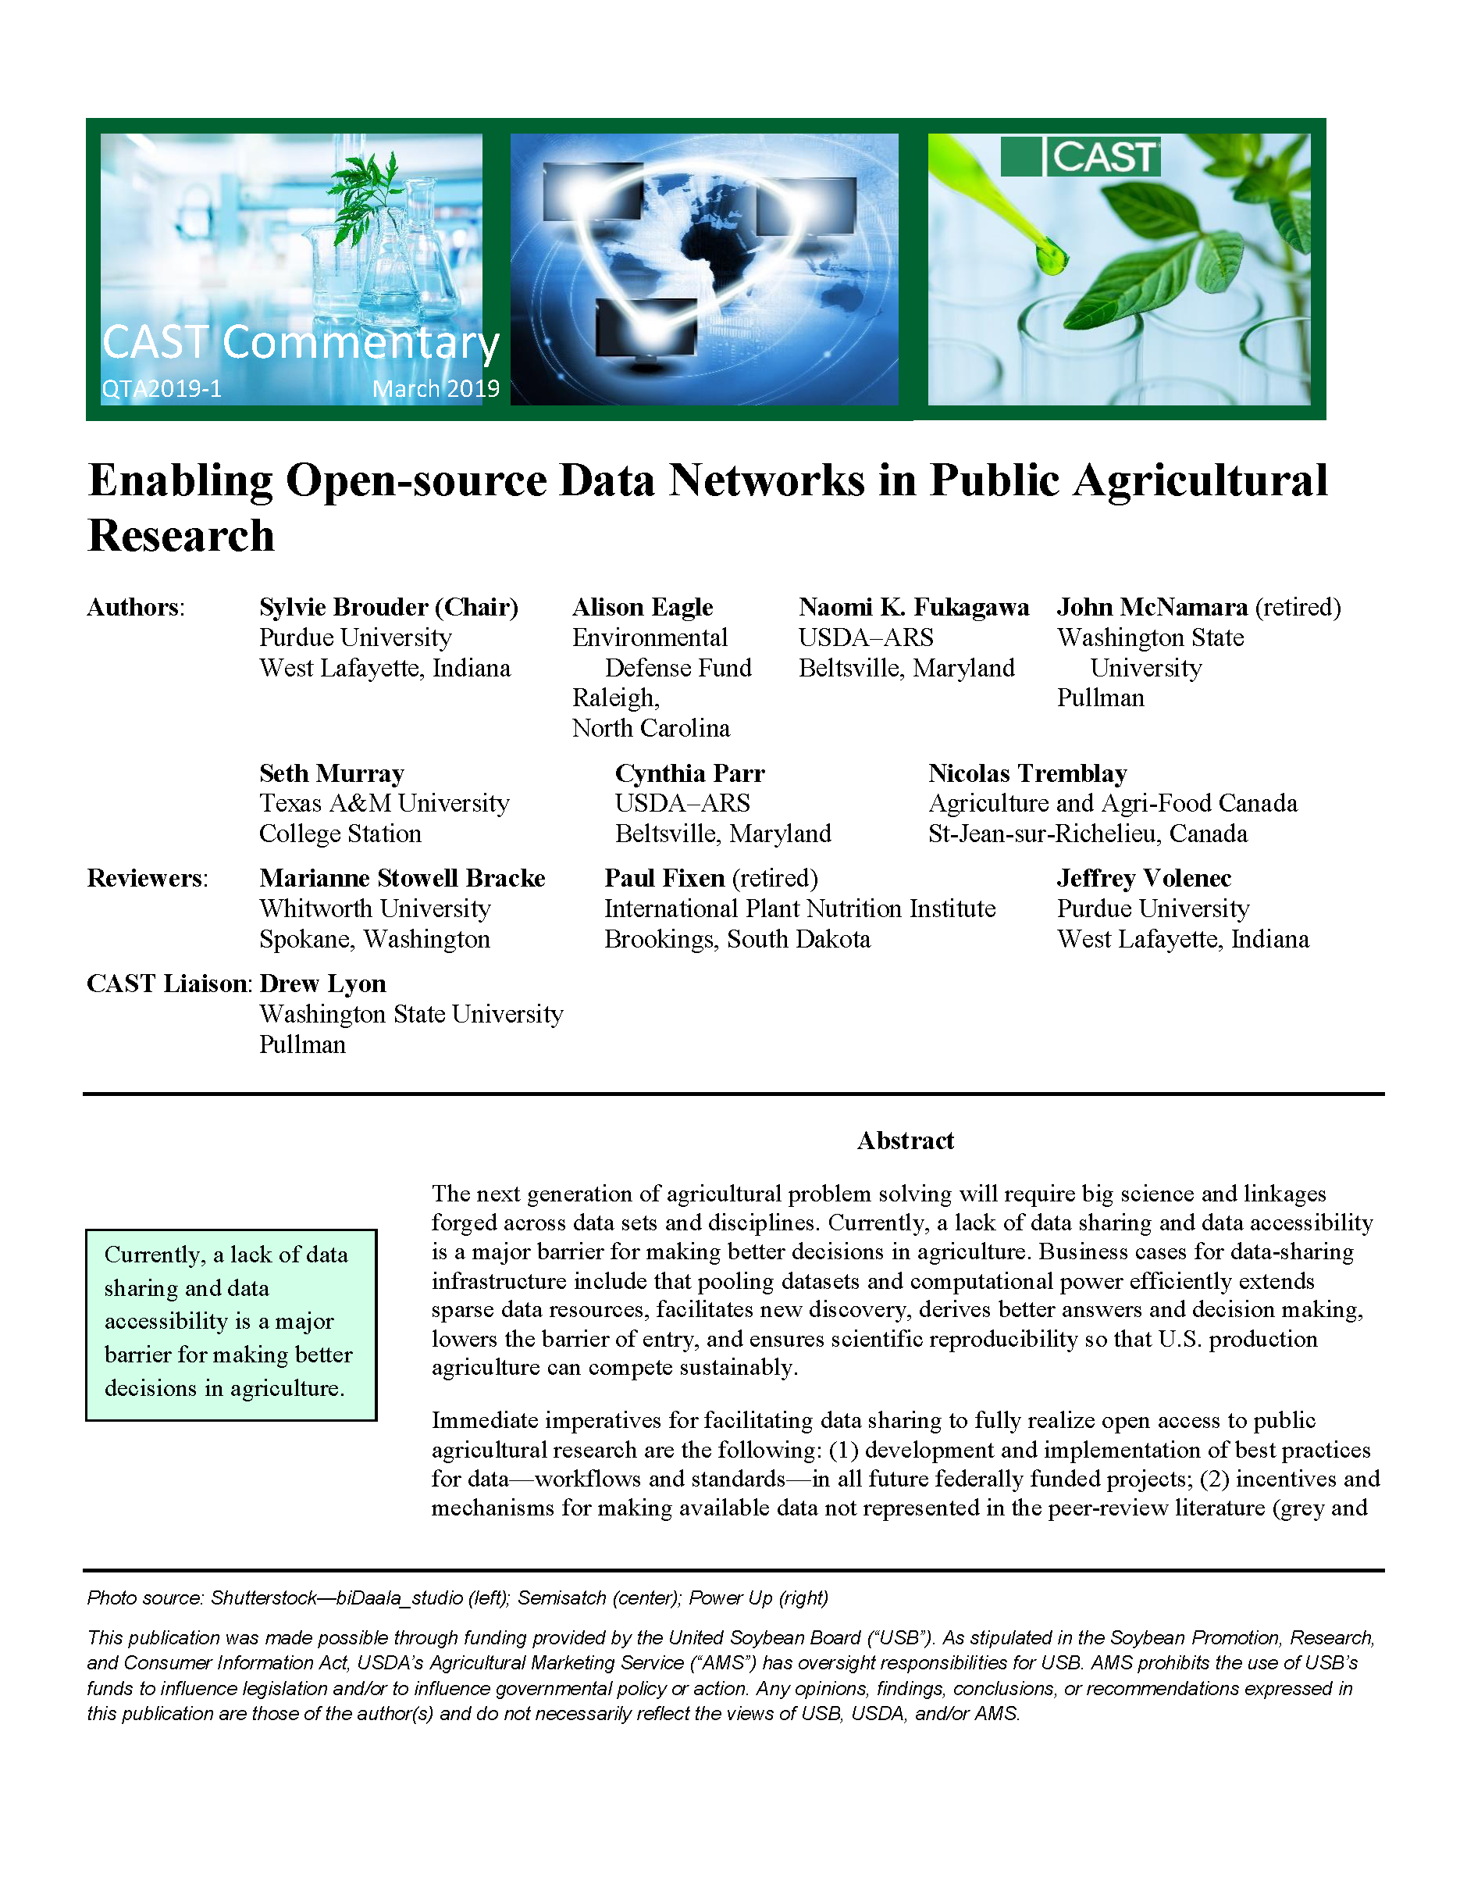

What should the data ecosystem look like for big ag data?
Taskforce to examine the question for public research data in the context of “open access” trends
This CAST Commentary is available at
www.cast-science.org/
publications.
#CASTreports2019

