Slide 1
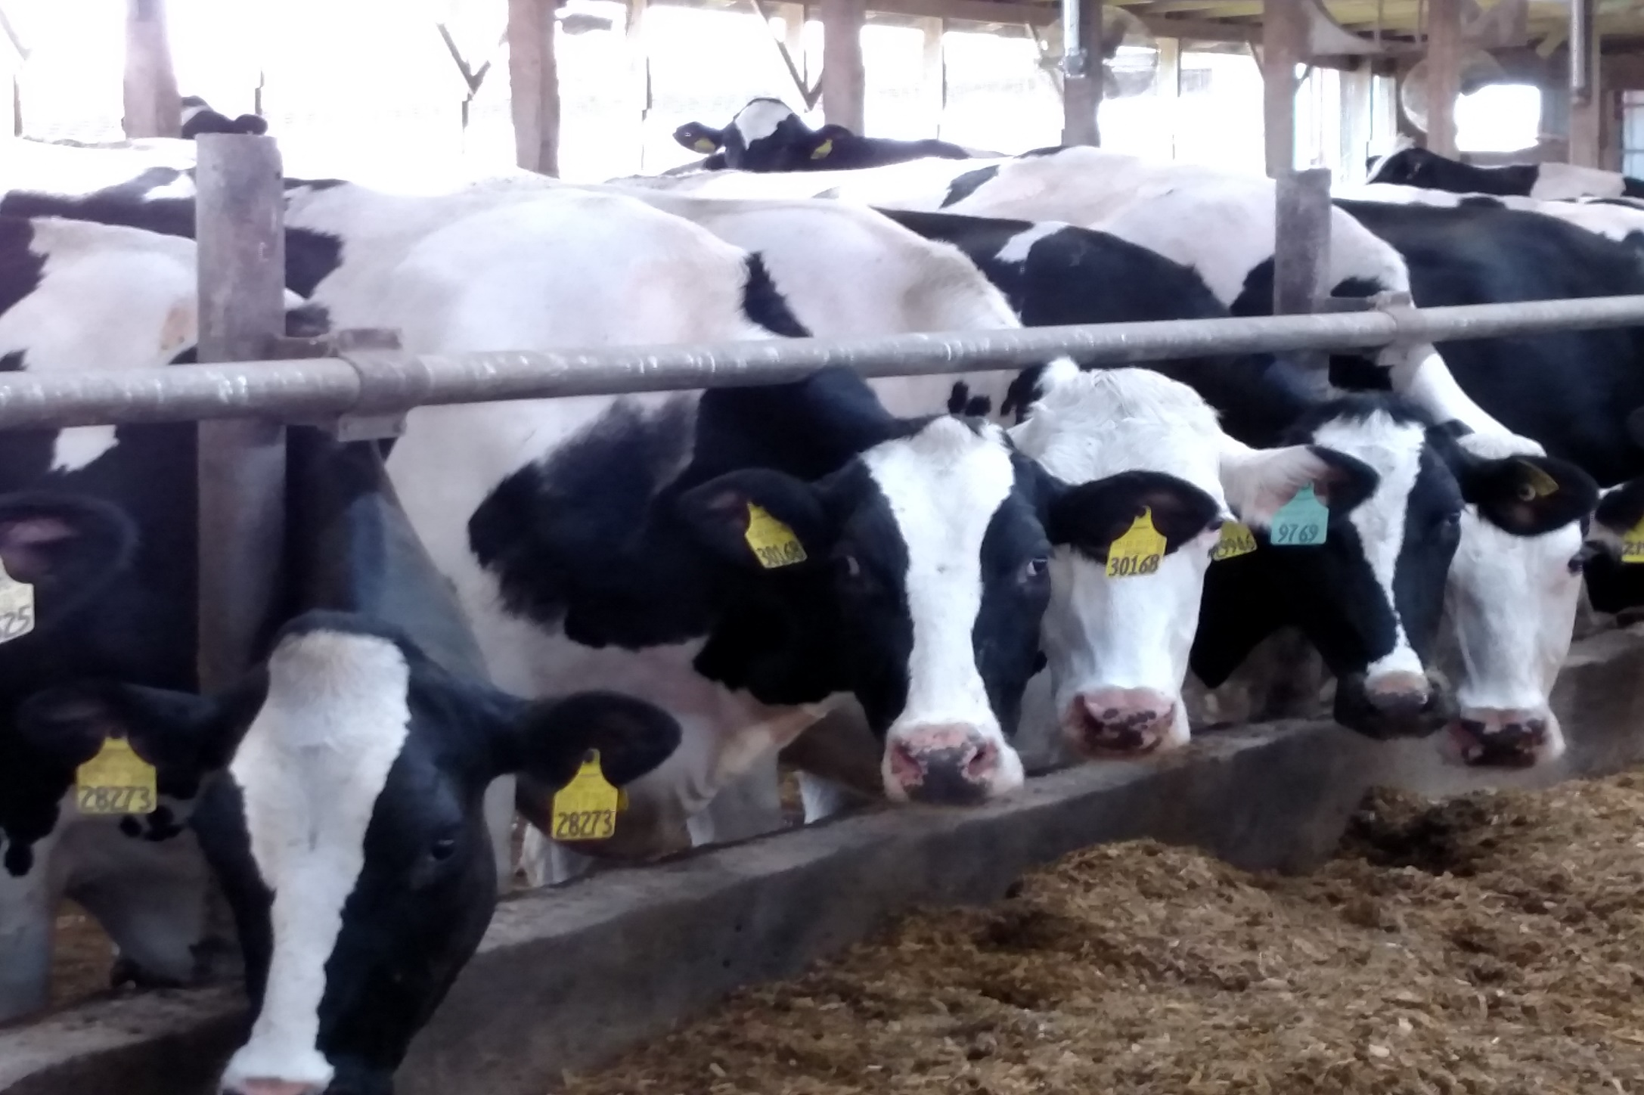
U.S. Dairy Outlook
Carolyn Liebrand
Dairy Program, AMS/USDA
2022 USDA Agricultural Outlook Forum
February 25, 2022

Slide 2
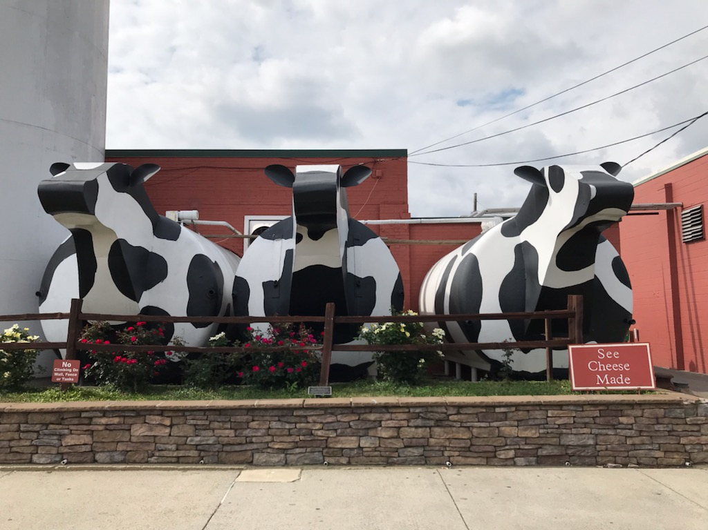
Dairy Outlook
2021
  COVID-19 and its repercussions
  Dairy productivity gains
  Record exports
2022
  Slow milk production growth
  Stronger prices

Slide 3
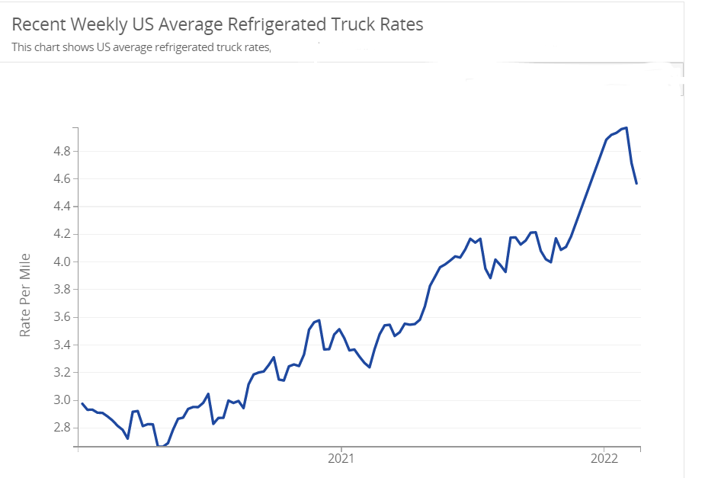

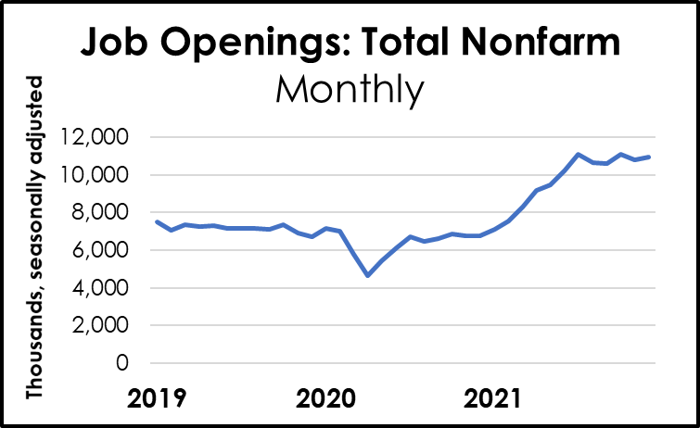
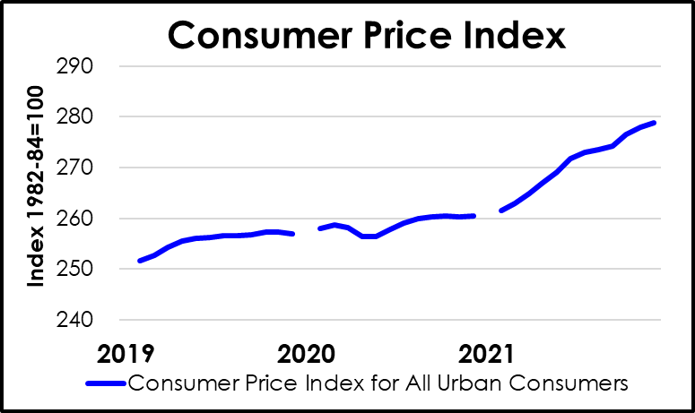
2021. Another remarkable year
+ $1.70/mile from 2/2/21
Weekly U.S. Average Refrigerated Truck Rates, $/Mile
Pandemic rages on
Business disruption persists
Labor
Transit
Costs
Source: AMS/USDA
Licensed under CC BY-SA
Source: Federal Reserve Bank of St. Louis
Source: Bureau of Labor Statistics

Slide 4
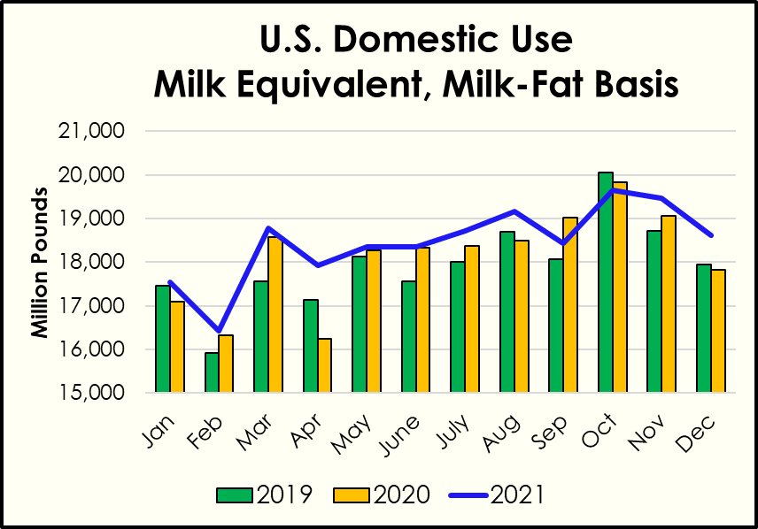
2021. Dairy continued to grow
+1.6 percent more milk produced (adjusted for leap year)
More fat consumption
Milk gets richer
1 milk cow = enough milk fat for 36 people
Sources: ERS/USDA; WAOB/USDA

Slide 5
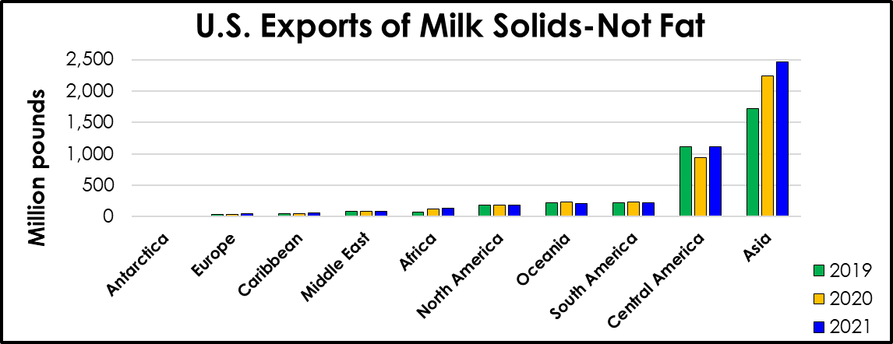
2021. Exports increase
+24.7 percent, raw milk equivalent (m.e.), milk-fat basis
+8.3 percent, m.e., skim-solids basis
62,000 export certificates issued
Sources: Trade Data Monitor; AMS/USDA

Slide 6
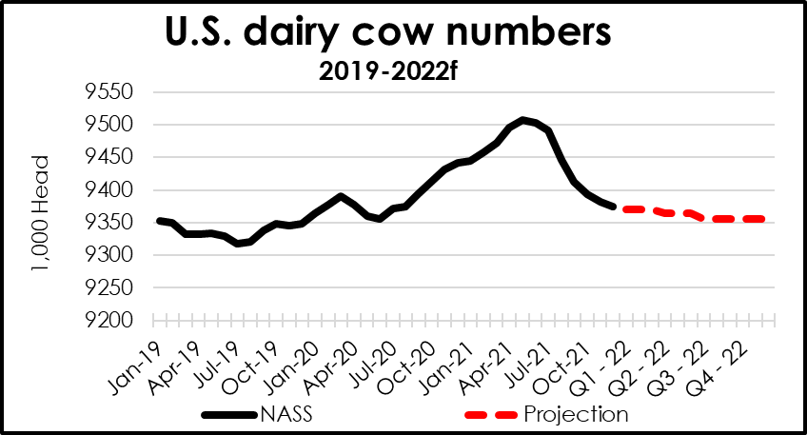
2022. Slow milk supply growth worldwide
Less than 1 percent growth projected for top exporters
U.S. cow numbers projected to fall to 2020 low
Sources: NASS/USDA; WAOB/USDA

Slide 7
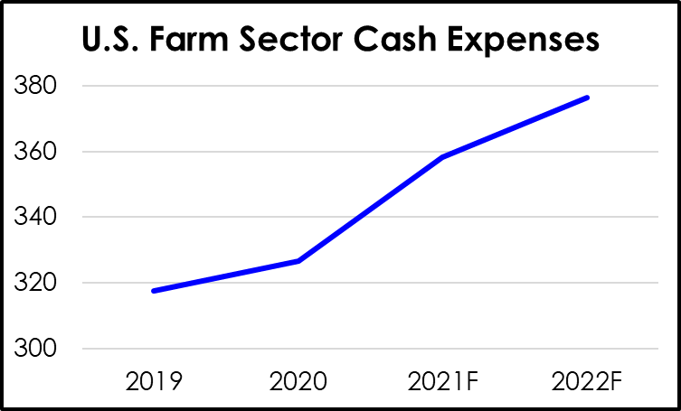
2022. Milk prices, costs expected to increase
Feed prices rise
Milk prices improve
Other production costs rise
Source: U.S. farm sector financial indicators, 2015–2022F, ERS/USDA

Slide 8
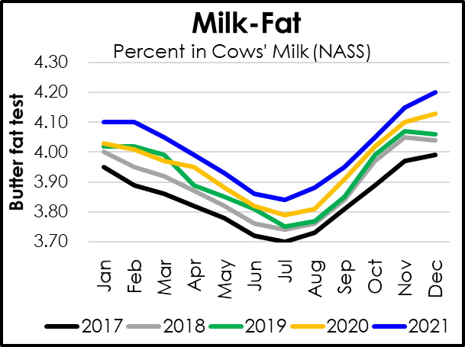
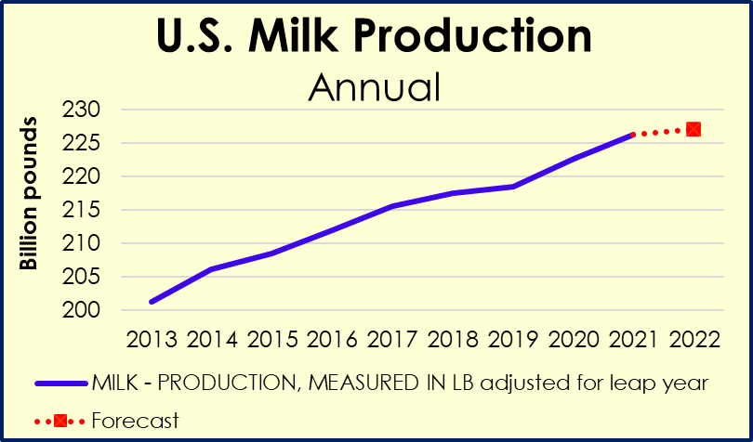
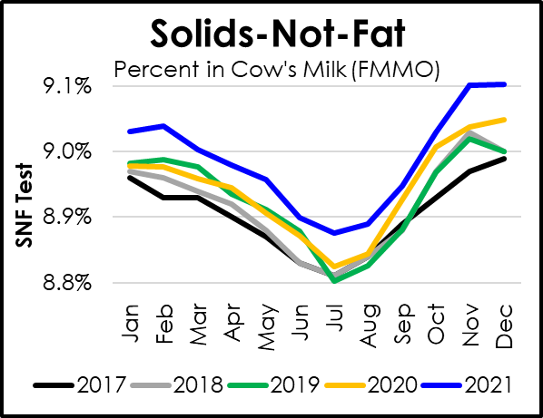
2022. More milk components from fewer cows
Yield/cow +1.3 percent
Milk-fat and solids-not-fat content up
Total production +0.4 percent
Sources: NASS/USDA; WAOB/USDA

Slide 9
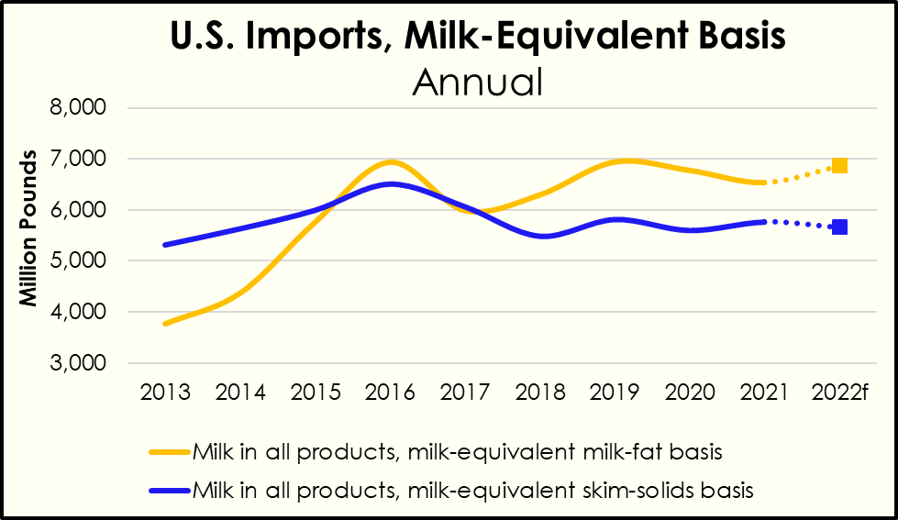
2022. Dairy product imports
Gap between U.S. and world prices narrows
+ 0.4 billion pounds on milk-fat basis
- .01 billion pounds, skim-solids basis
Sources: ERS/USDA; WAOB/USDA

Slide 10
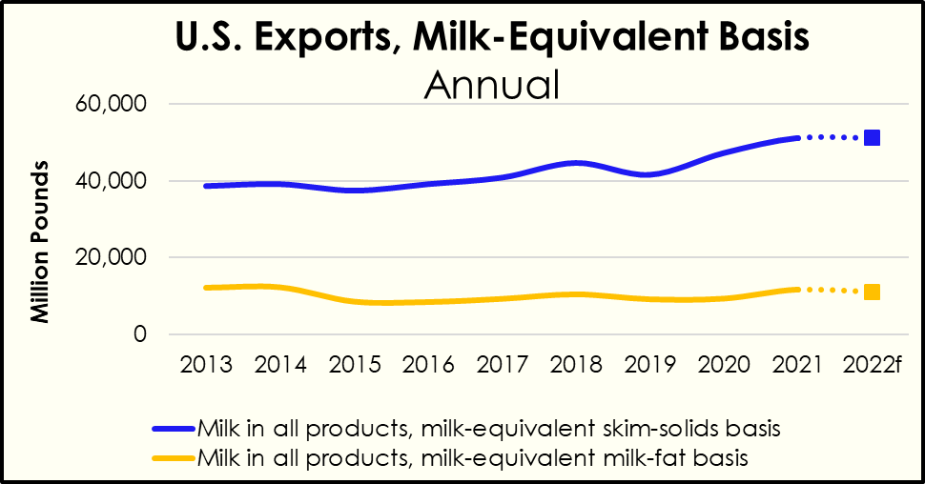
2022. Commercial exports
High U.S. prices v. world prices
- 0.6 billion pounds on milk-fat basis
+ 0.1 billion pounds, skim-solids basis
Sources: ERS/USDA; WAOB/USDA

Slide 11
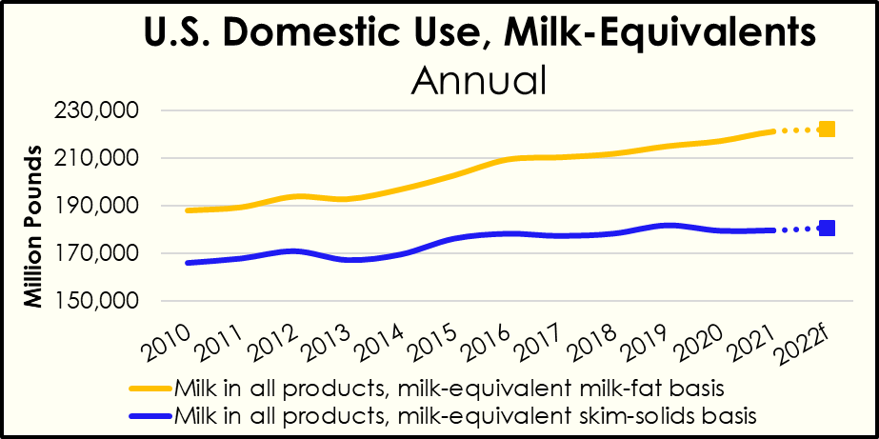
2022. Domestic commercial use
Inflation; COVID-19 demand impacts; retail price increases
+ 0.4 percent on milkfat basis
+ 0.5 percent, skim solids basis
Sources: ERS/USDA; WAOB/USDA

Slide 12
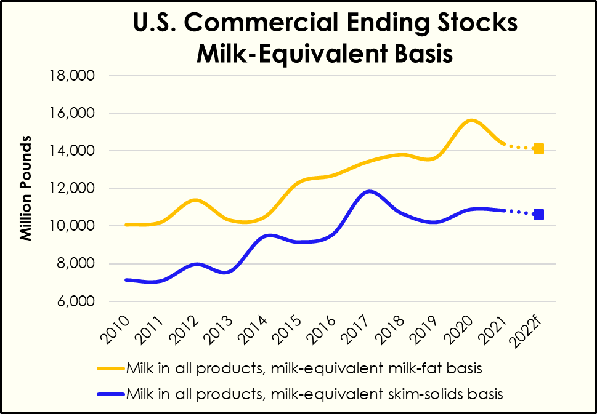
2022. Commercial ending stocks
Domestic use and exports outpacing supply
- 0.3 billion pounds, milk-fat basis
- 0.2 billion pounds, skim-solids basis
Sources: ERS/USDA; WAOB/USDA

Slide 13
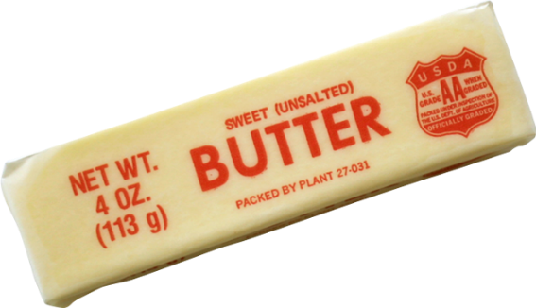
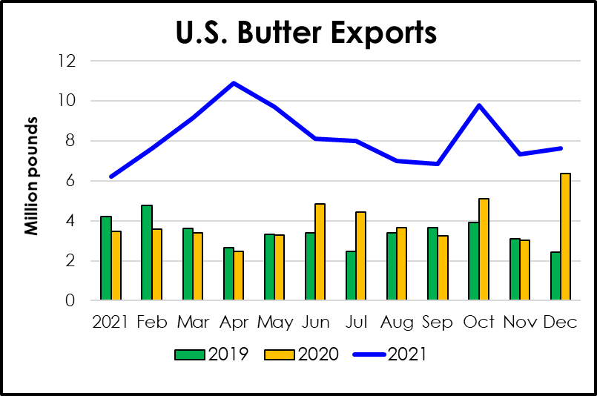
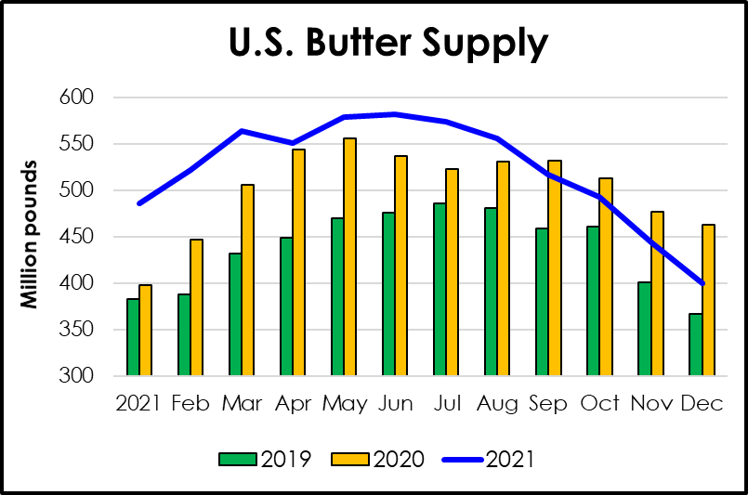
Butter. 2021 review
2021 prices created export opportunities
2021 domestic use up 2.1 billion pounds
2021 supplies tightened
This Photo by Unknown Author is licensed under CC BY-NC
Source: ERS/USDA

Slide 14
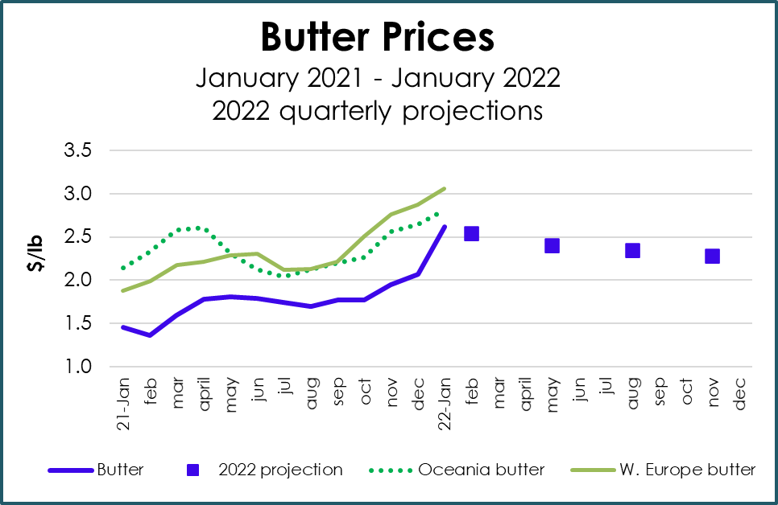
Butter. 2022 price outlook
+ 66 cents per pound
Sources: AMS/USDA; WAOB/USDA

Slide 15
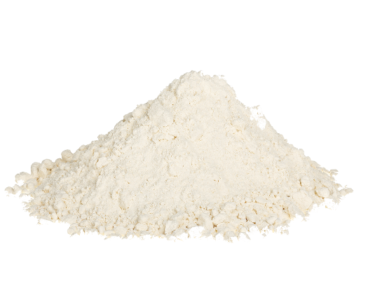
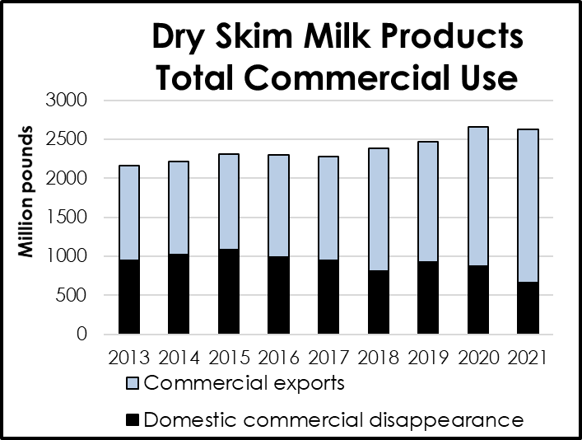
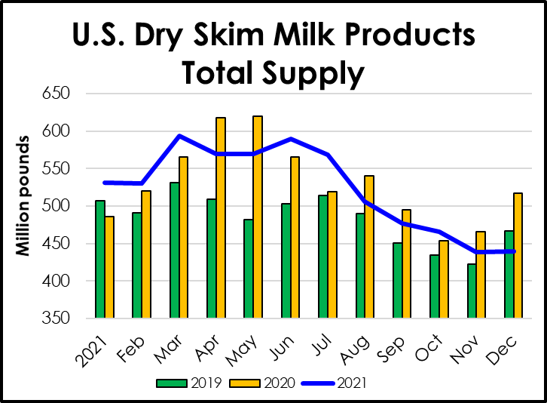
Nonfat Dry Milk. 2021 review
World dry skim milk product markets tight
U.S. prices below world prices
U.S. exports increased 10.2 % to 2.0 billion lbs
Source: ERS/USDA

Slide 16
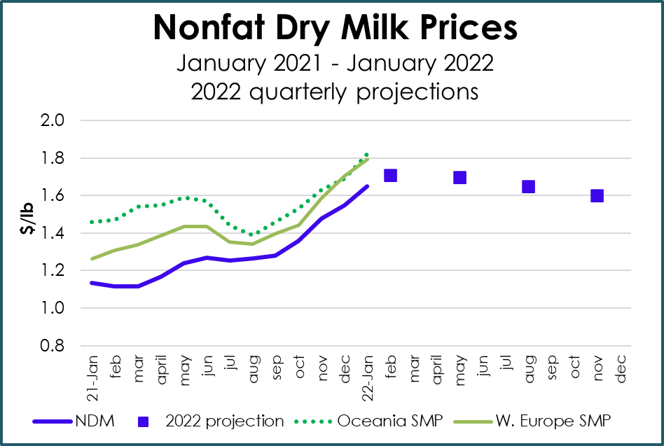
Nonfat Dry Milk. 2022 price outlook
+ 40 cents per pound
Sources: AMS/USDA; WAOB/USDA

Slide 17

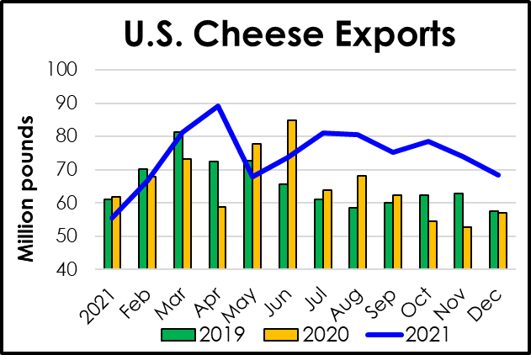
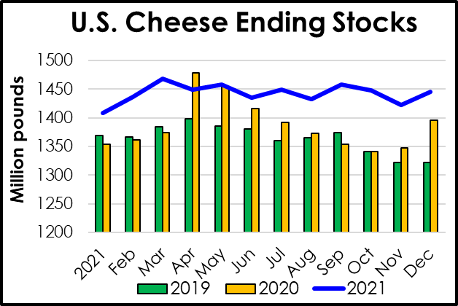
Cheese. 2021 review
ALL Cheese types:
Domestic commercial use of grew 2.7 percent
Exports grew 13.9 percent
Production grew 2.8 percent
Ending stocks grew to 1.4 billion pounds
Source: ERS/USDA

Slide 18
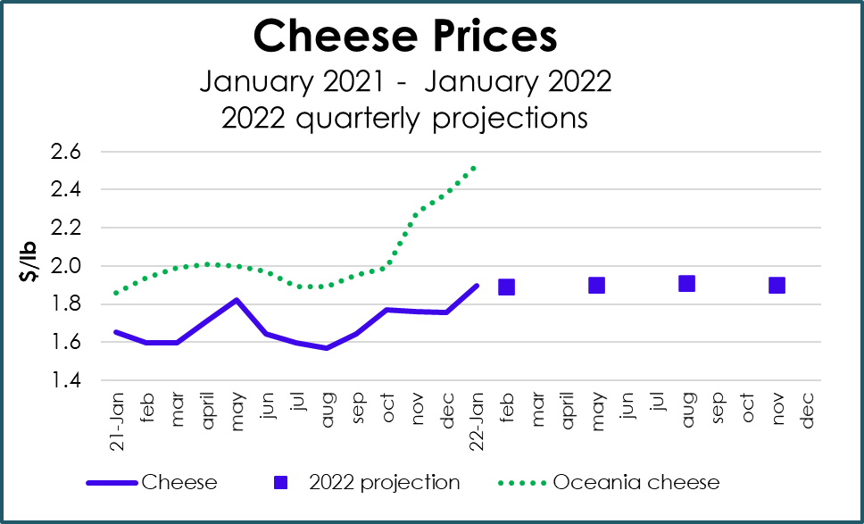
Cheese. 2022 price outlook
+ 22 cents per pound
Sources: AMS/USDA; WAOB/USDA

Slide 19
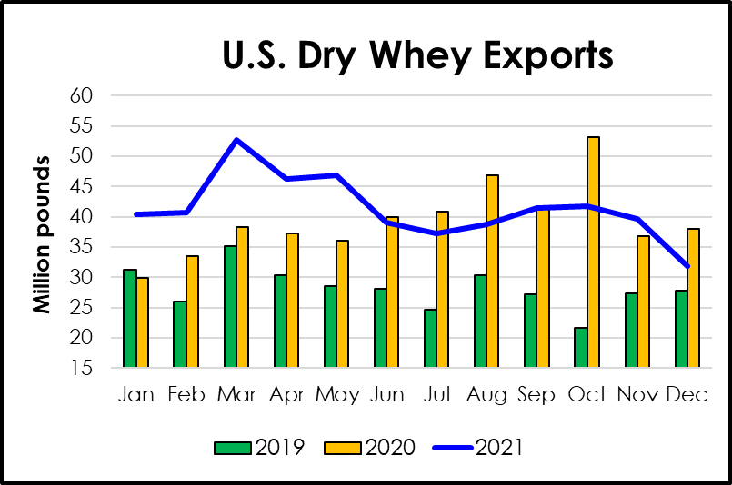
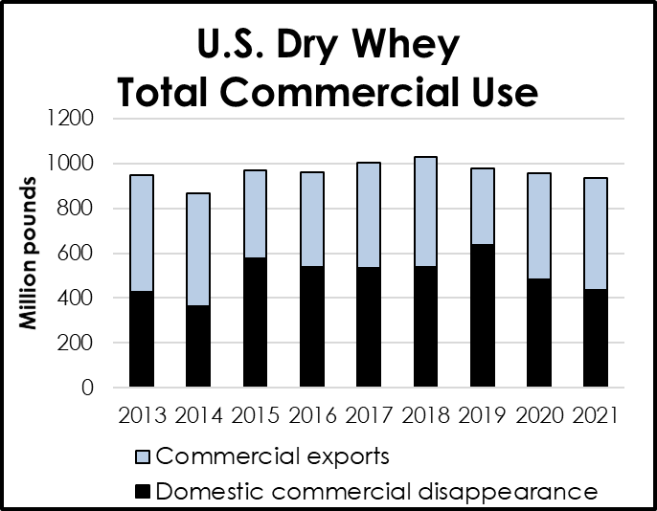
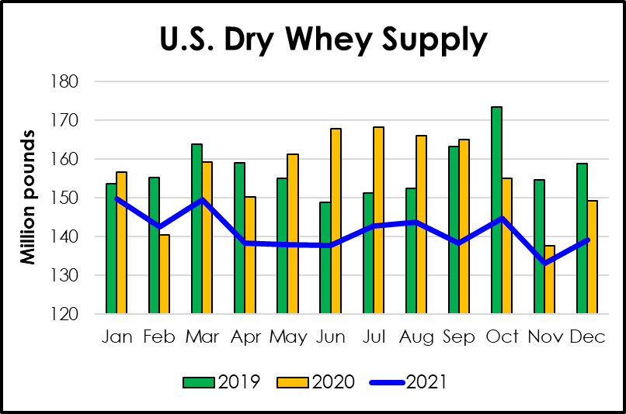
Dry Whey. 2021 review
Exports up 5.2 percent
Supplies down 3.0 percent
Ending stocks down 11.3 percent
Source: ERS/USDA

Slide 20
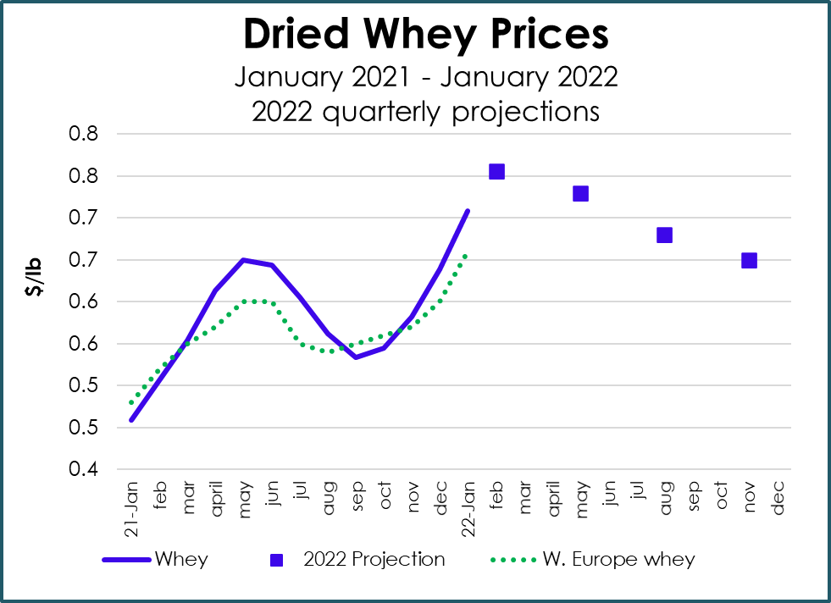
Dry Whey. 2022 price outlook
+ 14 cents per pound
Sources: AMS/USDA; WAOB/USDA

Slide 21
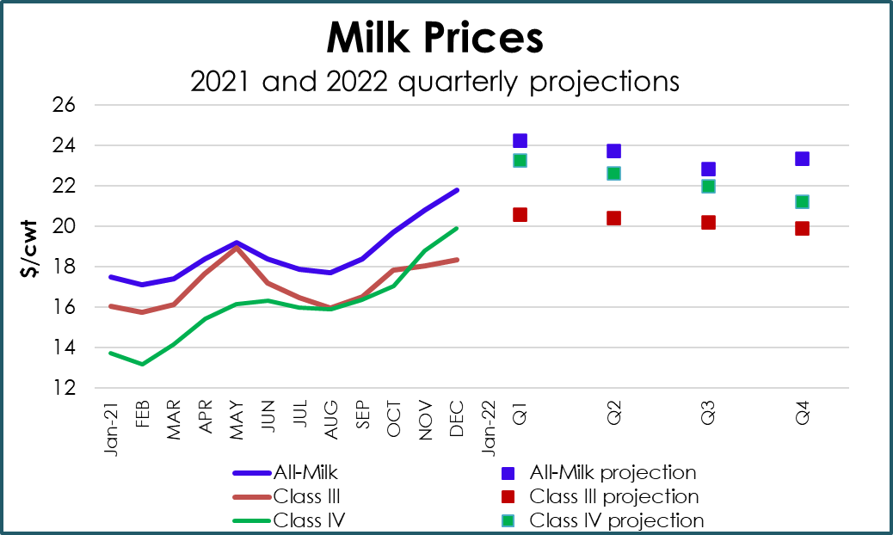

Milk prices. 2022 price outlook
+ $4.86 per cwt of farm milk
+ $3.22 per cwt milk used for cheese
+ $6.21 per cwt milk used for butter and/or dry milk products
Sources: AMS/USDA; WAOB/USDA

Slide 22
Please send an email to CPP’s “New Vendor” address: NewVendor@usda.gov

Slide 23
Links
Additional information about the dairy forecast and current market information:
World Agricultural Supply and Demand Estimates http://www.usda.gov/oce/commodity/wasde/index.htm
Livestock, Dairy, and Poultry Situation and Outlook
https://usda.library.cornell.edu/concern/publications/g445cd121?locale=en
Dairy: World Markets and Trade
https://www.fas.usda.gov/data/dairy-world-markets-and-trade
Dairy Program/Agricultural Marketing Service
https://www.ams.usda.gov/about-ams/programs-offices/dairy-program
Current Dairy Market News:
https://www.ams.usda.gov/market-news/dairy
Information on Federal Milk Marketing Orders
https://www.ams.usda.gov/rules-regulations/moa/dairy
Email me: Carolyn.Liebrand@usda.gov

