Slide 1
Farm Income and Financial Forecasts for 2022
February 2022

Slide 2
Summary*
Net cash farm income for 2022 is forecast at $136.1 billion (up $1.9 billion or 1.4 percent relative to 2021, in nominal dollars). Net farm income is forecast at $113.7 billion (down $5.4 billion or 4.5 percent).
Cash receipts from crop and animal/animal product sales are expected to increase $29.3 billion (6.8 percent) in 2022.
Direct government payments are forecast to decrease $15.5 billion (57.0 percent) and federal commodity insurance indemnities to increase $4.2 billion (44.9 percent).
Total production expenses are forecast to increase $20.1 billion (5.1 percent).
Farm sector assets, debt, and equity are forecast to increase slightly (1.3, 2.9 and 1.0 percent, respectively).
Average net cash farm income for farm businesses is forecast to increase 1.8 percent to $91,500 in 2022.
Median total farm household income is forecast to increase 5.9 percent to $88,234 in 2022.
*All values here are in nominal dollars. Inflation is forecast at 4.1 percent in 2021 and 3.6 percent in 2022.

Slide 3
Farm sector profits expected to remain above 20-year average in 2021-22
-2.1% from ’21
-7.9% from ’21

Slide 4
Net farm income forecast to decline in 2022
$ billion
Lower Government payments and higher expenses outweigh expected increases in livestock and crop receipts.
F= Forecast. Component changes may not sum to total because of rounding.
Source: USDA, Economic Research Service, Farm Income and Wealth Statistics
Data as of February 4, 2022.

Slide 5
Total crop cash receipts forecast to increase in 2022
Corn, soybean and wheat cash receipts expected to rise due to higher quantities sold.
Cotton receipts forecast to rise following higher quantities sold and higher prices.
Change from 2021F
Corn +1.1%
Soybeans +5.1%
Cotton +29.1%
Fruits/Nuts -8.1%
Veg/Melons -1.1%
Wheat +6.7%
F= Forecast. Values are adjusted for inflation using the U.S. Bureau of Economic Analysis Gross Domestic Product Price Index (BEA API series code: A191RG) rebased to 2022 by USDA, Economic Research Service.
Source: USDA, Economic Research Service, Farm Income and Wealth Statistics
Data as of February 4, 2022.

Slide 6
Total animal/animal product cash receipts forecast to increase in 2022
Receipts for cattle, dairy and broilers expected to increase due to higher prices.
Hog receipts expected to decrease mostly due to lower prices.
Change from 2021F
Cow/calf +4.8%
Dairy +17.8%
Broilers +8.3%
Hogs -13.4%
Eggs -0.6%
F= Forecast. Values are adjusted for inflation using the U.S. Bureau of Economic Analysis Gross Domestic Product Price Index (BEA API series code: A191RG) rebased to 2022 by USDA, Economic Research Service.
Source: USDA, Economic Research Service, Farm Income and Wealth Statistics
Data as of February 4, 2022.

Slide 7
Total direct Government payments to farmers expected to decline in 2022
2001-20 Average (2022 $) = $19.8 Billion
COVID-19 Related Assistance
USDA pandemic assistance:
2021F=$7.8B; 2022F=$3.4B
Non-USDA pandemic assistance:
2021F=$8.7B

Slide 8
Total production expenses forecast to continue increasing in 2022
2020 was the first increase since 2014 (in inflation adjusted series).
Expenses forecast to increase 1.5% in 2022 when adjusted for inflation and 5.1% in nominal terms.

Slide 9
Most individual expense items forecast to increase in 2022
2021F-22F % change
+12.0%
+10.4%
Feed and fertilizer are expected to see largest dollar increases.
Net rent expected to decline in 2022.
+6.8%
+6.1%
+5.9%
+2.1%
+1.8%
+1.4%
-0.3%
-6.6%

Slide 10
Balance sheet forecast remains relatively stable…
$ billion (2022)
2.8T, -2.5%
In nominal dollars, farm equity and assets forecast to rise 1.0 and 1.3 percent, respectively, and farm debt forecast to rise 2.9 percent. But when adjusted for inflation, each is forecast to fall.
0.5T, -0.7%
2022F
F= Forecast. T=Trillions. Values are adjusted for inflation using the U.S. Bureau of Economic Analysis Gross Domestic Product Price Index (BEA API series code: A191RG) rebased to 2022 by USDA, Economic Research Service.
Source: USDA, Economic Research Service, Farm Income and Wealth Statistics
Data as of February 4, 2022.

Slide 11
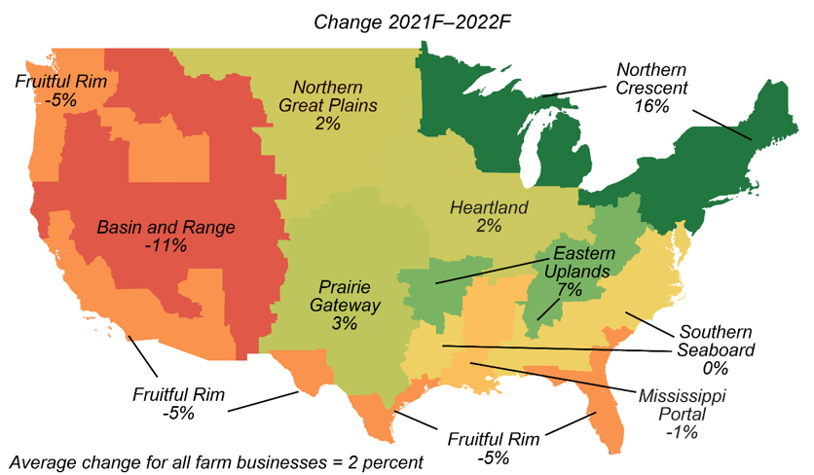
Farm businesses in 5 out of 9 regions expected to see higher average net cash income in 2022
Farm businesses are defined as operations with gross cash farm income of over $350,000 or smaller operations where farming is reported as the operator's primary occupation. The partial budget forecast model is based on the 2020 Agricultural Resource Management Survey (ARMS) using parameters from the sector forecasts. The model is static and does not account for changes in crop rotation, weather, and other location-based production impacts that occurred after the base year. Data as of February 4, 2022. Source: USDA, Economic Research Service, Farm Income and Wealth Statistics.

Slide 12
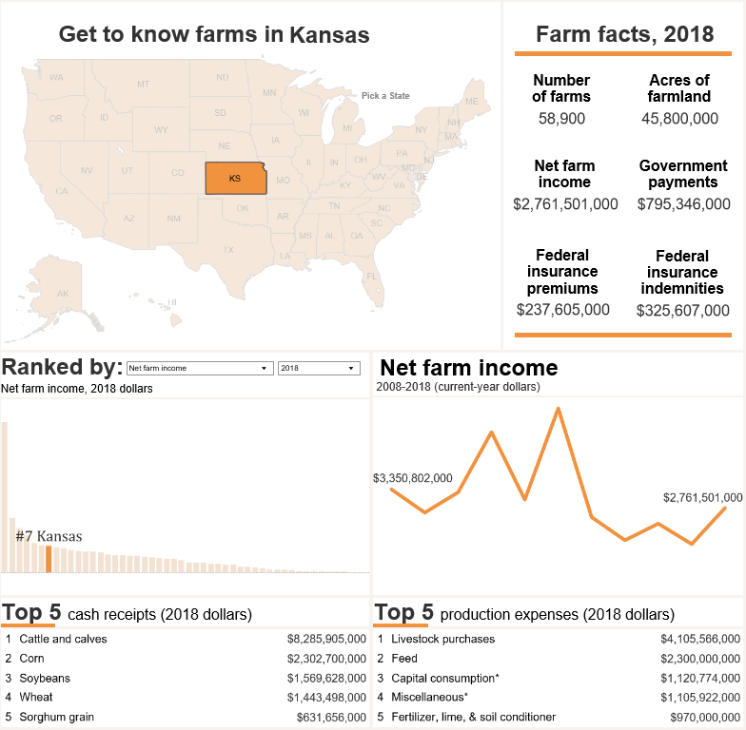
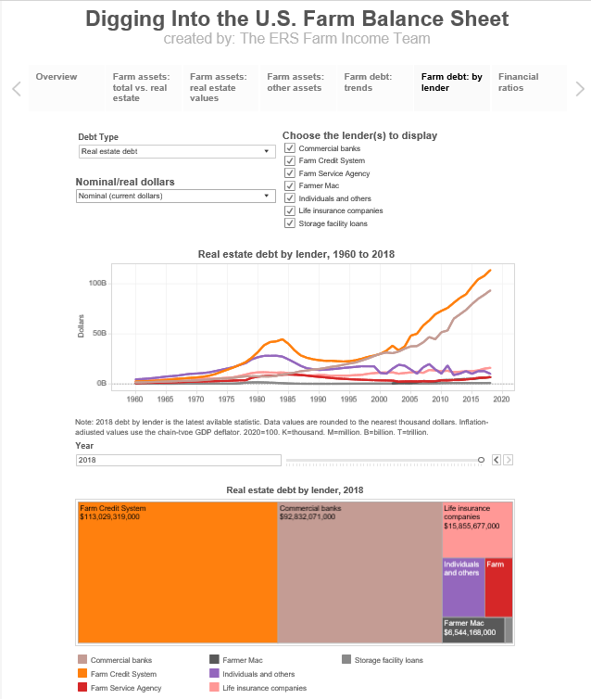
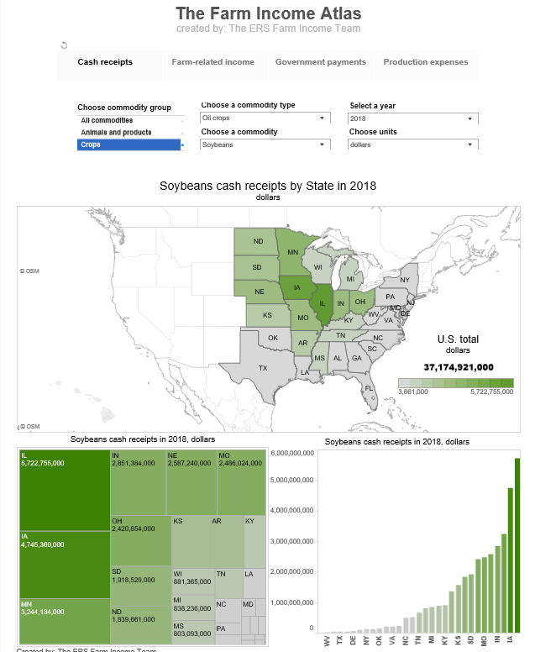
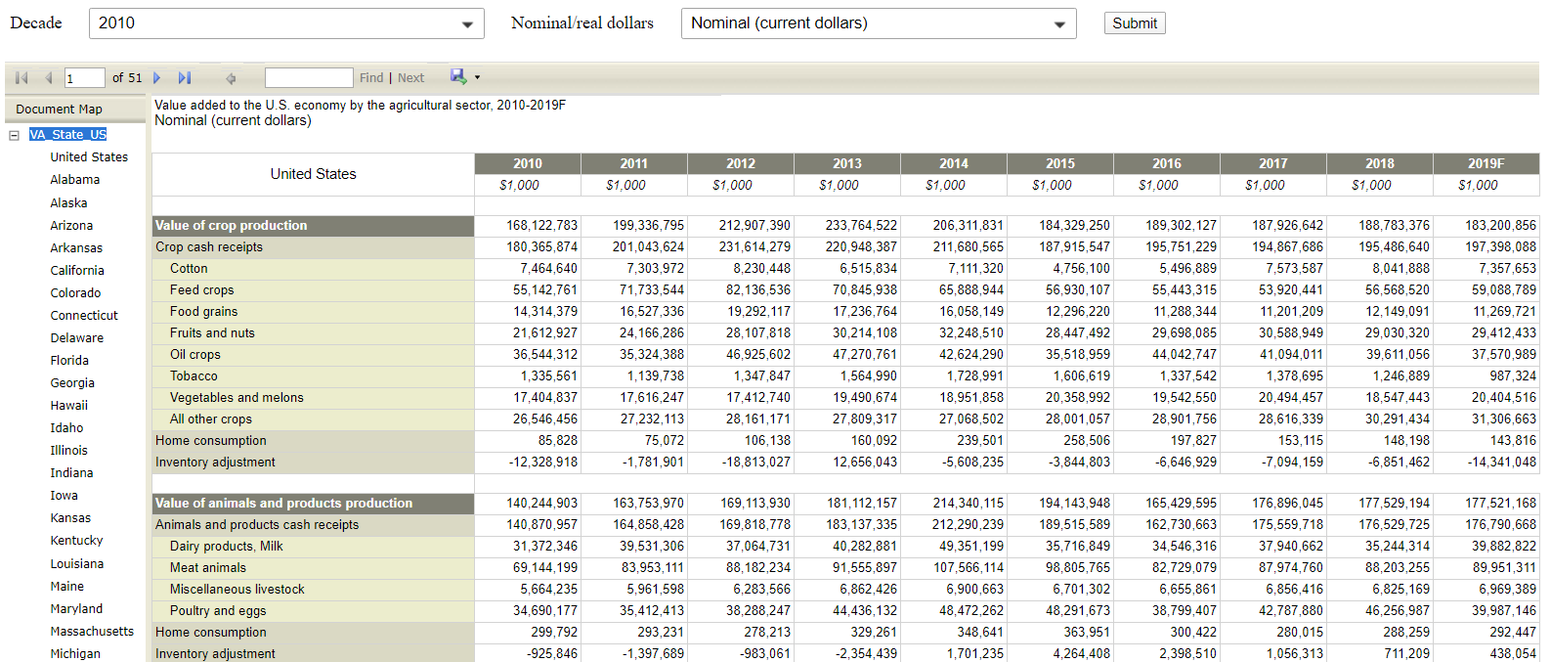
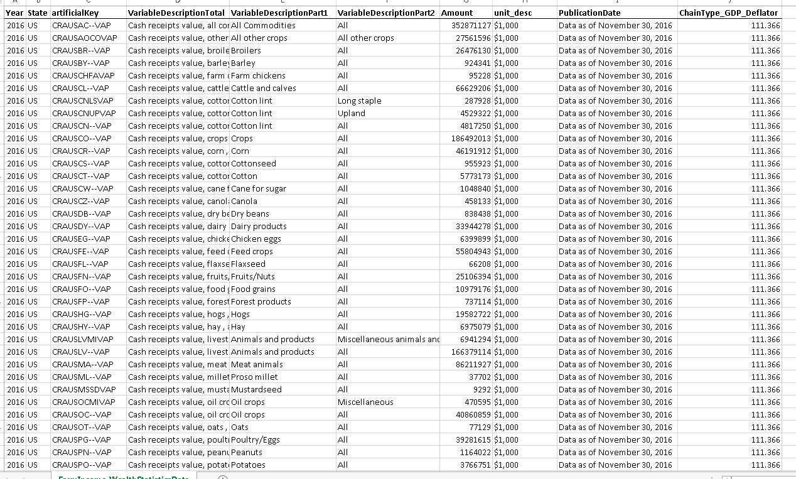
Many Ways to Explore the Data
https://www.ers.usda.gov/data-products/farm-income-and-wealth-statistics/
Visualizations let you dive into the financials of the farm sector
Current and archived comprehensive datasets
Tailored financial reports

Slide 13
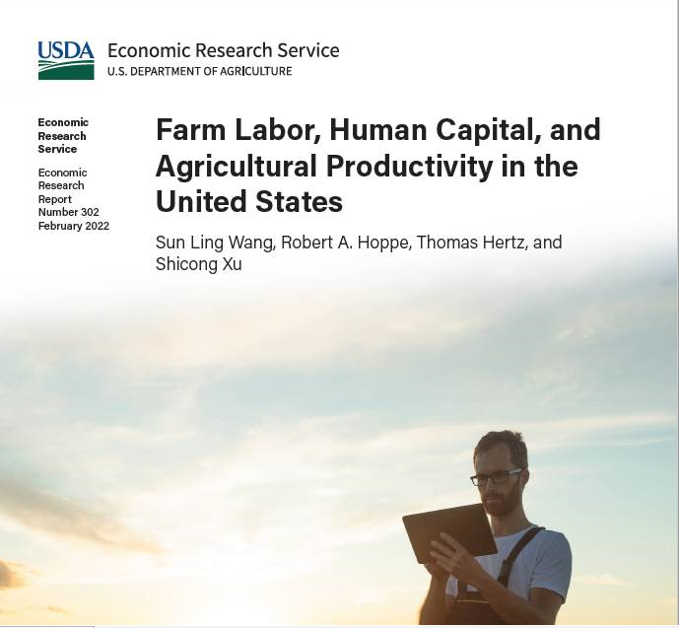
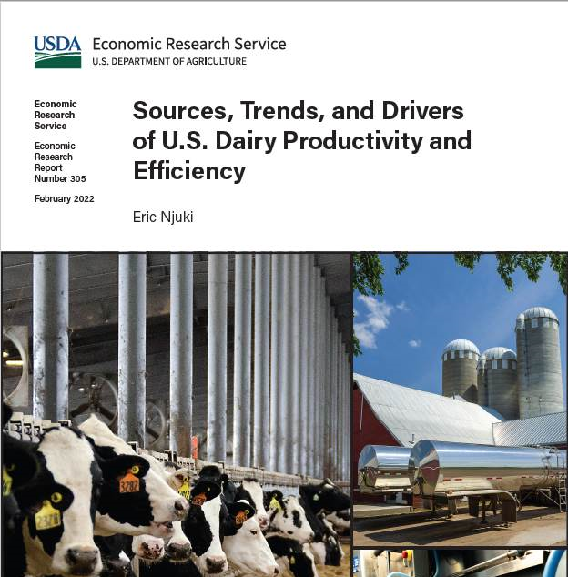
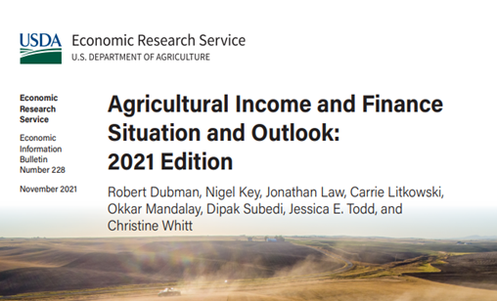
Some recent ERS publications relating to farm income
Notes:
AIS: trends in farm income by major component, changing distribution in direct Government payments, trends in Chapter 12 bankruptcy filings (state and nationa).

Slide 14


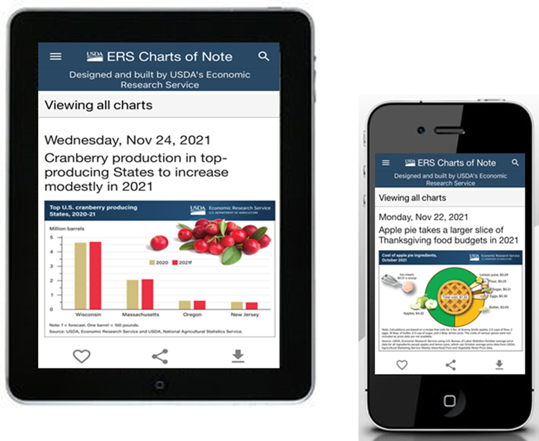


Like, Share, & Follow
Like, Share, & Follow
Coming Soon!
Charts of Note Mobile App
@USDA_ERS
linkedin.com/company/USDA-Economic-Research-Service
ERS.USDA.gov/subscribe
ERS.USDA.gov/multimedia
ERS.USDA.gov/about-ers/careers-at-ers/
Notes:
Before I close, I’d like to note a few ways you can stay up-to-date with ERS research.
On social media, you can find us on Twitter (@USDA_ERS) and LinkedIn (USDA Economic Research Service).
You can also visit our website – www.ERS.USDA.gov – to find full copies of our reports or subscribe to specific products of interest.
Our multimedia page includes a variety of webinars too.
In the next couple of months, be on the lookout for a new Webinar Series that will highlight the ins and outs of some of our most popular data, such as food access and agricultural trade multipliers. Our experts will even walk you through how to find the data on the ERS website.
Stay tuned for announcements that’ll be shared via Twitter, LinkedIn, the ERS website and our subscription emails.
I’d also like to give a shoutout to our new Charts of Note Mobile App – coming soon to Google Android & Apple app stores in the next month or two.
Once available, this app – free of cost -- will deliver the latest ERS research straight to your mobile device.
With this app, you can easily search ERS’s full library of charts, mark your favorites and share them on social media.
Remember to keep ERS in mind as you consider future pursuits – whether as a helpful resource or potential career path. We’re always seeking the best and the brightest minds to advance our research. Visit our careers webpage – listed at the bottom of this slide – to learn more.

Slide 15
Questions?
Farm Sector Income and Finances:
https://www.ers.usda.gov/topics/farm-economy/farm-sector-income-finances/
Contact Information:
farmincometeam@usda.gov

