Slide 1
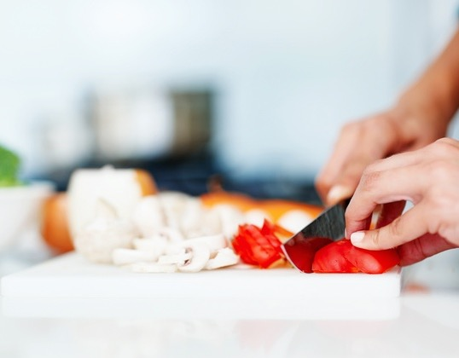
Communication Breakdown: why communicating food safety science to impact behavior change is so hard
Ben Chapman, PhD | February 21, 2020

Slide 2
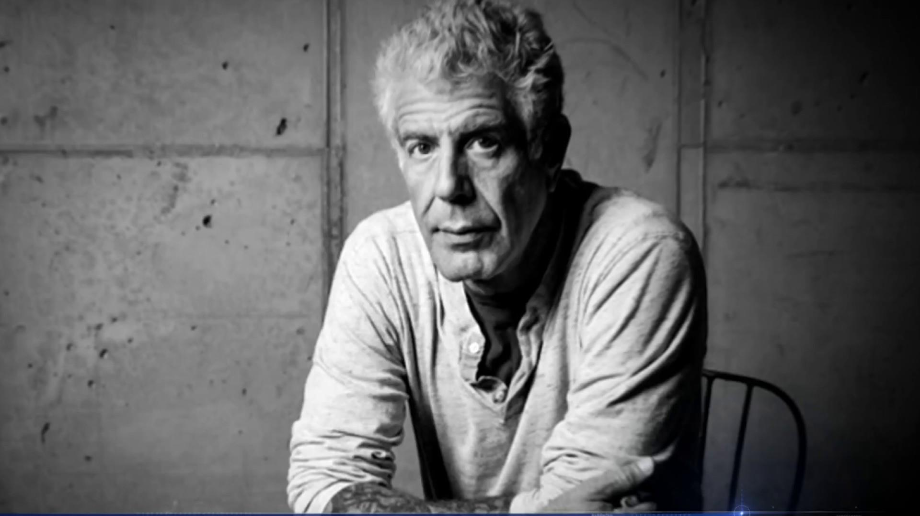
“I've long believed that good food, good eating, is all about risk. Whether we're talking about unpasteurized Stilton, raw oysters or working for organized crime 'associates,' food, for me, has always been an adventure”

Slide 3
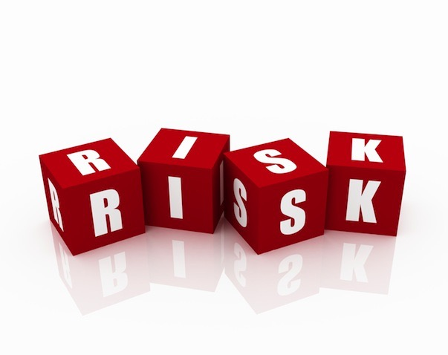
Food is risky

Slide 5
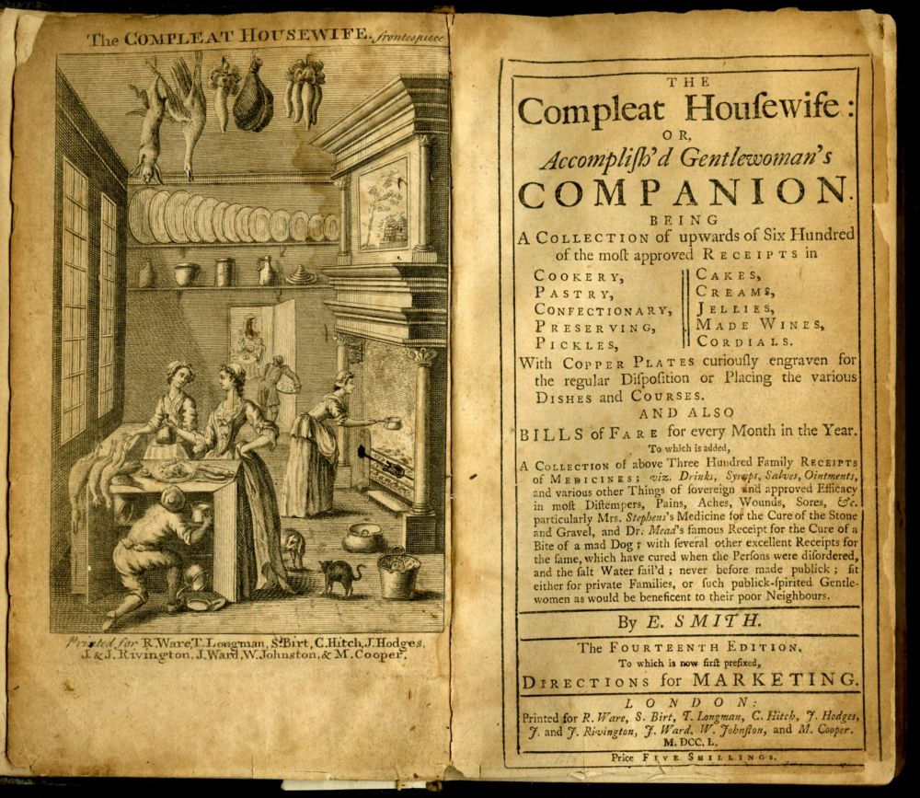

Slide 6
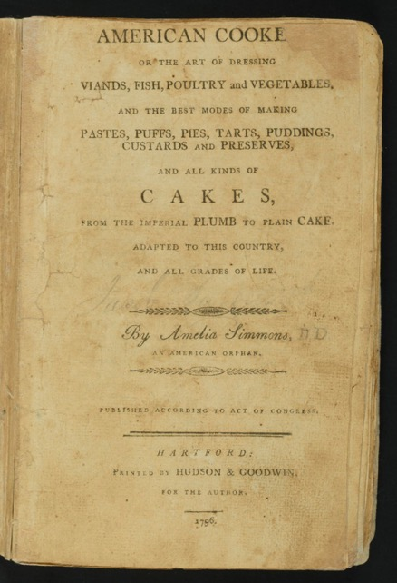
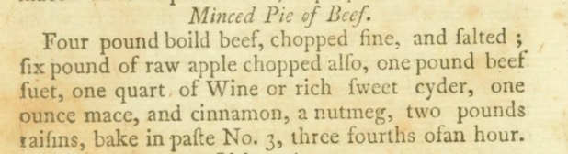

Slide 7
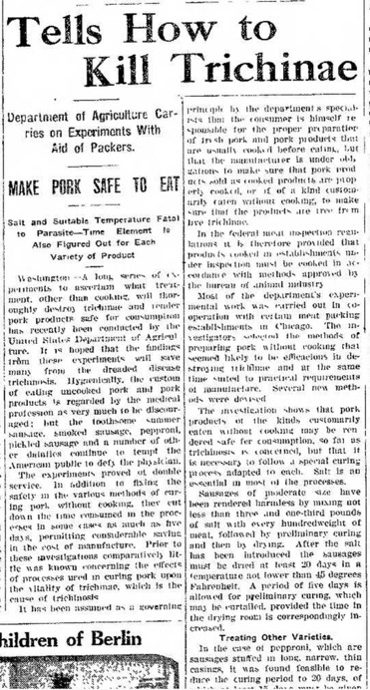

Slide 8
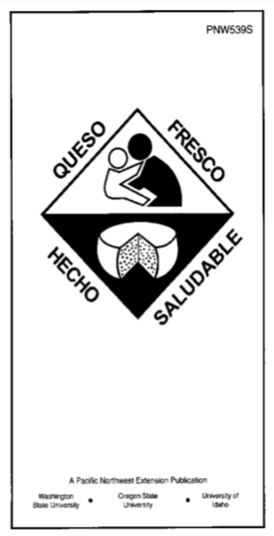
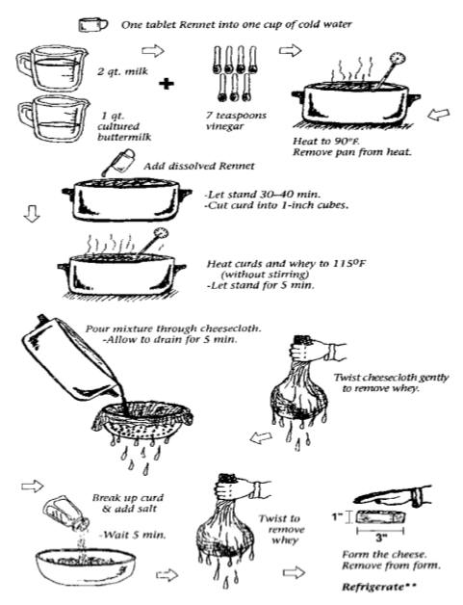

Slide 9
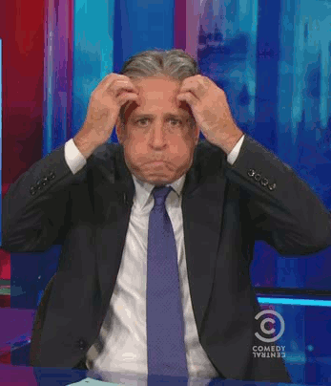
Food preparation has all kinds of complicated messages

Slide 10
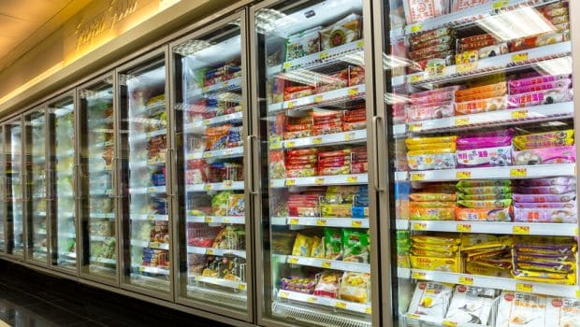

Slide 11
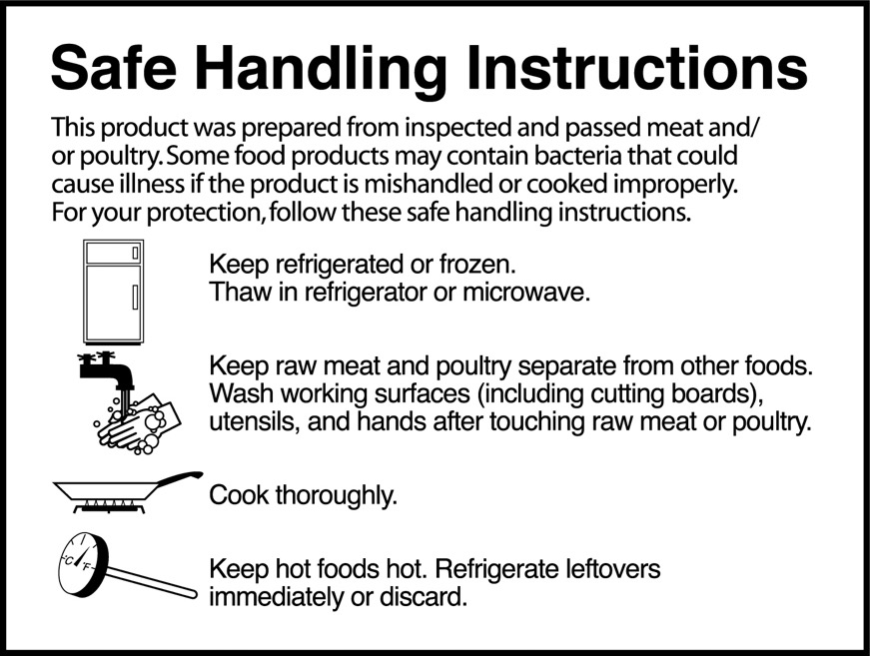

Slide 12
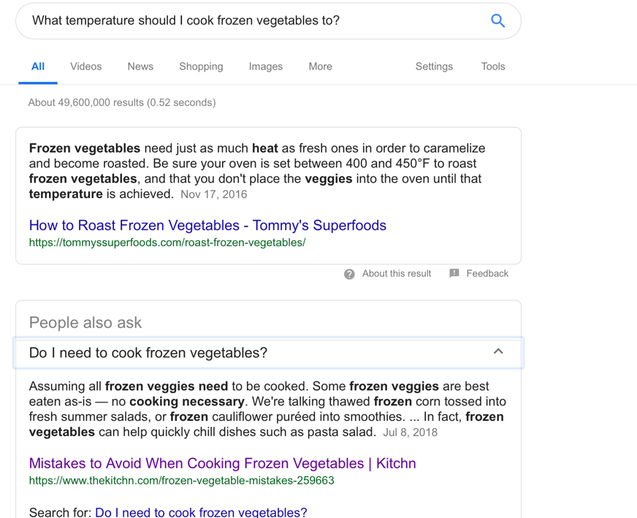

Slide 13
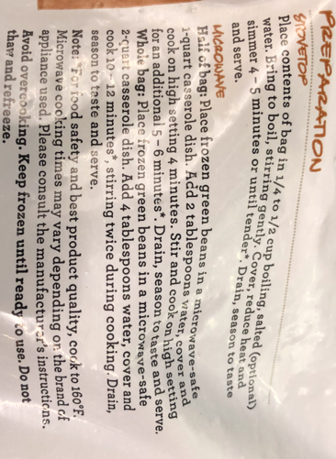
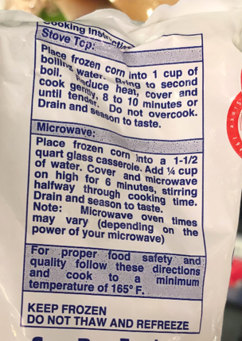
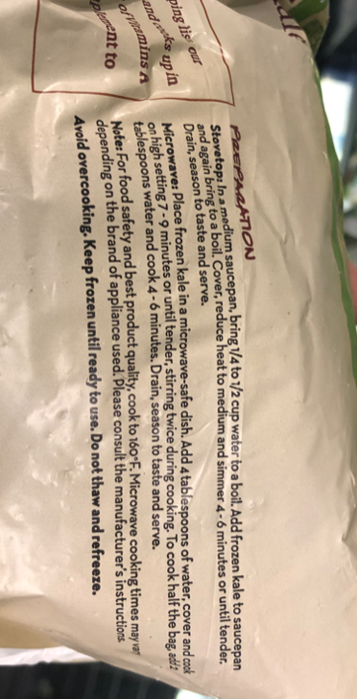

Slide 14
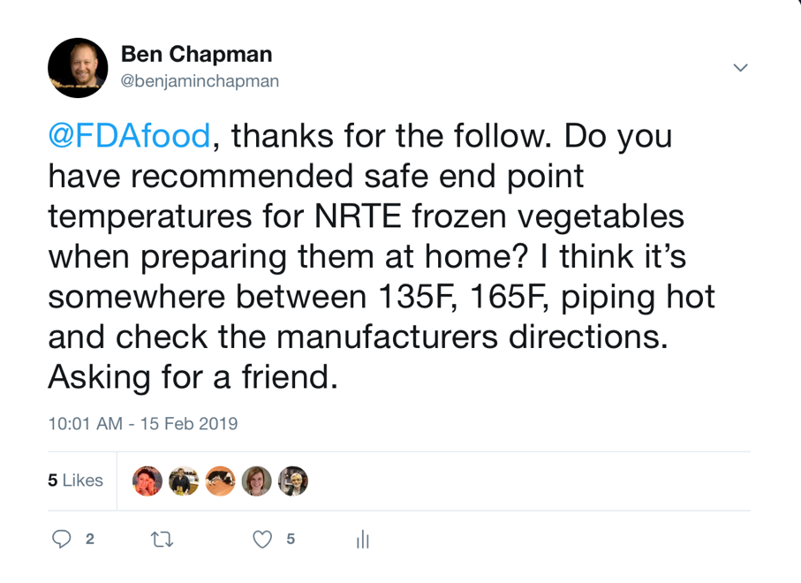

Slide 15
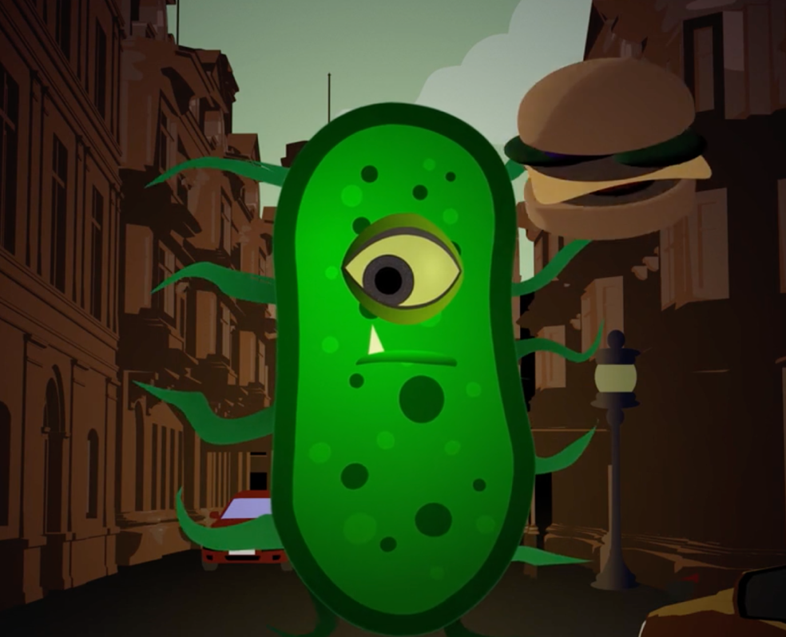

Slide 16
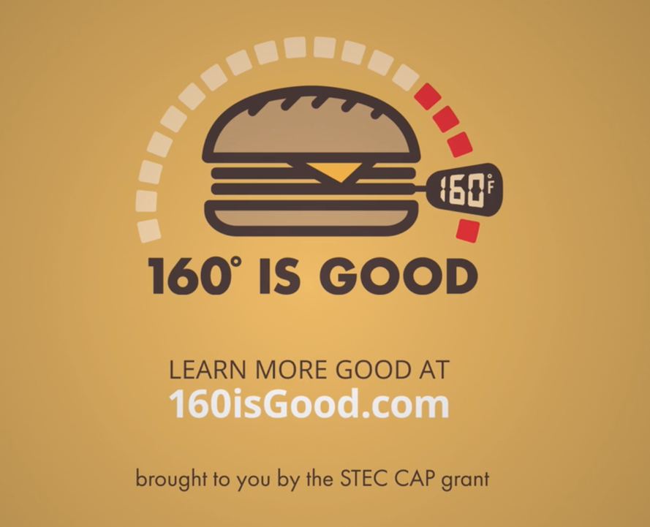

Slide 18
Messages need to be relevant, concise and visually appealing.
Identify the content and audience
Craft message and visuals for the appropriate platform
Peer review

Slide 19
Department of Agricultural and Human Sciences
Indicates a named space

Slide 20

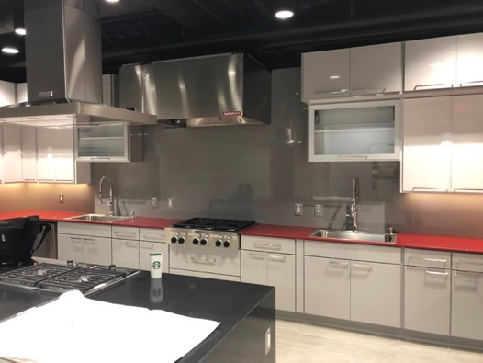
Department of Agricultural and Human Sciences

Slide 21
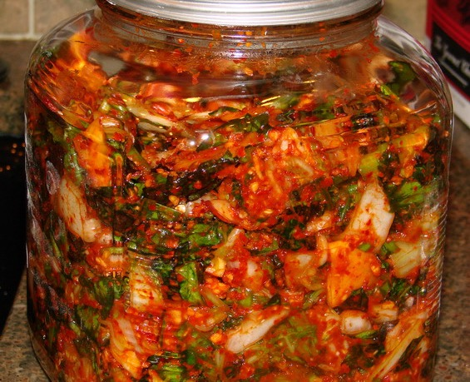
How do you make kimchi?

Slide 22
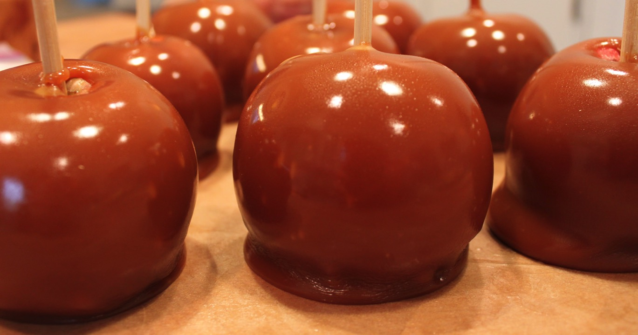

Slide 23
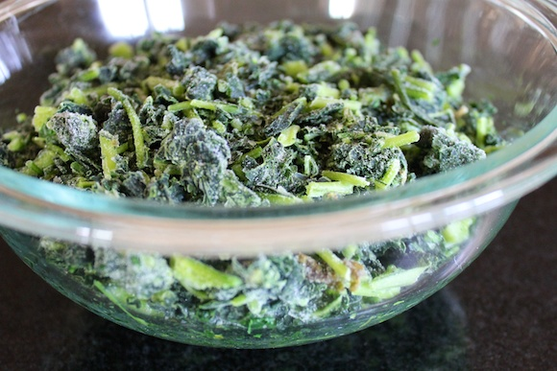

Slide 24
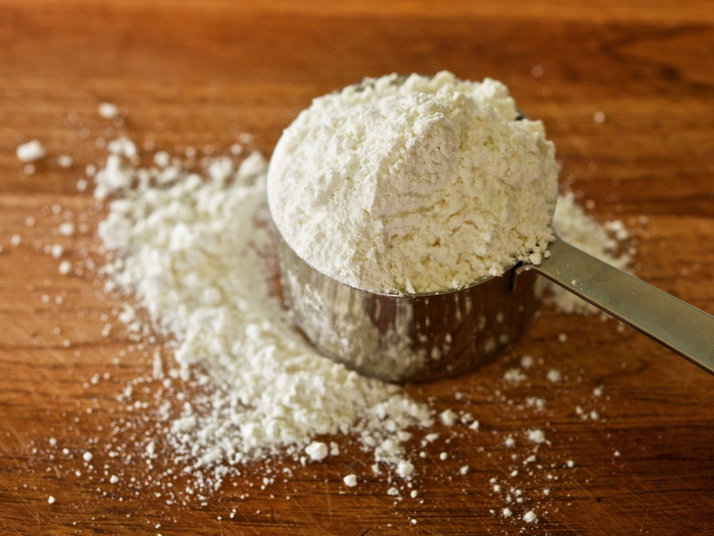

Slide 25
