Slide 1

New Food Technology: What’s in a Name?
Decision-Making from the Consumer Perspective
USDA Ag Outlook Forum 2020
Rob Chiles, PhD
Penn State University
Lina Tami-Barrera, MBA
Penn State University
Nicole Negowetti, JD
Harvard Law School

Slide 2
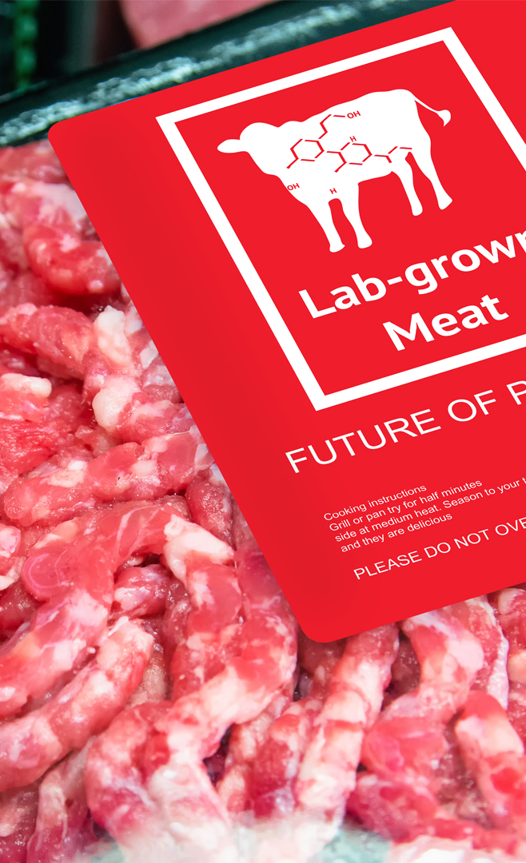
How are consumers, policy-makers, and other stakeholders supposed to wrap their heads around this?
This Photo by Unknown Author is licensed under CC BY-ND

Slide 3
• Why naming is controversial
• Recent policy developments
• Who & what is “the consumer”(?)
• A few thoughts on labeling
• Reflections on the future
This Photo by Unknown Author is licensed under CC BY-ND

Slide 4
Technology
Consumer Culture
Technical and cultural understandings about cell-based foods are unstable, contested, and fluid

Slide 5
Technology
Consumer Culture
Disputes over governance (e.g. naming and
labeling) are about which type of meaning is ultimately stabilized and institutionalized

Slide 6
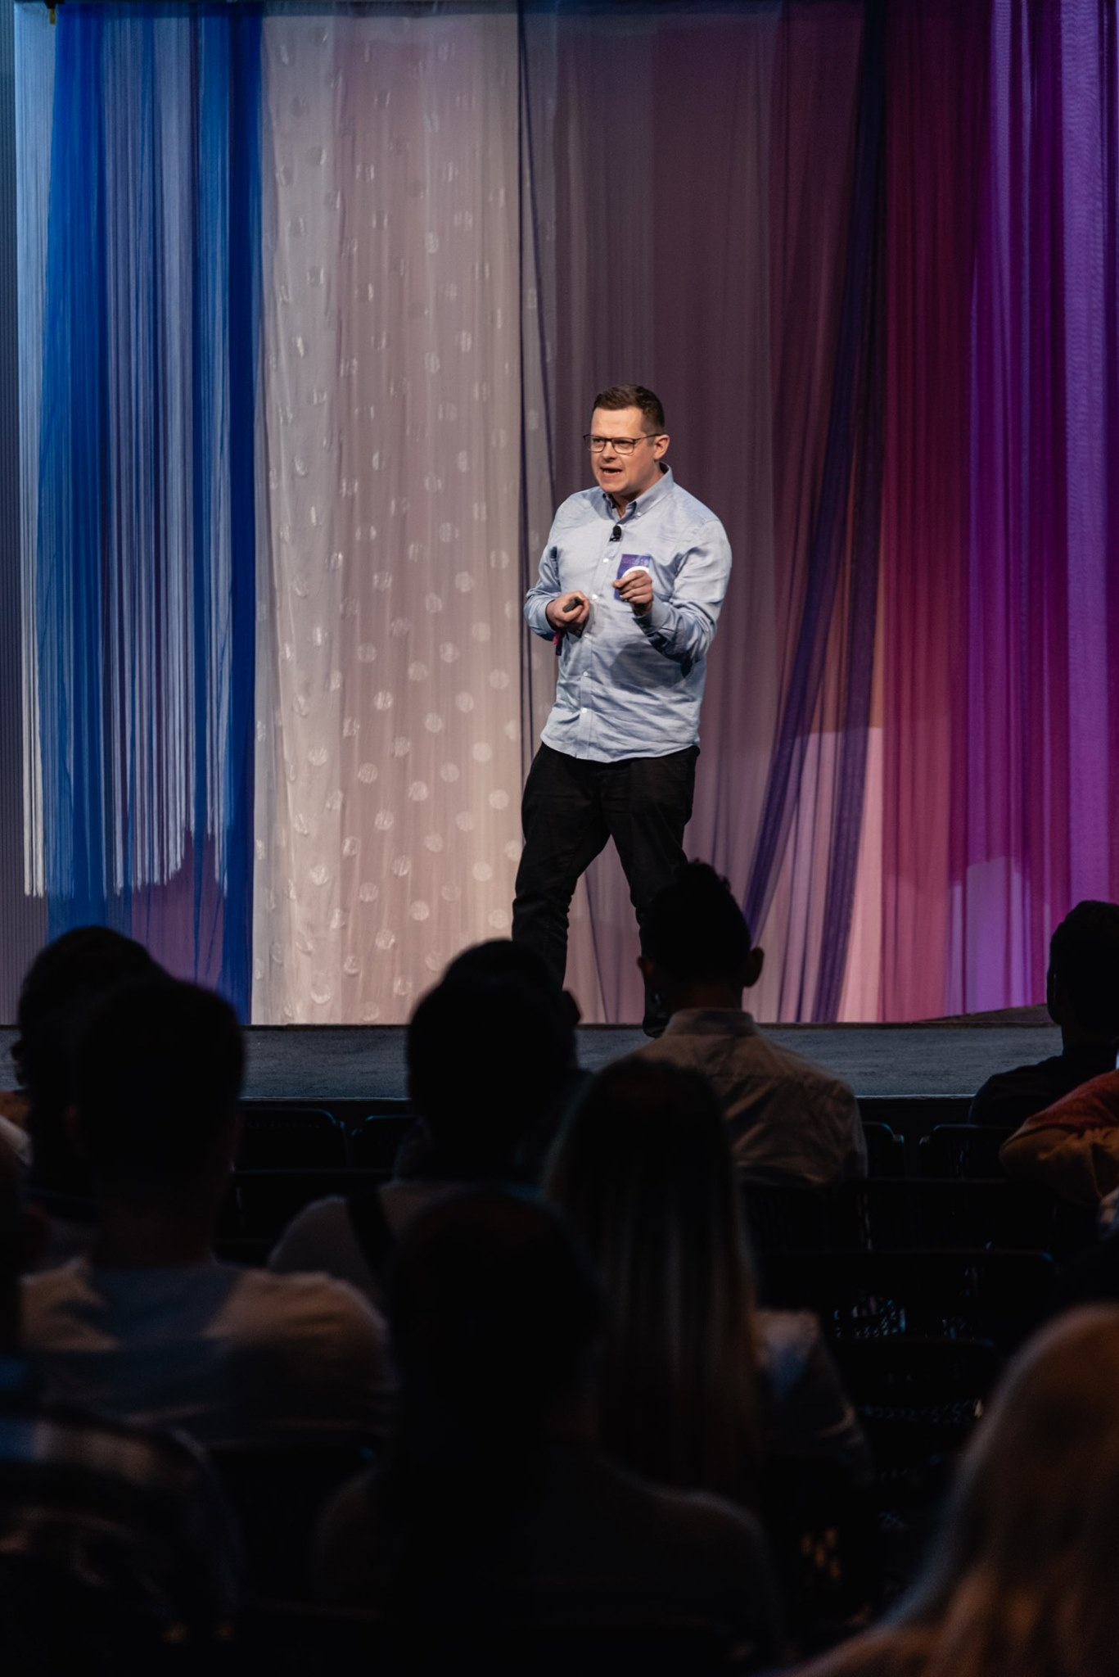
Cultured meat is “an ontologically ambiguous object in the process of becoming.”
Stephens, 2019

Slide 7
Cultured meat is “an ontologically ambiguous object in the process of becoming.”
“There are definitely culturally prevalent definitions of cultured meat out there now, but they’ve not yet stabilised.”
Stephens, 2019

Slide 8


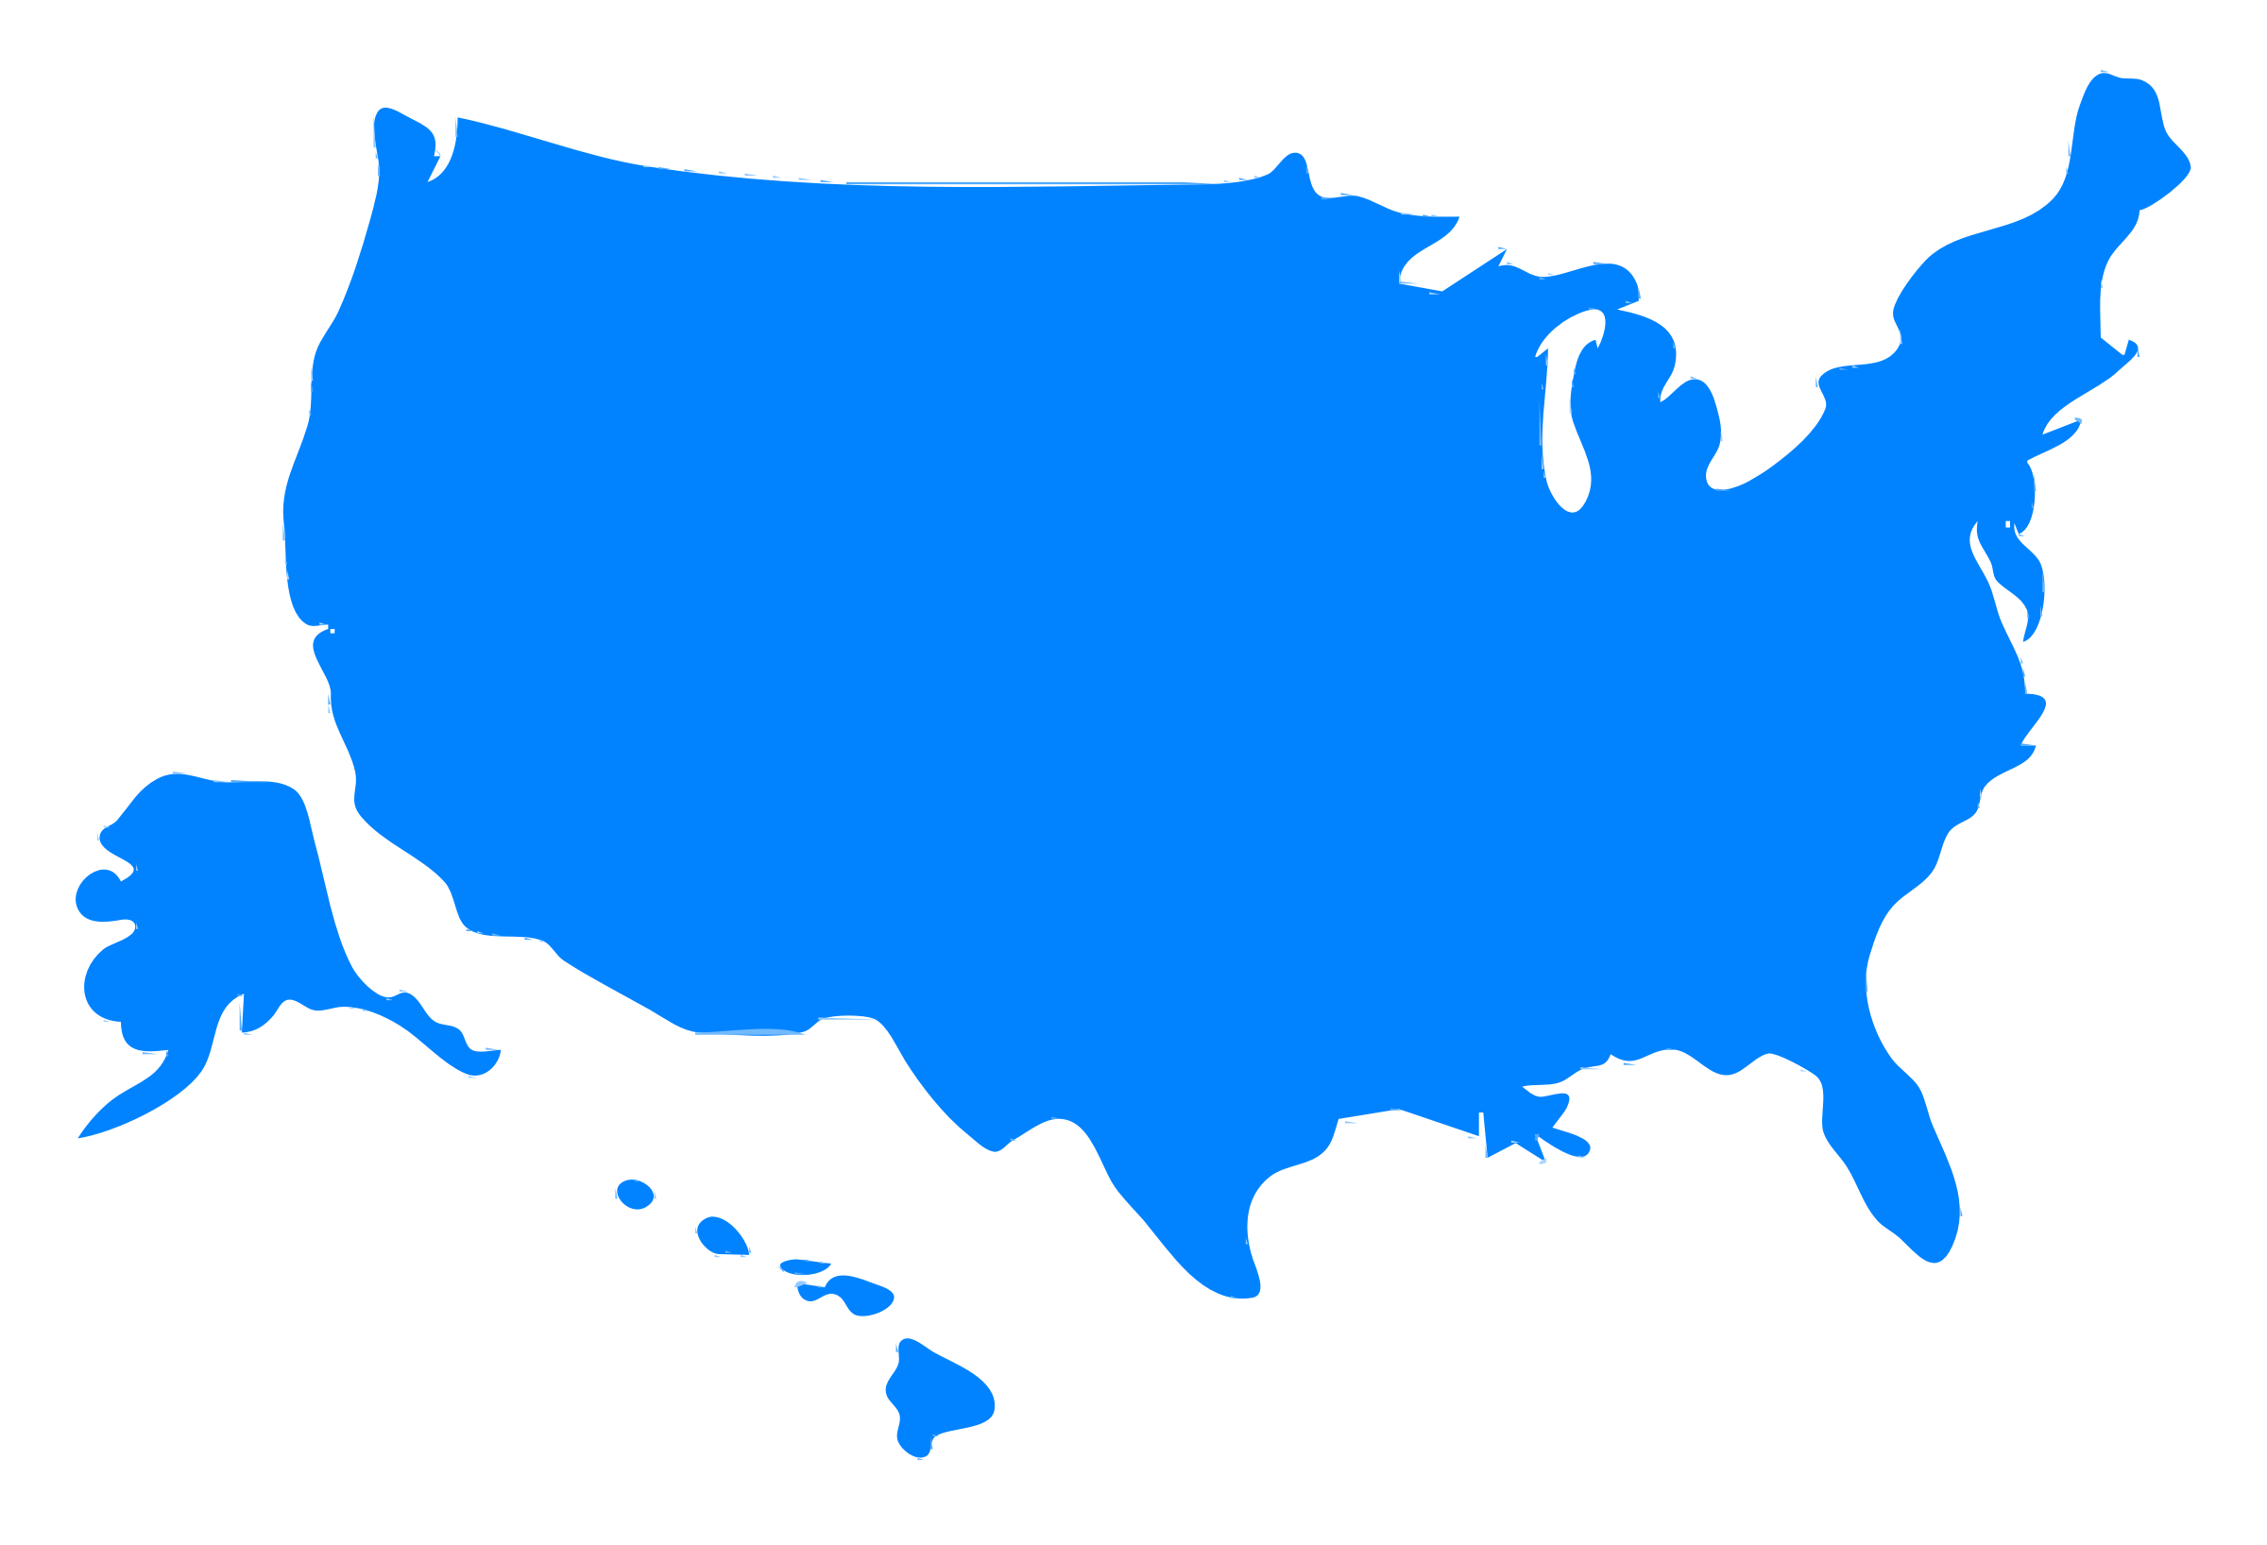
Recent policy developments
• U.S. Cattlemen’s petition
• USDA/FDA Memorandum
• Real MEAT Act of 2019
• State-level actions (MO, MI, AR)
• FMIA and PPIA

Slide 9


Who and what is “the consumer”
(?)

Slide 10

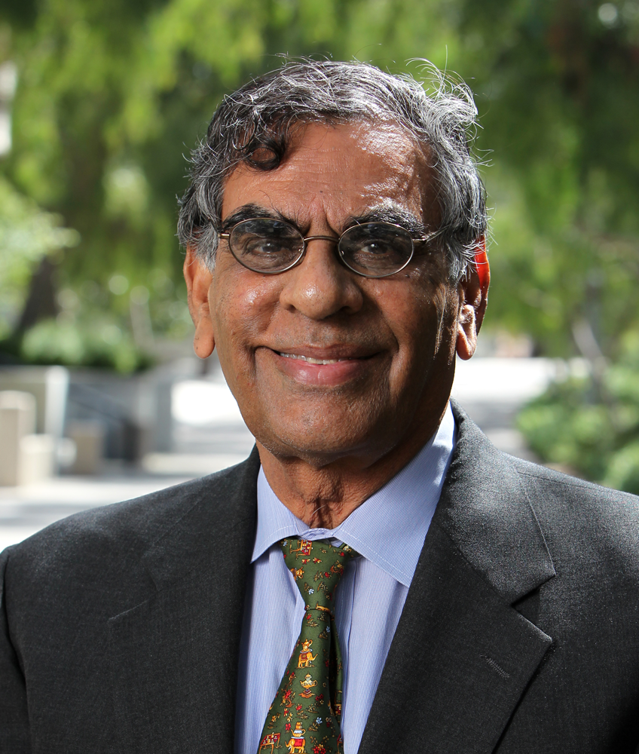
“No single probe into the lives of consumers can provide a complete picture of the actual consumer and, certainly, never a complete picture of the potential consumer.
Firat and Venkatesh, 1995

Slide 11
“No single probe into the lives of consumers can provide a complete picture of the actual consumer and, certainly, never a complete picture of the potential consumer.
Yet, if and when each "discovery" is received with belief in its validity and expectations of its confirmation, especially by a community that can be powerful in its representations, these discoveries tend to mold and construct the consumer in their own image.”
Firat and Venkatesh, 1995

Slide 12
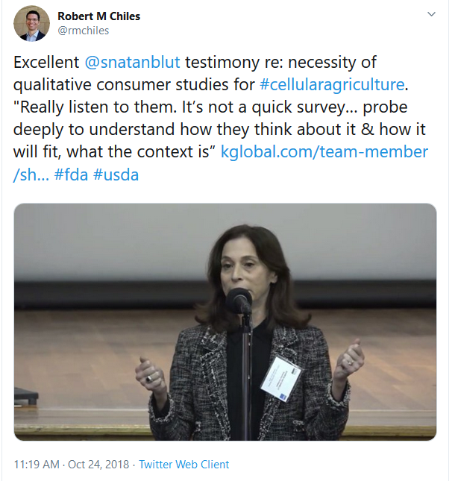

Slide 13
“What seems to resonate with consumers?”

Slide 14
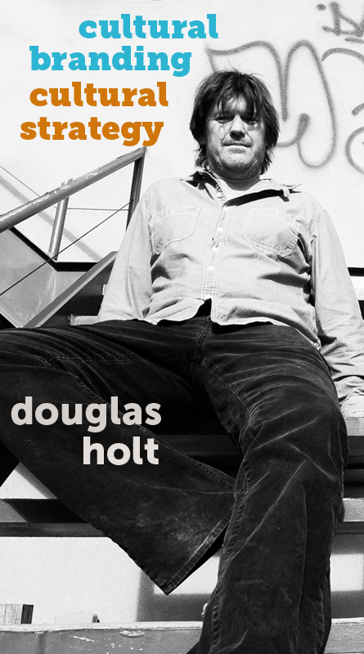
“Brands become iconic when they are woven into the most potent ideological currents in society.”
Holt, 2006

Slide 15





Socioeconomic, environmental, and cultural context
Environmental Degradation
Land and water use / GHG
Animal welfare
Animal slaughter / extreme confinement
Global food security
9 Billion people by 2050 – Food demand
Human Health
Foodborne illness, overweight and undernourishment
Food Safety
Antibiotics / contamination risk
Ronteltap, et al.,2016; Stephens, et al.,2018; Bryant and Barnett, 2019; Cameron, et al., 2019; Weinrich et al.,2020.

Slide 16
Technology features influence public response to new agrifood technologies

Slide 17
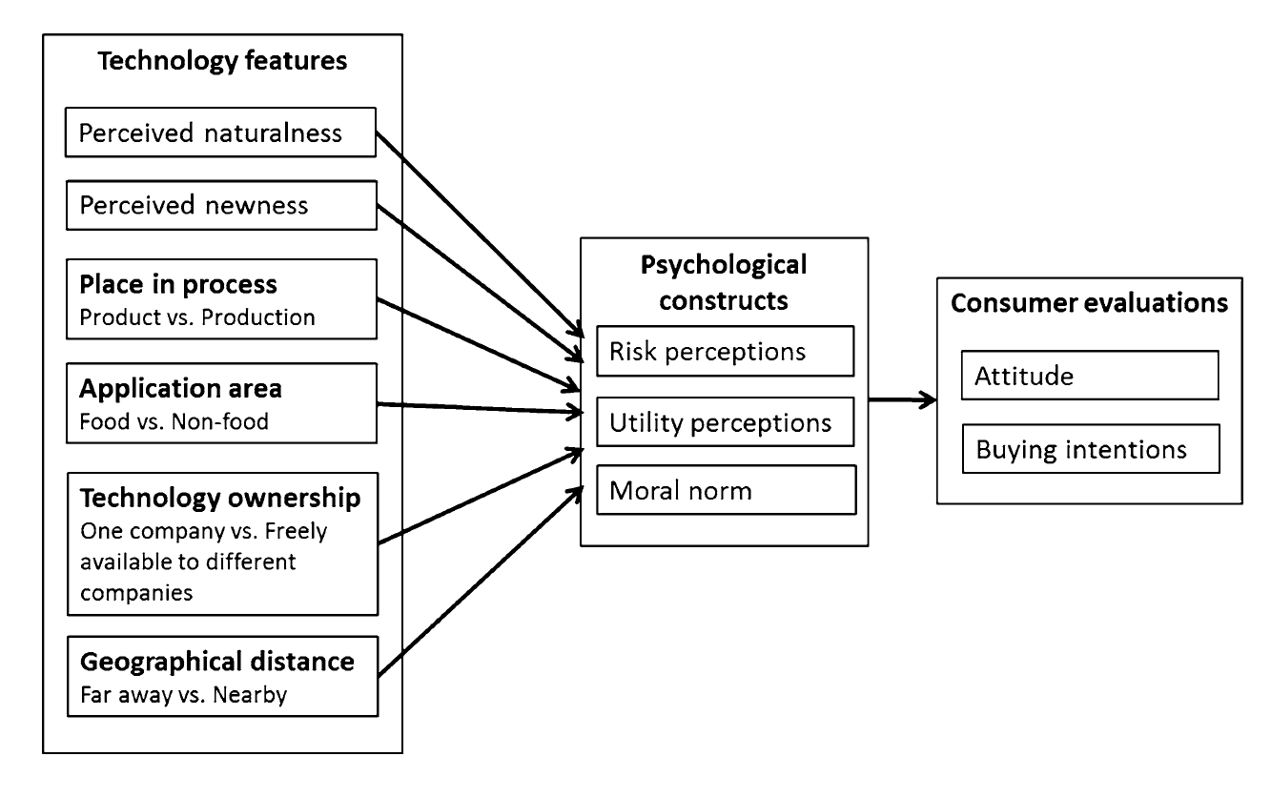
Technology features influence public response to new agrifood technologies

Slide 18
Technology features influence public response to new agrifood technologies
"The theoretical framework overall represented the mechanisms of consumer response well. Features explained between 64 and 70% of the variance in attitude and intentional behavior Ronteltap, et al.,2016)."

Slide 19

Results
Technologies that were seen as more natural and newer were perceived as less risky, more beneficial, and were evaluated more positively.
Ronteltap, et al. (2016)

Slide 20
Results
Technologies that were seen as more natural and newer were perceived as less risky, more beneficial, and were evaluated more positively.
Technologies applied to food were judged to be more beneficial, but also riskier than those applied to non-food.
Ronteltap, et al. (2016)

Slide 21
Results
Technologies that were seen as more natural and newer were perceived as less risky, more beneficial, and were evaluated more positively.
Technologies applied to food were judged to be more beneficial, but also riskier than those applied to non-food.
Technologies used in the production process were perceived to be less risky and evaluated more positively than those used in the product.
Ronteltap, et al. (2016)

Slide 22
Results
Technologies that were seen as more natural and newer were perceived as less risky, more beneficial, and were evaluated more positively.
Technologies applied to food were judged to be more beneficial, but also riskier than those applied to non-food.
Technologies used in the production process were perceived to be less risky and evaluated more positively than those used in the product.
Technologies owned by the market leader were perceived to be more beneficial and evaluated more positively than those that were freely available.
Ronteltap, et al. (2016)

Slide 23
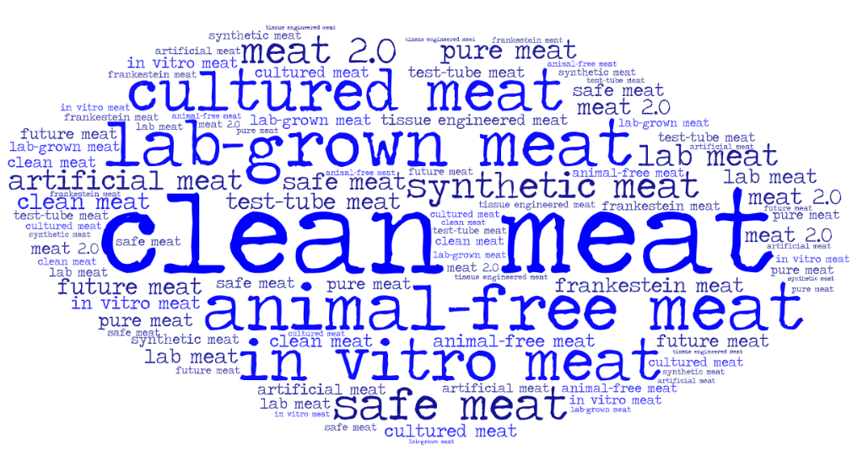
Bryant and Barnett, 2019.

Slide 24
What's in a name? Consumers perception of in vitro meat under different names
Bryant and Barnett, 2019.

Slide 25
What's in a name? Consumers perception of in vitro meat under different names
1. Which associations do people make with the different names?
Bryant and Barnett, 2019.

Slide 26
What's in a name? Consumers perception of in vitro meat under different names
1. Which associations do people make with the different names?
2. How does the name influence consumer attitudes?
Bryant and Barnett, 2019.

Slide 27
What's in a name? Consumers perception of in vitro meat under different names
1. Which associations do people make with the different names?
2. How does the name influence consumer attitudes?
3. How does the name influence stated behavioral intentions?
Bryant and Barnett, 2019.

Slide 28
What's in a name? Consumers perception of in vitro meat under different names
1. Which associations do people make with the different names?
2. How does the name influence consumer attitudes?
3. How does the name influence stated behavioral intentions?
Participants generated a total 721 words or phrases; 338 of them were unique.
Bryant and Barnett, 2019.

Slide 29
Results
"Lab grown meat evoked the most negative associations overall. This is largely due to the associations with artificiality, unnaturalness, disgust and unusualness”.
Bryant and Barnett, 2019

Slide 30
Results
"Lab grown meat evoked the most negative associations overall. This is largely due to the associations with artificiality, unnaturalness, disgust and unusualness”.
"Animal-free meat appeared to confuse consumers, who gave the highest number of associations with vegetarianism/veganism. Participants also gave association with uncertainty from the apparent contradictions in this name."
Bryant and Barnett, 2019

Slide 31
Results
"Lab grown meat evoked the most negative associations overall. This is largely due to the associations with artificiality, unnaturalness, disgust and unusualness”.
"Animal-free meat appeared to confuse consumers, who gave the highest number of associations with vegetarianism/veganism. Participants also gave association with uncertainty from the apparent contradictions in this name."
"Cultured meat evoked the most associations related to science and participants gave many associations related to meat preparation.
Bryant and Barnett, 2019

Slide 32
Results
"Lab grown meat evoked the most negative associations overall. This is largely due to the associations with artificiality, unnaturalness, disgust and unusualness”.
"Animal-free meat appeared to confuse consumers, who gave the highest number of associations with vegetarianism/veganism. Participants also gave association with uncertainty from the apparent contradictions in this name."
"Cultured meat evoked the most associations related to science and participants gave many associations related to meat preparation.
"Clean meat most evoked associations with healthiness, nutrition, tastiness, cleanness, and naturalness. This name evoked the most positive associations compared to the others."
Bryant and Barnett, 2019

Slide 33
Bryant et al. (2019) "A survey of consumer perceptions of plant-based and clean meat in the USA, India, and China." Frontiers in Sustainable Food Systems 3: 11.
Stated likelihood of purchasing clean meat:
 | Not at all | somewhat | Very/extremely
USA | 23.6% | 46.6% | 29.8%
China | 6.7% | 33.9% | 59.3%
India | 10.7% | 37.7% | 48.7%

Slide 34

A few thoughts on labeling

Slide 35

“Whether a consumer finds a label compelling depends upon the consumer's perception of the label's message, design and source, and how that fits with the consumer's own values and characteristics…
Zepeda et al., 2013

Slide 36
“Whether a consumer finds a label compelling depends upon the consumer's perception of the label's message, design and source, and how that fits with the consumer's own values and characteristics… For a consumer to find a label consistent with their personal values, it must convey a desired attribute, the design must be appealing, and the source must be trustworthy.”
Zepeda et al., 2013

Slide 37
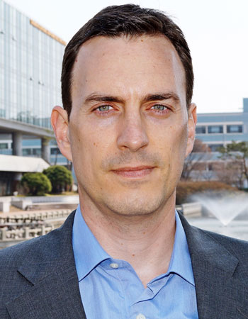
“Scholars should go beyond studies of consumers’ use or interpretations of new food labels.”
Frohlich, 2017

Slide 38
“Scholars should go beyond studies of consumers’ use or interpretations of new food labels.”
We need to pay attention to the “informational infrastructure,” and the ways that labels institutionalize cultural discourses
Frohlich, 2017

Slide 39
Some reflections on the future of food governance
This Photo by Unknown Author is licensed under CC BY-ND

Slide 40
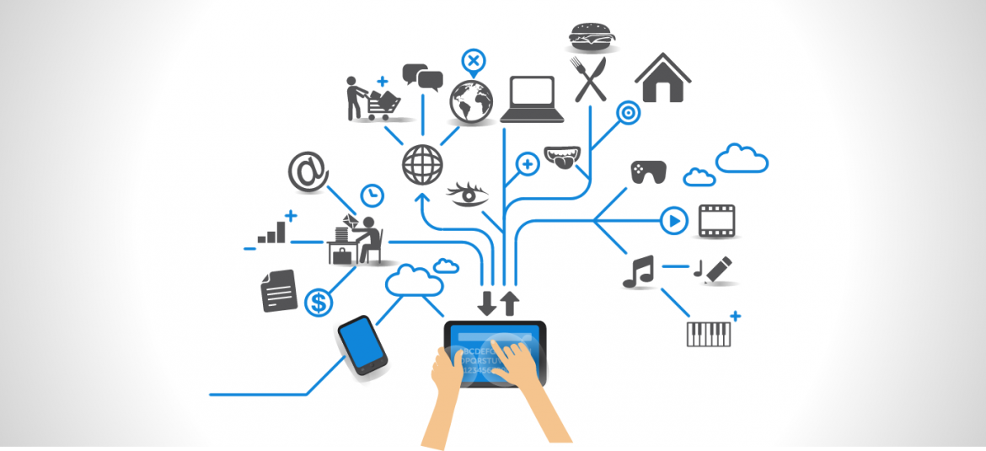
Continued convergence (and blurring) between the digital, material, and biological domains
- What does that mean for ag and food governance (?)
This Photo by Unknown Author is licensed under CC BY-SA-NC
Schwab, 2016

Slide 41
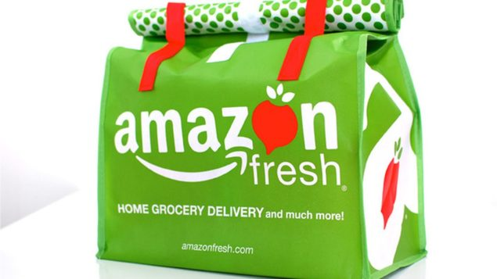
Online, on-demand, and no-click delivery (or 3D printing) of micro-targeted, personalized products with personalized labels, optimized by big data, IoT, and AI.
This Photo by Unknown Author is licensed under CC BY-SA-NC

Slide 42
Online, on-demand, and no-click delivery (or 3D printing) of micro-targeted, personalized products with personalized labels, optimized by big data, IoT, and AI.
Do you regulate every printing, every product, every label (?)
This Photo by Unknown Author is licensed under CC BY-SA-NC

Slide 43

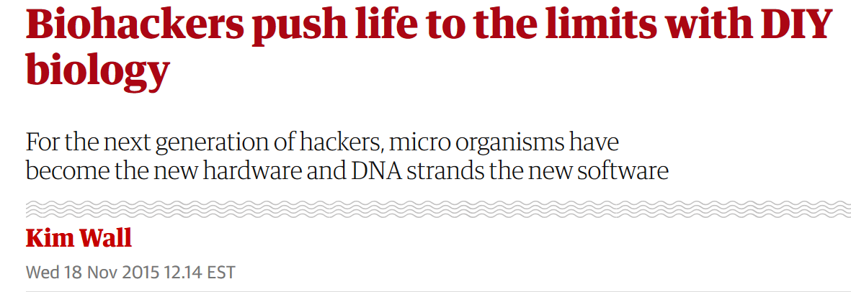
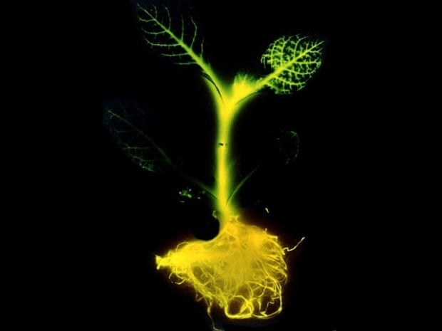
https://www.theguardian.com/science/2015/nov/18/biohackers-strange-world-diy-biology

Slide 44
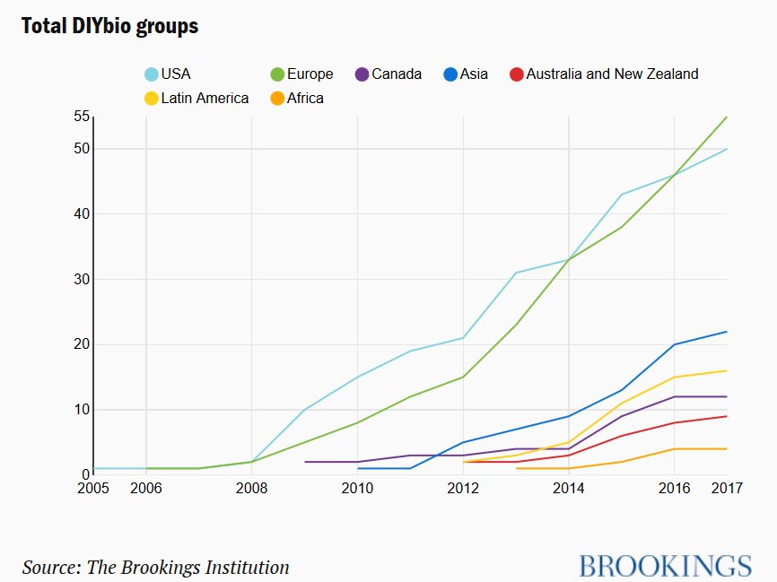

Slide 45
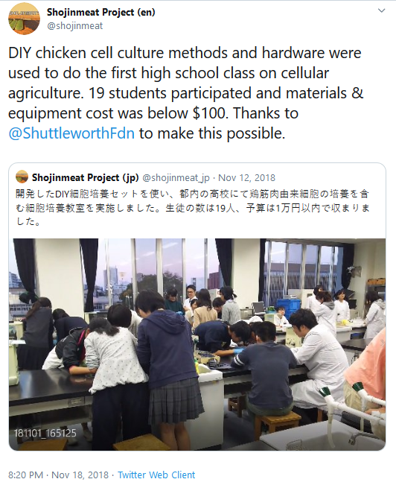

Slide 46
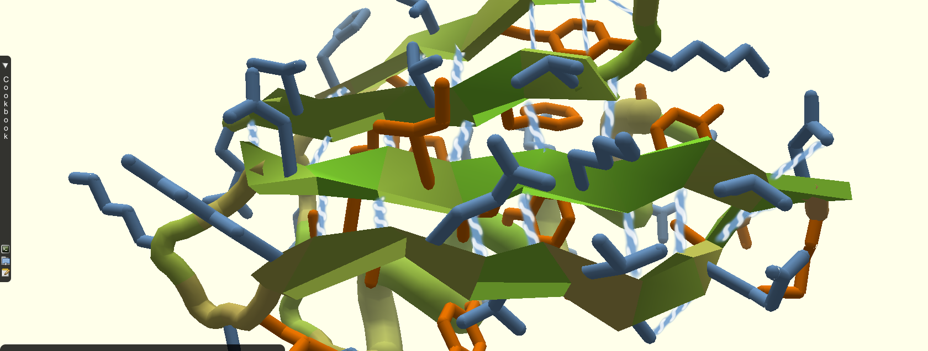
FoldIt:
“A revolutionary crowdsourcing computer game enabling you to contribute to important scientific research.”
https://fold.it/

Slide 47
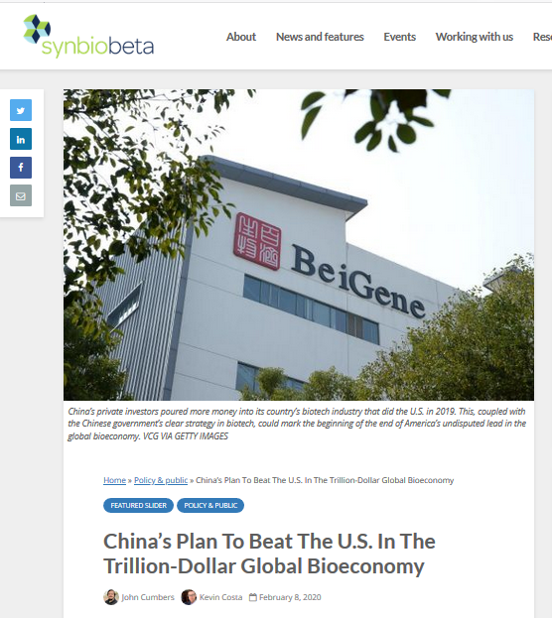

Slide 48
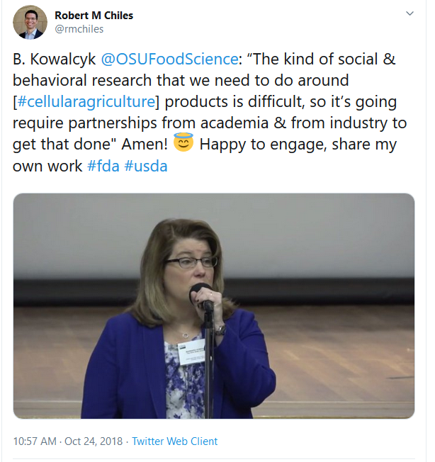

Slide 49

“National governments must recognize that they can no longer work at the speed of a large bureaucracy. They must engage in collaboration and in long-term planning, and they must be nimble enough to act more quickly in order to confront the future of AI.”
Webb, 2019

Slide 50

Thanks!
- Rob, Lina, and Nicole

