Slide 1
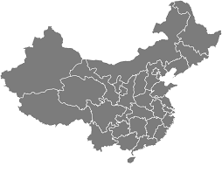
China’s Belt and Road Initiative for Agriculture
Fred Gale
Senior Economist
Economic Research Service
U.S. Department of Agriculture
Fred.Gale@usda.gov
Presentation to USDA Agricultural Outlook Forum
February 20, 2020

Slide 2
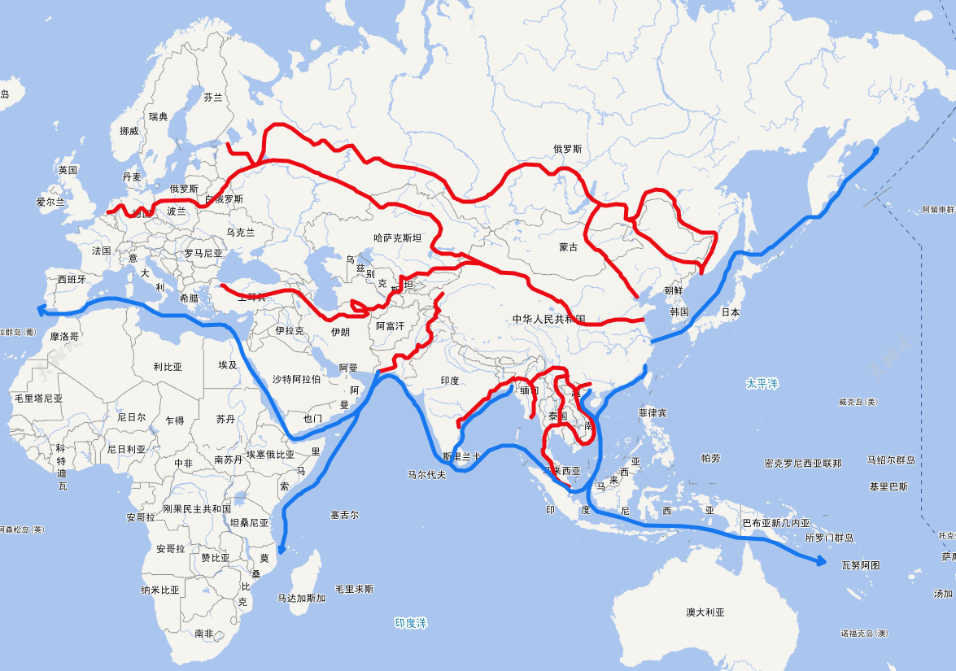
One Belt, One Road: “New Silk Road Economic Belt” and
“21st Century Maritime Silk Road”
Xi Jinping launched initiative in 2013
Build and develop trade corridors across land and sea routes between Asia and Western Europe
Trade goes in both directions
Invest in and cooperate with 65-plus countries along these routes
Make trade “fair” and “inclusive”
Source: 52maps.com/ditu_yidaiyilu.php

Slide 3
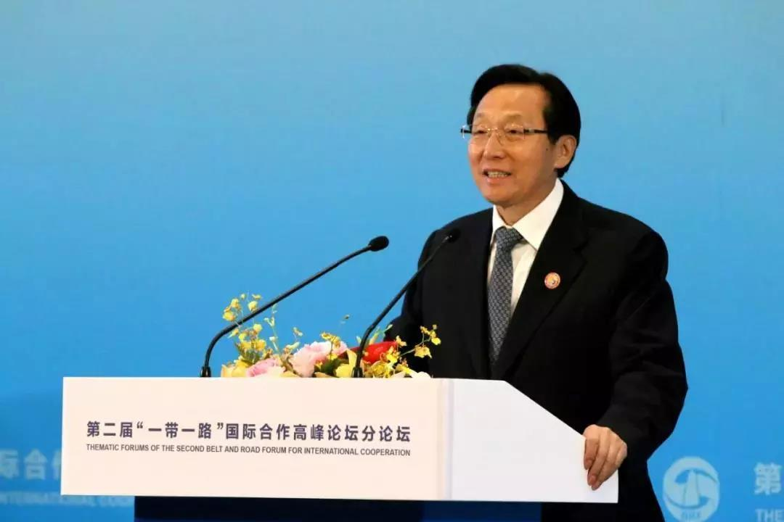
Agriculture is one of many facets of “One Belt One Road”
Expand agricultural trade
  Diversify sources of agricultural imports
  Cut tariffs, form new free trade agreements
  Actively participate in multilateral agreements/organizations
Cooperation
  Foreign investment by Chinese agribusiness firms
  Scientific exchanges
  China provides agricultural technical assistance
  Sharing market and policy information on Chinese platforms
Trade facilitation
  More ports/points of entry, especially inland rail/truck crossings
  More efficient customs clearance, inspection/quarantine
Making trade more “open,” “transparent,” “inclusive,” and “non-discriminatory”
  Change rules governing trade
  Reduce power of oligopolies and cartels in ag markets
At the 2nd Belt and Road Forum for International
Cooperation, April 2019, Minister of Agriculture
and Rural Affairs Han Changfu called for expanding
contacts in agricultural trade, reducing trade
barriers, and forming equitable, long-term relations
between trade partners.
“多位中外部长共商 ’一带一路’ 农业合作大计 [Many
Chinese and foreign ministers discussed ‘belt and road’
Agricultural cooperation],” Official news media.

Slide 4
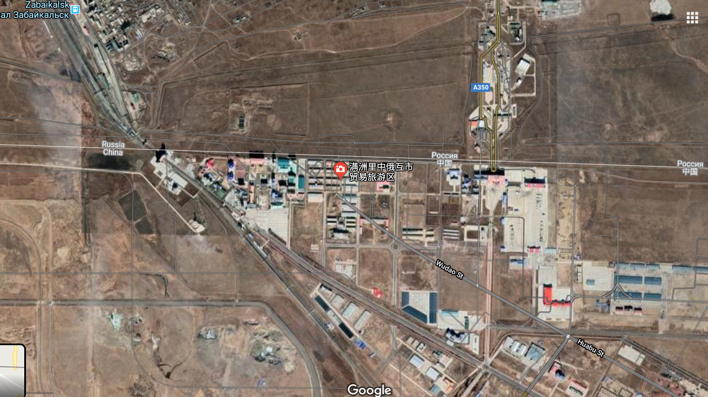

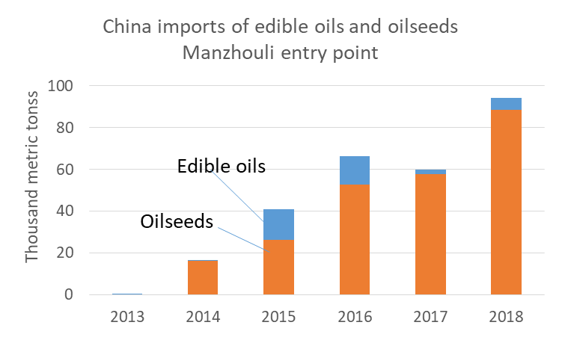
Example: China-Russia Manzhouli border crossing
Image of Manzhouli border crossing from Google maps
Road
crossing
Rail
crossing
According to Chinese State news media:
2012: Manzhouli was chosen as strategic inland port
2013: Officials set up a factory to process 120,000 tons of
oilseeds and grain imported from Russia, financed by a
provincial bank and a real estate conglomerate in South China.
2018: Oilseed imports via Manzhouli reached 90,000 tons
Jan-Apr 2019: Imported 15,000 tons of grain
Jan-Mar 2019: 1,500 border crossings by Chinese workers
engaged in agriculture and lumber industries in Russia.
Russia
Russia
China
China
Source: ERS calculations using China customs data
accessed by Trade Data Monitor.

Slide 5
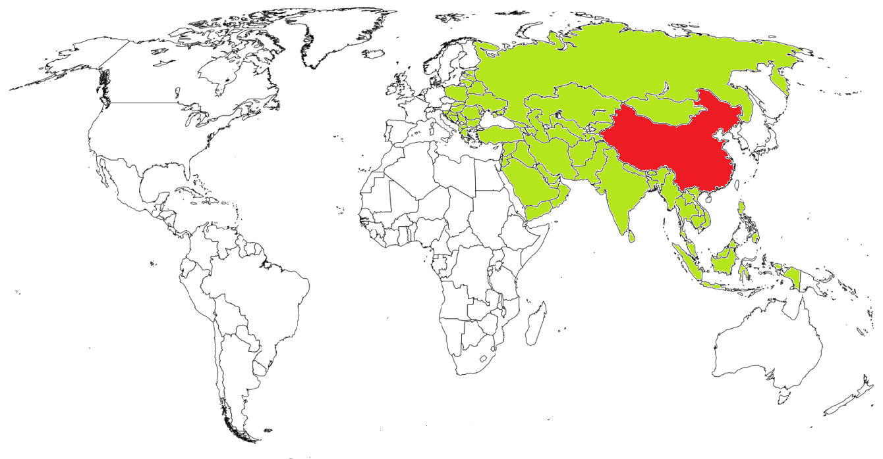
China imported $29 billion of agricultural products from “Belt and Road” countries in 2019
China's agricultural imports, 2019
All ag imports | $133 bil
From 65 “Belt and Road” countries | $29 bil 22%
Top Belt-Road sources:
Thailand | $8.0bil
Indonesia | 5.3
Malaysia | 2.8
Vietnam | 2.5
Ukraine | 2.4
Russia | 1.3
Philippines | 0.9
Myanmar | 0.6
Laos | 0.4
China has officially designated “65-plus” countries and regions
as part of the “One Belt, One Road” initiative (but no
country is excluded).
Note: Share of China’s value of “BICO Agricultural” imports.
Source: ERS calculations using China customs data from Trade Data Monitor.

Slide 6
China’s ag imports from South America rose more than imports from “Belt and Road” countries during 2018-19
The share of China’s agricultural imports from Belt and Road countries has been consistently in the range of 20-22%
The U.S. share of China’s agricultural imports fell from 21-23% during 2013-16 to 10% in 2019
The largest share (31%) of China’s agricultural imports and the chief source of growth is from South America (not officially part of the Belt and Road)
Note: Share of China’s import value using USDA’s “BICO Agricultural” definition.
Source: ERS calculations using China customs data from Trade Data Monitor.

Slide 7
“Belt and Road” countries are significant agricultural export markets for the United States
U.S. exports of agricultural products, 2018
All “Belt and Road” countries | $24.9 bil 18%
Top Belt and Road destinations:
Vietnam | $4.0bil
Indonesia | 3.1
Philippines | 3.0
Thailand | 2.1
India | 1.5
Pakistan | 1.4
Turkey | 1.4
Saudi Arabia | 1.4
Bangladesh | 1.1
Malaysia | 1.0
In 2018, U.S. agricultural exports to “Belt and Road” countries:
  Totaled $24.9 billion
  Accounted for 18% of U.S. ag exports
  For the top 10 Belt and Road countries, exports exceeded $1 billion each
Can China
  Raise productivity in these countries through investment and technical assistance?
  Nurture these countries as suppliers of China’s imports?
Note: Value of “BICO Agricultural” imports. Not including China or Hong Kong.
Source: ERS calculations using data from Trade Data Monitor.

Slide 8
Travel and trade between China and new partners transmits pests and pathogens
China took precautions against invasive species and pests
  2016-20 five-year plan called for stronger public health and biosecurity measures at ports and border crossings to address these risks
  China was on alert for years to prevent entry of African swine fever (ASF)
Nevertheless, China is facing major challenges from a pathogen and a pest that appear to have entered from Belt and Road countries:
  2018: ASF entered China—probably from Russia or Eastern Europe—and spread to neighboring countries
  2019: Fall army worm entered China from Myanmar and spread across most of the country within months—spreading again in 2020
  2020: Spread of locusts from East Africa to Pakistan to China is a new concern
China also has many pathogens, pests, and invasive species that could spread to Belt and Road countries
  Belt and Road countries are on alert against spread of coronavirus from China

Slide 9
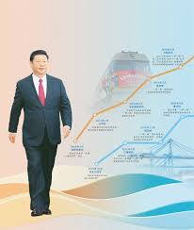
In Agricultural Trade, All Roads Lead to the American Continent
Belt and Road revives 15th-century trade routes that pre-date the emergence of the American continent and Oceania as exporters and innovators in agriculture
  China’s agriculture benefited from crops, livestock, and production systems introduced from the Americas
  Natural resources, bottom-up investment and innovation, and prudent/pragmatic regulation made these countries major agricultural exporters
China can continue to benefit from cooperation with the United States
  The Phase One U.S.-China trade agreement encourages cooperation in multiple areas

Slide 10
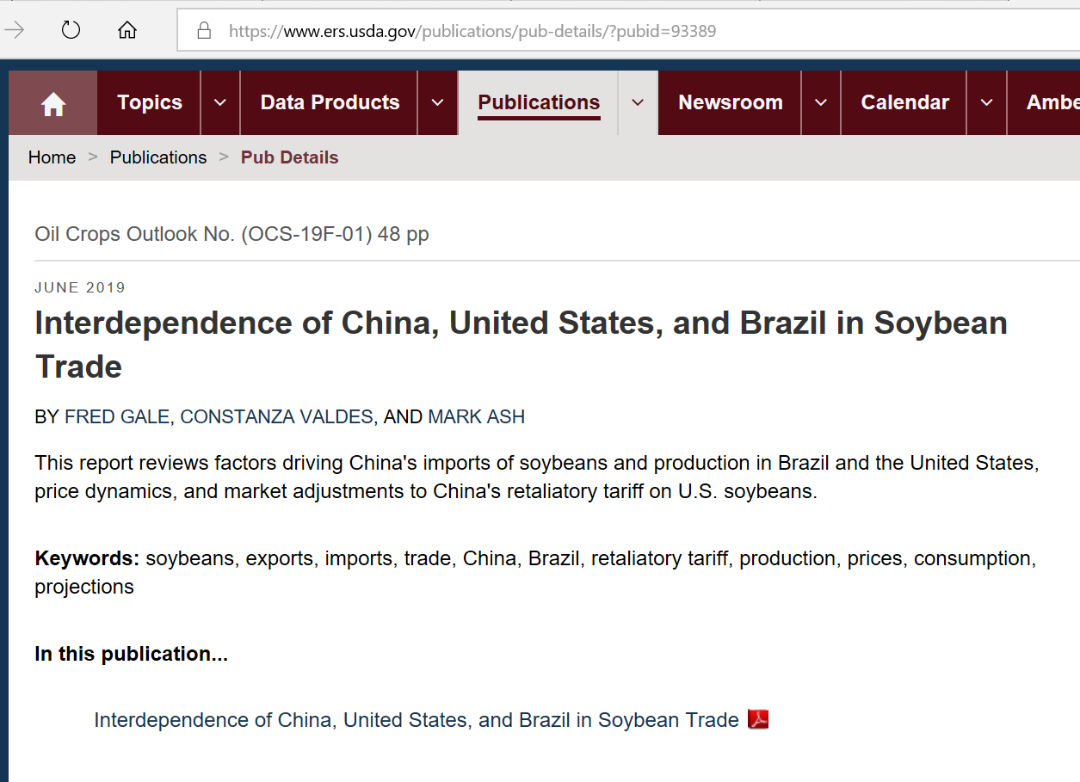
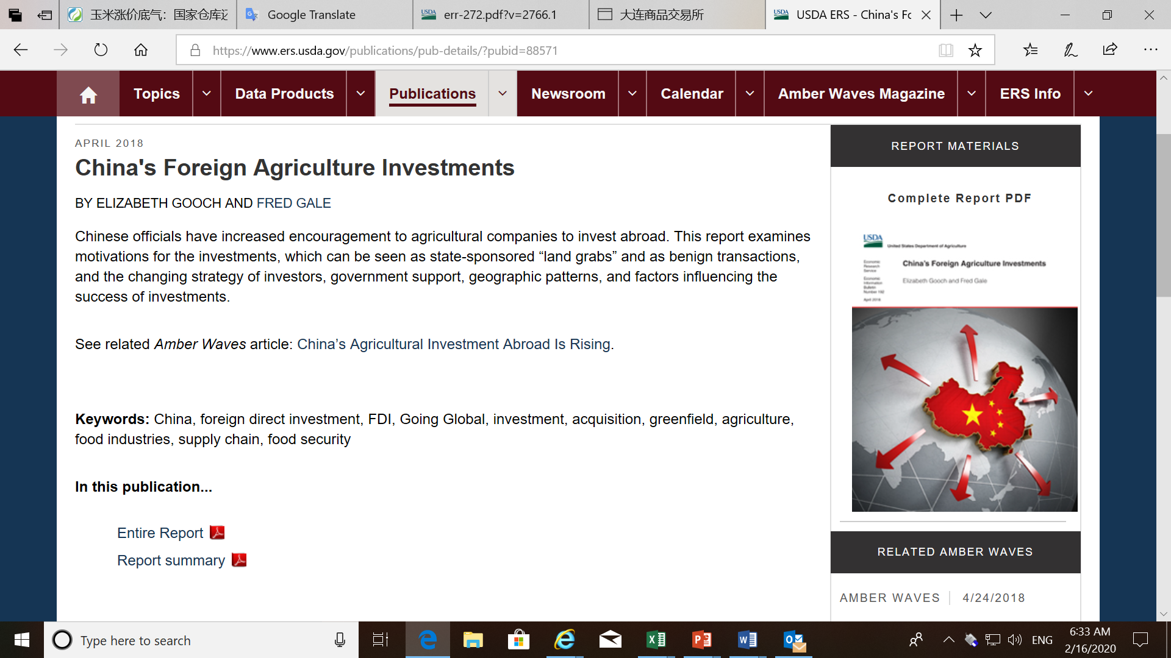
Economic Research Service web site for more information http://www.ers.usda.gov

