Slide 1
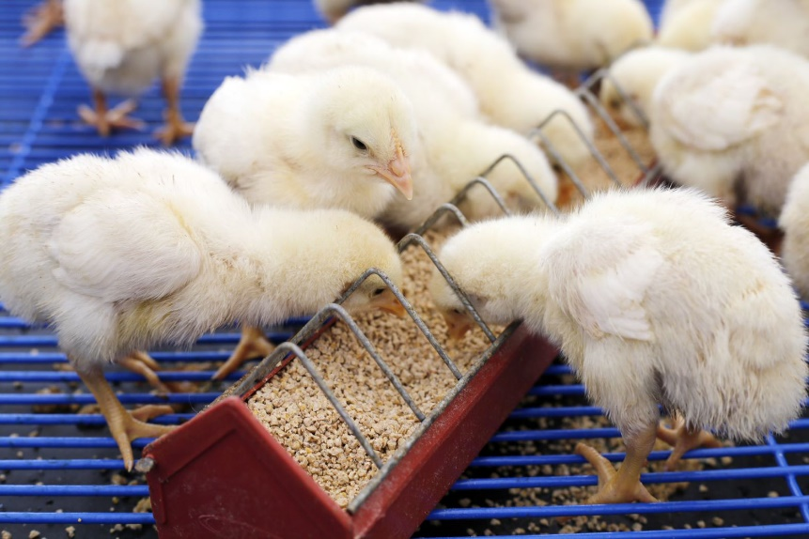
Today’s Presentation
A Tale of Two Trade Deals
  U.S. VS EU- differing objectives affecting SPS
Standards by Any Other Name Can Be Influenced
  China using ISO standards to influence the system

Slide 2
Trade Agreements
U.S. | VS | EU
U.S. Mexico Canada Agreement (USMCA) |  | EU-Canada Comprehensive Economic and Trade Agreement
U.S.- China Economic and Trade Agreement (Phase One) |  | EU-Japan Economic Partnership Agreement
All have an SPS language BUT U.S. language emphasizes expanding and enhancing WTO SPS commitments

Slide 3
U.S.
USMCA | “advance science-based decision making” Science-based joint risk assessments “encourage the development and adoption of science-based international standards”
China- Phase One | “To ensure mutual trust…” “…and recognizing the importance of ensuring that SPS measures are science-based…” “…science- and risk-based regulatory frameworks and efficient authorization processes…”

Slide 4
EU
EU-Canada Comprehensive Economic and Trade Agreement | Science-based NOT mentioned Information may be exchanged regarding “a risk analysis or scientific opinion that a Party has produced and that is relevant to this Chapter.“ Creates a Joint Management Committee for SPS Measures
EU-Japan Economic Partnership Agreement | Science-based NOT mentioned “…international standards would be ineffective or inappropriate for the fulfilment of legitimate objectives pursued”

Slide 5
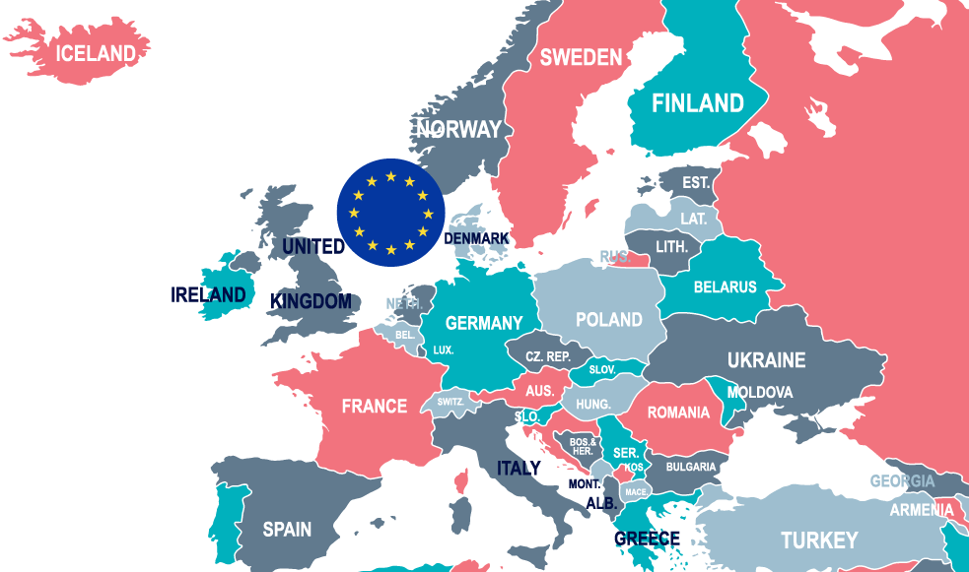
EU Global Influence
EU weakening SPS approach
  Banning ethoxyquin decision influenced Vietnam and Nicaragua
  Banning formaldehyde in poultry feed
Pre-cautionary principle
  When opinions overtake science

Slide 6
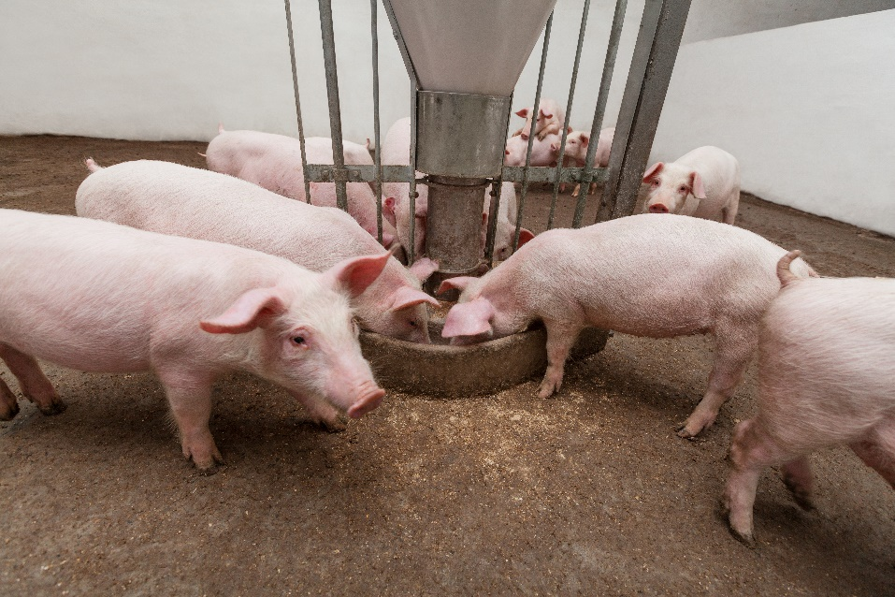
EU Global Effect
Inability to successfully challenge unscientific practices has led to U.S. businesses changing how they operate, increasing costs and in some cases reducing sustainability

Slide 7
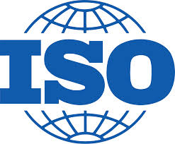
International Organization For Standardization (ISO)
2014- China submitted proposal to ISO to establish a new technical committee to create international standards for feed machinery- ISO/TC 293
Three standards to be created in the areas of:
  Terminology
  Safety
  Hygiene
Initiative led by Chinese feed machinery manufacturer
  Secretariat for ISO/TC 293 is from this company

Slide 8

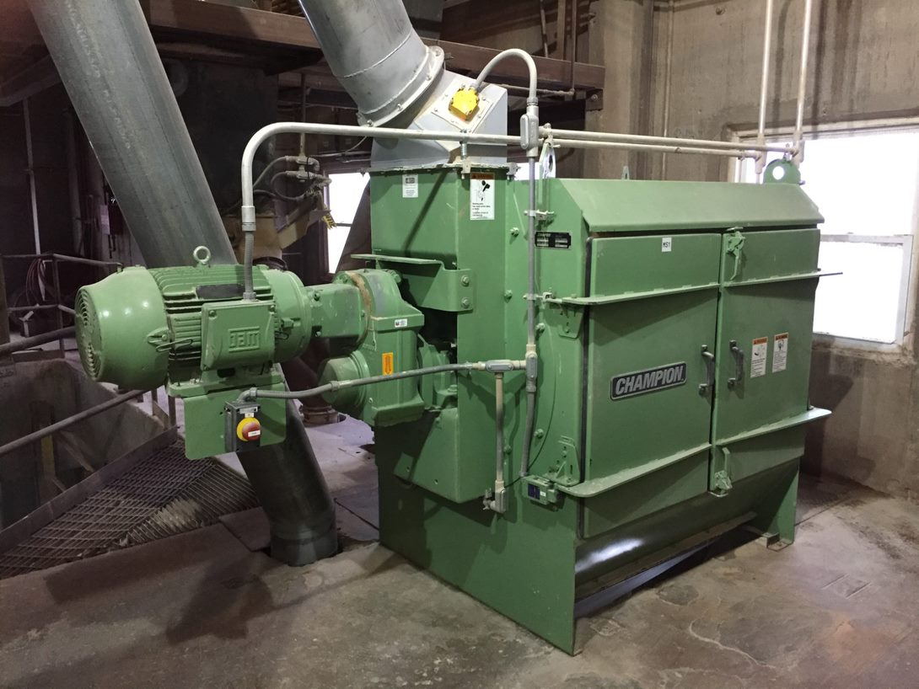
ISO and China
No inherent need for intl. standards for feed machinery
Initial lack of engagement globally in ISO process
Threat of development of ISO standards that favor Chinese industry standards while disadvantaging competition with no safety improvements

Slide 9

What if the U.S. Wasn’t Involved?
We may have had 56 individual standards to manage
  9 Terminology
  30 Safety
  17 Hygiene
The Chinese national standards could have become the international standards
International trade in feed machinery could have been drastically affected

Slide 10




THANK YOU

