Slide 1
Situation and Outlook for the
U.S. Dairy Industry
Jerry Cessna
Market and Trade Economics Division
Economic Research Service
February 21, 2020

Slide 2
A Perspective on the
2019 Dairy Situation
Note: The data and forecasts do not reflect the latest Milk Production report, published by USDA, National Agricultural Statistics Service, on February 20, 2020.

Slide 5
A basic understanding of milk equivalence of dairy products is helpful in understanding USDA data and projections.

Slide 6
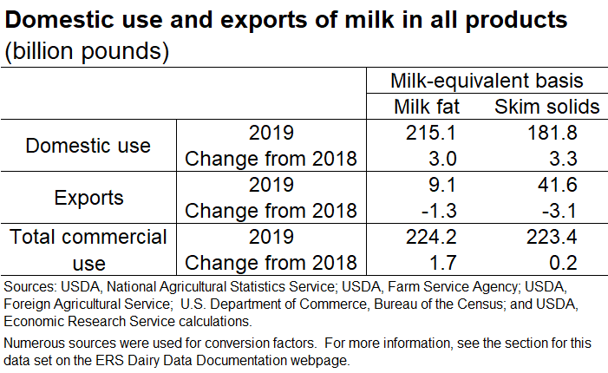
For milk in all products, the increase in domestic use in 2019 was greater than the decline in exports on both milk-fat and skim-solids bases.

Slide 7
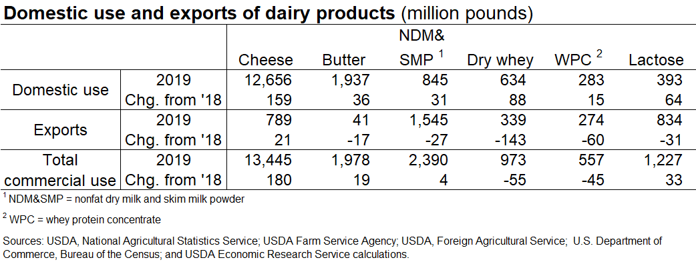
Most major dairy products had a year-over-year decline in exports. For most, the increase in domestic use was greater than the decrease in exports.
Note: Complete 2019 data are not yet available for fluid beverage milk sales. However, partial
2019 data indicate that the long-term decline in fluid milk sales has continued.

Slide 8
Tariffs Added to Dairy Imports by Major Trading Partners in 2018 and 2019
Summer of 2018: Mexico, Canada, and China added import tariffs to many products from the United States in response to tariffs added by the U.S. on imports of certain products from those countries.
Tariffs relevant to U.S. dairy imports:
  Mexico added tariffs on cheese.
  Canada added tariffs on yogurt.
  China added tariffs on a wide variety of dairy products.
May 2019: Canada and Mexico lifted tariffs in response to the United States’ agreement to lift tariffs on steel and aluminum.
As trade tensions increased, China added more tariffs in June and Sept. 2019.
Sept. 2019: China exempted some products from tariffs that had previously been imposed. The only dairy product included in this exemption was modified whey for animal use with a lactose content of 76-88 percent. Whey permeate meets this criteria. China is likely trying to rebuild its swine inventory after losses due to African Swine Fever.

Slide 11
Additional tariffs on U.S. imports from the European Union
After finding the EU failed to implement WTO Dispute Settlement Body regulations, the United States began applying tariffs of 25 percent on certain goods from the EU beginning October 18, 2019, including many dairy products.
These tariffs are in addition to the tariffs already in place for imported goods from most WTO members.
These tariffs were applied to a complex list of dairy products
  Includes cheese, butter, butterfat products, whey protein concentrate, yogurt, and fermented products.
  Not all products within the categories are assessed.
  Does not apply uniformly to countries within the EU. For example, some apply to only imports from Germany, Spain, and the United Kingdom.

Slide 12
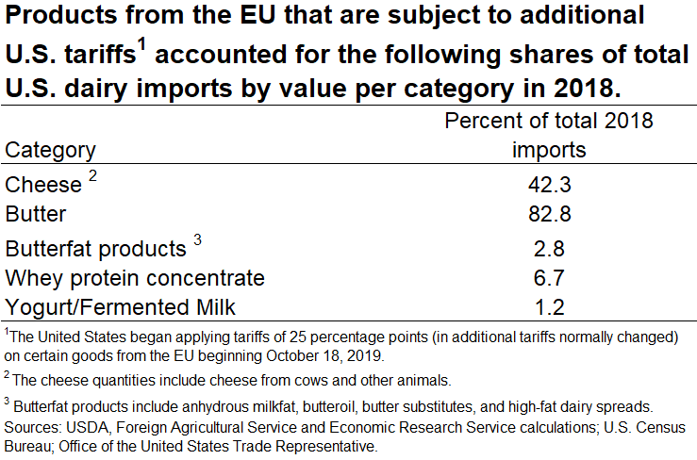

Slide 16
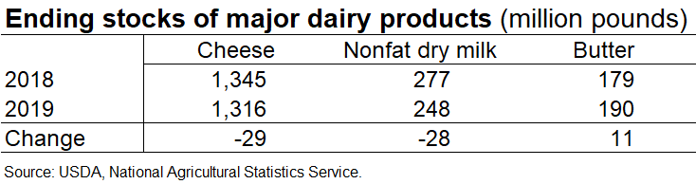
While 2019 ending stocks for cheese and nonfat dry milk where lower than 2018, ending stocks for butter were higher.

Slide 18
Butter price: Declined last 5 months of 2019. Year-over-year stocks increased as production and imports rose, and exports declined.
Cheese price: increased for most of 2019 before falling in December. Year-over-year stocks declined as total commercial use increased and milk flowed toward butter/powder production.
NDM price: Increased through 2019 as international export prices rose and stock levels declined.
Dry whey price: Averaged higher than 2018, but declined through most of the year as exports of whey products to China fell due to tariffs and African Swine Fever.

Slide 19
Federal Government Assistance to the Dairy Industry in 2019 and 2020

Slide 20
Dairy Margin Coverage (DMC)
Administered by USDA Farm Service Agency.
Offers protection to dairy producers when the difference between the all milk price and the average feed price (the margin) falls below a certain dollar amount selected by the producer.
About 82 percent of dairy operations participated in the DMC program for 2019.
Estimated indemnity payments are $312 million for 2019.
At the time of signup for the 2020 program in late 2019, it appeared that 2020 margins for dairy operations would be higher than they were in 2019. Only about 43 percent of dairy operations enrolled in the 2020 program.

Slide 21
Dairy Revenue Protection (Dairy-RP) and
Livestock Gross Margin for Dairy (LGM-Dairy)
Both programs administered by USDA, Risk Management Agency.
Dairy-RP
  Designed to insure against unexpected declines in the quarterly revenue from milk sales relative to a guaranteed coverage level.
  2019:
    Total premiums $95.1 million
    Government subsidies: $41.8 million
    Indemnity payments: $5.7 million
LGM-Dairy
  Provides protection when feed costs rise or milk prices drop.
  Can be tailored to any size farm.
  2019:
    Total premiums: $6.1 million
    Government subsidies: $2.5 million
    Indemnity payments: $5.4 million

Slide 22
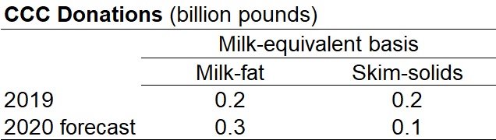
Trade Mitigation Programs
Food Purchase and Distribution Program (FPDP).
Administered by USDA Agricultural Marketing Service using Commodity Credit Corporation (CCC) funds.
CCC is a Government-owned and operated entity that supports farm income.
Most purchased food is provided to States for food banks and pantries.
$78 million in contracts for 2019; $68 million target for 2020.
Shown as CCC donations in USDA World Agricultural Supply and Demand Estimates (WASDE).
Market Facilitation Payments (MFP)
May 23, 2019, announcement: USDA would again provide aid of $14.5 billion in direct payments to farmers for 2019.
Dairy producers were included in the aid package; payment rates are per cwt on production history as calculated for DMC.
Payments made in 3 tranches with last tranche in February 2020.

Slide 23
Recent Developments in Dairy Markets

Slide 24
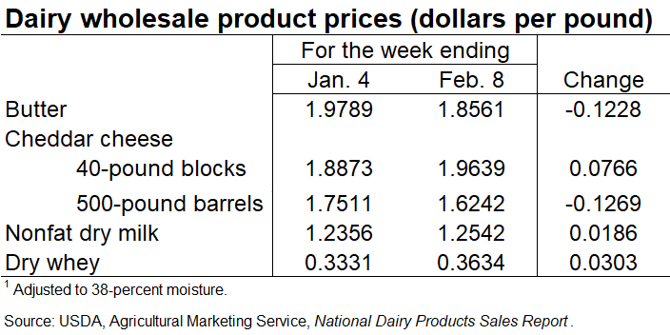

Slide 27
Recent trade policy developments
U.S.-Japan Trade Agreement, effective January 1, 2020.
  Similar to Comprehensive and Progressive Agreement for Trans-Pacific Partnership (TPP) and the EU-Japan Economic Partnership Agreement.
  Tariff reductions for most dairy products phased in over several years.
Phase One trade deal with China
  Deals with mostly nontariff issues.
  Includes provisions to increase imports of agricultural products, but no specific allocation for dairy.
February 14, 2020: China’s reduced tariffs by 2.5 percentage points on some U.S. dairy products. (Note: Tariffs on these products were 38 to 50 percent.)
U.S.-Mexico-Canada Agreement (USMCA) signed by President Trump on January 29.
  Phased-in access of dairy product trade between the U.S. and Canada.
  Changes to Canada’s classified pricing system for ingredient milk class.
  Not figured into USDA forecasts: Canada has not yet ratified the agreement.

Slide 28
Forecasts for 2020

Slide 29
Inventory falling slightly in the first quarter of 2020, expansion in the second quarter, flat the last two quarters:
Rising milk-feed ratio signals expansion.
However:
High slaughter rates continue.
Low inventory of milk replacement heifers on January 1.

Slide 30
Relatively strong growth of yields in 2020:
Compared to 2019, higher milk prices relative to feed costs promote higher yields.
With high slaughter rates, lower performing cows culled.
We assume normal weather.

Slide 31
Higher milk production growth in 2020 than 2019.
1.4 percent growth for 2020 is same as the annual compound average growth rate for the last 10 years.

Slide 32
Domestic use continues to grow in 2020:
Continued economic growth supports demand.
Growth rate not as high in 2020.
  Quantity demanded to be affected by higher prices for some dairy products.
  Deceleration from relatively large growth rate in 2019 on skim- solids basis.

Slide 33
Exports up in 2020 from 2019:
Currently, U.S. prices competitive with international export prices.
Strong NDM/SMP exports of recent months are expected to continue.
No tariffs on U.S. cheese to Mexico.
Tariffs from China in 2018 and 2019 assumed to continue, but U.S. exporters are finding alternative markets.
Exports of whey permeate to China may increase.

Slide 34
Imports down in 2020:
Additional 25-percent tariffs on many dairy products imported from the EU are assumed to continue.
Currently, U.S. domestic prices are competitive with most international export prices.

Slide 35
Ending stocks for 2020 compared to 2019:
Down on a milk-fat basis: Growth in domestic use plus exports more than offsets growth in total supply.
Up on a skim-solids basis: Relatively slow growth in domestic use plus growth in exports is not as great as the increase in total supply.

Slide 36
Dairy product prices in
2020 compared to 2019:
Butter price down:
Price decline in recent months.
More milk fat as NDM&SMP production goes up with higher NDM price.
Cheese price up:
Lower beginning stocks.
Growth of domestic and export demand.
No tariffs from Mexico.
However, price decline since fourth quarter 2019.
NDM price up:
Relatively strong exports.
U.S. domestic price competitive with international export prices.
Dry whey price down:
Weak exports expected as tariffs from China (added in 2018 and 2019) assumed to continue.
China hog inventory down due to ASF.

Slide 37
Milk prices in
2020 compared to 2019:
Class III price about the same as higher cheese price is offset by lower dry whey price.
Class IV price higher as higher NDM price more than offsets lower butter price.
All milk price higher due to higher Class IV price and higher component values (milk fat, protein, and other solids).

Slide 38
Forecast in a Nutshell and Factors on the Horizon
Forecast in a nutshell:
2020 milk prices should be higher than 2019 due to:
  Slow growth in milk production.
  Continued growth in domestic consumption.
  Relatively low beginning stocks.
  Lower imports due to U.S. tariffs added on dairy product imports from the EU.
  Stronger expected exports.
However, milk prices are not expected to be very much higher:
  Cheese and butter prices have declined since Q4 2019.
  Exports continue to be constrained by China’s tariffs.
  China’s hog inventories down due to ASF: Exports of whey products expected to continue being affected.
Factors on the horizon:
Coronavirus: At this time, impacts are uncertain.
Trade negotiations with China.
Ratification, implementation, and timing of USMCA.

Slide 39
Thank you.

