Slide 1
Record U.S. Red Meat Exports Through the Logistical Logjam
Erin Borror, USMEF Economist
February 25, 2022 USDA Agricultural Outlook Forum

Slide 2
Today’s discussion
Beef & pork exports are essential and rely on complex supply chains
Exports were record-large but could have been even larger
Maintaining the momentum could be more challenging

Slide 3

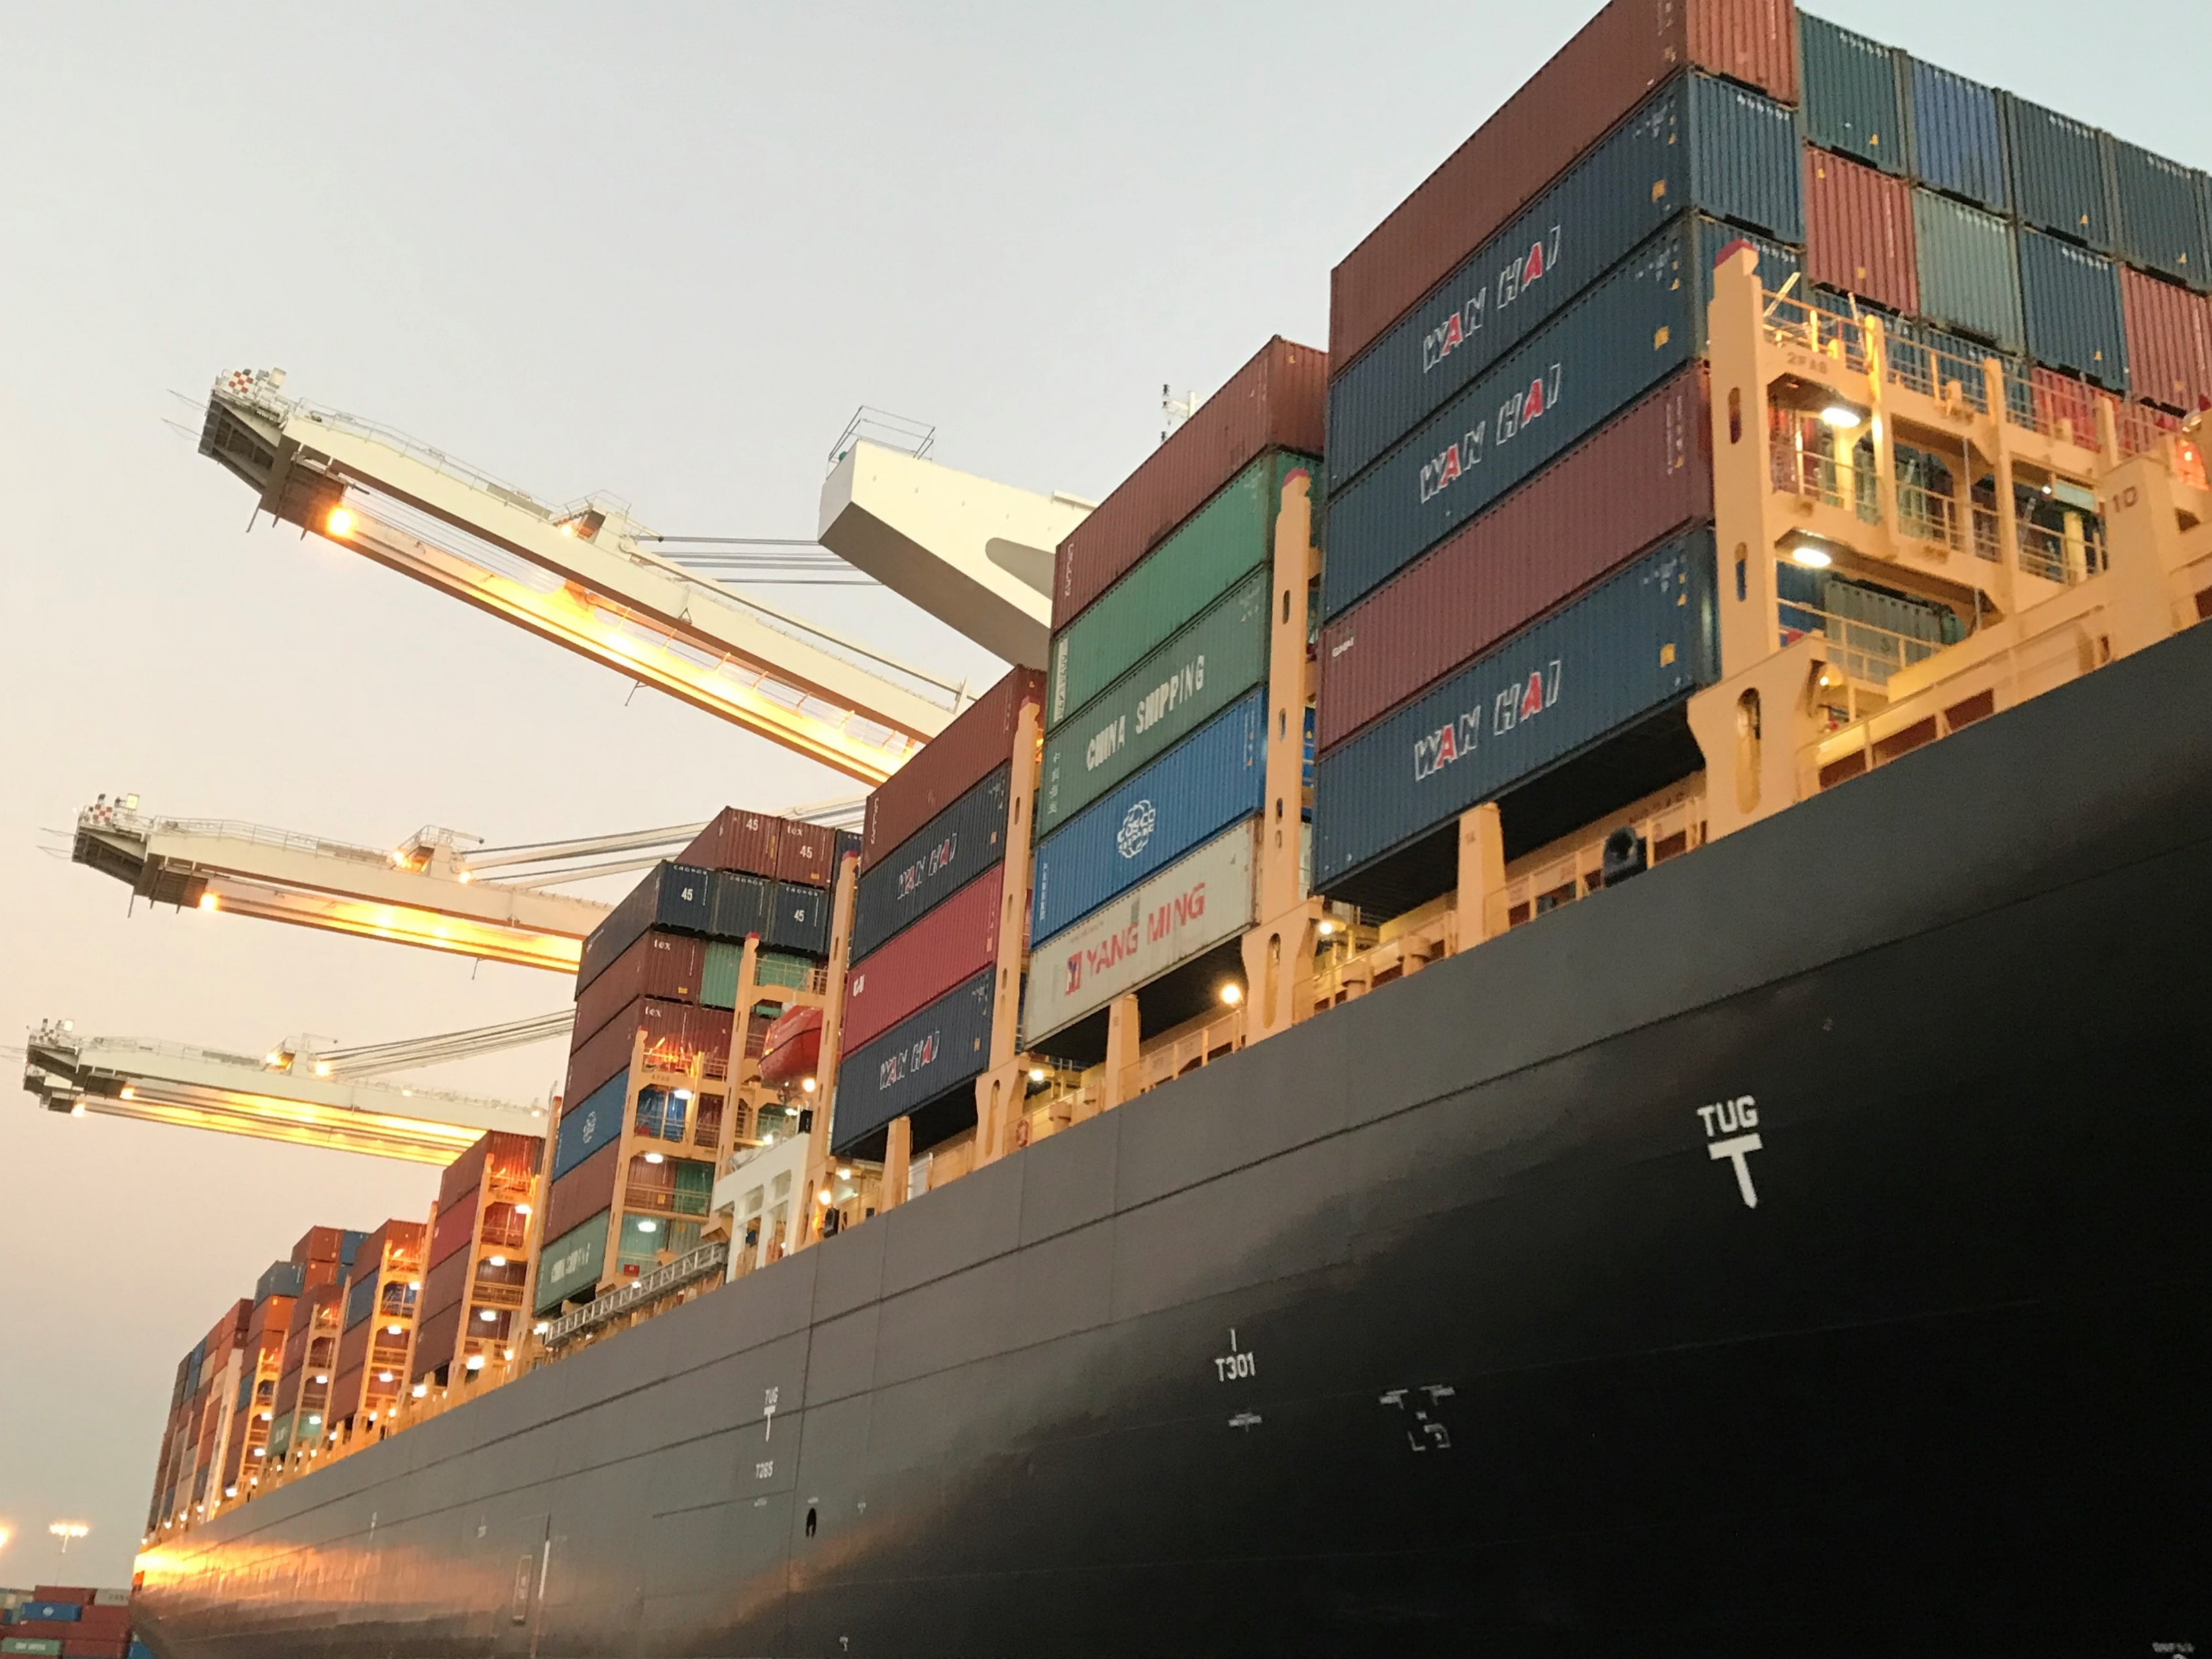
Exports are essential

Slide 4
Record U.S. beef and pork exports in 2021
$18.7 billion, a $3.3 billion or 22% increase over 2020
$10.6B
$8.1B
Source: USDA/FAS, USMEF
Notes:
Based on USDA/ERS trade multipliers, U.S. beef and pork exports of $18.7 billion in 2021 contributed additional export activity of $33.9 billion for combined total economic output of $52.6 billion. Total jobs related to meat exports are estimated at about 204,000.

Slide 5
Beef is complex and each part of the animal has unique attributes, desired by different customers at different times of the year. Exports enable maximization of value of every animal produced, keeping the U.S. industry competitive, while also enabling U.S. consumers affordable access to their preferred steaks and burgers
Average fed cattle dressed weight 2021: 878 lbs. Convert to product wt. 627 lbs.
Export pounds per fed head: 96.7 or 15%
Export $/head: $365.40 and for beef/bvm: $407.22
Choice carcass $/head: $2,458
Export share of value: 17%
Live steer $/head: $1,789
Export share: 23%
Top Export Cuts:
Short plate cut: 95%
Short rib/chuck short rib/rib finger: 85%
Gooseneck round: 42%
Outside skirt: 31%
Chuck shoulder clod: 21%
Chuck roll: 17%
Top inside round: 16%
Inside skirt: >10%
Top butt: 8%
Striploin: 7%
Heavy boneless ribeye: 6%
Brisket: 4%
Tenderloin: 3%
Chuck >14%
Chuck Rolls, Clods
Rib 20%
Loin 3%
Ribeye, Cap, Wedge, Short rib
Striploin, Top Butt,
Tri tip, Hanging tender
Round
>7%
Worldwide
Worldwide
Korea, Japan, EU
Mexico,
Canada
Short Plate 53%
Short plate, Short rib,
Rib Finger, Skirt
Flank 2%
Brisket 2%
Japan, China, Korea, Taiwan, ASEAN
Source: USDA/AMS, USMEF 2021 estimates for export volume as a share of total primal beef production

Slide 6




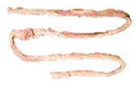

The majority of edible beef variety meats are exported…exports surpassed record $1 billion in 2021
Average Per Head* Examples:
Tongues to Japan: 1.81 lbs. & $17.58
Tripe total:
3.73 lbs. & $5.33
Tripe Mexico:
2.71 lbs. & $3.25
Livers total:
6.6 lbs. & $4.07
Lips to Mexico:
2.05 lbs. & $2.15
Hearts to Mexico:
1.76 lbs. & $1.85
Tripe & intestines to Japan:
0.89 lb. & $1.59
Tongues, Lips
Stomach, Intestine
Variety meat exports equated to 25.5 pounds per head of fed slaughter
Liver, Heart, Kidney
Japan, Mexico
Egypt, S. Africa, S. America, Mexico, Indonesia
Mexico, Japan, China
And value of $41.82 per fed head
Source: USMEF 2021 estimates, *using NASS fed slaughter for per head conversions
Notes:
Egypt main market for livers with 4.04 pounds and $2.59

Slide 7

Pork is complex, exports of end meats allow Americans affordable access to favorite middle cuts and exports optimize overall value of each animal produced
12% Loin
2021:
41 lbs. per head exported, 26% of production
At average of $53.28 per head
Pork/pvm export averaged $62.86/head, which was 32% of the hog value of $194.50 and 28% of the per head cutout value of $220.80
35% Butt
Japan, Canada, Mexico
46%
Leg/Ham
Northern Asia
14% Rib
Mexico, China, Colombia, Australia, Canada,
DR
Latin America, China
10% Belly
54%
Picnic
Northern Asia
Northern Asia,
South America, Mexico,
Canada
Source: USMEF 2021 estimates for export volume as a share of total U.S. pork production

Slide 8


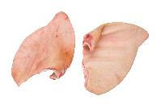

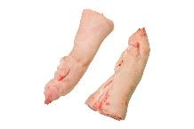
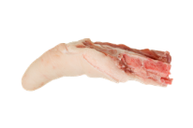

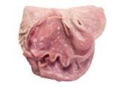


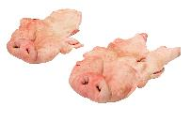

The majority of edible pork variety meats are exported, and reached a record $1.2 billion
China & Mexico accounted for 86% of total U.S. pork variety meat export volume in 2021
Feet exports to China averaged $3.28 and 2.99 pounds per head
Stomachs to China averaged $1.28 per head and 0.65 pounds & Stomach exports to Mexico of $0.45 per head and 0.32 pounds
Edible variety meat exports equated to 8.9 pounds per head in 2021
Feet, Snout, Ears, Tail
Heart, Liver, Kidney
Stomach, Bladder, Uterus
And value of $9.58 per head
China
China, Mexico
Philippines
China, Mexico
Tongues to Mexico, Japan, China
Head exports to China averaged $0.84/head and 1.39 pounds
Frozen Tongues $0.39 and 0.36 pounds per head
South America
Korea
Stomachs $2.22/head and 1.08 lbs.
Source: USMEF 2021 estimates, using NASS commercial slaughter for per head conversions

Slide 9
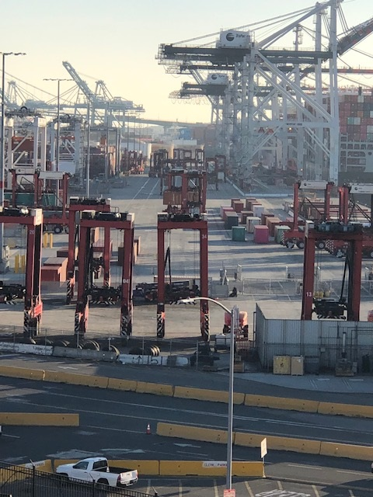
Exports rely on a complex supply chain
Waterborne
Beef exports: $8.75 Billion
Pork: $5.5 Billion
Total: $14.2 Billion
Truck (and rail) to Mexico and Canada
Beef:$1.8 Billion
Pork $2.6 Billion
Total: $4.46 Billion

Slide 10
More U.S. beef was exported out of the main ports in 2021
Pork export growth was mainly in Latin America, so more East & Gulf port shipments and more trucks to Mexico
Source: PIERS, USDA FAS, USMEF, excludes HS 0504 variety meats

Slide 11
74% of U.S. waterborne beef exports went via the west coast ports, down from 75% in 2019 but up from 73% in 2020.
For pork, the share through WC was 54%, down from 61% in 2020 and 55% in 2019
Source: PIERS, USMEF, Jan-Nov 2021, includes HS0206 variety meats

Slide 12
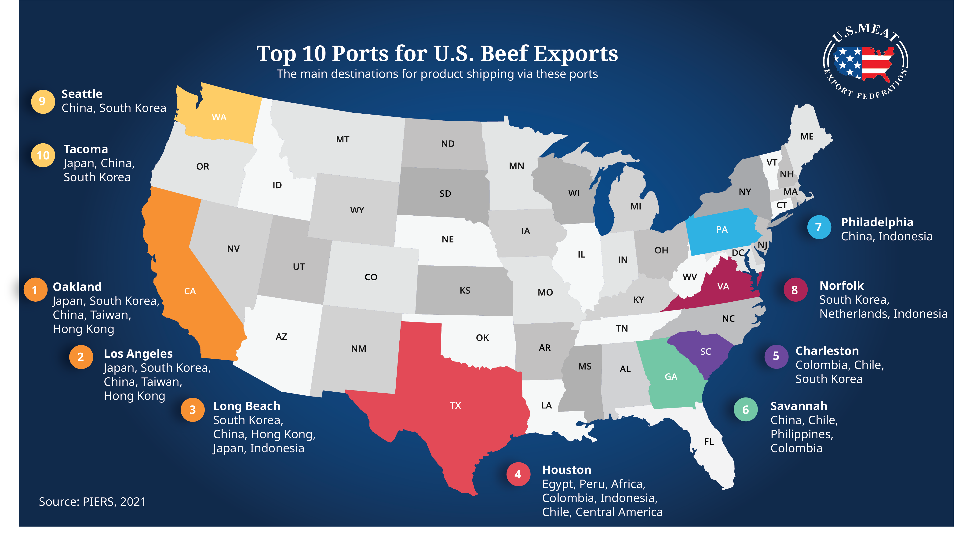

Slide 13
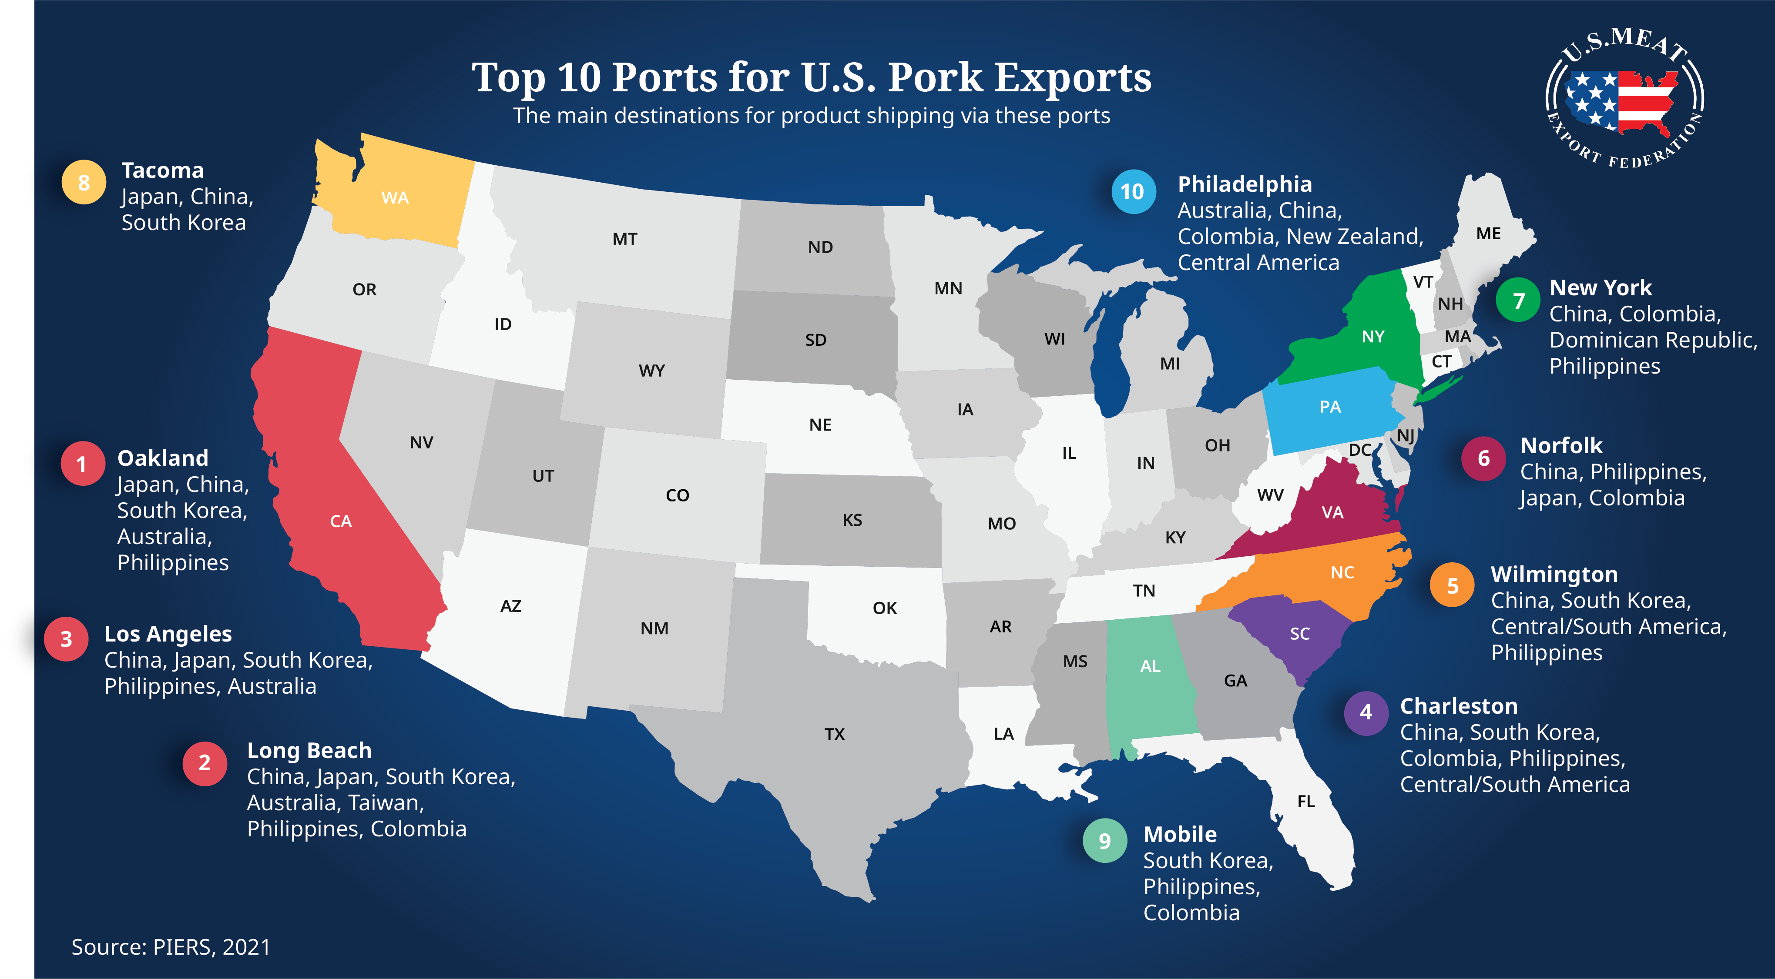

Slide 14
Meeting the growing demand in Central and South America has meant more U.S. beef through Charleston, Houston, Savannah and other East Coast and Gulf ports
Source: PIERS, USMEF, Jan-Nov 2021, includes HS0206 variety meats

Slide 15
The logistical challenges are taking a toll
Added costs & uncertainty
Lost opportunities
Market access issues, risks, costs
Damage to the chilled business

Slide 16
U.S. consumer demand for stuff surged
Driving larger imports and higher shipping costs
But container throughput at Sen Pedro Bay complex dropped below year-ago from Sept-Dec, even as 2021 totals were sharply higher year/year:
Port | Inbound | YOY/ vs. ’19 | Outbound loaded | YOY/ vs. ‘19
Los Angles | 5,513,286 | 14% / 17% | 1,184,145 | -23%/ -33%
Long Beach | 4,581,848 | 15% / 22% | 1,437,917 | -3%/ -2%
Oakland | 1,055,614 | 6%/ 8% | 852,374 | -8%
NWSeaportAlliance | 1,464,662 | 17% / 7% | 691,446 | -12.5% / -25%
>70% of containers returned to Asia from LA/LB empty
Even sharper decreases in loaded exports were reported for the month of December
Source: FRED, Pacific Maritime Association
Notes:
2020 Early Pandemic
Manufacturing in Asia impacted due to COVID lockdowns
Imports from Asia to U.S. slow significantly
Mid-2020
Asia manufacturing regains stability, combined with beginning of COVID stimulus and stay at home orders in the U.S.
U.S. consumers start buying – A LOT – especially via ecommerce
Office equipment, workout equipment, things we all needed to shelter in place
Coincided with U.S. port labor shortages due to COVID restrictions and increased people out sick
End of 2020
By year end, imported container volume through LA and Long Beach was up almost 30% year on year
Export containers down about 5%

Slide 17
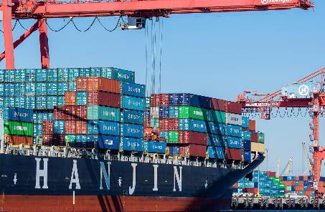
The import surge
Shortages & delays as ports and inland supply chains are overwhelmed
Export containers denied shipping space, empties go back to Asia
Asian exporters paying premium shipping rates
Shipping rate disparity incentivizes sending back empty containers
Notes:
2020 Early Pandemic
Manufacturing in Asia impacted due to COVID lockdowns
Imports from Asia to U.S. slow significantly
Mid-2020
Asia manufacturing regains stability, combined with beginning of COVID stimulus and stay at home orders in the U.S.
U.S. consumers start buying – A LOT – especially via ecommerce
Office equipment, workout equipment, things we all needed to shelter in place
Coincided with U.S. port labor shortages due to COVID restrictions and increased people out sick
End of 2020
By year end, imported container volume through LA and Long Beach was up almost 30% year on year
Export containers down about 5%

Slide 18
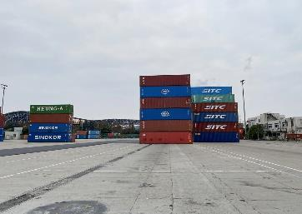

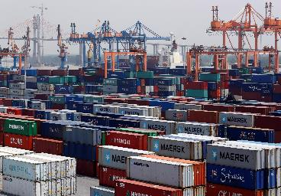
Cost to U.S. Exporters
Equipment Shortages
Shipment Delays
Detention & Demurrage Fees
Lack of containers/chassis due to congested terminals and dislocations
As exports get bumped for empty containers on ships, cargo is delayed weeks or months waiting for shipment space
Containers that are held on the terminal, on rail or on trucks charged daily D&D fees by shippers, sometimes exceed value of cargo & difficult to price products, pass on costs
Notes:
• The PMA has expanded hiring efforts in response to the unprecedented demands for labor. But even as ILWU labor hours have reached historic levels in recent months, production per hour has fallen due to terminal congestion caused by supply chain disruptions. With nowhere for containers to go, ships at the San Pedro Bay Port Complex declined or canceled labor more than 1,000 times between October 2020 and March 2021.

Slide 19
Added costs and uncertainty
Added costs are mostly from demurrage and other fees- hard to price & pass on
Delays and shifting schedules and lack of containers/ ships to load
  Loss of spot sales opportunities for U.S. exporters
  Loss of market opportunities for importers as well (timing the market)
Challenges for smaller markets, off the beaten path, price sensitive
Ships changing course once they have sailed, added uncertainty, especially for feeder vessels
  If third country stop is added in route and no USDA seal, product can be rejected (Japan)
  Seal/container numbers on certificates
Shelf life issues- resell loads at loss, freeze chilled product at loss
Meet customer needs for chilled or processed products = air freight at significant added cost (prices also up, to $1.20-$1.25/lb), with limited availability, especially for volume, depending on routes and passenger flight status
Forgone export opportunities to Asia at higher value and shift to Latin America to reduce logistical risks
Fortunately competitors have also faced issues & tight supplies in the case of beef
Notes:
HK, Shanghai, Tokyo to feeder vessel into SE Asia –access to feeder vessels limited/expensive
LA/LB first for Oakland in a lot of cases (unless direct call)
one trader in Atlanta had to resell many loads of MSC at a loss since the product past the importers shelf life requirements while being held up at port. It exceed the customer’s 90 days requirement. I am sure others also faced this.

Slide 20
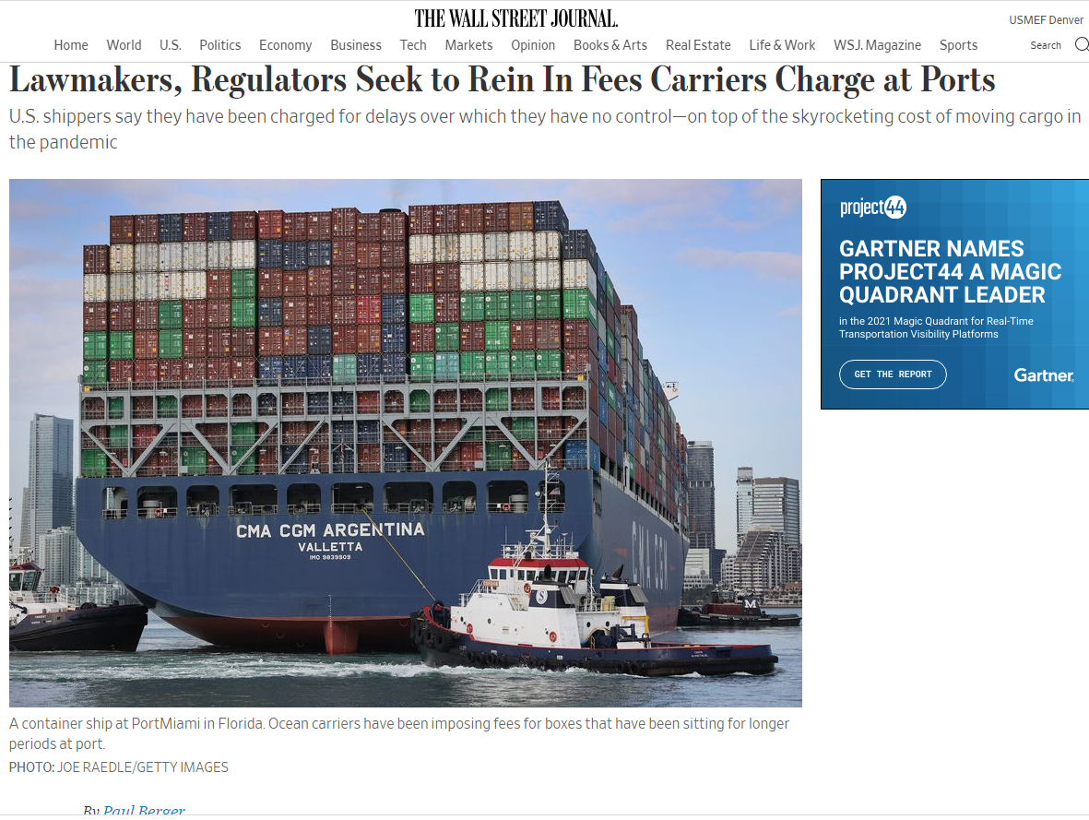
Higher costs of shipping are mainly in demurrage and other fees, also higher trucking costs
Truck
Rail
Rail
Wall Street Journal image, shipping cost quotes from exporters, USMEF
Notes:
Convert to container basis would be additional $6,000 per frozen rail container and – Australia pork example

Slide 21
Chilled is a big part of U.S. red meat export portfolio and competitive advantage
$3.73 Billion in waterborne chilled beef exports, up 38% or +$1 Billion over 2020
Export volume has doubled since 2015
  Chilled premiums over frozen:
    Japan $1.77/lb
    Korea $2.20/lb
    Taiwan $2.54/lb
  Allows U.S. to capture high quality advantage while minimizing the “commodity” price volatility and competition from lower cost suppliers
  Consistent business benefits exporters and importers
  Just in time supply chain
  Disruption causes retailers to purchase from competitors or attempt to add frozen
  Some importers have been forced to freeze product on arrival at a huge cost = reducing chilled business
  Shelf life issues damage product quality and image
Source: TDM, USMEF, Japan includes chilled variety meats
Notes:
Chilled waterborne pork exports $1.17 billion and 240,000 mt

Slide 22
Chilled waterborne pork exports $1.17 billion
Chilled premiums over frozen:
  Japan: $0.59/lb
  Korea: $1.36/lb
Differentiating factor against EU
Retail penetration in Japan, potential future growth in Korea after doubling last year
But Japanese retailers are selling some defrosted European product due to shipping issues and inconsistency of U.S. supplies
Canada has faced challenges too
Source: TDM, USMEF

Slide 23
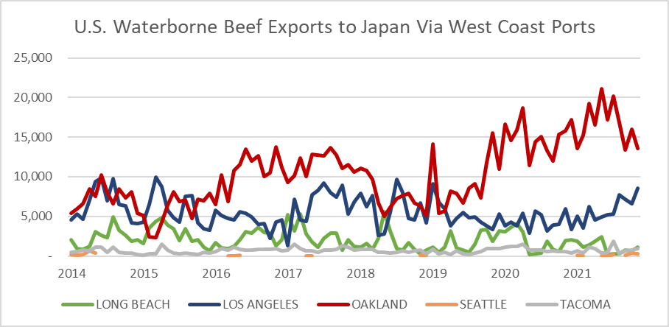
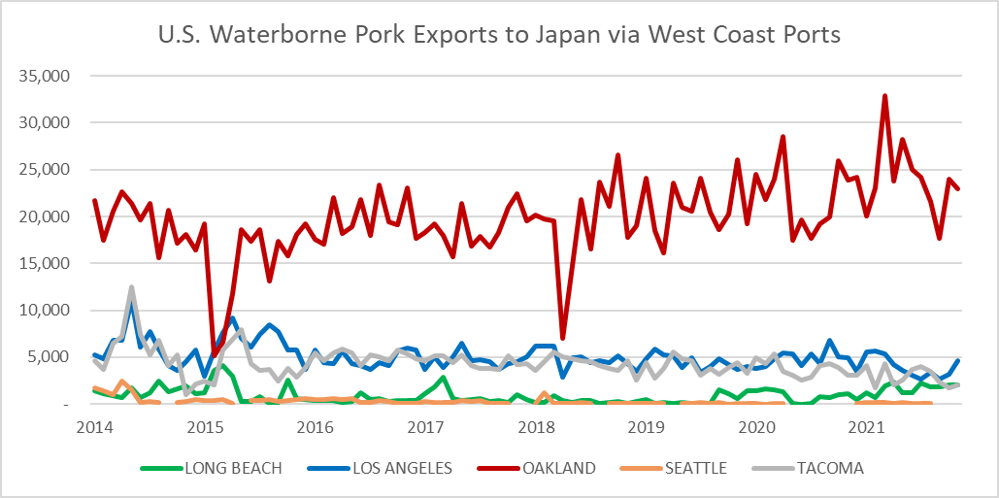
Chilled U.S. red meat exports are reliant on consistent shipping out of Oakland
Japan is the largest destination for U.S. waterborne chilled beef and pork
Japan’s safeguard on U.S. beef would have triggered again this March, without the shipping issues
Concern again this year with the upcoming ILWU labor contract negotiations
Source: PIERS, USMEF, Jan-Nov 2021, metric tons, includes HS0206 variety meats
Notes:
In 2008, West Coast terminal operators secured the right to automate in the Pacific Coast Labor Contract Document, which ILWU rank-and-file members overwhelmingly ratified and ILWU leaders do not dispute. The right to automate remains part of the current agreement between the ILWU and the PMA. (Three terminal operators have moved forward with automation projects in Southern California, with a fourth announcing plans to modernize operations, including through the introduction of low emission automated equipment.) However, modernizing terminals through automation will likely be a key issue in the negotiations. • The PMA recently proposed a 1-year extension of its current agreement with the ILWU, responding to ongoing supply-chain disruptions and their effects on the national economy. The union declined that offer in November, setting the stage for contract negotiations to begin in the spring of 2022. The current contract dates back to 2014 and was later extended through July 1, 2022.

Slide 24

The U.S. relies on live animal and meat trade with Canada and Mexico
Beef
  Exports to:
  Mexico 200,628 mt, +4%
  Canada 104,277 mt, -4%
  Imports from:
  Canada 351,461, +14%
  Mexico 271,902, +5%
Pork
  Exports to:
  Mexico 874,589 mt, +27%
  Canada 220,444 mt, -2.5%
  Imports from:
  Canada 343,243, +29%
  Mexico 45,670 mt, +38%
Cattle
  Imports from:
  Mexico 1.128 million head, -22%
  Canada 676,742 head, -3%
  Exports to:
Canada 392,830 head, +45%
Mexico 93,710 head, +181%
Hogs
Imports
Canada 6.665 mil head, +26%
Source: TDM, USMEF, volumes for 2021, change from 2020, includes variety meats
Notes:
The U.S. exported more pork, beef and cattle to Mexico and imported fewer Mexican cattle and more beef and pork. U.S. exported more cattle to Canada, imported more beef, hogs, pork from Canada

Slide 25
Growth in U.S. pork to Mexico and most other markets nearly offset the drop in volume to China
Source: USDA/FAS, USMEF

Slide 26
Higher export prices for pork as well, even with a major drop in volume to China
Source: USDA/FAS, USMEF

Slide 27
Broad based beef export growth
And complaints everywhere about the “shortage” of U.S. beef International demand exceeded supply due mainly to shipping constraints
Source: USDA/FAS, USMEF
Notes:
China Phase 1
KORUS
Japan US
CAFTA –DR

Slide 28
And record U.S. beef export volumes went at sharply higher prices
Another sign of strong demand and perceived shortages
Source: USDA/FAS, USMEF

Slide 29
Shortage of chilled U.S. meat in Korea
With soaring numbers of reefer container cargo ahead of the year-end holiday season, most containers were delayed
Because of the delays, importers frequently freeze the chilled meat at substantial loss of premium once landing – importers are now reducing chilled orders to limit financial loss risk
The delays also caused a shortage of chilled meat products at the retail sector (including e-commerce)
A few retailers prepared some main product volume for the year-end holiday season by airfreight to avoid the shipping congestion.
Due to the logistics disruption and unexperienced staff throughout the supply chain, we are dealing with more quarantine issues (documentation errors etc.) - these issues add further costs – and require constant support from USDA Post and DC
Notes:
Due to the global shipping chain gridlock, the US meat importers have a hard time to handle chilled meat.
Especially, by the soaring numbers of reefer container cargo ahead of the year-end holiday season, most containers were delayed; as a result, importers frequently freeze the chilled meat at substantial loss of premium once landing.
It also brought a shortage of chilled meat products at the retail sector including the hypermarkets and e-commerce platforms which are the largest destination of the U.S. chilled meat.
A few retailers prepared some main product volume for the year-end holiday season by airfreight to avoid the shipping congestion.
Korea office is also planning on holding promotions with the retailers and importers to react to changing market conditions.
Due to the logistics disruption and unexperienced staff throughout the supply chain, we are dealing with more quarantine issues derived from documentation errors, labeling/shelf life discrepancy, converting chilled to frozen products, sending products that are originally for domestic market, etc. – all these issues add further costs – and require constant support from USDA Post and DC

Slide 30
Shortages of U.S. beef in Taiwan, risk of eroding this chilled market worth $440 million
According to the importer's response, the shipping problem of the Australian line is less problematic compared to the U.S. line, but the high price of Australian beef and the lack of supply will also affect its sales of it.
As the shipping situation continues to deteriorate, it will take at up least 55 to 60 days for the containers from the U.S. to arrive in Taiwan because of the container shortage and the holidays
For the importers to maintain the demand of their customers before the Chinese Lunar New Year, some switched to air freight and absorbed the increased freight with their customers.
But increased freight cost will cause retailers and foodservice operators to increase their selling price, and will also indirectly affect the sales, therefore, the market is expecting that beef sales in the first quarter are not optimistic due to the shortage of goods and price factors.
Chilled beef was hit the hardest, with some retailers refusing to accept shipments close to the pull date due to the increased delivery time, which reduces the ability to sell meat.
When shipments are refused it makes it necessary for importers and packers to find other customers to buy the products, or to convert chilled beef to frozen and then sell it, or to lower the price and sell it to customers and then have the customers sell frozen products
According to the current market situation, the beef stocks are relatively low, and several items commonly used in the Taiwanese market are out of stock, such as short plate, chuck flap tail, and rib fingers.
Increasing demand, unstable supplies, and rising prices are the main reasons for the shortage of some items, such as boneless short ribs. Therefore, operators turned to use chuck flap as a substitute product, which caused it to be out of stock.
Notes:
As the shipping situation continues to deteriorate, we understand that due to the container shortage and the holidays, it will take at up least 55 to 60 days for the containers from the U.S. to arrive in Taiwan
For the importers to maintain the demand of their customers before the Chinese Lunar New Year, some switched to air freight and absorbed the increased freight with their customers.
However, this will cause retailers and foodservice operators to increase their selling price to reflect the costs, and will also indirectly affect the sales, therefore, the market is expecting that beef sales in the first quarter are not optimistic due to the shortage of goods and price factors.
Particularly chilled beef was hit the hardest, with some retailers refusing to accept shipments close to the pull date due to the increased delivery time, which reduces the saleability of meat.
This will also either make it necessary for importers and packers to find other customers to buy the products mentioned above, or to convert chilled beef to frozen and then sell it, or to lower the price and sell it to customers and then have the customers sell frozen products, which correspondingly will affect the sales of U.S. chilled beef in retail outlets.
According to the importer's response, the shipping problem of the Australian line is less problematic compared to the U.S. line, but the high price of Australian beef and the lack of supply will also affect its sales of it.
According to the current market situation, the beef stocks are relatively low, and several items commonly used in the Taiwanese market are out of stock, such as short plate, chuck flap tail, and rib fingers.
Increasing demand, unstable supplies, and rising prices are the main reasons for the shortage of some items, such as boneless short ribs. Therefore, operators turned to use chuck flap as a substitute product, which caused it to be out of stock. However, some importers said that due to the low domestic inventory, the pressure on the importer to increase the price to its customers was reduced to reflect the cost of imports.
The market share of U.S. chilled beef has also reached a record high of 81%, with imports increasing by 13% year-over-year, indicating that there is a strong demand for U.S. beef in the Taiwan market.
The increase in U.S. chilled beef imports made up for some of the decline in U.S. frozen beef imports (a decline of 28% in U.S. frozen beef imports year-over-year).
Mainly because U.S. beef exporters advised Taiwanese importers to increase their purchases of chilled beef due to insufficient frozen beef supplies.
In addition, the strong demand for U.S. chilled beef in retail outlets, which was affected by the pandemic, was also one of the reasons for the increase in U.S. chilled beef imports.
Consumers are also feeling the pressure of rising beef prices, as retailers and foodservice operators have been raising the prices of beef products since November, and some have even stopped selling some beef products due to the shortage of beef supply and higher prices or have developed new menus using beef from different countries or cuts.
The market has also predicted that the instability of shipping will continue to the end of 2022, while packers are not optimistic about the shipping situation in the first quarter of the year.
Therefore, price and unstable supply are the two major factors that concern us when it comes to the effectiveness of our product promotion in the Taiwan market.

Slide 31
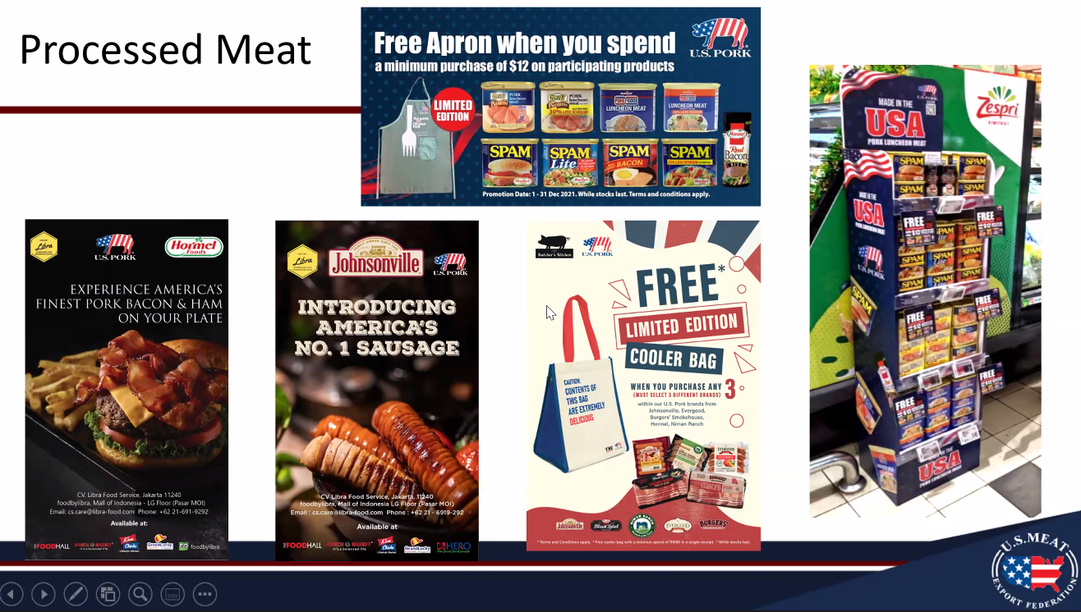
The future growth will be in value added and further processed products
USMEF ASEAN focused on processed because of shipping issues for frozen cuts (and strong demand for these products elsewhere)

Slide 32
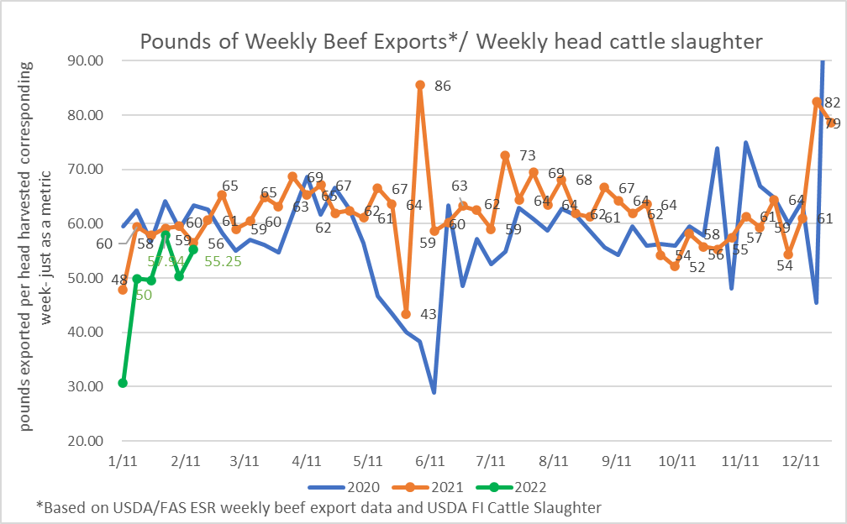
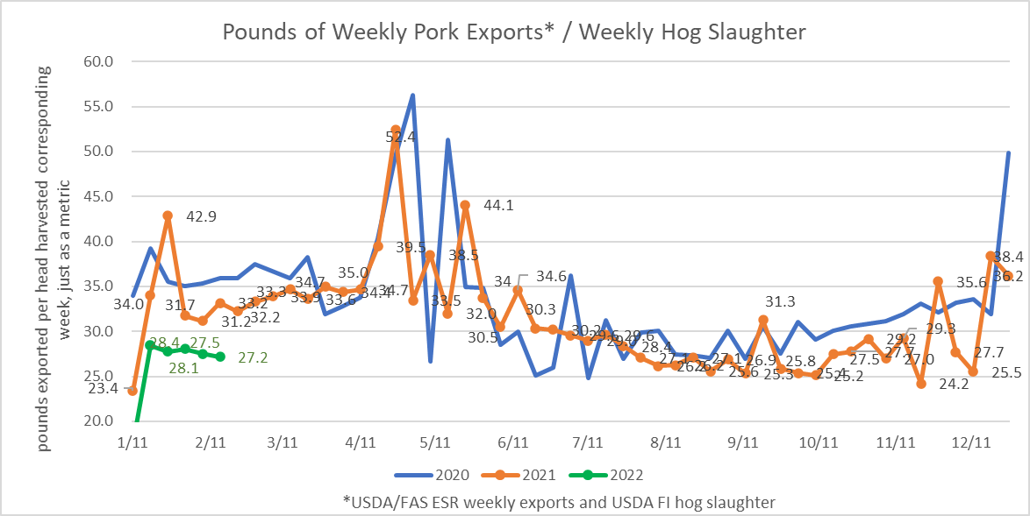
Maintaining the momentum will be a challenge partly due to the worsening logistics situation, since at least Q4 2021
Strong international demand for U.S. red meat continues…
Urgency of enabling timely exports of U.S. red meat before there is significant demand destruction

Slide 33

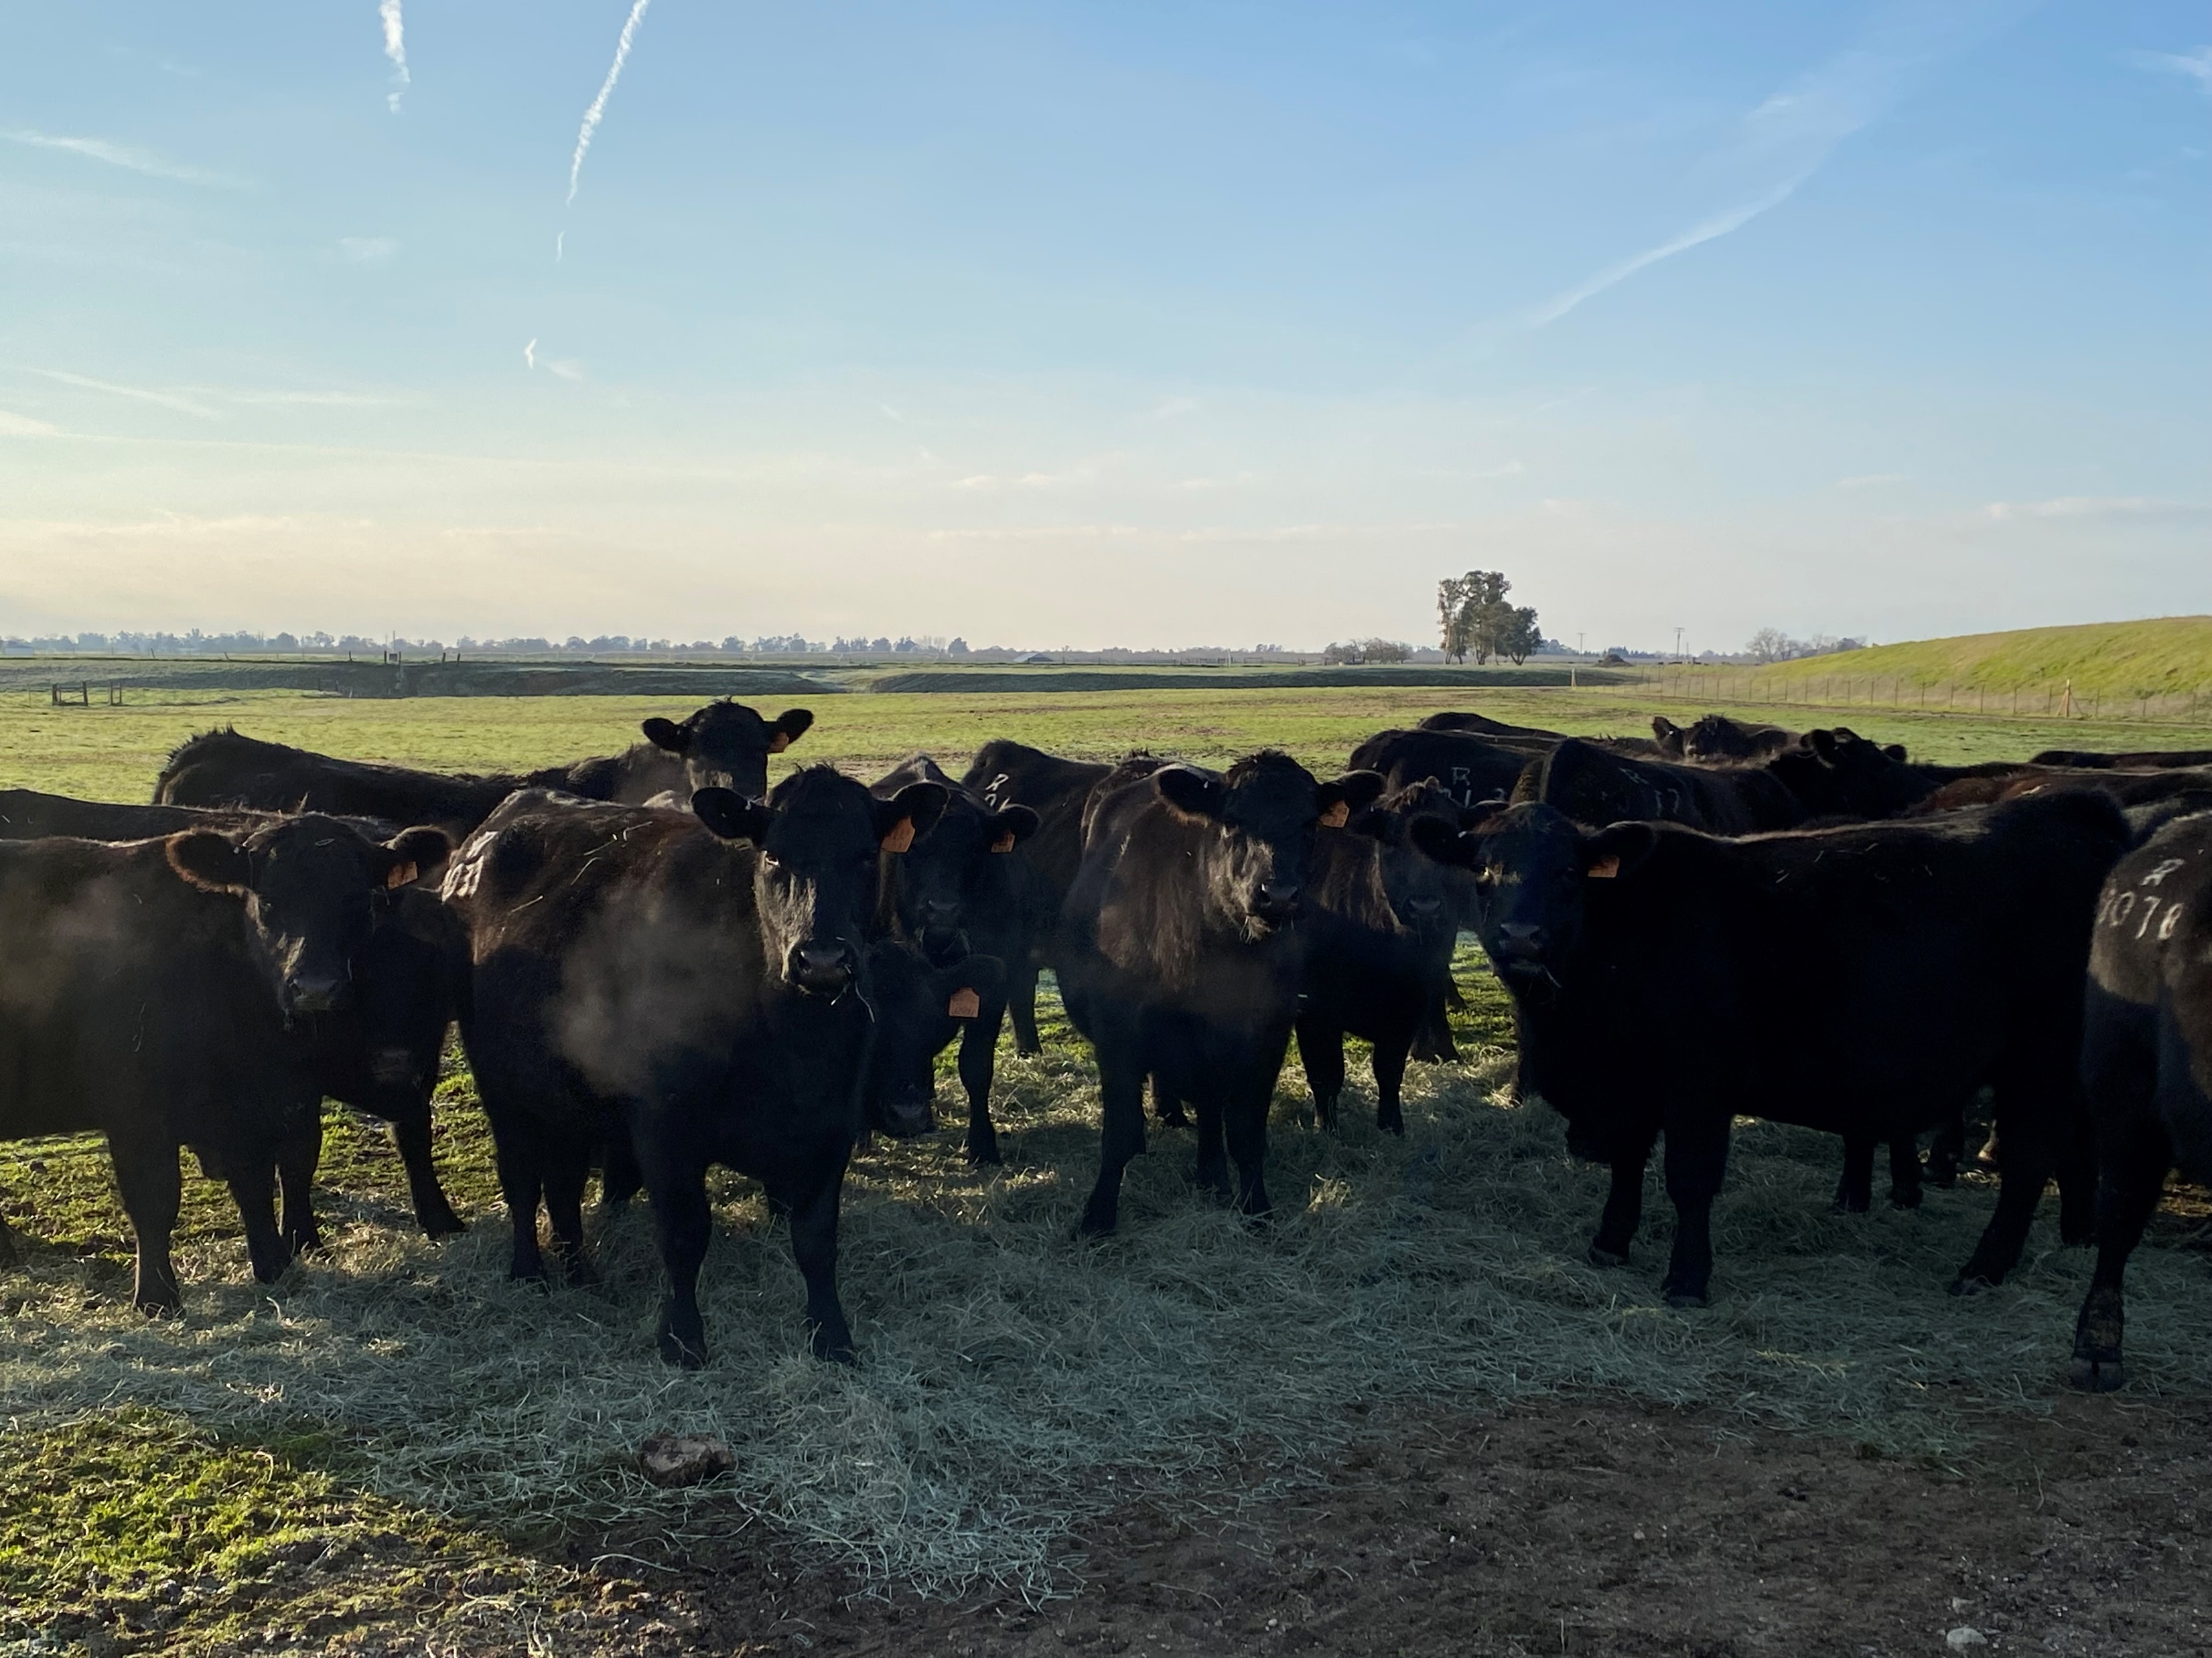

Thank you!
Erin Borror
eborror@usmef.org
www.usmef.org

