Slide 1

Supporting organic trade by expanding the phytosanitary toolbox
United States Department of Agriculture
Animal and Plant Health Inspection Service
Gabriel P. Hughes, Ph.D.
Risk Manager – Entomology
USDA-APHIS-PPQ
February 26, 2022
Notes:
Good afternoon. Today I am going to talk to you about some of the tools available on organically grown fruits and vegetables. I am a risk manager entomologist with USDA-APHIS-PPQ, and my primary role is to determine import requirements that will reduce the risk of pests arriving into the United States on imported fruits and vegetables. Although the principles can apply to both imports and exports, I will be speaking of imports because that is my area of primary responsibility.

Slide 2
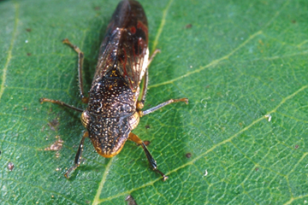
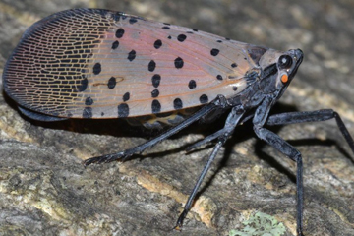
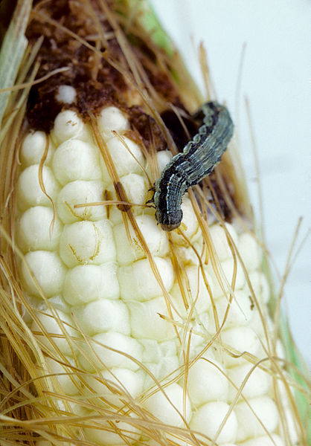
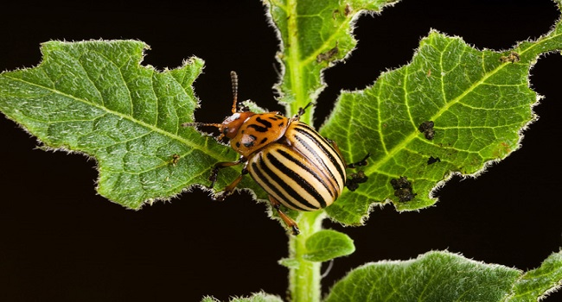
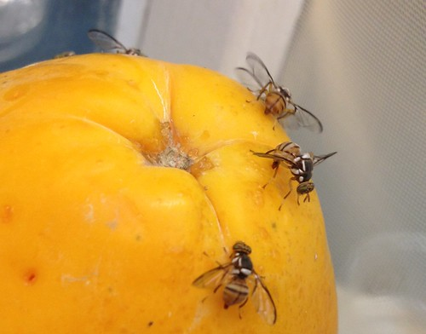
Photo credit: Jack Kelly, University of California
Notes:
The whole reason we are here talking about organic fruit and vegetable production is because pests eat our food. Without pests, we could grow, trade, and eat our produce without any worry. Obviously this isn’t the case, and insecticides were introduced to control this threat. But there has been growing concern over the use of pesticides, and perhaps particularly the overuse of pesticides in agricultural production. This has led to a keen interest on so-called “organic” fruits and vegetables. To be clear, there are approved organic insecticides and fungicides, but USDA has been moving towards a more comprehensive approach to pest risk management.

Slide 3
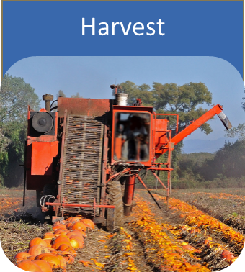
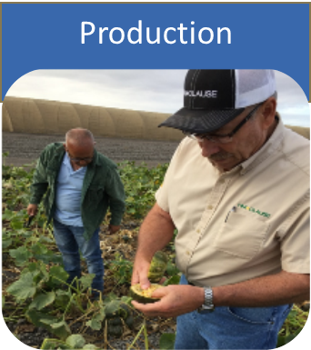
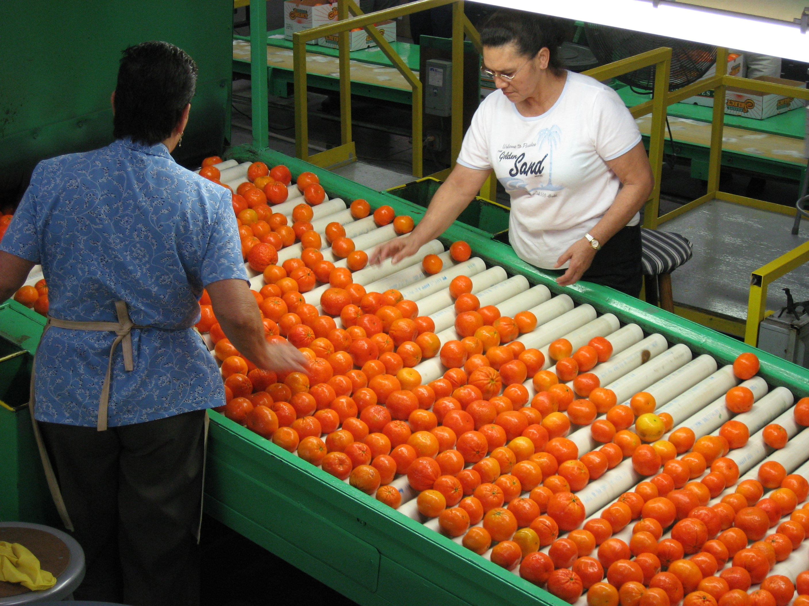
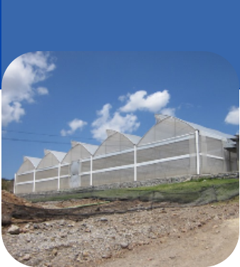

Cumulative Risk Reduction
Postharvest
Sanitation, Ripeness
Pre-production
Pesticides, Trapping
Culling, Treatment
Distribution
Pre-production
ALPP, Certification
Packaging, Inspection
HIGH
RISK
LOW
RISK

Slide 4
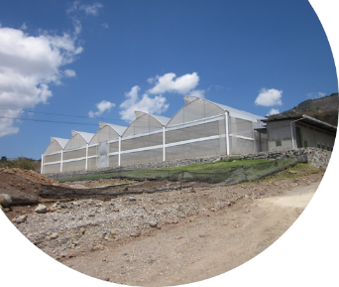
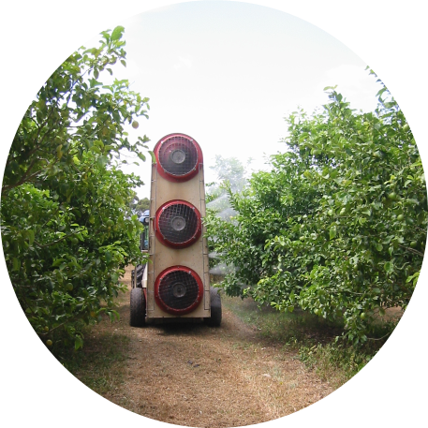
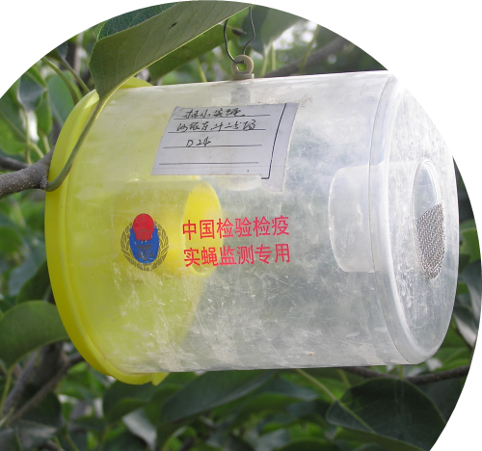
Systems Approaches
Definition (ISPM 5)
Circumstances for use (ISPM 14)
A pest risk management option that integrates different measures, at least two of which act independently, with cumulative effect
▪ Used when individual measures not available or restrictive
▪ Measures can be monitored / corrected
▪ Pest / pest-host relationship known
▪ Prevalence of the pest(s) is known and can be monitored
Notes:
Systems approaches are increasingly being used as an alternative to treatments, which may not be available. Systems approaches are defined as a pest risk management option that integrates different measures, at least two of which act independently, with cumulative effect.
Systems approaches offer more opportunities than traditional options. The may include cultural practices, treatments, packing/exporting procedures that result in overlapping layers of protection. ISPM 14 states that system approaches may be considered when one or more of the following circumstances apply: when individual measures are unavailable or restrictive; when individual measures can be monitored and corrected; when pest and pest-host relationship are well-known; when prevalence of the pest or pests is known and can be monitored. The requirement for monitoring the efficacy of measures may be difficult or resource intensive, but combining measures can be quite effective.

Slide 5
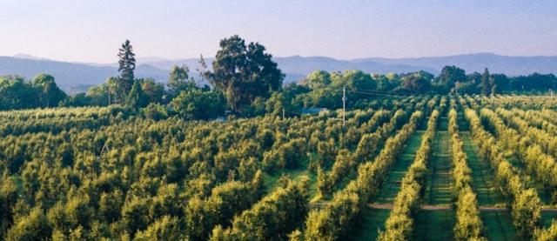
Preharvest Measures
No other hosts in buffer / production area
Elimination of mature or over ripe host fruits from production area
Removal of shade trees within buffer / production area
Only specific cultivars allowed (resistant or less susceptible)
No harvest after specific date or trapping triggers

Slide 6
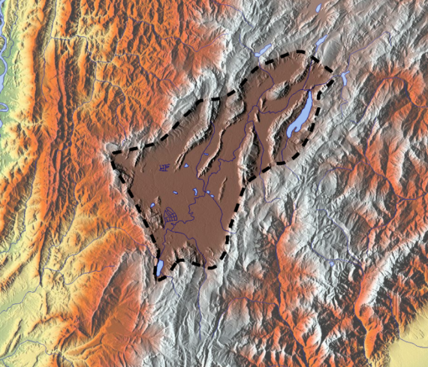
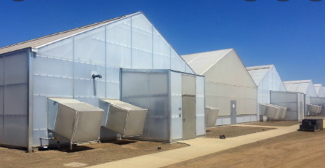
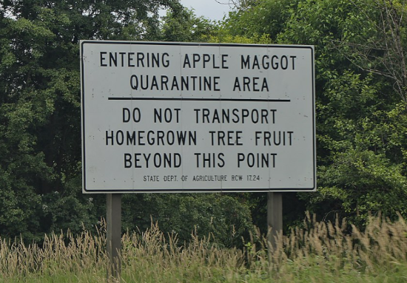
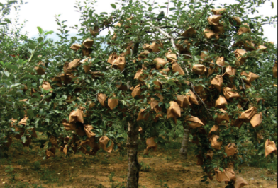
Field Measures
Pest free growing structure
Limit altitude for growers and packing area to certain levels
Quarantine road stations /signs
Fruit bagging
Registered or approved production sites

Slide 7
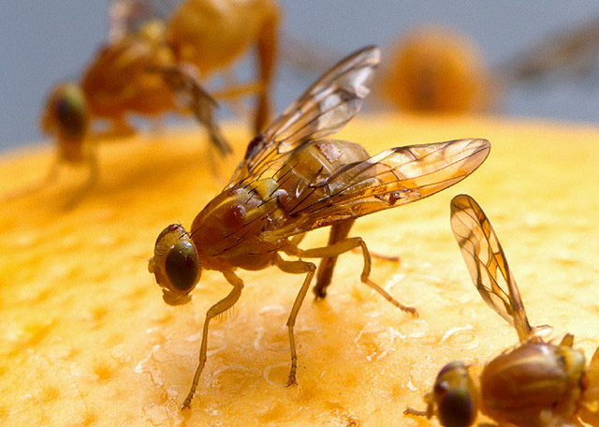
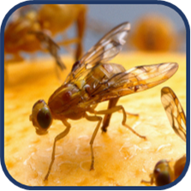
Example: Papaya from Central America
Target Pest: Medfly (Ceratitis capitata)
  Major Mitigations:
    Poor host
    Low prevalence (trapping)
    Specific cultivars
    Specific maturity stage
    Hot water dip
Notes:
One example of a systems approach used to facilitate export of fruit fly host material is the case of fresh papaya fruit imported into the United States from Central America.
The target pest here is Ceratitis capitata, Medfly.
The major components of the systems approach are the poor host status of the commodity, low prevalence of the pest in export production areas, the requirement for specific resistant cultivars of the ‘Solo’ type, limiting export fruit to specific stages of maturity and a hot water dip treatment.

Slide 8
Recent Examples of Systems Approaches used by APHIS
Chile blueberry (2020)
China citrus (2020)
Colombia avocado (2017)
Colombia cape gooseberry (2014)
Peru avocado (2010)
Nicaragua pitahaya (2011)

Slide 9
Cumulative Risk Reduction
Postharvest
Sanitation, Ripeness
Pre-production
Pesticides, Trapping
Culling, Treatment
Distribution
Pre-production
ALPP, Certification
Packaging, Inspection
HIGH
RISK
LOW
RISK

Slide 10



Treatments
← Cannot be certified organic
Fumigation
(methyl bromide)
Cold
Can be certified organic →
Heat, steam, and immersion
Irradiation
Notes:
There are a variety of post-harvest treatments that can be applied to fruits and vegetables including methyl bromide, irradiation, cold treatment, and heat/steam/and hot water immersion. Consignments that receive methyl bromide or irradiation cannot be certified organic, while temperature treatments can be. For the most part, post-harvest treatments are “condition of entry” that is, the commodity cannot be distributed in the U.S. unless it has undergone the specified treatment. Methyl bromide is unique in that it is also used as a remedial treatment. In other words, if a quarantine pest is found on a consignment, rather than being reexported, the consignment can receive methyl bromide treatment to mitigate the pest risk, and then it is released for distribution. [Add where remedial measures are taken – after a pest is found on the commodity.]
Currently, there are no remedial treatments that allow for the Organic certification. There has been some research on other methods, but nothing has been approved. For example, there is some interest in using controlled atmospheres, such as ozone, but there has been difficulty with both the consistency of the treatment and dialing in the dose accurately enough to kill pests without damaging the commodity.

Slide 11
Thank you!
United States Department of Agriculture
Animal and Plant Health Inspection Service

