Slide 1




Sweetener Industry Perspective on Consumption Moving Forward
P. Courtney Gaine, PhD, RD
President and CEO
Sugar Association, Inc.
USDA Outlook Forum
February 21, 2020
Crystal City, VA

Slide 2















Established in 1943, our members are U.S. sugar cane and beet growers, processors and refiners.
The Sugar Association is the scientific voice of the U.S. sugar industry, seeking to make a difference by continuously supporting scientific research and sharing our knowledge of sugar to increase consumer understanding and confidence in the role that sugar plays in a nutritious, balanced and enjoyable diet.
Notes:
The Mission of the Sugar Association is to promote the consumption of sugar through sound scientific principles while maintaining an understanding of the benefits that sugar contributes to the quality of wholesome foods and beverages.

Slide 3

Consumption
Trends

Slide 4
Trends in Added Sugars Consumption
Reducing consumption by ~60 calories will meet %DV
% DV
Welsh, et al. AJCN 2011, USDA WWEIA 2011-2012, 2015 DGAC 2013-2014
Notes:
Current intake of added sugars is not far from the target recommended by the 2015-2020 DGAs

Slide 5
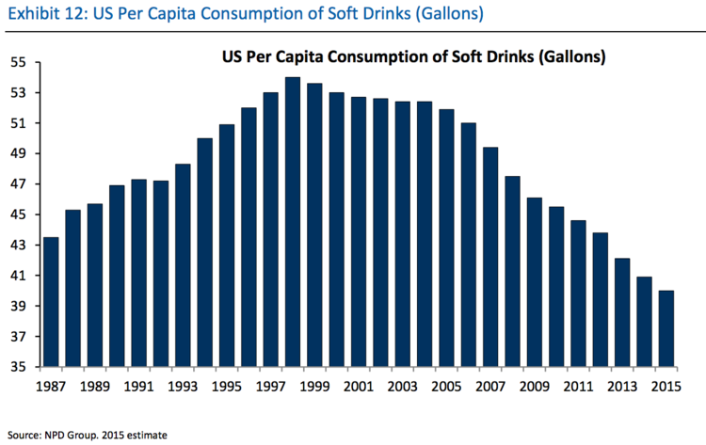
2018
Notes:
2018 consumption is ~38 gallons/person

Slide 6
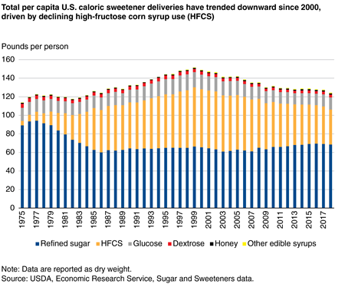
December 2, 2019
https://www.ers.usda.gov/amber-waves/2019/december/us-caloric-sweetener-deliveries-continue-to-decline-on-a-per-capita-basis-driven-by-lower-high-fructose-corn-syrup-use/

Slide 7
Sources of added sugars in the diet
USDA ARS Food Pattern Equivalents Database, updated 2018; Bailey et al, Nutrients 2018
Notes:
Added sugars are found in a variety of foods and beverages for different reasons, many times for functions beyond sweetness.
Calorically sweetened beverages such as soft drinks, tea and fruit drinks are the main source of added sugars in the diet across all age groups (older than 2 years), making up almost half of added sugars calories (47%).
Snacks and sweets are the second main source of added sugars calories, making up close to one-third (31%).
Also among the top sources of added sugars in the diet are foods that contain important nutrients such as fibers, vitamins and minerals.
These foods include ready-to-eat cereal, flavored milk and yogurt. Sugars are added to these products for functional purposes, including making certain nutritious foods more enjoyable to eat.
Because of this, sugar is a key partner in nutrient delivery.
In a recent analysis of people with low and high intakes of added sugars, people on the lower end of added sugars intake chose similar types of foods with added sugars as those on the higher end.
The main differences were in the amounts of specific foods chosen. From this analysis, we can see that many people are enjoying the same types of foods that contain added sugars, but the portion sizes are different.
Surplus/duplicate content moved to notes section
Calorically sweetened beverages are the main source of added sugars across all age groups (older than 2 years)
Snack and sweets second highest source
Cereal, flavored milk and yogurt are also among top source of added sugars
These food contain important nutrients, making sugar a key partner in nutrient delivery
People with both low and high intakes of added sugars chose similar types of foods with added sugars – the difference is portion size
; Council on School Health, Pediatrics 2015; Johnson et al, Circulation 2009; Gibson, Nutr Res Rev 2007

Slide 8

Sugar’s Nutrition
Policy Landscape

Slide 9
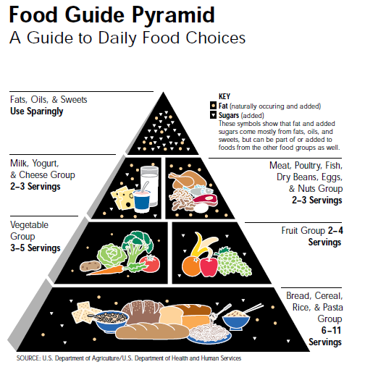
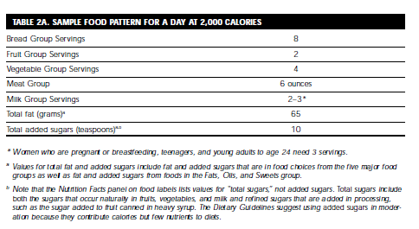
1992 Food Guide Pyramid

Slide 10
Sugar and obesity
60%
600 cal
50%
550 cal
40%
500 cal
30%
450 cal
Prevalence of obesity among adults
20%
400 cal
Consumption of caloric sweeteners per person, per day
(USDA availability data)
10%
350 cal
0%
300 cal
1974
1976
1978
1980
1982
1984
1986
1988
1990
1992
1994
1996
1998
2000
2002
2004
2005
2006
2007
2008
2010
2012
2014
2016
Flegal et al, JAMA 2016; Ogden & Carroll, CDC 2010; Fryar et al, CDC 2010; USDA ERS, Sugar and Sweeteners Yearbook 2018
Notes:
The cause of obesity is a complex issue and there are many factors that contribute to obesity, including excess caloric intake, genetics and low physical activity levels, along with other factors.
Just like protein, starch, fat, alcohol and other carbohydrates, sugar is a source of calories in the diet. Excess calories from any source, including sugar, can lead to weight gain, increasing the risk of obesity and other chronic diseases.
A recent systematic review of the evidence concluded that “if there are any adverse effects of sugar, they are entirely due to the calories it provides.”
Additionally, three authoritative scientific organizations, including the U.S. Institute of Medicine, European Food Safety Authority, and the U.K. Scientific Advisory Committee on Nutrition, each conducted extensive scientific reviews of “added sugars” and obesity and found no unique role for added sugars in the development of obesity.
Data from the past 40 years show that obesity trends do not mirror trends in added sugars consumption. Obesity has gone up as sugars intake has gone down.
Moved from slide to notes section because it’s repeated in the talk track.
The cause of obesity is complex
Excess calories from any source, including sugar, can lead to weight gain
“If there is any adverse effects of sugar, they are entirely due to the calories it provides.”
Obesity trends do not mirror trends is added sugars consumption

Slide 11
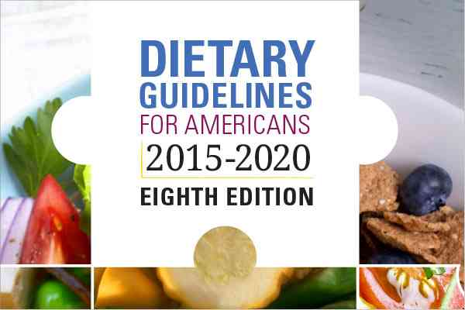
Dietary Guidelines:
History of Sugars Recommendations
1980 Avoid too much sugar
1985 Avoid too much sugar
1990 Use sugars only in moderation
1995 Choose a diet moderate in sugars
2000 Choose beverages and foods to moderate your
intake of sugars
2005 No specific sugars guideline
2010 Reduce intake of calories from added sugars
2015 Limit calories from added sugars to <10%
  200 calories or 50 grams or 12 tsp based
  on a 2000 calorie diet
  There are 15 calories in 1 teaspoon of sugar
Notes:
Since 1980, the U.S. government has published the Dietary Guidelines for Americans, updating them every 5 years. Each version of the guidelines has included a general recommendation for Americans to moderate intake of sugars.
The 2015–2020 Dietary Guidelines for Americans were the first to quantify moderation, recommending Americans limit added sugars to no more than 10% of calories per day
This recommendation is based on food pattern modeling (a tool used to figure out how you can meet all of your food group recommendations within calorie needs), and the 10% target is an attempt to help individuals move toward healthy eating patterns within calorie limits.
It is not based on health outcomes, nor is it an amount above which causes harm.
Added sugars intake can be presented in teaspoons, grams, calories or percent of total calories. In a 2000 calorie diet, the Dietary Guidelines Recommendation translates to: 12 tsp, 50 g, 200 calories or 10% of total calories.

Slide 12
2015 Dietary Guidelines | Why 10%?
Added sugars include syrups and other caloric sweeteners. When sugars are added to foods and beverages to sweeten them, they add calories without contributing essential nutrients.
Consumption of added sugars can make it difficult for individuals
to meet their nutrient needs while staying within calorie limits.
The recommendation to limit added sugars to no more than 10 percent of calories is a target that applies to all calorie levels to help individuals move toward healthy eating patterns within calorie limits.

Slide 13
The U.S. Food & Drug Administration’s New Food Label
Released May 20, 2016
Implementation date: January 2020 with leeway to July 1 2020
Based on the 2015 Dietary Guidelines
Daily Value of 10% based on 50g (adults) and 25g (children <4yrs)
<5% = “LOW”
>20% = “HIGH”
Serving size for sugar was also increased from 1tsp (4 grams) to 2 tsp (8 grams)

Slide 14

“THE” RATIONALE for FDA’s added sugars declaration
    We (FDA) are proposing mandatory declaration of added sugars on all foods because of:
  the variability in ingredients used,
  the need for consumers to have a consistent basis on which to compare products,
  the need for consumers to identify the presence or absence of added sugars, and
  when added sugars are present, the need for consumers to identify the amount of added sugars added to the food.
  The mandatory declaration of added sugars may also prompt product reformulation of foods high in added sugars like what was seen when trans fat labeling was mandated.

Slide 15


?
When sugar is removed, new ingredients need to take it’s place.
There is
no substitute
for sugar.
Notes:
When sugar is removed from a food, there are new ingredients (often more than one) that need to take its place.
There is no substitute for sugar. No single ingredient can replace sugar’s flavor and function.

Slide 16
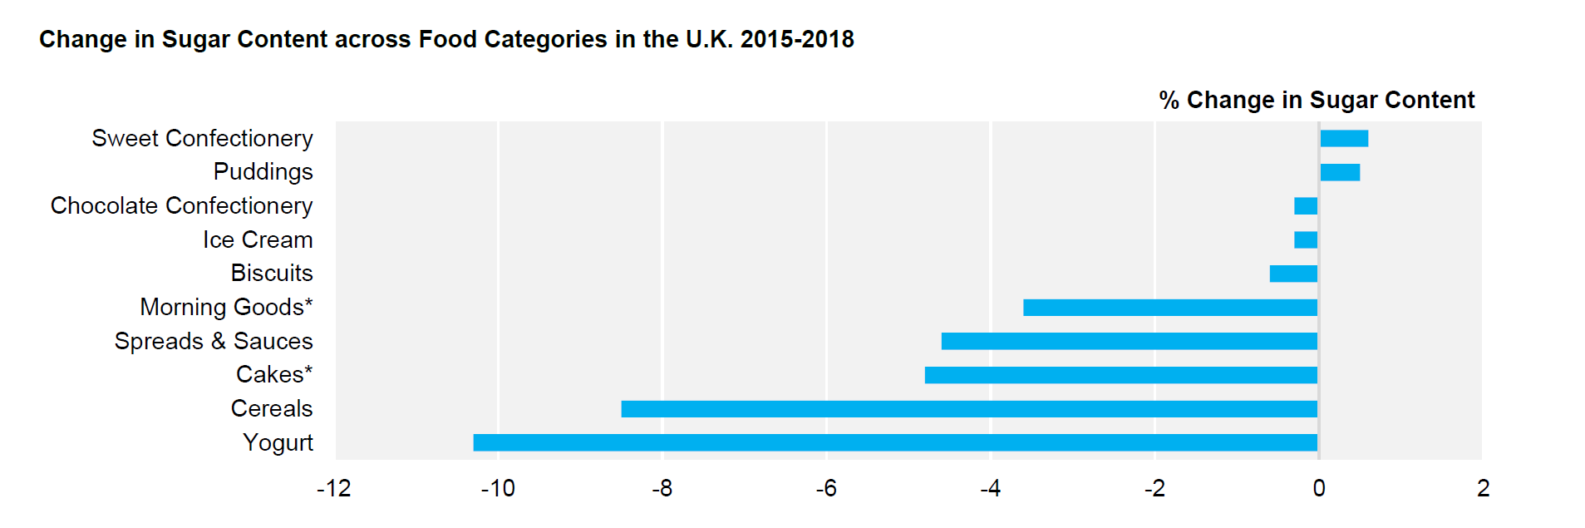
UK Failing to Meet Public Health England’s 20% Reduction by 2020 Target
The average sugar reduction in products from 2015-2018 was just 2.9%

Slide 17
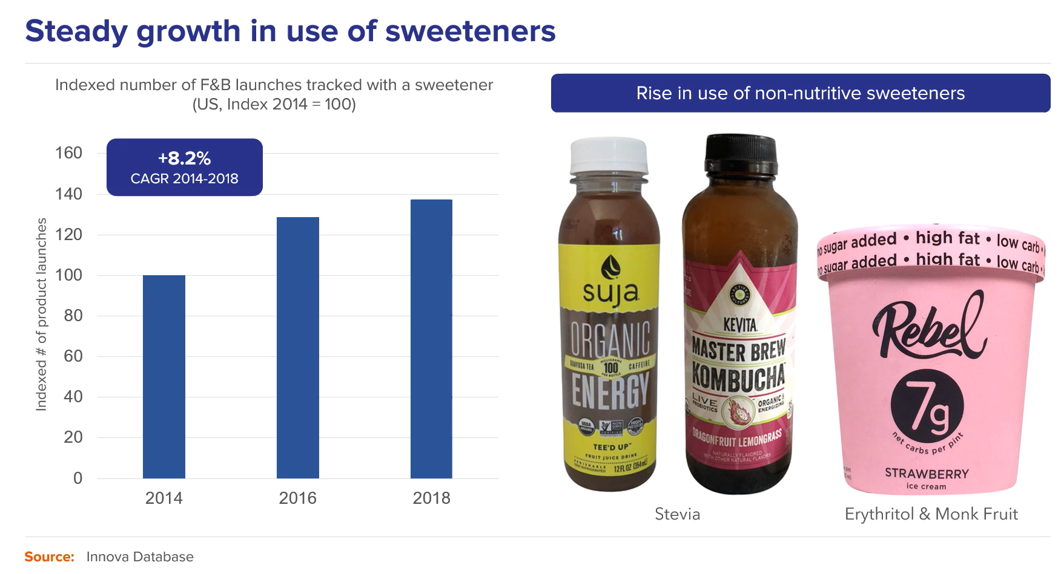

Slide 18
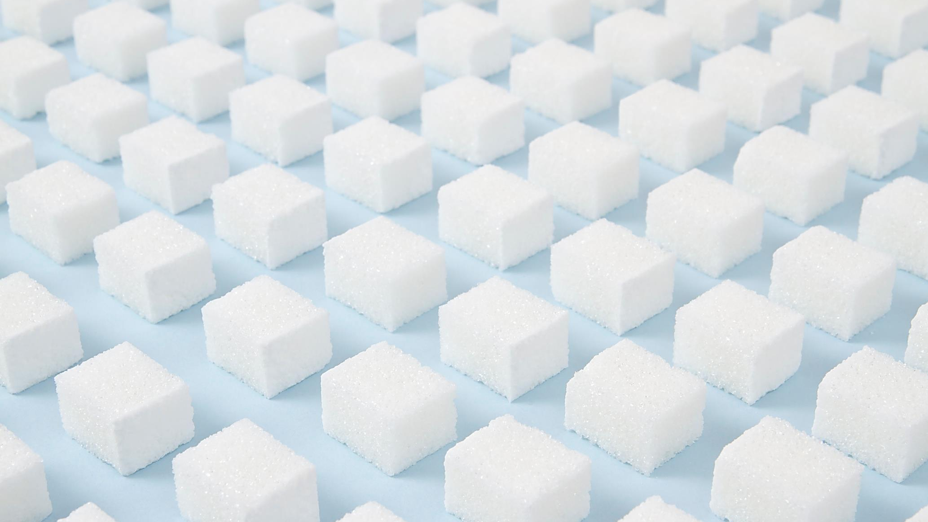

However, sugar grams per serving in the US remain steady as a whole
2015 | 2016 | 2017 | 2018
11.34 | 11.91 | 12.00 | 11.88
Average grams sugar per serving of the 6 largest global food & beverage companies (using their 10 largest categories), based on all new product launches 2015-18 (6,325 items)

Slide 19
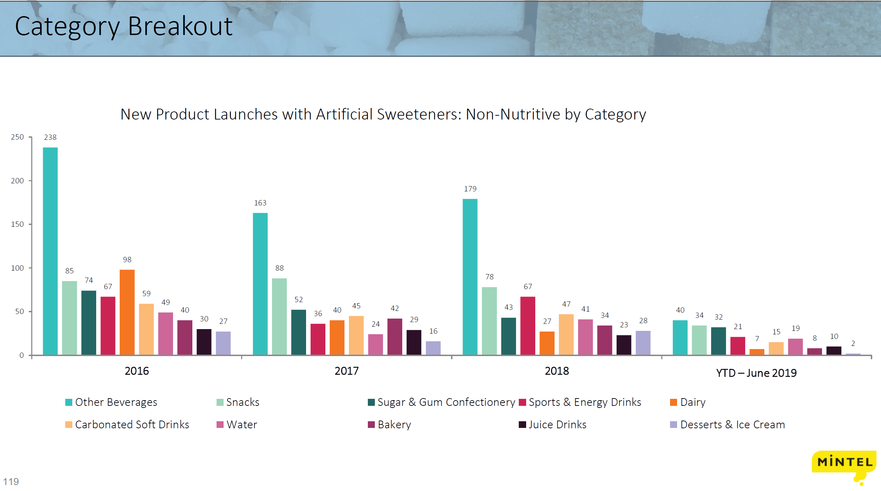
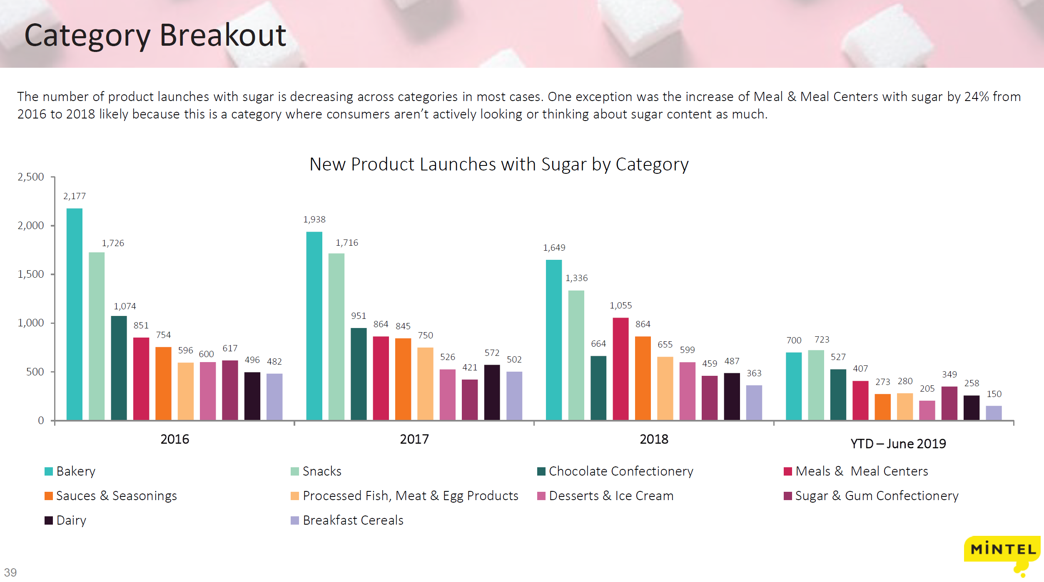
New Product Launches with ANY Sweetener Down from 2016-2019

Slide 20
Yet to Come:
Companies’ Commitments to Sugar Reduction
Nestlé –
  In 2016, they announced plan to reduce added sugars in their foods and beverages by 5% by 2020.
  Results: As of this year, Nestle has removed 0.8% of sugar from their foods and beverages.
Unilever –
  Reducing sugar levels in ready-to-drink teas to achieve goal of removing 25% sugar by 2020. This commitment has been extended to powdered ice tea and milk tea products.
Kellogg’s
  pledged in 2015 that 90% of cereals would have fewer than 10 grams of added sugars per 30 gram serving by 2020.

Slide 21


Consumer Sentiment

Slide 22
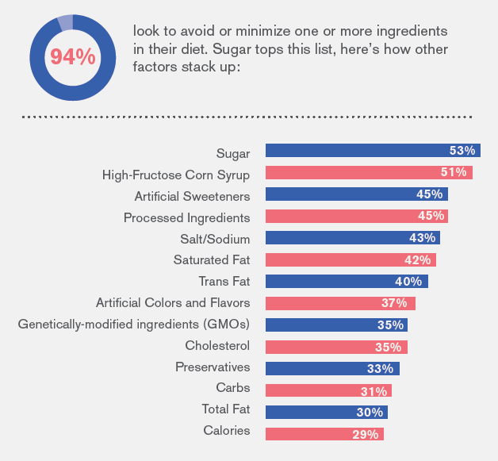
Sweeteners, processed ingredients top list of what consumers try
to avoid
Sugar Association Research – December 2018

Slide 23
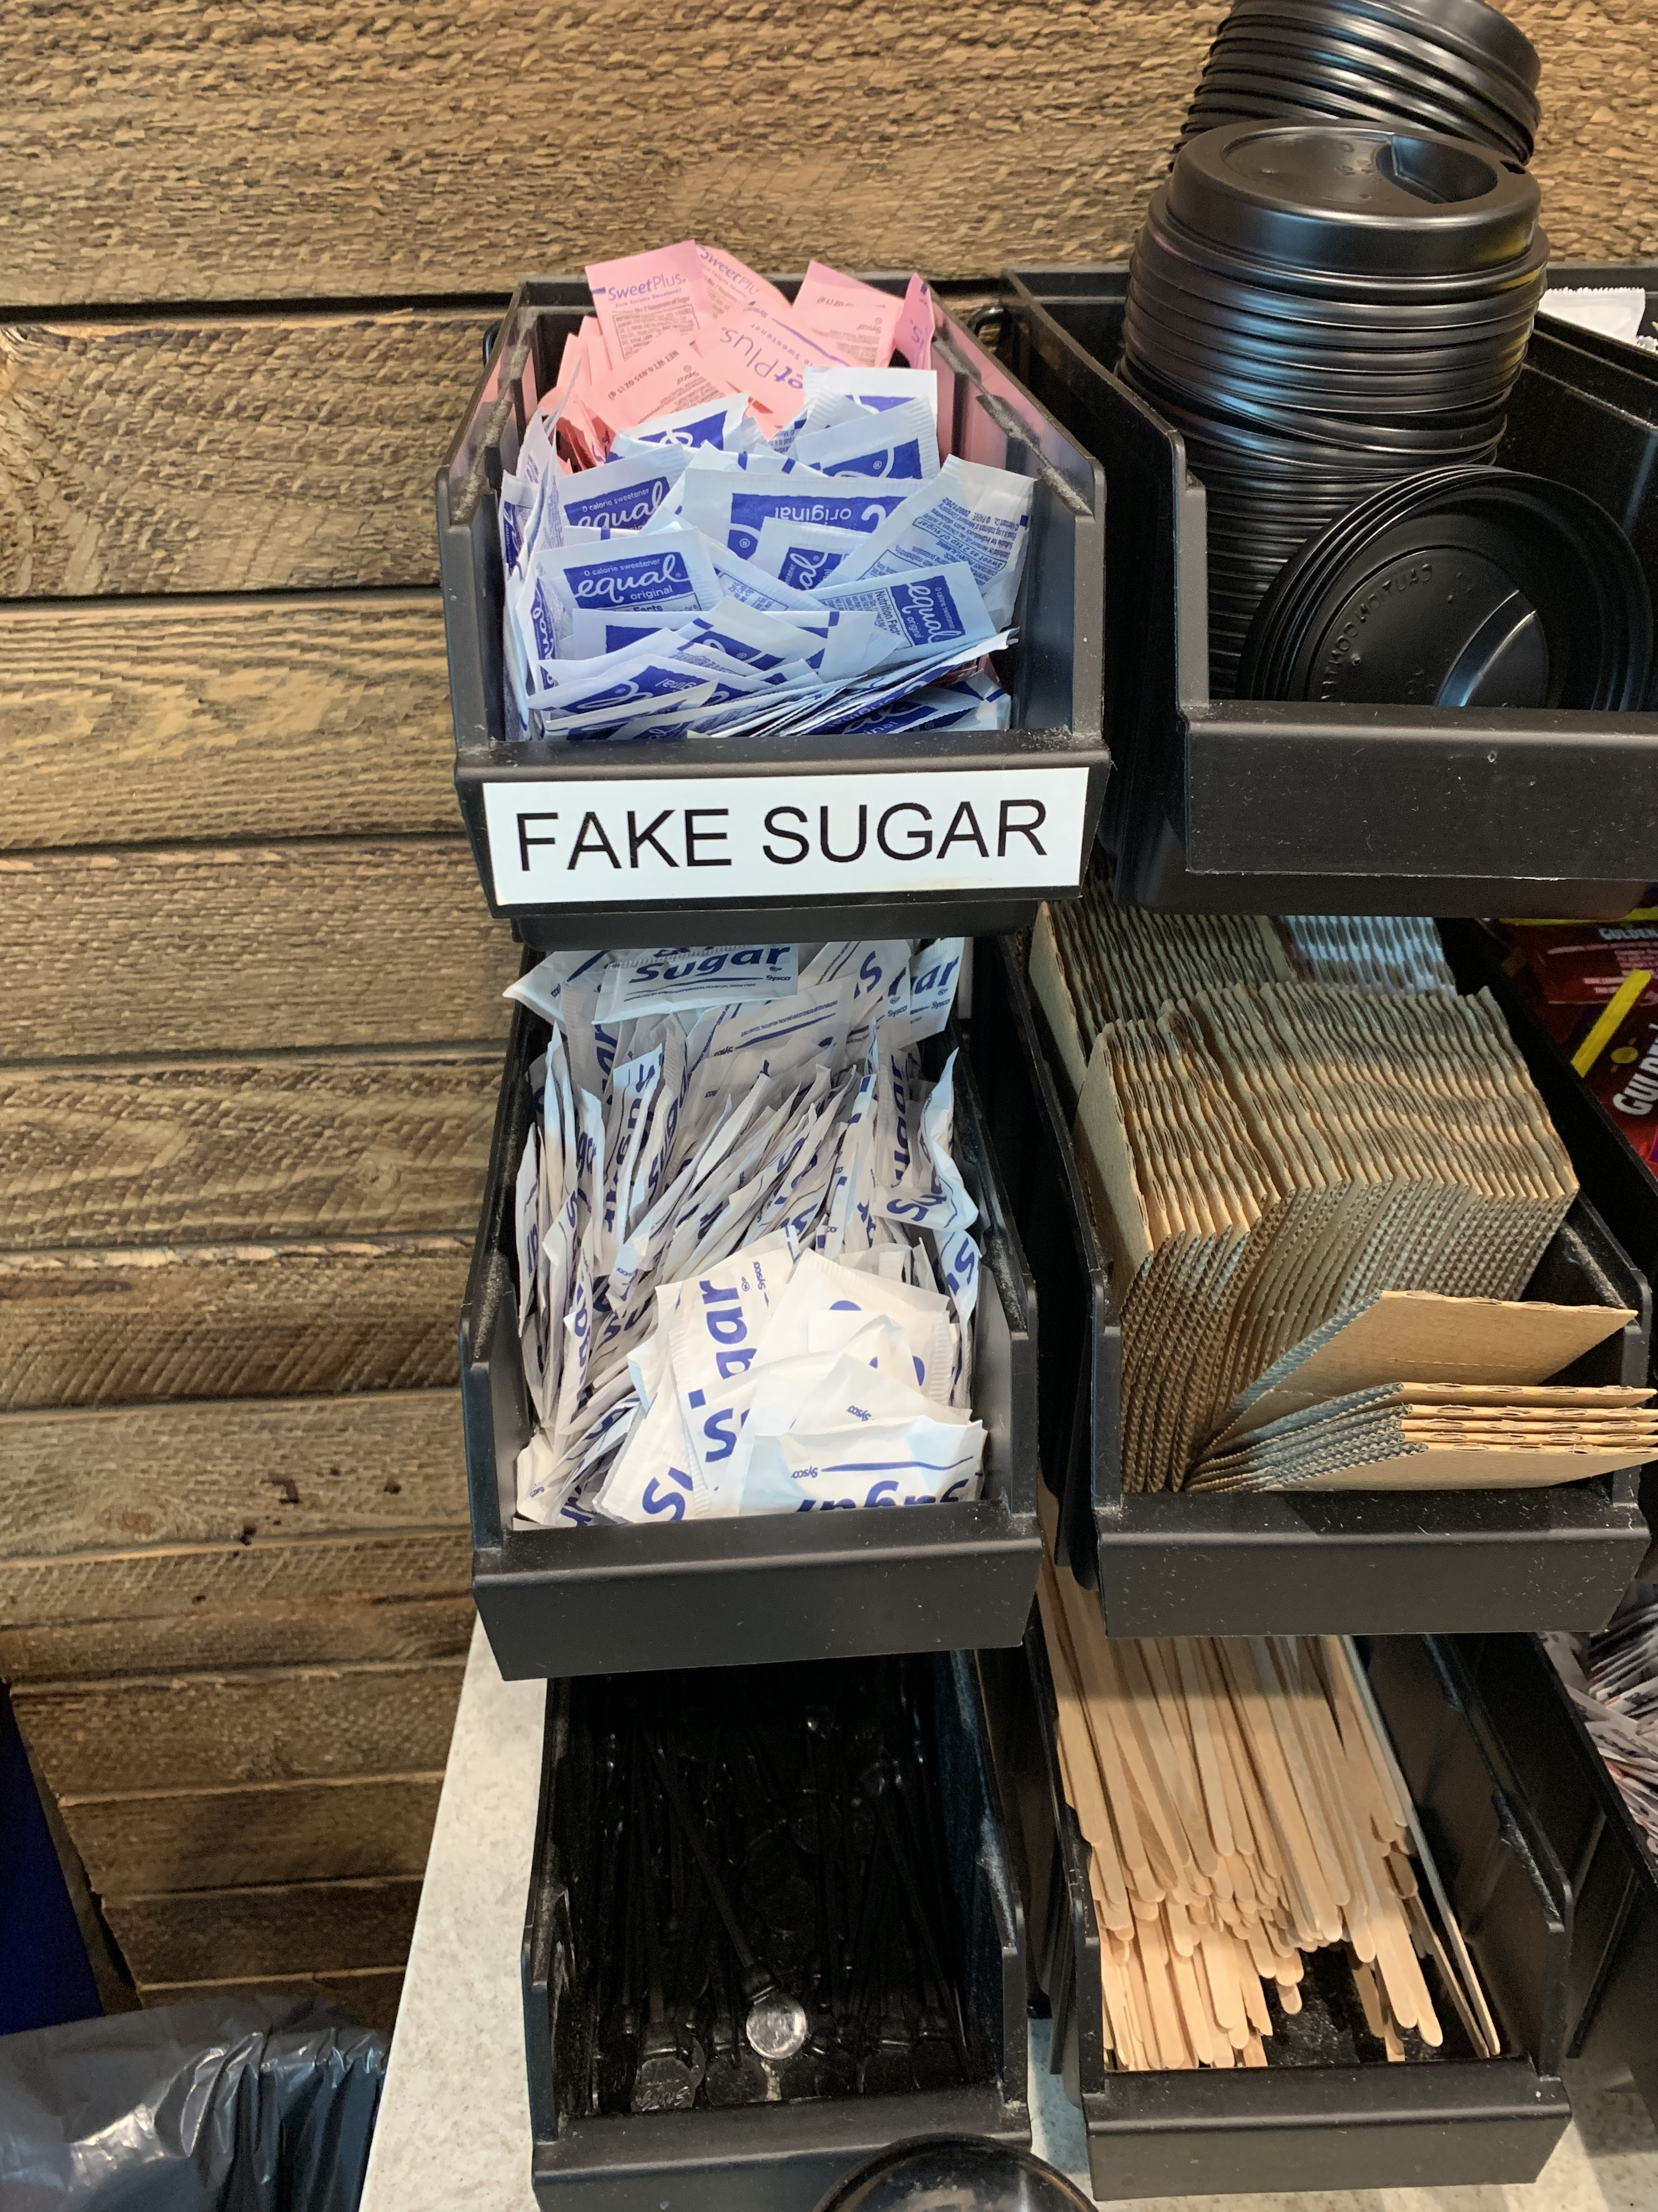
Things are changing

Slide 24
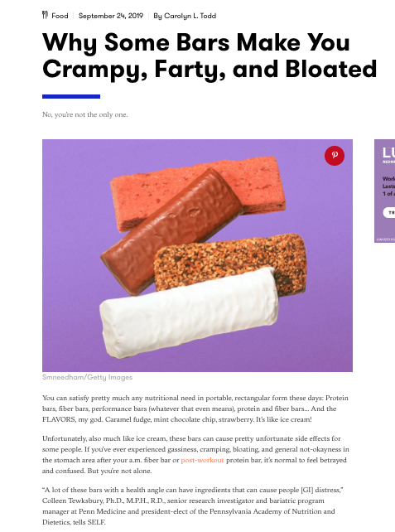
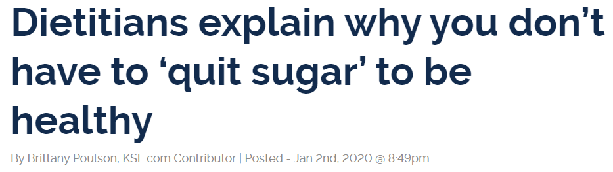
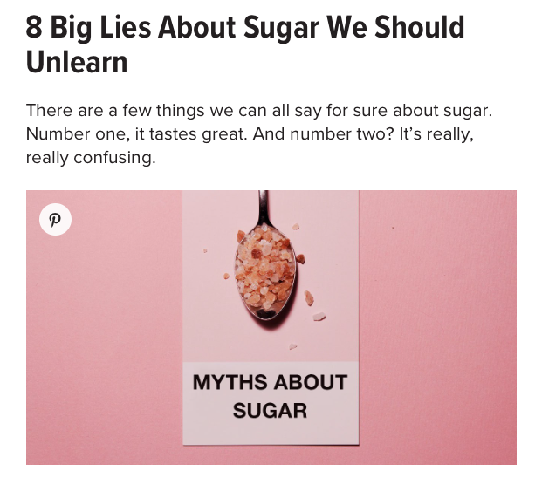

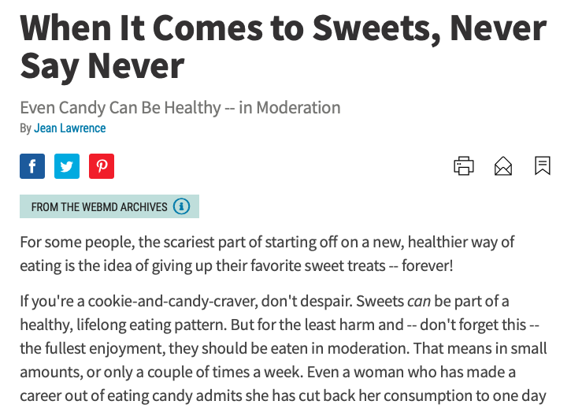

Slide 25
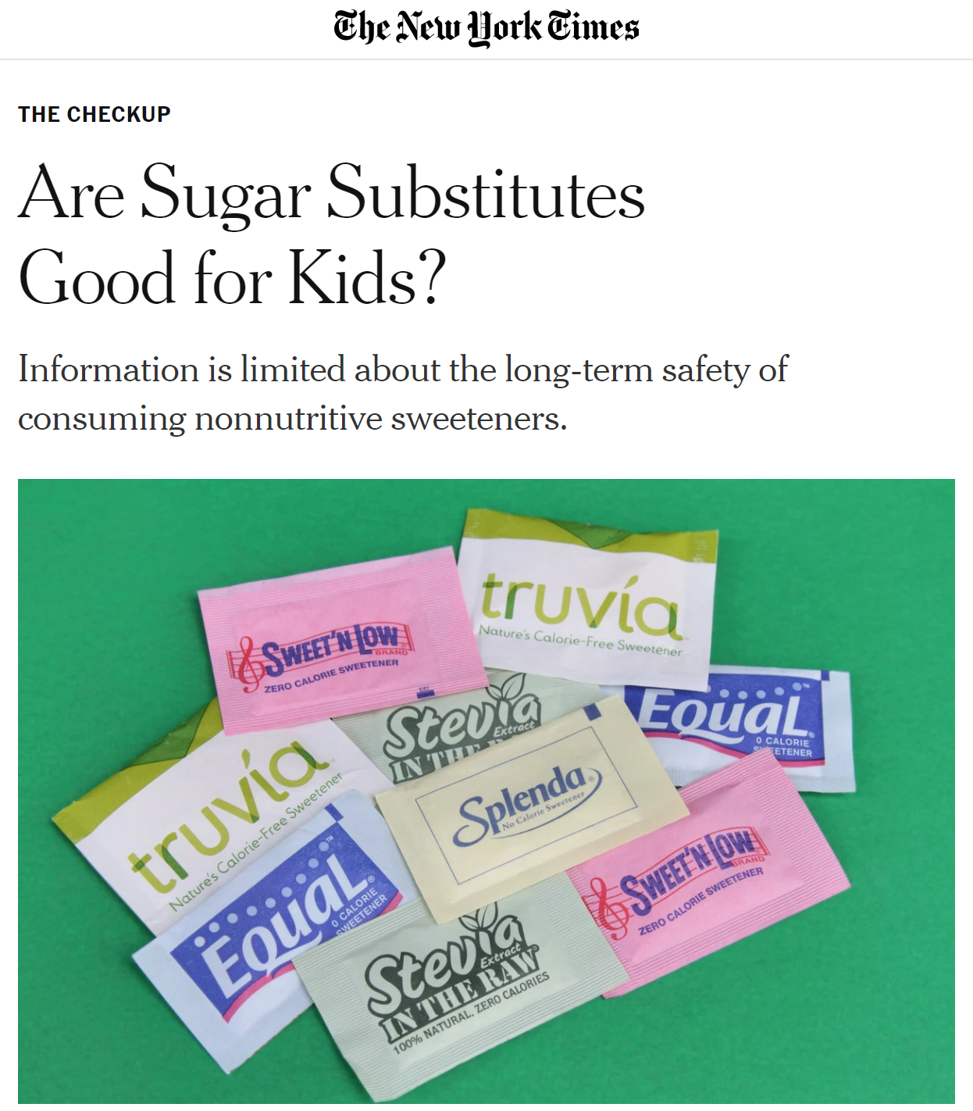



Slide 26

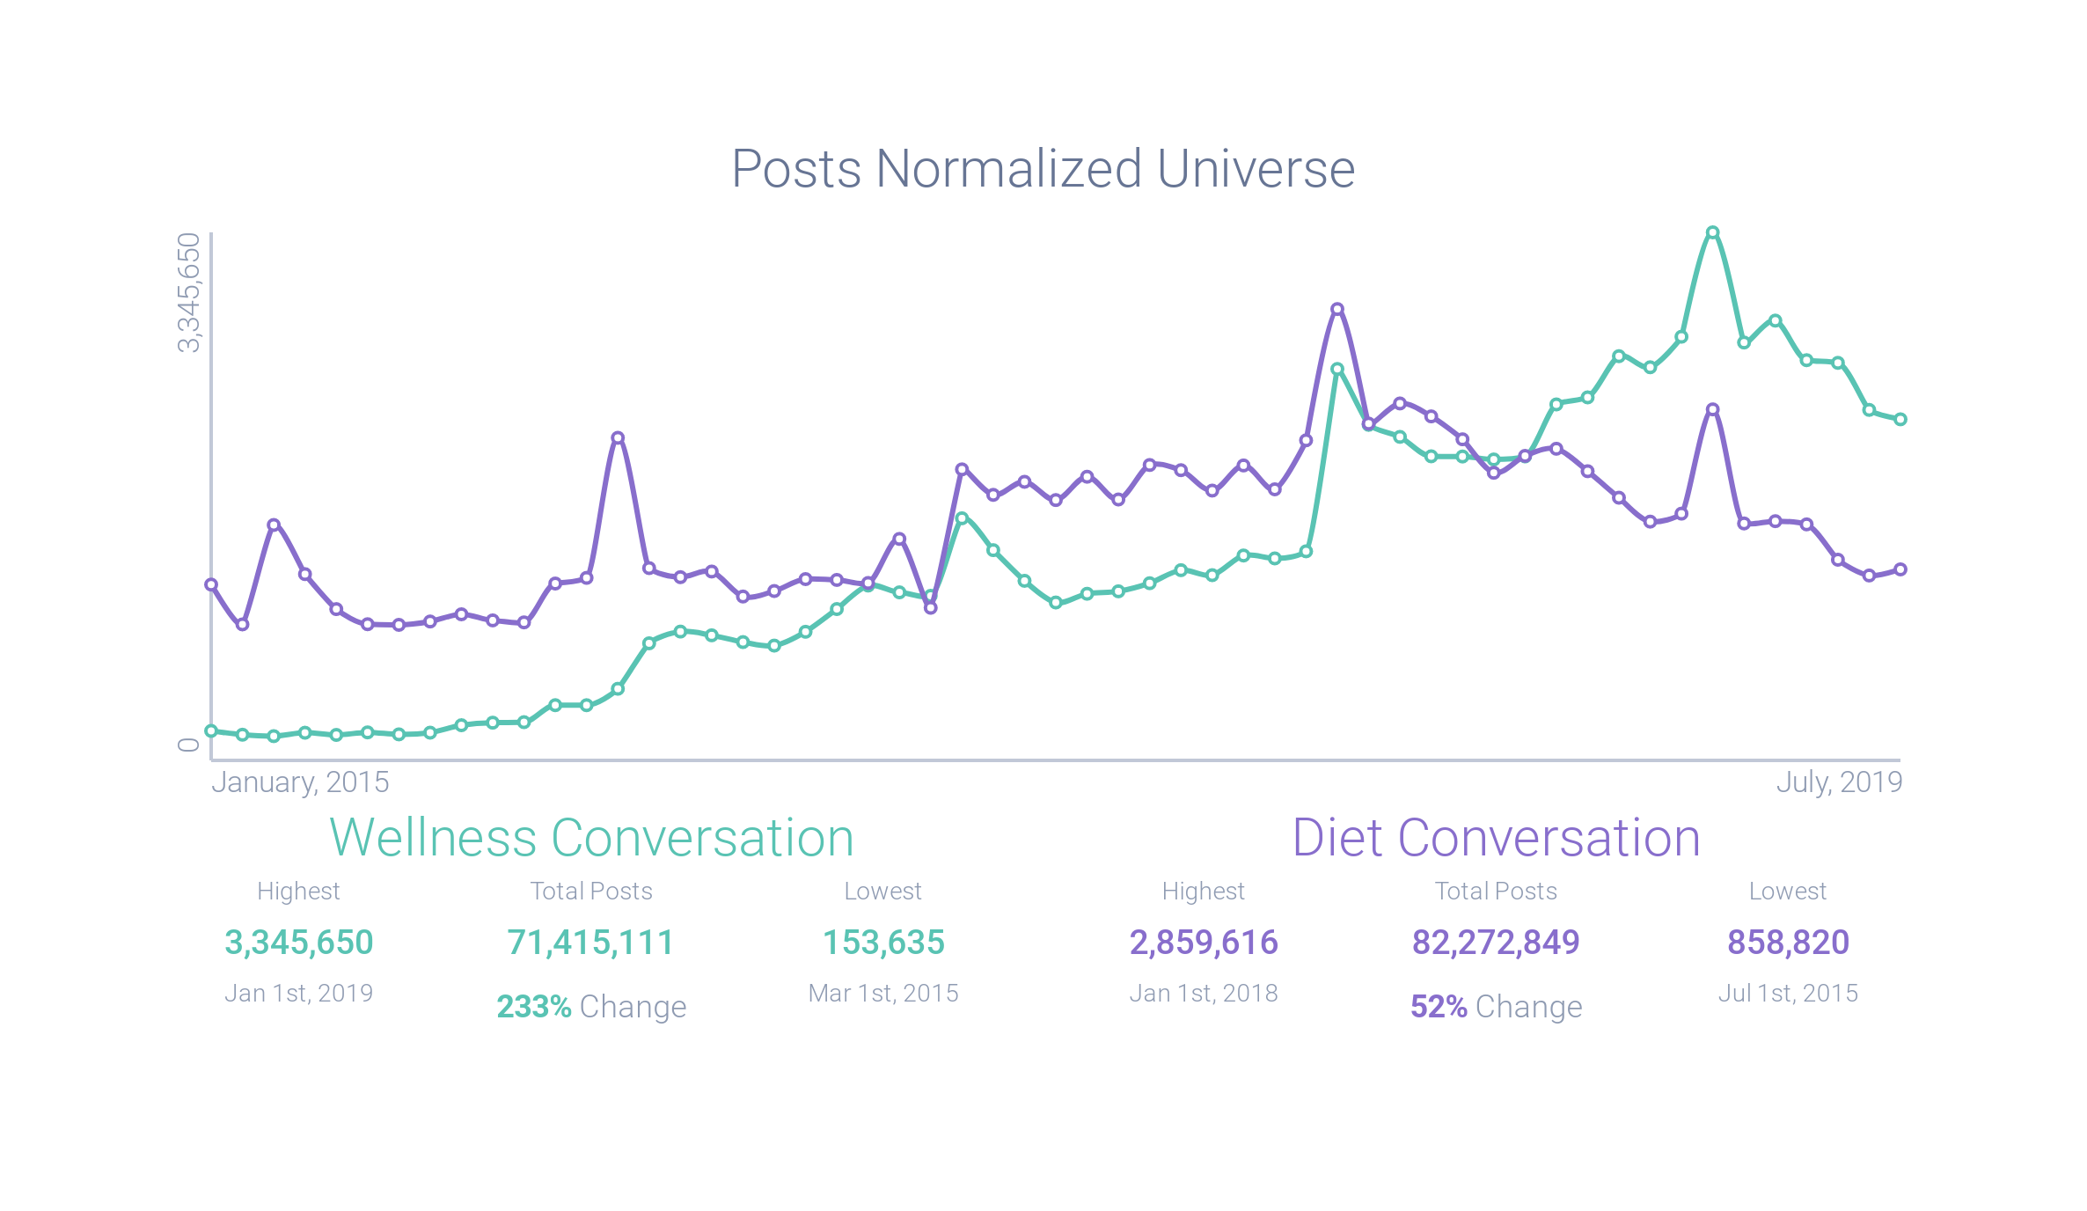
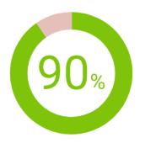
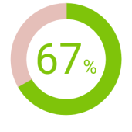
Wellness Trending – Shifting from Restriction to a Lifestyle
Wellness Sentiment:
Dieting Sentiment:

Slide 27
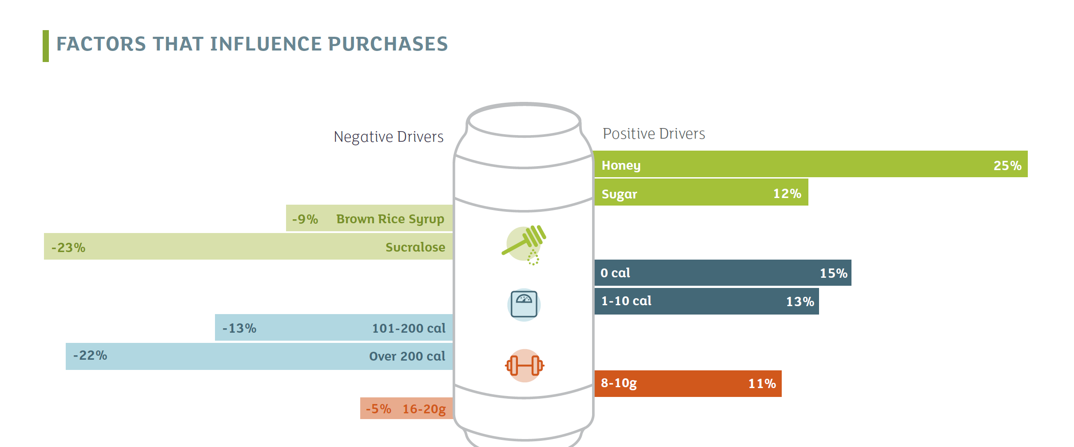
Kerry Proprietary Consumer Research 2018

Slide 28


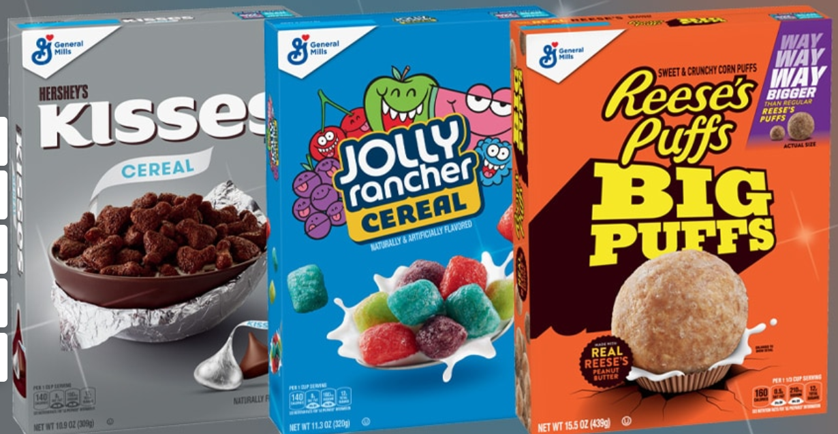

Slide 29


Nestlé is pulling its low-sugar chocolate bar from shelves less than two years since launching it for not meeting consumer expectations and poor sales.
The Milkybar Wowsomes were introduced in March 2018, promising 30% less sugar using their new technology that creates sugar with a more porous structure that can be likened to hollowing out the sugar crystals.

Slide 30

When sugar is tied to its origin, it’s in the same category as honey and maple syrup.
NATURAL + HEALTH SCORES How natural/healthy do you feel each of the following products is? Showing % | NATURAL % “Very Natural” + “Somewhat Natural” | HEALTHY % “Very Healthy” + “Somewhat Healthy”
Honey | 94 | 87
Raw sugar | 84 | 57
Cane sugar | 84 | 57
Maple syrup | 80 | 60
Real sugar | 79 | 52
Pure sugar | 78 | 54
Beet sugar | 75 | 63
Sugar | 67 | 44
Agave | 66 | 57
Stevia | 41 | 44
High Fructose Corn Syrup | 26 | 18
Sucralose | 20 | 21
Erythritol | 20 | 19
Aspartame | 18 | 19
Focus on simplicity

Slide 31
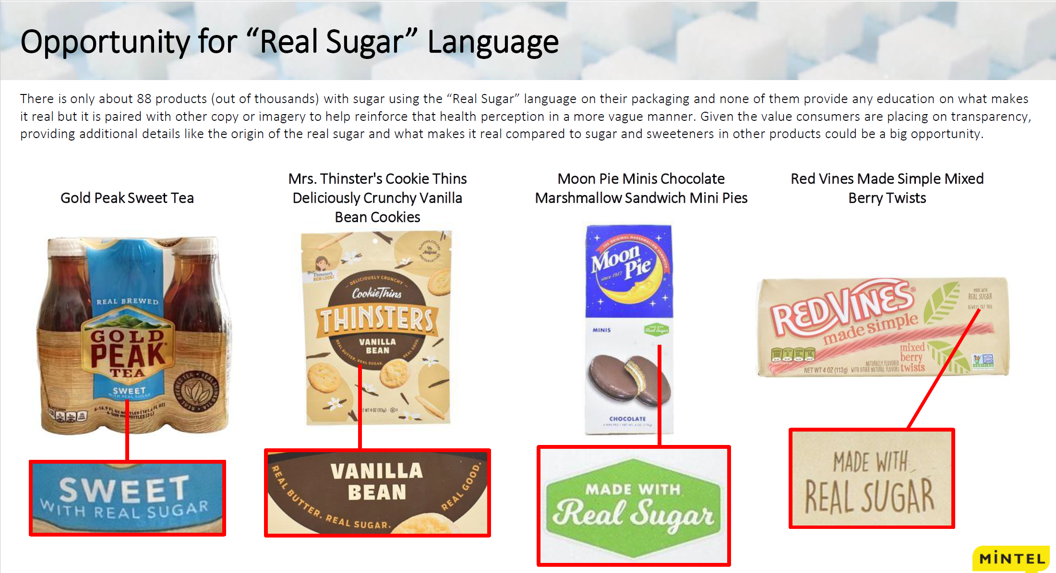

Slide 32
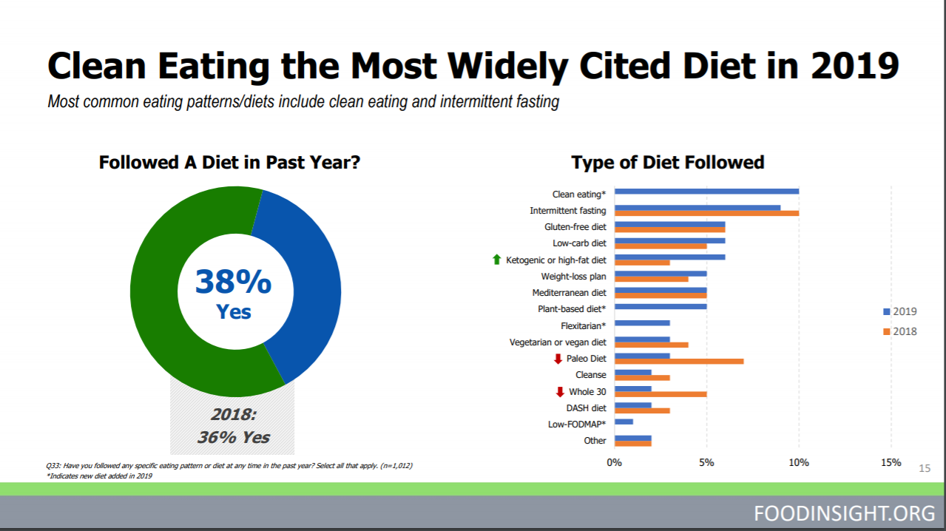
Clean eating the most widely cited diet in 2019
Followed a diet in past year?
Type of diet followed
Source: IFIC 2019 Food and Health Survey

Slide 33






Sugar’s positive attributes
TASTE
    Functionality
    No substitute 1 for 1
    Clean label
    Familiarity
    Minimally processed
    From plants
Notes:
TASTE is still king
Although consumers are reducing the amount of sugar they consume, a recent study found that 73% of consumers say taste is more important than grams of sugar per serving.
So, although consumers want to reduce their sugar intake, they are more interested in a product’s overall taste than they are about the sugar content.
Food and beverage manufacturers must meet the consumer’s desire for reduced sugar without compromising a product’s taste or its ingredient label.

Slide 34

Consumers are looking for permission and seeking balance

Slide 35
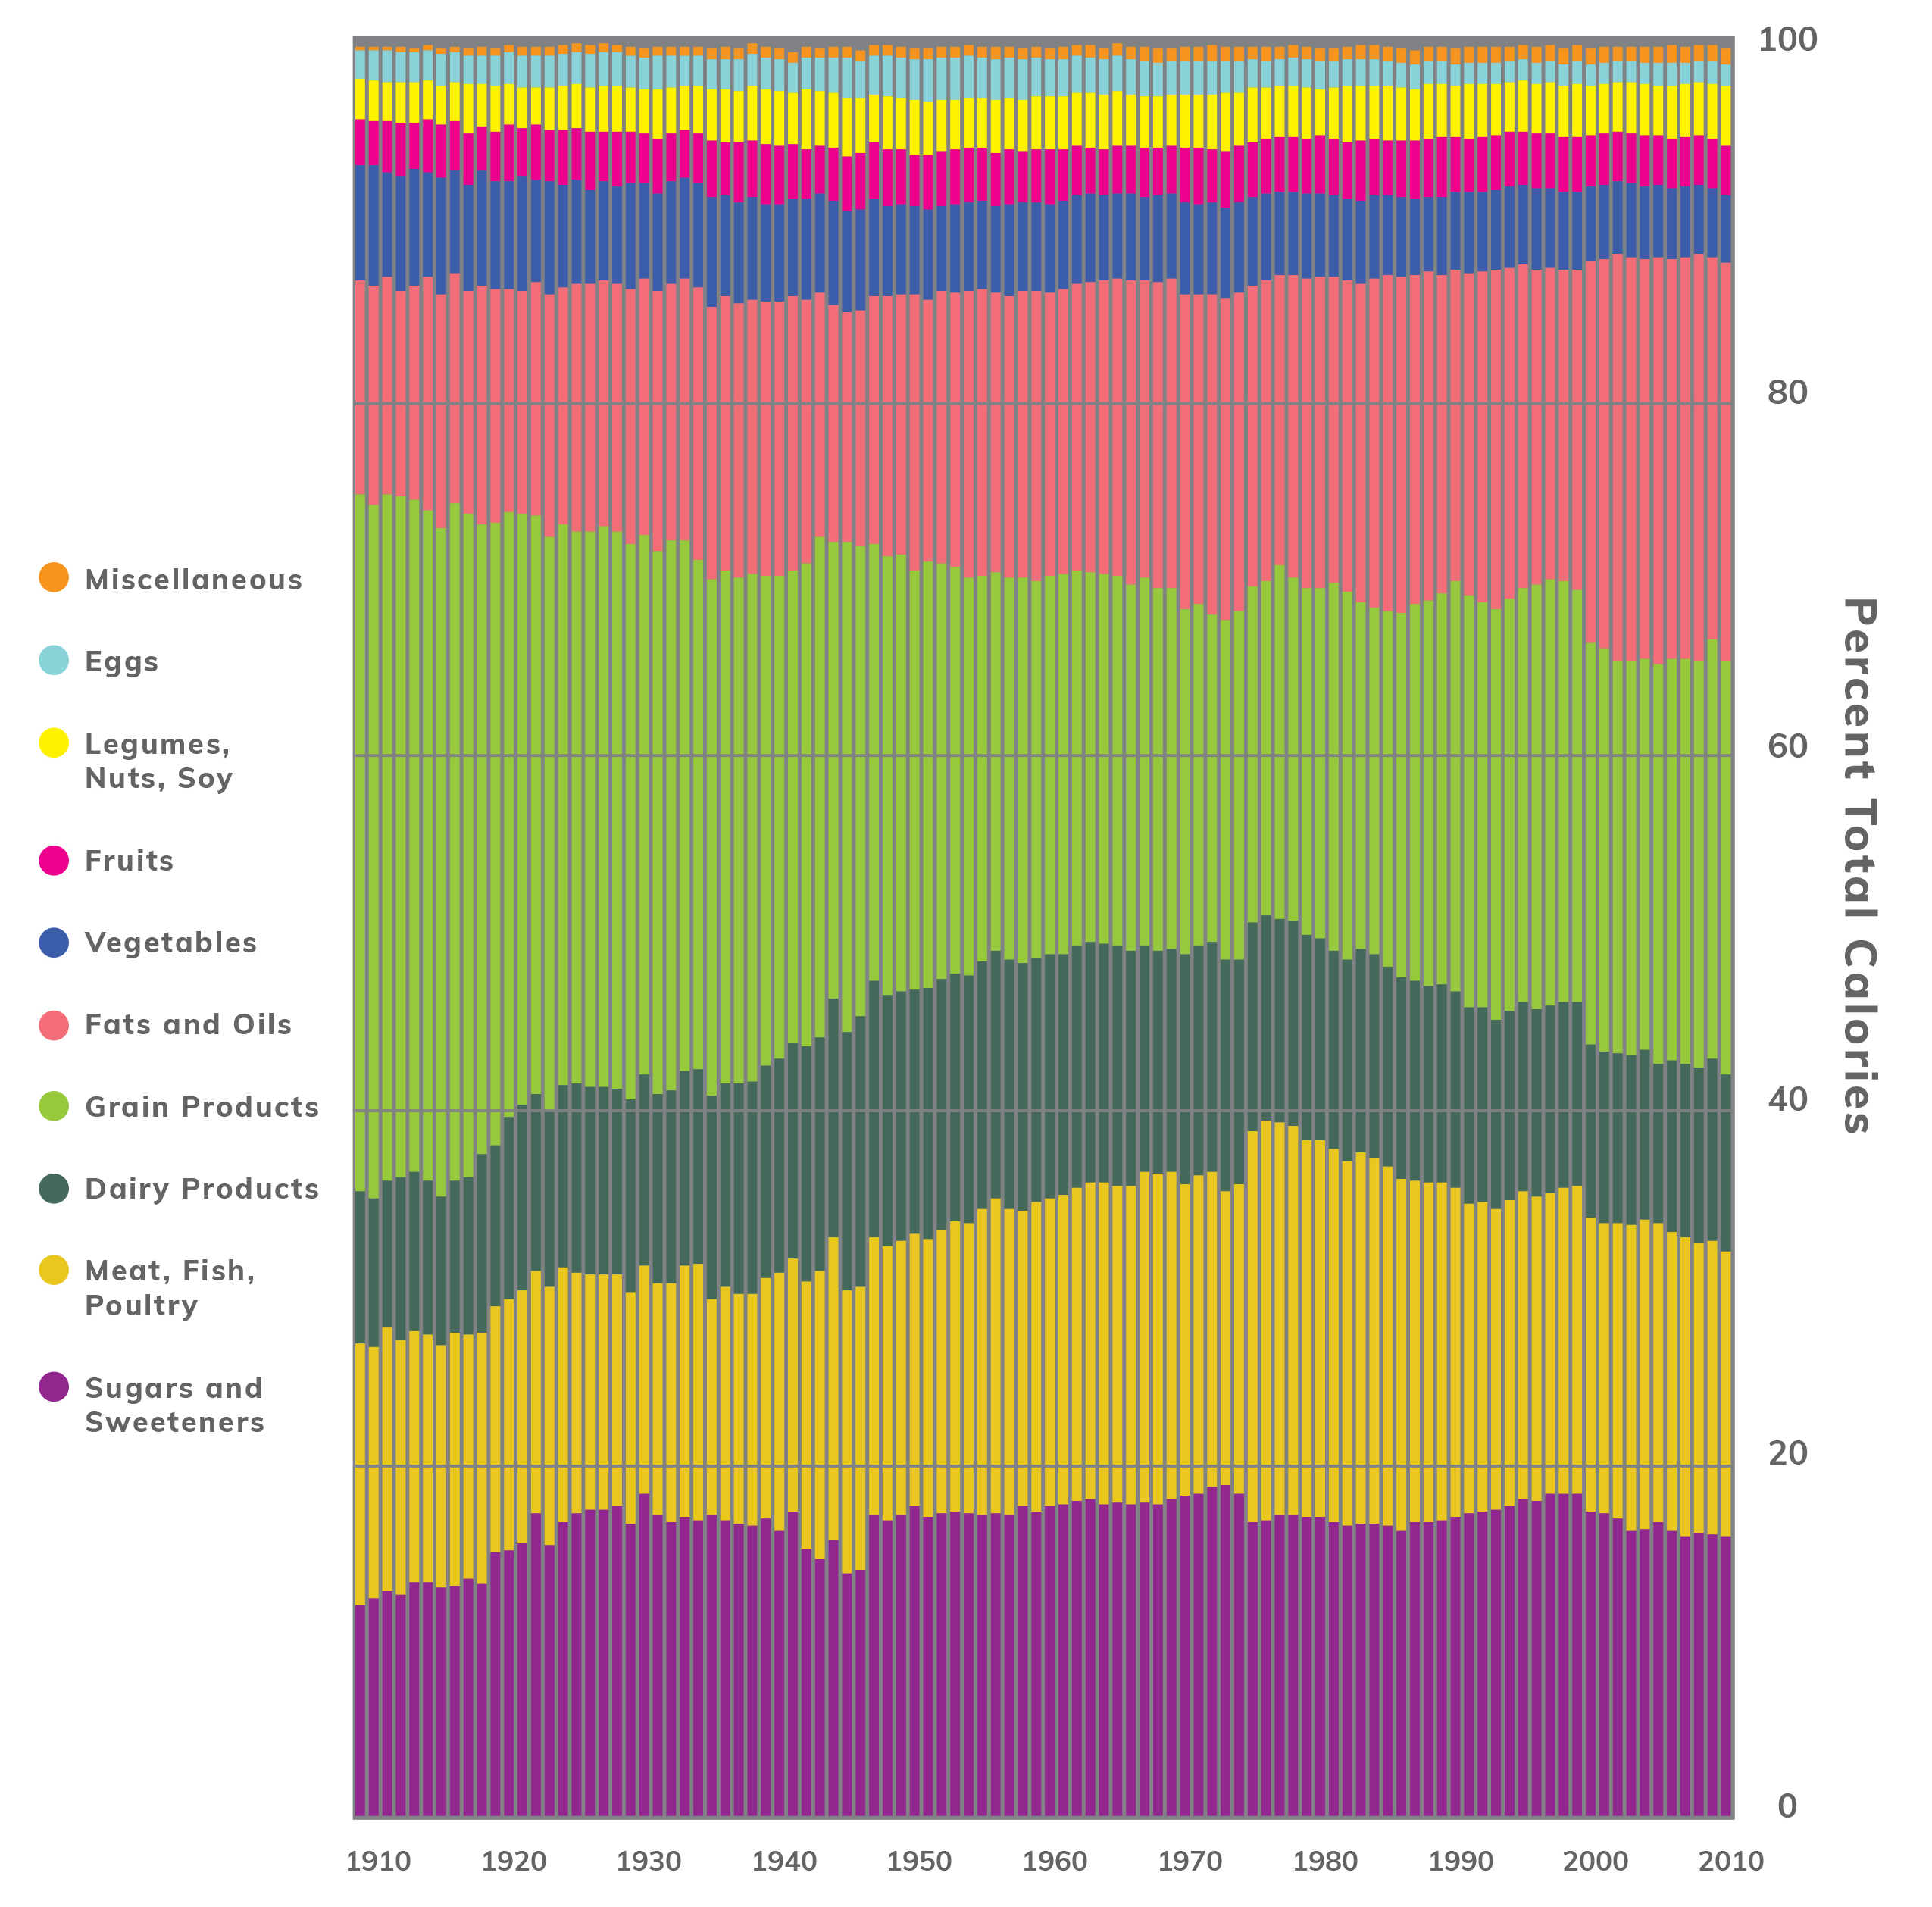
The U.S. Diet:
An Historical Perspective
USDA CNPP, 2018
Notes:
The U.S. Department of Agriculture has been collecting food supply data for a long time!
Looking back over 100 years, sugars and sweeteners made up 11.9% of all calories in the food supply in 1909.
Over the past century, there have been some ebbs and flows in this percentage, the highest being 18.2% in 1997–1999. However, since the turn of the 21st century, the percentage of calories from sugars and sweeteners has dropped steadily.
It is important to note that total calorie intake has come up since 1909, but as a percentage of total calories, total sugars and sweeteners consumption is on the decline.
The most recent report was published in 2010, and sugars and sweeteners make up even less now.
As you can see, the calories contributed by major food groups have also shifted over the years.

Slide 36
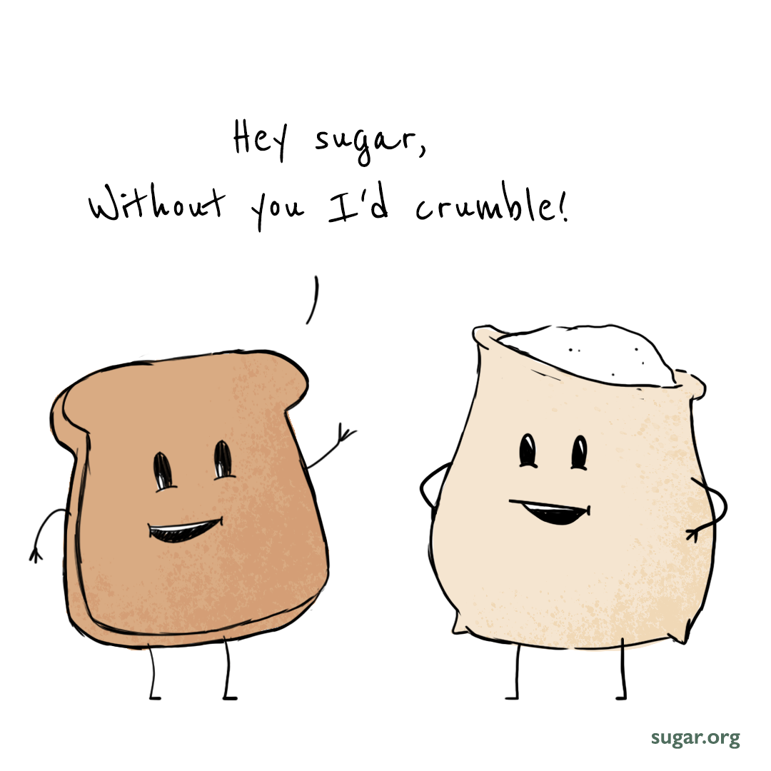

Slide 37


Thank You!
Visit sugar.org

Slide 38
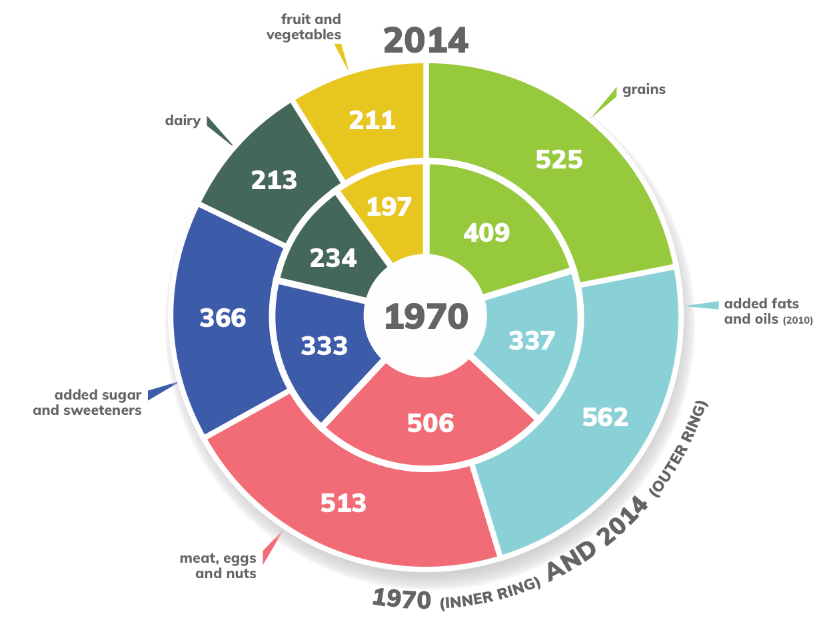
Added sugars
in the context
of the total diet
USDA ERS Food Availability; USDA ERS Sugar and Sweeteners Yearbook; Bentley, USDA ERS 2017
Notes:
Between 1970 and 2010, Americans’ daily caloric consumption went up by more than 450 calories. And as a society, we move a lot less now then we did almost 50 years ago.
In 1970, people were consuming 2024 calories each day. Fast-forward to 2010 (the most recent calorie availability data), and that figure jumped to 2476—nearly a 25% increase in calories.
But added sugars didn’t make up a very big percentage of the increased intake. Added sugars consumption increased by only 12 calories per day (a 4% increase), from 20.8 teaspoons per day in 1970 to 21.6 teaspoons per day in 2017.
Calories from added fats and oils have increased by 225 calories per day (a 66% increase) and calories from grains have increased by 116 calories per day (a 28% increase).

