Slide 1

Forests, Fire and Washington
Washington
Department of
Natural
Resources
Opportunities and planning efforts in Washington State to achieve cross-boundary fuels and fire management in the northwest.

Slide 2

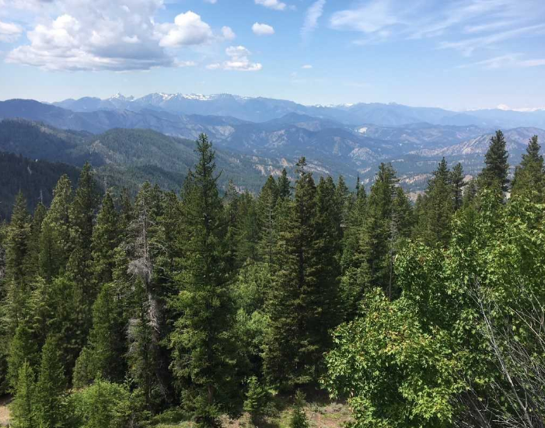
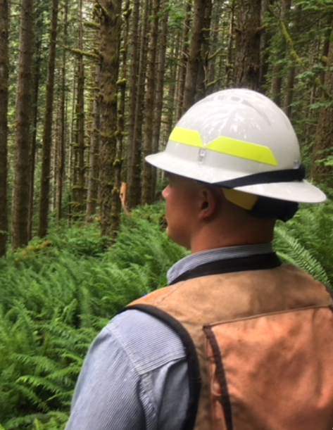
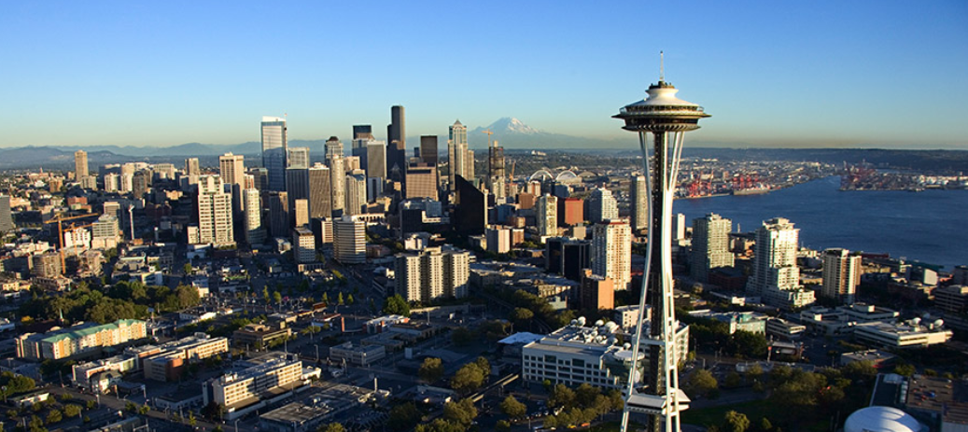
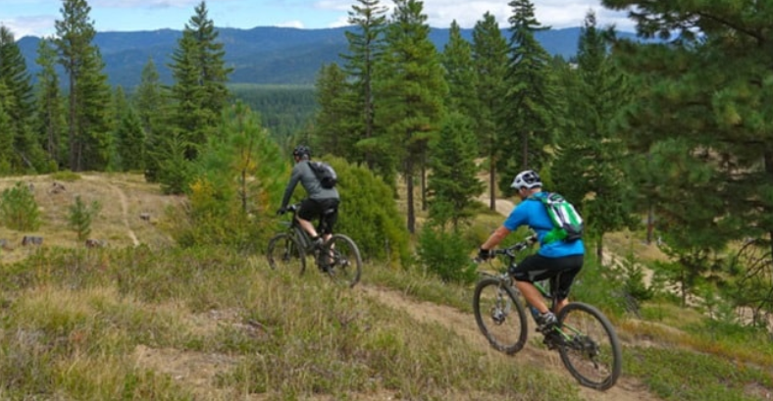
Washington’s Forest-scape
7.5 Million people, 4.5 million in the greater Seattle area
Federal lands equal 12.2 million acres (28% of total lands).
DNR manages 5.6 million acres state lands (13% of total lands)
Private landowners own approximately 9.4 million acres (21% of total lands)
Eastern and Western Washington, two distinct ecological and political landscapes

Slide 3
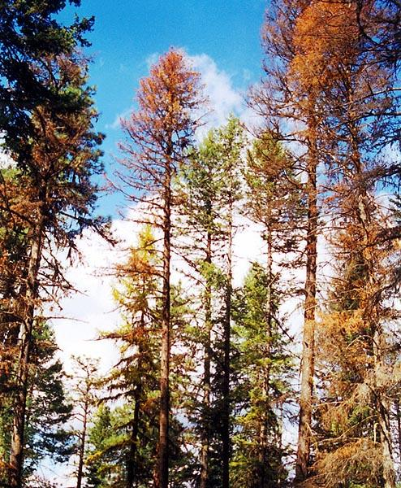
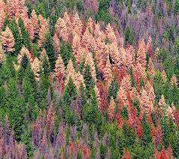
Nearly 2.7 million acres in eastern Washington alone need treatment to be more resilient against insects, diseases and wildfires.

Slide 4
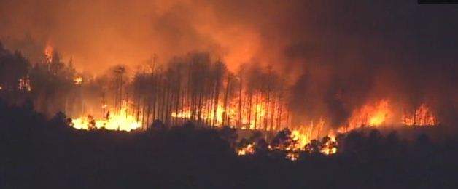
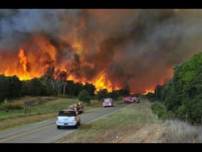
Wildland fire suppression costs have continued to increase due to wildland fire complexity and climatic conditions.

Slide 5
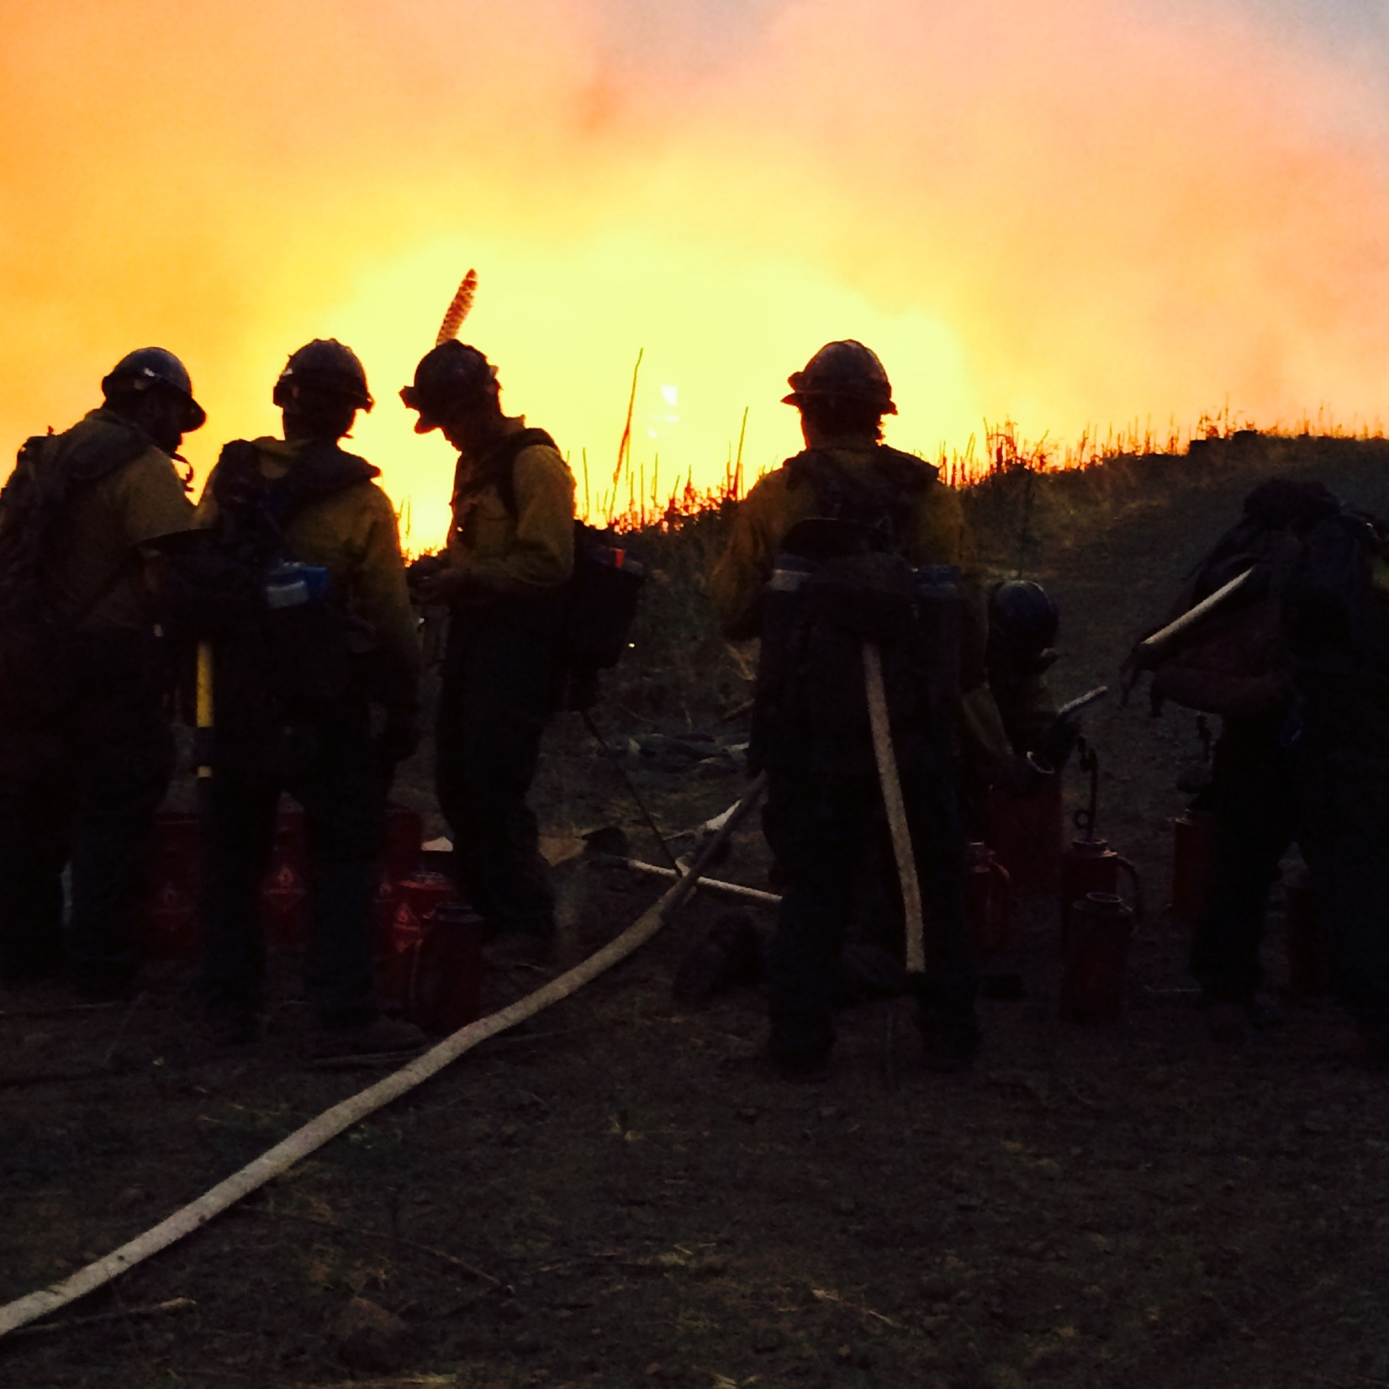
Washington’s Fire-scape
Suppression in the state is fully interagency.
  All IMTs are staffed by federal, state and local fire service personnel
  Initial attack is coordinated using all partners
  Heavy use of IA aviation (DNR, Federal and Contract)
  Wildland fire suppression contactors are fully utilized for suppression and support services
Over $1 Billion spent on wildland fire suppression since 2010

Slide 6
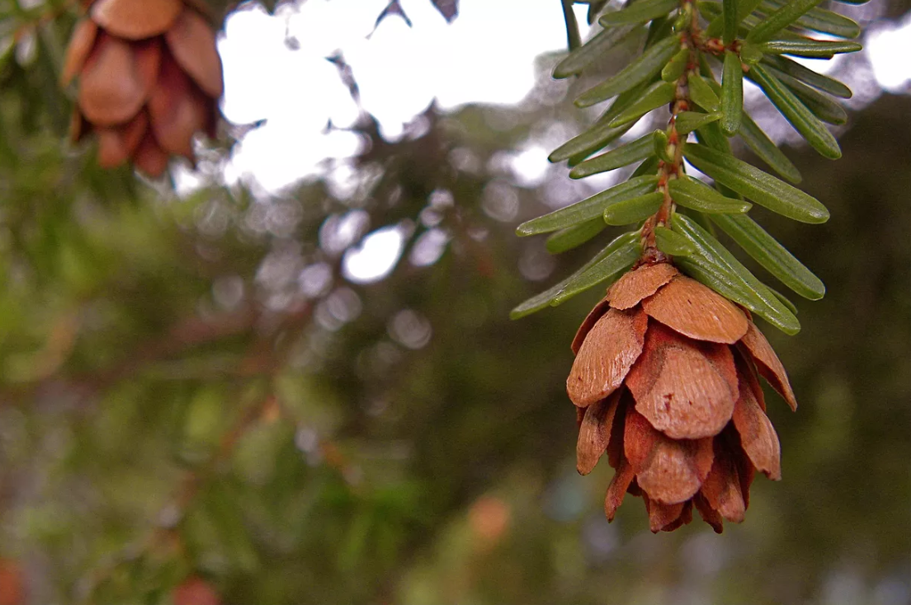
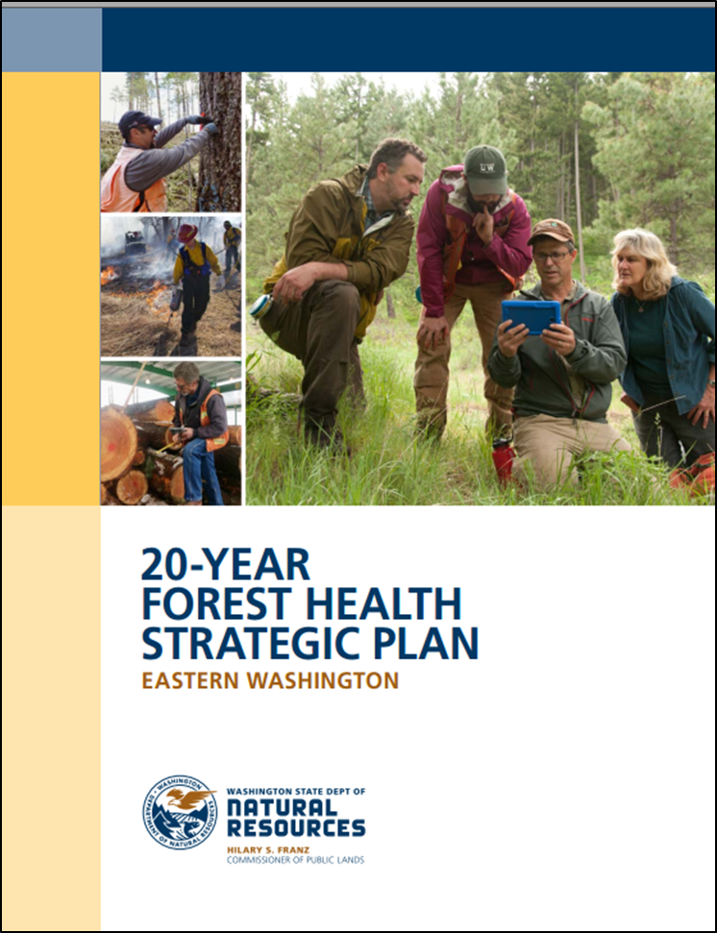
Washington’s Path Forward
State Forest Action Plan
  Provides comprehensive analysis of issues faced statewide. Complete analysis of western forest health and establish strategy.
Forest Health Treatments
  Priority watersheds designated by 20 Year Strategic Plan to manage for resilient landscapes and mitigate risks from wildfire, insect, disease and climate change
  Improve the health of our forests and communities
  Working directly with all partners to establish defined goals and outcomes, establish roles, report achievements
Forest Health Commitment
  State investment in forest health on all lands
  Increased staffing for forest health division, federal lands management, RxB, etc.

Slide 7
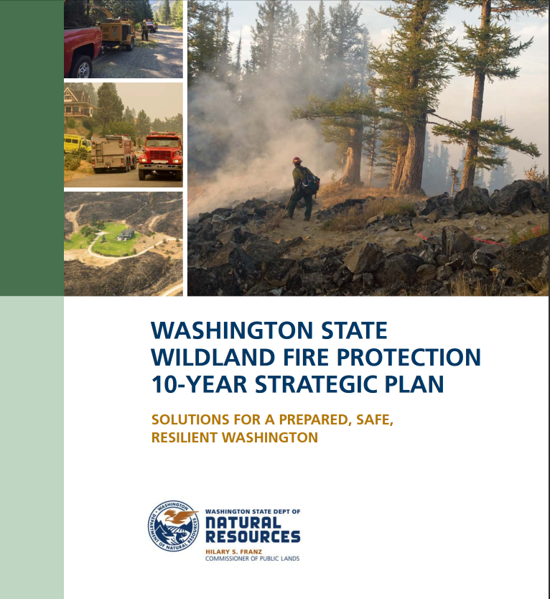
Washington’s Path Forward
Focus on Suppression Preparedness and Safety
  Interagency Training
  Increase numbers of firefighters available (DNR and Local Resources)
  Increase aviation resources and improve availability
  Improved coordination of federal, state and local resources
Community Preparedness
  Planning
  Partners involved
  Education and outreach
Wildland Fire Commitment
  State Funding for increase capacity, outreach
  Increased staffing for state agency and cooperators
  Engagement of all partners to implement strategy

Slide 8
How
Employ “All Lands. All Hands” mindset.
USFS, State Agencies, Tribes and Collaboratives are embracing the concept of Shared Stewardship
Use all the tools - all existing authorities and programs (USDA State and Private Forestry Programs, Cooperative Forestry, GNA, LSR, 2 Chiefs, etc.) and implement on the ground work using the best techniques and science (thinning, RxB, harvesting, etc.)
Work together as equal partners with shared decision-making and priority setting while using unique strengths appropriately.
Co-managing wildfire and forest health risk
Targeting resources based on outcomes and performance measures
Use the best available science alongside existing Forest Action Plans and strategies.

Slide 9
What do we mean by all of this?
Use of Tribal Forest Protection Act of 2004
  Olympic NF - In the interest of protecting water quality, a wastewater treatment plant was constructed on the NF; the Forest entered into a service contract with the Quinault Nation to run the plant.
Use of Joint Chiefs Landscape Restoration Partnership
  Mitigate wildfire threats to Colville National Forest land and adjacent private property in Ferry, Stevens and Pend Oreille counties. Project completed over a three-year period with $2.2 million of USDA FS funds, and $1.5 million of NRCS funds, leveraged with state agency and private landowner contributions.
And Other Grants and Programs used such as:
  USDA State and Private Forestry (Forest Stewardship, Forest Health, SFA/VFA, Community Forestry, etc.)
  Washington’s All Lands Forest Restoration and Building Forest Partnerships Grant Programs
  USDA Regional Conservation Partnership Program (with state match)

Slide 10
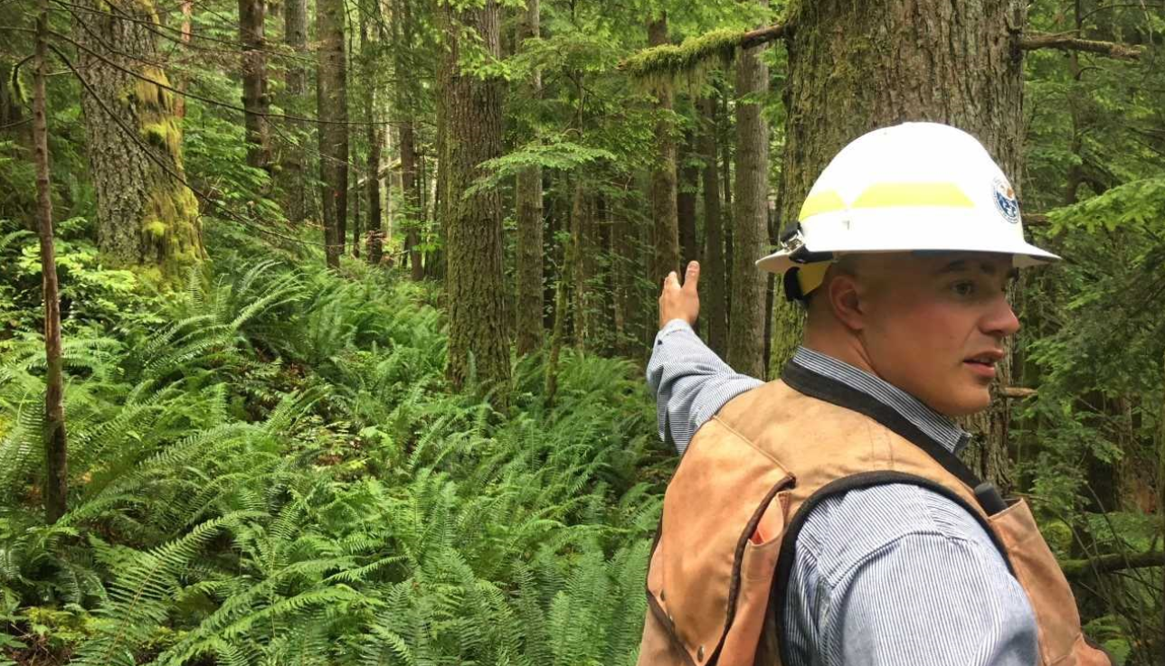
Non-Commercial Restoration Projects
Eastern Washington
  Primarily fuels/wildfire reduction projects
  Contribute to DNR’s Forest Health 20 Year Strategic Plan
  NEPA Planning Support, increasing scale
Western Washington
  Watershed and Forest Restoration
  Salmon recovery, fish passage and habitat
  Coordination at watershed level
  Forest Roads, and recreation benefits
  Complex social, economic, and political factors

Slide 11
An Example of How it Works

Slide 12
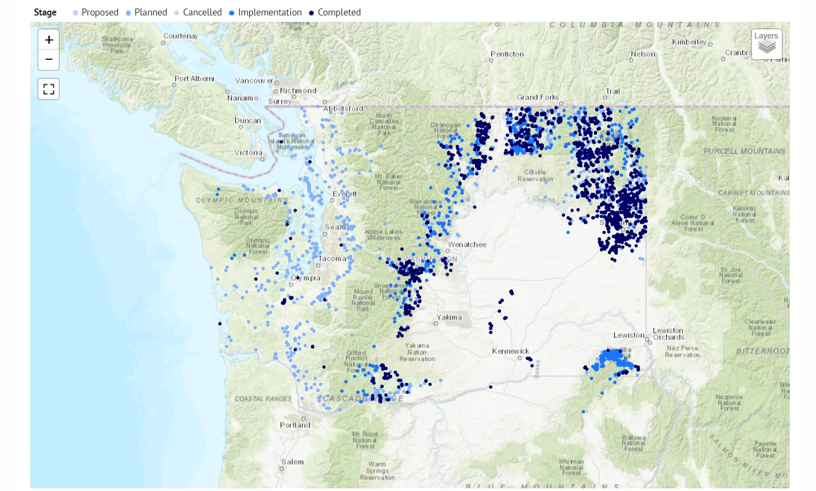

Projects on the Landscape - All Partners Working Together

Slide 13
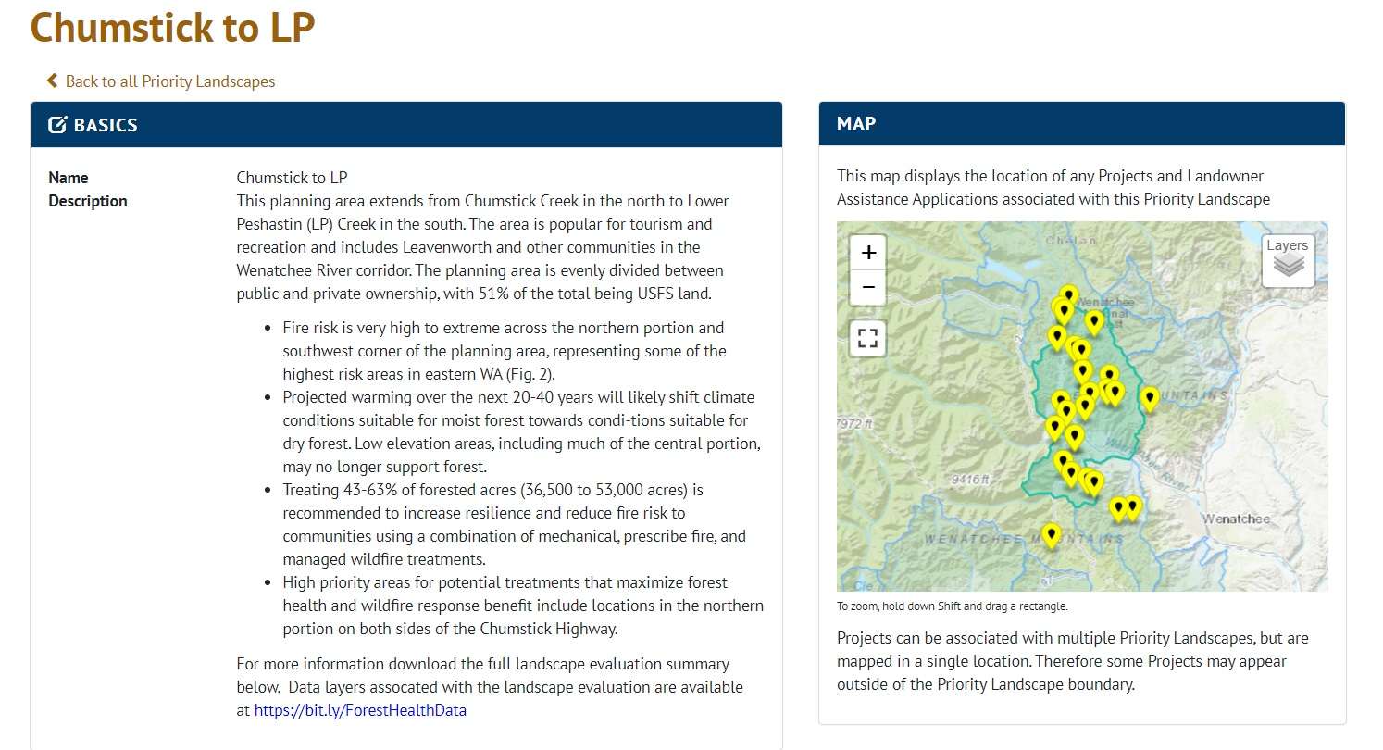

Slide 14
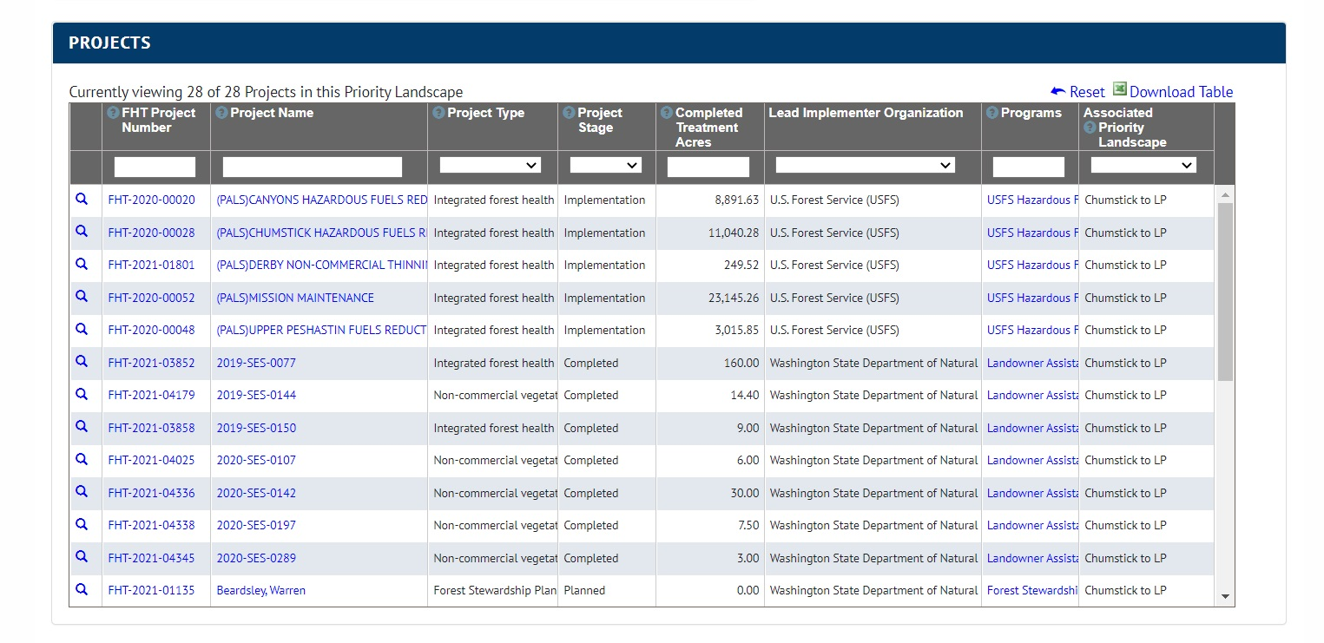

Slide 15
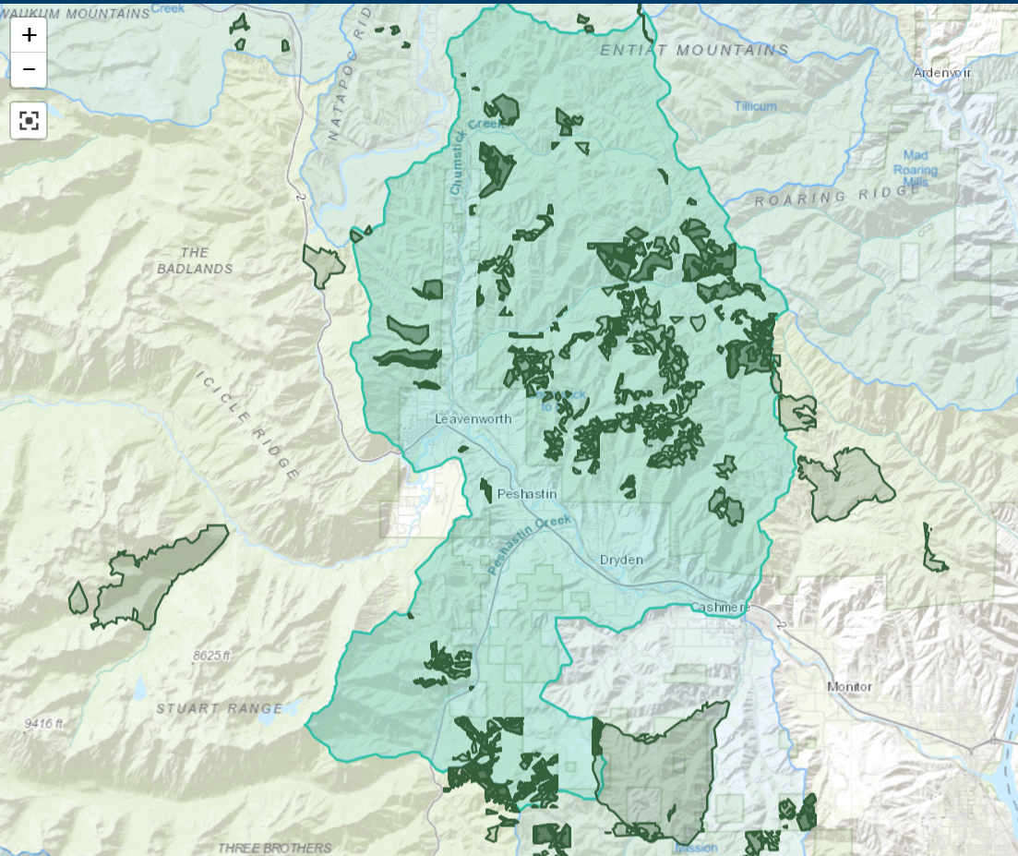

Slide 16
Shared Priorities

Slide 17
  COMMITMENT
  Work across boundaries
  Collaboration, Strong State/Federal/Tribal/Stakeholder Partnerships
  Recognized shared goals and mission
  Interagency working environment (wildland fire suppression, program development, etc.)
  State, Federal and Private support and funding for implementation of all programs
  Use of best available science

Slide 18
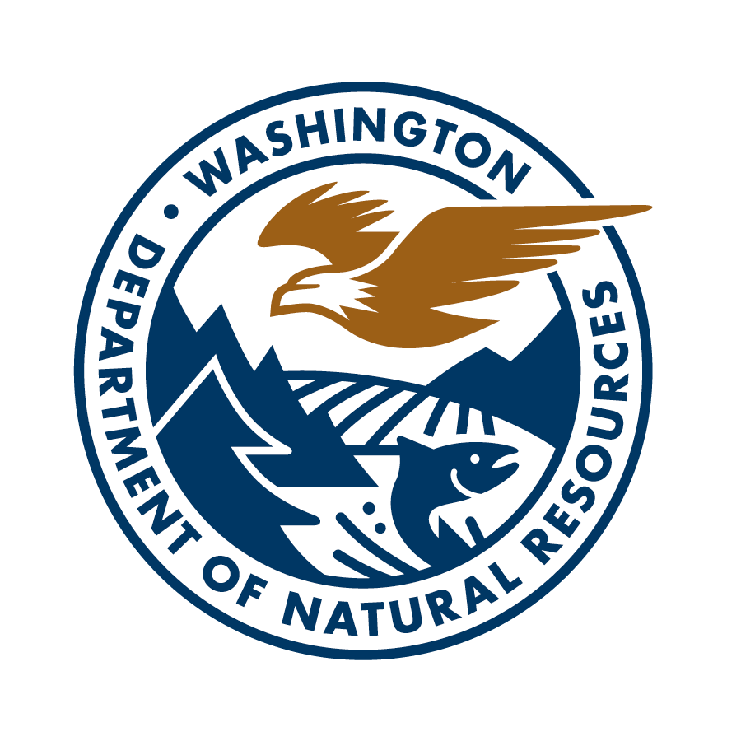
George L. Geissler
State Forester | Deputy, Wildland Fire and Forest Resiliency
Department of Natural Resources
george.geissler@dnr.wa.gov

