Slide 1

The Path Forward: Growing Resilience in Rural Communities
Dr. Barb Glenn
Chief Executive Officer

Slide 2
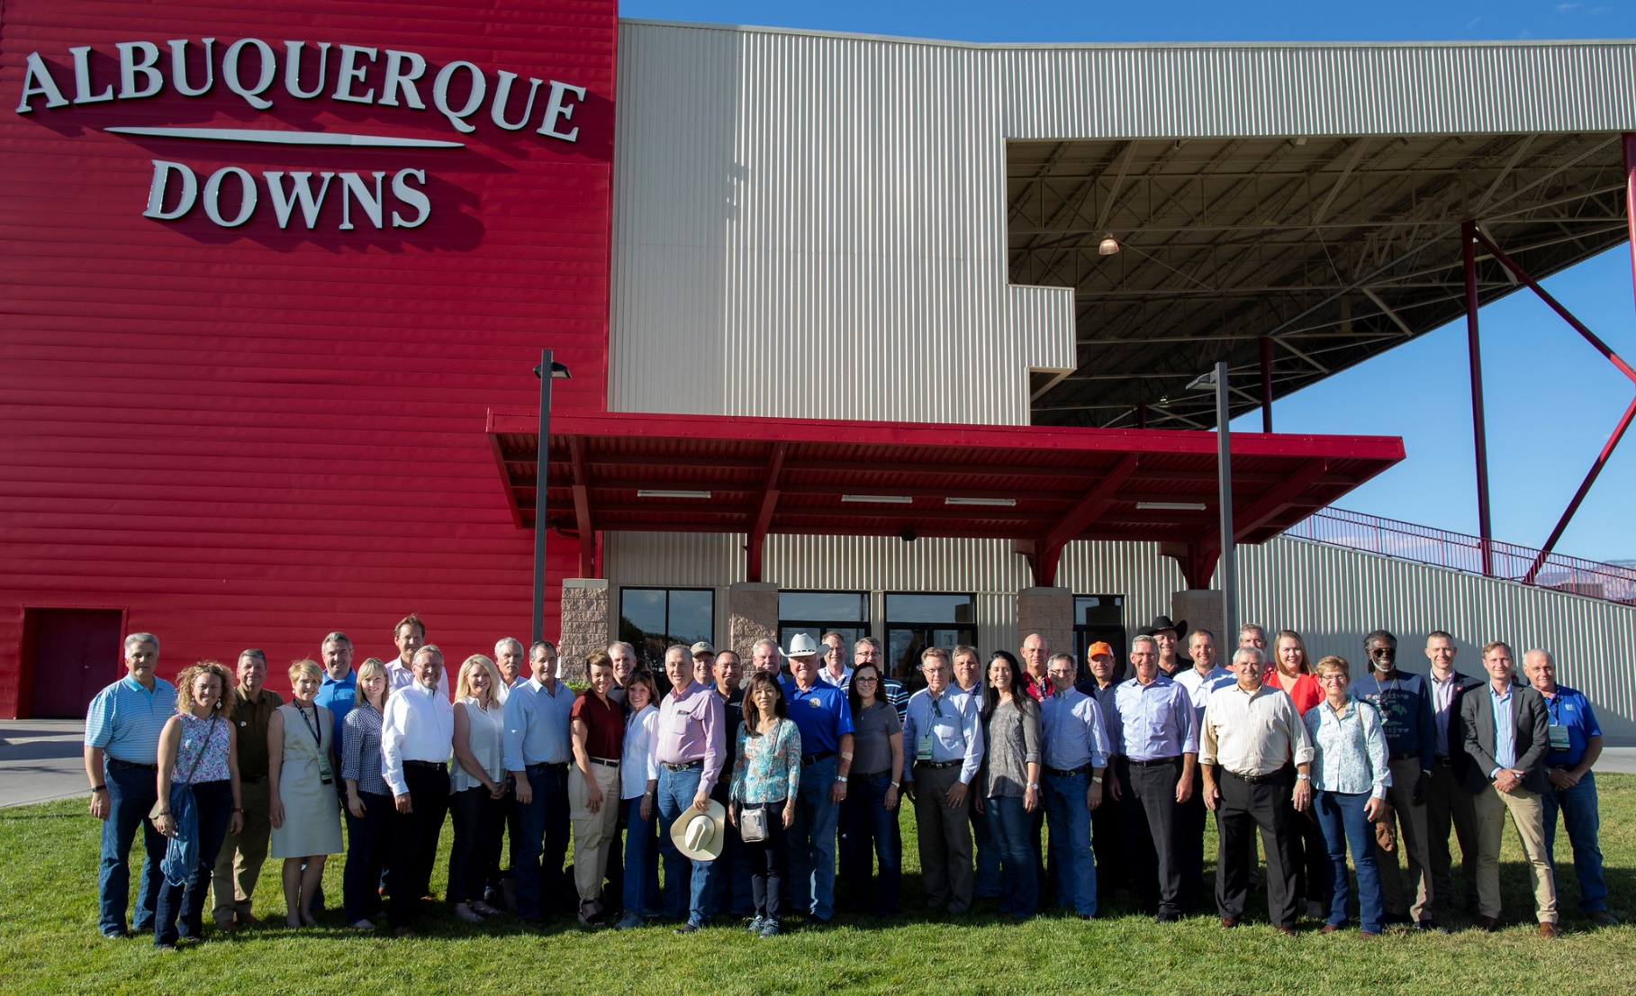
Who is NASDA?
Notes:
NASDA is a non-profit, non-partisan association which represents the elected and appointed commissioners, secretaries, and directors of the departments of agriculture in all fifty states and four U.S. territories.
12 are elected, all others are appointed

Slide 3
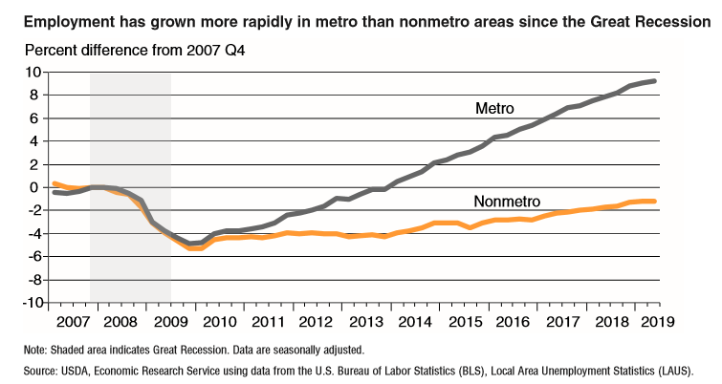
The Climate Resiliency Opportunity in Rural America
Notes:
Introduce the idea of the rural opportunity gap – how climate resilient practices also present an opportunity for rural communities

Slide 4
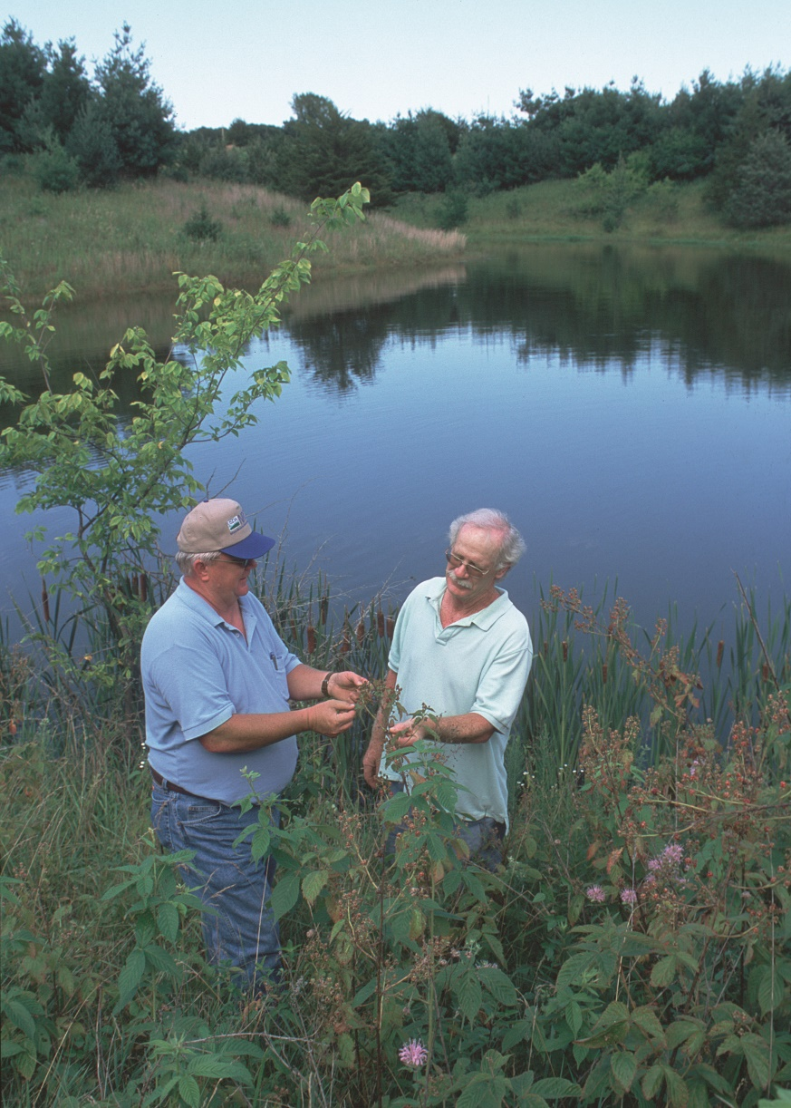
The Climate Resiliency Opportunity in Rural America
Time of major disruption across the agriculture value chain
Multiple climate policy efforts in D.C. and beyond
What is our path forward?

Slide 5
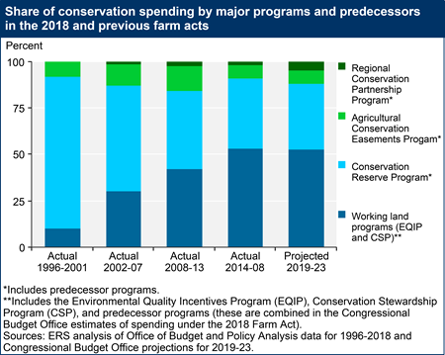
The Value of America’s Conservation Framework
Voluntary, incentive-based program models
All climate is local
Progress in the 2018 Farm Bill (e.g., soil health)

Slide 6
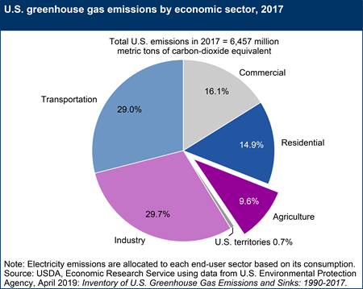
Strengthening Partnerships Across the Public and Private Sector
Why partnerships matter
States are leading the way
We cannot do it alone

Slide 7
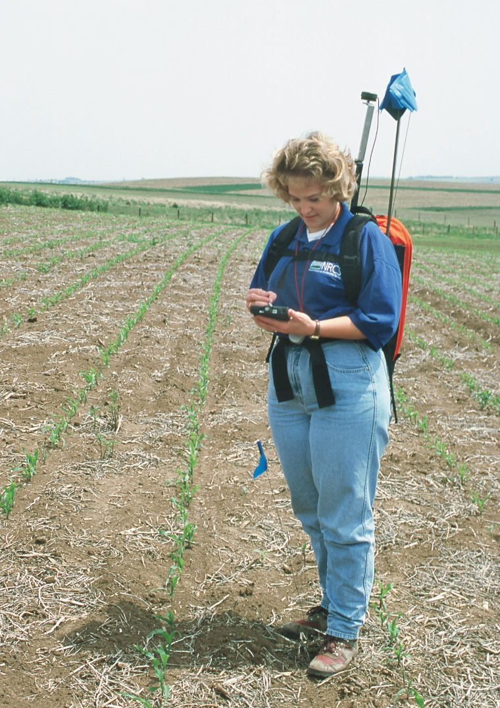
Investing in Foundational Research, Knowledge, and Tools
Full range of climate solutions remain unknown
Research/data enables important actions
How can expanded partnerships help achieve our goal?

Slide 8
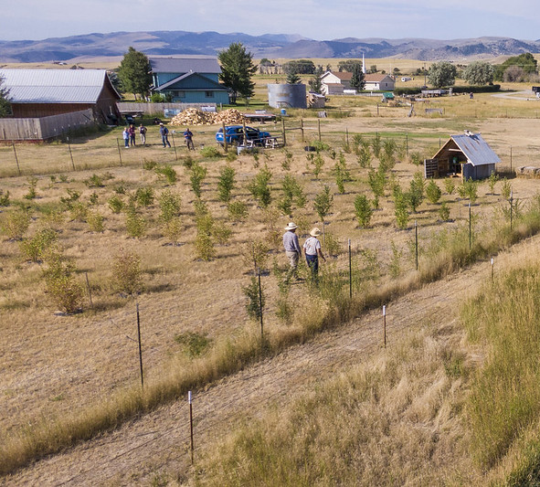
Prioritizing Rural Communities
Rural communities need business success – and quality of life
Prioritize rural communities through investments such as broadband

Slide 9
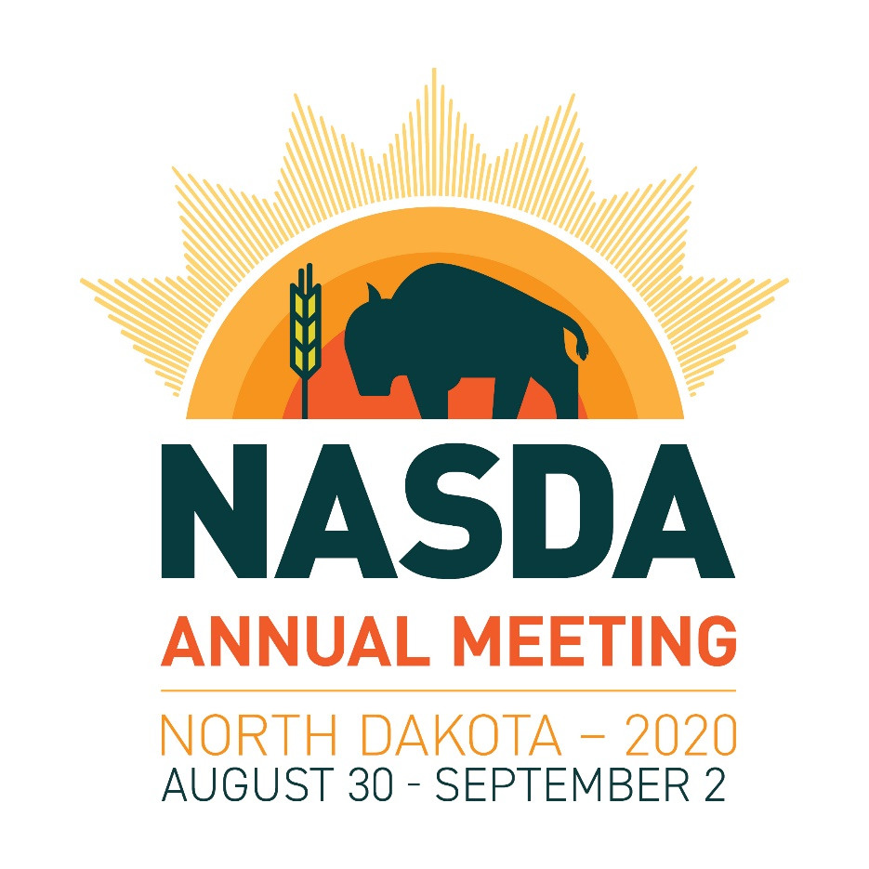
Questions?
Dr. Barb Glenn
Chief Executive Officer
(202) 296-9680
4350 N. Fairfax Drive
Suite 910
Arlington, VA 22203
Twitter: @NASDANews
Instagram: @NASDANews
www.nasda.org

