Slide 1
Characteristics of Socially Disadvantaged and New/Beginning Farmers and Ranchers in the 2017 Census of Agriculture
2020 Agricultural Outlook Forum, 2/20/2020
Notes:
Thanks for the opportunity to talk to you about demographic data from the census today. The census contains nearly 6.4 million distinct data points released on April 11, 2019. Only a few are highlighted today. We are excited to work with you and all data users to further explain and explore this valuable public resource.
Add background notes below this line.

Slide 2
History of the Census of Agriculture
The first Census of Agriculture was conducted in 1840 in 26 states and the District of Columbia
175 years later:
  The 2017 Census of Agriculture is the 29th in the series, and the 5th conducted by NASS
  In 1997 the Census was transferred from the Census Bureau to NASS
  The Census encompasses 50 states, Puerto Rico, and outlying areas
Data are available for:
  National, state, and county levels
  Congressional districts, watersheds, and zip codes
Notes:
Slide 3 – History of the Census of Agriculture
Just a few comments regarding the Census. Conducted once every five years, the census covers virtually every aspect of U.S. agriculture, providing a complete count of the nation’s farms and ranches and the people who operate them. It looks at land use and ownership, production practices, expenditures and other factors that affect the way farmers do business and succeed in the 21st century. The first census of agriculture occurred in 1840. The 2017 Census of Agriculture is the 29th in the series and the 5th census conducted by NASS.
The power of the Census is the ability to visualize and understand important change for key topics in agriculture at National, State, and County levels.
---------------------------------------------------------------------------------
Add background notes below this line.
The censuses of agriculture, which began in 1840, were originally conducted every 10 years in conjunction with the censuses of population. In that first 1840 census, about 70 percent of the population reported that they were engaged in agriculture. Sixty years later, in 1900, over 60 percent of the U.S. population still lived in rural areas.
The census, conducted once every five years, covers virtually every aspect of U.S. agriculture, providing a complete count of the nation’s farms and ranches and the people who operate them. It looks at land use and ownership, production practices, expenditures and other factors that affect the way farmers do business and succeed in the 21st century.
For the 1997 census of agriculture, the responsibility of the conduct of the census moved from the Census Bureau to the National Agricultural Statistics Service (NASS). NASS has conducted the Census of Agriculture since the 1997 transfer of authority from the Census Bureau.
The census reports on agriculture in all 50 states and Puerto Rico and the outlying areas. In addition to reporting agricultural information at the national, state, and county levels, the census also summarizes information for other geographic areas of interest, such as congressional districts, watersheds and zipcodes.
This is the most complete agricultural data resource available. It provides comprehensive and objective information for every state and county in the nation.
The census also includes a number of follow-on surveys. For example, currently an irrigation and aquaculture survey are underway. The survey is based on those who responded that they had irrigated acres or aquaculture on the 2017 census. Other follow-on surveys will include organics, horticulture, and local foods.
Consistent with federal law, NASS is committed to keeping all individual information confidential. Processes are in place to ensure that when data are reported at the county level, for example, the information cannot be linked to any individual producer.

Slide 3
Farm Definition
  Since 1974, the Census of Agriculture has defined a farm as
  “any place from which $1,000 or more of agricultural products were produced and sold, or normally would have been sold, during the census year.”
Notes:
Just a few comments regarding the Census. Conducted once every five years, the census covers virtually every aspect of U.S. agriculture, providing a complete count of the nation’s farms and ranches and the people who operate them. It looks at land use and ownership, production practices, expenditures and other factors that affect the way farmers do business and succeed in the 21st century. The first census of agriculture occurred in 1840. The 2017 Census of Agriculture is the 29th in the series and the 5th census conducted by NASS.
The power of the Census is the ability to visualize and understand important change for key topics in agriculture at National, State, and County levels.
A farm, by definition, is any place from which $1,000 or more of agricultural products were produced and sold, or normally would have been sold, during the census year. The census is the only source of demographic data on farm producers that is available at the county level.

Slide 4
Number of Farms and Land in Farms, 1997-2017
2012 | 2017 | % change
Number of farms
2,109,303 | 2,042,220 | -3.2
Land in farms (acres)
914,527,657 | 900,217,576 | -1.6
Average farm size (acres)
434 | 441 | +1.6
Number of Farms (millions)
Land in Farms (million acres)
Notes:
Number of Farms and Land in Farms, 1997-2017
A brief look at the big picture numbers from the census, in order to provide perspective for the other numbers you will be seeing. The number of farms at 2.04 million decreased 3.2% from 2012 to 2017, or about 67,000 farms, while land in farms was down 1.6%, or 14.3 million acres. The average size of farm increased 1.6% from the previous census. The last 20 years has seen a gradual decline in total farms and land devoted to agriculture.

Slide 5
Census of Agriculture Terms and Definitions
Producer: a person involved in decision making for the farm or ranch
Detailed data for up to 4 persons per farm
Census of Agriculture uses Office of Management and Budget (OMB) race and ethnicity categories
New/Beginning Producer: a producer who has been farming on any farm for 10 years or less
The census is the only source of demographic data down to the county level
Notes:
As we focus on the demographics of US producers, I am going to briefly discuss a few terms and definitions relating to the demographic data collected on the census.

Slide 6
Farm Structure, 2012 and 2017
Farms by Number of Producers (thousands)
Producers by Sex (millions)
 | 2012 | 2017 | % change
All producers | 3.18 | 3.40 | +6.9
Male producers | 2.21 | 2.17 | -1.7
Female producers | 0.97 | 1.23 | +26.6
Notes:
Farm Structure, 2012-2017
In response to feedback from data users after the 2012 Census, changes were made to the demographic questions on the census in order to enhance collection of data from all persons involved in making decisions for the farm or ranch. The new questions, which identify a producer as someone involved in decisions for the farm, led to more people identifying as producers. While the number of farms was down 3.2%, the number of producers was up by nearly 7%. The main change was that more farms reported multiple producers. In 2017, the majority of farms (54%) reported more than one person. In 2012, 56% of all farms identified only one operator.
Most of these newly identified producers were female. While the number of male producers fell by 1.7%, the number of female producers increased by nearly 27%, which underscores the effectiveness of the changes made to better represent all people involved in farm decision making.
When comparing numbers from 2012 to 2017 for any demographic group, this overall trend needs to be taken into account.

Slide 7
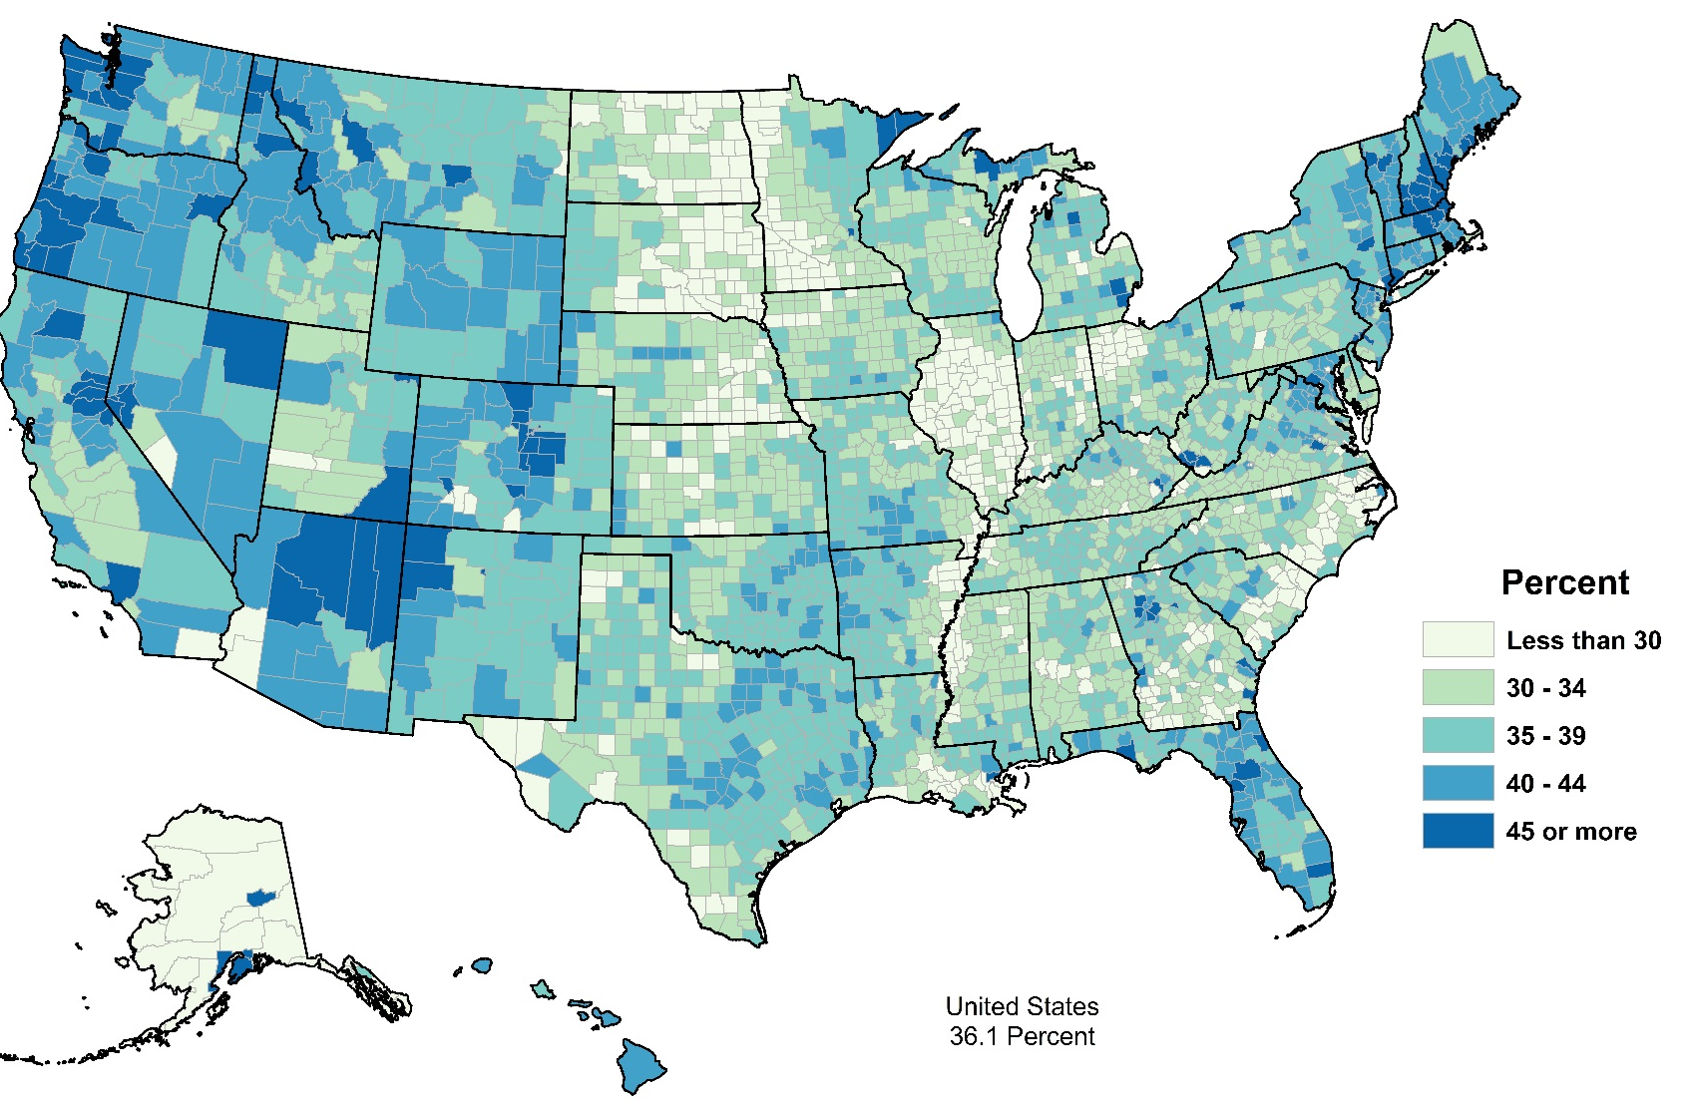
Producers by Sex, 2017
Female Producers as a Percent of Total
Producers
 | Female | Male
Number | 1,227,461 | 2,172,373
Average age | 57.1 | 57.7
Farms
Number | 1,139,675 | 1,867,308
Average farm size (acres) | 340 | 463
Average TVP | $129,792 | $204,513
U.S. = 36%
Notes:
Producers by Sex, 2017
Let’s take a quick look at some of data on female producers.
36% of all producers are female and 56% of all farms have at least one female decision maker. On average, farms with a female producer are smaller in terms of both acres and dollars. Similar to 2012, the map shows distinct regional differences in the tendency for farms to have a female producer.

Slide 8
Demographic Characteristics of Producers by Ethnicity and Race, 2017
Producers
 | All Producers | Hispanic | American Indian or Alaska Native | Asian | Black | Native Hawaiian or Pacific Islander
Number of producers | 3,399,834 | 112,451 | 79,198 | 25,310 | 48,697 | 5,296
Average age | 57.5 | 55.0 | 56.6 | 54.9 | 60.8 | 54.9
% less than 35 years | 8 | 9 | 10 | 9 | 6 | 11
% New/beginning | 27 | 36 | 28 | 40 | 29 | 35
% Primary occupation farming | 42 | 40 | 47 | 48 | 44 | 39
Notes:
Slide 31 – Characteristics by Race and Ethnicity
The Census of Agriculture also collects data on the race and ethnicity of farm producers. The census uses the categories identified by OMB for federal statistical agencies, which also specify that race and ethnicity are two separate questions. Producers who are identified as Hispanic can be of any race. Producers may also select multiple race categories.
Since we want to discuss a variety of topics in the panel today, I am going to focus on only a few data points available from the census about the characteristics of producers by race and ethnicity. Many other statistics are available, and I hope you fully explore the data on our website. In addition, I have brought some material to this session, which you can find on a table in the back of the room. Highlights are available for each race group as well as for Hispanic and female producers.

Slide 9
Farm Characteristics by Ethnicity and Race, 2017
Farms
 | All farms | Hispanic | American Indian or Alaska Native | Asian | Black | Native Hawaiian or Pacific Islander
Number | 2,042,220 | 86,278 | 60,083 | 18,338 | 35,470 | 4,341
Average farm size (acres) | 441 | 372 | 978 | 160 | 132 | 240
Average TVP | $190,245 | $252,267 | $58,885 | $406,669 | $39,928 | $163,776
Average Net Income of Operation | $43,053 | $45,226 | $8,577 | $111,319 | $3,509 | $24,867
% with internet access | 75 | 70 | 66 | 74 | 62 | 79
Notes:
Farm Characteristics by Race and Ethnicity
The previous slide focused on the demographic characteristics of producers. This slide highlights characteristics of farms where at least one of the 4 producers reports the specified race or ethnicity.
Again, this is just a few statistics at the national level- I encourage you to explore similar data available for your state and county.
-----------------------------------------------------------------------------------------
The Census of Agriculture also collects data on the race and ethnicity of farm producers. The census uses the categories identified by OMB for federal statistical agencies, which also specify that race and ethnicity are two separate questions. Producers who are identified as Hispanic can be of any race.

Slide 10
Number of Farms by Race and Ethnicity: Changes from 2012 to 2017
 | 2012 | 2017 | % change
All farms | 2,109,303 | 2,042,220 | -3%
Any farm with a producer reporting as:
Hispanic | 79,807 | 86,278 | 8%
American Indian or Alaska Native | 56,092 | 60,083 | 7%
Asian | 18,007 | 18,338 | 2%
Black | 36,382 | 35,470 | -3%
Native Hawaiian or Pacific Islander | 3,236 | 4,341 | 34%
Notes:
One of the items of interest when looking at census data is always how the numbers have changed over time. When looking at trends, it’s important to remember the general trend in the number of farms since 2012- a 3% decrease in the number of farms overall. This slide shows how the number of farms have changed where at least one producer is of the specified race/ethnicity. The 2017 Census showed an increase in the number of farms with Hispanic, American Indian, Asian, and Native Hawaiian producers, and a decline in the number of farms with a Black producer.

Slide 11
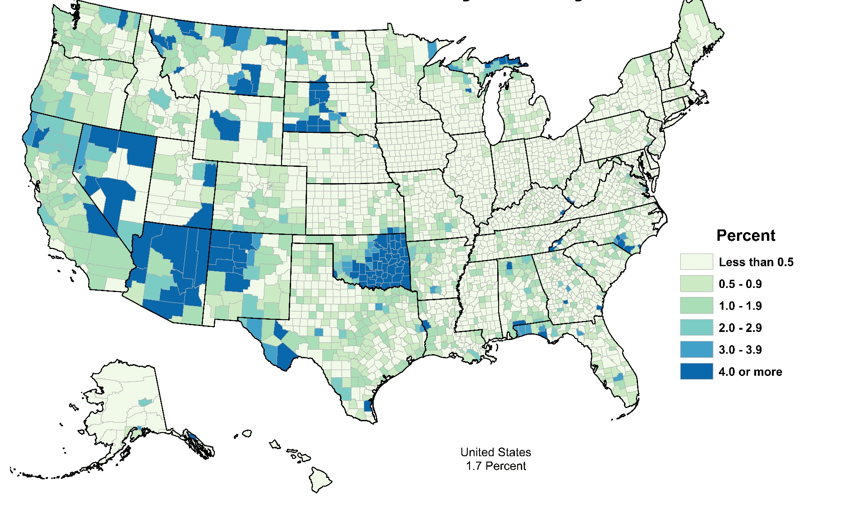
American Indian or Alaska Native Producers, 2017
American Indian Producers as a Percent of Total
Producers
 | American Indian | All
Number | 79,198 | 3,399,834
Average age | 56.6 | 57.5
Farms
Number | 60,083 | 2,042,220
Average farm size (acres) | 978 | 441
Average TVP | $58,885 | $190,245
U.S. = 2.3%
Notes:
The next set of slides looks at some geographic trends, with maps that show regions where the share of producers of the specified group is highest, along side some of the data you saw earlier with a few selected characteristics.
Overall, 2.3 of producers are American Indian or Alaska Native. The share of American Indian producers is highest in the Western US, particularly in Oklahoma, New Mexico and Arizona, and the Northern Plains.

Slide 12
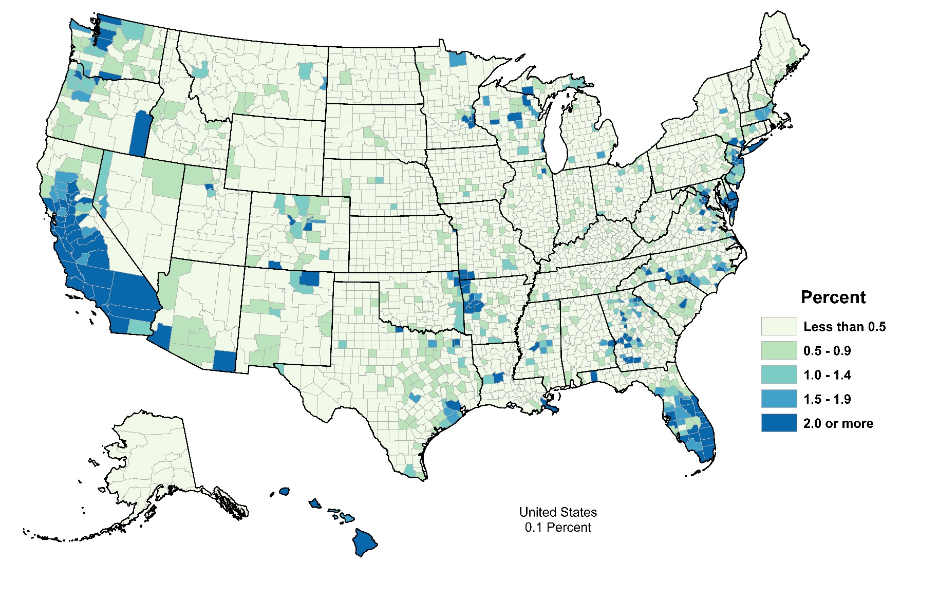
Asian Producers, 2017
Asian Producers as a Percent of Total
Producers
 | Asian | All
Number | 25,310 | 3,399,834
Average age | 54.9 | 57.5
Farms
Number | 18,338 | 2,042,220
Average farm size (acres) | 160 | 441
Average TVP | $406,669 | $190,245
U.S. = 0.7%
Notes:
Overall, 0.7 percent of producers are Asian. The share of Asian producers is highest in the Western US, particularly in California and Hawaii.

Slide 13
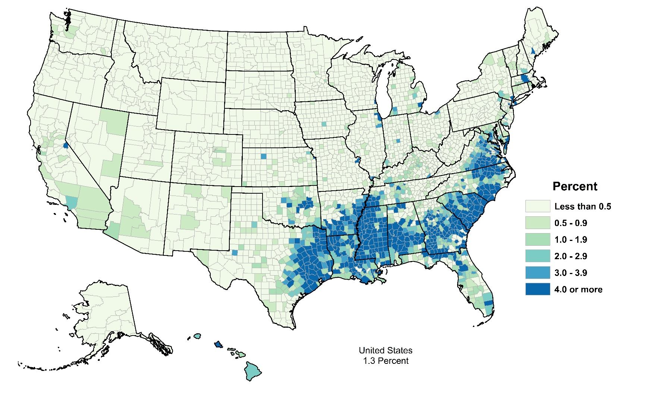
Black Producers, 2017
Black Producers as a Percent of Total
Producers
 | Black | All
Number | 48,697 | 3,399,834
Average age | 60.8 | 57.5
Farms
Number | 35,470 | 2,042,220
Average farm size (acres) | 132 | 441
Average TVP | $39,928 | $190,245
U.S. = 1.4%
Notes:
Overall, 1.4 percent of producers are Black. The share of Black producers is highest in the Southern US and in Texas, particularly in east Texas, Louisiana, Mississippi , Alabama, Georgia and North and South Carolina and Virginia.

Slide 14
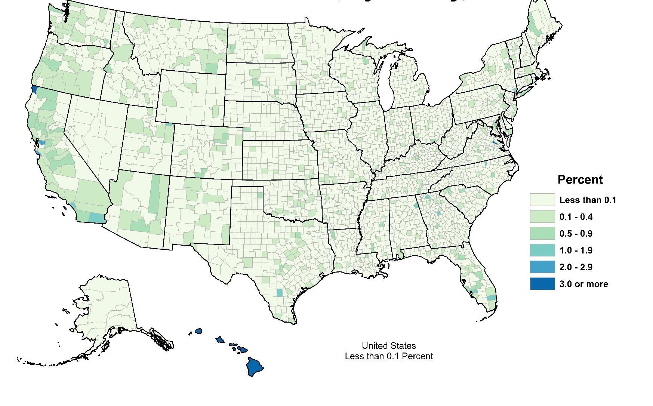
Native Hawaiian or Pacific Islander Producers, 2017
Native Hawaiian Producers as a Percent of Total
Producers
 | Native Hawaiian | All
Number | 5,296 | 3,399,834
Average age | 54.9 | 57.5
Farms
Number | 4,341 | 2,042,220
Average farm size (acres) | 240 | 441
Average TVP | $163,776 | $190,245
U.S. = 0.2%
U.S. = 36%
Notes:
Overall, 0.2 percent of producers are Native Hawaiian/Pacific Islander. The share of Native Hawaiian/Pacific Islander producers is highest in Hawaii and California.

Slide 15
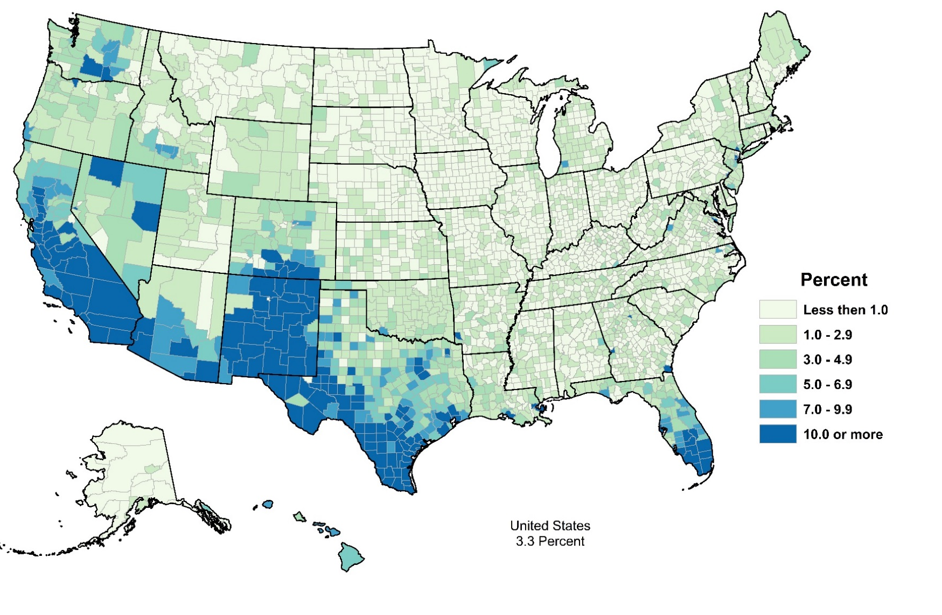
Hispanic Producers, 2017
Hispanic Producers as a Percent of Total
Producers
 | Hispanic | All
Number | 112,451 | 3,399,834
Average age | 55.0 | 57.5
Farms
Number | 86,278 | 2,042,220
Average farm size (acres) | 372 | 441
Average TVP | $252,267 | $190,245
U.S. = 3.3%
Notes:
Overall, 3.3 percent of producers are Hispanic. The share of Hispanic producers is highest in the Western US, Texas and Florida

Slide 16
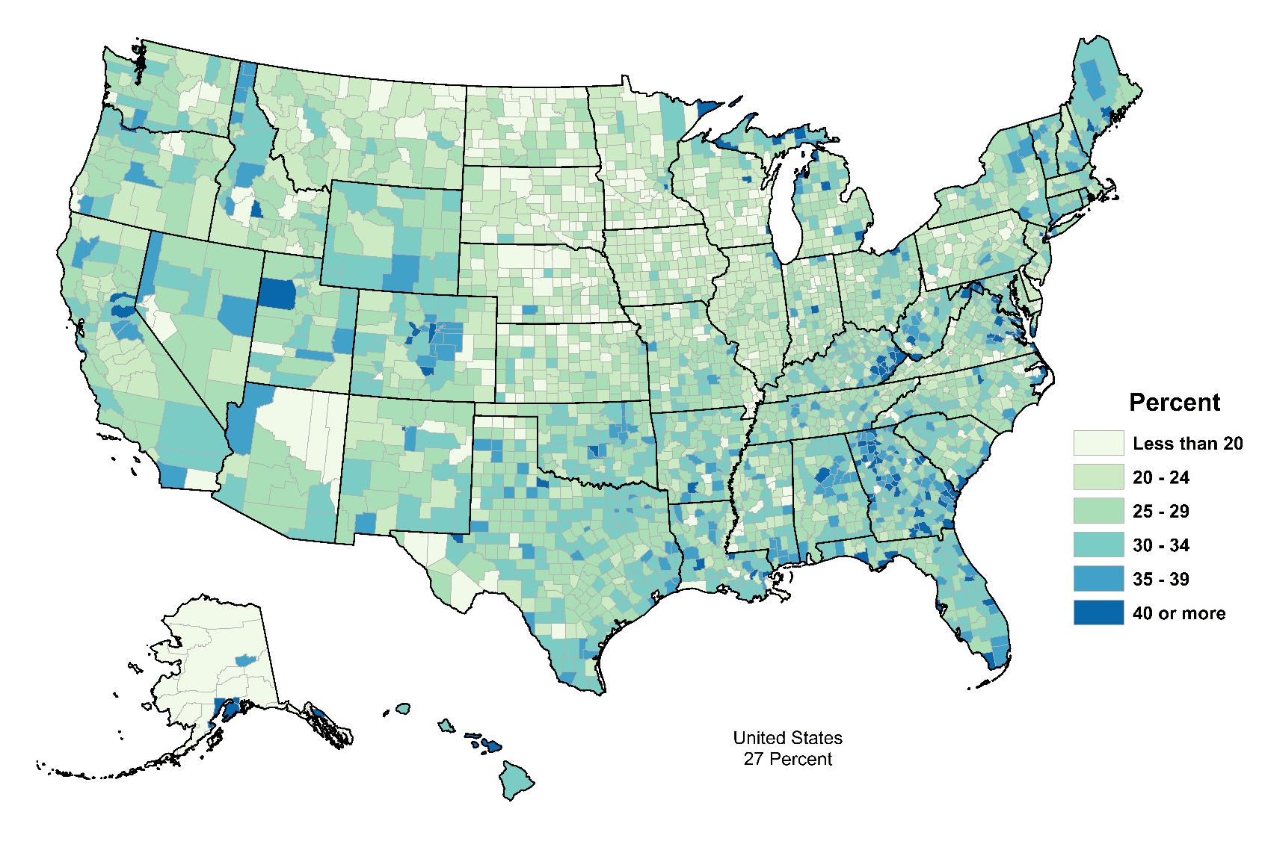
New and Beginning Producers (10 years or less on any farm), 2017
As a Percent of All, by County
Producers
 | New and Beginning | All
Number | 908,274 | 3,399,834
Average age | 46.3 | 57.5
Farms
Number | 597,377 | 2,042,220
Average farm size (acres) | 324 | 441
Average TVP | $147,408 | $190,245
U.S. = 27%
Notes:
Now let’s look at some census data for new and beginning producers.
A new or beginning producer is anyone who has operated any farm for 10 years or less, including the census year.
Overall, 27% of producers are new or beginning. 29% of all farms have a new or beginning producer. As you can tell from the numbers, not all new or beginning producers are young. In fact, the average age of a new or beginning producer is 46.3. However, this average is much lower than the average age of all producers.
Farms with a new or beginning producer participating in decisions for the farm are smaller than average in terms of both acres and sales.
Most farms are operated by producers with many years of experience. On average, producers have over 23 years of experience operating a farm.

Slide 17
Producers by Years on Present Farm: Changes from 2012 to 2017
Years on present farm | 2012 | 2017 | % change
All producers
2 years or less | 132,528 | 201,061 | 51.7%
3 or 4 years | 186,511 | 268,316 | 43.9%
5 to 9 years | 501,875 | 495,022 | -1.4%
10 years or more | 2,359,160 | 2,435,435 | 3.2%
Notes:
When we look at the detailed data on when producers started farming on their current, and changes from 2012, a few trends are apparent. Compared to 2012, the census shows a large increase in the number of producers who have been farming 4 years or less . Those are producers who have started farming since the last census of agriculture. The category of producers who have been on their current farm 5-9 years fell from 2012 to 2017, compared to the overall increase of almost 7% in the number of producers.

Slide 18
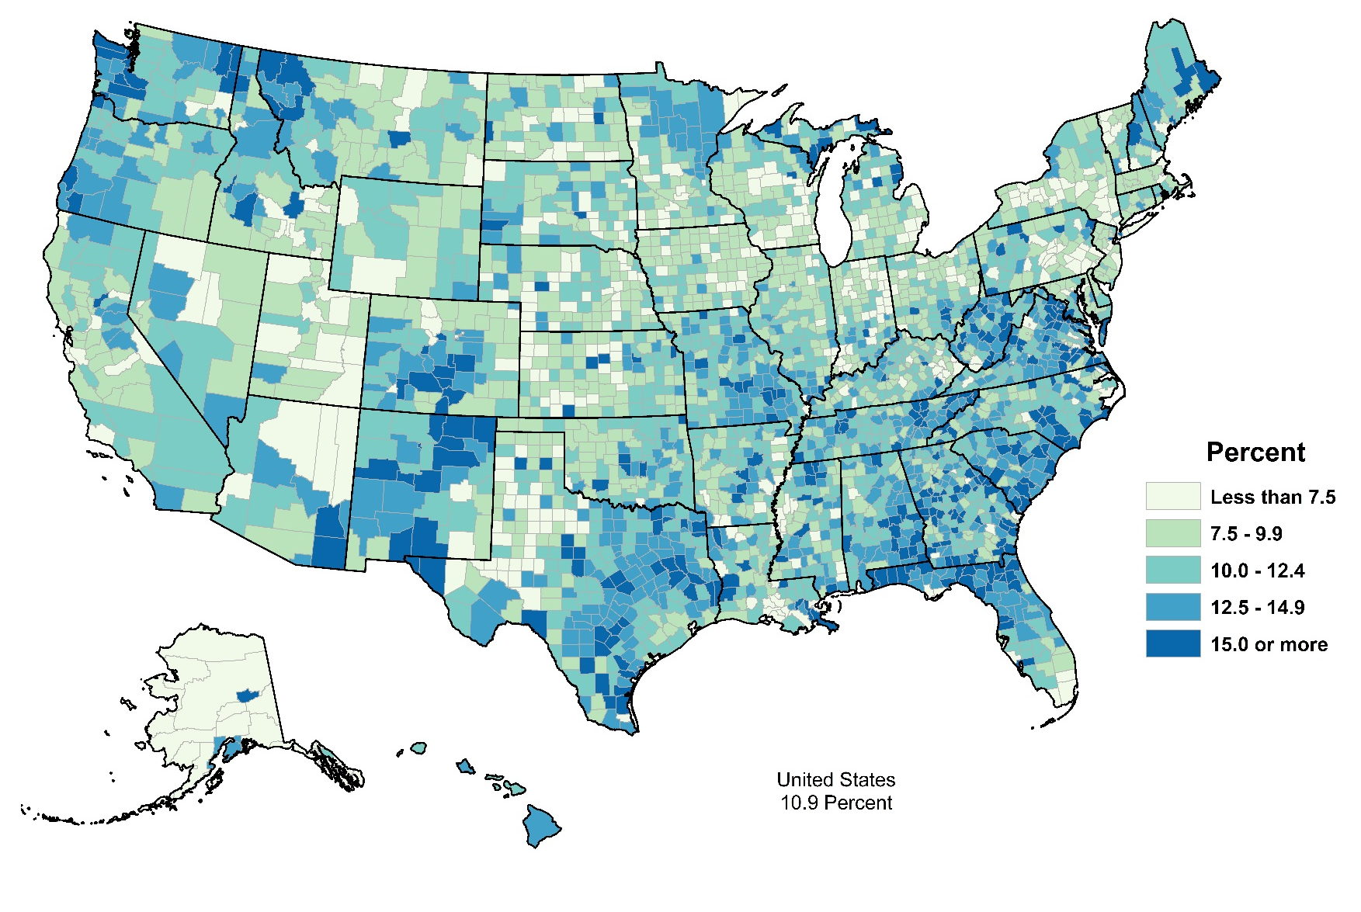
Producers with Military Service, 2017
As a Percent of All, by County
Producers
 | With Military Service | All
Number | 370,619 | 3,399,834
Average age | 67.9 | 57.5
Farms
Number | 355,393 | 2,042,220
Average farm size (acres) | 363 | 441
Average TVP | $114,876 | $190,245
U.S. = 11%
Notes:
The 2017 Census of Agriculture included a new question to identify producers who have served or are serving in the U.S. Armed Forces.
Overall, 11% of producers have military service. 17% of all farms have a producer who has served in the armed forces. The average age of a producer with military service is almost 68 years old. This average is much higher than the average age of all producers.
Farms with a producer with military service participating in decisions for the farm are smaller than average in terms of both acres and sales.
The share of farms with producers who have served in the military is highest in the Southeast.

Slide 19
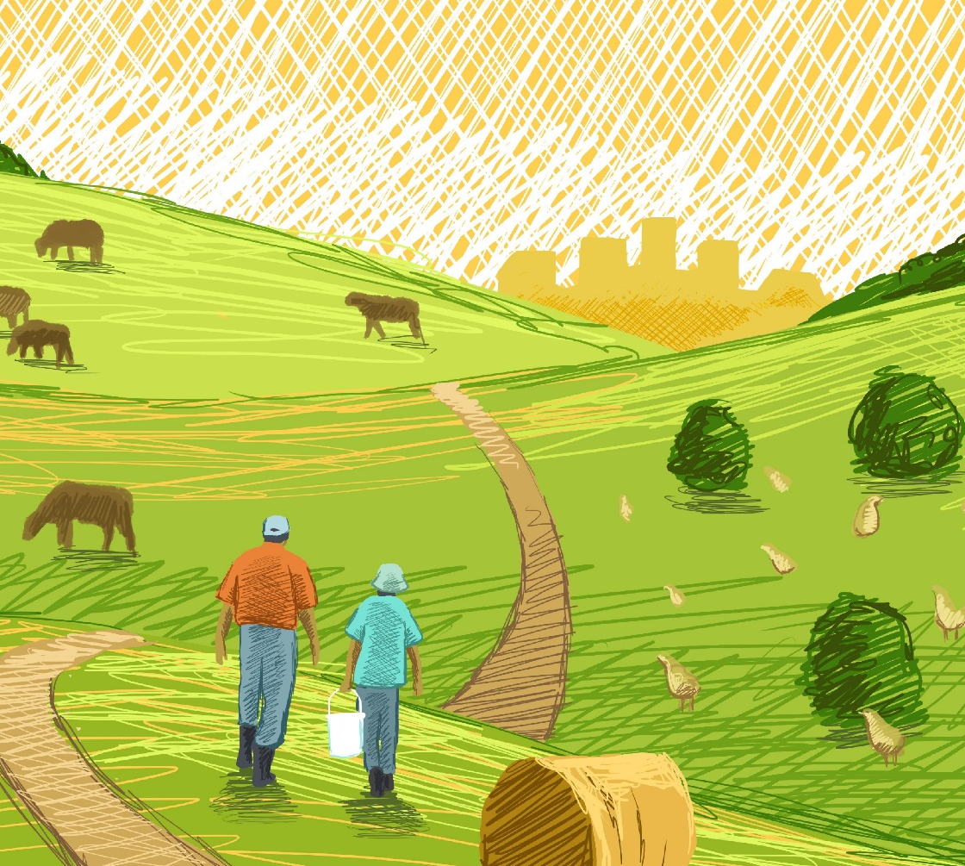
All Reports Available At www.nass.usda.gov
For Questions
Virginia Harris, Demographics
  virginia.harris@usda.gov
  Telephone 502-907-3211
Notes:
Slide 35
NO SPEAKER NOTES

