Slide 1

We Provide Advice When Your Business Needs It Not Just When You Ask For It!
Fat of the Land: Market Outlook for Low Carbon Intense Raw Materials from the Rendering Industry
USDA Ag Outlook Forum
February 24. 2022
Kent Swisher
President & CEO

Slide 2
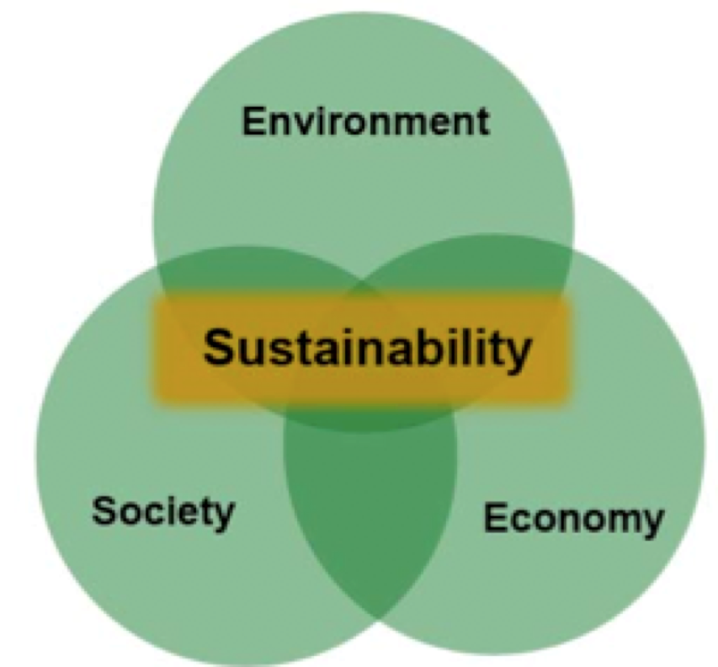

Presentation Outline
Who we are
What we do
What is rendering?
Sustainability
  Rendered Fat
  Rendered Protein Meals
Markets
Conclusion

Slide 3

Founded 1933
Represent over 95% of rendering in U.S. and Canada
  Packer renderers
  Independent renderers
Headquartered in Alexandria, VA
Offices in Hong Kong and Mexico City

Slide 5
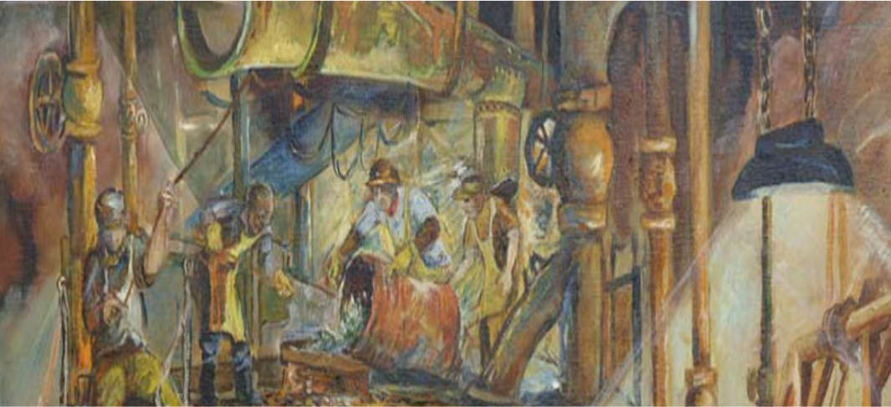

Production
dvice When Your Business Needs It Not Just When You Ask For It!

Slide 6
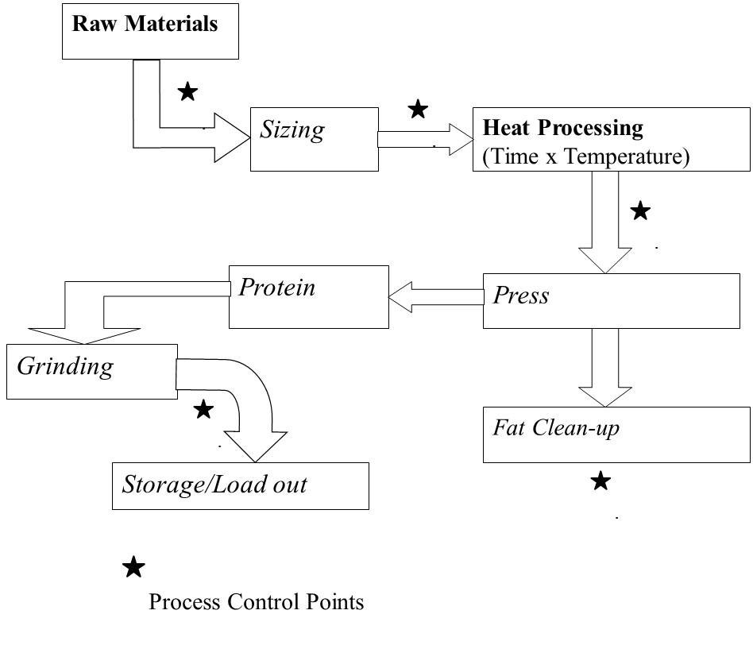
Processing Steps of Rendering

Slide 7
We Provide Advice When Your Business Needs It Not Just When You Ask For It!

Slide 8
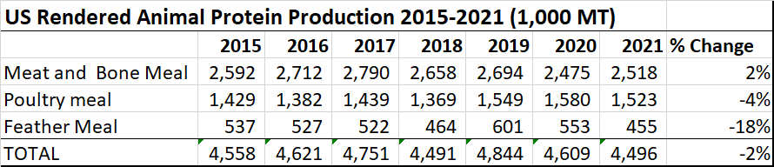
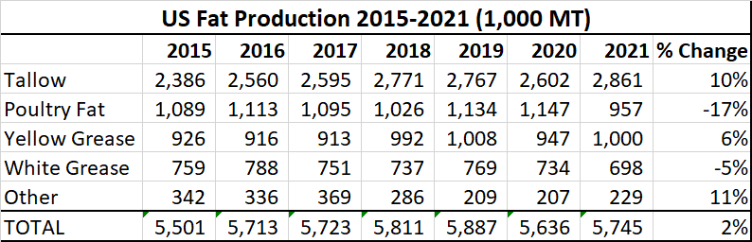
Source: USDA, National Agricultural Statistic Service

Slide 9
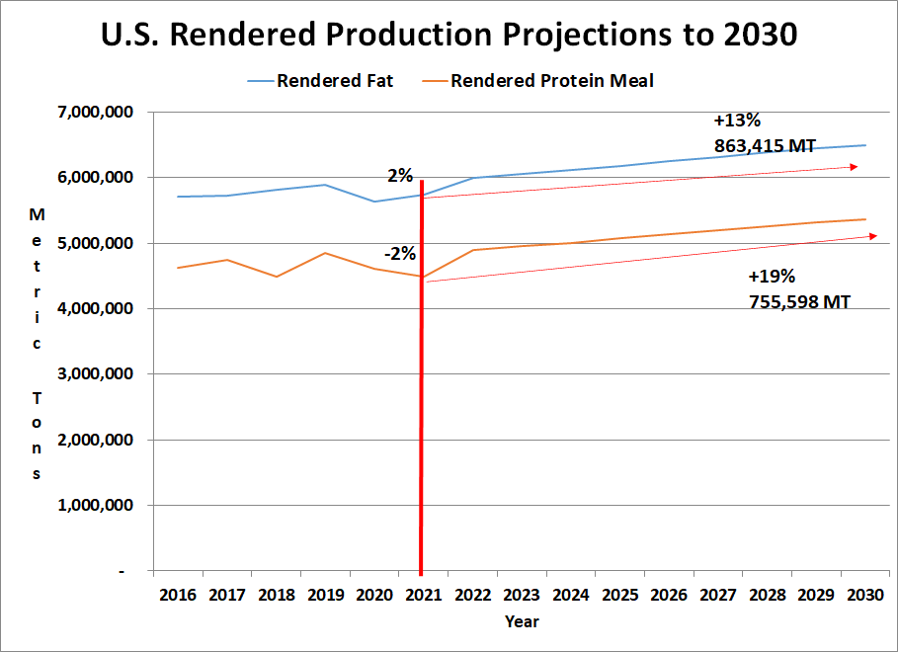
We Provide Advice When Your Business Needs It Not Just When You Ask For It!
Source: NARA Forecast Based off USDA Slaughter Projections

Slide 10
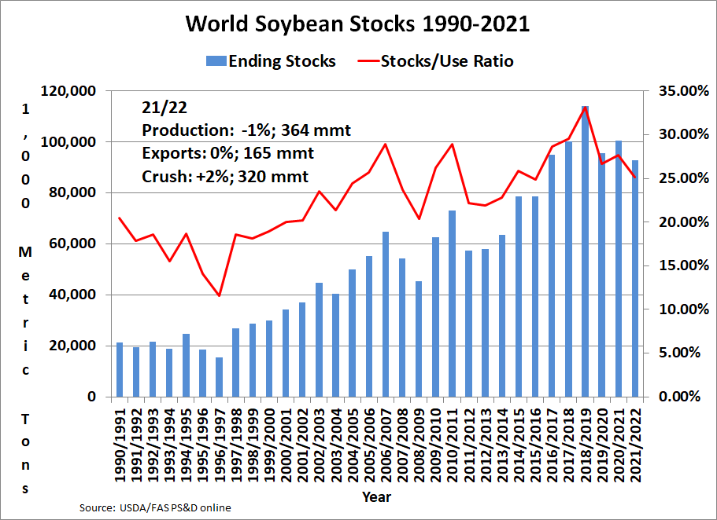
We Provide Advice When Your Business Needs It Not Just When You Ask For It!

Slide 11
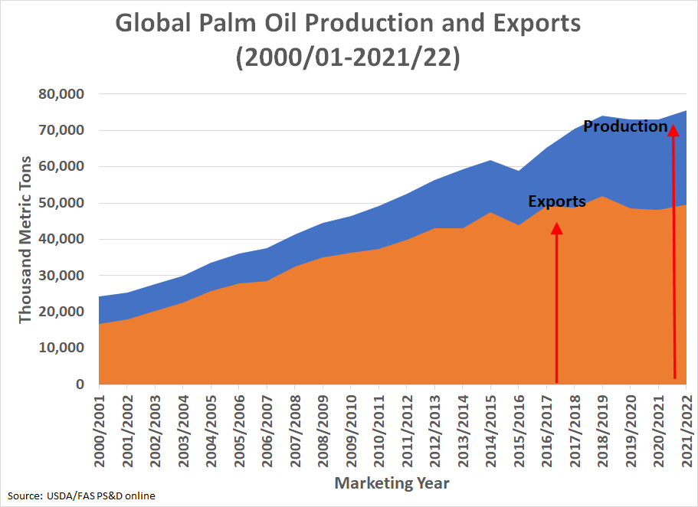
We Provide Advice When Your Business Needs It Not Just When You Ask For It!

Slide 12
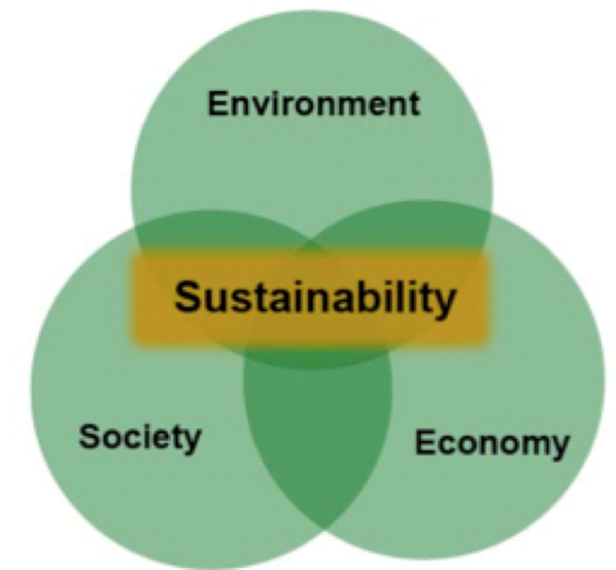
UN Definition - 1987
Development that meets the needs of the present without compromising the ability of future generations to meet their own needs.
Source: United Nation's World Commission on Environment and Development (the Brundtland Commission), 1987.
We Provide Advice When Your Business Needs It Not Just When You Ask For It!

Slide 13
The Original Recyclers

Slide 14
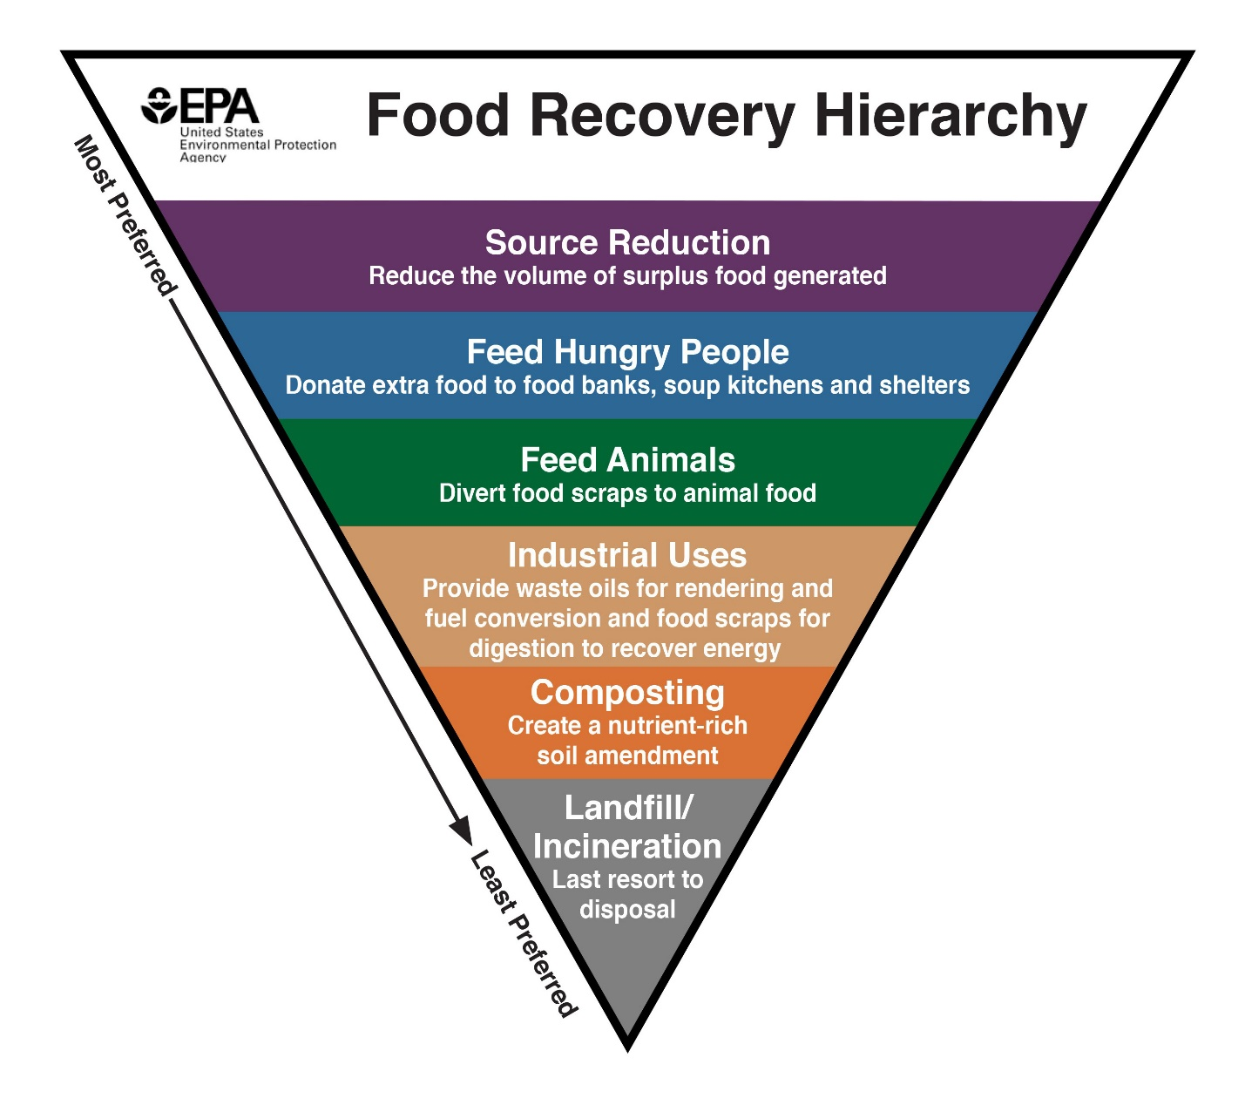
EPA Food Recovery Hierarchy
We Provide Advice When Your Business Needs It Not Just When You Ask For It!
Rendering
Source: https://www.epa.gov/sustainable-management-food/food-recovery-hierarchy

Slide 15
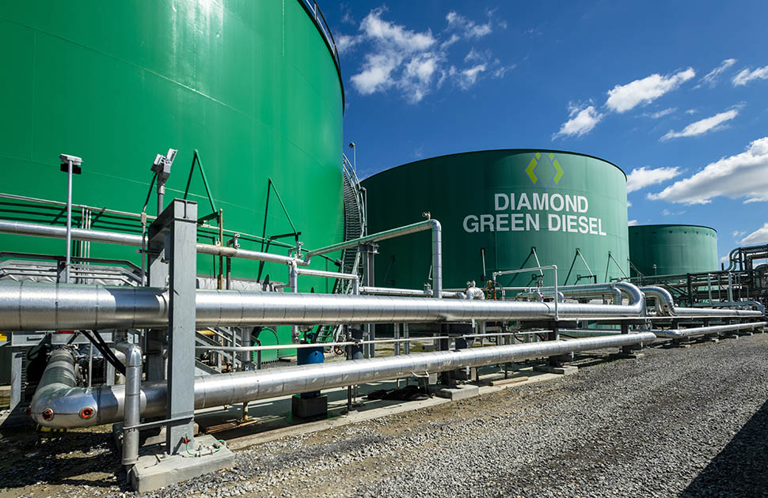
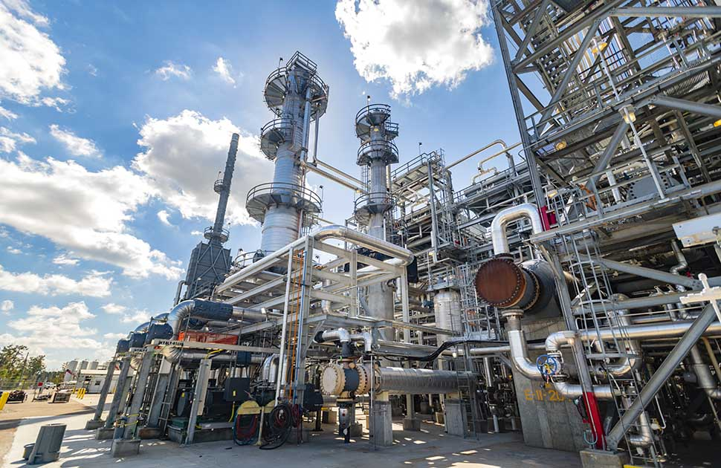
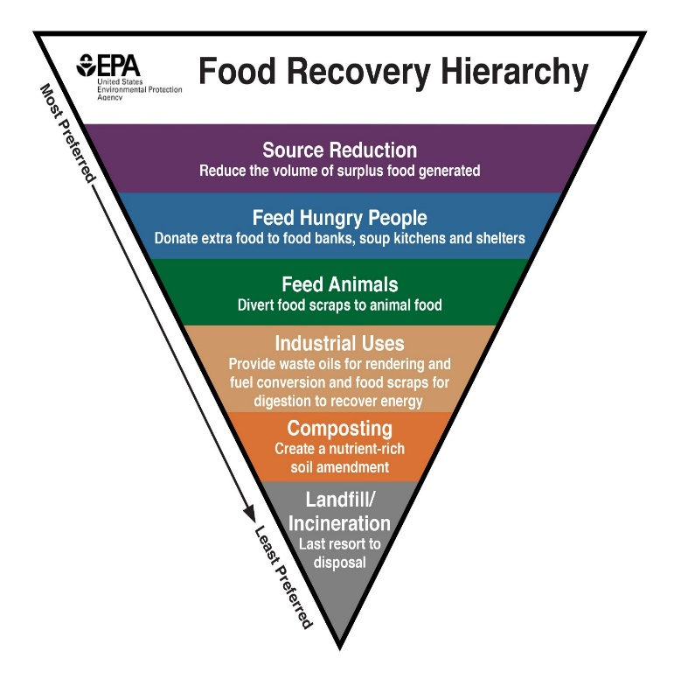

Industrial Uses
We Provide Advice When Your Business Needs It Not Just When You Ask For It!

Slide 16
US Renewable Fuel Standard (RFS) VS. California Low Carbon Fuel Standard (LCFS)
Renewable Fuel Standard (RFS) - US
  RFS sets fuel volumes
Low Carbon Fuel Standard - California
  LCFS sets carbon volumes
Additional States/Provinces Implementing LCFS – Oregon, British Colombia
States Considering LCFS – Washington, Colorado, South Dakota, Minnesota, Iowa

Slide 17
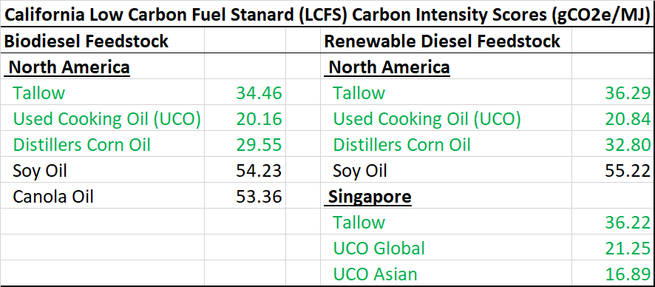
California Low Carbon Fuel Standard (LCFS) Carbon Intensity (CI) Scores (gCO2e/MJ)
Source: California Air Resources Board (CARB); https://ww2.arb.ca.gov/resources/documents/lcfs-pathway- certified-carbon-intensities

Slide 18
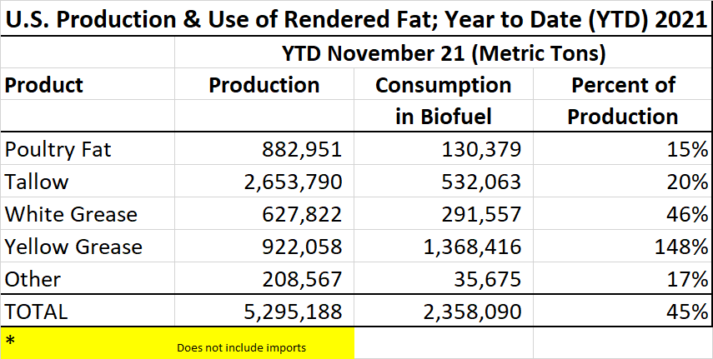
What does this mean?
Source: Energy Information Agency, Monthly Biofuels Capacity and Feedstocks Update
USDA, National Agricultural Statistics Service, Fats and Oils: Oilseed Crushings, Production, Consumption and Stocks

Slide 19
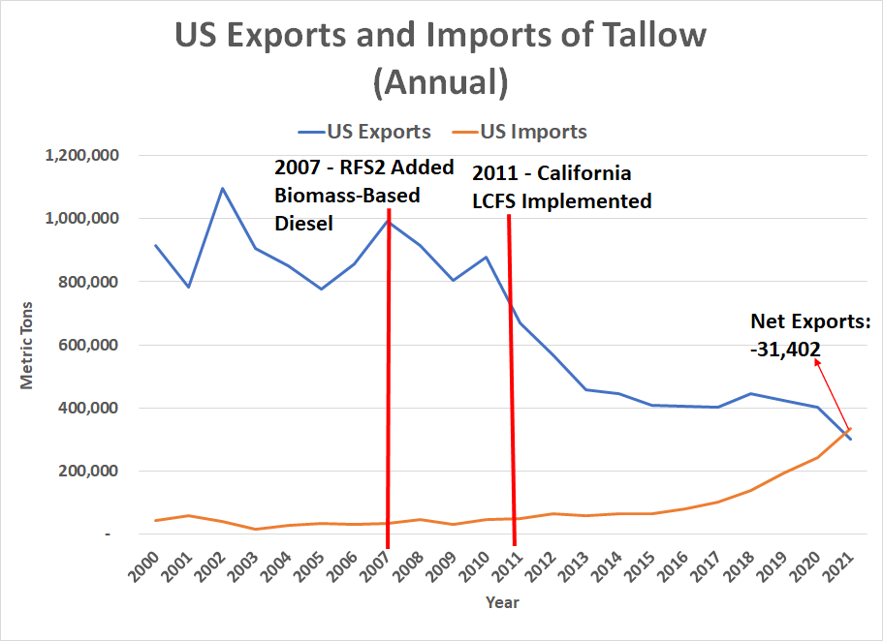
What does this mean?
Source: Trade Data Monitor

Slide 20
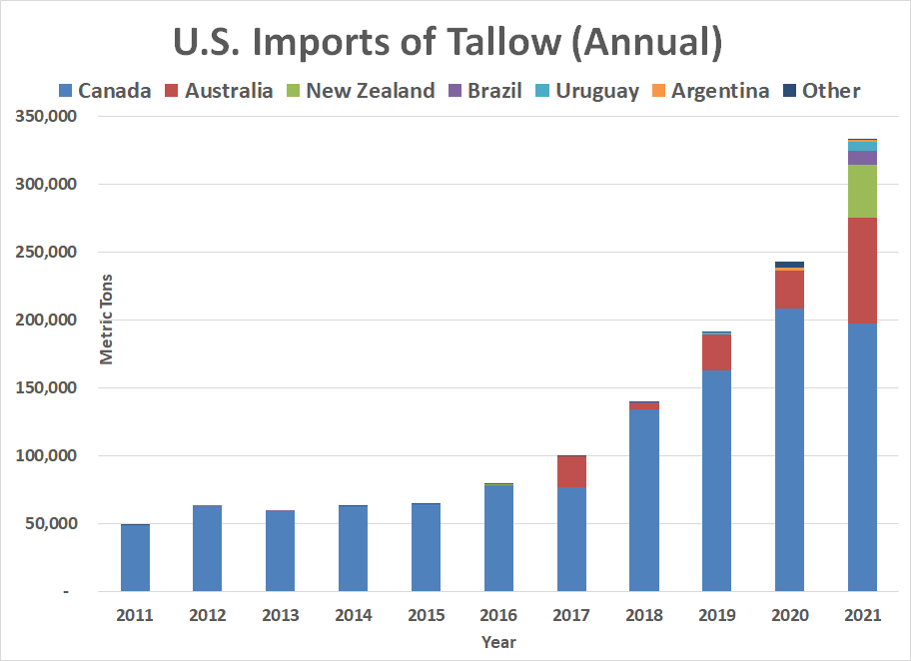
Source: Trade Data Monitor

Slide 21
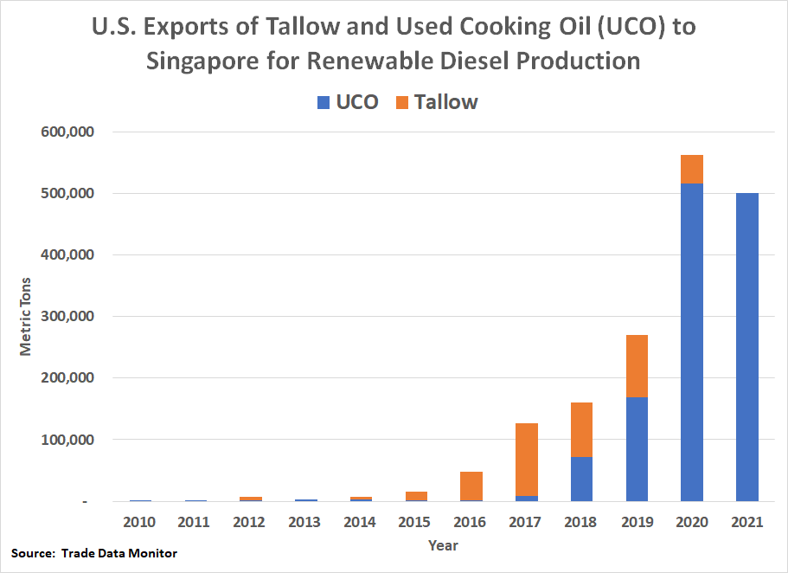

Slide 22
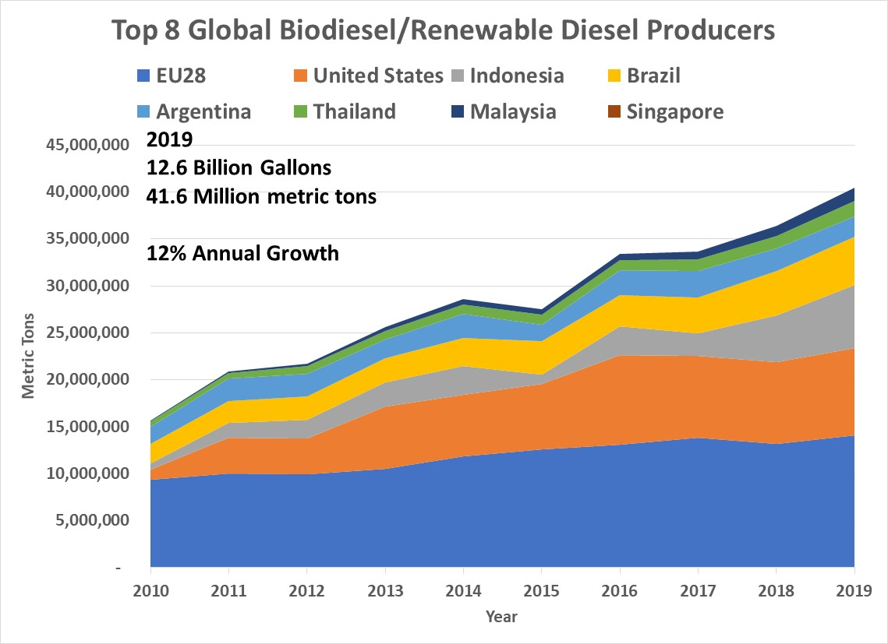
What does this mean, globally?

Slide 23
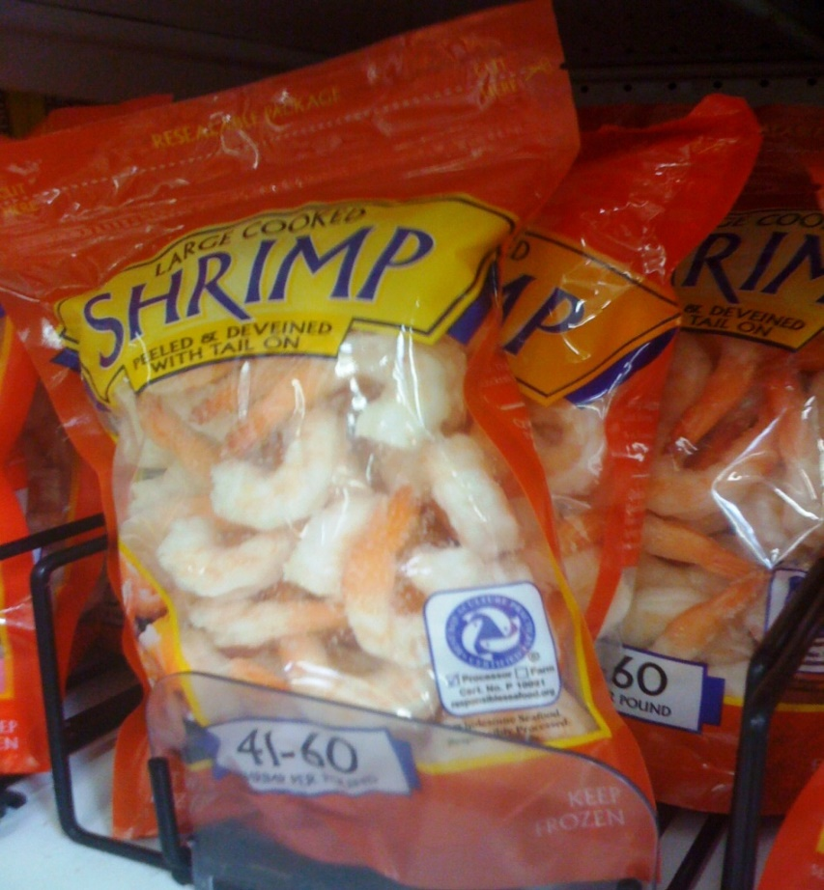

Sustainability

Slide 24
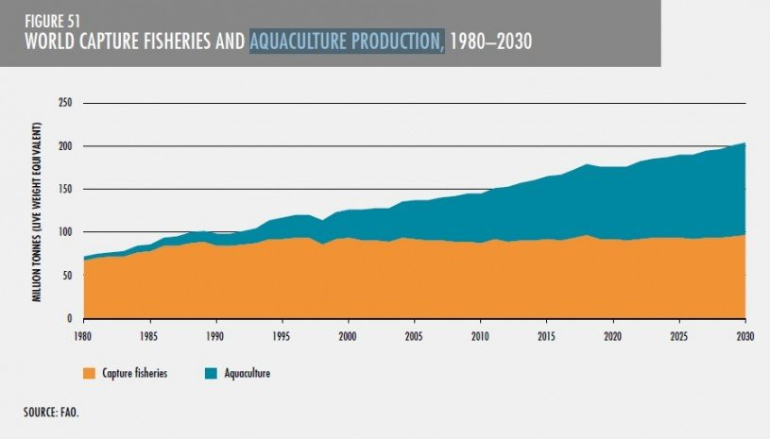

Slide 25
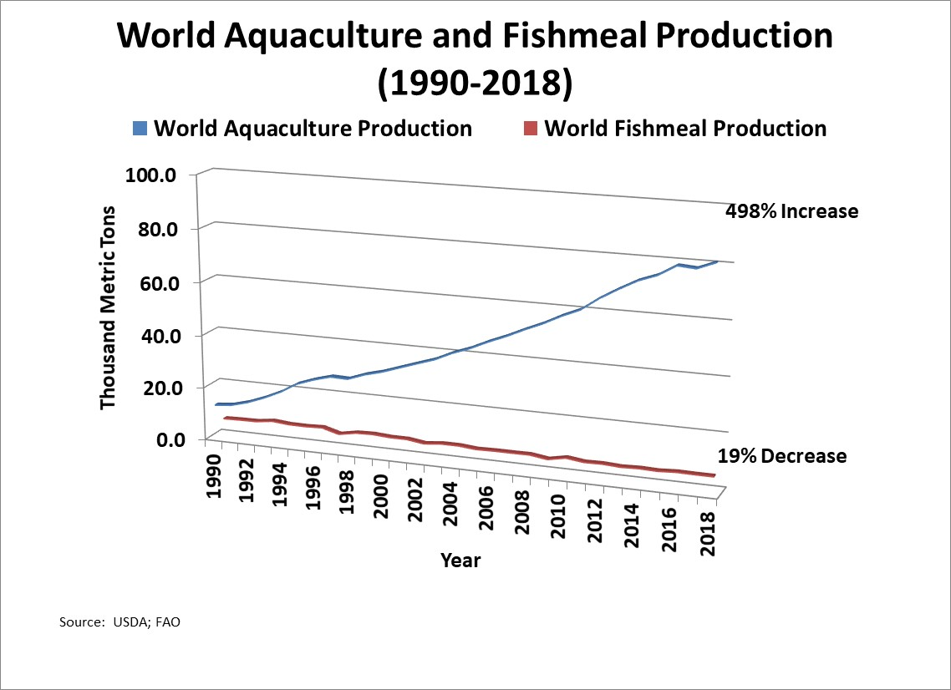
What does this mean, globally?

Slide 26
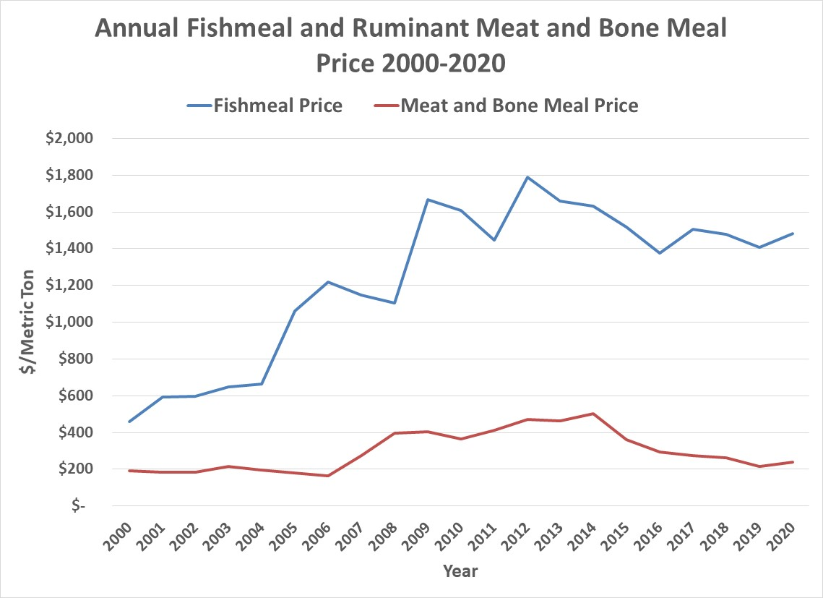
Source: The Jacobsen Report
USDA/FAS Oilseeds: World Markets and Trade

Slide 27
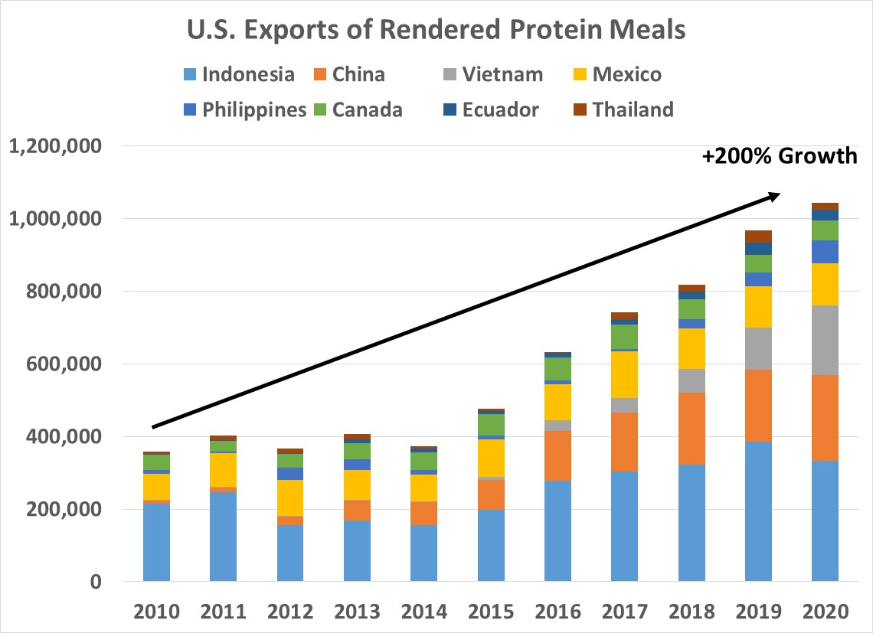
We Provide Advice When Your Business Needs It Not Just When You Ask For It!

Slide 28


Questions/Comments?
We Provide Advice When Your Business Needs It Not Just When You Ask For It!

