Slide 1

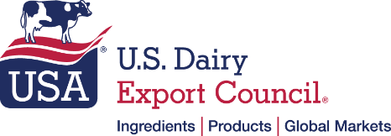
U.S. Dairy Exports: Where are Future Growth Markets
USDA Agriculture Outlook Forum
Thursday, February 24, 2022

Slide 2

2021: A Record Year for U.S. Dairy Exports
Total Volume
Volume
Increases
Total
Value
2.299 million MT, Milk Solids Equiv. +10%
(+214,698 MT)
‘20-’21
$7.75 billion
+18% (+$1.2 bil)
‘20-’21
SMP/NFDM (+10%),
Whey (+10%),
Cheese (+10%),
WMP (+3%),
Butterfat (+121%)
Notes:
Last year was a record year for dairy exports with a total of over $7.75 billion sold abroad. That equated to approximately 18% of our milk supply, which is a record high.
We are thankful for the close working relationship between USDEC and USDA that supports success by helping to build markets for the high-quality, sustainably produced US dairy products and to tackle barriers to trade that threaten to choke off opportunities to sales.

Slide 3
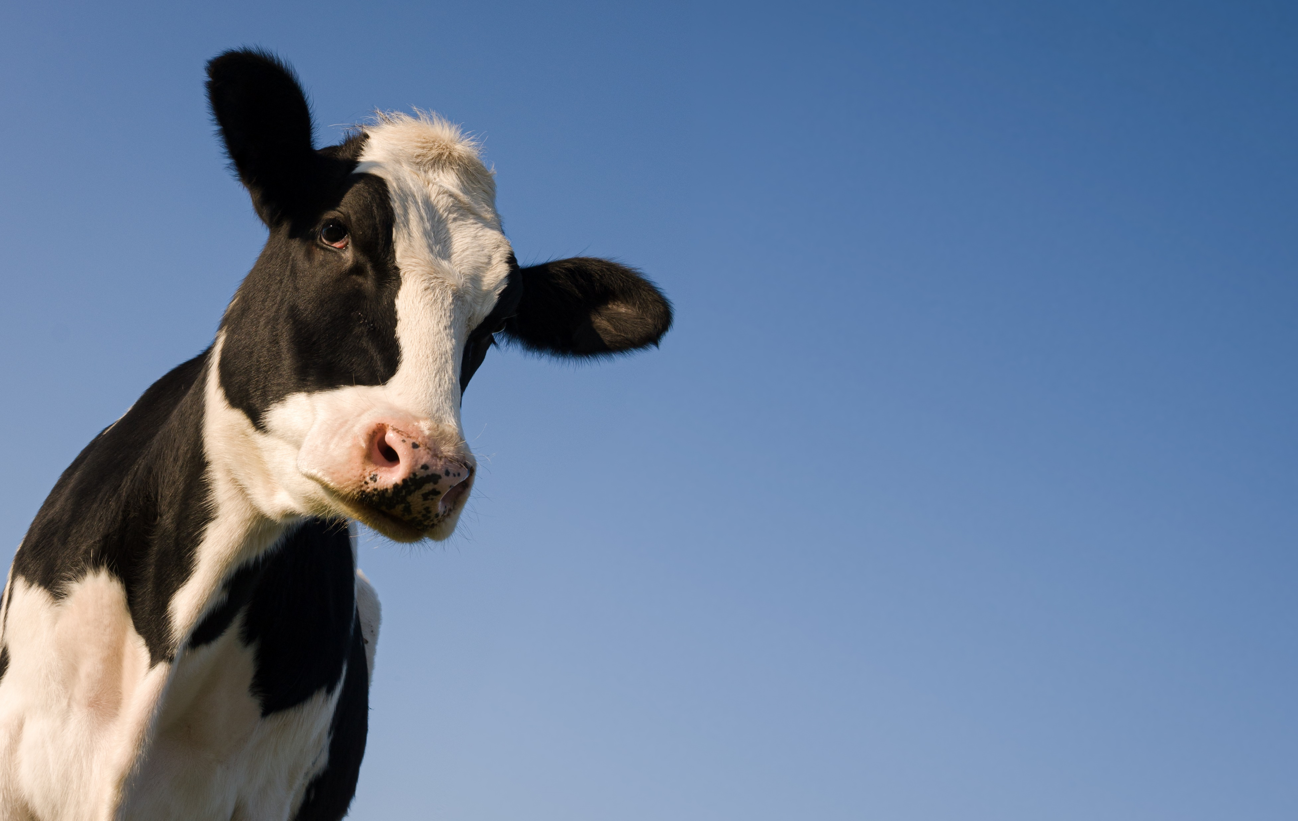
Demand for Sustainable Products
Our farmers have world’s lowest
GHG emissions per gallon of milk
U.S. Farmers Assuring Responsible
Management Program
Committed to GHG neutrality
by 2050
Innovation Center for U.S. Dairy &
Greener Cattle Initiative
Notes:
We have a strong story to tell – and evidence to back it up with – in terms of the sustainability of U.S. dairy. It’s an area we’re seeing increasing interest in certain overseas markets.
Our farmers have the world’s lowest GHG emissions per gallon of milk per data published by the UN Food and Agriculture Organization. The U.S. Farmers Assuring Responsible Management program is the very first dairy animal care program to become internationally certified. 99% of milk produced in the U.S. comes from farms certified under the FARM Animal Care program.
We’re not resting on our laurels though; our industry has committed to achieve GHG neutrality by 2050 in addition to taking other steps to enhance our sustainability profile like reducing water use and improving water quality.
We’ve placed a particular focus on cutting methane emissions and are proud that the Innovation Center for U.S. Dairy is part of the Greener Cattle Initiative, a multi-stakeholder partnership to share knowledge and accelerate the development of scalable and commercially feasible technologies that reduce enteric methane emissions.

Slide 4



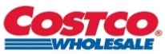
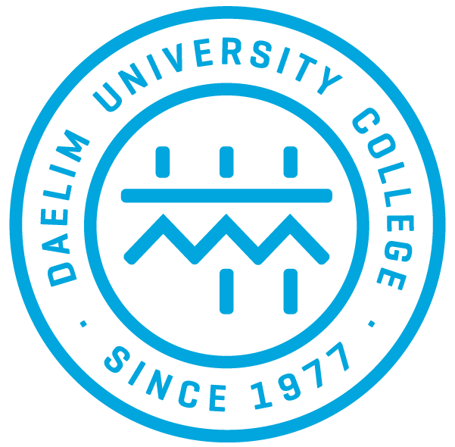












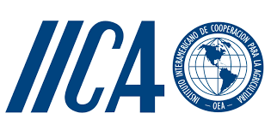
Defining U.S. Dairy Through Partnerships
USA Cheese Specialist™ Certification Program
Culinary partnerships in 7 countries
8 retail chain partnerships in 5 countries
5 Ingredient Innovation Partnerships
2 Partnerships to drive policy collaboration
Notes:
There are a lot of misconceptions about American agriculture and USDEC is working to help dispel those myths and help educate key buyers and officials overseas about the reality of U.S. dairy farming and manufacturing. We emphasize how deep our industry’s commitment to sustainability really is.
In partnership with USDA, we’ve been working to cultivate greater dairy demand and showcase how US dairy is the best option to fill that demand with programs such as: Cheese Educational Partnerships: USDEC created the USA Cheese Specialist™ Certification Program to educate professionals across the foodservice and retail sectors about U.S. cheese quality, varieties, tastes, applications, and the industry’s commitment to exports. This builds awareness and the heritage of U.S. cheese to create a generation of U.S. cheese advocates and build long-term demand. We do this by having:
Culinary partnerships with leading culinary schools in seven countries:
UAE, South Korea, Taiwan, Japan, Mexico, China and Hong Kong.
Partnerships with eight different retail chains in five countries or regions:
China, South Korea, Mexico, Singapore, and the Middle East.
Ingredient innovation partnerships with in-market affiliates: Develop new applications to use ingredients in local food addressing styles and trends in existing markets to drive consumption and penetration. These partnerships deliver on diverse and growing consumer needs from health and wellness to indulgence.
Singapore Polytechnic’s Food Innovation and Resource Centre (FIRC)
China’s Jiangnan University (JU)
Japan’s Kiyota Sangyo
Vietnam’s Blue Techni
Mexico’s Tec de Monterrey
Nutrition partnership in Korea with the Korean Dietetic Association and its Food Forum group
Building partnerships with likeminded organizations that work with us to advance science-based policymaking and remove barriers to trade is also critical to growing U.S. dairy exports.
We’ve been proud to work over the last several years with the Pan American Dairy Federation, FEPALE, and Inter American Institute for Cooperation on Agriculture, IICA, to advance these shared goals and push back against attempts to minimize the critical role dairy plays in a sustainable food system.

Slide 5
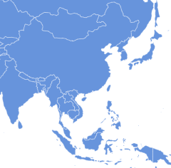
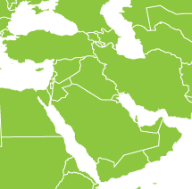
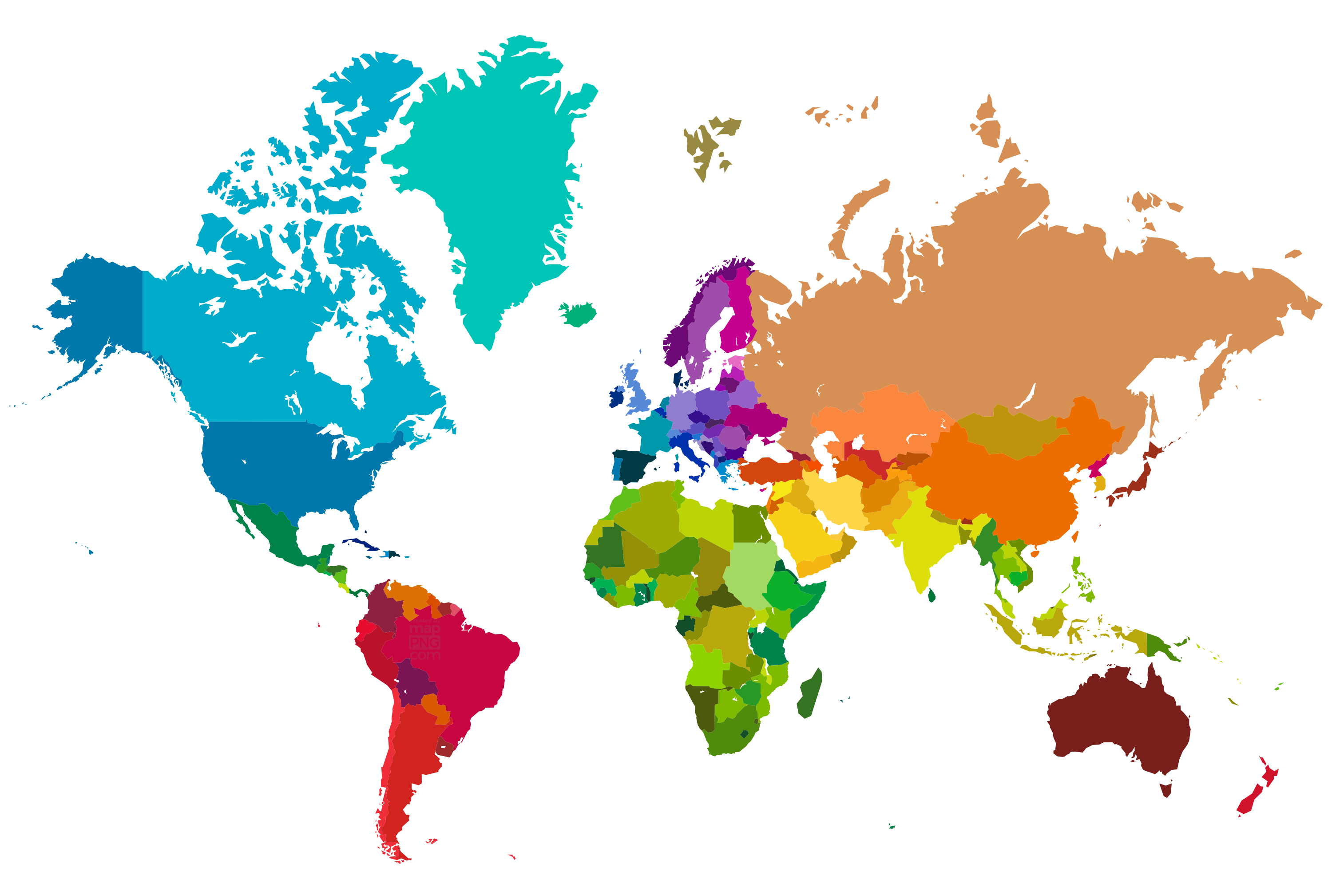
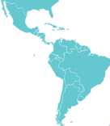
Maintaining and Expanding Markets
Key Objectives
Resolve non-tariff trade barriers
Trade Agreements
End Supply Chain Crisis
Markets to Watch
Mexico | China
SE Asia & Japan | Middle East
Central & South America
Notes:
Barriers & Policy Needs / Future Priority Areas
As important as that offensive marketing and demand building work is, we need to be playing a strong defense at the same time, as well as doing the future preparation work that’s needed to chart a positive future.
Re: Defense examples…We rely tremendously on the work with FAS to help resolve trade and non-tariff trade barriers to our exports.
For instance, FAS’s role is absolutely critical in helping to tackle what’s become a global trade barrier threat for us – the growing set of bans on the use of common cheese names created by the misuse of geographical indications; this impacts our cheese growth ability in a great many markets which is why developing a proactive approach to curtailing this problem is so important.
Or closer to home for instance, USDA’s work together with USTR on the USMCA dairy case has been important to prove to our trading partners that the US is willing to enforce trade deals with struck on ag exports.
Re: future prep work…One thing we continue to hear over and over from our members is the importance of expanding market access opportunities to help them remain competitive internationally.
We see tremendous potential to build further on our export sales – but it’s going to be harder each year to do that if we aren’t moving forward with trade agreements to provide a level playing field on tariffs and address nontariff barriers that can derail trade flows.
Some key markets that offer promise are Southeast Asia, the Middle East, Japan, China, and the United Kingdom.
In several of those, our competitors have struck trade deals which the US doesn’t have – by putting us at a disadvantage from the outset.
We would very much like to see the US restart comprehensive trade negotiations with key ag importing markets this year. In the meantime, we hope to be able to work with USDA and USTR on using all trade tools – whether TIFAs, the Indo-Pacific Framework, multilateral standard-setting bodies, etc. – to make headway in using forums to smooth over the tariff, policy and regulatory challenges that complicates exports.

Slide 6

Krysta Harden
kharden@usdec.org

