Slide 1
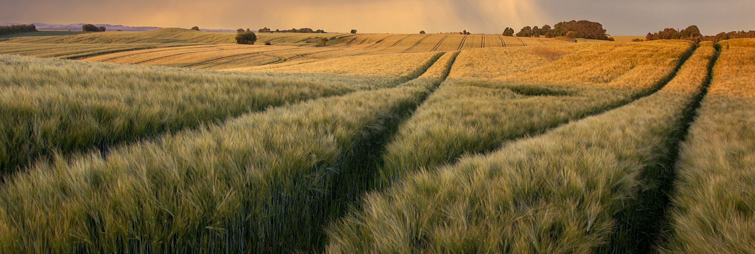
Managing Weather Risks Using Regenerative Ag and Crop Insurance
Lance Griff
Twin Falls, Idaho

Slide 2
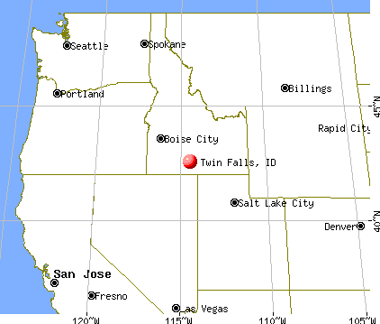

Slide 3
Idaho Statistics
Many of you might only know Idaho for it’s “famous potatoes”
Idaho produces more than 185 commodities
Idaho has the 5th largest state ag economy as a percent of GDP
We are the #1 producer of potatoes, barley, peppermint, and trout nationally
We are the 2nd largest grower of sugarbeets and hops
Idaho is 3rd in the country for alfalfa production as well as the 3rd largest milk producer.

Slide 4
Background
3rd Generation farmer
Farm 4,000 irrigated acres with my dad
Located in Twin Falls County, Idaho
Grow conventional soft white wheat, corn, alfalfa, barley and organic corn, alfalfa, and barley
Our irrigation water comes from a shareholder owned reservoir that irrigates 25,000 acres
Our farms range from 4,000-4,800 feet elevation
We average around 10 inches of precipitation/year
We have a moderate number of prevent-plant situations due to lack of water
With many large dairies locally, we have access to and apply a lot of manure and compost.
Began transitioning to no-till and cover crops on our conventional acres in 2013.

Slide 5
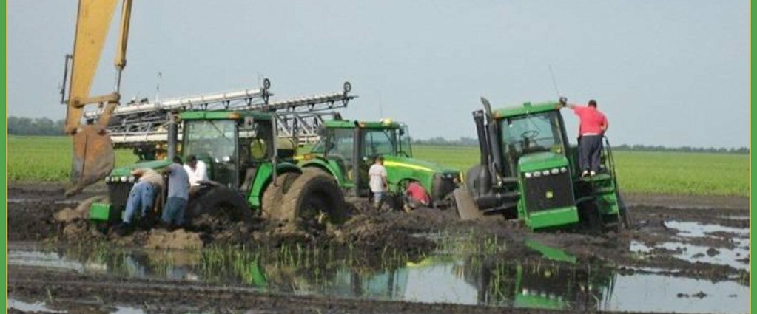
My Frustration Before our Soil Health Transition
This Photo by Unknown Author is licensed under CC BY
Notes:
I was getting frustrated and I’m sure I was frustrating my dad with all of my soil health talk and new things I wanted to try. I’m sure I’m the only one who has ever been frustrated with their Dad or business partners and vice versa!

Slide 6
Our Journey
I kept trying to convince my dad of the benefits of soil health practices from things I had learned from presentations, YouTube videos, and magazine articles.
In 2012 I was able to purchase 70 acres of my own to try whatever I wanted without trying to convince my dad it was a good idea.
I began no-tilling and planting cover crops.
I had enough successes that my dad could see the benefits, so we began implementing soil health practices on our whole farm.
Our first no-till crop was corn planted into the previous year’s wheat stubble.
I realize that many of you have been using soil health practices for many years already. However, here in Southern Idaho there are very few people who have implemented soil health practices. Our challenge was adapting principles of soil health to our local conditions and crops grown.
Notes:
I think one of the barriers to more soil health practices here in southern Idaho is the number of crops that can be grown. Another reason there hasn't been widespread adoption is some the main crops grown in my area such as beets and potatoes are very disruptive to the soil when they are dug out of the ground and growers aren't sure how to deal with this challenge. However, many farmers are now planting beets into a cover crop of wheat or other grass species to hold the soil from blowing when the beets are emerging and are most susceptible to being cut off by blowing sand.

Slide 7
Why Change to Regenerative Model?
Economically made sense. For example, we saved 4 tillage passes in our corn crop moving from a tillage model to no-till.
Wanted to be more efficient with our irrigation water. We save about 2” of precious irrigation water per year on corn.
Saw a way of improving soil and plant health with the expectation of using less fertilizer since our soil would be more healthy.
Work with the soil, not against it; we were looking at the soil like a chemistry set and fighting against the biological processes in the soil by tilling and using a lot of inorganic fertilizers.
If we wanted different results than what we’d been getting, we’d have to change our approach.
Leave healthier soils for my kids.
I believe I’m a steward of the land God loans me, so I want to take care of it and work within the biological systems He designed.
Have more resiliency in the soil to endure weather challenges.
Notes:
If you can't make money and stay in business doing soil health practices, then what is the point?

Slide 8
What Did We Change?
Moved to much less tillage
Plant no-till as much as possible
Use cover crops between cash crops in order to keep a living root in the soil as much as possible to feed the microbes that make fertilizer available.
Leave residue on soil surface to armor the soil from wind and water erosion and prevent as much evaporation in the summer
Use manure and compost rather than commercial fertilizer when possible
Spread harvest residue more evenly to enable better no-till stands
In drought years, leave cover crop growing in fields or volunteer crop to compete with weeds instead of tilling them to control weeds

Slide 9
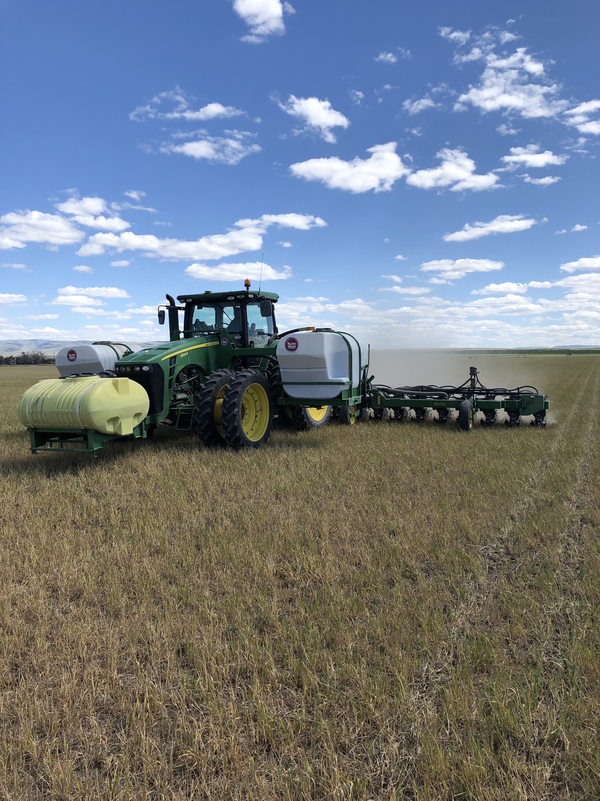
Planting Corn

Slide 10
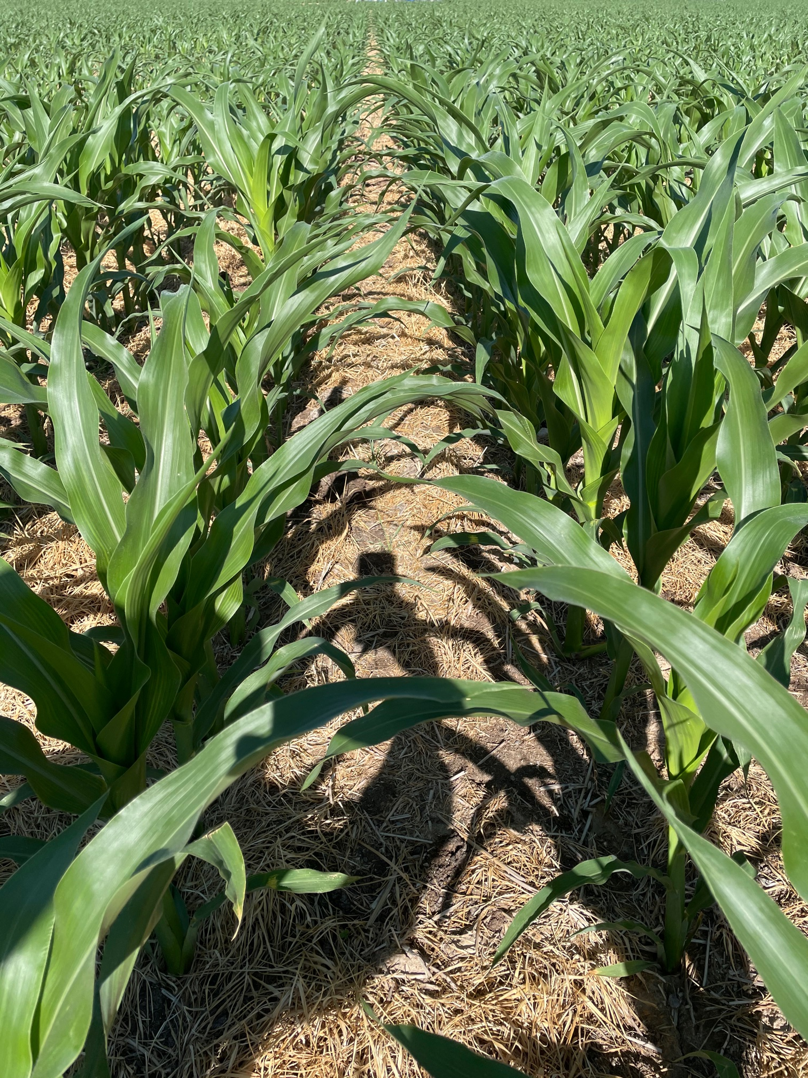
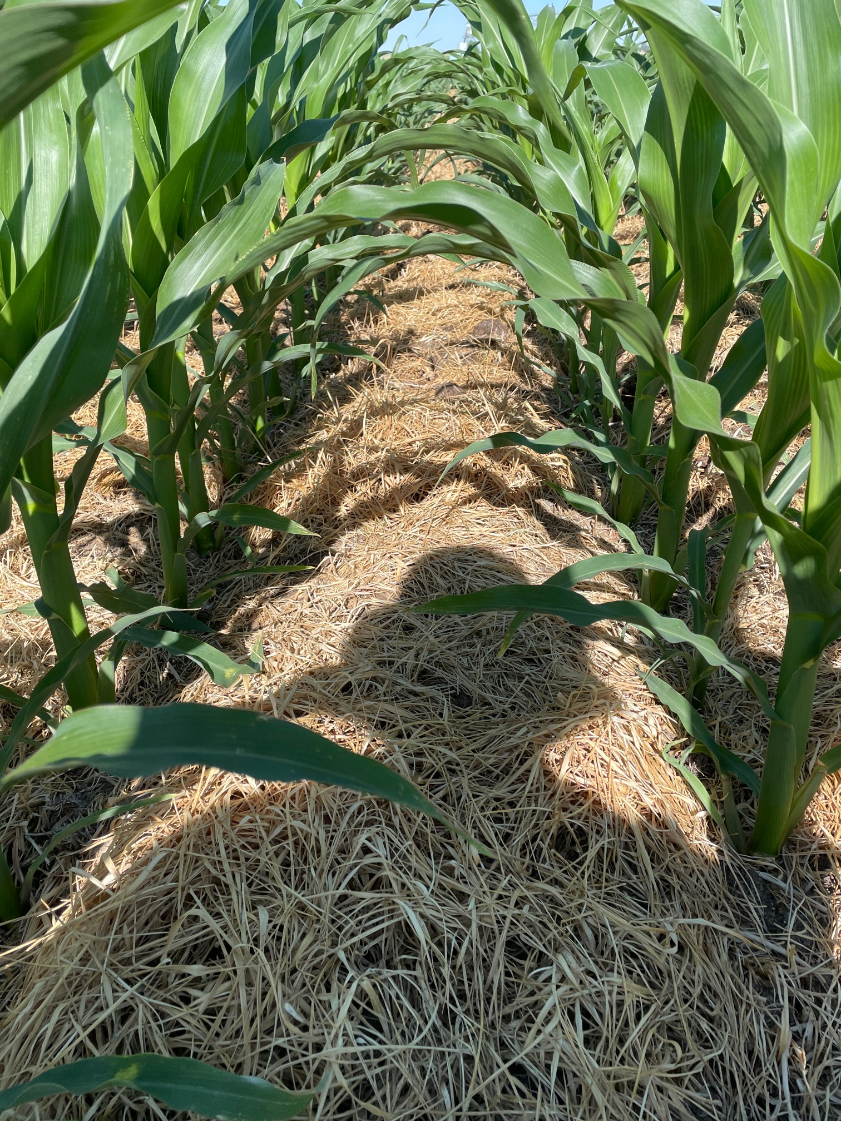
Notes:
We spread 30 tons/acre of dairy manure on this field in the previous fall after the wheat crop was off. In the spring, we simply sprayed the cover crop out and planted the corn.

Slide 11
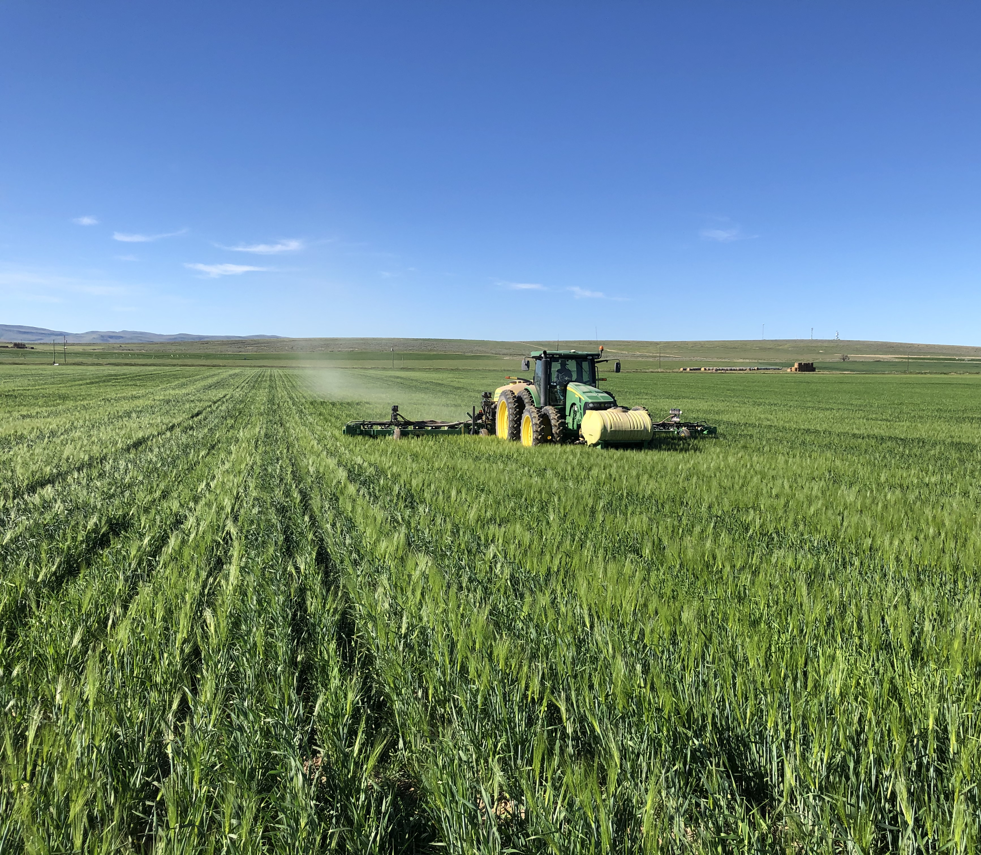
Planting ”Green”

Slide 12
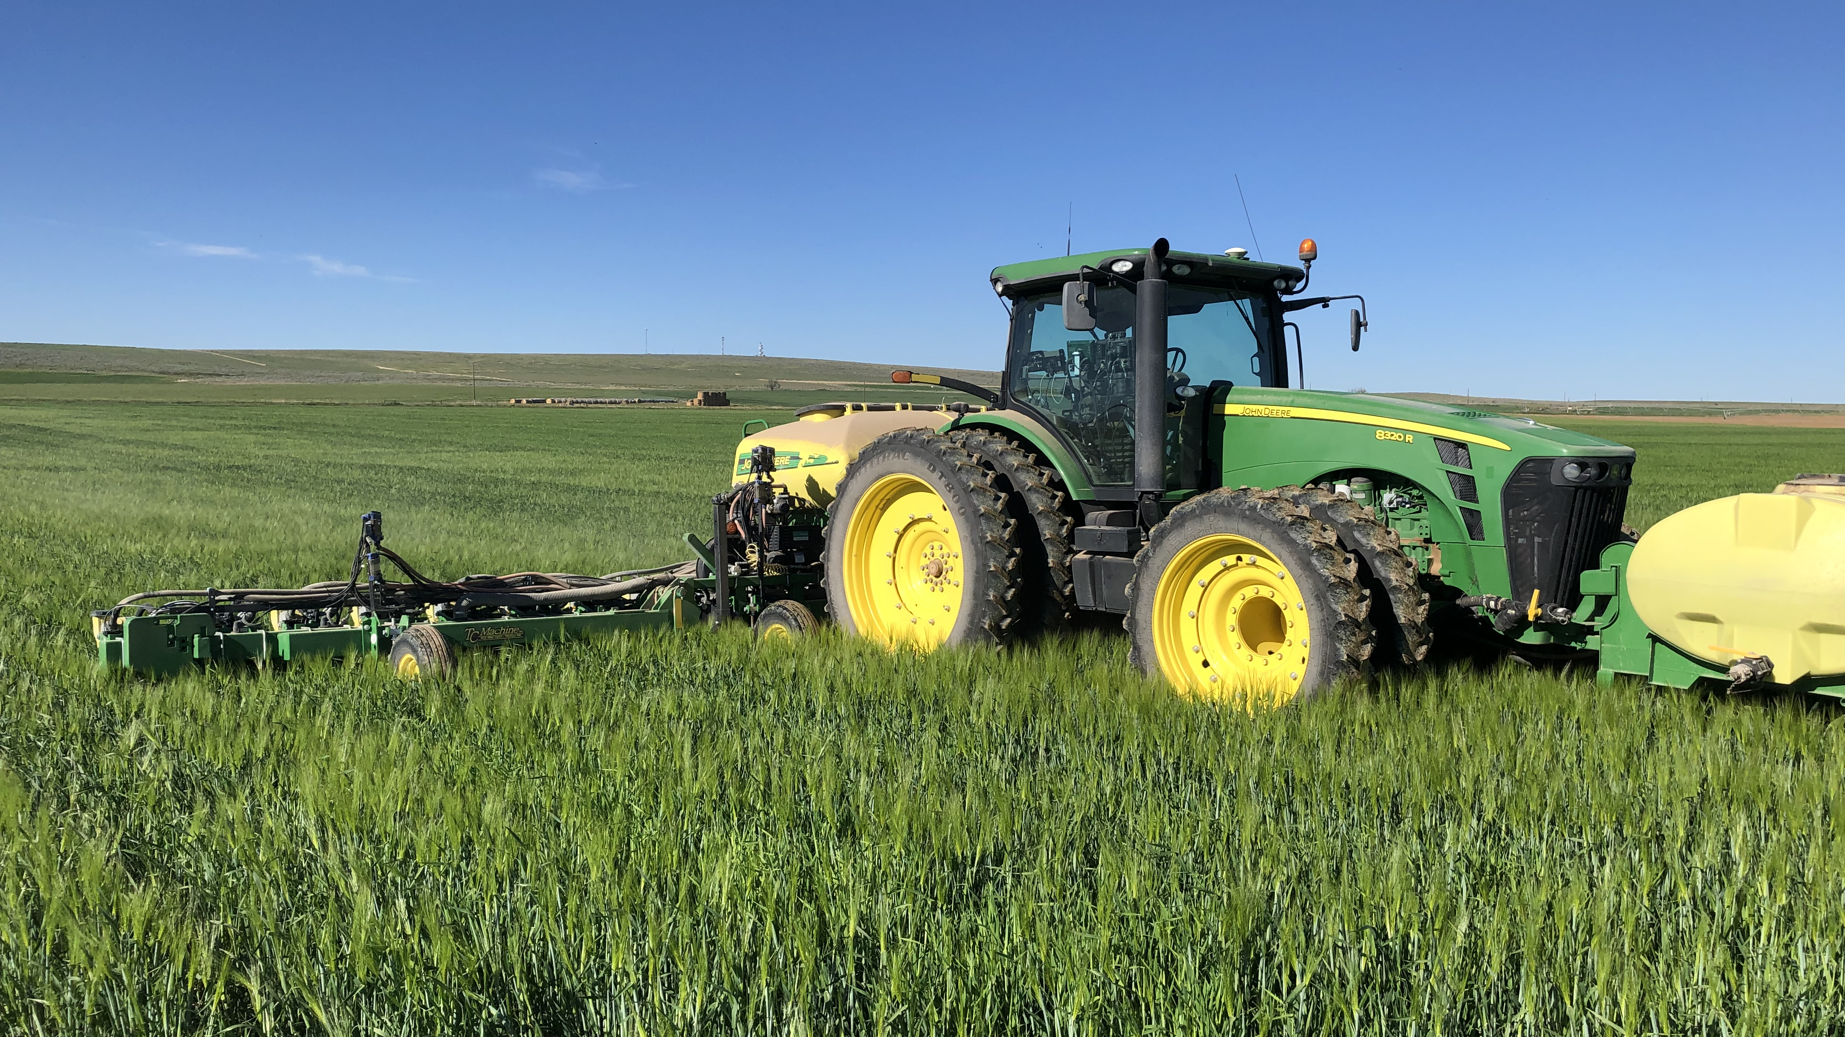

Slide 13
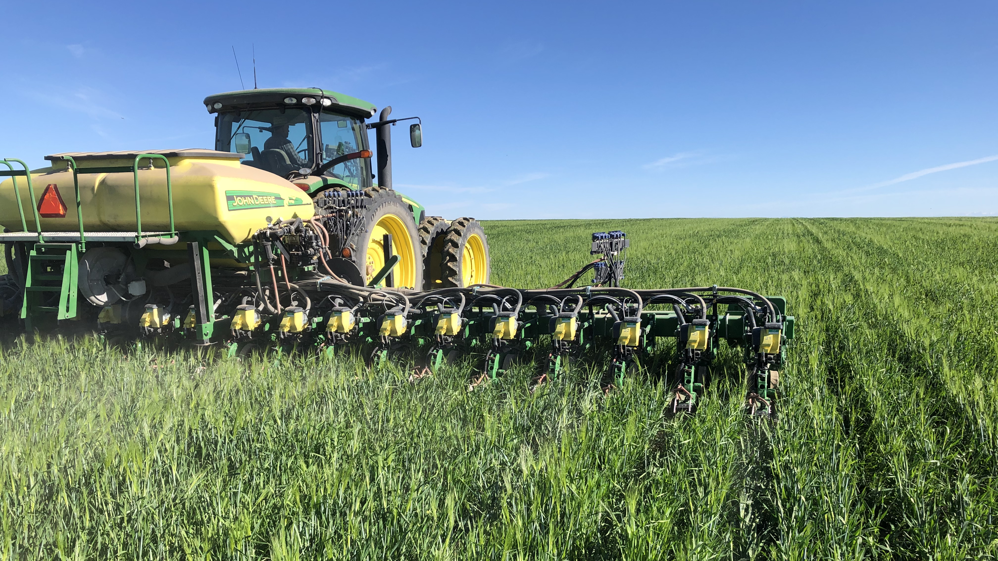

Slide 14
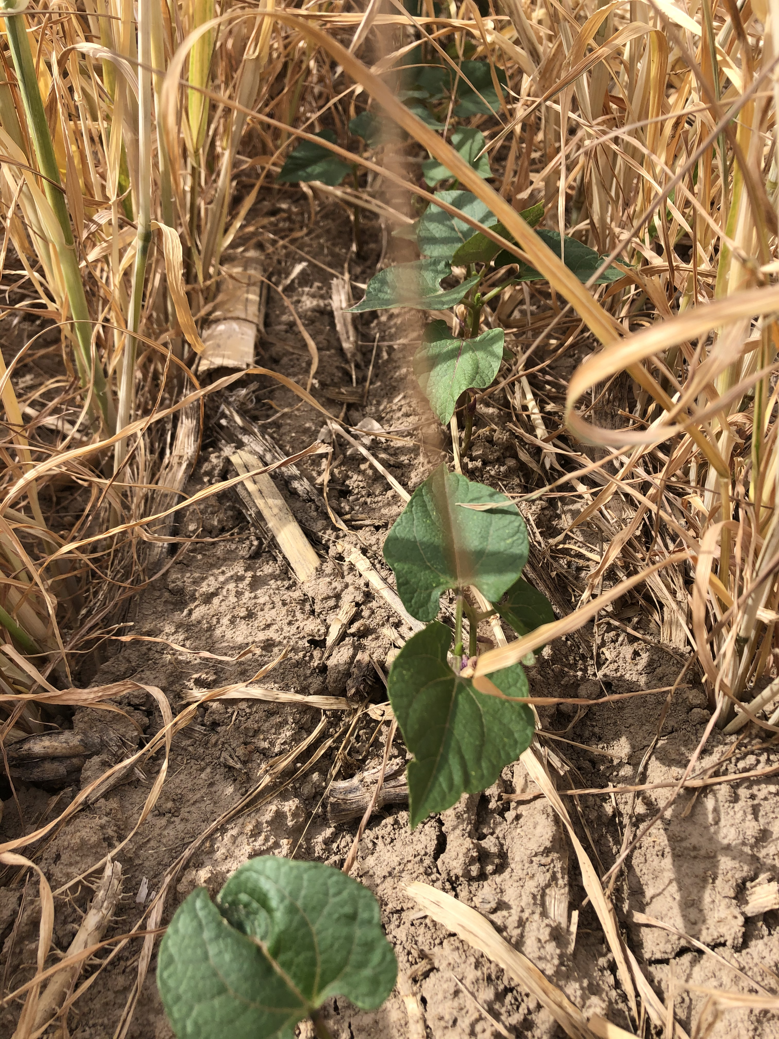
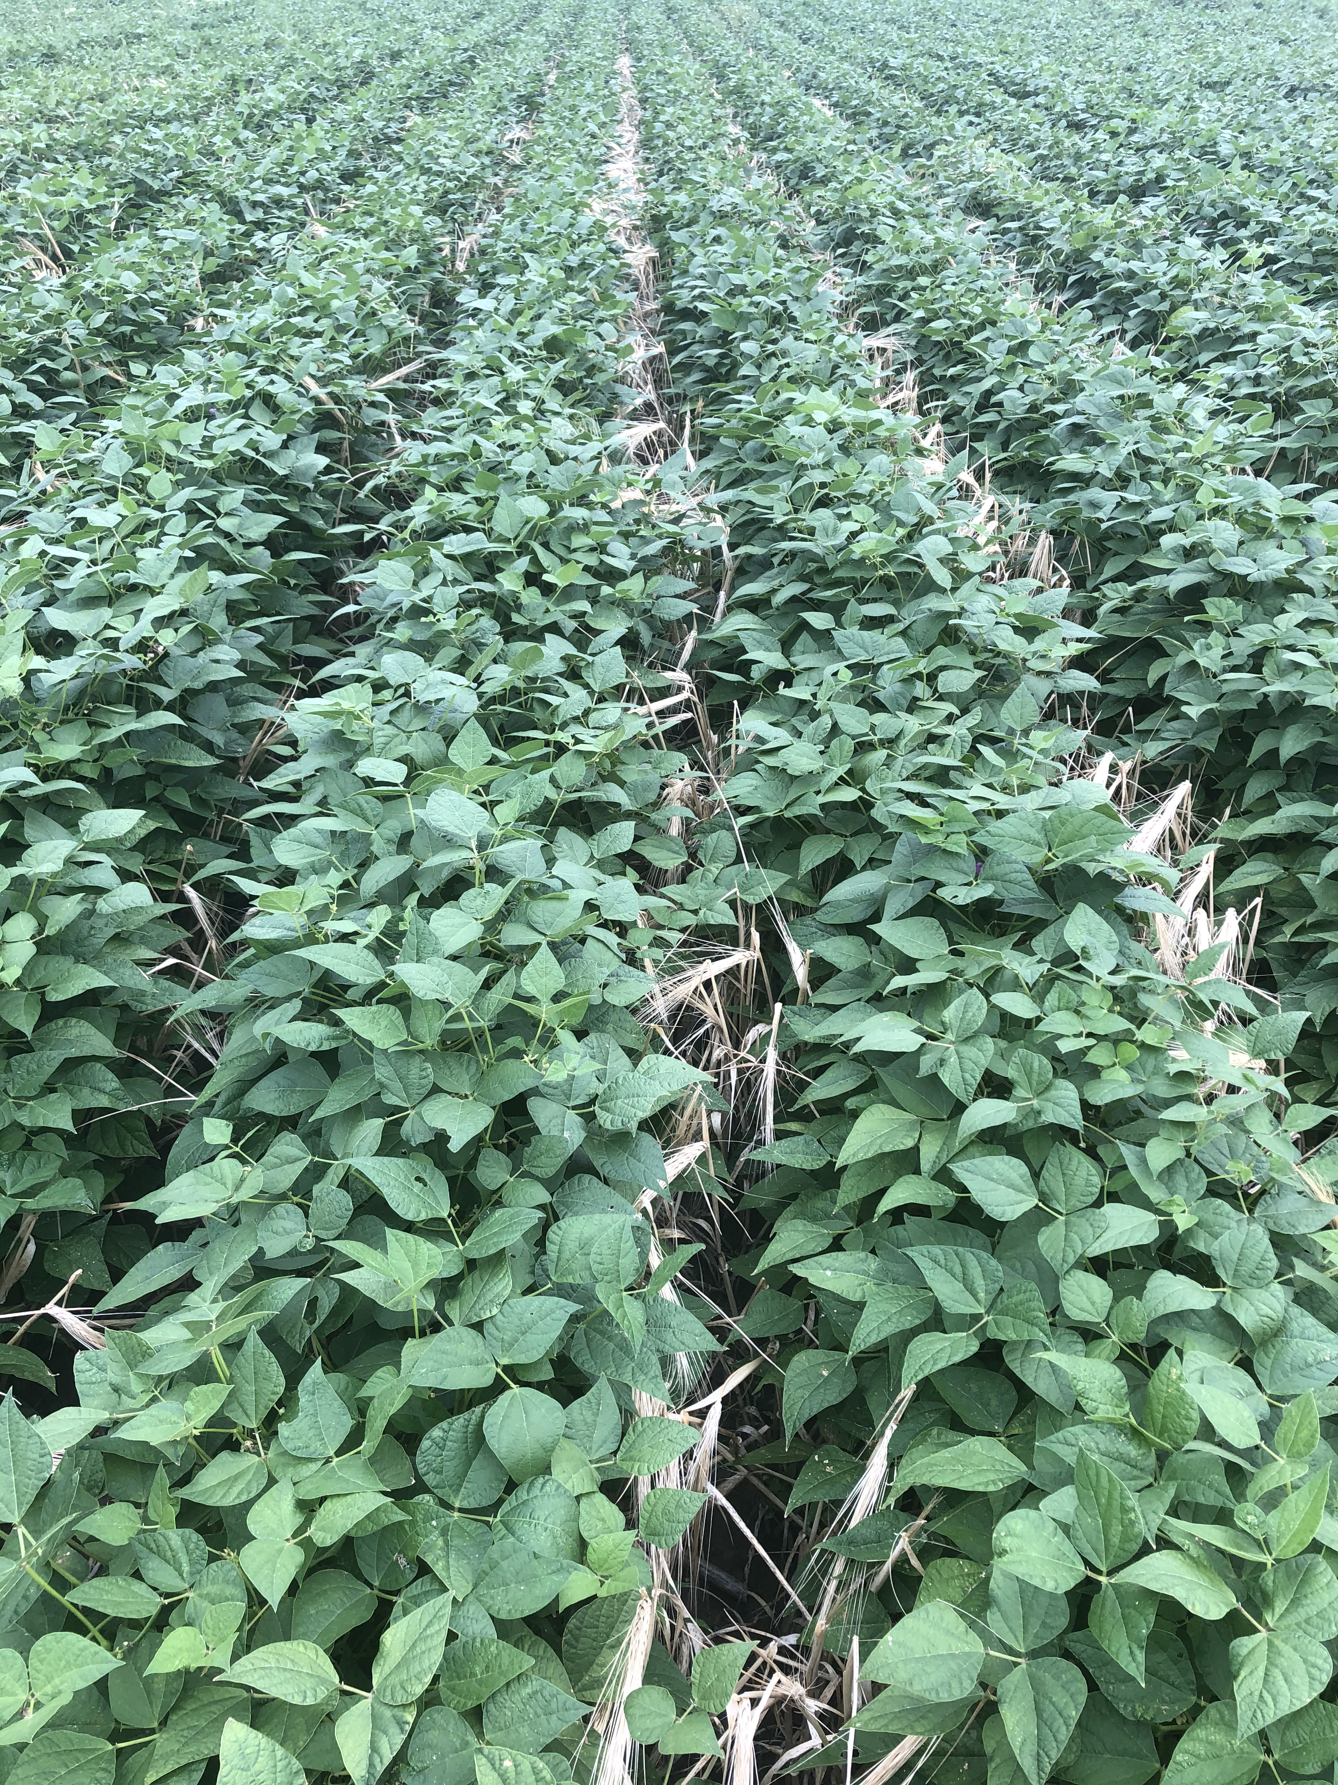

Slide 15
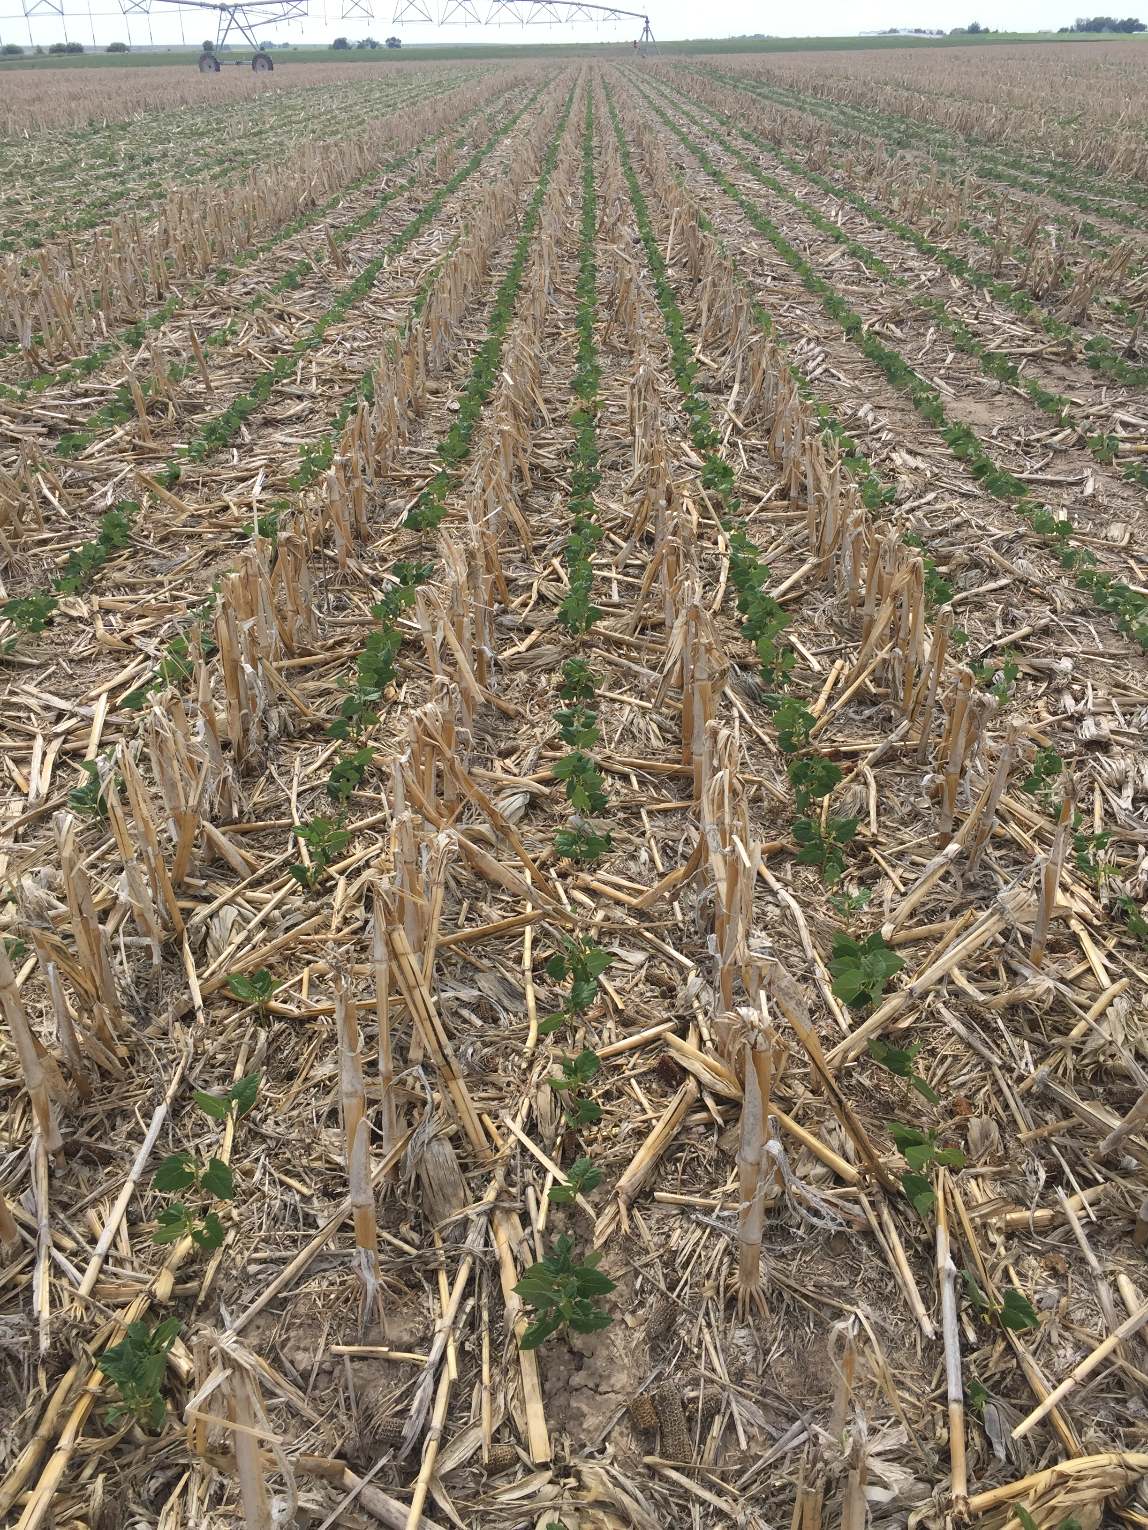
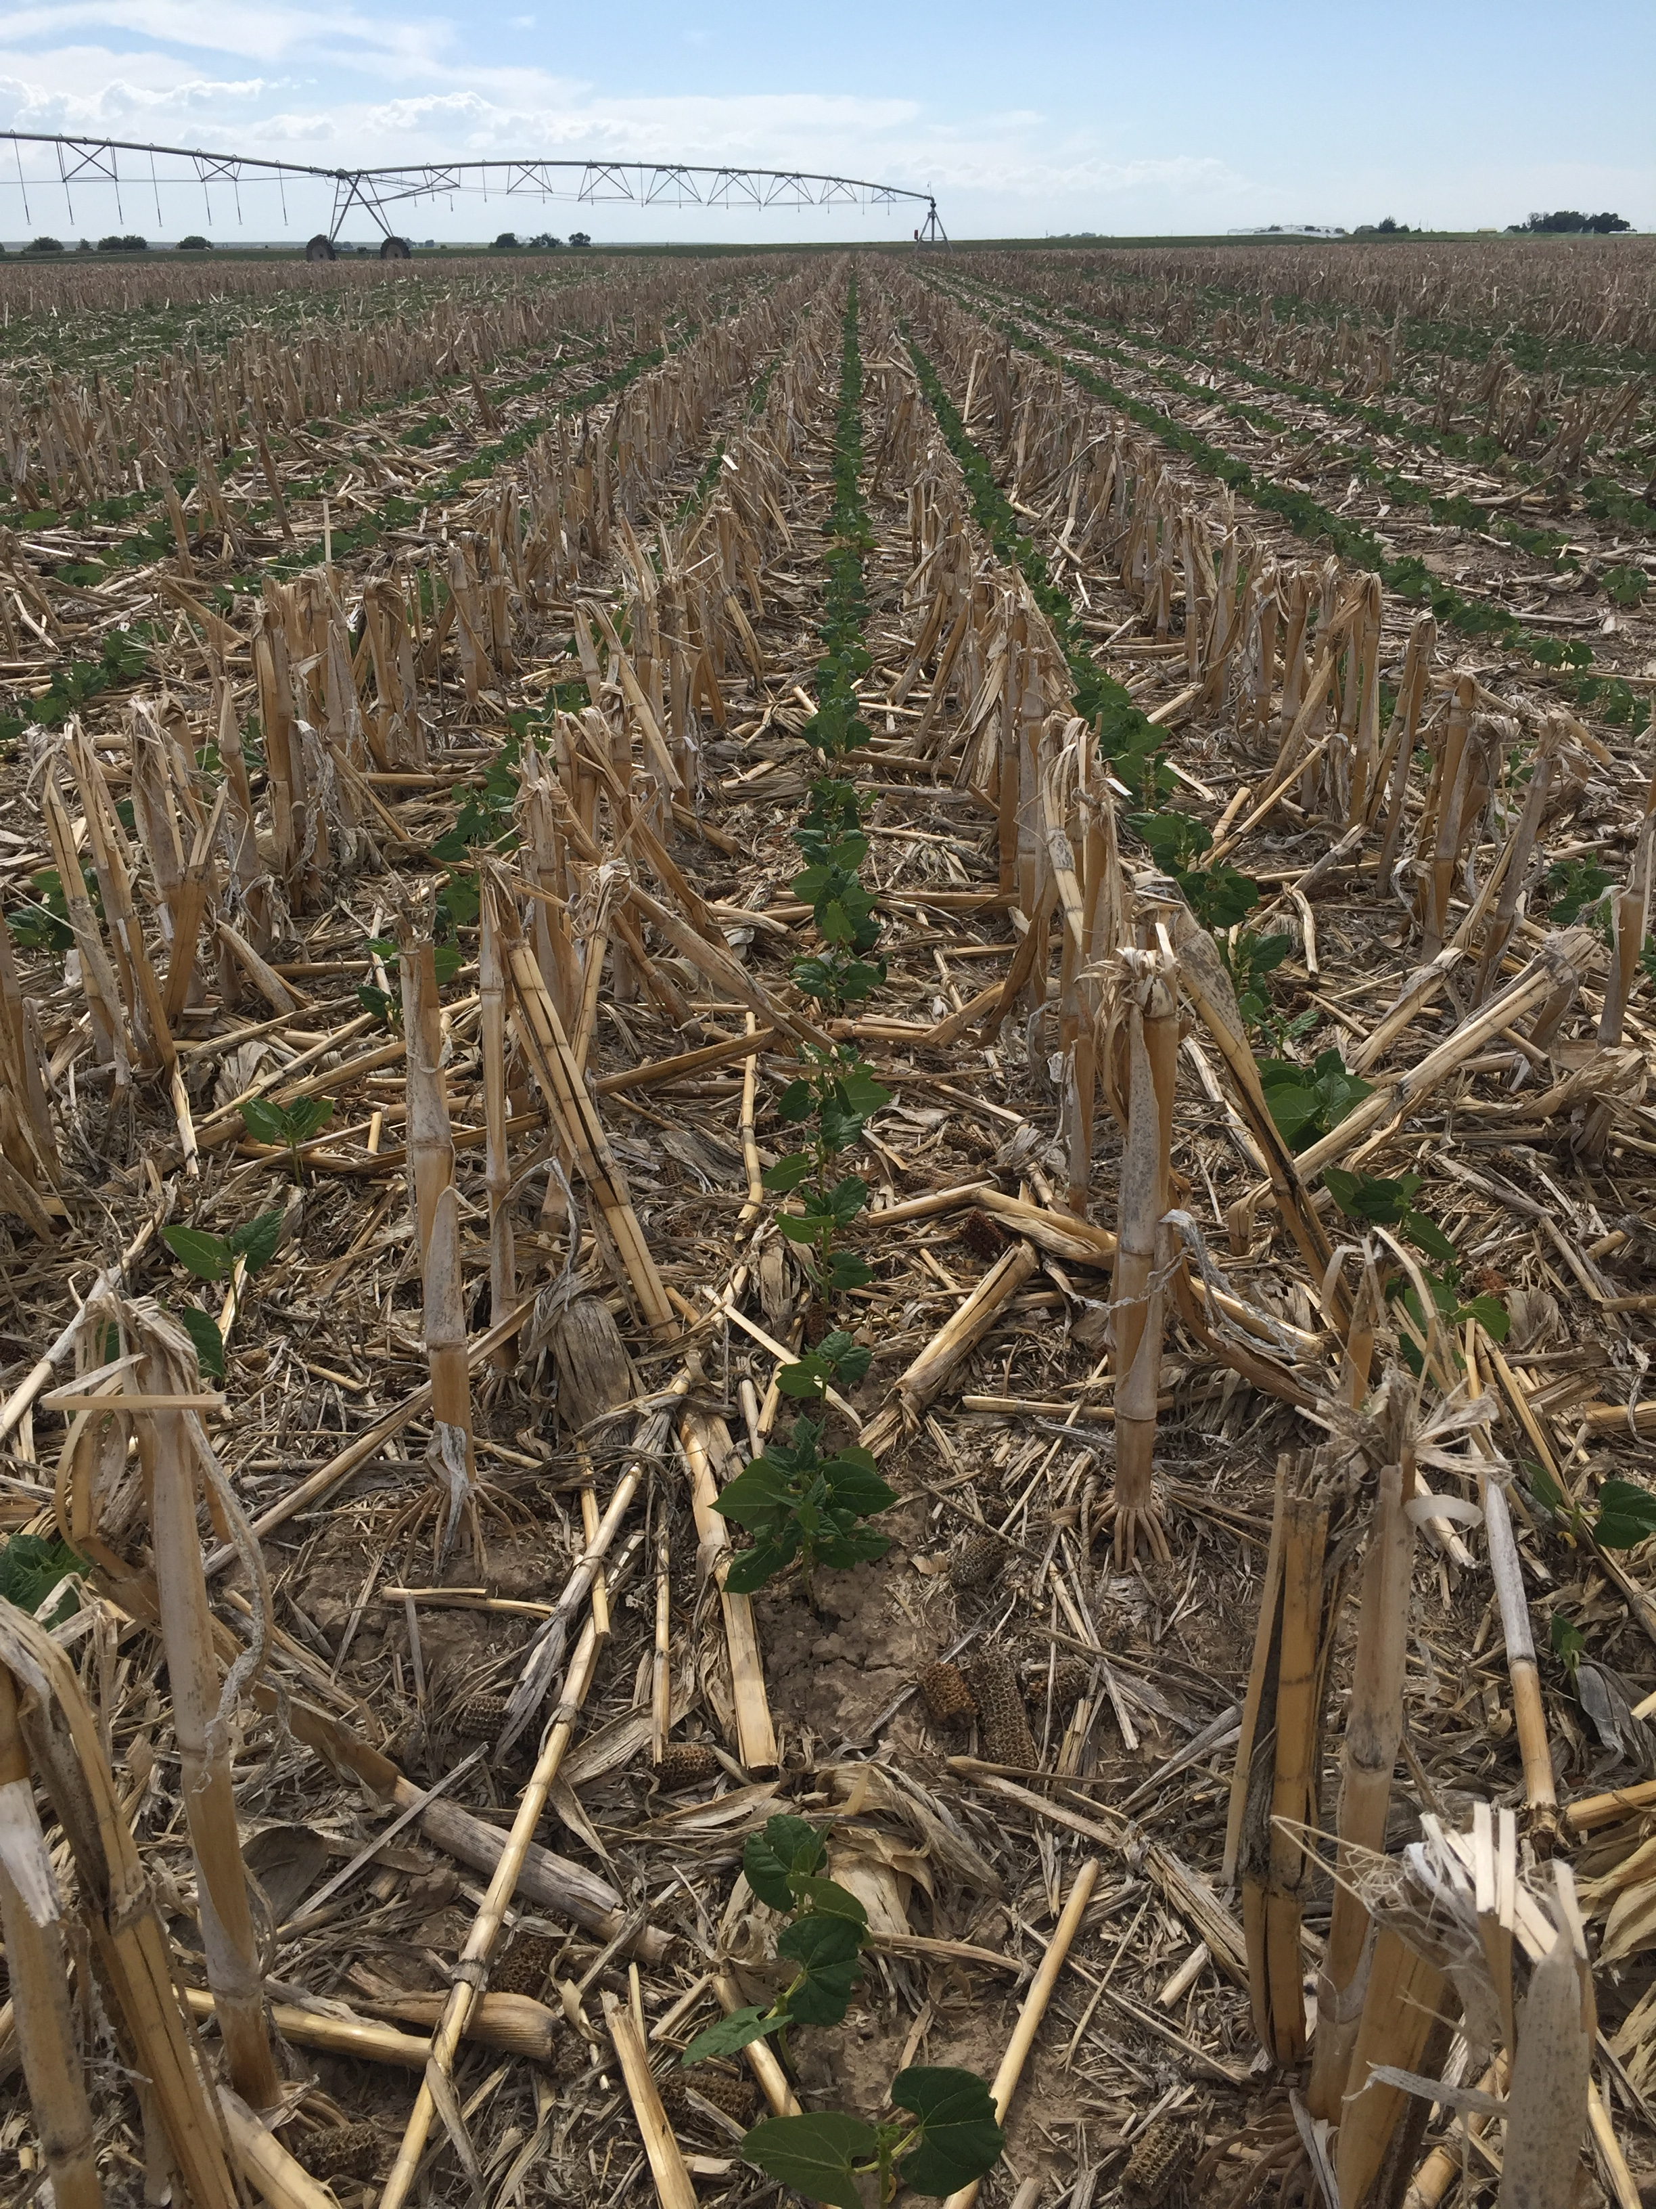

Slide 16
Federal Crop Insurance to Mitigate Risk
As I stated before, we can have droughts that prevent us from planting our later planted crops such as corn and dry beans. Some farmers listening to this will be prevented from planting due to too much moisture. Our problem is the opposite.
A very important tool that we use is the federal crop insurance program. We use multi-peril crop insurance and have used both the yield and revenue-based policies depending on risks, market conditions, etc. Multi-peril crop insurance covers losses such as drought, excess moisture, freeze, disease, and more.
By far the biggest risk for us is the failure of our irrigation water supply because of lack of precipitation.
Using NRCS SNOTEL sites located in our snow basin, we can gauge and calculate how much water will run into the reservoir once it starts melting in the spring. We can get on the internet and monitor each site throughout the snow season and get an idea of how much snow is in the mountains. In early April, we have an annual forecast meeting where an NRCS hydrologist presents the NRCS predictions of how much water will be available for use. Each farmer then uses that information and makes a crop plan to maximize profit given the amount of water each farmer expects to receive.
Based on the SNOTEL site information, experience, and discussions with other area farmers, we decide on what percentage level of crop insurance to carry. We must make this decision by March 15th for our spring/summer planted crops. For us, this affects our corn and dry edible beans if we decide to grow either of them.
If we think there is a good chance of being short of water for the upcoming season, we will raise the percentage level of coverage in order to cover ourselves in case of a prevent-plant situation on our corn. We will then use all our water on the crops already in the ground such as the winter wheat, barley, and alfalfa and prevent-plant our corn or a portion of our corn acres.

Slide 17
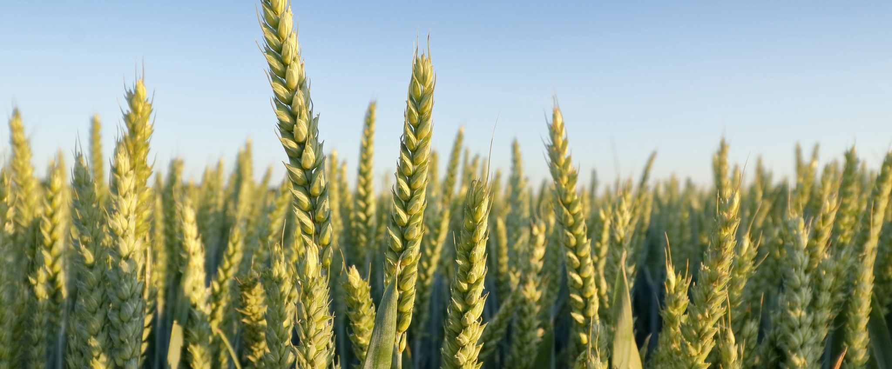
How Crop Insurance and Regenerative Ag Work Together Now

Slide 18
Changes
When we were conventionally tilling everything and had a prevent plant situation, to keep weeds down we would till the soil which would increase the risk of wind erosion and we weren’t keeping a living root in the soil.
Now, if we have a prevent plant situation, we either plant a cover crop or leave the volunteer crop growing from the previous year. This allows us to keep a living root in the soil to feed the biology, build soil structure, and keep the soil anchored.
Thankfully, the NRCS and the Risk Management Agency (RMA) have been responsive to grower concerns, and they updated their rules to allow for cover crops and other conservation practices in prevent-plant years. For example, this past year in 2021, the RMA allowed producers to hay, graze, or chop their cover crops as of July without penalty to their prevent-plant payment as opposed to November 1st under the old rules.
In the past, the crop insurance adjusters wanted to see a clean-tilled field when they were looking at prevent-plant acres. Now, having a cover crop out there is accepted and promoted.

Slide 19
Summary
No-till and cover crops have helped us to conserve irrigation water and improve soil health.
Crop insurance is a vital tool we employ to help us plan for the upcoming year and mitigate crop production risks that are inherent to farming.
These tools help us be optimistic and resilient in confronting the challenges that face farmers in the 21st century.
“Agriculture is our wisest pursuit, because it will in the end contribute most to real wealth, good morals, and happiness.” – Thomas Jefferson

