Slide 1

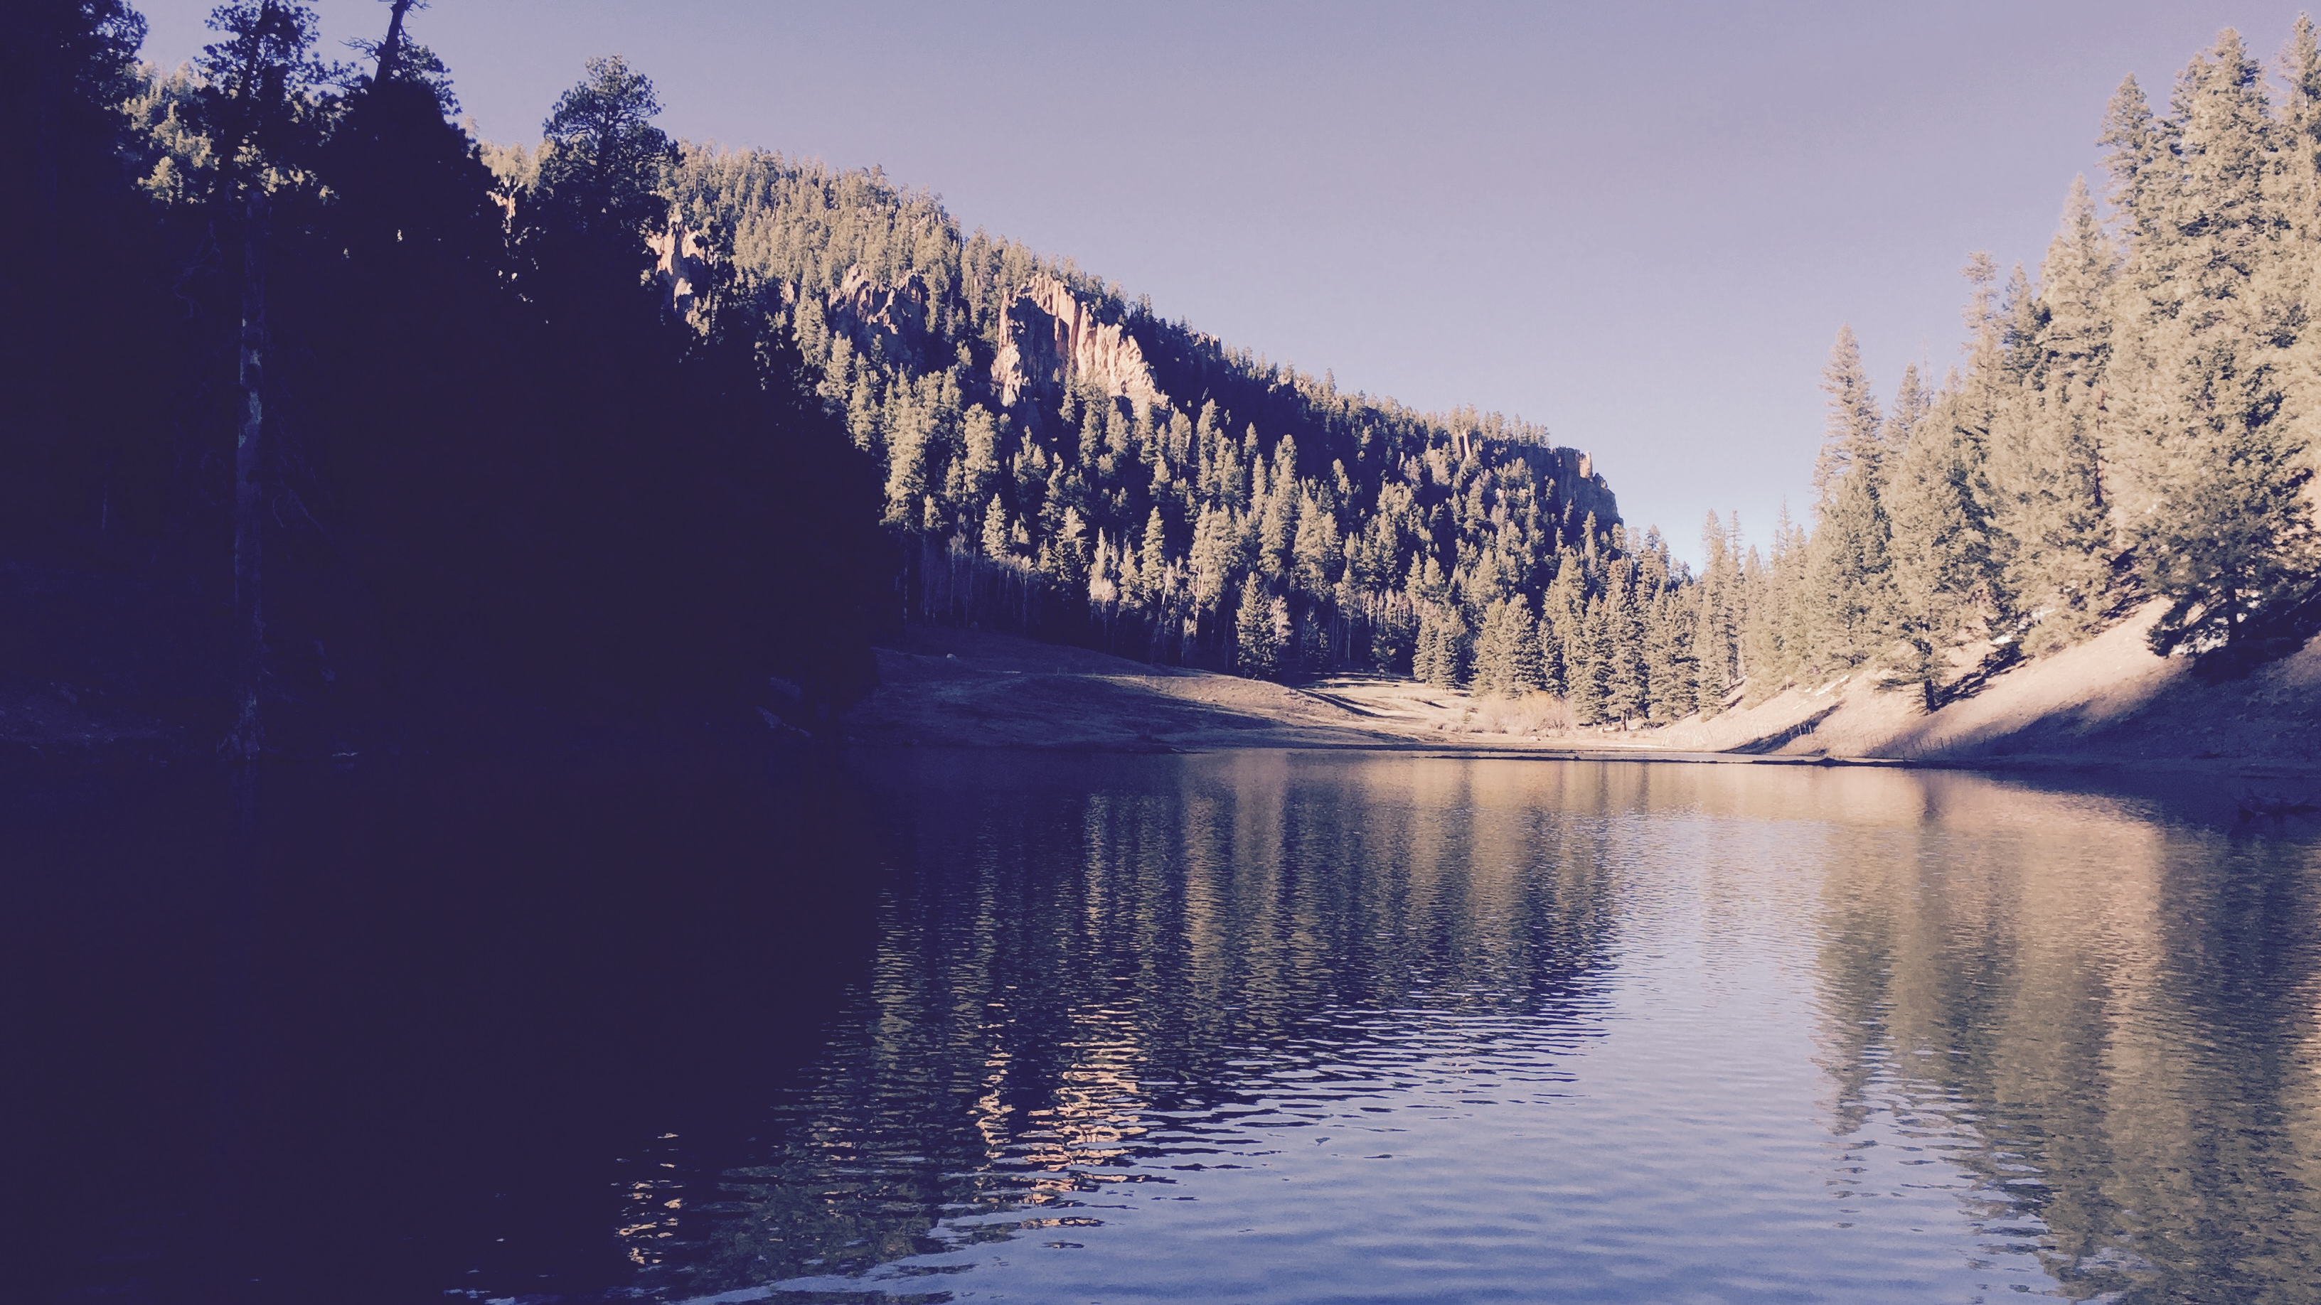
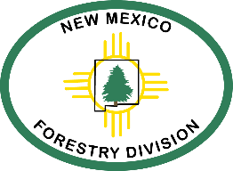
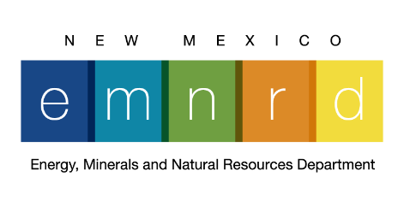
Forests to farm then table & tap
Laura McCarthy New Mexico State Forester
Energy, Minerals and Natural Resources Department February 2022

Slide 2
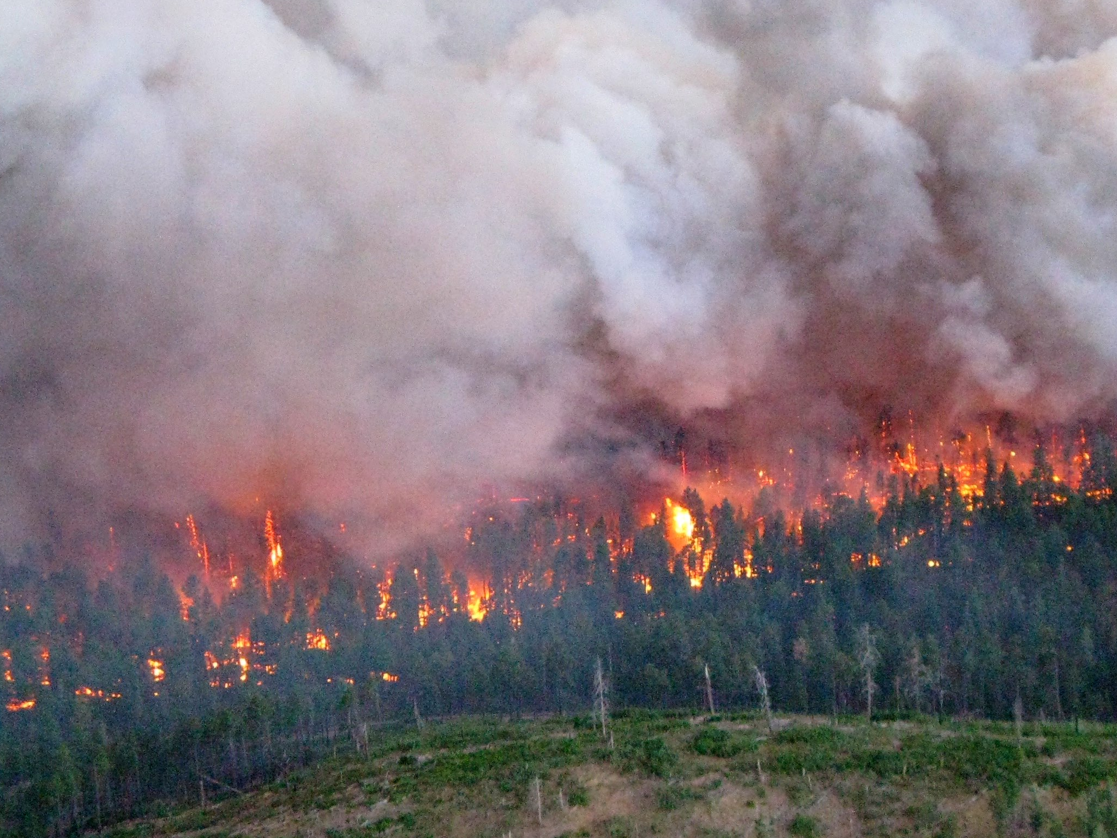
Credit: B. Klieson
Notes:
which leads to a novel fire regime for ponderosa where fires burn from one tree crown to the next, destroying the mature forest canopy. This is exactly what happened during the Las Conchas fire in 2011, shown here. the next few slides are from that fire and its effects.

Slide 3
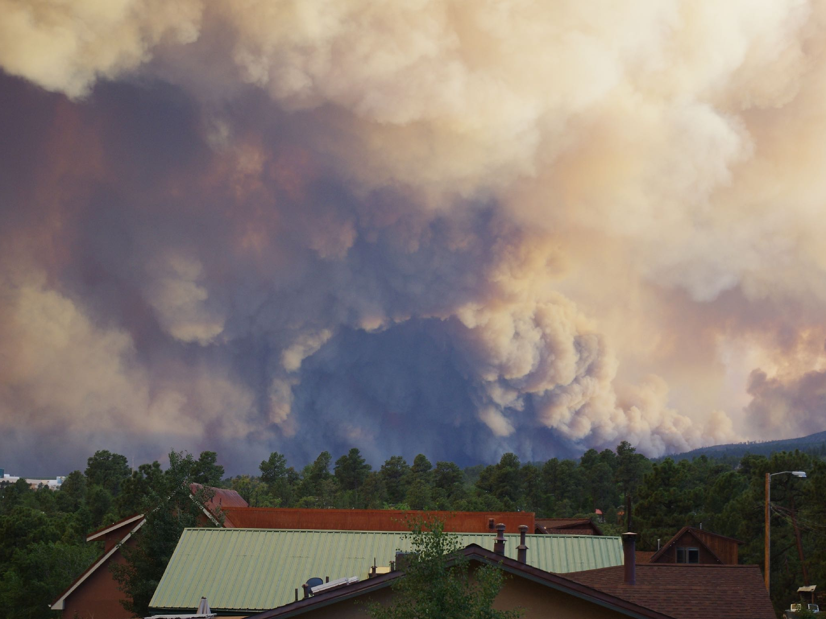
Credit: J. Haffey
Notes:
and for communities that depend on them…

Slide 4
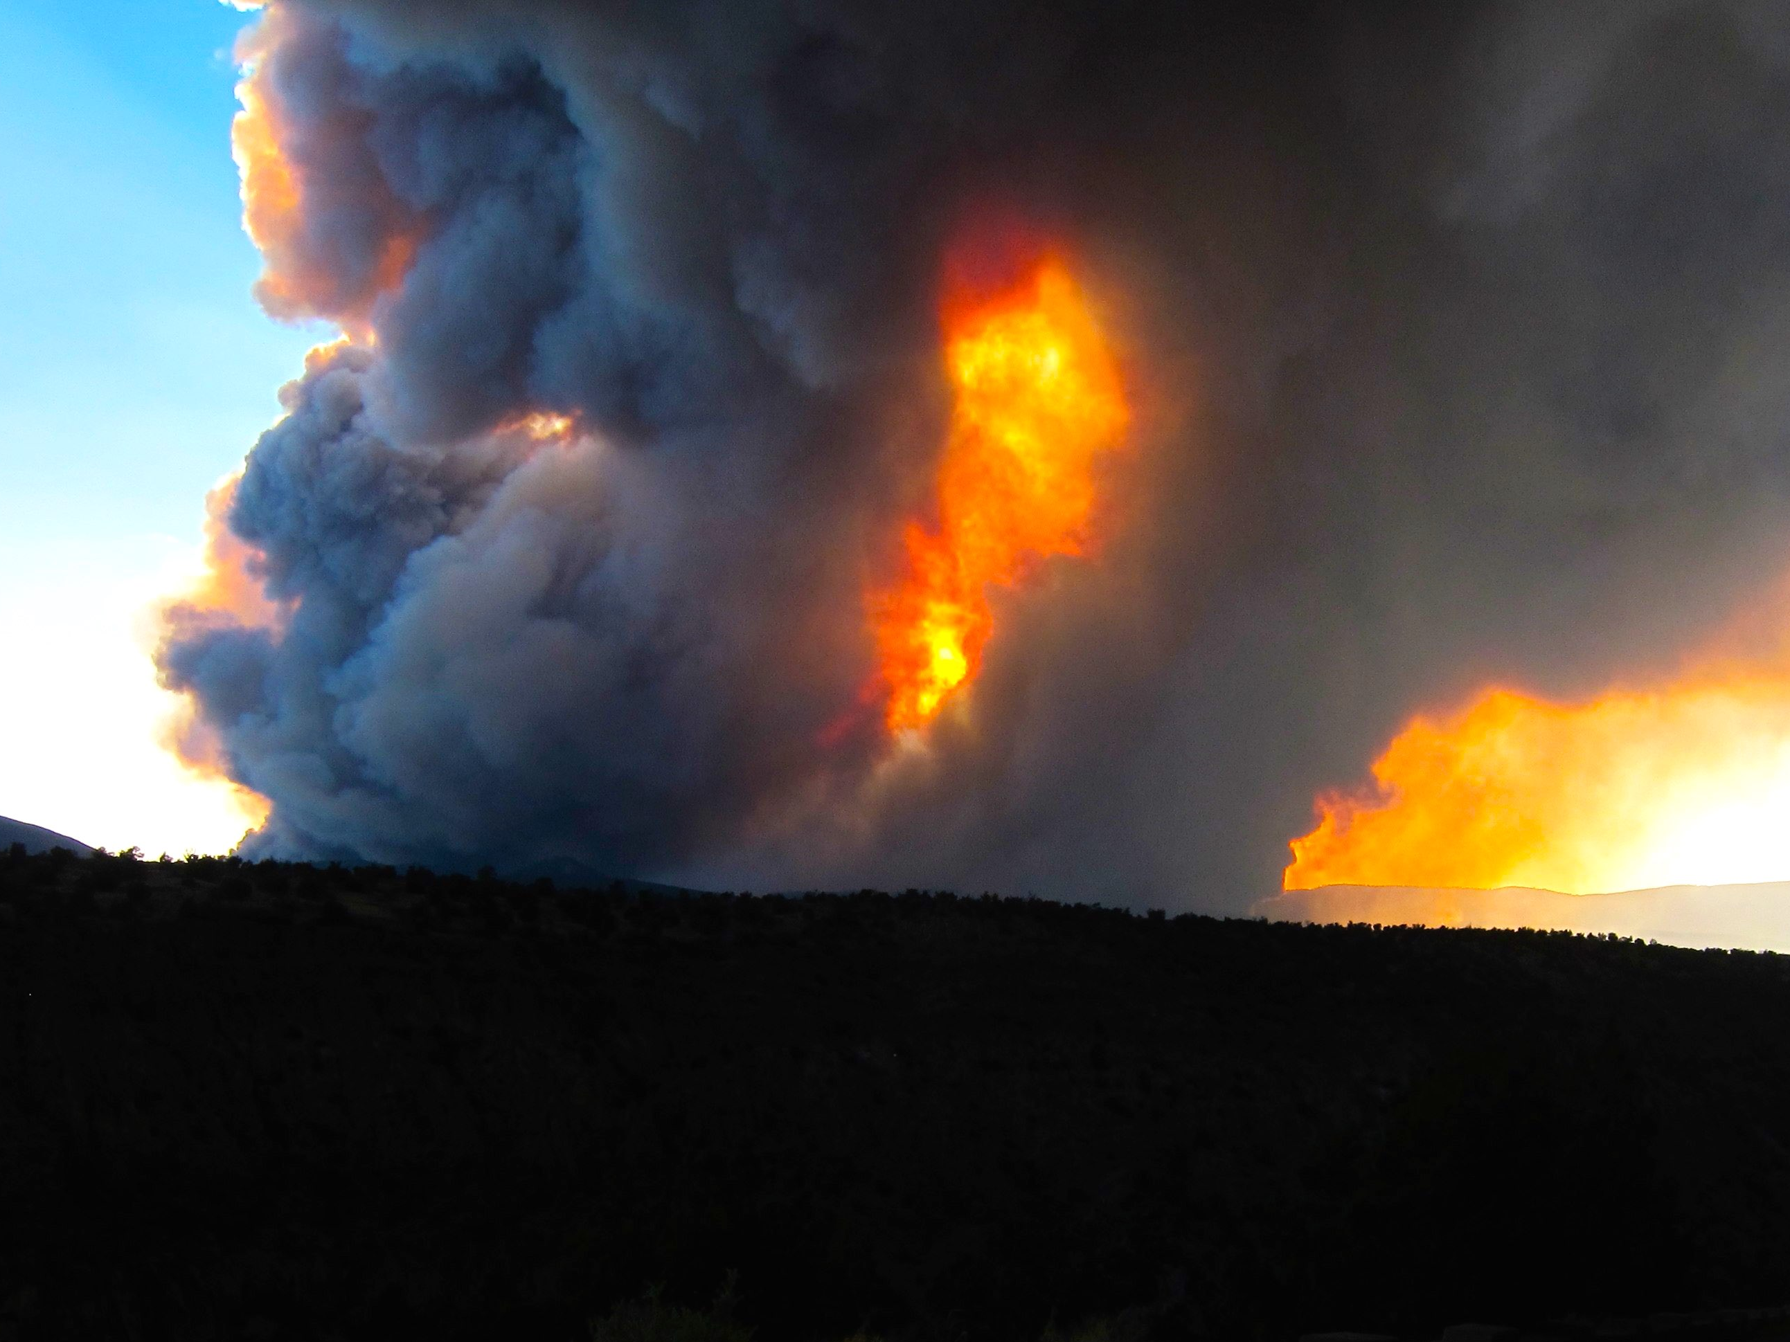
Credit: C. Allen
Notes:
Such extreme fire behavior results in large, high severity, patches…

Slide 5
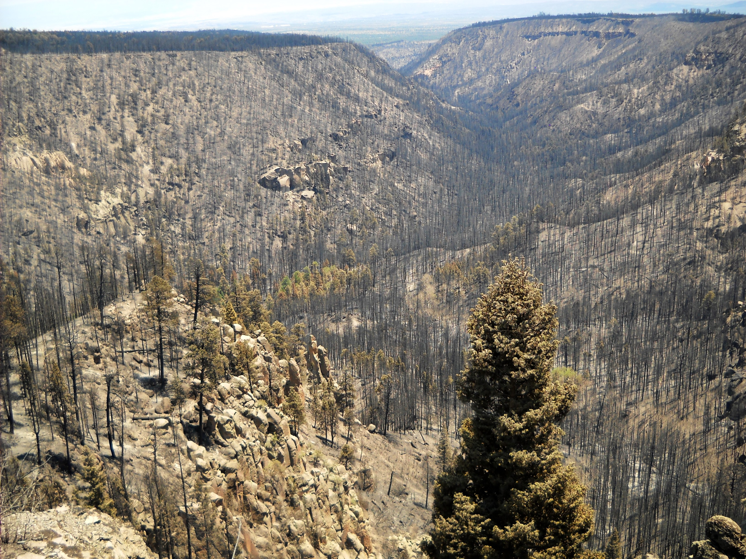
Notes:
with little or no surviving forest.

Slide 6
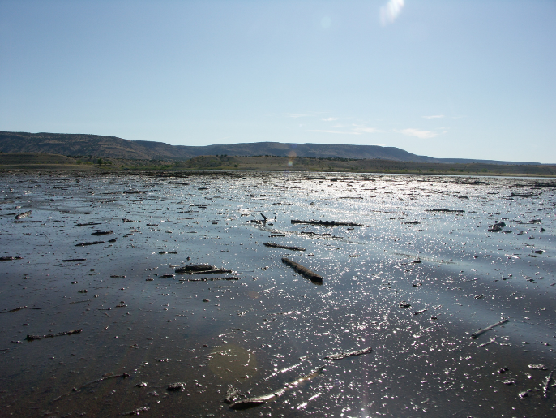

Project Goals:
Restore 600,000 acres over 20 years
Offer large-scale solution to forest health and resilience
Provide a new mechanism for collaboration, coordination and $
Catalyze state and federal policy

Slide 7
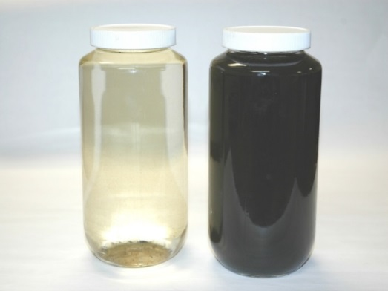

Slide 8
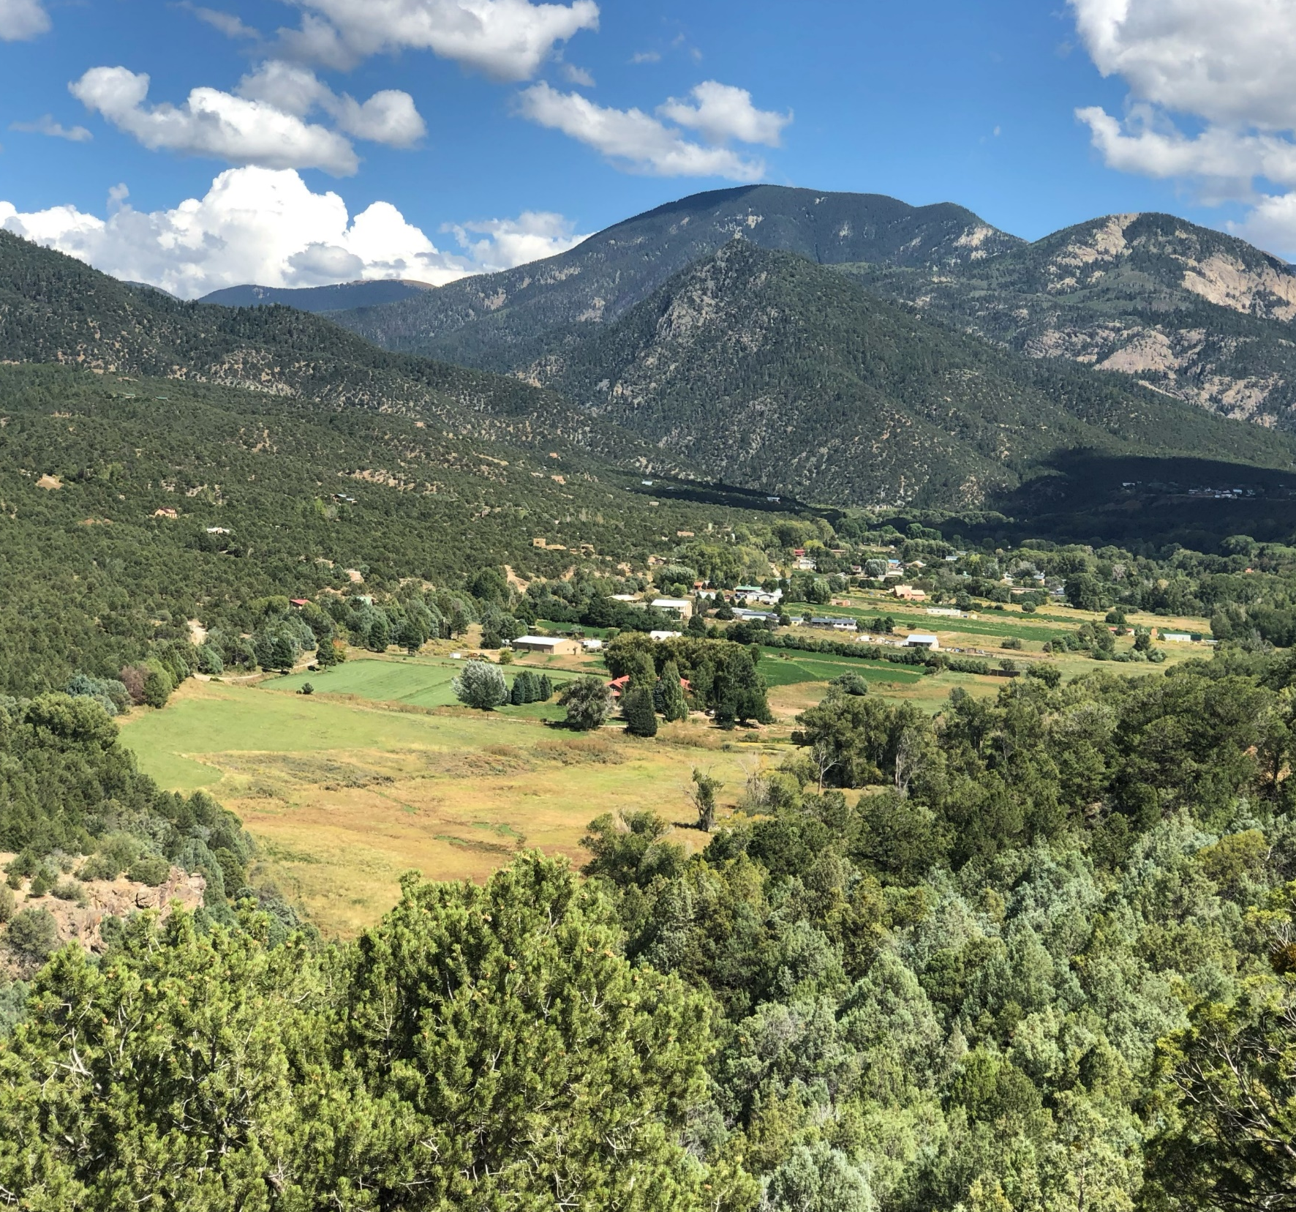
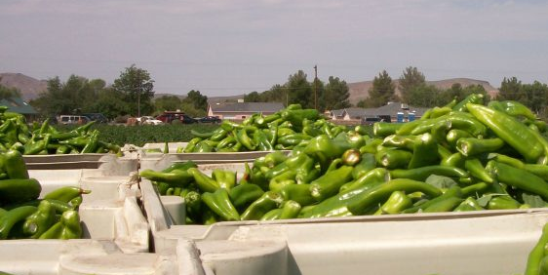
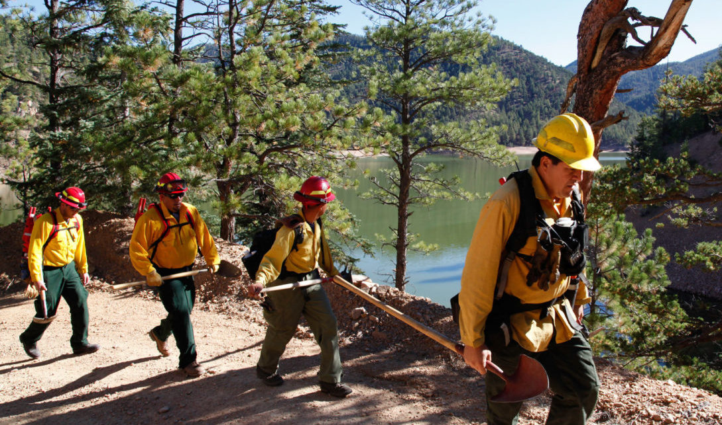
Credit: NMDA
Credit: Alan Eckert
Notes:
Our watersheds and forested areas are inextricably linked to the downstream farms, communities, and economies in New Mexico. Our coming water challenges are filled with uncertainties, but one thing is clear.
We must protect and restore healthy forests to ensure the vitality of future generations
We know everything is connected in some ways our job as land managers is shifting to one of managing, strengthening, and restoring the connections rather that simple managing the pools of resources or creating the demand. We must manage the flow.

Slide 9
50-70% of the municipal and agricultural water originates in forests.
NM EMNRD
Notes:
Add source

Slide 10
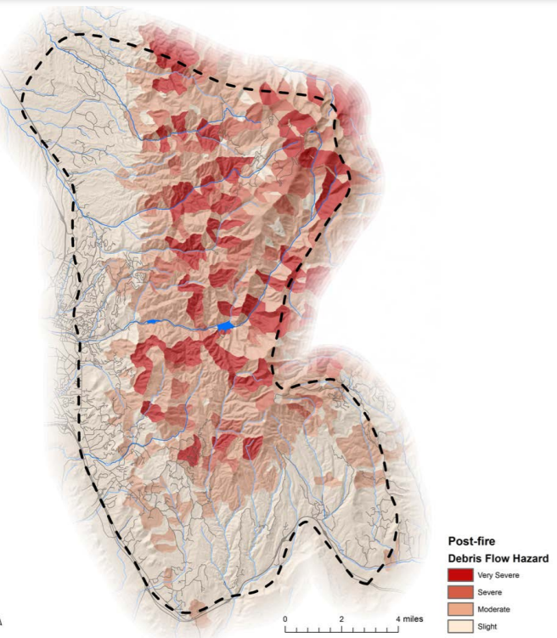
Pilot: Santa Fe Fireshed
Used peer-reviewed method to analyze risks to area surrounding Santa Fe
Collaboratively driven
Led to several actions and strategies (e.g., landscape scale NEPA)
Notes:
Much of the forest is managed by the USFS but the downstream users are finding ways to have a say over how management takes place. Using science to create a robust foundation and community values to prioritize the placement and timing of treatments we are able to create a collaborative management framework that results in strategic decisions rather than random acts of conservation.

Slide 11
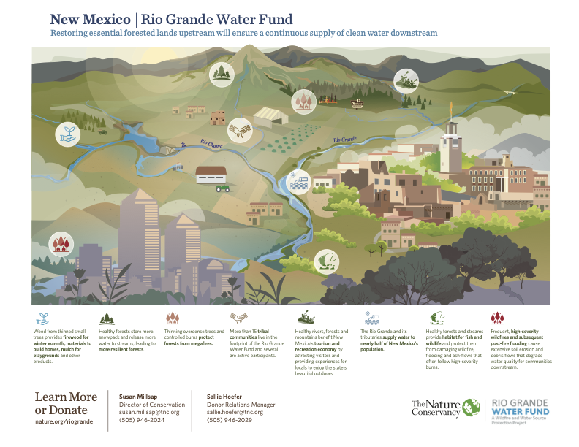
Notes:
Scaled up from 1 large fireshed centered around one large municipal watershed to 7 million acres. The rio grande water fund in NM is a public private partnership that... but in many ways it is still a pilot project (or a series of pilot projects) covering only a portion of the state. We need to learn at scale and enact strategies statewide.

Slide 12
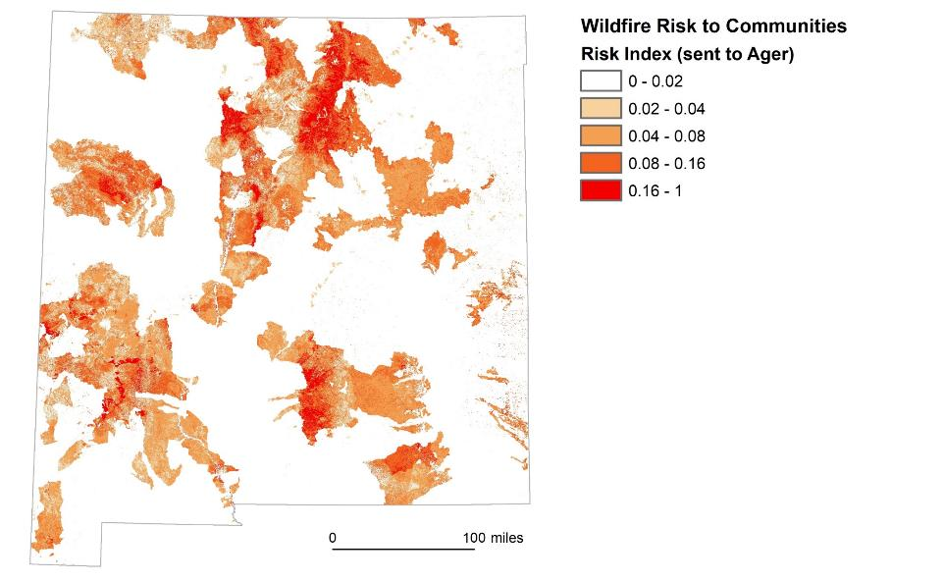
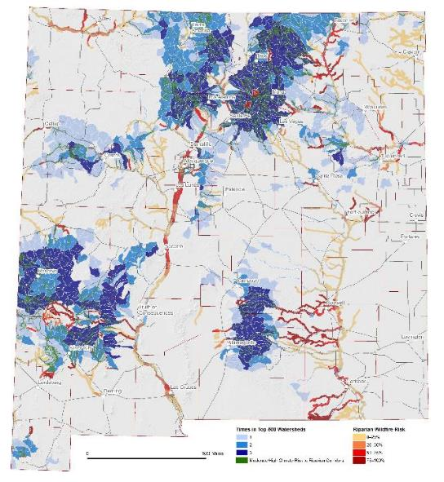
Notes:
Water Fund statewide in FAP
Following the success of the RGWF, the state worked to continue the effort and developed the 2020 forest action plan (a requirement of the farm bill). But rather simply "check the box" we used this as an opportunity to engage partners and determine priority areas down to the huc 12 level. During the processs we engaged over XX organizations including tribes, land grants, acequias across the state. In total we identified 10 priority landscapes and focal areas associated with them. Along with the spatial components we developed specifc actions items that roll up to stratgies. We coorindate and problem solve the implimentation of these strategies through place-based collaboratives and a state-wide forest and watershed health coordinating group.

Slide 13
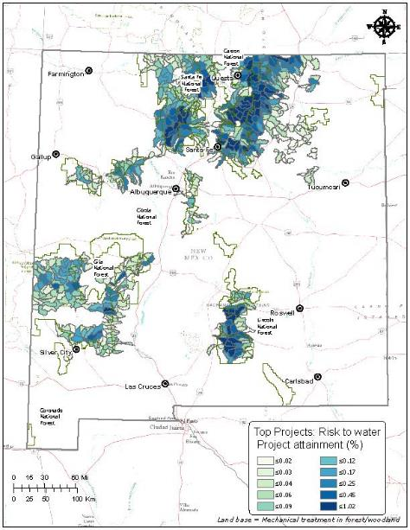
All Lands Shared Stewardship Priorities – Top 500
Notes:
Top 500 Watersheds
Following the success of the RGWF, the state worked to continue the effort and developed the 2020 forest action plan (a requirement of the farm bill). But rather simply "check the box" we used this as an opportunity to engage partners and determine priority areas down to the huc 12 level. During the processs we engaged over XX organizations including tribes, land grants, acequias across the state. In total we identified 10 priority landscapes and focal areas associated with them. Along with the spatial components we developed specifc actions items that roll up to stratgies. We coorindate and problem solve the implimentation of these strategies through place-based collaboratives and a state-wide forest and watershed health coordinating group.

Slide 14
10 Forest Action Plan Strategies
Restore Forests and Watersheds
Fire Management
Private Land Stewardship
Utility Rights of Way
Rare Plants
Reforestation
Urban Forests and Communities
Restoration Economy
Land Conservation
Outdoor Recreation

Slide 15

Forest and Watershed Restoration Act
Dedicated non-federal funding for restoration
Tied to Forest Action Plan
Must be landscape scale and benefit downstream water users
Photo by Geran de Klerk on Unsplash
Notes:
Brief description on FAWRA, the end state of pilots at scale is policy that solves real challenges that are identified in the field, from the bottom up. As opposed to solutions created in a lab or policy office.

Slide 16
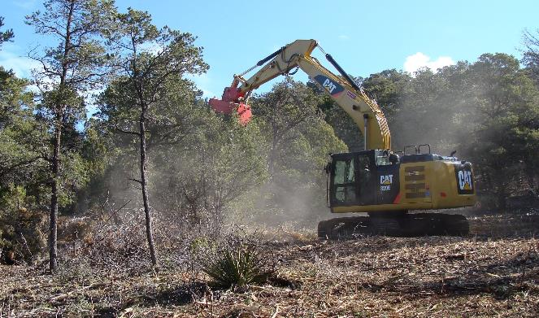
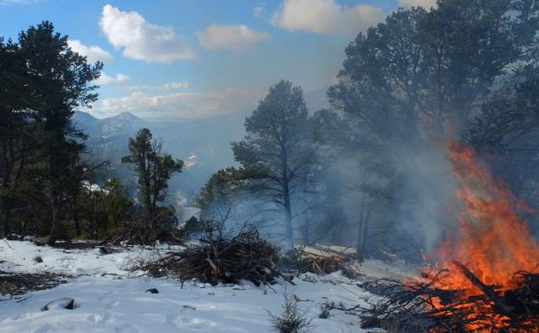
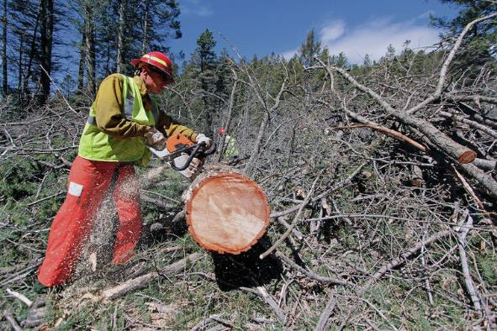
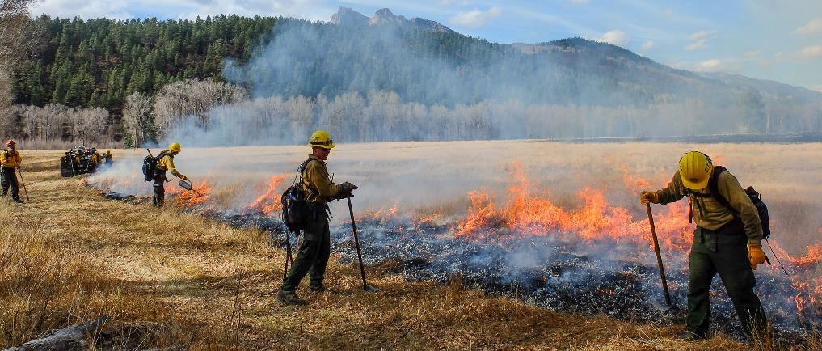
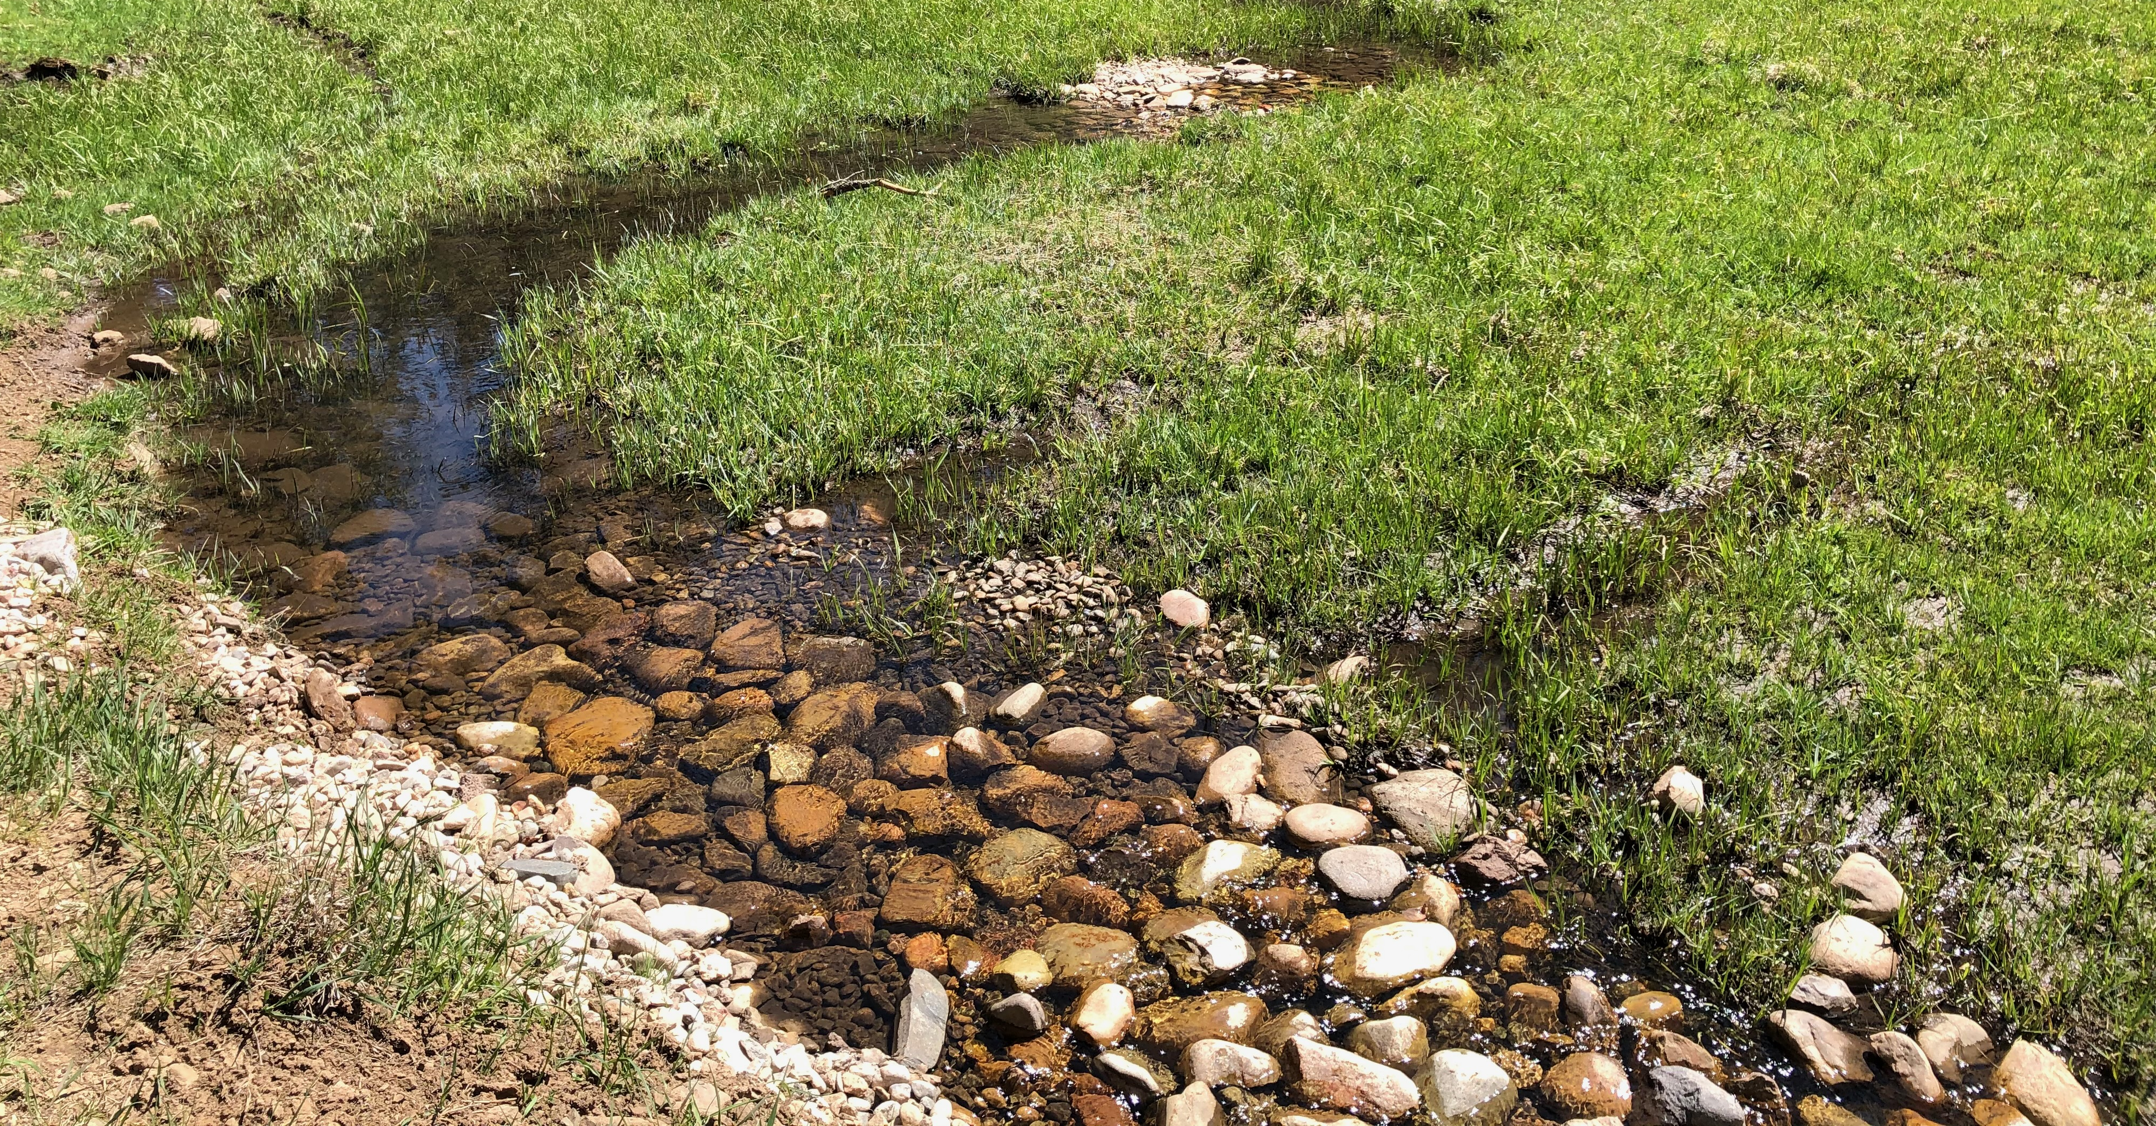
FAWRA can fund: Treatments, Planning and Economic Development
Photo courtesy of Esme Cadiente
Notes:
All the things that FAWRA can fund, including survey and other compliance needs, this is one way that the state can support shared stewardship and leverage our state dollars to match the federal dollars and make it all go as far as possible with the biggest impact.

Slide 17
26 jobs and $5M of economic impact for every $1M spent on restoration
Huber et al., USGS Open-File Report 2019–1108
Notes:
Including direct and secondary effects, one million dollars spent on landscape-scale forest restoration treatments supports an estimated 26 jobs, $1,274,000 in labor income, $1,549,000 in value added, and $2,231,000 in economic output within the Western States region.

Slide 18
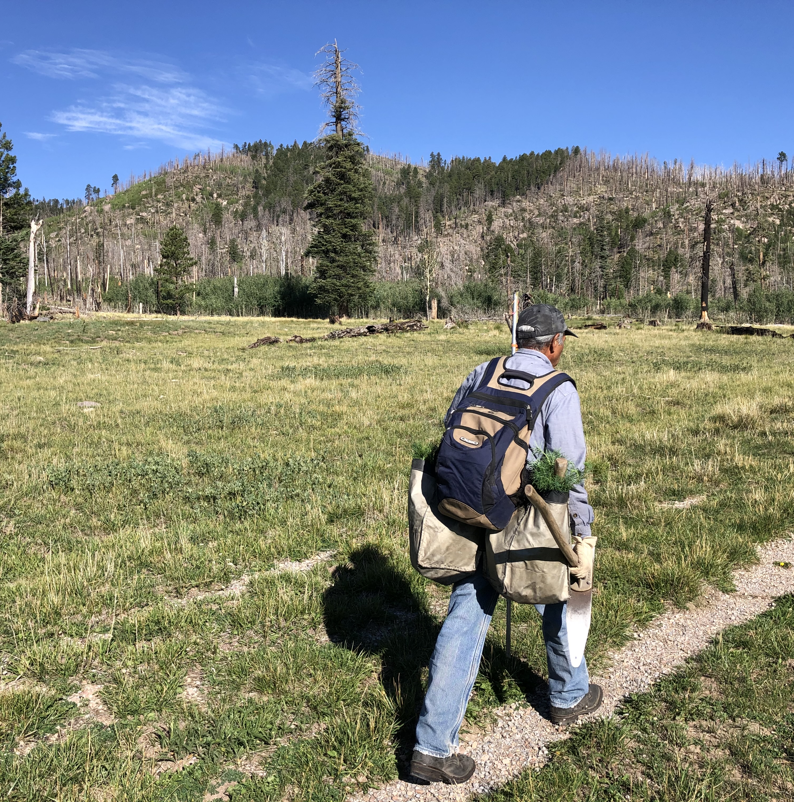
Focus: Workforce Development
Youth and professional education
Jobs and skills training
Business incentives
Increase local contractor capacities
Notes:
We know restoration can have a benefit to the local economy but it does beyond the economy to supporting a way of life that is connected to the landscape and passing values down from one generation to the next through education and experience. We hope to create year-round work for people who want to stay in NM and earn a living while being with the families and contributing to their communities.

Slide 19
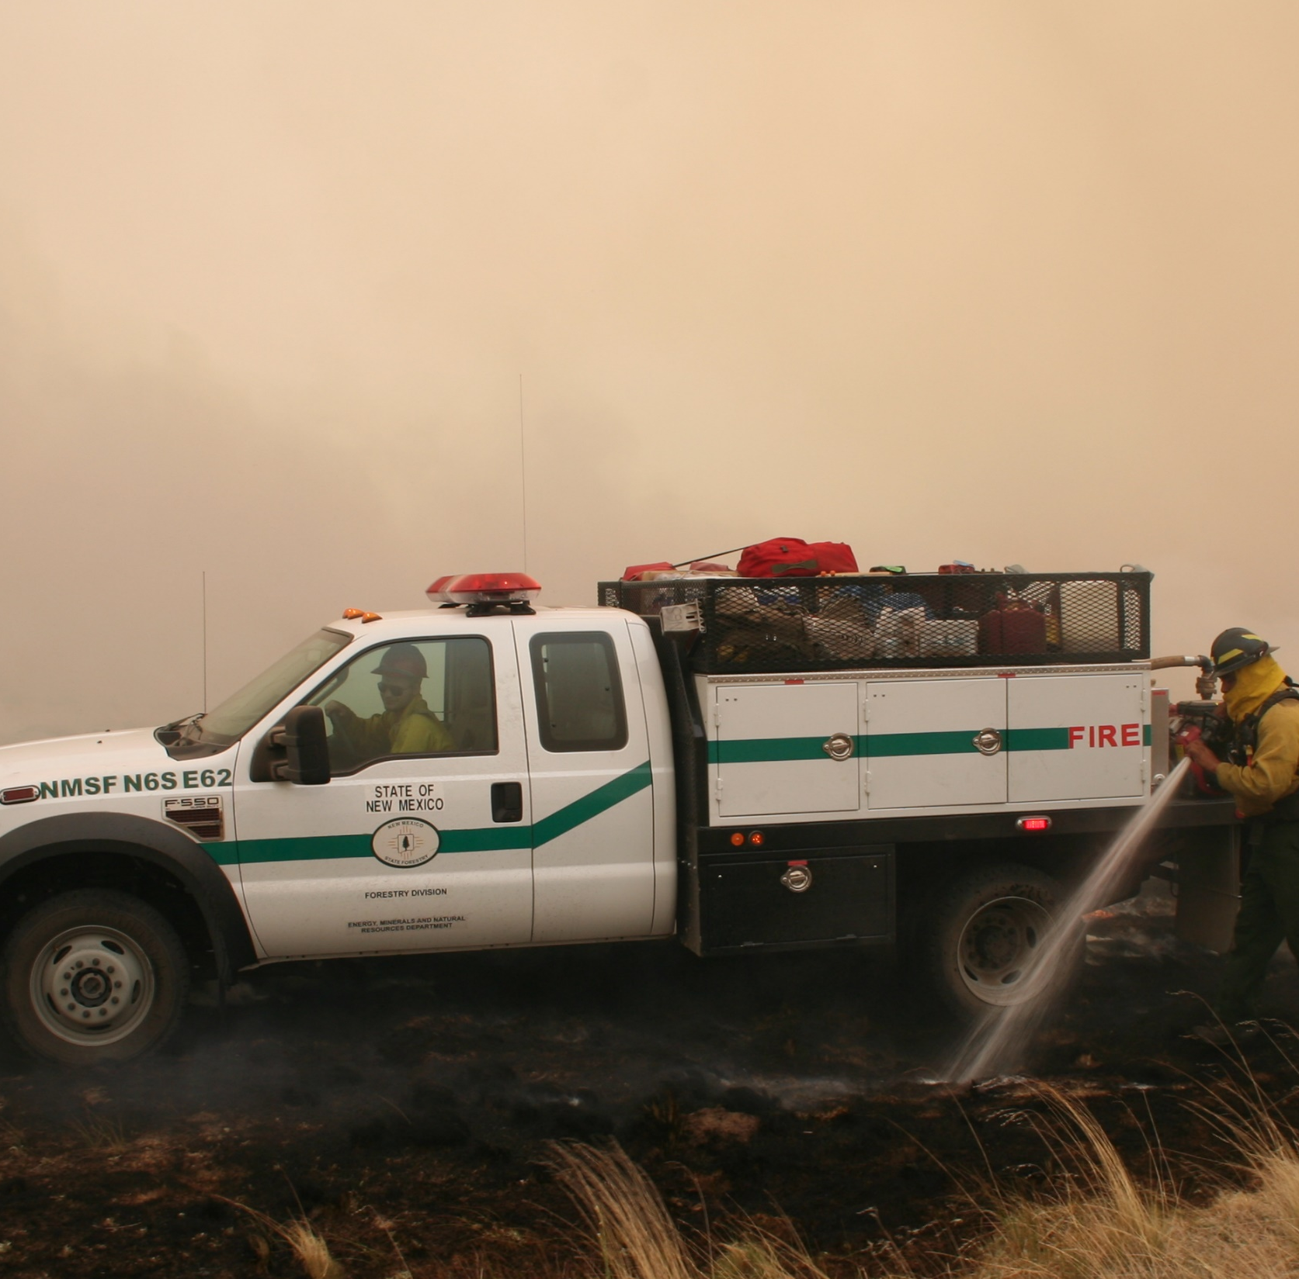
52 weeks of fire
Planning season
Training season
Suppression season
Rx fire season
Notes:
Still have 4 seasons but they are now focused on different aspects of responding to fire : basically the cohesive strategy but now it is all year round. Joke : These might not be as distinct as the spring summer fall and winter but in NM we are used to mixing our mixing our seasons, especially summer during winter these days.

Slide 20
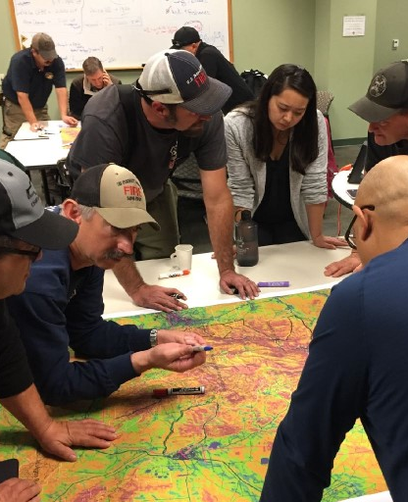
Fire effects not fence lines
Driven by landowner goals
Utilizes Potential Operational Delineations to maximize fire fighter safety
Increases operational decision space
Avoids inefficient suppression efforts
Notes:
Modified suppression focusing on fire fighter safety
Avoids dumb things like suppressing a fire at a fence line for no other reason than the boundary

Slide 21
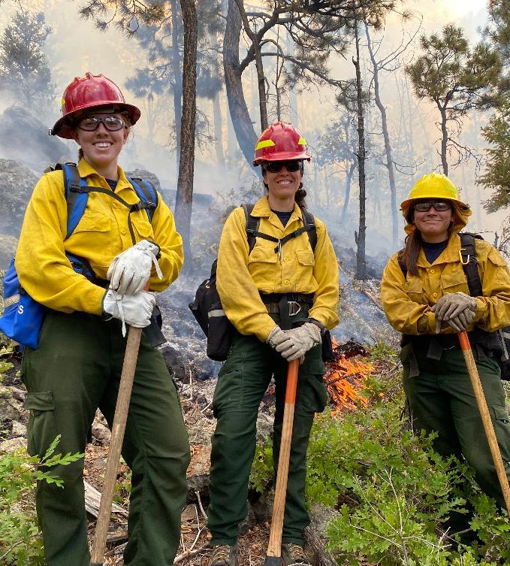
Getting more good fire on the ground
2021 passed the prescribed fire act creating the “right to burn” for private landowners
Reduces liability by defining standards
Creates certified burner program
Notes:
Prescribed burn act stuff

Slide 22
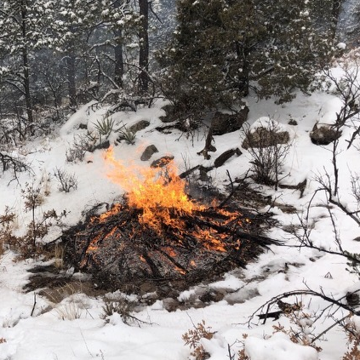
Pile Burn Certificate
Low complexity
Burn activity fuel from property
A good entry into Rx fire

Slide 23
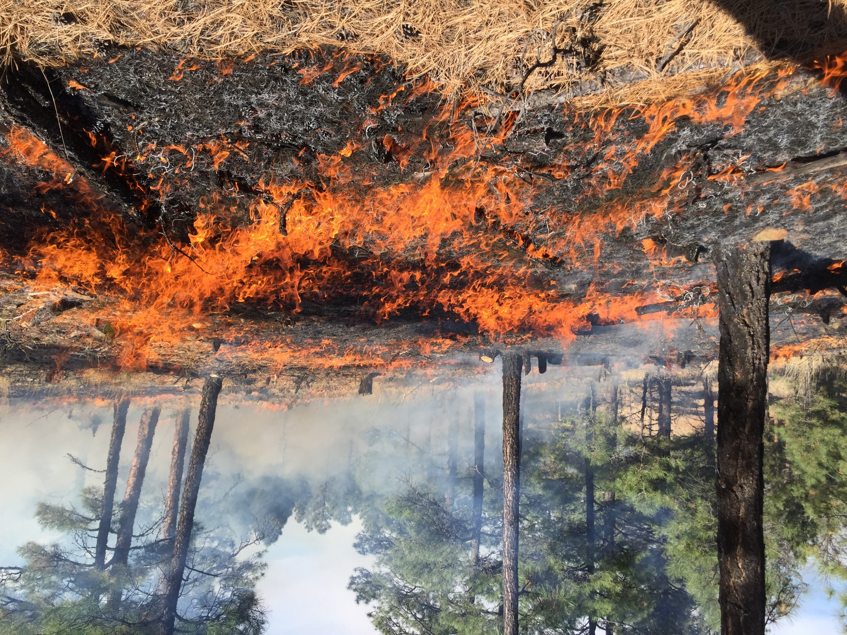
Broadcast Burn Certification
Higher complexity
Larger scale land management
Opportunity for contractors and business development

Slide 24
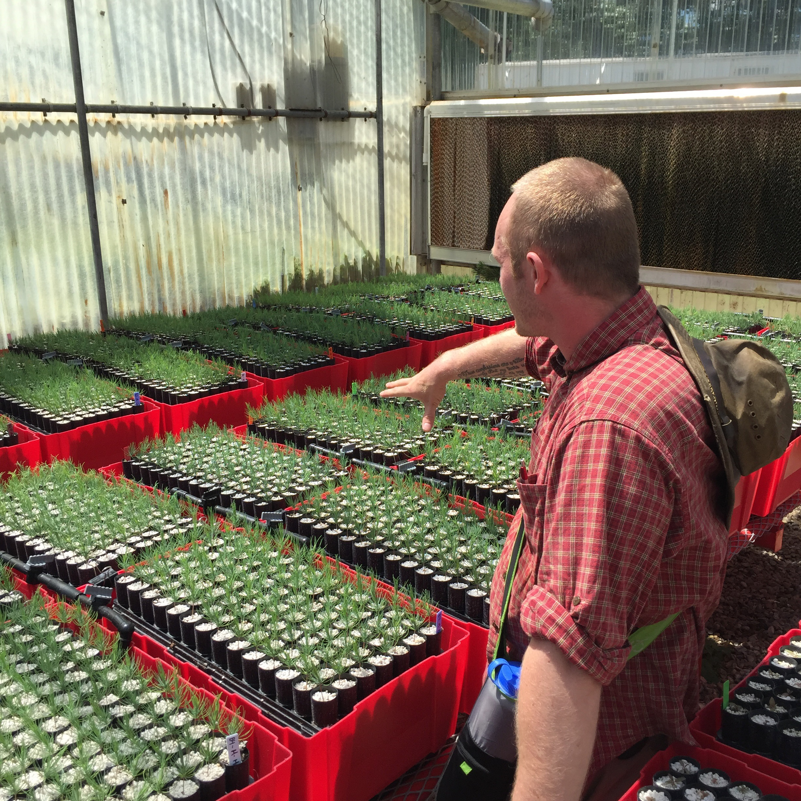
Reforestation after fires
New Mexico State Univ., NM Highlands Univ., UNM, NM Forest and Watershed Restoration Institute (SWERI)
3 Parts
  Nucleation Planting
  Field research on reforestation and climate change
  Research to improve seedling stock
Notes:
Late night work in a hotel in Taos.

Slide 25
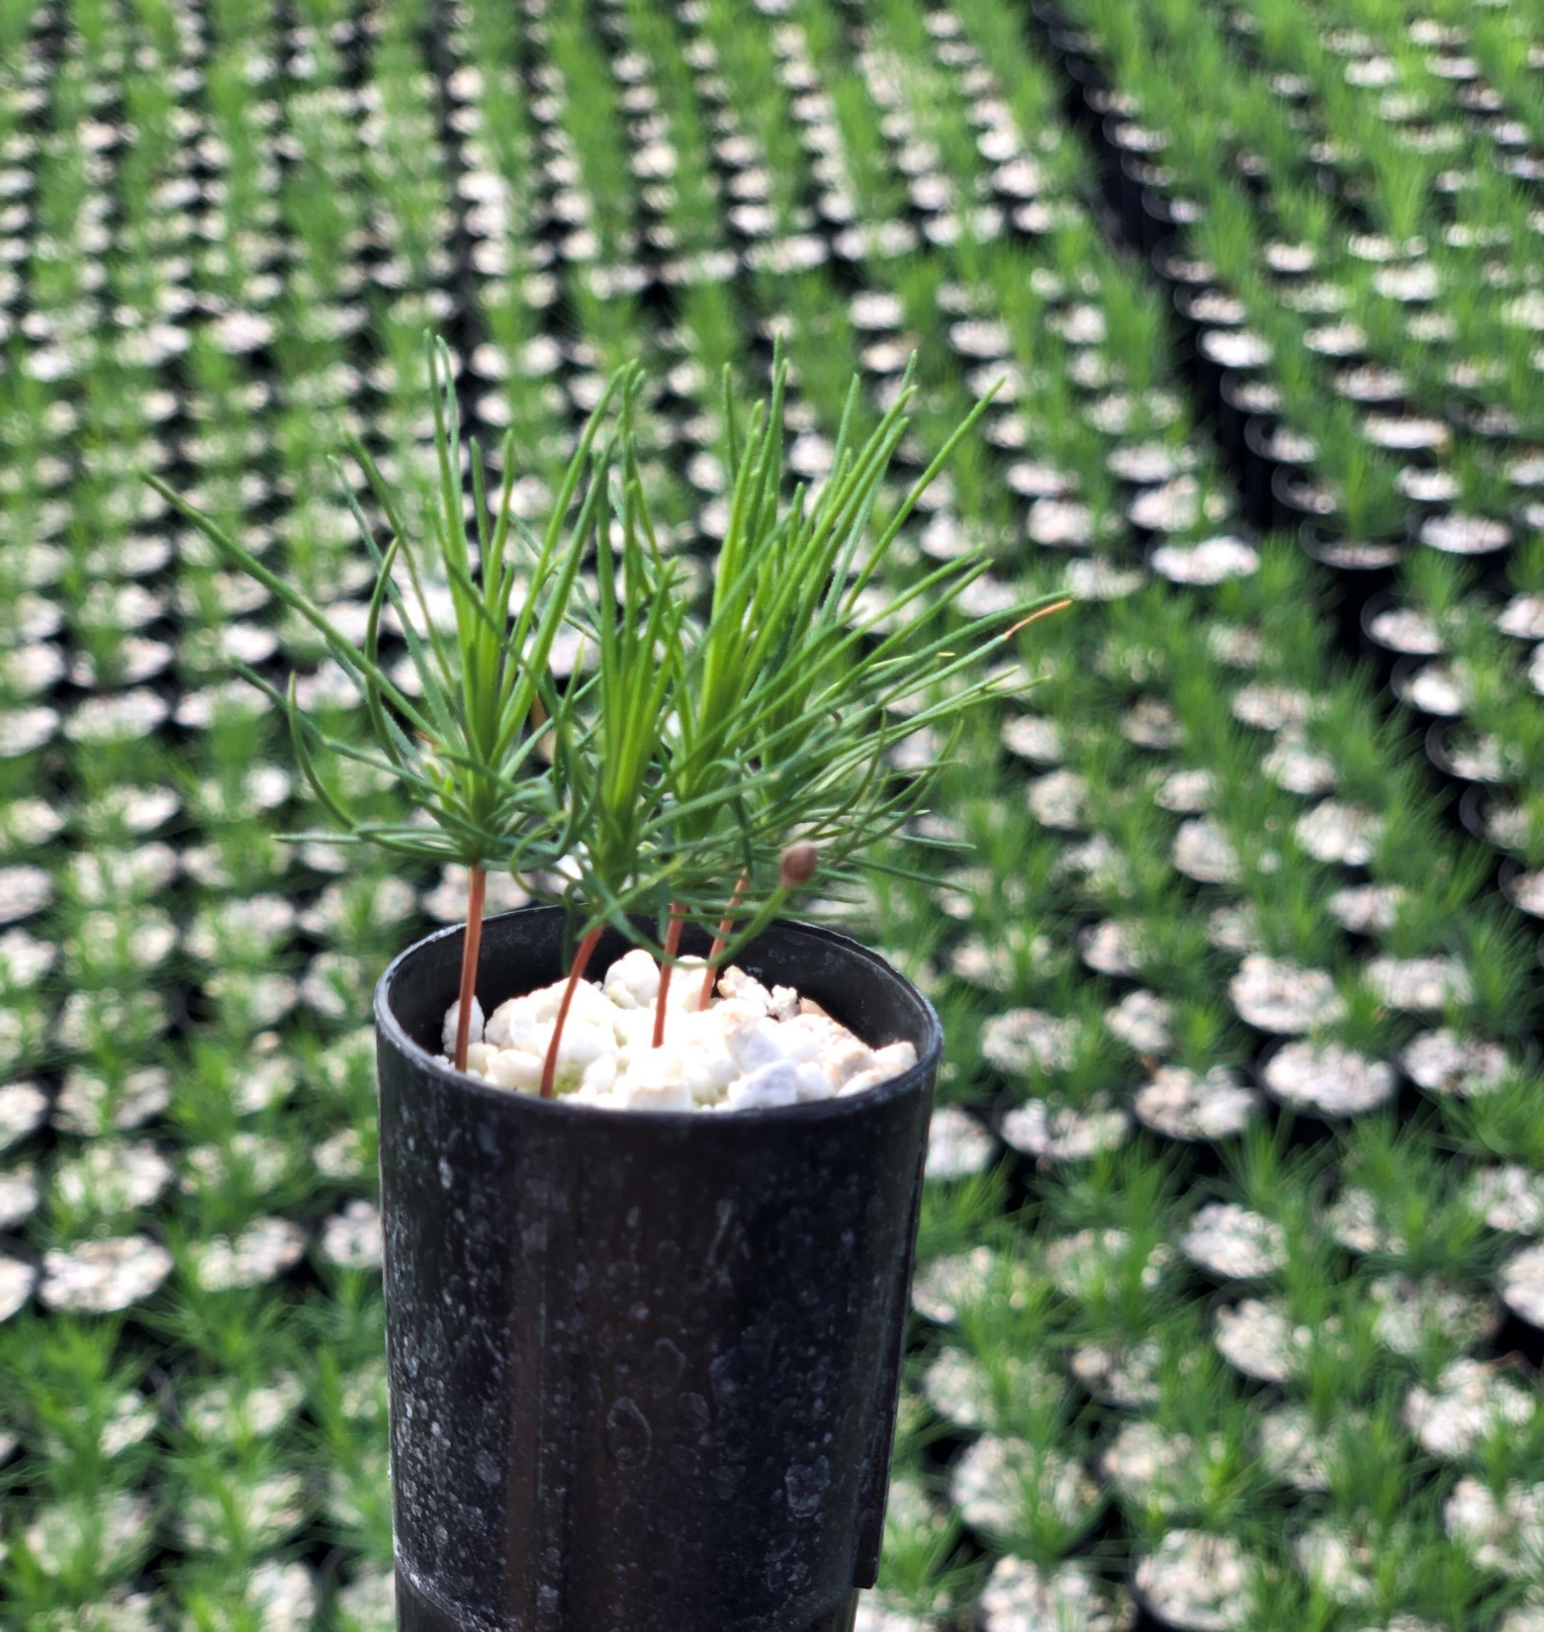
NM Reforestation Center
Collaborative agreement between Forestry Division and Universities
Focus on post-fire reforestation
Addresses the reforestation pipeline challenges
  Seed
  Nursery
  Planting
  Post-planting
Notes:
Job and business development in all of this

Slide 26
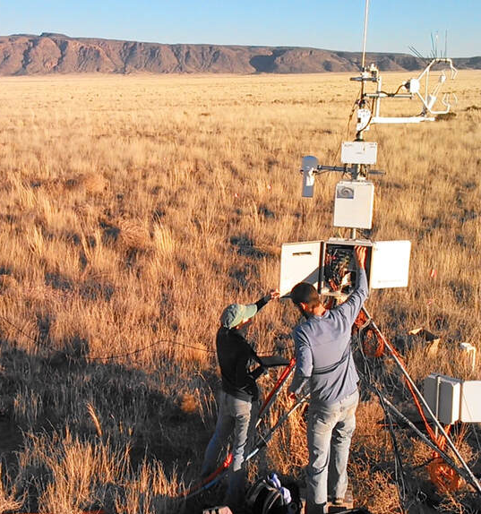
Working lands and carbon flux
Working with landowners to pilot efforts that stabilize or increase carbon on working lands
Creating place-specific carbon accounting models for New Mexico's arid environment
Collaborting across a network of scientists, landowners, and managers. Includes NMDA, SW Climate Hub, Climate Adaptation Science Center and NM Univs.
Credit: Litvak Lab​
Notes:
Job and business development in all of this

Slide 27
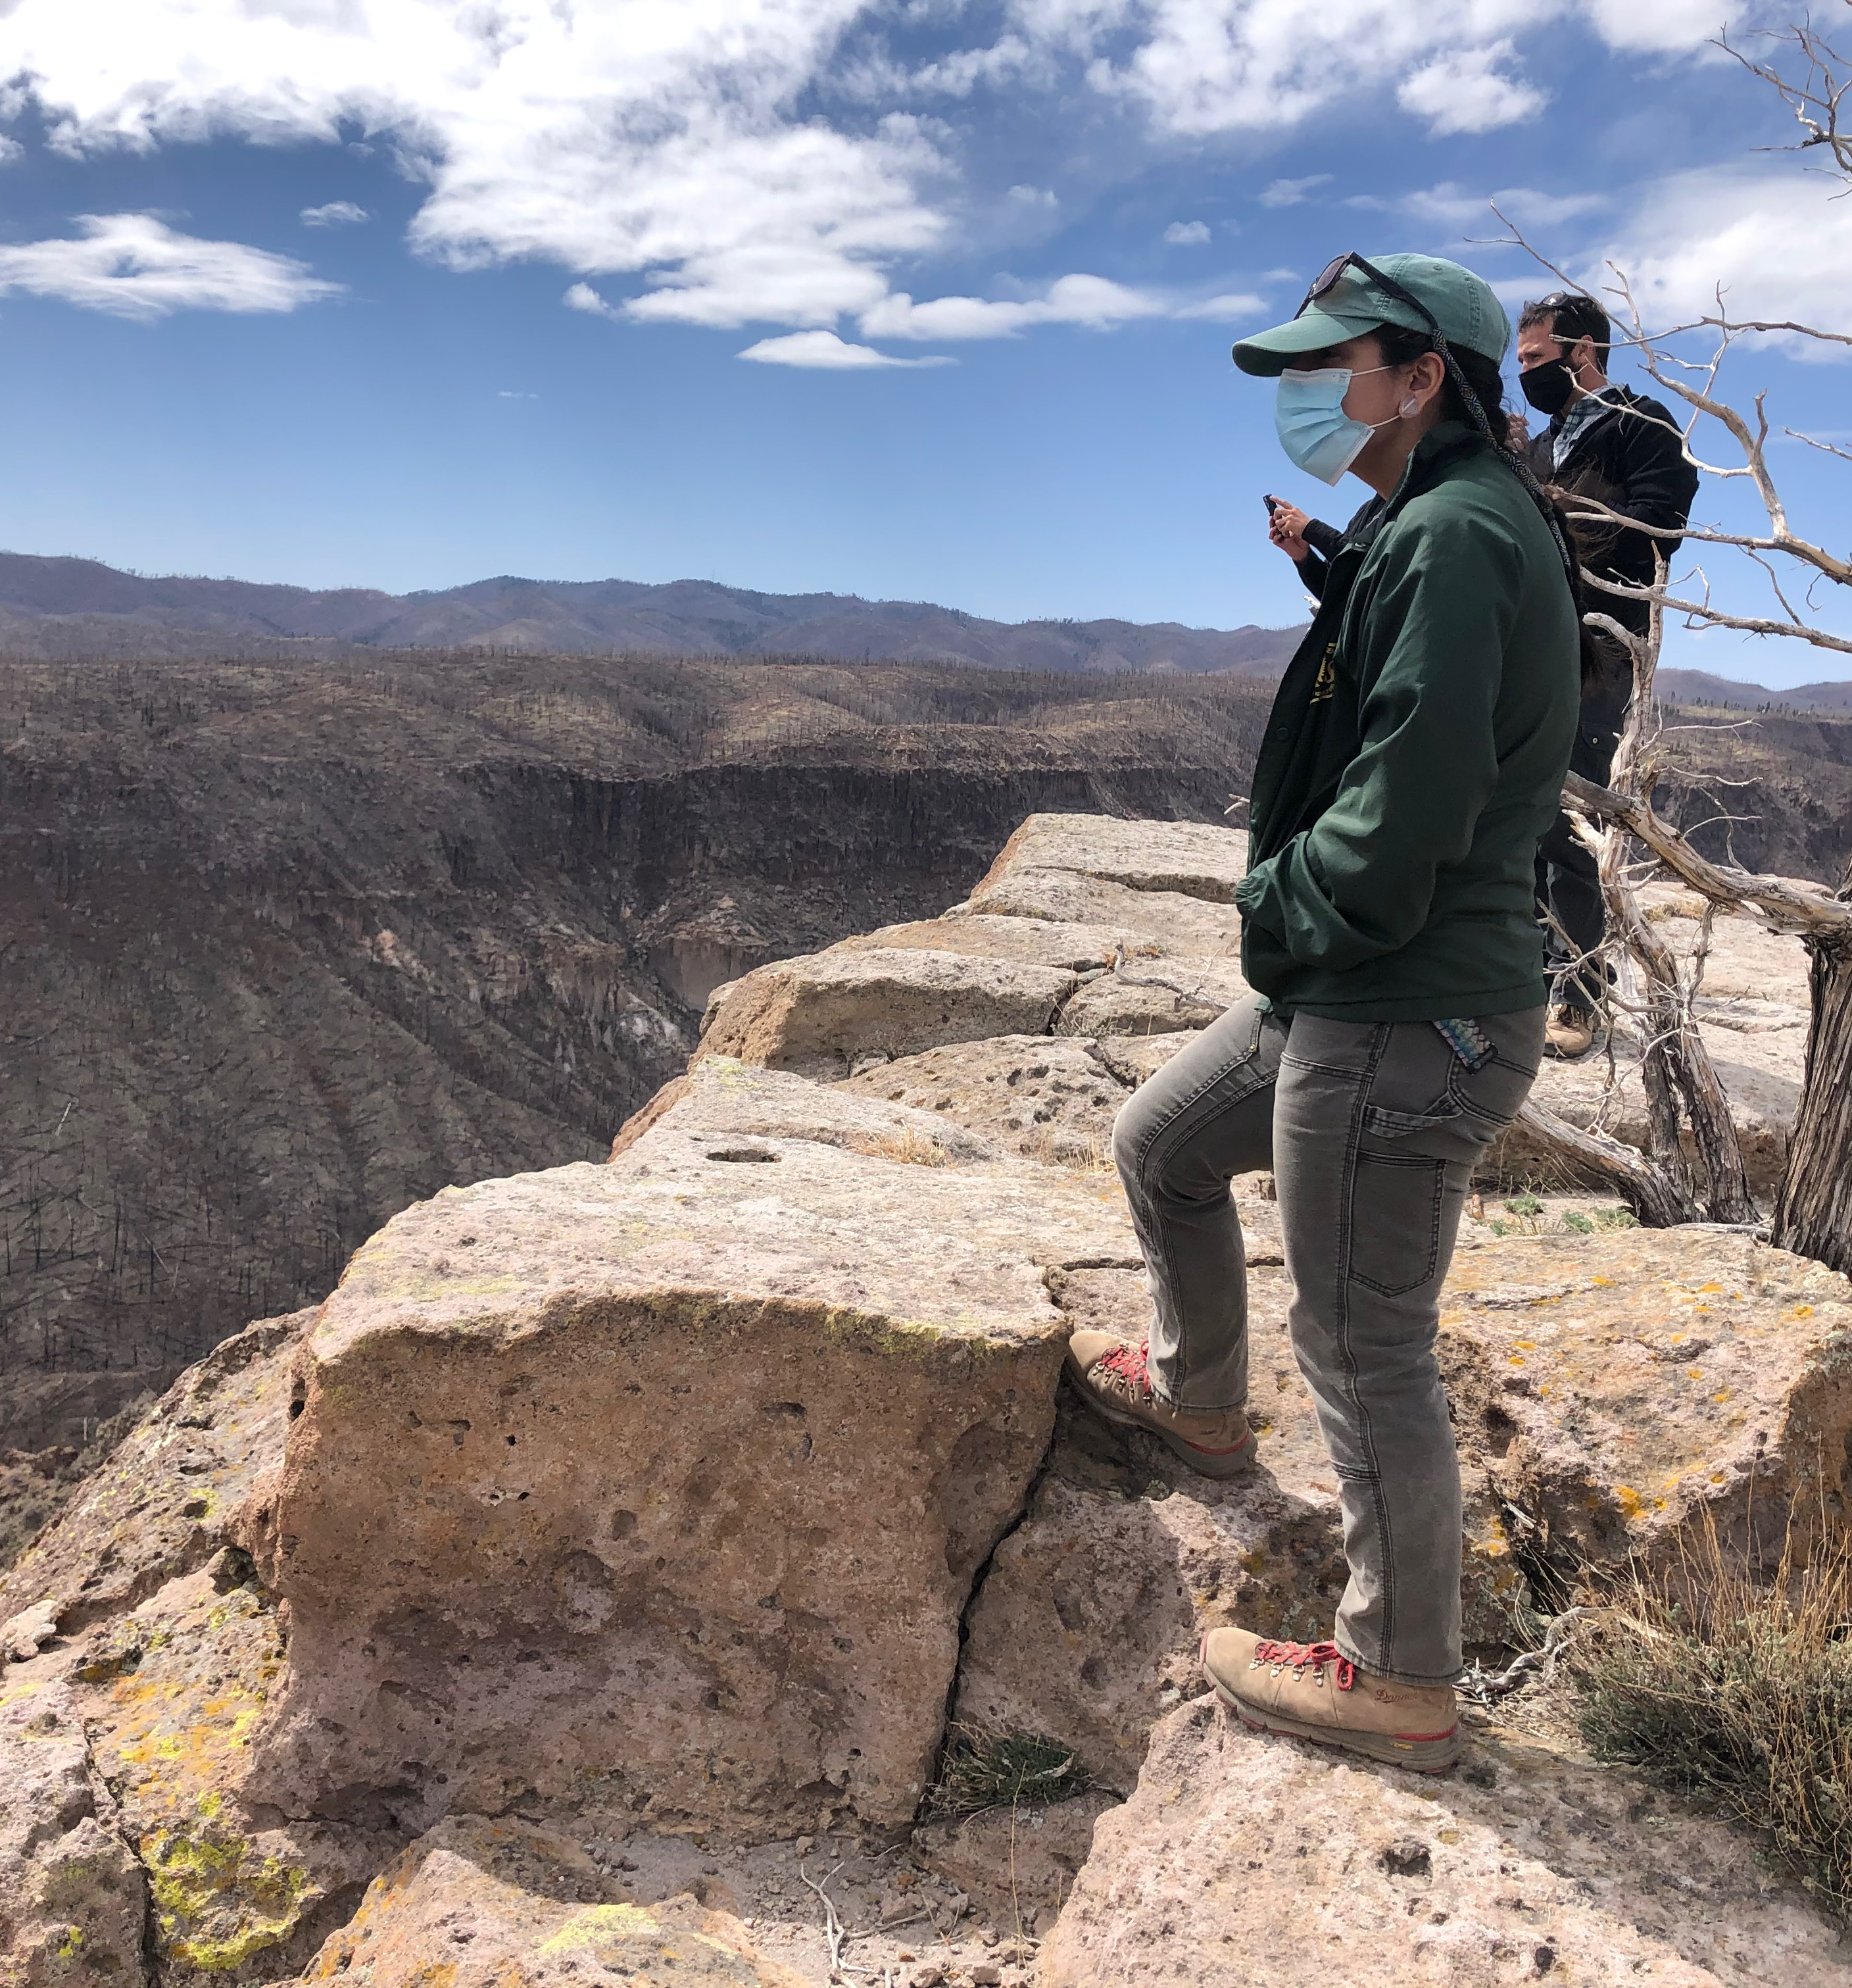
Looking forward: Challenges
Funding is coming – this will stretch our collective capacity to the max
Persistent dry conditions – moving into an ignition limited season
Bureaucracy isn’t keeping pace with drying conditions – hiring, procurement, environmental regulations, all need to be rethought to meet the challenge
Capacity building needs

Slide 28
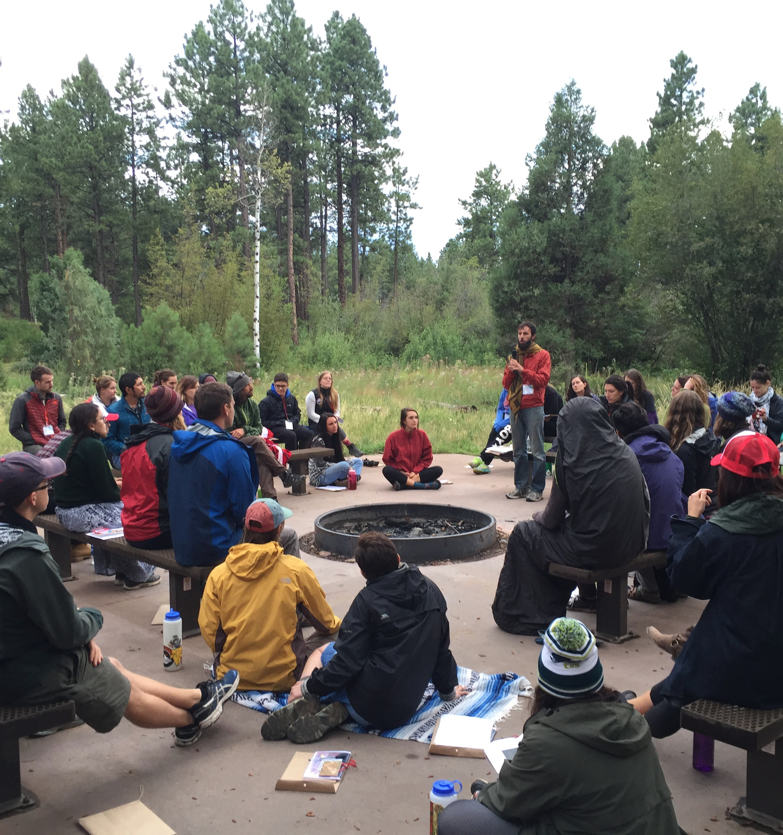
Looking forward: Enabling Conditions
Funding is coming – dollars for days
Strong support from leadership for proactive fire management -- our bosses “get it”
Partners willing and able to innovate and work together

Slide 29
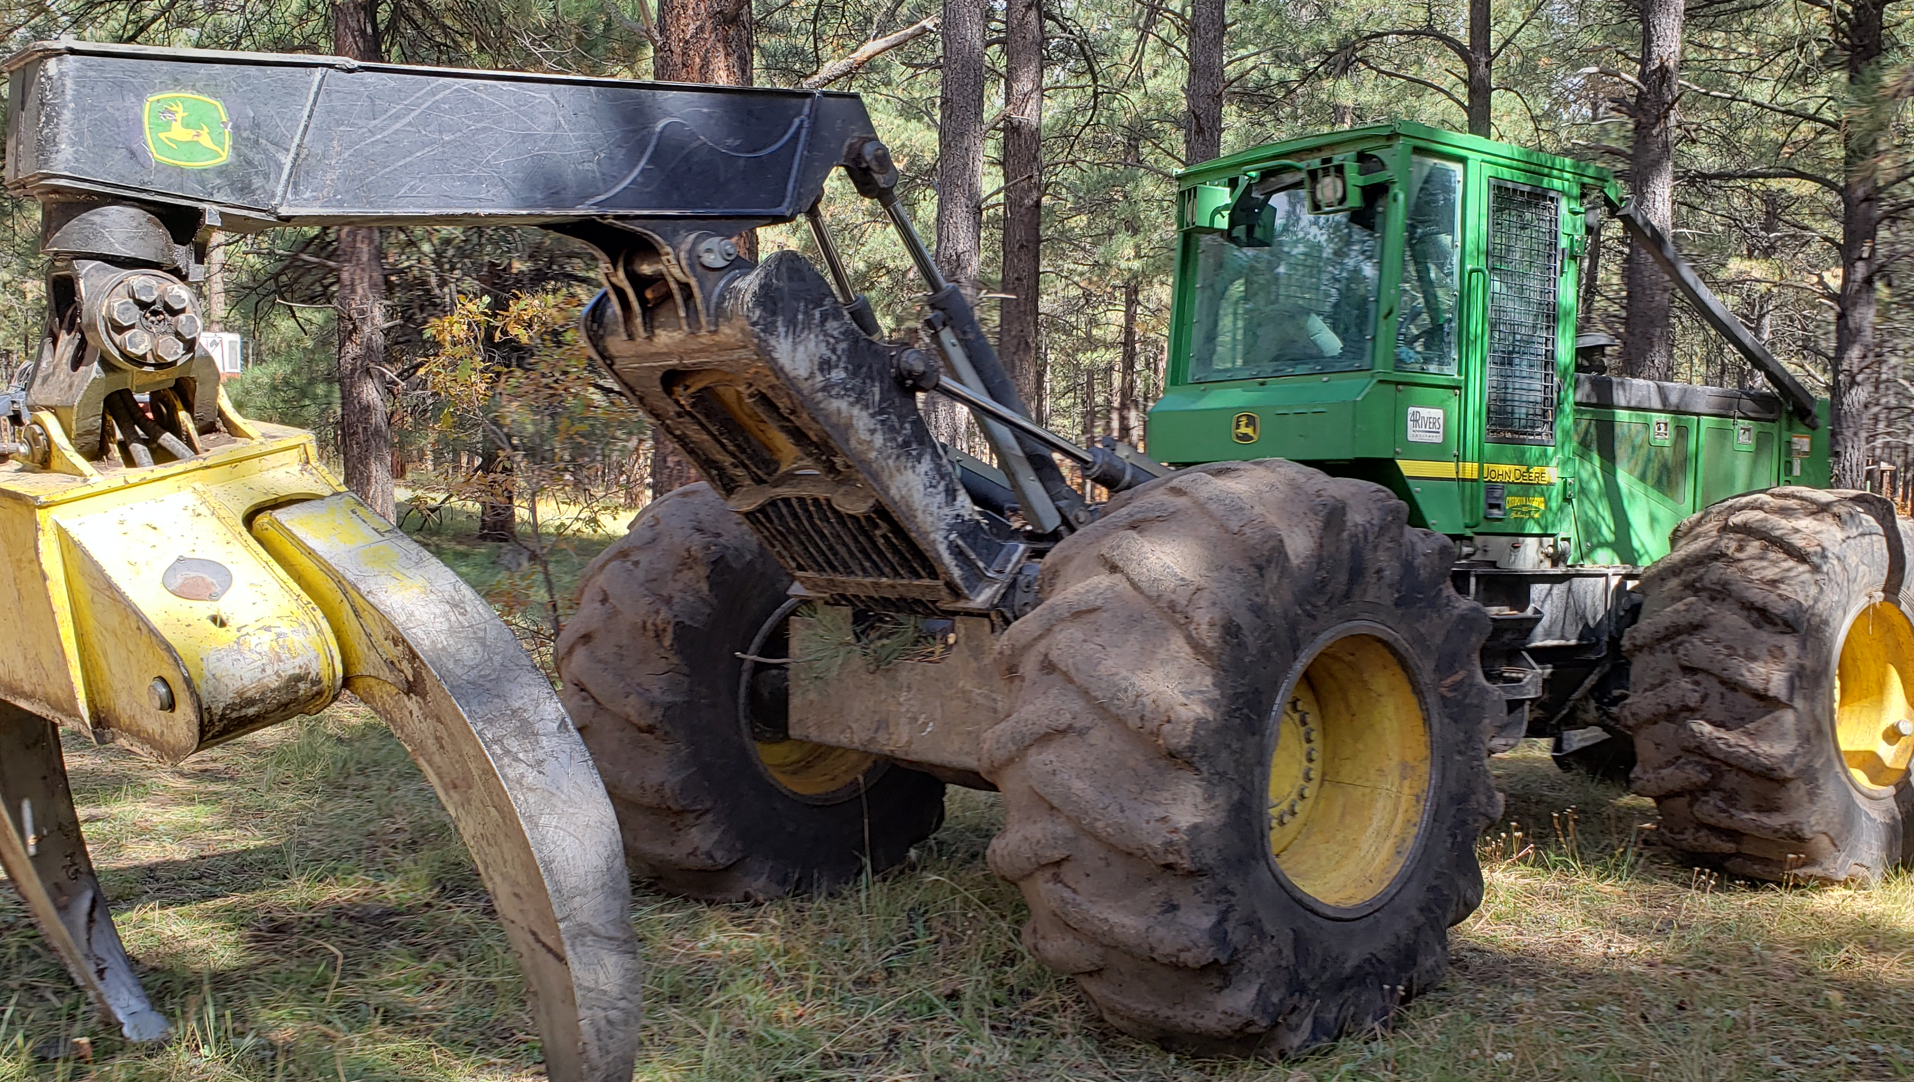
Thank you!

