Slide 1
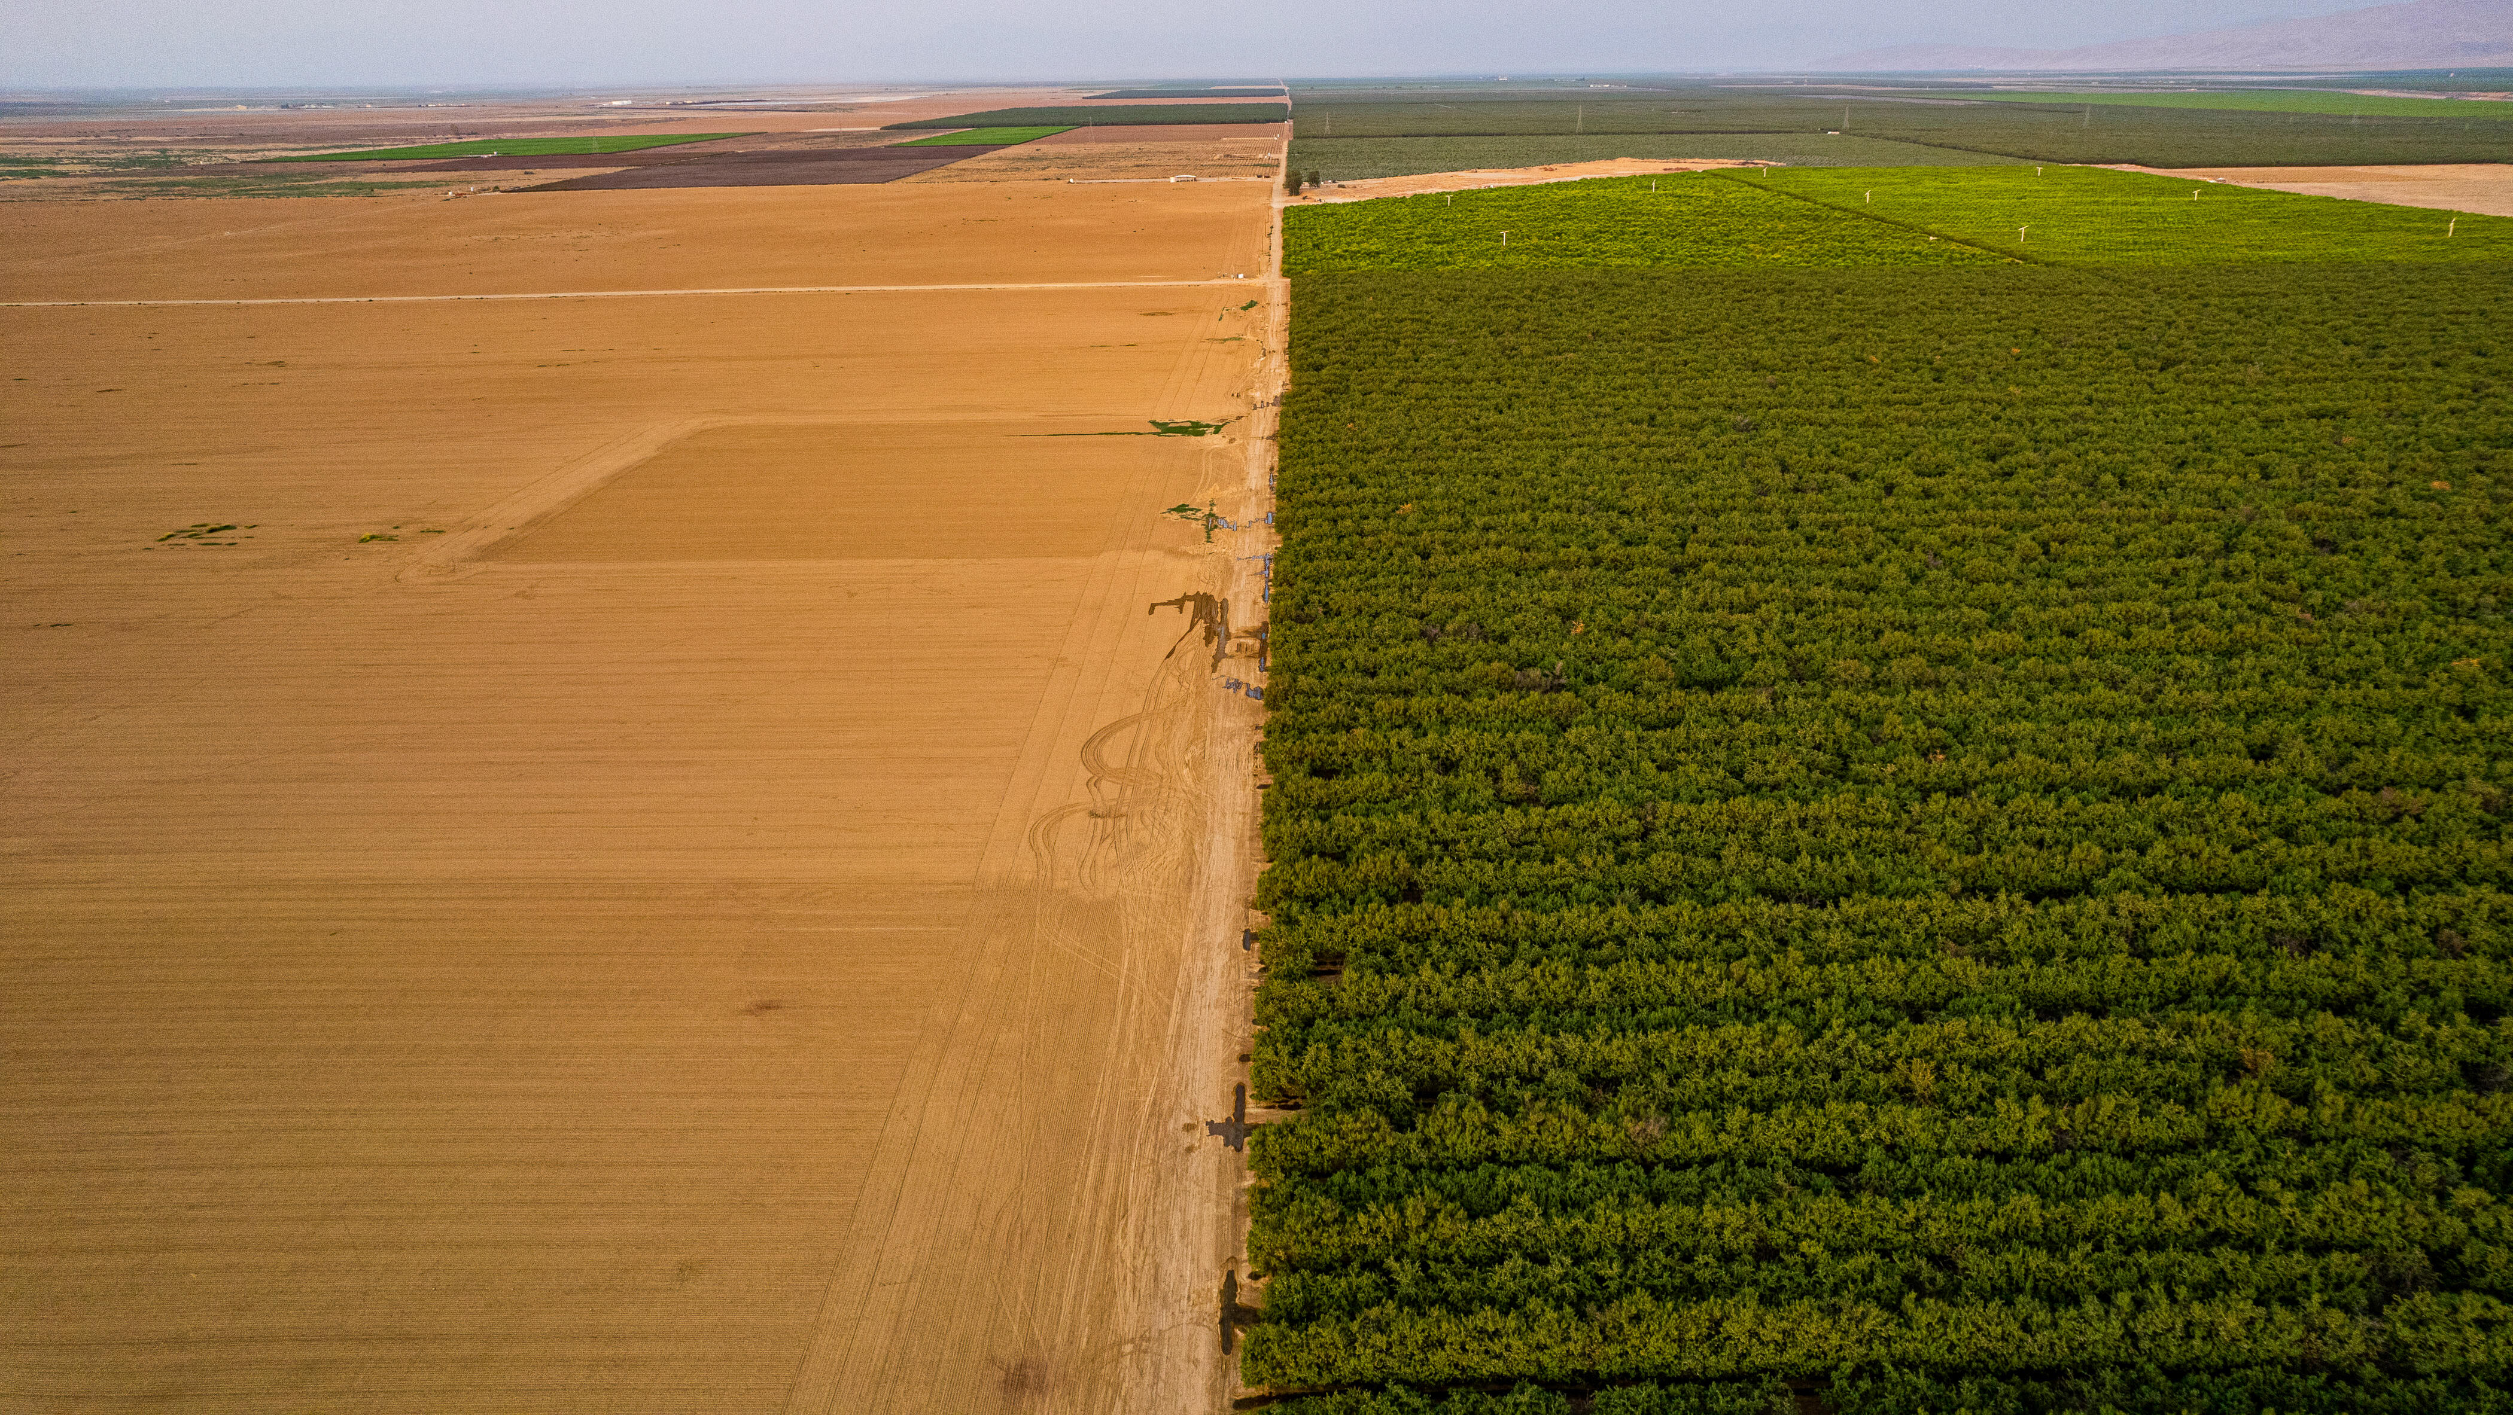

Soil carbon and soil health
in agricultural systems
Lesley Atwood, PhD
Agriculture & Climate Scientist

Slide 2
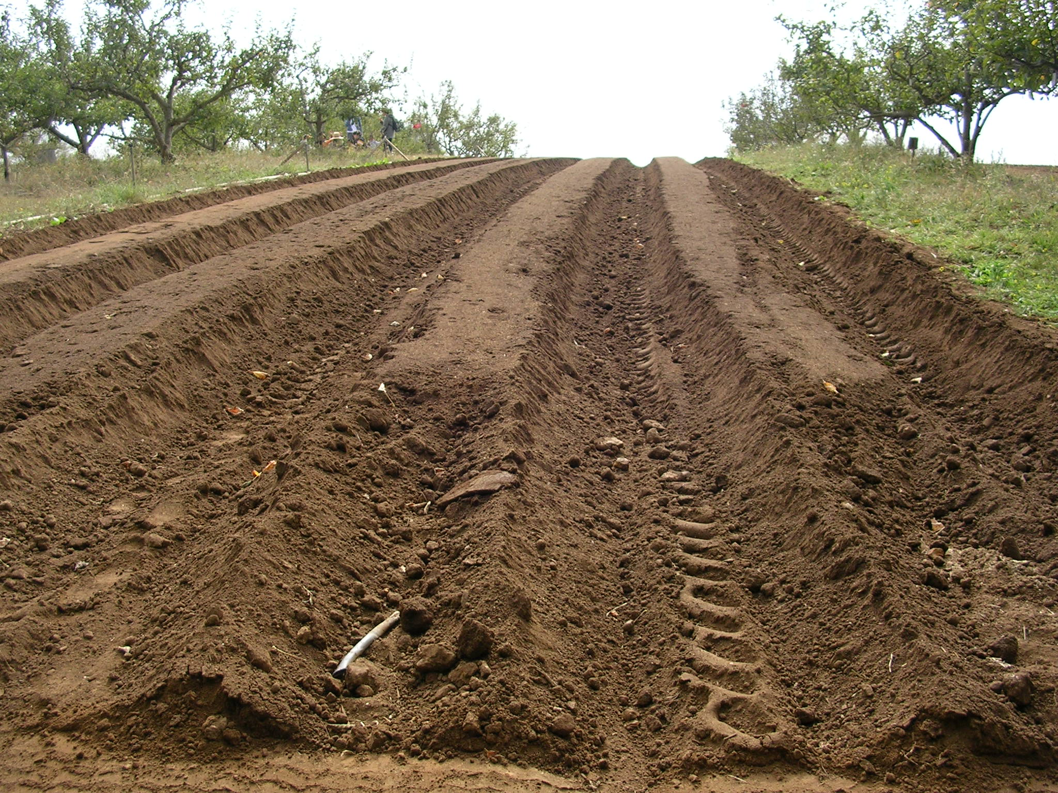
1. Why should we rebuild soil carbon in croplands?
2. How do we rebuild carbon stocks in agricultural soils?
3. Who can help facilitate the rebuilding of soils?

Slide 3
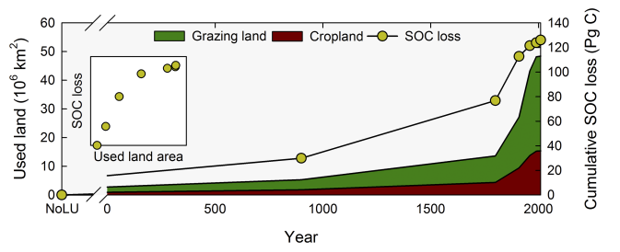
Why should we rebuild soil carbon in croplands?
The rate of soil organic carbon loss has accelerated with the expansion of agriculture
Sanderman et al. 2017, PNAS

Slide 4
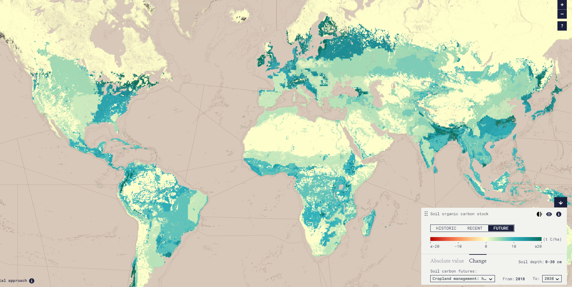
Why should we rebuild soil carbon in croplands?
The potential to rebuild is substantial
www.soilsrevealed.org

Slide 5
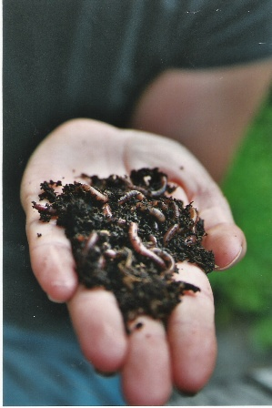
Why should we rebuild soil carbon in croplands?
Benefits to Climate and Soil Health
Emission reductions are not enough
Sequestration of atmospheric carbon is essential
Healthy soils contribute to key ecosystem functions
Soil carbon is the building block of soil health

Slide 6
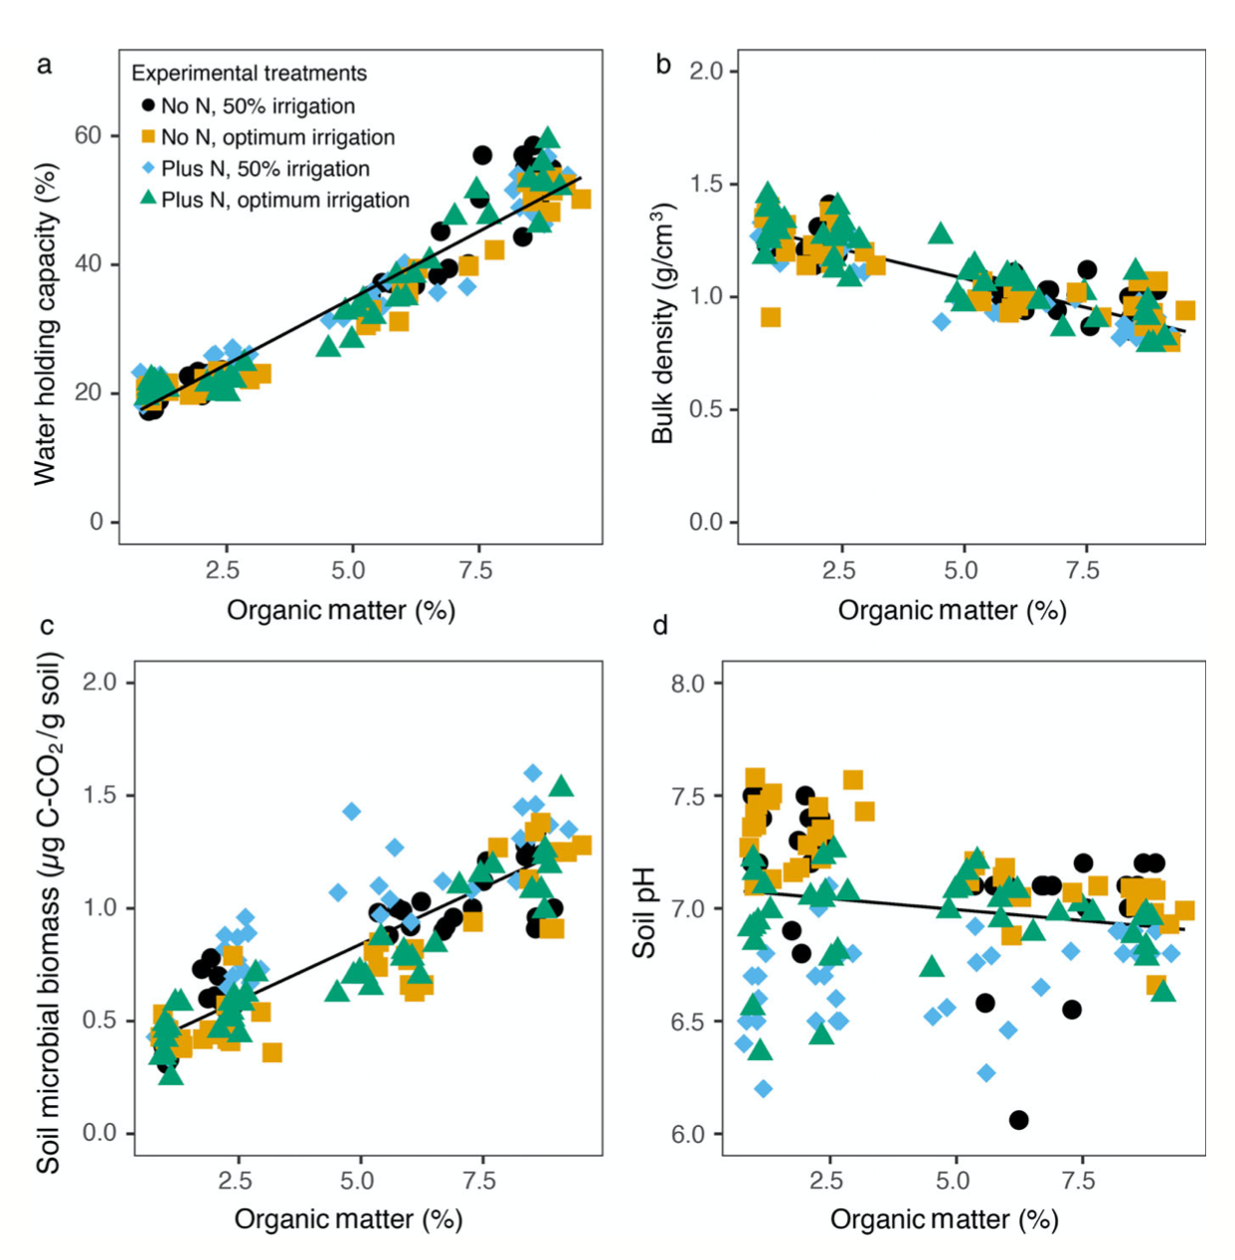
Why should we rebuild soil carbon in croplands?
Multiple functional soil properties improve with organic matter
Oldfield et al. 2020, Ecol Appl

Slide 7
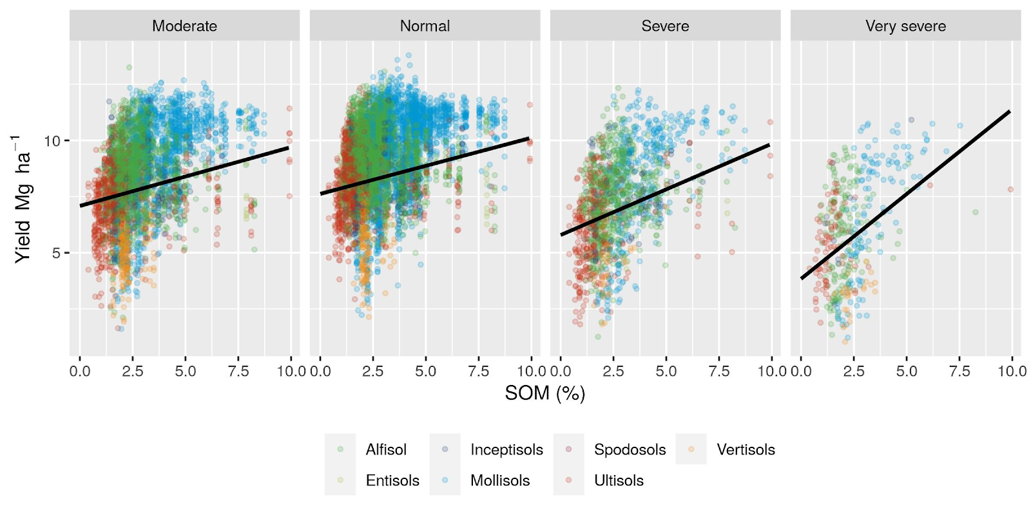
Why should we rebuild soil carbon in croplands?
The relationship between SOM and corn yield increases with drought conditions
Kane et al. 2021, Environ Res Lett

Slide 8
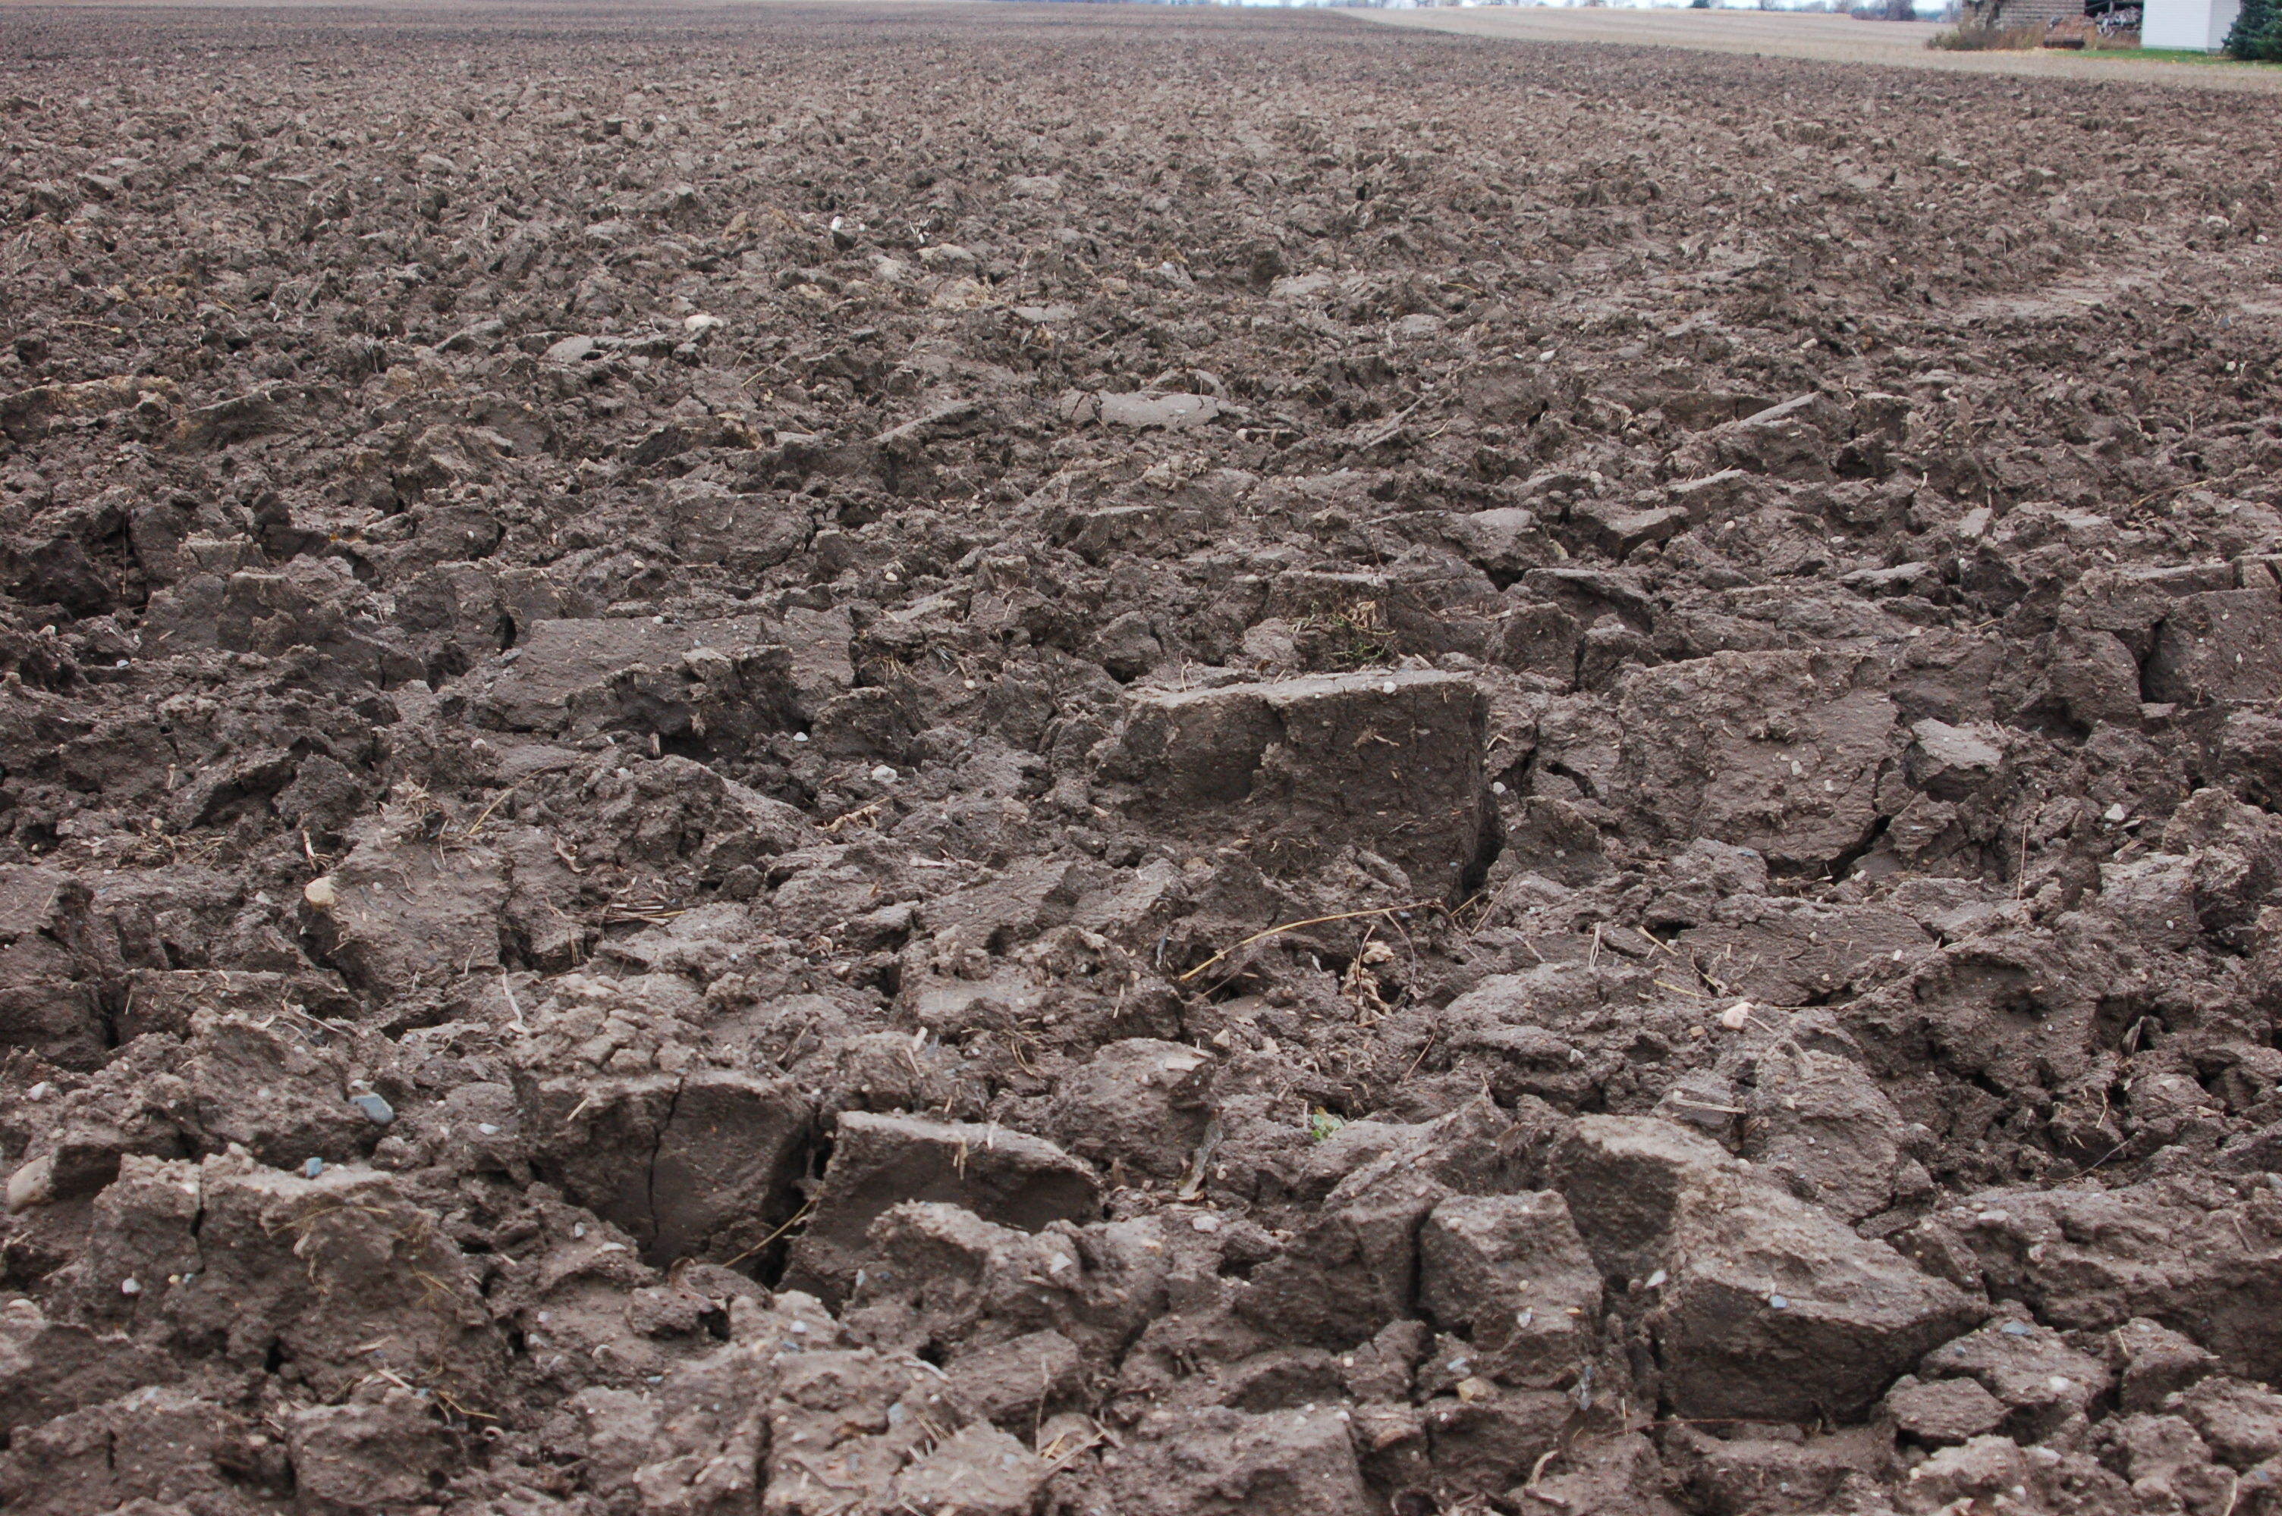
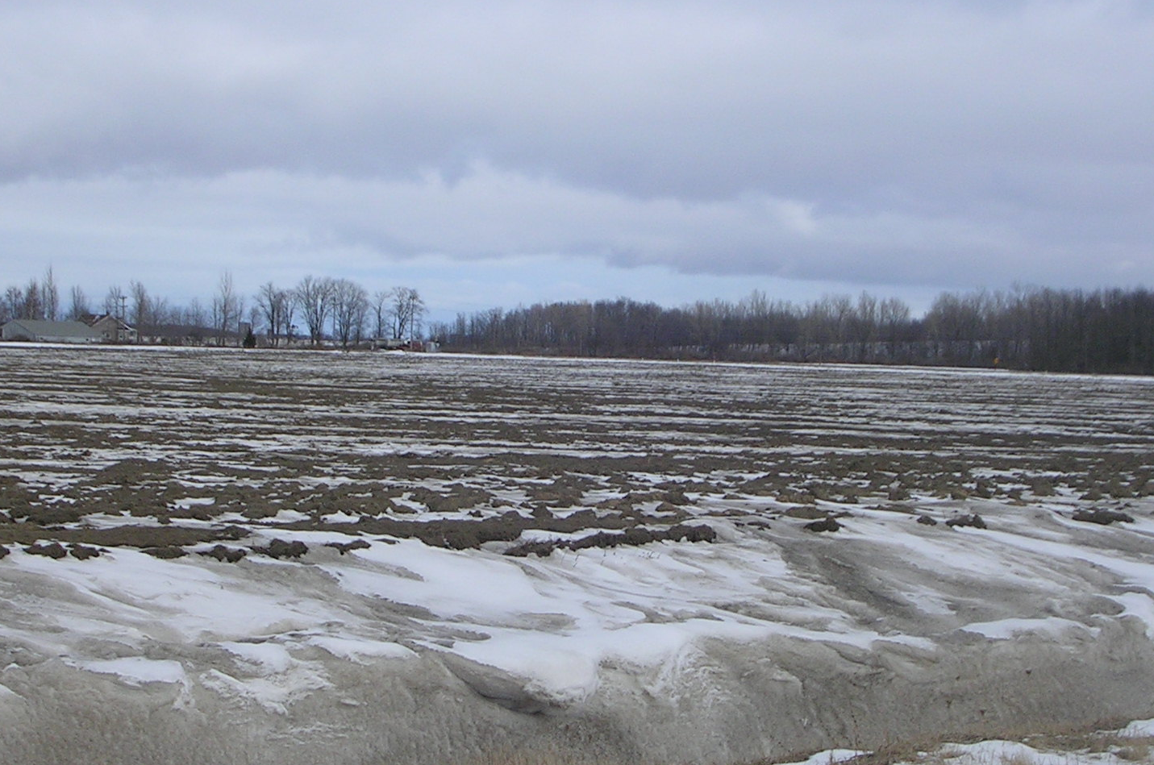
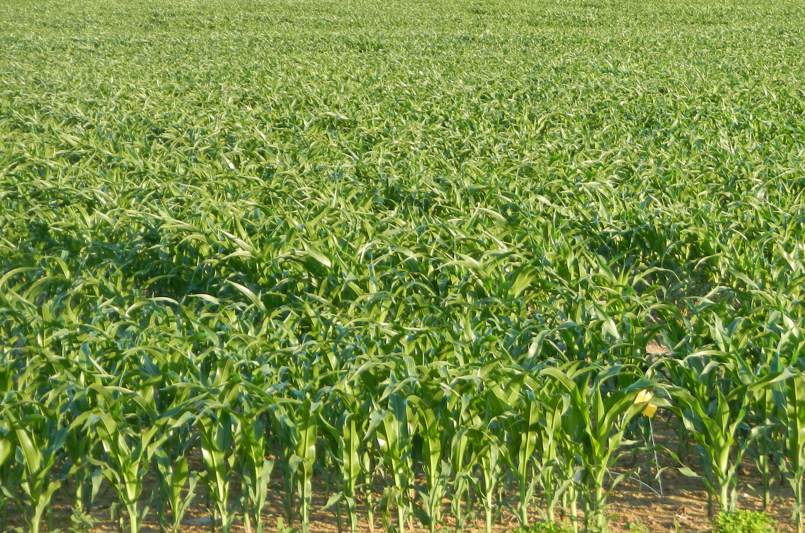
How do we rebuild carbon stocks in agricultural soils?
Few
Plant Inputs
Simplified
Carbon Inputs
Intense
Soil Disturbance
Soil Carbon

Slide 9
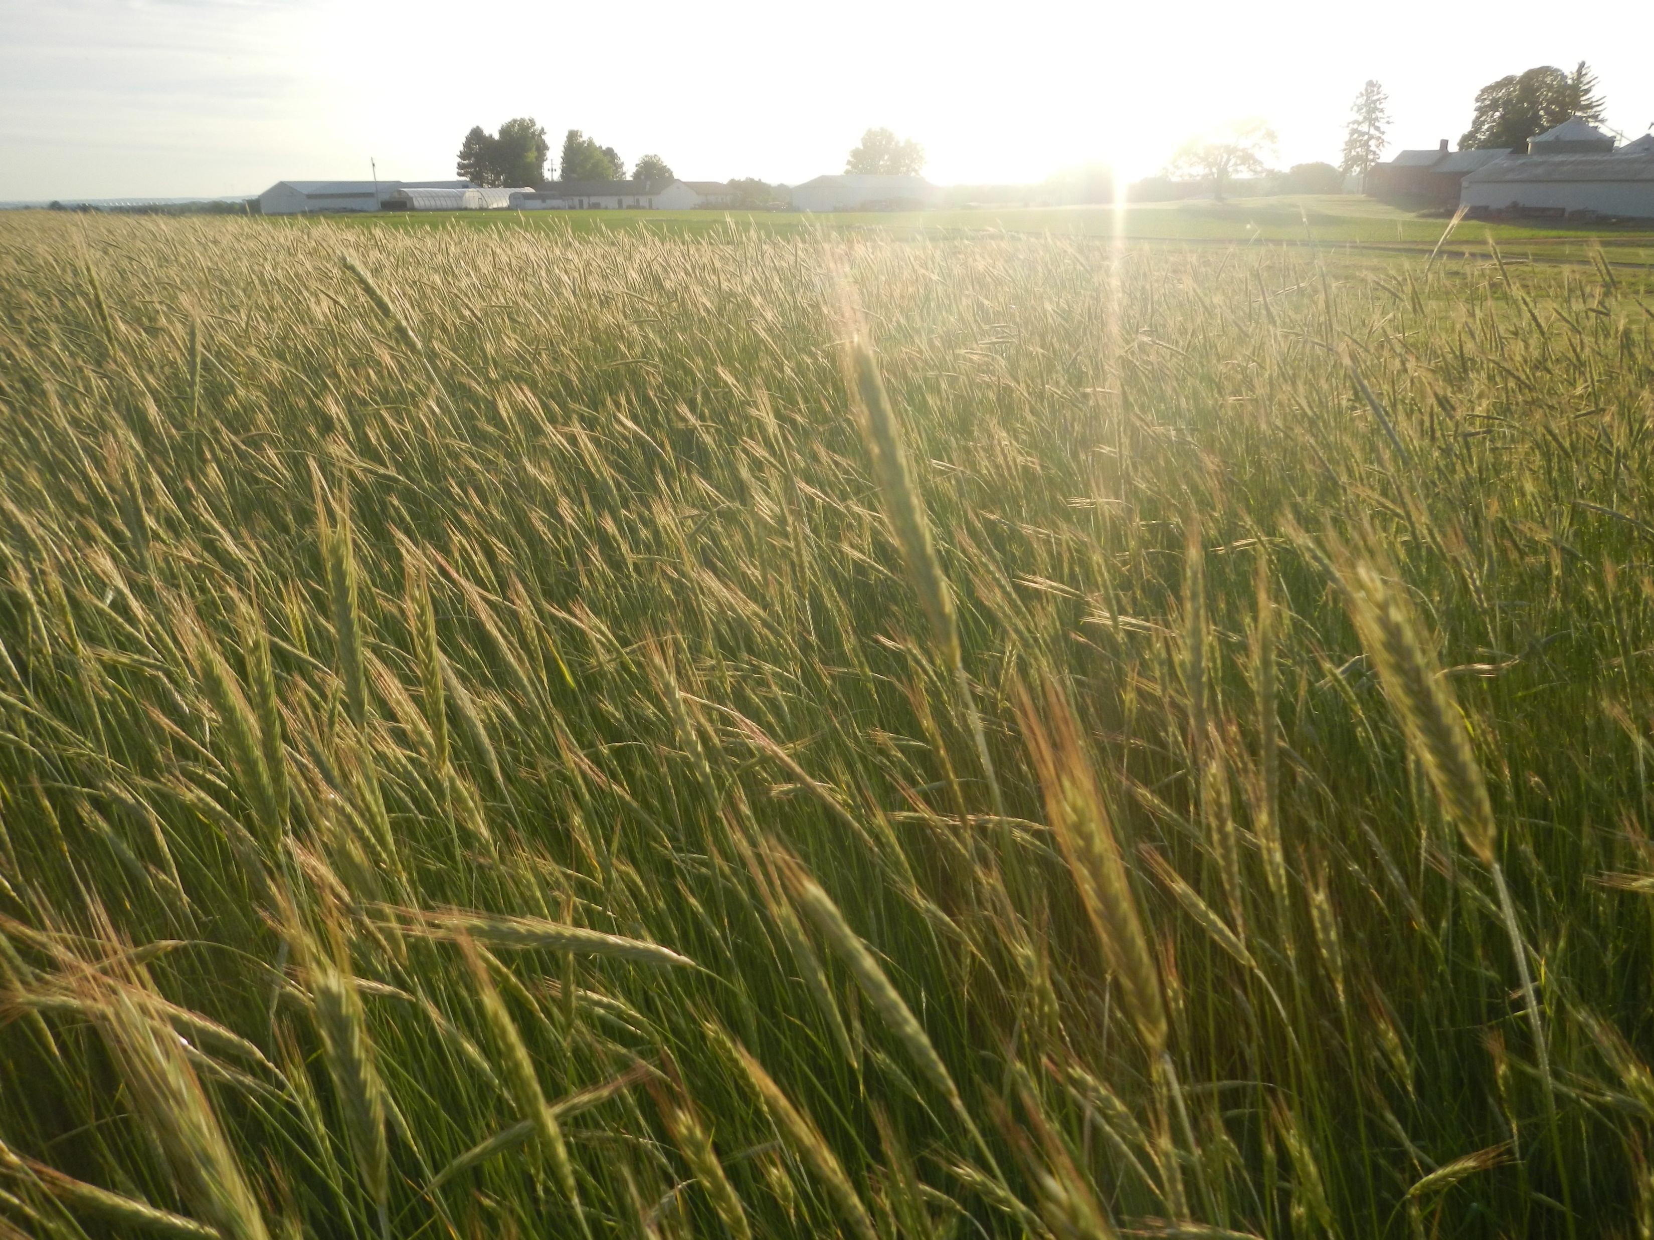
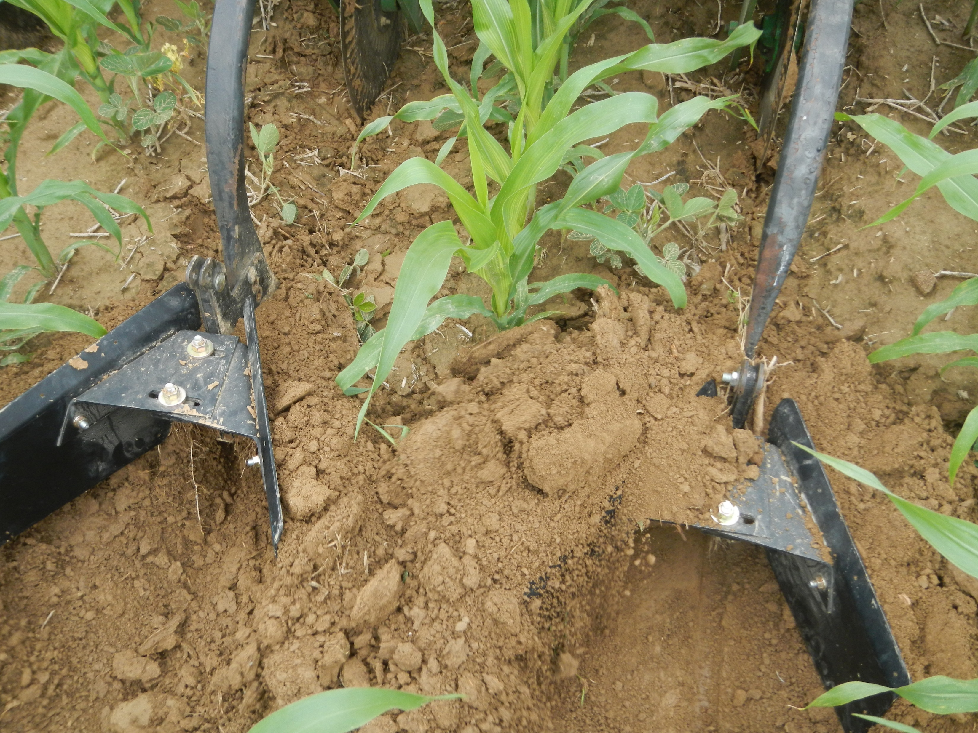
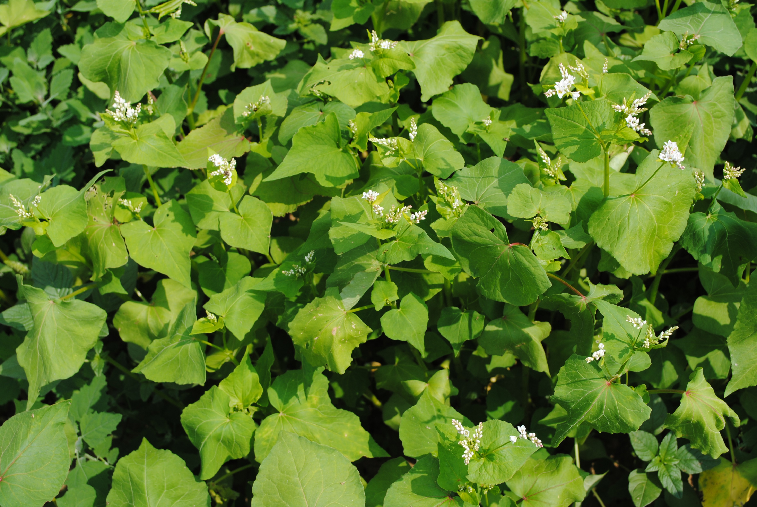
How do we rebuild carbon stocks in agricultural soils?
Abundant
Plant Inputs
Reduced
Soil Disturbance
Diversified
Carbon Inputs
Soil Carbon
Increase soil carbon inputs and protection

Slide 10
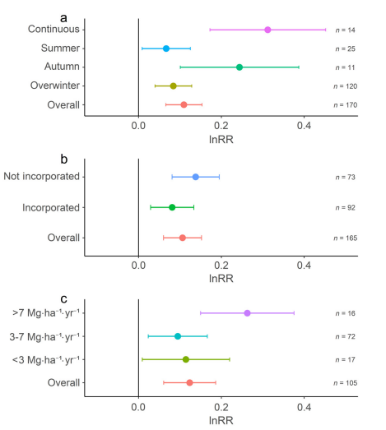
How do we rebuild carbon stock in agricultural soils?
Cover Crop Planting Window
How cover crops are managed affects soil carbon stocks
Cover Crop Aboveground Biomass
McClelland et al. 2021, Ecol Appl
No effect
More effect

Slide 11
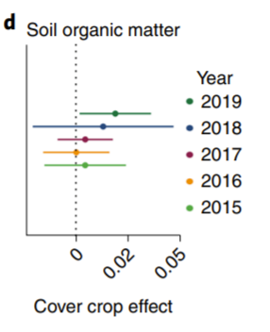
How do we rebuild carbon stock in agricultural soils?
Cover crops have a stronger effect after longer periods of use
Wood & Bowman, 2021 Nat Food

Slide 12
How do we rebuild carbon stock in agricultural soils?
www.AgEvidence.org
There is a lot of variability in the impact of practices on carbon stocks
Atwood & Wood, 2020 KNB

Slide 13
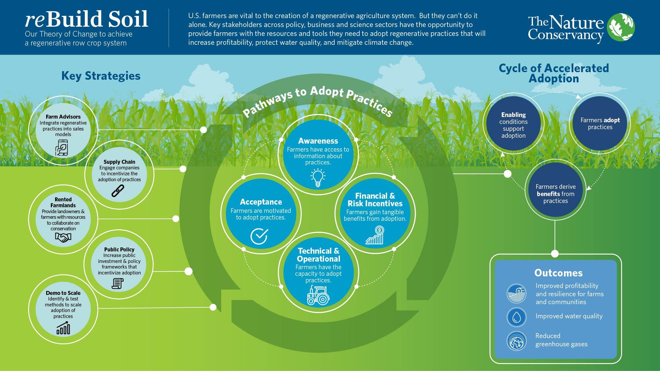
Who can help facilitate the rebuilding of soils?

Slide 14
Why would we want to rebuild soil carbon in croplands?
Climate Benefits & Improved Soil Health
2. How do we rebuild carbon stocks in agricultural soils?
Increase soil carbon inputs and protections
3. Who can help facilitate the rebuilding of soils?
Farmers, Private Industry, Policy Makers, Researchers, & Supply Chains

Slide 15
Thank You
Lesley Atwood, PhD
Agriculture & Climate Scientist
The Nature Conservancy
Lesley.Atwood@tnc.org

