Slide 1
Natural Resources
Conservation Service
USDA’s 96th Annual Agricultural Outlook Forum
Matthew Lohr
Chief, NRCS
February 21, 2020

Slide 2
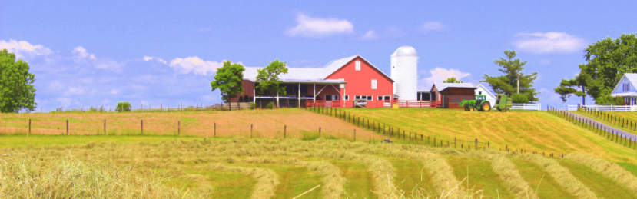
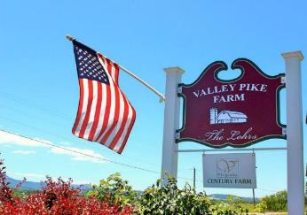
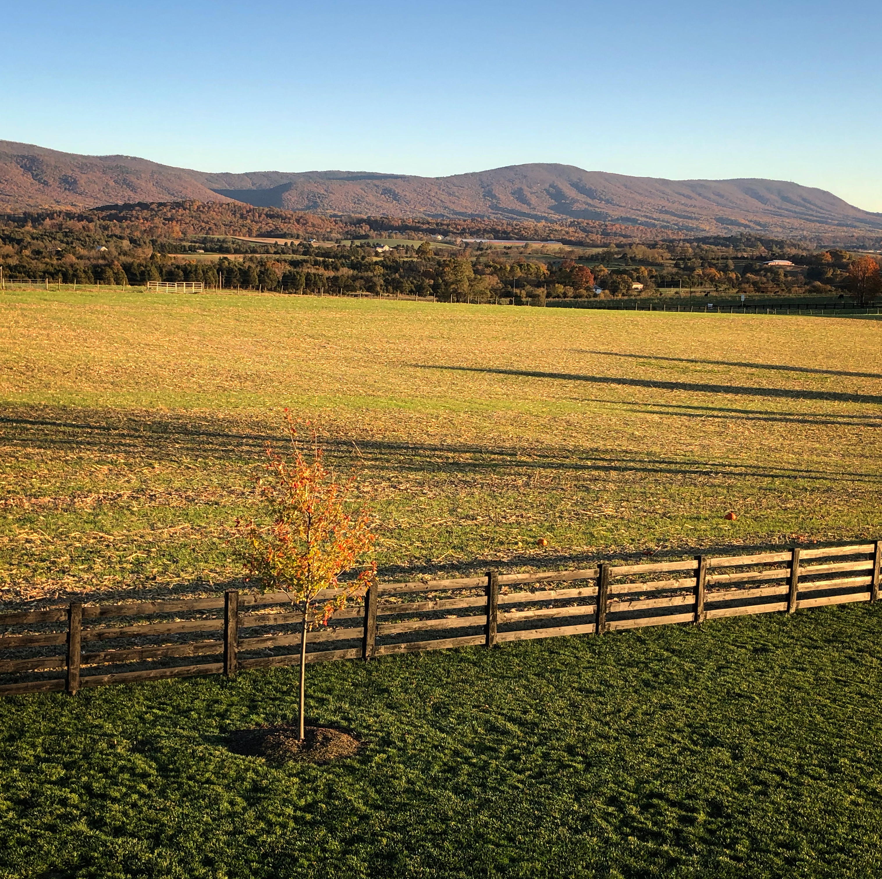
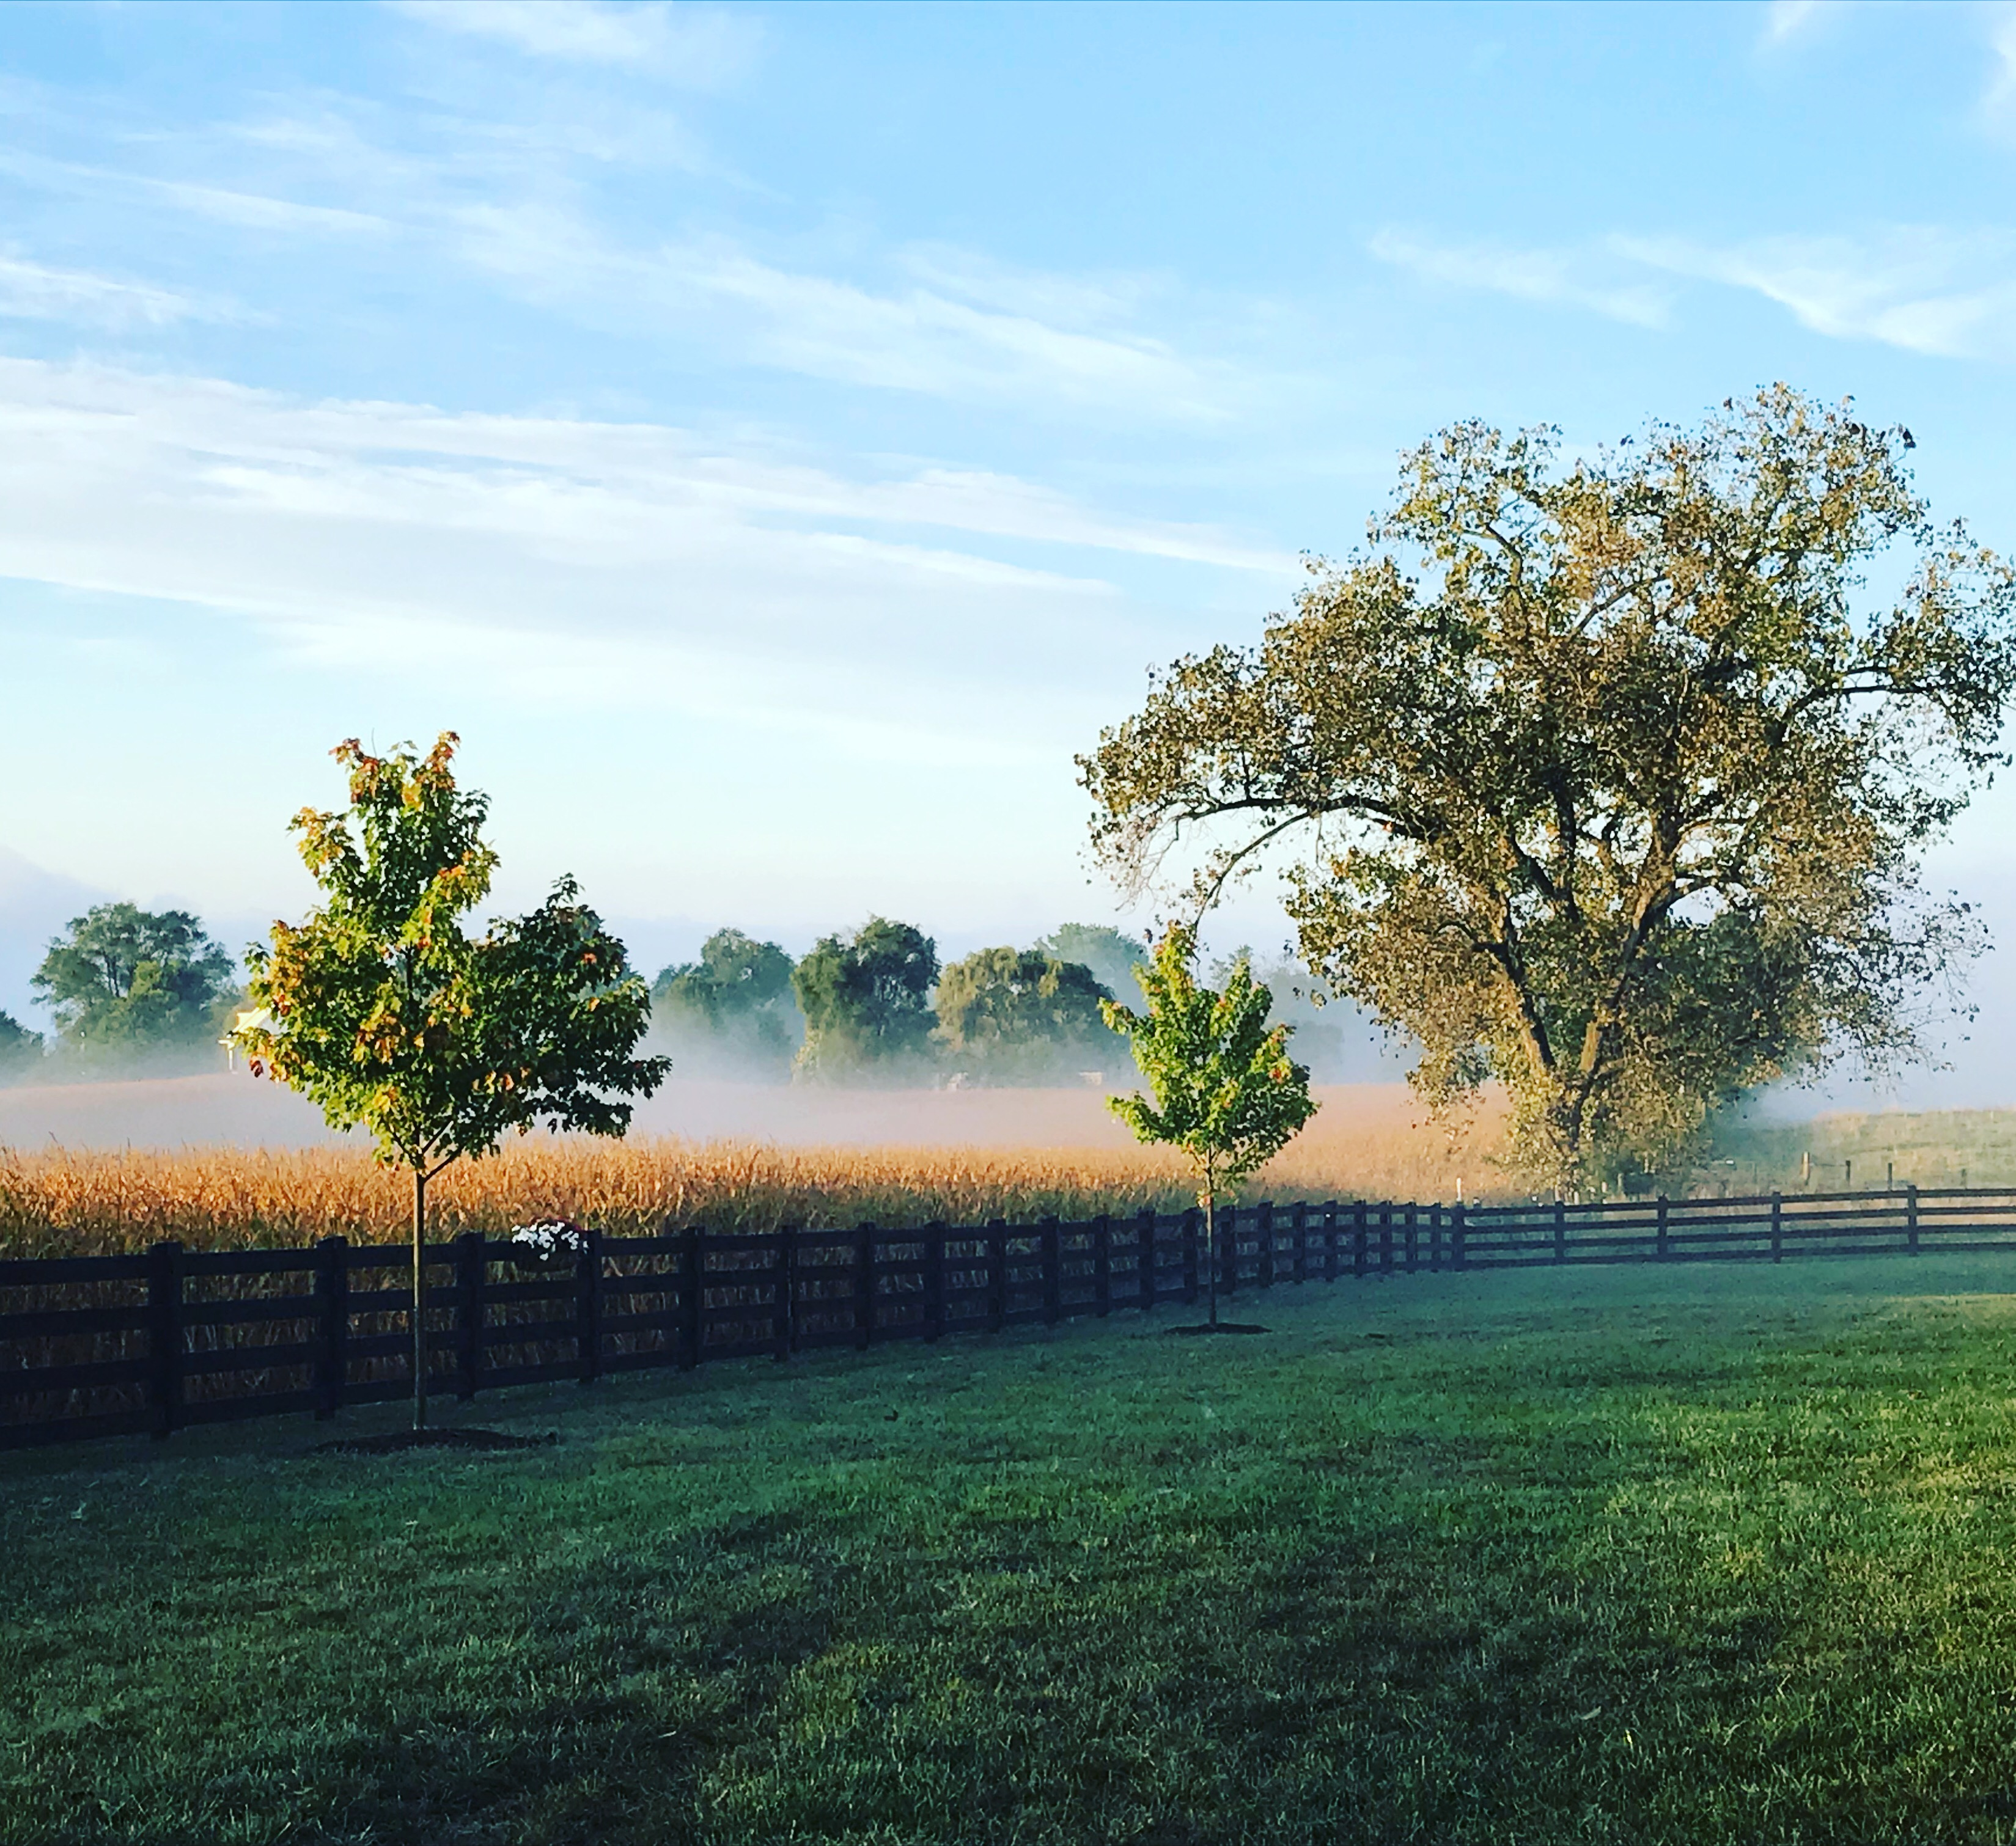
Valley Pike Farm, Inc.

Slide 3
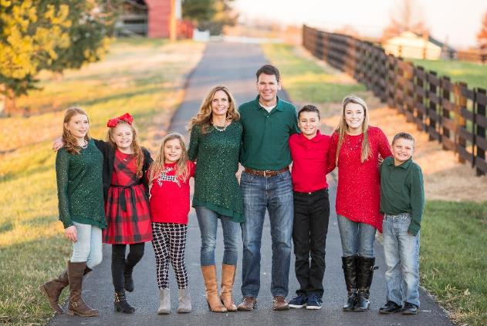
This is why I believe in conservation

Slide 4
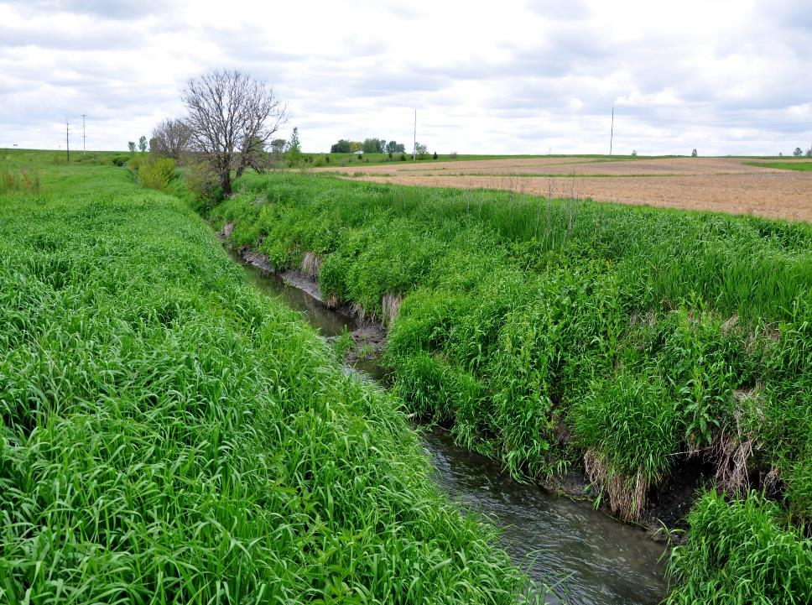
Shared Stewardship---
We are all partners in conservation

Slide 5
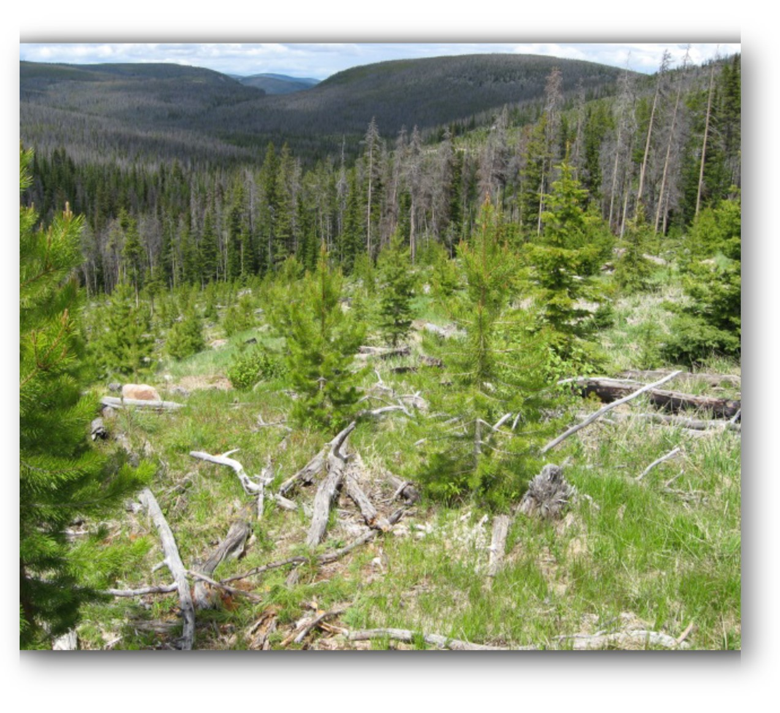
Joint Chief’s Landscape Restoration Partnership
Partnership efforts aim to reduce wildfire threats to communities and landowners, protect water quality and supply, and improve wildlife habitat.
Multi-year partnership between the USDA Forest Service and NRCS directly funds outcomes by improving the health and resiliency of forest ecosystems where public and private lands meet across the nation.
NRCS and FS began the partnership in FY 2014.
Annual solicitation for projects is made to NRCS State Conservationists and Forest Service Regional Foresters.

Slide 6
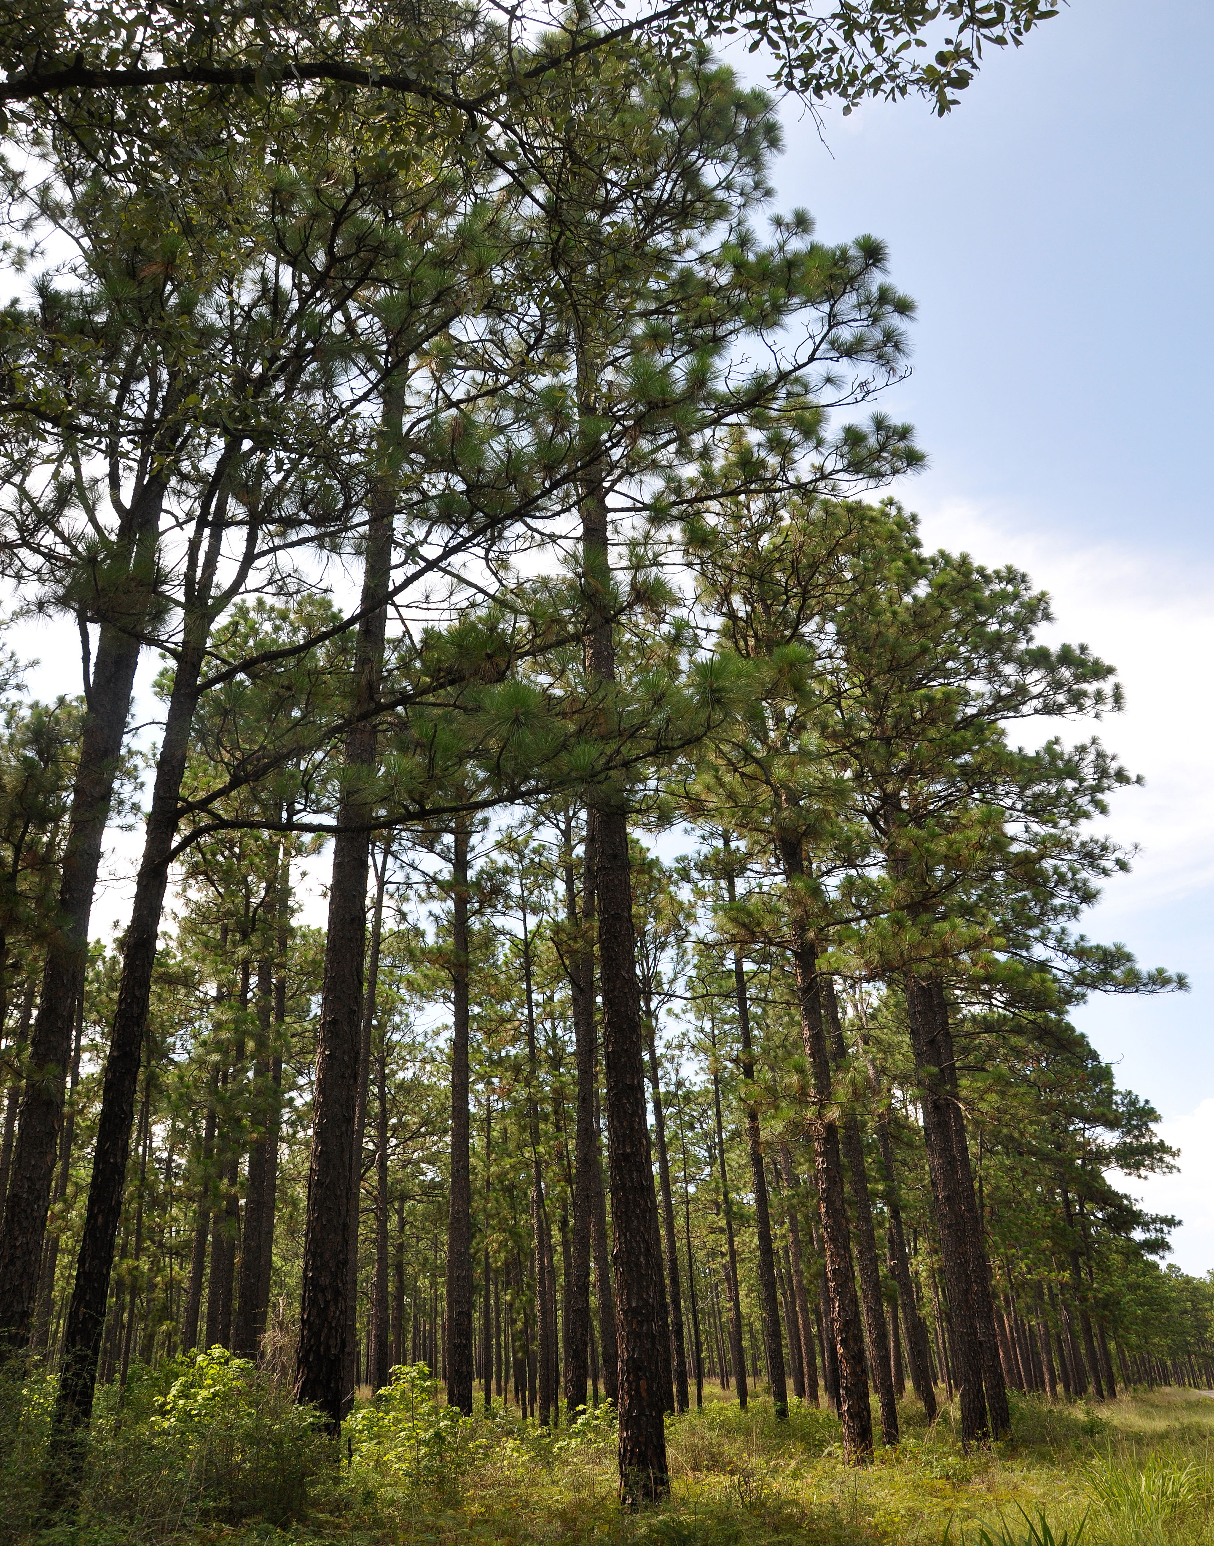
Joint Chief’s Stewardship Successes
2014- 2020 by the numbers:
USDA has invested more than $225 million over 7 years.
85 Joint Chiefs’ Projects funded in 40 States plus Puerto Rico.
49 projects completed.
Average of 11 new projects funded each year (ranging between 7 and 16).

Slide 7
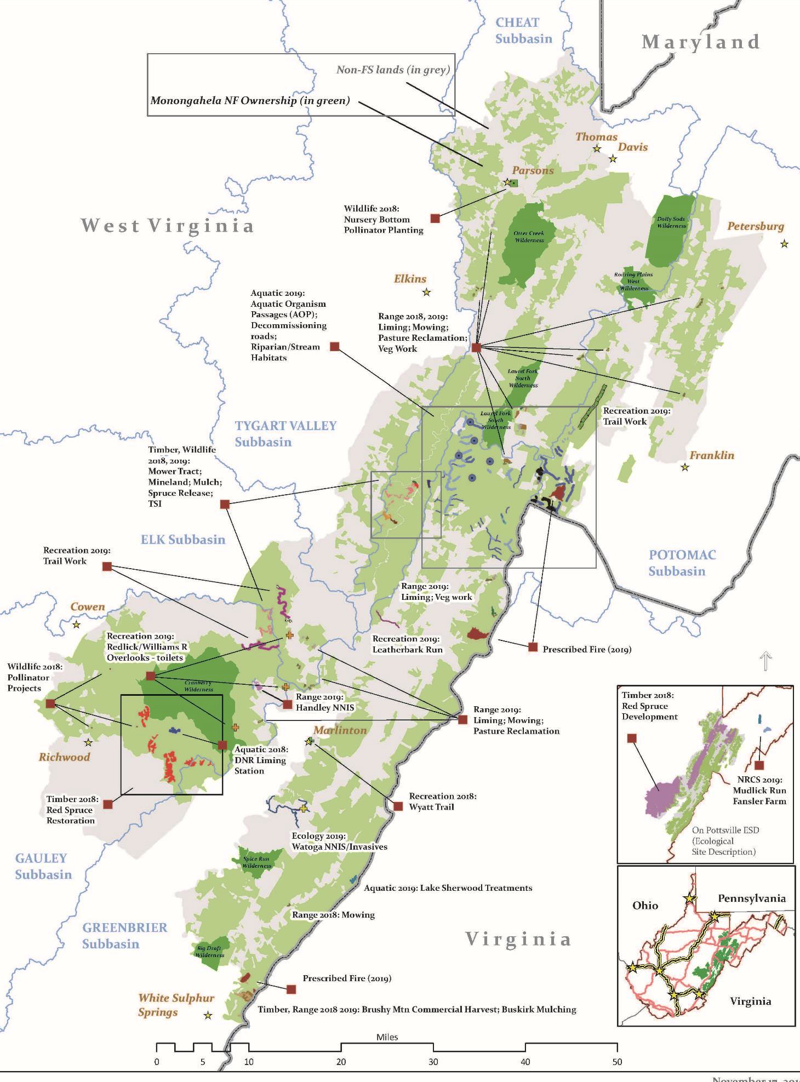
Joint Chiefs’ Project:
Appalachian Ecosystem Restoration Initiative
Mixed ownership.
Potomac and Ohio Rivers
headwaters.
Landscape-scale aquatic habitat
needs across jurisdictions.
Notes:
Located in West Virginia along the border with Virginia and Maryland.
Funded by Joint Chiefs’ FY17 – FY19.
Classic case of a highly interspersed landscape with federal lands and private ownership.
This is very detailed large map, but what I want to point out is how Joint Chiefs’ projects are designed to work across jurisdictional boundaries. Here the Monongahela National Forest is in green (designated wilderness areas in dark green) and private lands in grey. This area is also the headwaters of the Potomac and Ohio Rivers.
This project addressed water quality concerns and aquatic habitat issues across multiple watersheds. Through EQIP the NRCS is capable of working with landowners on a range of projects. Here practices on land and in water were completed to achieve the overall goals of the project.
Landscape-scale projects like these are very difficult to implement without a coordinated approach and dedicated funding. In particular, for aquatic resources and migratory species, coordination across jurisdictions and ownerships is critical for beneficial landscape-scale outcomes.

Slide 8
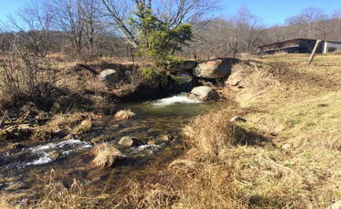
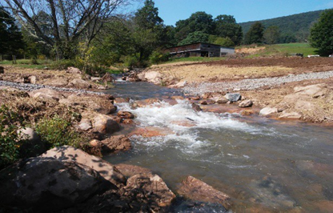
Appalachian Ecosystem Restoration Initiative Culvert Removal on Cattle Farm
Before
After
Notes:
Here is the first of two complementary projects undertaken for the Joint Chiefs’ Appalachian Ecosystem Restoration Initiative.
Located on a working family cattle farm, a perched and undersized culvert was a barrier to brook trout migration. The culvert was replaced with a new low-water crossing and in-stream habitat structures to allow for fish passage.
Along with the culvert removal -- through EQIP -- the farm installed over one mile of fence to keep the cattle out of the creek and a wet meadow, restored almost a mile of creek habitat, installed an off-channel watering facility, and enhanced an existing woodland.

Slide 9
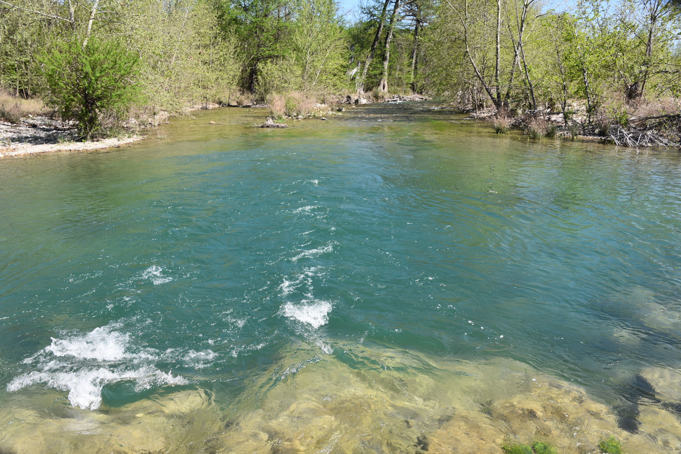
USDA invests $56.4 million for improving water quality
This year NRCS is continuing landscape level efforts through the Mississippi River Basin Healthy Water Initiative (MRBI) and the National Water Quality Initiative (NWQI).

Slide 10
MRBI investments
$17.5 M to producers in 13 states:
Arkansas, Illinois, Indiana, Iowa, Kentucky, Louisiana, Minnesota,
Mississippi, Missouri, Ohio, South Dakota, Tennessee, Wisconsin
Utilizes Farm Bill programs such as EQIP and ACEP
Since its launch, MRBI has:
  2010-2019, $307 M obligated to MRBI projects through contracts
  Helped producers implement conservation on nearly 1.5 million acres
  Reduced sediment loss by 2.1 million tons
  Reduced phosphorous loss by 4.1 million pounds
  Reduced nitrogen loss by 16 million pounds.

Slide 11
NWQI Investments
NRCS will make available $38.9 M to producers across the nation
Partnership with NRCS, EPA and state water quality agencies to address impaired water bodies
Targeted funding for financial and technical assistance in small watersheds
Also targets ground and surface sources of drinking water
Since its launch 8 years ago, NWQI has:
  Helped producers implement conservation on 825,000 acres.
  Reduced sediment loss by 850,000 tons.
  Reduced phosphorous loss by 2 million pounds.
  Reduced nitrogen loss by 9.6 million pounds.

Slide 12
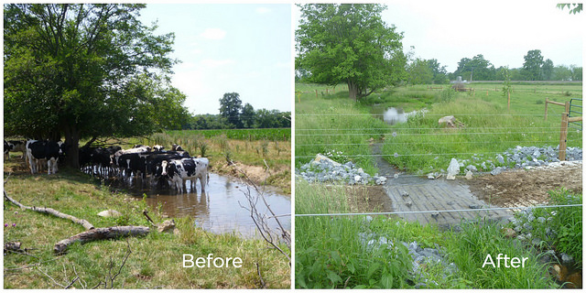
NWQI Success Stories
Saucony Creek feeds into Lake Ontelaunee, the water supply for Reading, PA.
In the early 2000s, nitrates in Kutztown’s water supply approached unsafe
levels for drinking water, related in large part to farms in the area.
Partnership of non-profit organizations, government agencies, and private entities
formed to ensure the safety of the city’s water supply, by helping farmers install conservation practices that protect and improve water quality.
The NRCS has more than $2 M in funding to farmers through its National Water Quality Initiative
Notes:
JCLRP funded FY14-16. This is also a good point water source story.
Montana
Municipal water supply for City of Helena
Helena National Forest

Slide 13
Regional Conservation Partnership Program
(RCPP)
Promotes coordination of conservation activities with partners.
Value added contributions expand ability to address on-farm, watershed and regional natural resource concerns.
NRCS co-invest with partners to implement projects that demonstrate innovative solutions to conservation challenges.
Allows partnership agreements to be longer than 5 years in select situations, as determined by NRCS.
NRCS invests $300 million annually

Slide 14
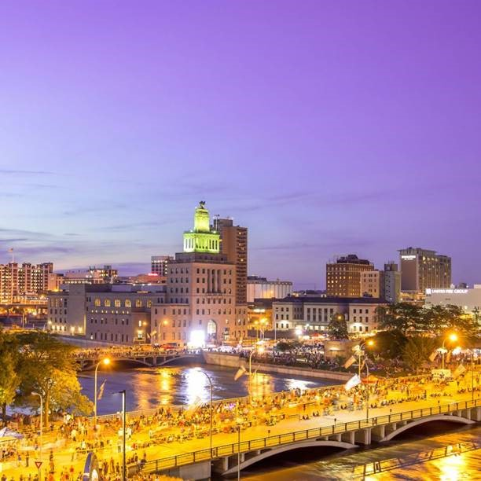
Middle Cedar Watershed
Middle Cedar watershed in east central Iowa designated priority watershed in Iowa’s Nutrient Reduction Strategy.
City of Cedar Rapids draws drinking water from the shallow alluvial wells via the Cedar River.
70% of drinking water produced goes to large industrial users like Pepsico and Cargill.
To address nitrate levels in drinking water and frequency of flooding events the city led 15 partners in creating the Middle Cedar Partnership Project (MCPP).
MCPP applied to RCPP and was awarded $1.6 M which was matched by project partners and focused on improve water quality, reducing flood risk and improving soil health.
5 year project connects downstream water consumers with upstream ag producers
Notes:
JCLRP funded FY14-16. This is also a good point water source story.
Montana
Municipal water supply for City of Helena
Helena National Forest

Slide 15
2018 Farm Bill
NRCS Conservation Programs
Demonstrates strong congressional support
$4.3 Billion annually for CTA and FB programs
EQIP, CSP, ACEP, RCPP
Helps streamline, target and simplify NRCS programs
Developing rules that will be ready for FY20 signups
10% source water protection
Notes:
The 2018 Farm Bill, like the others before it, demonstrates strong congressional support for private lands conservation.
It will help NRCS continue its work to streamline, target and simplify our programs, and will help us fulfill the Secretary’s additional goal of improving overall customer service.
No new NRCS programs were added, and none were eliminated. RCPP especially changed.
NRCS will continue to offer the programs and assistance producers and partners have come to expect.
NRCS developing Rules now
Rules will be ready for FY20 signups

Slide 16
Thank You
Contact: Matthew Lohr, Chief, NRCS at Matthew.Lohr@usda.gov
The USDA is an equal opportunity employer, provider and lender.

