Slide 1

Engineering Transformative and Sustainable Food Animal Agriculture
Charles R. Long, PhD
Department of Veterinary Physiology and Pharmacology
Texas A&M University
clong@cvm.tamu.edu
USDA Agricultural Outlook Forum, February 21, 2020, Arlington, VA

Slide 2
How do you sustainably feed 9 billion people in 2050 with less resources in an adverse environment?

Slide 3
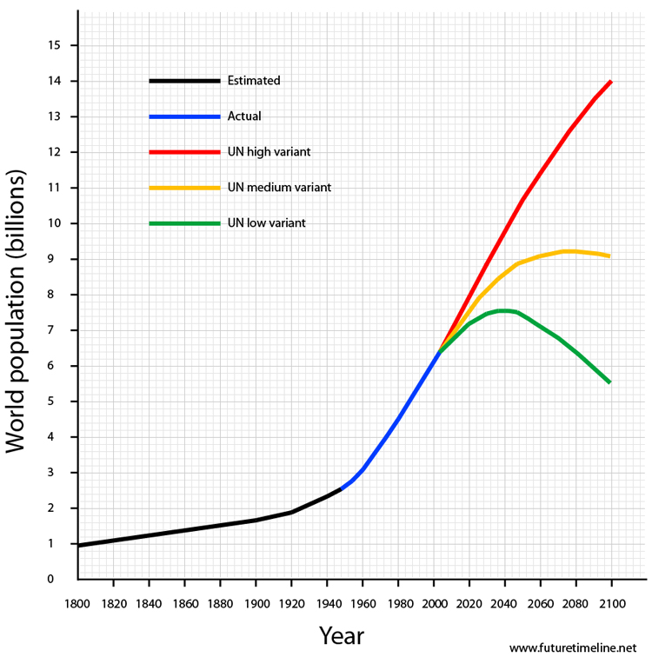
World Population Continues to Increase

Slide 4
Climate Change is Real
Increased frequency and intensity of drought
Increased frequency and intensity of devastating storms
Rising sea levels
Water shortages
Increased stress on livestock and decreased production
USGCRP 2009

Slide 5
We Need More Food With Less Land
The World Bank, World Resources Institute

Slide 6
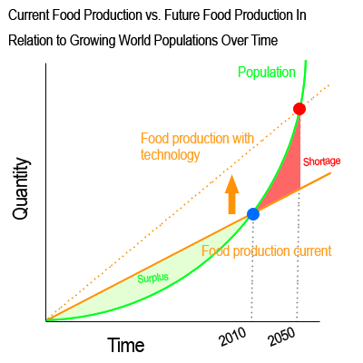
The Potential Of Genetically Engineered Livestock
GE animals with new traits like:
  Enhanced growth and production
  Disease resistance
  Drought and heat tolerance
  Insect tolerance
… will allow for high quality food to be produced in parts of the world where disease, climate, or accessibility of forage material have previously limited the ability to raise food animals.
FDA Guidance January 2009

Slide 7
Goals of Genetic Engineering In Livestock Production
Produce regionally adapted, pest and disease resistant livestock with improved performance traits that meet consumer demands
  Efficiently convert grass to high value protein
    Increased product (meat and milk) per animal
    Improved quality and health benefits of products
    Decrease the current practice of feeding human foods to animals
    Reduce the environmental impact

Slide 9
Random Mutations Occur in Each New Offspring Produced from Natural Matings
Approximately 44-83 random de novo mutations occur in the mammalian genome every generation.
This is the driving force behind evolution and the ability to select livestock for improved traits.
Acuna-Hildago et al., 2016

Slide 10
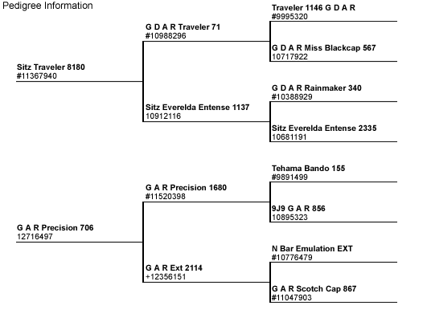
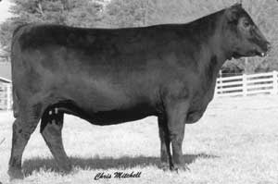
Classic Genetic Selection

Slide 11
Limits to Classical Genetic Selection
You can not select for a trait that does not exist in the population.
Exposing a herd to a pathogen to discover individuals that are resistance is not practical.
Breeding to introduce a desirable trait can lead to development of deleterious traits.
Slow, random, limited to traits already in the population

Slide 12
Traditional crossbreeding takes many years and leaves unwanted genetic elements
Genetic engineering
Brahman
Angus
15 or more years and ~94 million residual DNA base pairs from Brahman
Notes:
Animals not showing the desired traits are culled.

Slide 13
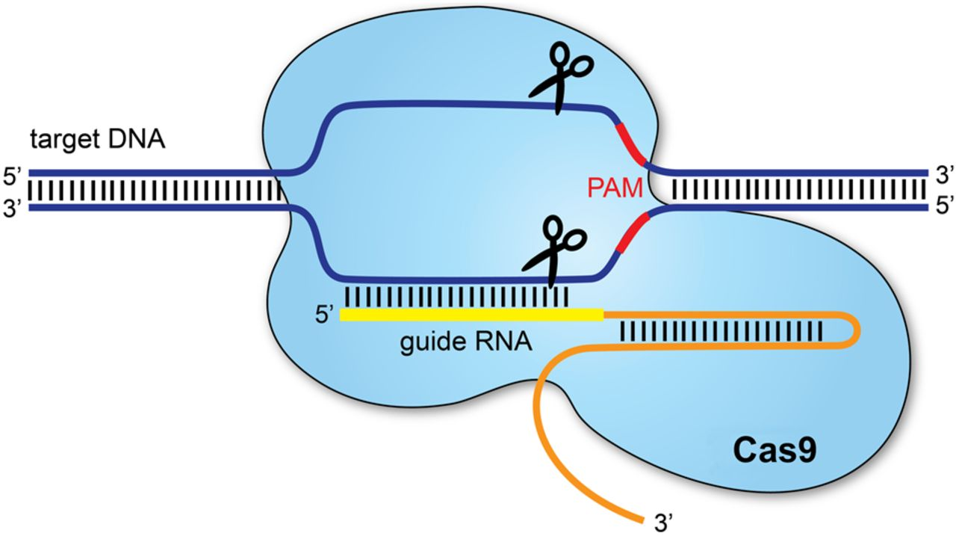
CRISPR/Cas and Other Gene Editing Tools
Allow For Precise Genetic Changes
Technology is no longer a limiting factor.

Slide 14
Gene editing innovations that protect and improve performance in livestock production systems
Disease Resistance:
  Pigs
    Porcine reproductive and respiratory syndrome virus
    Porcine epidemic diarrhea virus/transmissible gastroenteritis virus
    African swine fever virus
  Chicken
    Avian leucosis virus
    Avian influenza virus
  Cattle
    Bovine spongioform encephalopathy (BSE)
    Tuberculosis
    Bovine respiratory disease
    Mastitis

Slide 15
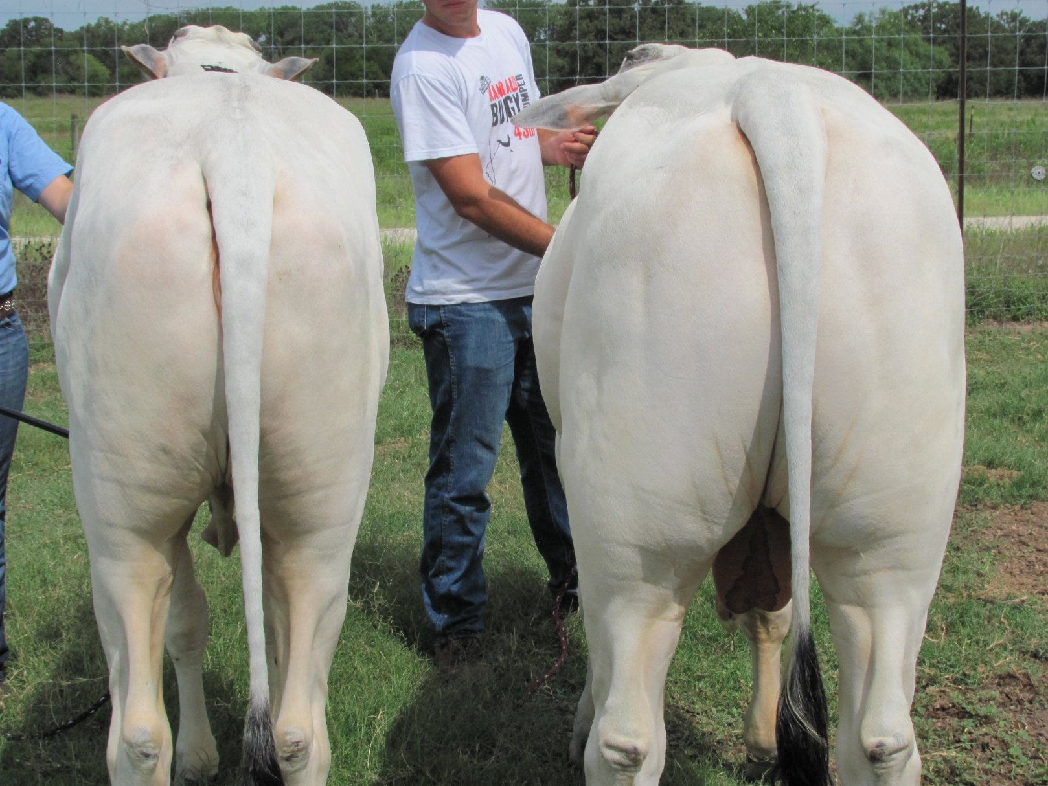
Gene editing innovations that protect and improve performance in livestock production systems
Environment
  Decreased phosphate polluction
Enhanced Production
  Heat tolerance
  Polled (hornless) cattle
  Reduction of milk allergens
  Increase quantity and quality of meat
    Increase growth rate of fish (AquaBounty salmon)

Slide 16
A Failed Regulatory Framework Limits
Innovation In Animal Agriculture
Politics holds back animal engineers
Funds and approvals lag for transgenic livestock in US.
Nature, October 17, 2012
Gene-edited animals face US regulatory crackdown
Nature, January 19, 2017
Gene-edited animal creators look beyond US market
Tired of regulatory confusion and a lack of funding, some US researchers are taking their gene-edited livestock abroad.
Nature, February 20, 2019
Food and Drug Administration- Veterinary Innovation Program
https://www.fda.gov/animal-veterinary/animals-intentional-genomic-alterations/vip-veterinary-innovation-program

Slide 17
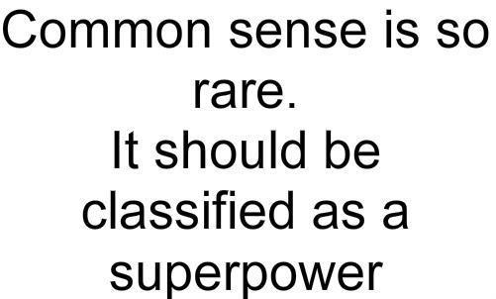
We must have clear risk based assessment of gene edited food, but only for those products that pose a reasonable risk

Slide 18
“One of the wonderful things about transgenesis is that we can do all at once what evolution has taken millions of years to do.”
Francis Ruddle

Slide 20


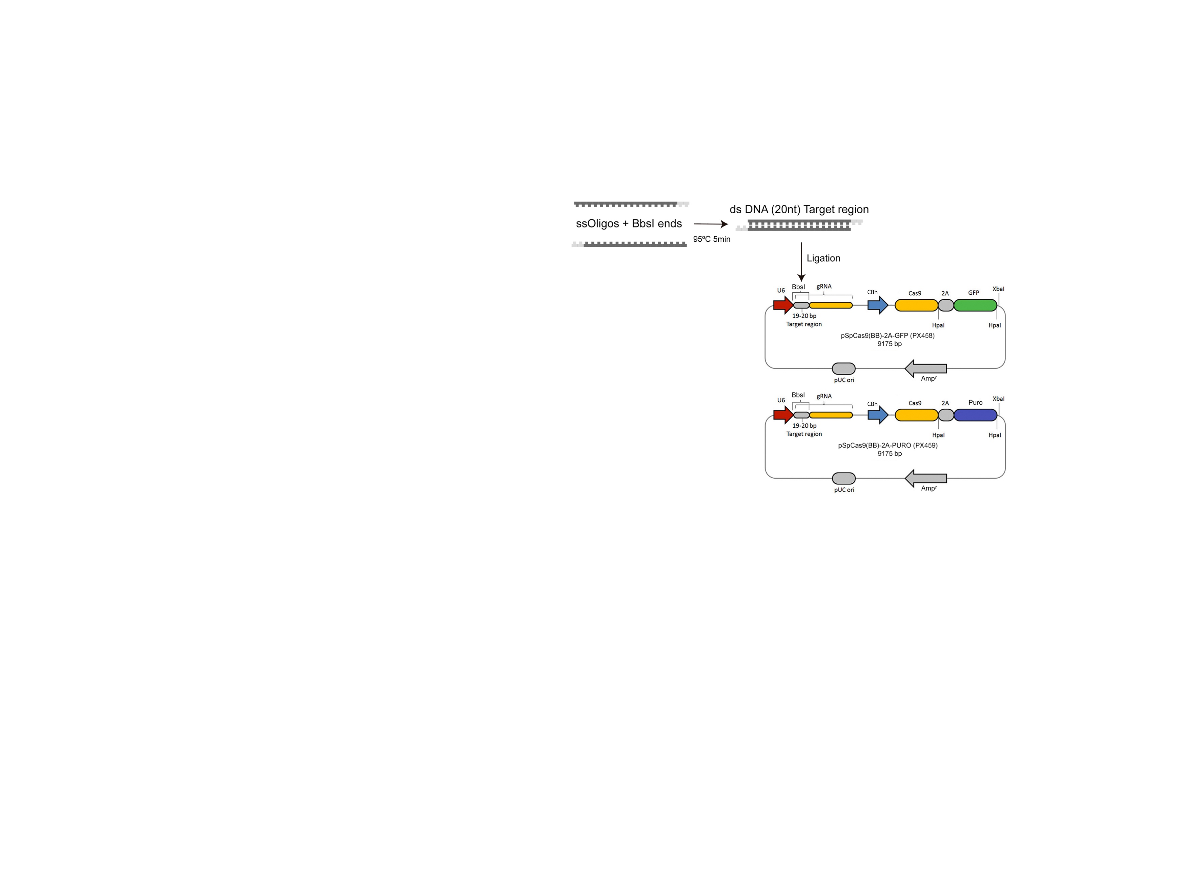
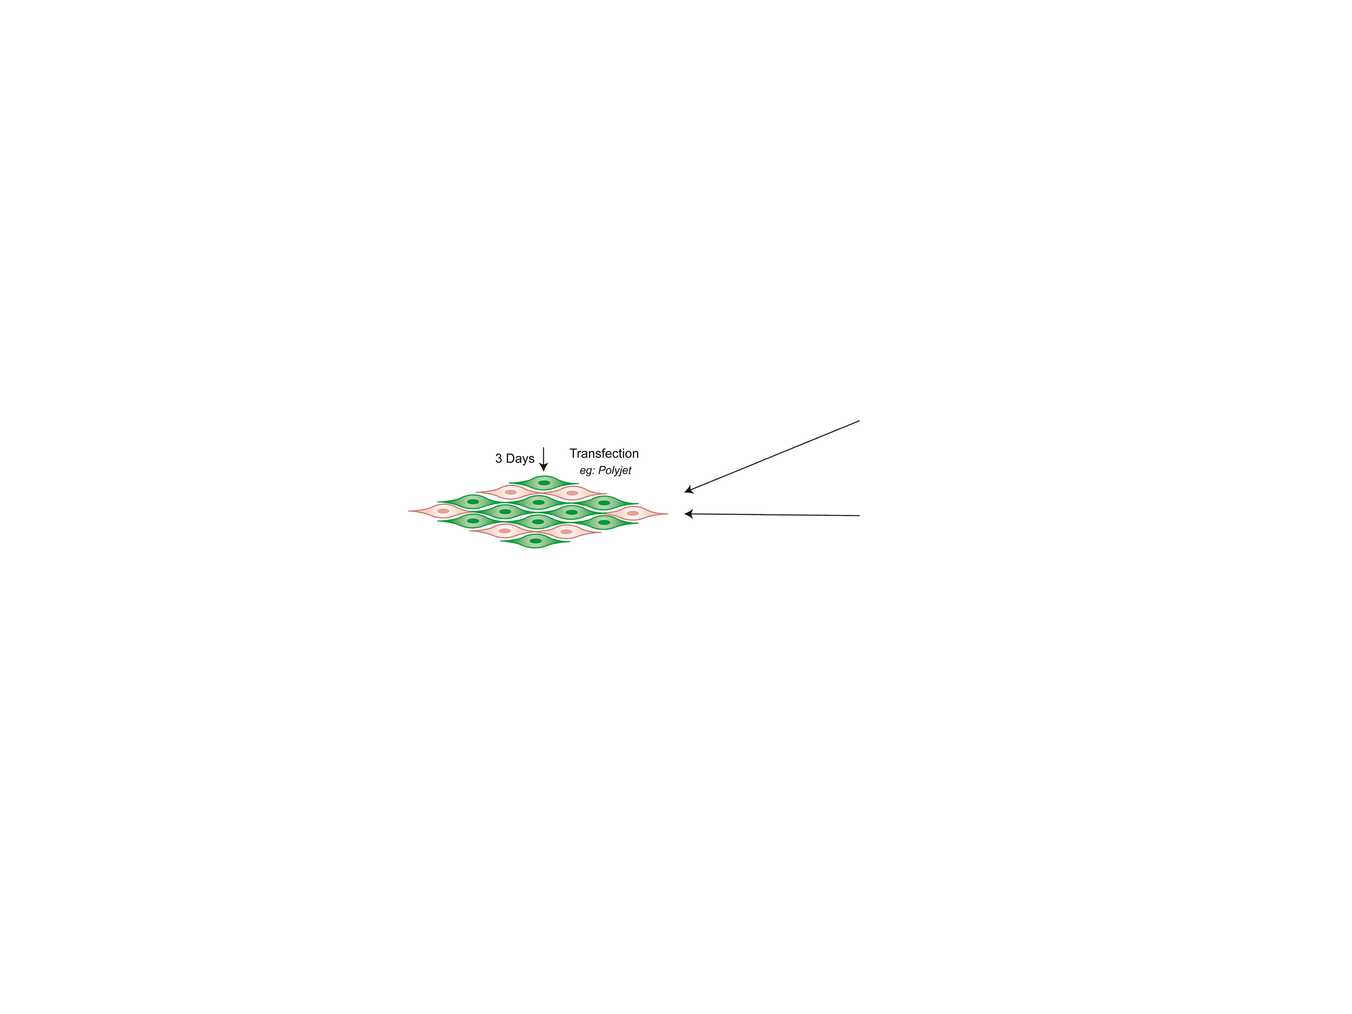
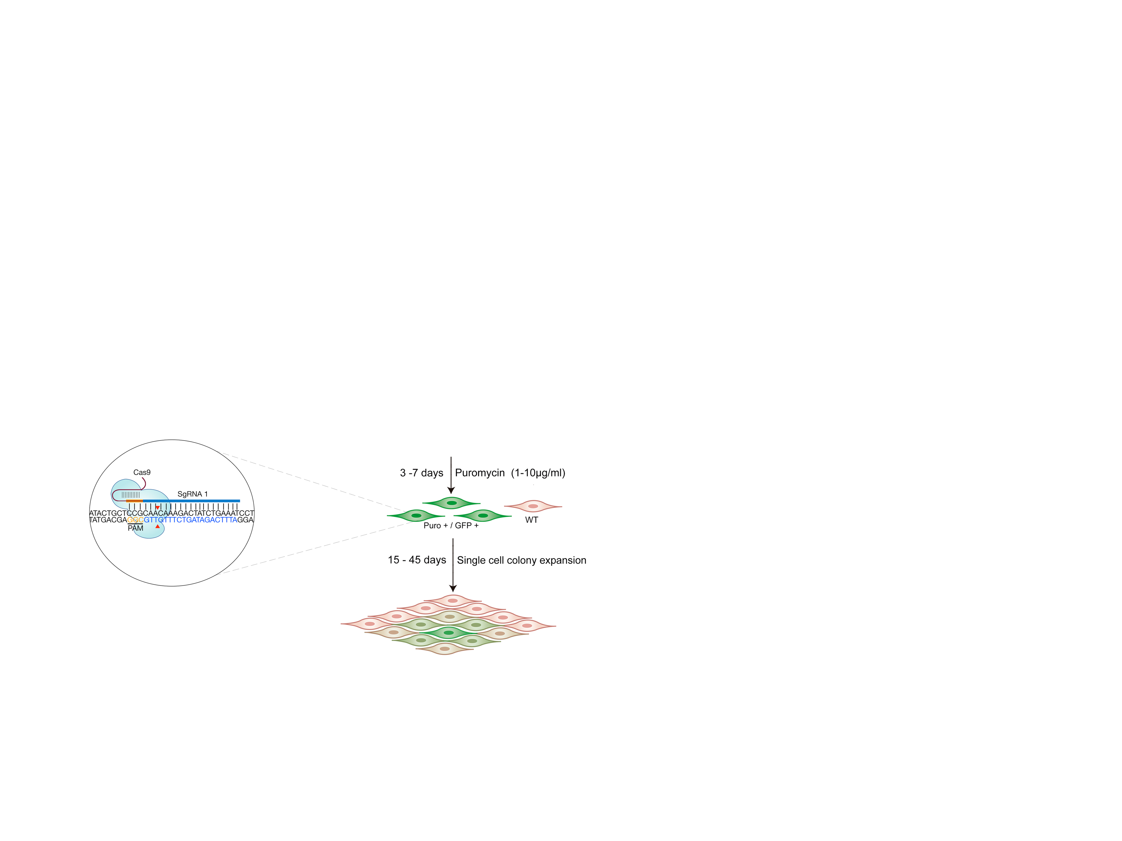
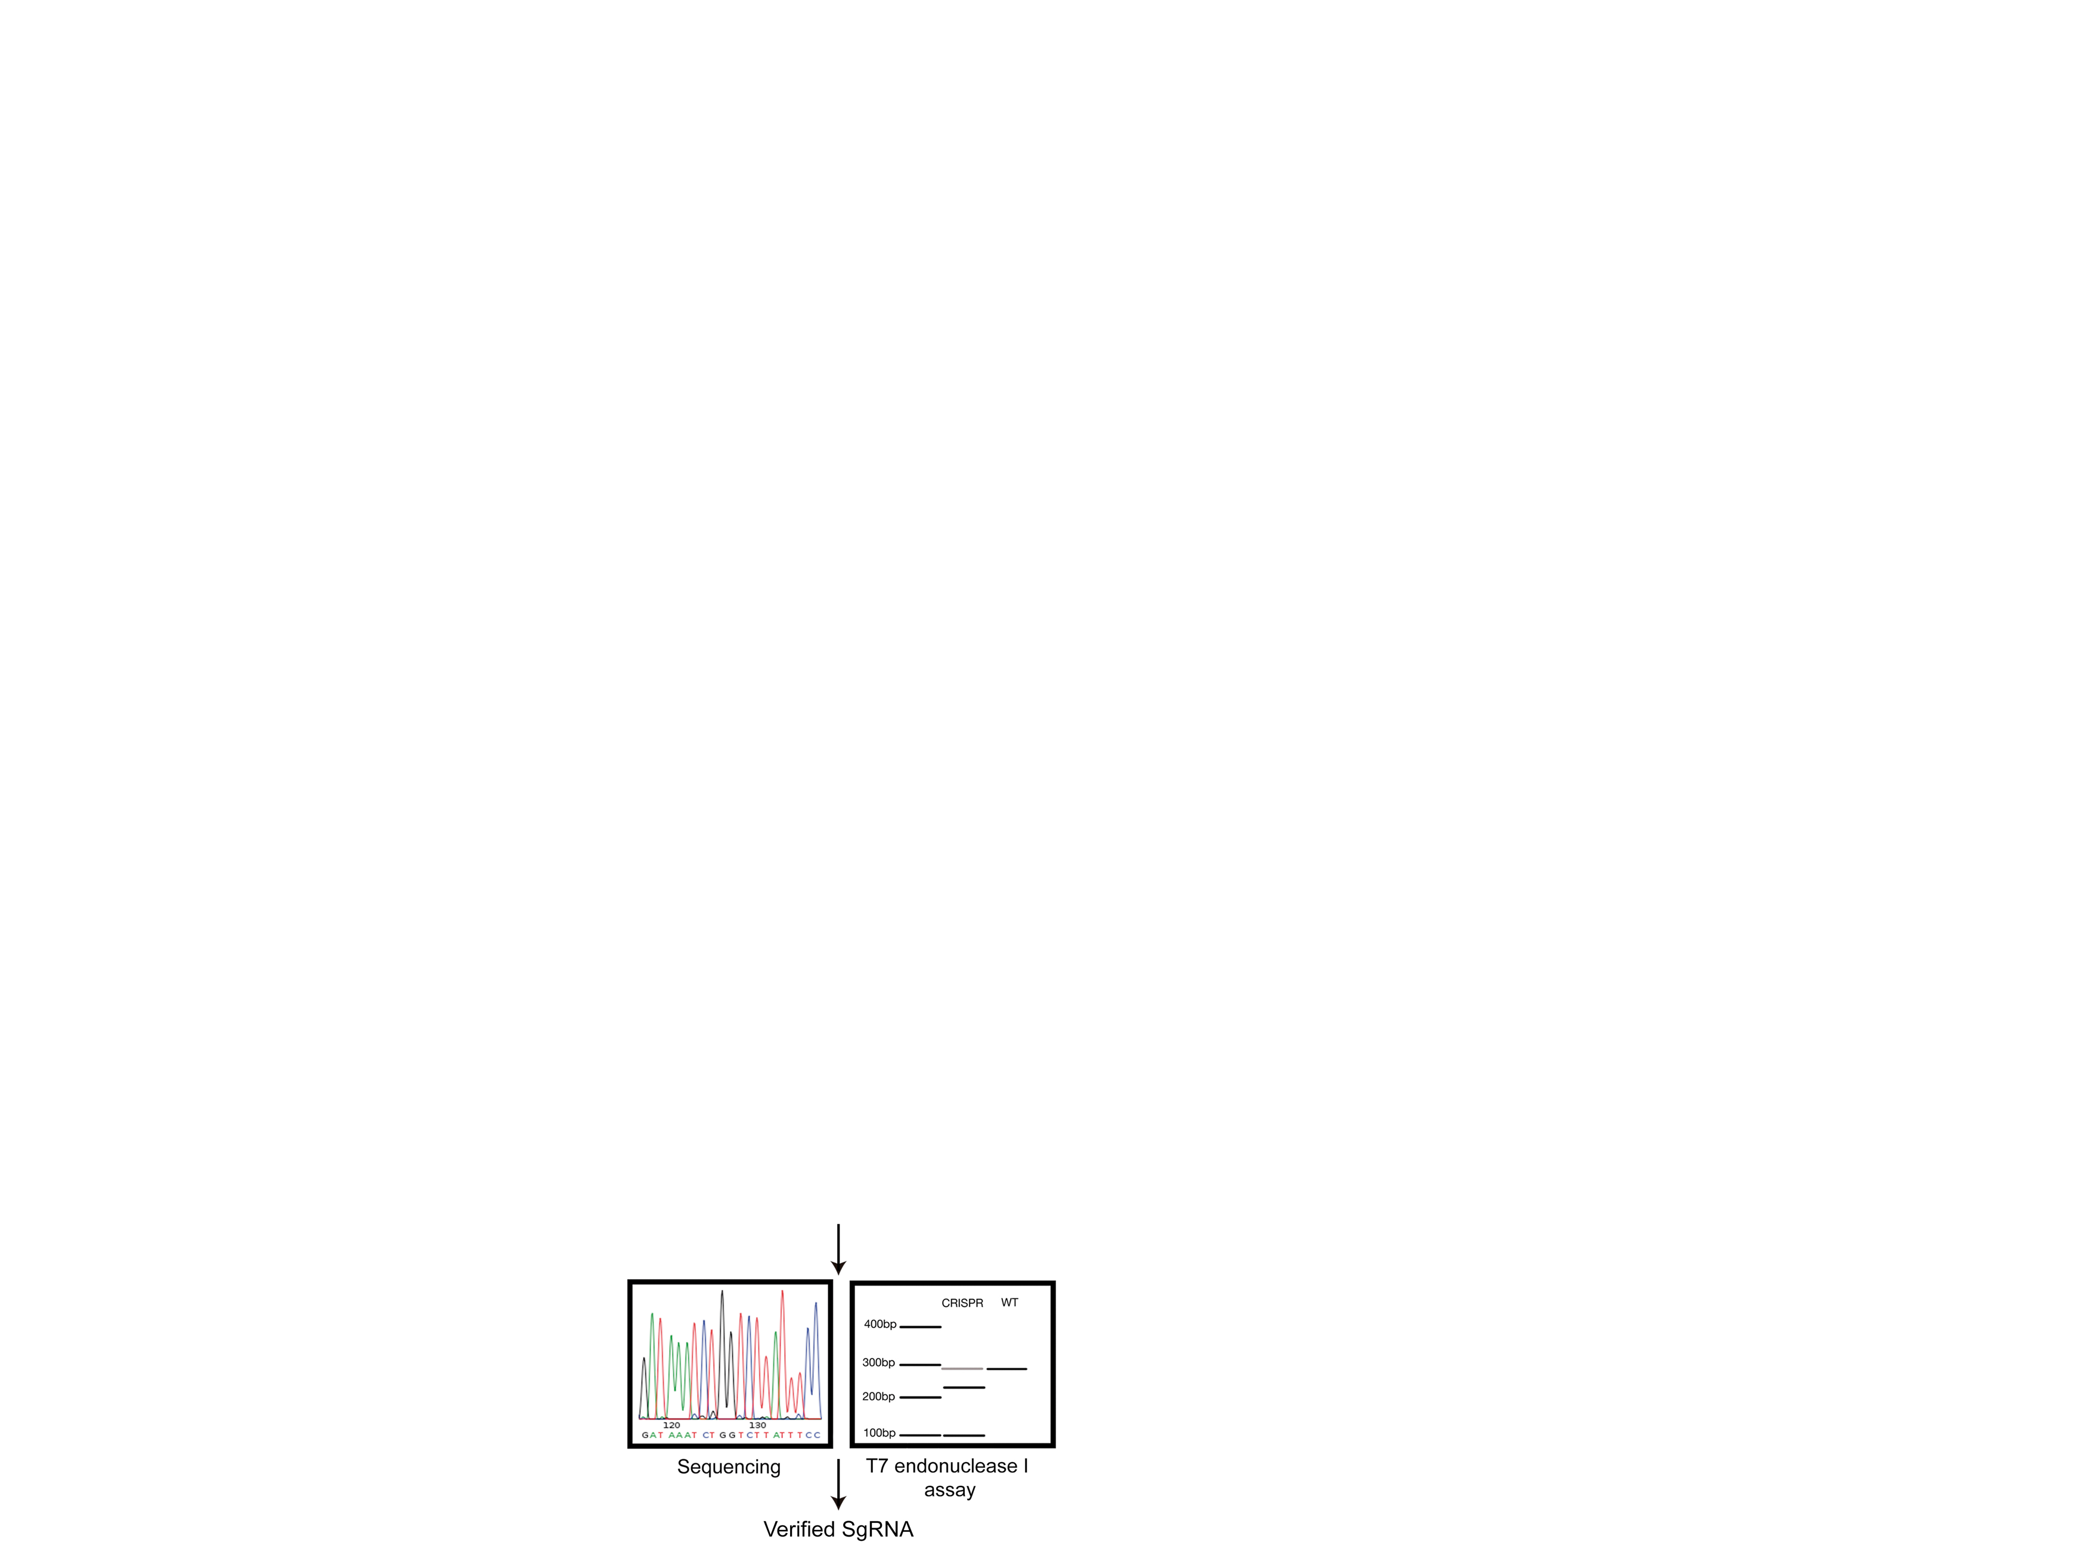
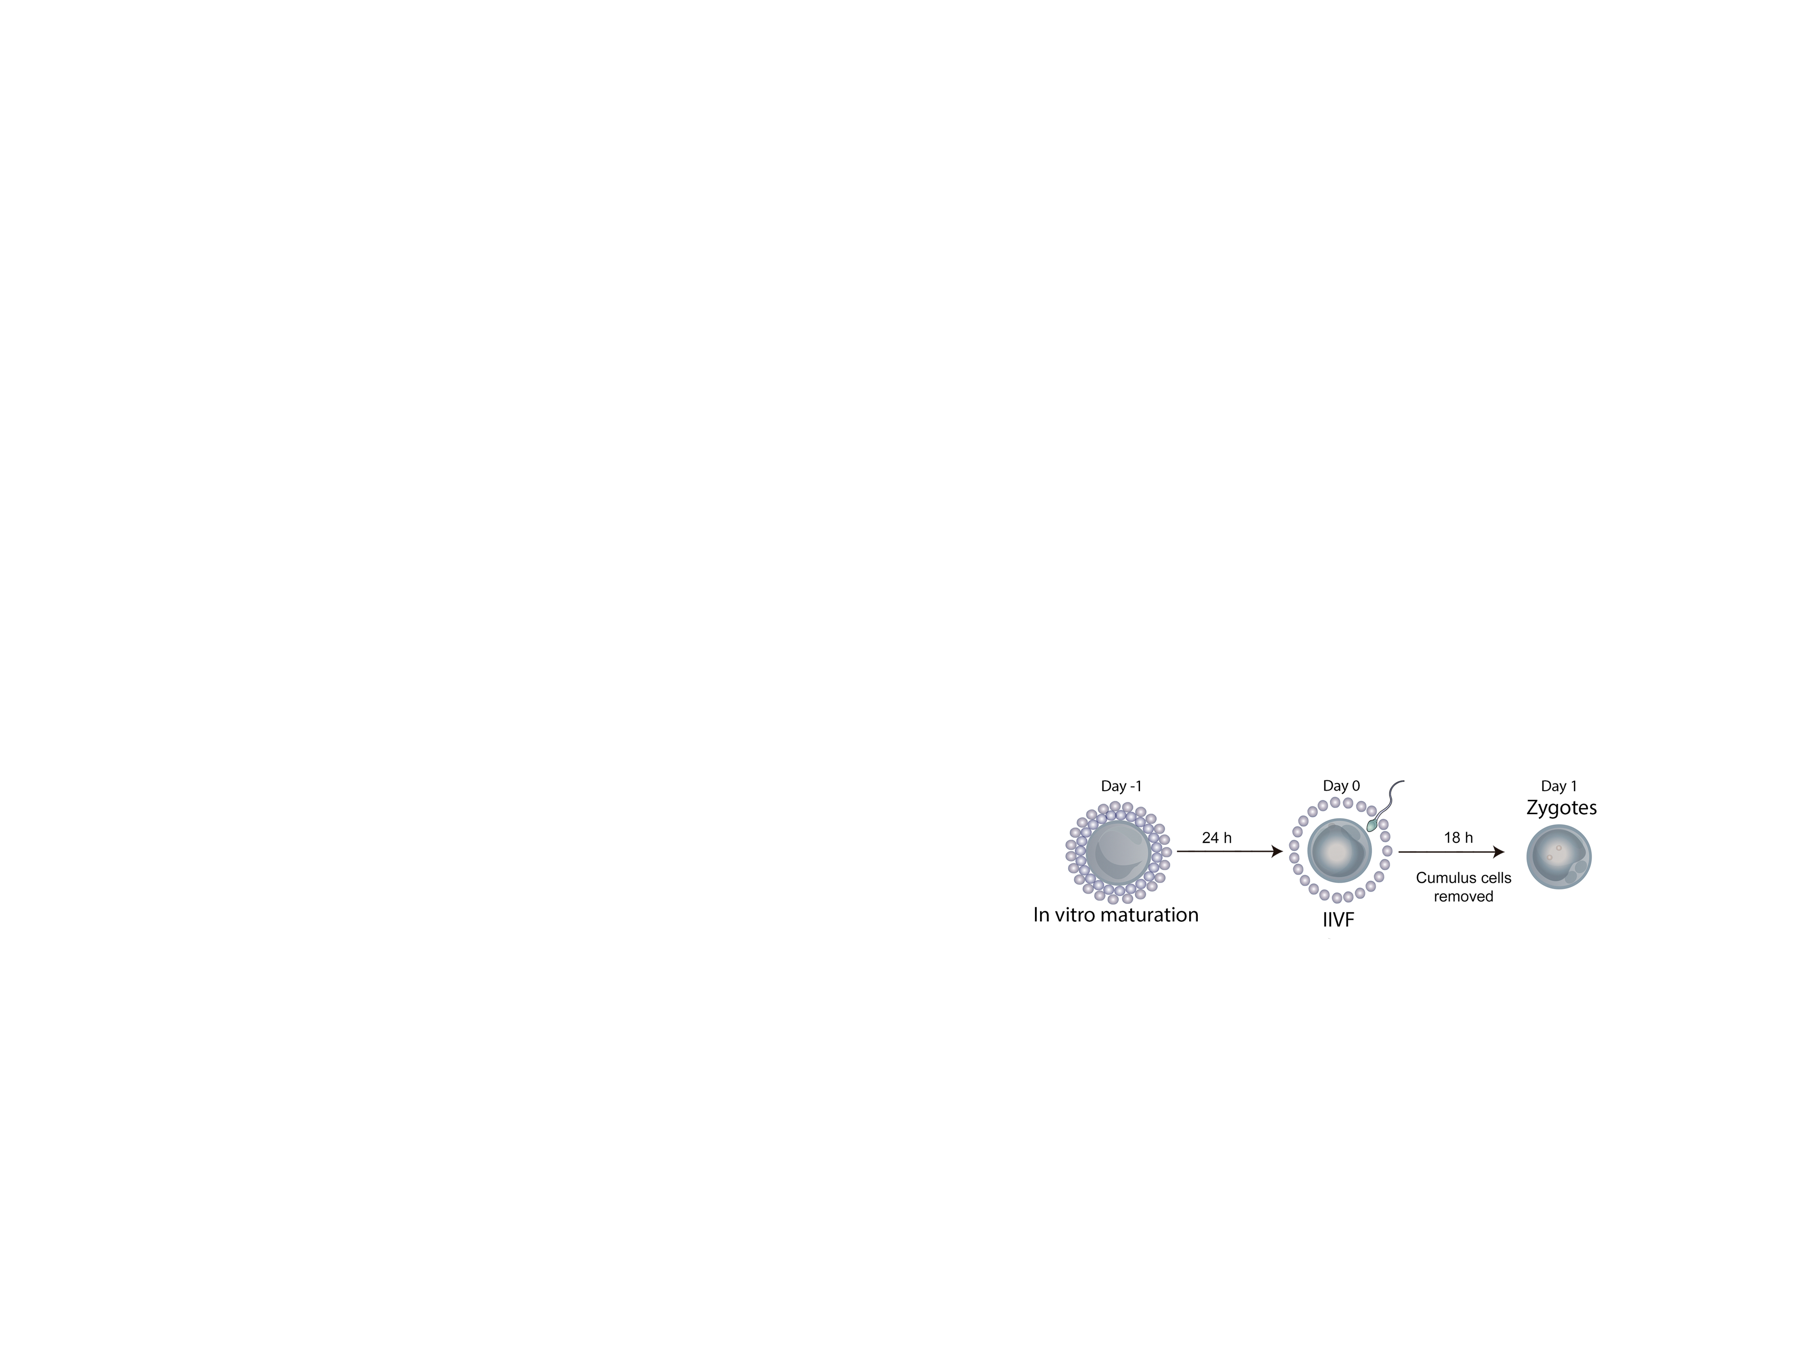
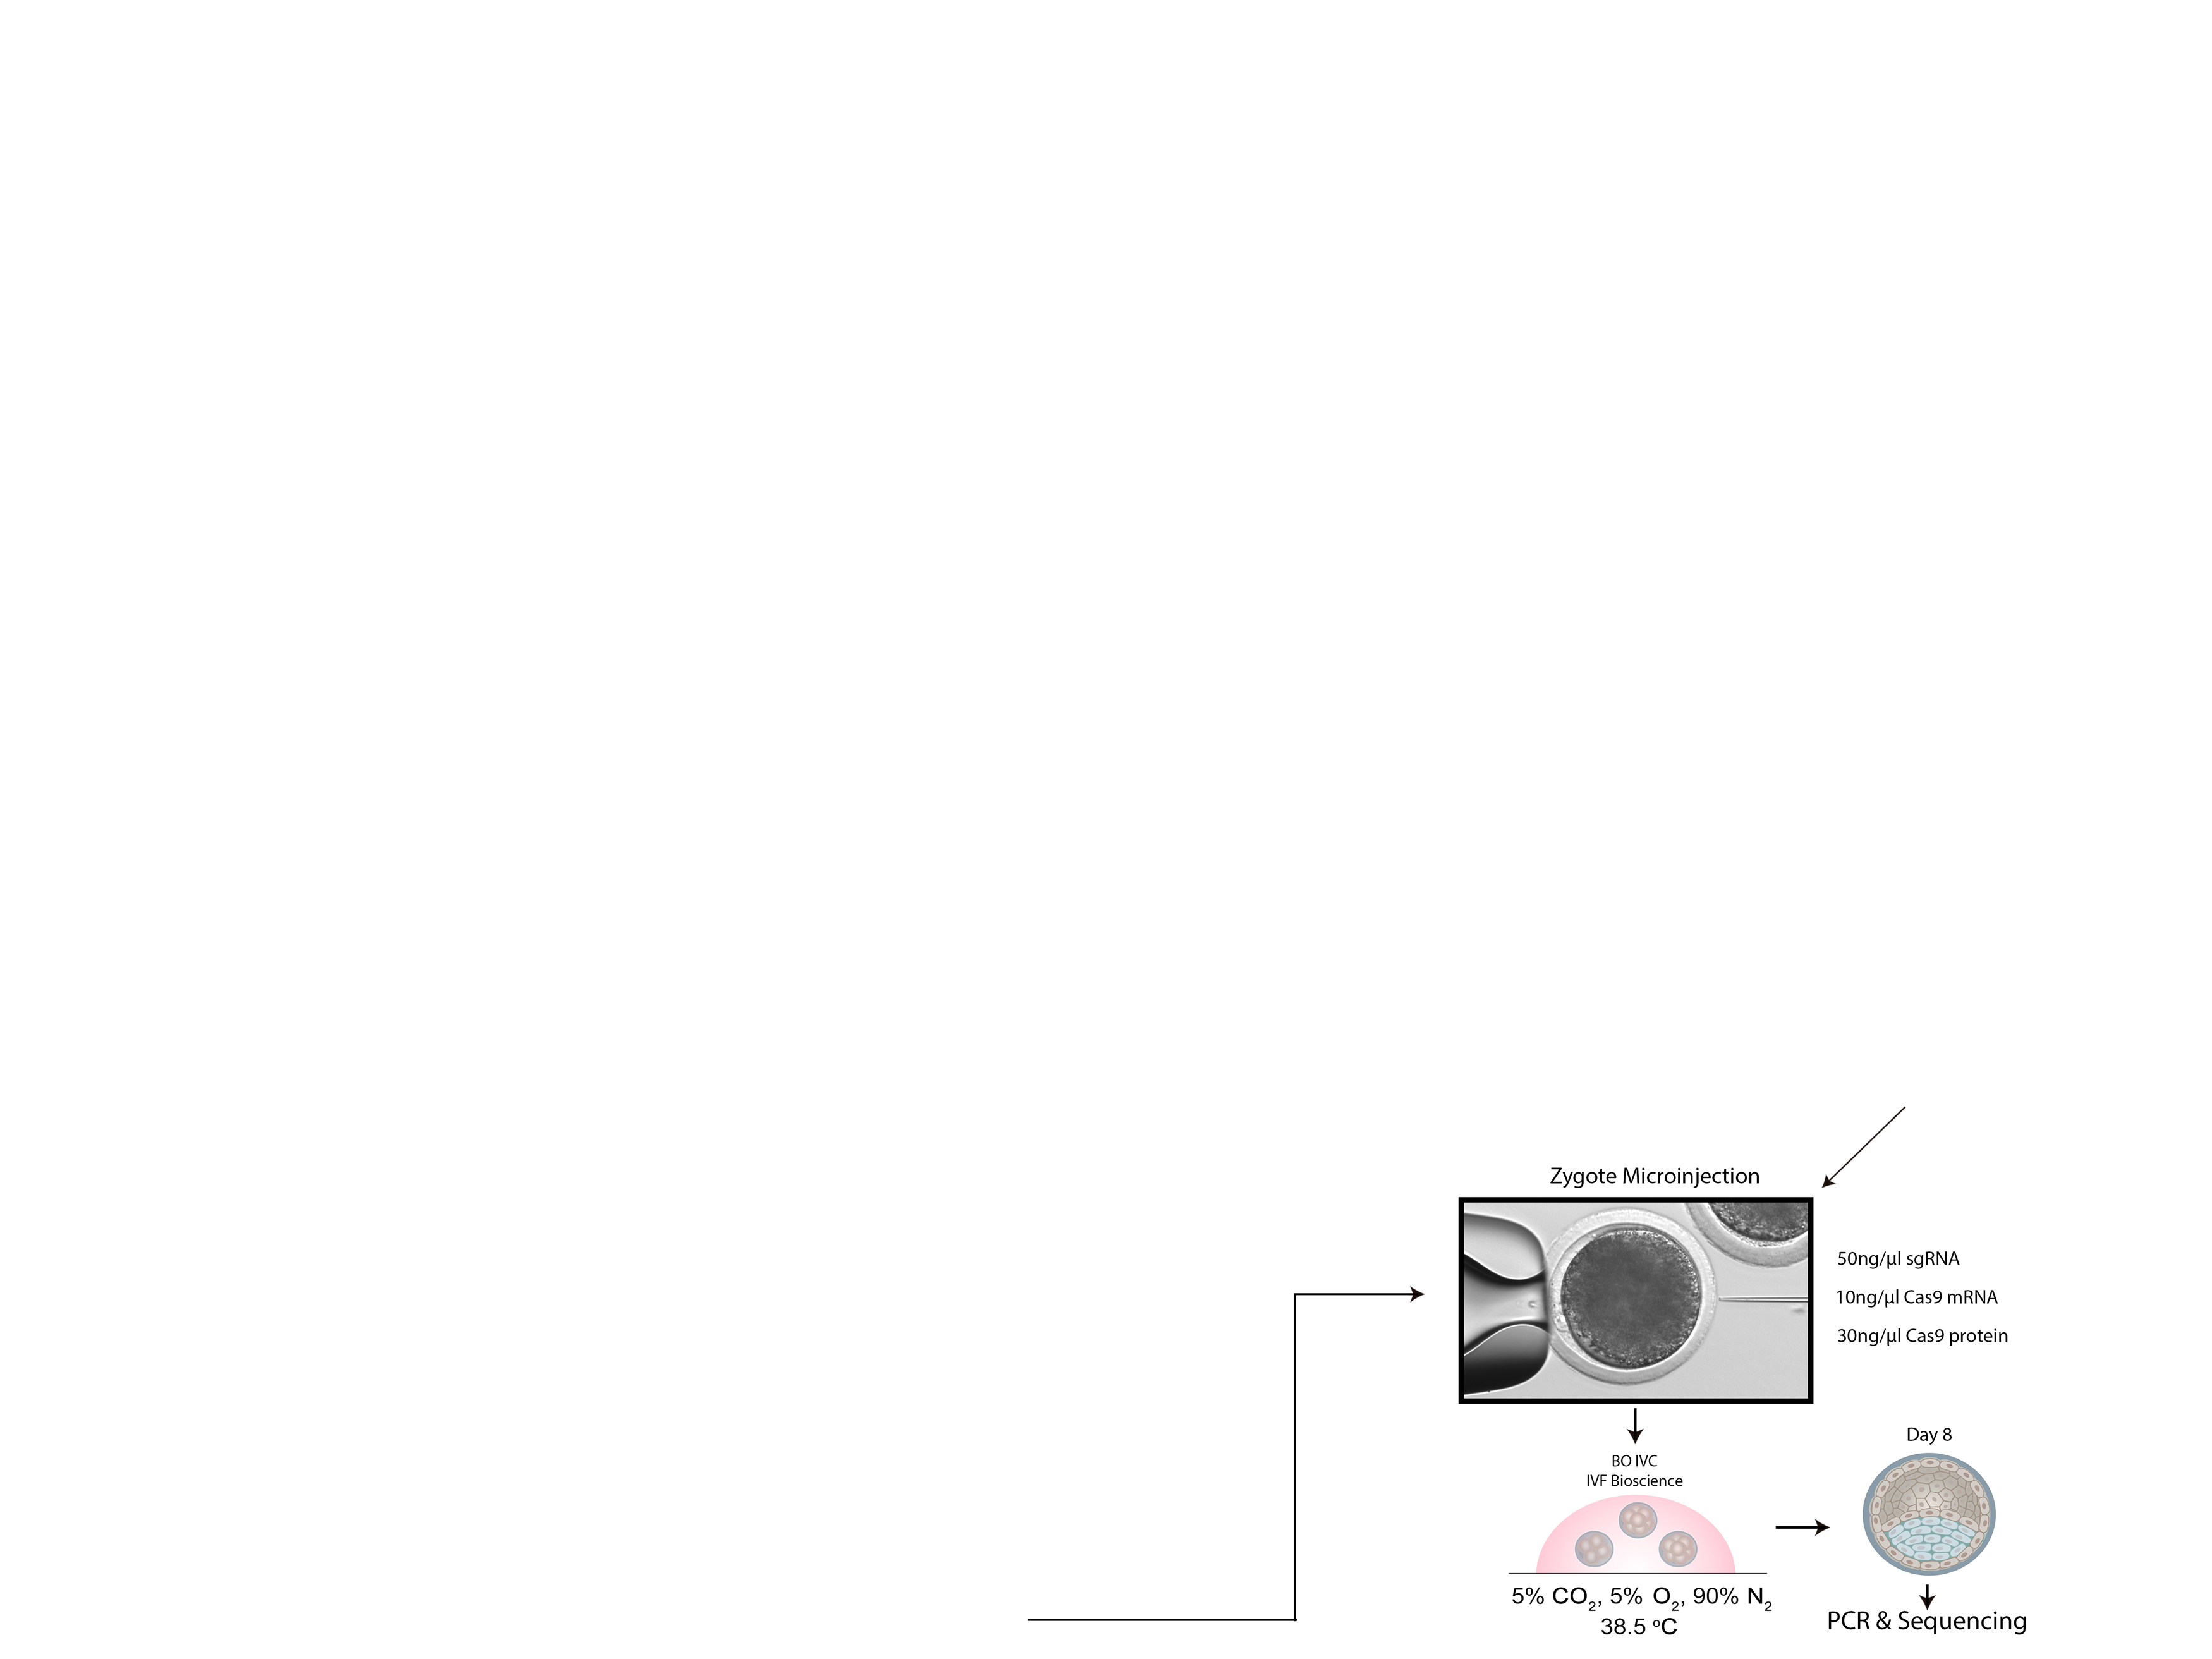
Targeting Bovine Myostatin by Microinjection

Slide 21
What is needed is legislation regulating varieties and their products based on their (new) characteristics and a reasonable a priori risk assessment, not the breeding methods that produced them. It is urgent legislation. We will sacrifice our agriculture and our food production if we fail to produce it.
André Heitz | February 14, 2020
geneticliteracyproject.org

Slide 22
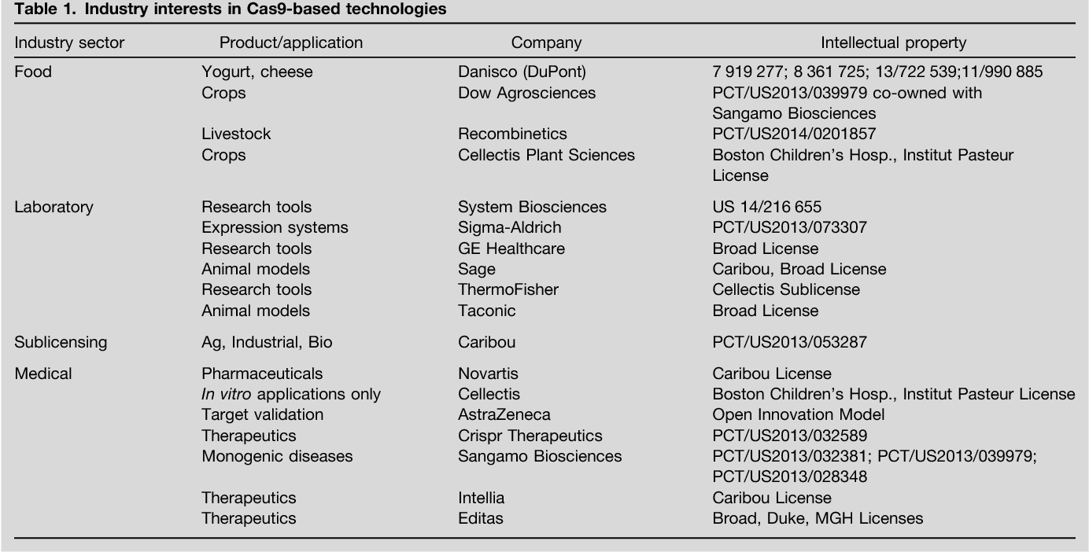

Slide 23
CRISPR is Not New Anymore
Now approximately 100 new publications per week!
http://wwwuser.cnb.csic.es/~montoliu/CRISPR/

Slide 24
