Slide 1


Trends in Adoption of Conservation Practices in the United States
Maria Bowman, Ph.D.
Economist and Conservation Liaison
USDA Economic Research Service
USDA 2022 Ag Outlook Forum
February 25th, 2022
The findings and conclusions in this presentation are those of the author(s) and should not be construed to represent any official USDA or U.S. Government determination or policy. In addition, this work was supported in part by the U.S. Department of Agriculture, Economic Research Service.
Notes:
Thank you Bill. And before I get started, let me begin by saying that my presentation today represents the work of a number of ERS researchers…and I’m excited to be here representing ERS and to tell you a little bit about our research and the data we collect on conservation practices.

Slide 2
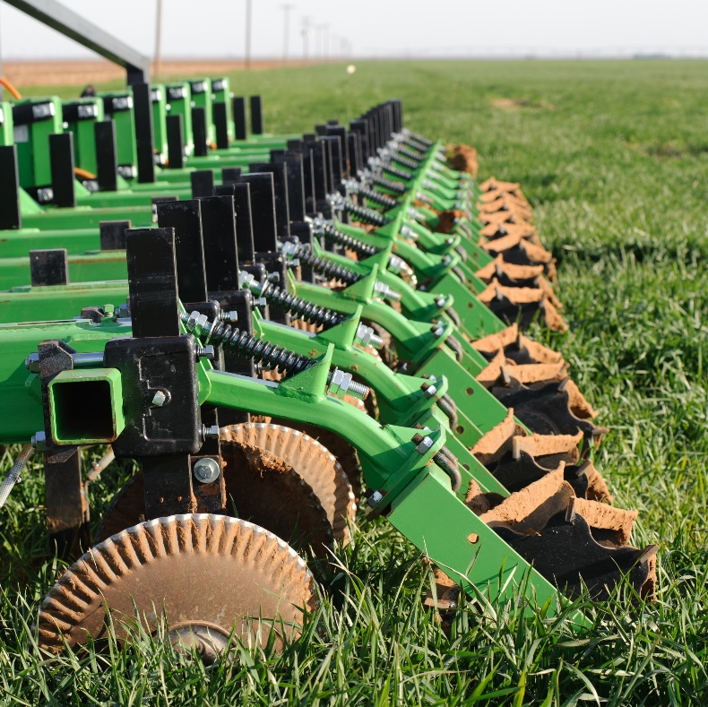
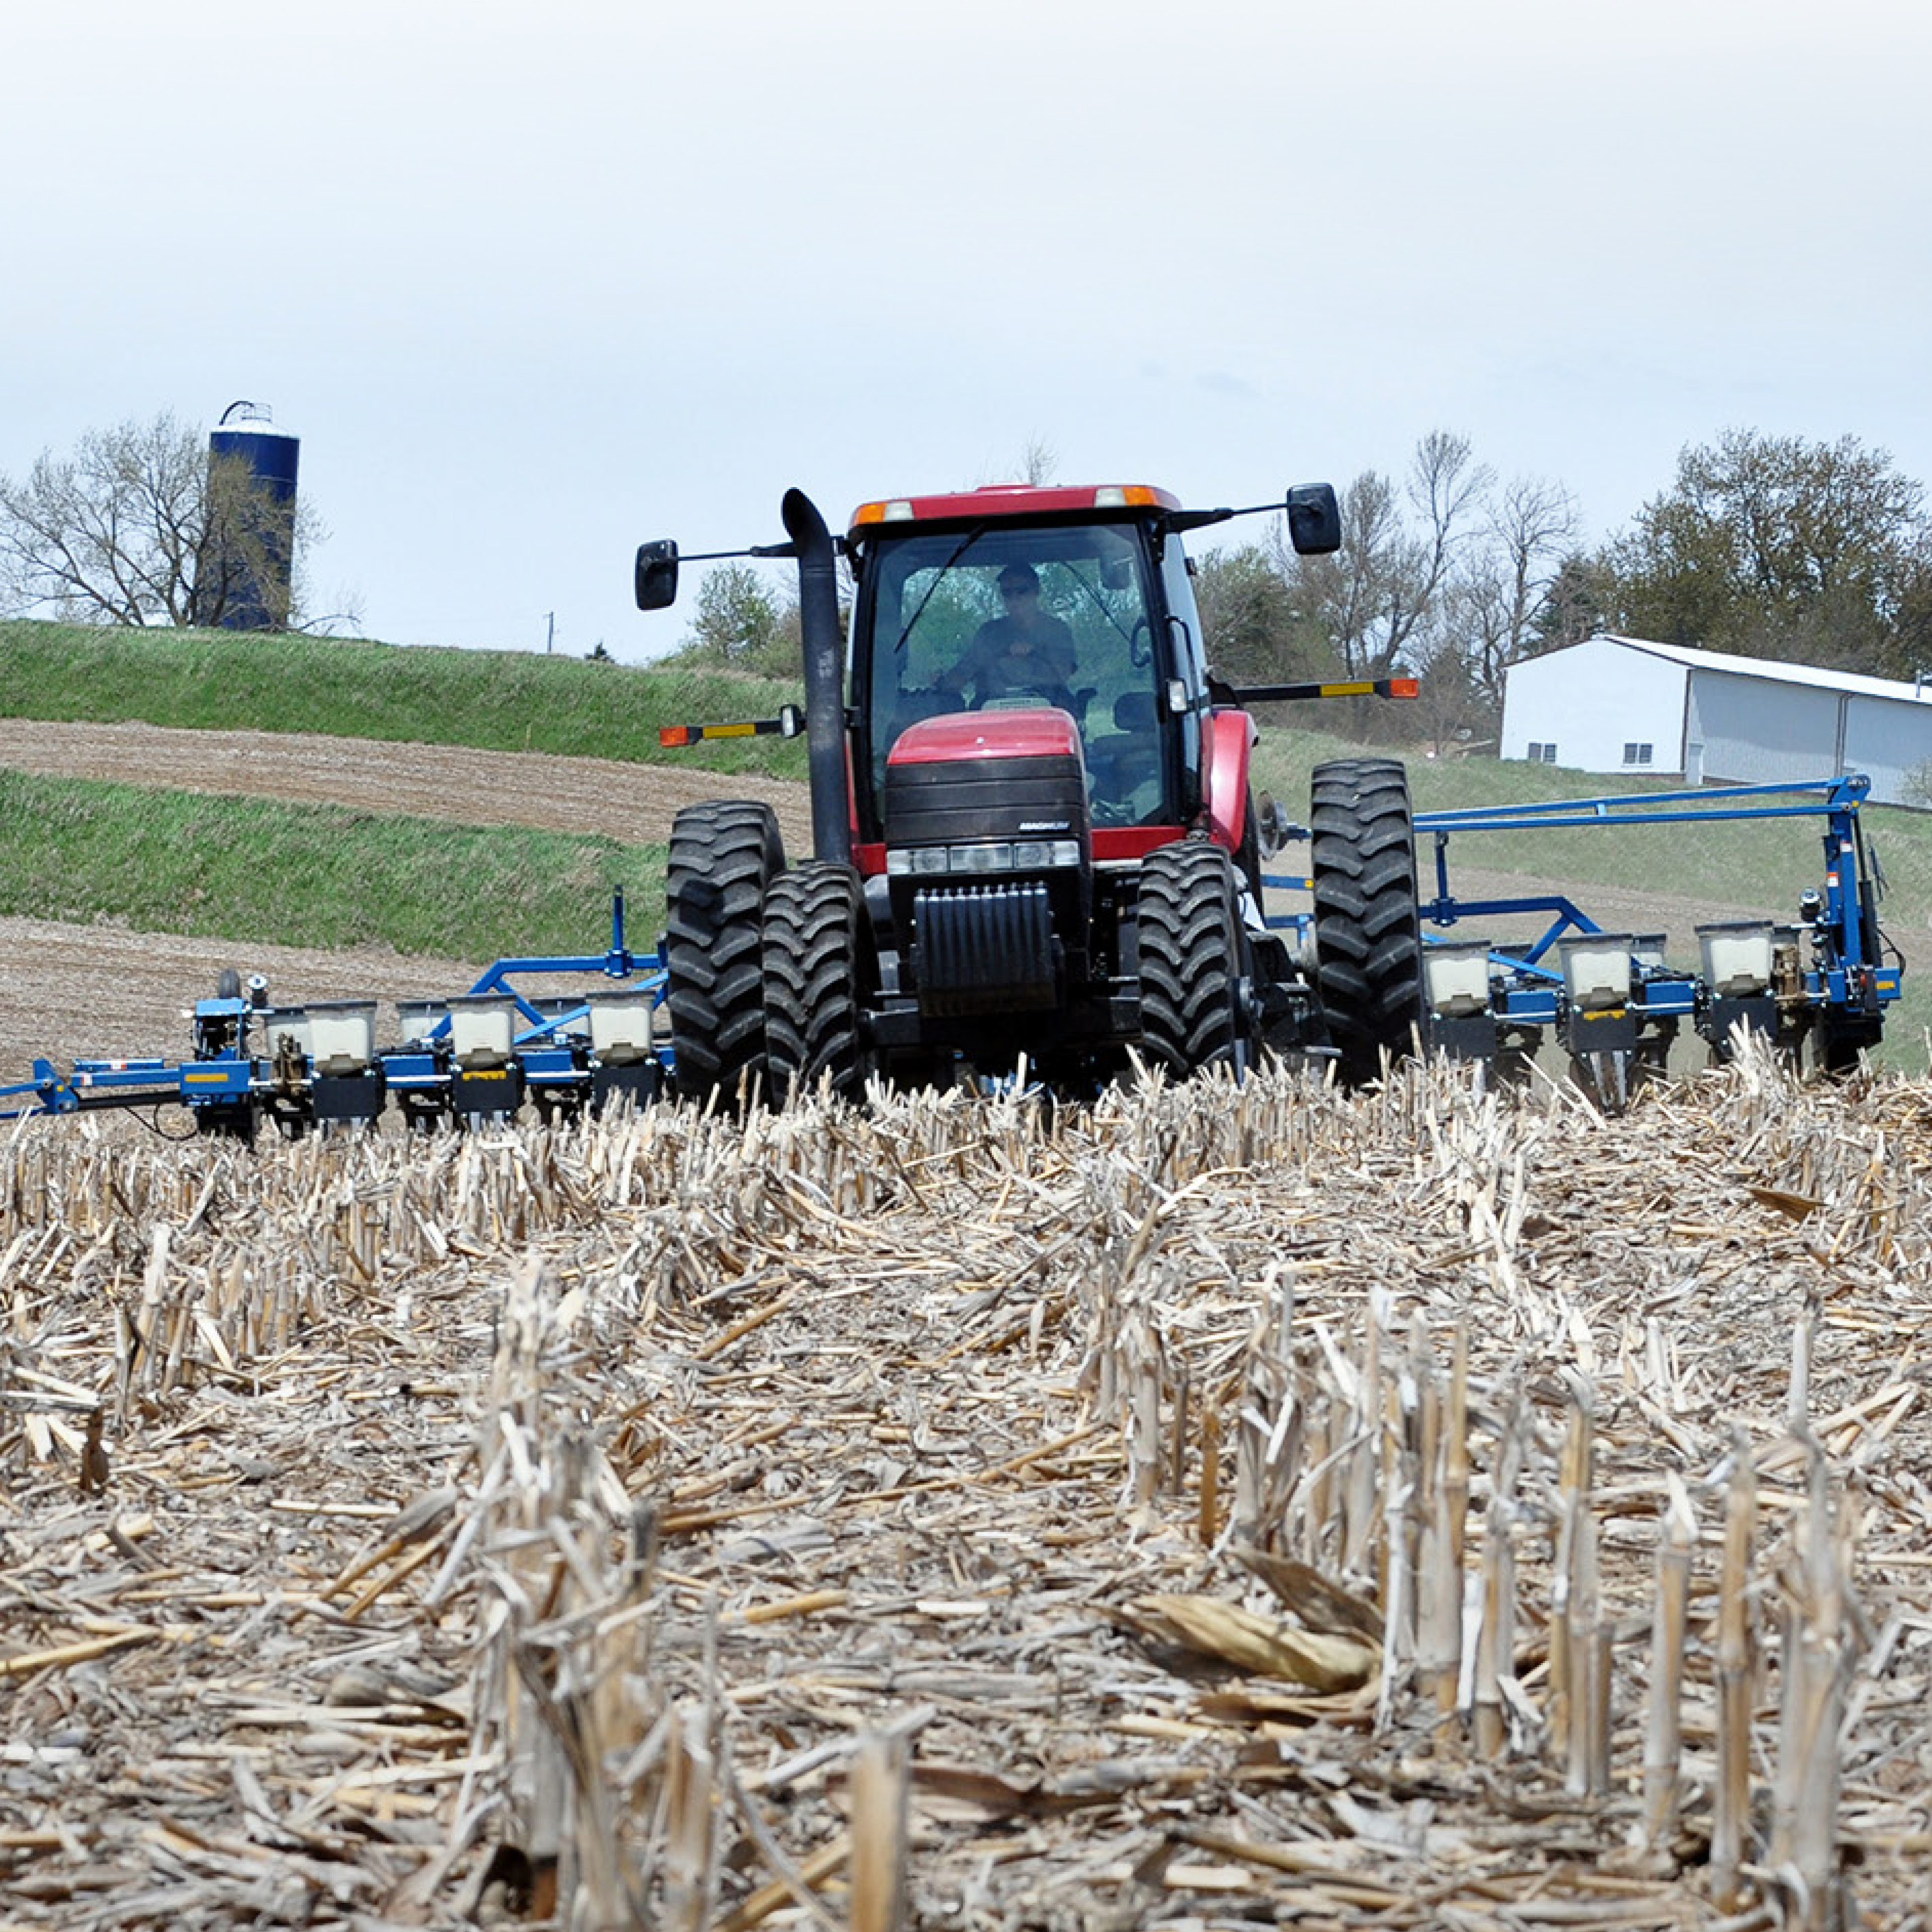
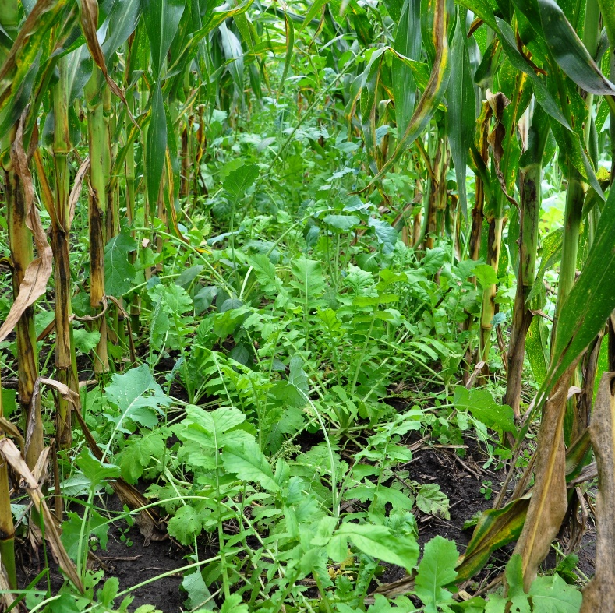

Conservation tillage
(No-till/reduced tillage)
Nutrient Management
Cover crops
Photo credits: (1) USDA NRCS Texas; (2) USDA NRCS; (3) NRCS/SWCS by Lynn Betts
Notes:
Now, there are many, many conservation practices that U.S. farmers and ranchers use for a variety of purposes,
But today, I’m going to focus on three that play a role in greenhouse gas mitigation: NAME. Keep in mind that these practices play a role in reducing GHG emissions, but also that they can provide other environmental benefits such as reducing soil erosion, improving soil health, and improving water quality—to name a few.
Although today I’ll be talking about these practices as individual practices and discussing adoption trends for each, farmers are managing a cropping system. So, for example, they may be adopting cover crops and reduced tillage together as part of a conservation or soil health management system—and they may be adjusting their nutrient management alongside other changes in conservation practices. Just something to keep in mind throughout the presentation.

Slide 3
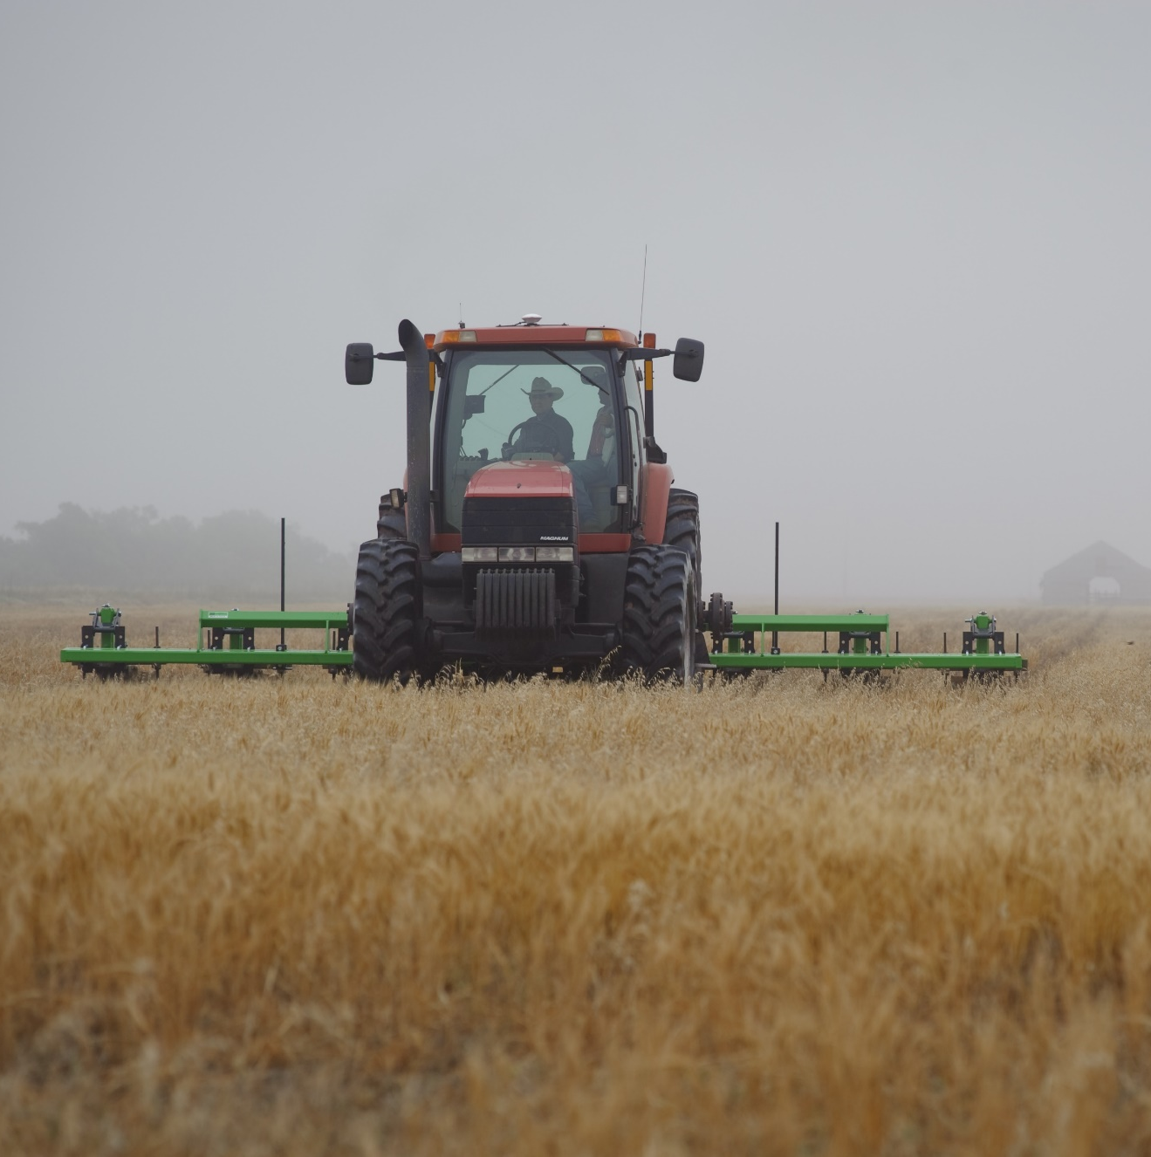
Conservation tillage
Tillage has historically played a role in preparing cropland for planting
Reducing or eliminating tillage has many benefits
Between 1994 and 2017, the number of acres in no-till expanded from 39 million acres (CTIC) to around 104 million acres (USDA Census of Agriculture)
A number of factors contributed to this expansion
Photo credit: USDA NRCS Texas
Notes:
Tillage has historically played a role in preparing cropland for planting
Weed control
Incorporating manure or fertilizer
Crop residue management
Reducing or eliminating tillage has many benefits
Reduced disturbance → reduced erosion; for example, you can see in the photo on the right if you look closely at this farmer pulling a strip-till rig in Texas that strip tillage means you are literally only tilling the strip of ground where the crop will be planted, and the area in between the strips is left undisturbed. Eliminating tillage, as in the case of no-till, can provide even greater benefits…..
Improvements in soil structure and soil health (tillage breaks up soil aggregates, so by reducing tillage, you can improve aggregate stability—how well that soil sticks together—which can reduce erodibility, improve infiltration, etc.)
Reduced GHG emissions and water quality improvements
Between 1994 and 2017, the number of acres in no-till expanded from 39 million acres (estimated by the Conservation Technology Information Center) to around 104 million acres (USDA Census of Agriculture)
Some of the factors driving the expansion:
Focus on soil and water conservation of the Soil conservation movement
Seed and planter technology- “Herbicide-tolerant have reduced reliance on tillage for weed management and new planters/no-till drills are equipped to cut through or clear crop residue from the row have made it easier to plant directly into untilled, residue-covered soil. “
Conservation compliance rules for highly-erodible land
Conservation financial and technical assistance

Slide 4
No-till adoption has slowed for some crops, but total acres under conservation tillage continues to increase
Source: USDA, Economic Research Service and USDA, National Agricultural Statistics Service, Agricultural Resource Management Survey
Notes:
This graph shows the estimated share of Wheat, Corn, Soybean and Cotton acres under conservation tillage over time—the yellow (bottom) part of the bar is no-till, and the brown or bottom part of the bar is reduced till.
These data come from the Agricultural Resource Management Survey, or ARMS—a survey that is jointly conducted by ERS and the National Agricultural Statistics Service (NASS)—and in particular, these ARMS surveys look at production practices and costs on fields that were planted to a particular crop in the survey year. We ask the farmer to tell us all of the different field operations that took place on that field in a given year—and we use that information to calculate the tillage intensity for the field.
If a farmer reports that no tillage operations occurred on the field, they’d be in that yellow no-till bar—and to calculate reduced tillage (or mulch tillage) we use an index developed by the Natural Resources Conservation Service to estimate the disturbance caused by the particular types of tillage that are occurring on the field and see if they meet the criteria for reduced tillage
These bars represent adoption rates in the survey year—so, a single snapshot in time. Previous ERS research has shown that many farmers change tillage practices from year to year, for example with crop rotations (e.g. no-till soybeans, and tilling before corn)—just something to keep in mind. Tillage practices are dynamic and influenced by many factors.
Couple of things to note here—
First, the share of total conservation tillage, or no-till and reduced till together, continues to increase for all four of these crops.
For example for wheat, conservation tillage increased from approximately 20% of acreage in 1998 to almost 70% of acreage in 2017
For cotton, although the share is lower overall, conservation tillage increased from 32% to 43% of acreage between 2003 and 2019.
No-till has continued to increase for corn and wheat acreage
large expansion in wheat from 9 to 45% of acreage
Corn expansion from 16% to 28% of acreage
But, you can also see that over time, no-till adoption has slowed or decreased for soybeans and cotton.
High of 45% no-till in 2006 in soybeans to 39% in 2018
High of 21% in cotton in 2007 to 19% in 2019
There are a couple of factors that are likely contributing to this….
Increase in herbicide-resistant weeds like water hemp, giant ragweed, and palmer amaranth
*Reduced tillage has a Soil Tillage Intensity Rating less than 80

Slide 5
Financial assistance through EQIP for top cropland management practices
Source: USDA-NRCS, National Planning and Agreements Database (NPAD), October 2020 via USDA-NRCS RCA Data Viewer.
Notes:
This graph shows trends in the number of land unit acres receiving a financial incentive payment for 5 conservation management practices through the Natural Resources Conservation Service Environmental Quality Incentives Program, or EQIP, from fiscal year 2005 through fiscal year 2020. The orange line shows nutrient management, blue line is no-till, green is conservation crop rotation, red—mulch till—and purple is cover crops.
Couple of things to note here. Through about 2010, the top practices in terms of the number of acres were nutrient management and no-till/strip-till.
But during the last decade, the relative emphasis shifted to cover crops—a practice that had lower adoption rates in the U.S., and that, at least as of around 2010, had higher “additionality”—meaning farmers were less likely to cover crop without financial assistance than to make the switch to no- or reduced tillage, for example—as we saw on the previous slide, rates of no-till/reduced-tillage were relatively high/stable for some crops

Slide 6

Cover crops
Cover crops can provide a number of benefits
Adoption is increasing across the U.S. (10 million acres in 2012 census vs. 15 million acres in 2017 census)
ERS data suggest that this trend is continuing
Adoption still (relatively) low compared to conservation tillage
NRCS/SWCS photo by Lynn Betts
Notes:
Talk about what a cover crop is
-planted in between two commodity or forage crops to provide seasonal, living soil cover.
-can be a single crop such as winter wheat or cereal rye---or a mix of species with different attributes
A number of factors have contributed to this increase in cover crop adoption….
- Federal and state financial assistance for cover crops
But adoption is still relatively low compared to conservation tillage. There are a number of factors that likely contribute to this:
Managing cover crops can be challenging and costly
-Short term return to practice may be negative
Fixed costs, learning costs, costs of experimentation
Variable costs of the practice
Benefits may show up slowly over time
Changes in the soil
Lack of information about a practice
What will the costs or benefits be?
Will I see a yield impact (either positive or negative)?
How long will it take for soil to change?
Is technical assistance available to support transition?
Risk

Slide 7
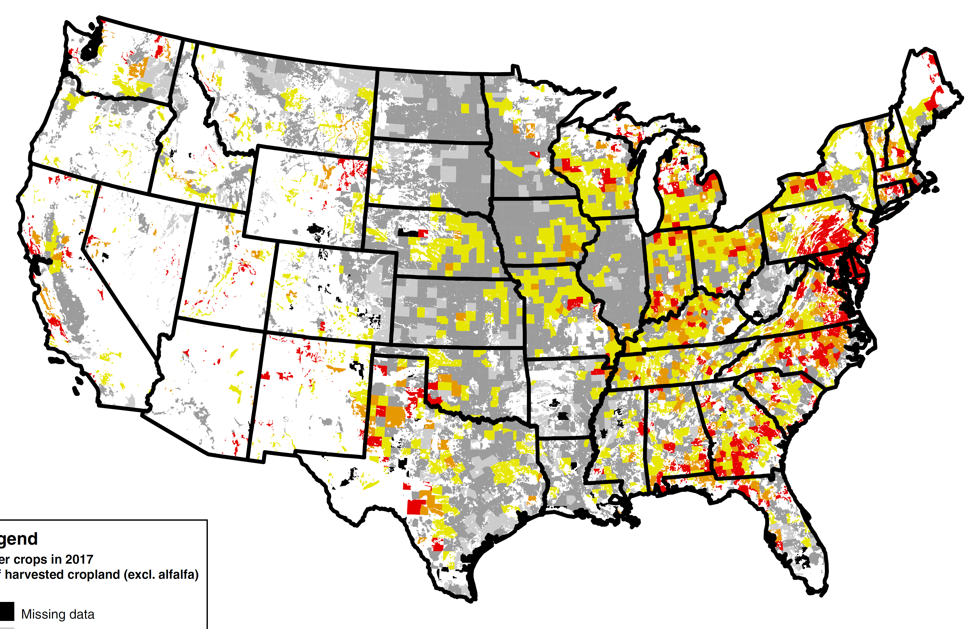
Adoption of cover crops varies across the U.S.
Different soils, cropping and livestock systems, and climate all affect costs and benefits of cover crop adoption
Cover crops relatively cost-effective for addressing water quality concerns
State programs and financial incentives for cover crops play a role
% of harvested cropland in 2017 (excl. alfalfa)
0
1-5
5-10
10-15
>15
Source: USDA Economic Research Service using data from the 2017 Census of Agriculture
Notes:
Maryland, which has been heavily promoting cover crops for well over a decade, has both a high adoption rate (about 33 percent in 2017) and a high growth rate (more than 6 percentage points from 2012 to 2017).
Crop insurance premium discounts of $5/acre in Iowa, Illinois and Indiana

Slide 8
Rates of fall cover crop adoption vary depending on the cash crop
Surveyed crop:
Source: USDA, Economic Research Service and USDA, National Agricultural Statistics Service, Agricultural Resource Management Survey
Notes:
This slide shows crop-specific trends in FALL cover crop adoption using USDA Agricultural Resources Management Survey data collected from 2010 to the present. These data come from a survey question in ARMS where we ask the farmer to tell us everything that was grown on that surveyed field for the past four years, including cover crops
So, for each of these lines, the fields are planted with the surveyed crop in the surveyed year (so, the year that corresponds to the last dot) and a mix of crops in earlier years.
The green lines represent cover crop adoption rates on fields that were planted to corn silage in the survey year, red lines are corn for grain, orange is cotton, blue is soybeans, and the black lines are winter and spring wheat.
In the fall preceding the survey year, farmers adopted cover crops on 5 percent of corn-for-grain (2016), 7 percent of soybean (2018), 19 percent of cotton (2019) and 25 percent of corn-for-silage (2016) acreage.
Why is cover crop adoption so high for, for example, corn grown for silage? There are a couple of contributing factors—
First, Because corn silage is used exclusively for feeding livestock, farmers planting corn-for-silage may also grow cover crops for their forage value, as well as to address soil health and erosion concerns on fields those fields
Corn-for-silage also is harvested earlier than corn harvested for grain—which gives the farmer a longer window to plant cover crops and get them established.
Finally, on livestock operations, planting cover crops can help operations meet nutrient management requirements in some states/regions (give PA example)

Slide 9
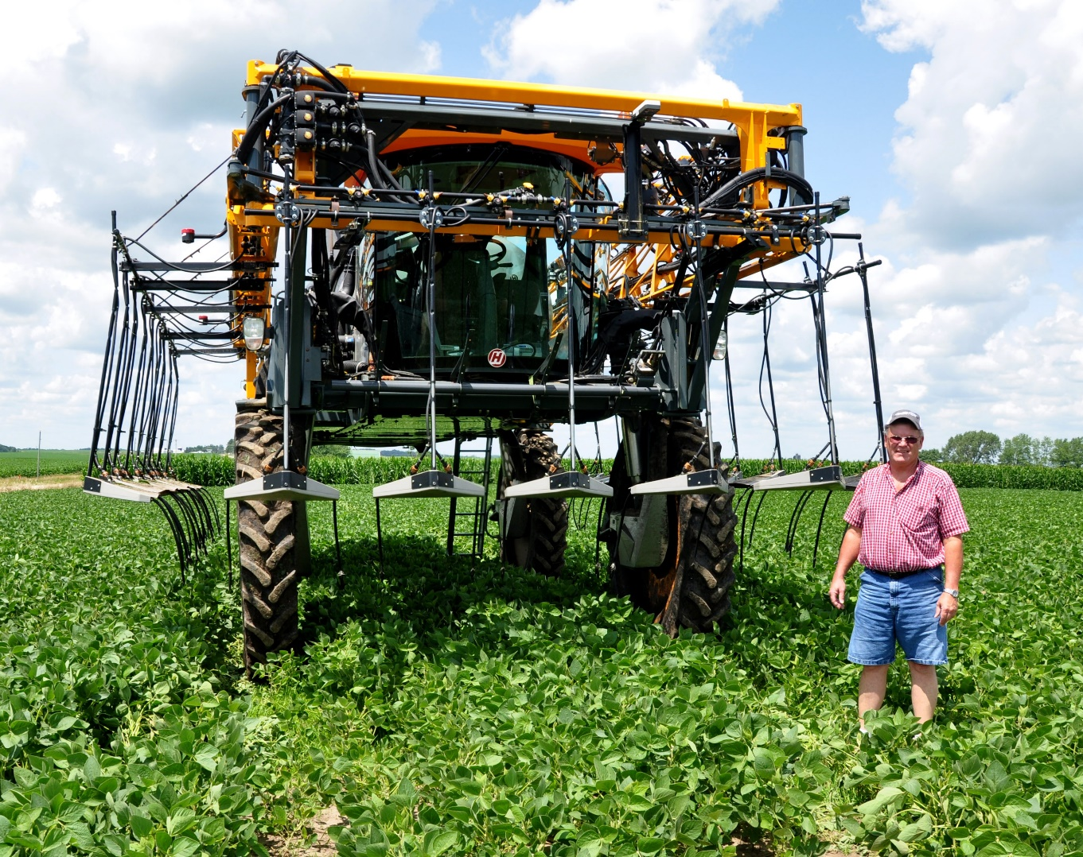
Nutrient management
Crop growth and environmental impacts of nutrient management affected by…
  Amount (rate) of nutrients applied
  Source of nutrients
  Timing and placement of nutrients
Examples of conservation at work in nutrient management:
  No fall application, or “split application”
  Aligning rate of nutrients applied with crop needs or profit-maximizing rate (not over-applying)
  Using soil test results to help determine application rates
Photo credit: Jason Johnson, Iowa NRCS
Notes:
Nutrients lost to air or water have GHG and water quality impacts
RJ Carson of Marion shows off his new Hagie Mfg. high clearance nitrogen applicator. The ability to apply nitrogen as late as mid-July is a key component in Carson’s spring fertilizer plan.

Slide 10
Nutrient management trends over time
In general, share of acreage w/ application rates >125% of agronomic need has decreased (N & P)
  Nitrogen on corn: 53% in 1997 vs. 28% in 2016
  Phosphate on cotton: 45% in 1997 in to 29% in 2015
When and how nutrients are being applied is changing
  In corn, some evidence that spring application is shifting from pre-plant to post-plant
  Will be examining trends for other crops, fields receiving manure
What role does precision nutrient management play in conservation, and how is this changing over time?
Source: USDA, Economic Research Service and USDA, National Agricultural Statistics Service, Agricultural Resource Management Survey
Notes:
Last but not least, I’m going to talk about some of the trends we’re seeing in nutrient management over time in the ARMS data—
Before I talk about the chart, let me say that one of the trends we’re observing is that….
In general, share of acreage w/ nitrogen and phosphate application rates at greater than 125% of agronomic need has decreased
For example, using that metric, overapplication of Nitrogen on corn decreased from 53% of acreage in 1997 to 28% in 2016
And over application of phosphate on cotton decreased from 45% of acreage in 1997 in to 29% in 2015
But there’s also some evidence that when and how nutrients are being applied is also changing—for example, the chart on the right shows the % of the nitrogen applied to corn fields (excluding corn fields that had manure applied) that was applied at different times. The grey line—the lower of those two middle lines—represents fall application of nitrogen, the blue line at the top represents nitrogen applied in the spring before planting, the orange line at the bottom indicates nitrogen applied at planting, and the yellow line in the middle shows nitrogen applied after planting, or post-plant.
And you can see that at least between 2010 and 2016, there’s some indication that more nitrogen was being applied to corn post- plant compared to in the spring prior to planting. This could mean that more of that nitrogen is being used by the growing plant, and we’ll be taking a look at trends in timing for other crops and fields receiving manure in the future, as well.
If you’re interested in this topic, I’ll also say that some of my colleagues conduct research on the adoption of precision agricultural technology, including nutrient management—so keep an eye out for new research on how precision ag is being used, based upon what we see in survey data.

Slide 11
For more information…
Notes:
If you’re interested in any of the practices I’ve talked about today, there are three ERS reports I’d encourage you to take a look at…
I’d also encourage you, if you’re interested in the economic issues at play with some of these conservation practices, to go back and watch the recording of my colleague Ben Gramig’s session from yesterday when it’s available, where he talks about some of the impacts of cover crops and conservation tillage on yield, cost, and other factors in the ARMS data

Slide 12

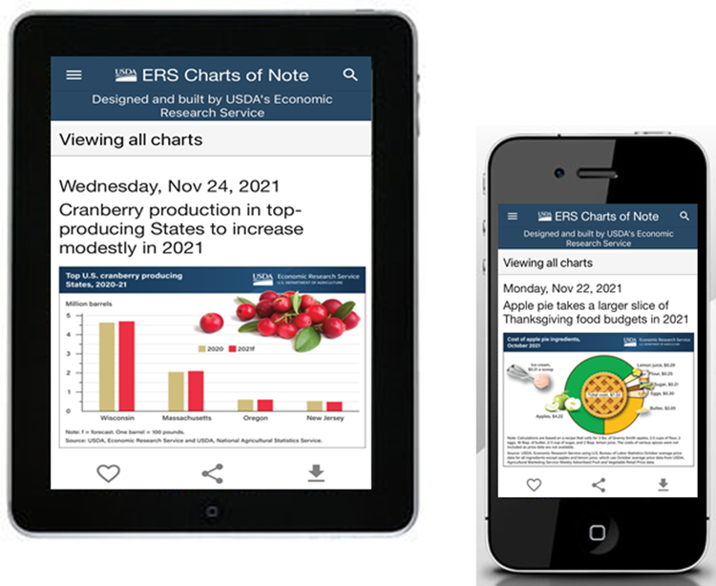

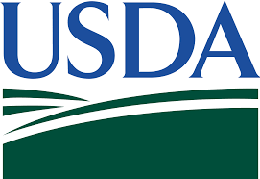
Like, Share, & Follow
Coming Soon!
Charts of Note Mobile App
@USDA_ERS
linkedin.com/company/USDA-Economic-Research-Service
ERS.USDA.gov/subscribe
ERS.USDA.gov/multimedia
ERS.USDA.gov/about-ers/careers-at-ers/
Notes:
Let me leave you with a few more ways you can stay up-to-date with ERS research.
You can always find us on Twitter (@USDA_ERS) and LinkedIn (USDA Economic Research Service), if you’re on social media…
In the next couple of months, be on the lookout for a new Webinar Series that will highlight the ins and outs of some of our most popular data, such as food access and agricultural trade multipliers. Our experts will even walk you through how to find the data on the ERS website.
Stay tuned for announcements that’ll be shared via Twitter, LinkedIn, the ERS website and our subscription emails.
One of our most popular products—our “Charts of Note”---will be available in the next month or two via our new Charts of Note Mobile App
Finally, at Ag Outlook Forum, if you get a chance—stop by our virtual exhibit booth to chat with ERS researchers and learn more about our work!

Slide 13
Thank you.
maria.bowman@usda.gov

