Slide 1
New Developments in Sugarbeet Seed Research and the Effect on the U.S. Beet Sugar Industry
Mike Metzger, Ph.D.
Vice President – Agriculture & Research
Minn-Dak Farmers Cooperative
Wahpeton, ND

Slide 2
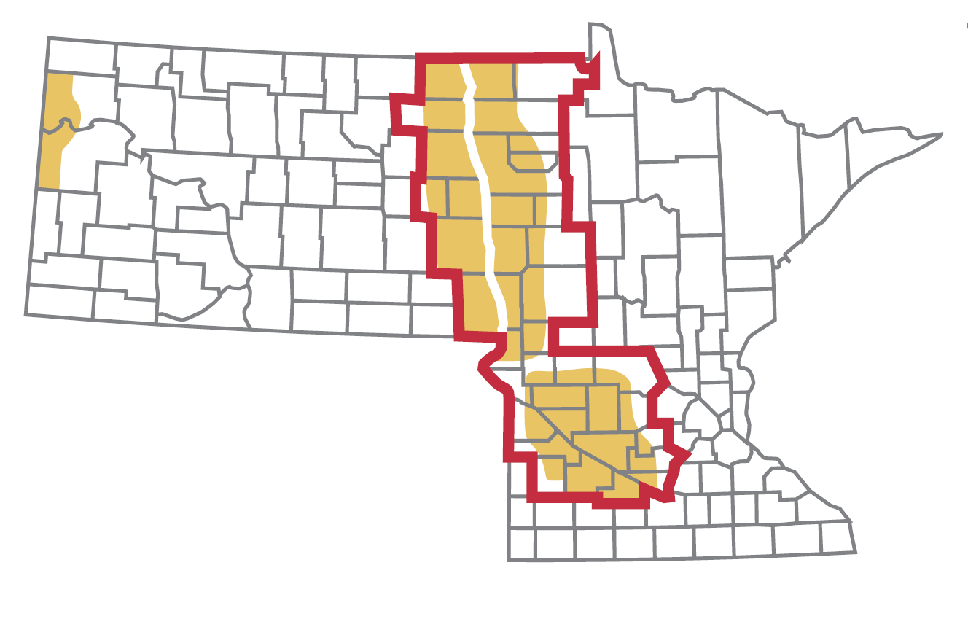
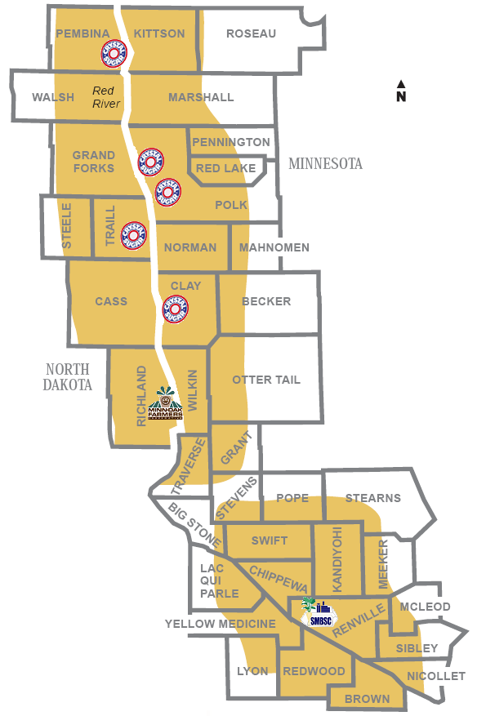

Slide 3
Big Impacts Can Come
From Small Things…
Seed Technology = What can be placed ‘on’ or ‘in’ the seed…
‘On-Seed’ Technology = Seed treatments
  Mainly fungicides, insecticides, and priming techniques
  Target-specific products widely adopted around 2010
‘In-Seed’ Technology = Genetic enhancement of a cultivar
  Genetic engineering or conventional breeding
  Have had two ‘game changers’ this century with another on the way

Slide 4
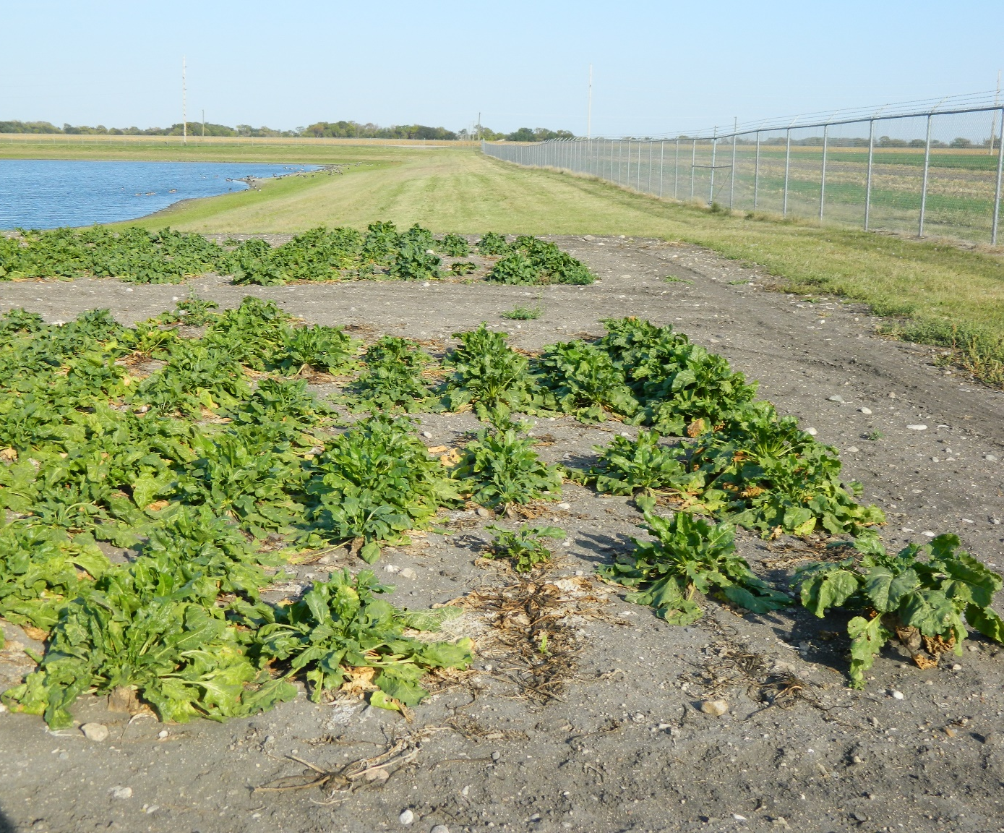
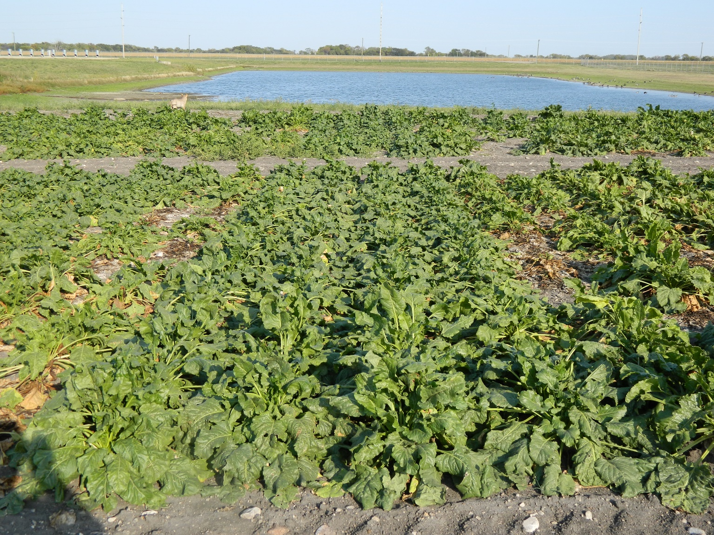
‘On-Seed’ Technology at Work…
Untreated Check
SDHI Seed Treatment

Slide 5
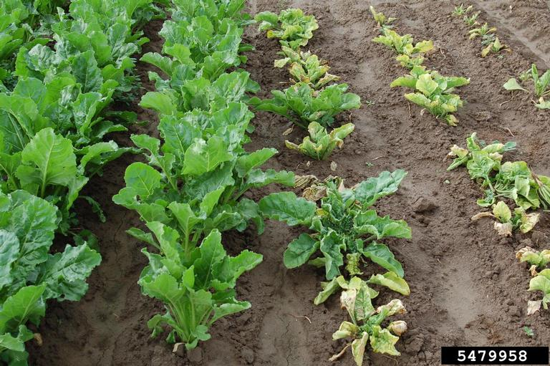
‘On-Seed’ Technology at Work…
Untreated Check
Poncho Beta Seed Treatment

Slide 6
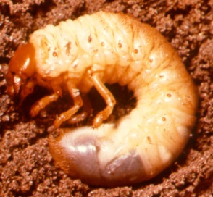
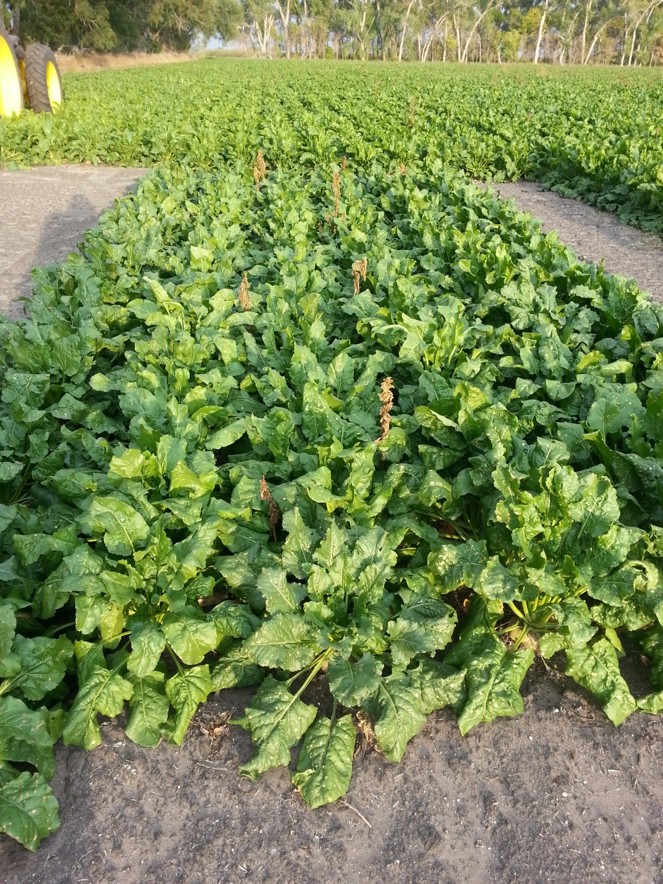
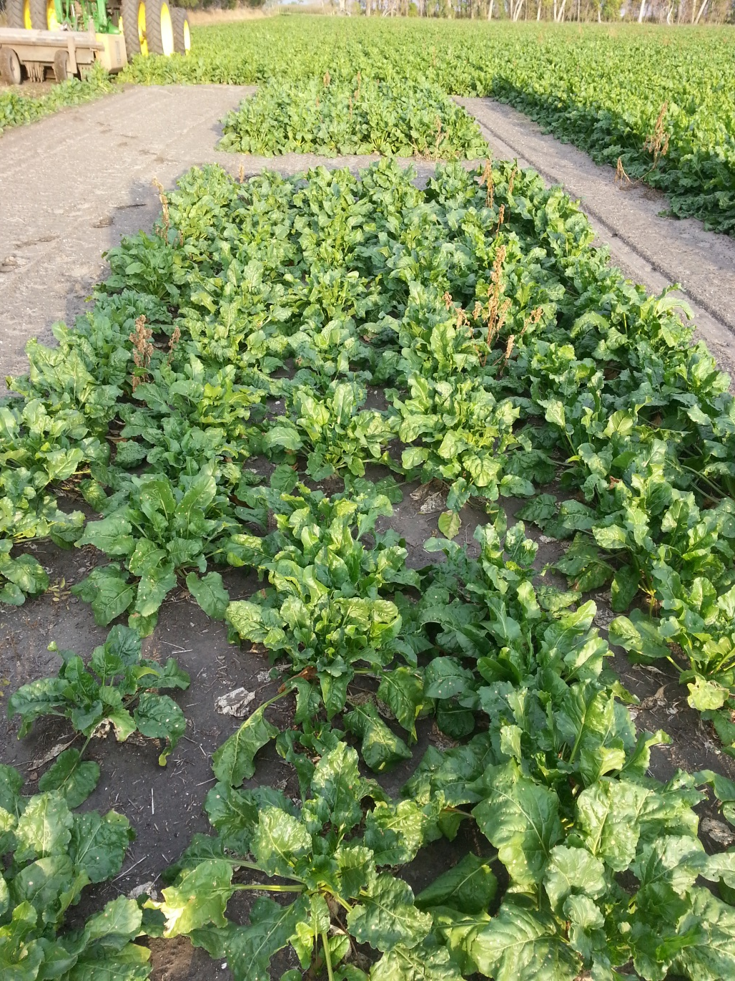
Poncho Beta
Check

Slide 7
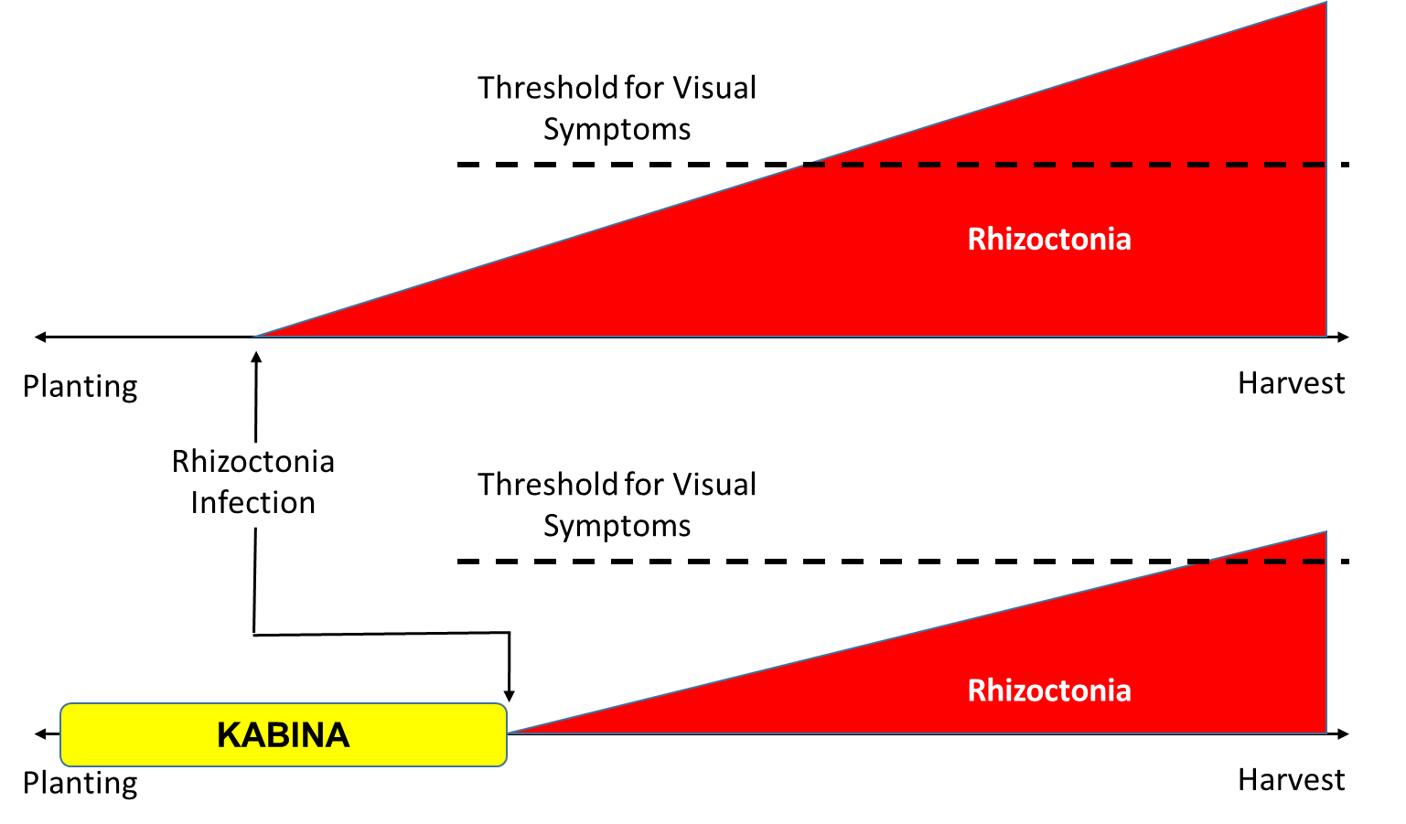
Why Seed Treatments Work…

Slide 8
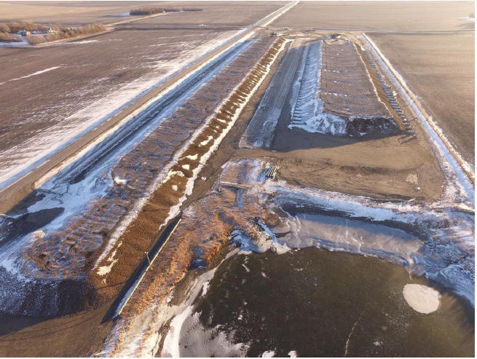
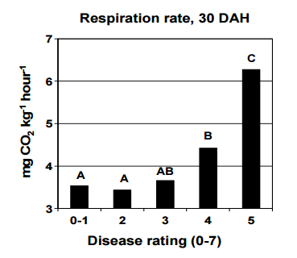
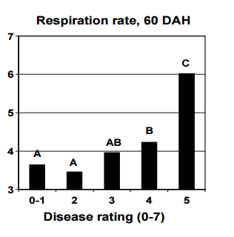
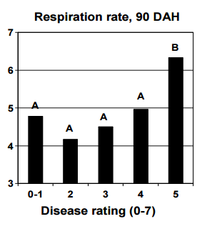
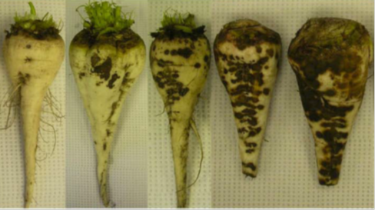
Garbage In – Garbage Out…
Disease Rating
1 2 3 4 5

Slide 9
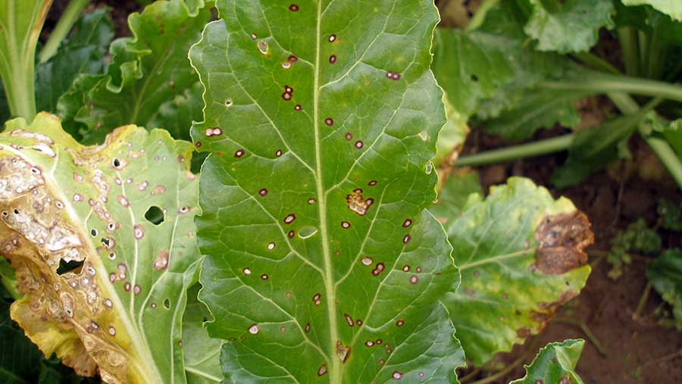

Slide 10
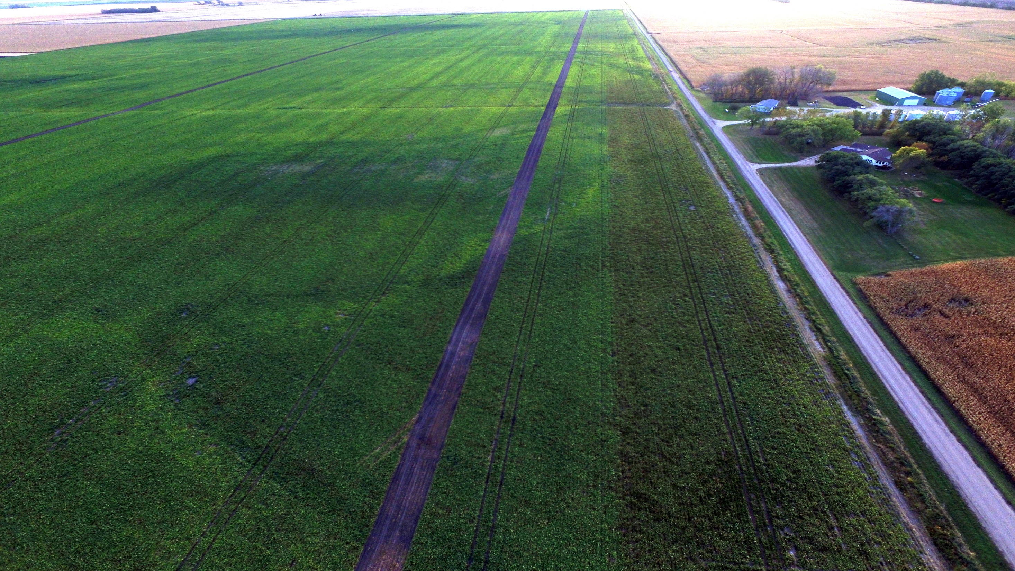
Sugar = 20.44%
Purity = 91.19%
RST = 356.52 lbs
TPA = 35.65 Ton
RSA = 12,708 lbs
Return = $1,734.71
Sugar = 19.01%
Purity = 89.64%
RST = 323.38 lbs
TPA = 31.24 Ton
RSA = 10,102 lbs
Return = $1,378.97
$355.73 per Acre Loss

Slide 11
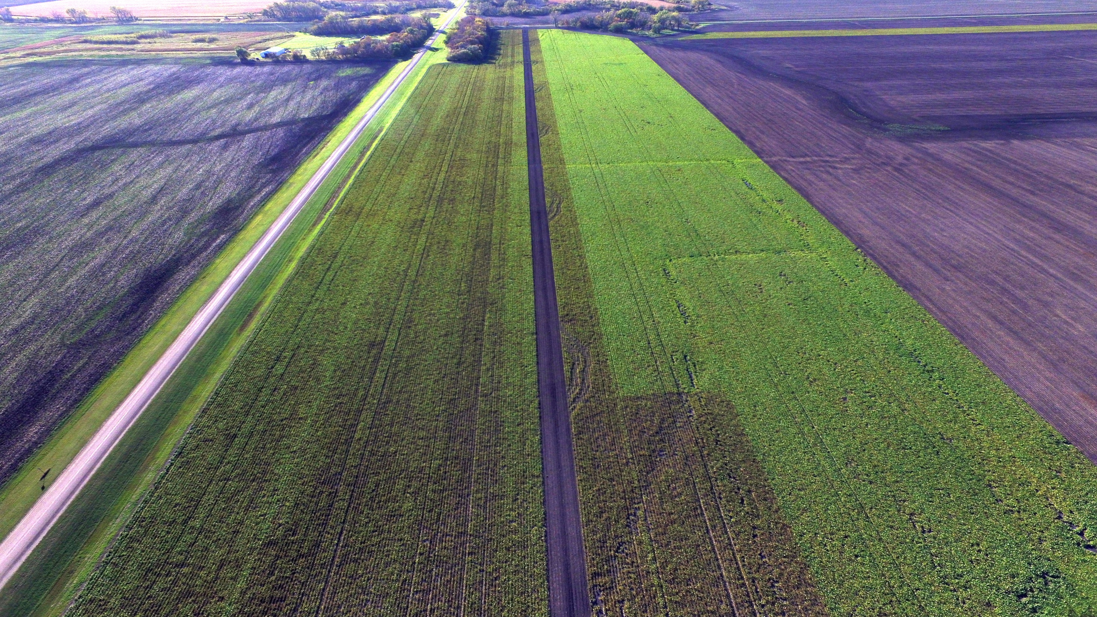
Sugar = 17.71%
Purity = 88.10%
RST = 293.25 lbs
TPA = 28.56 Ton
RSA = 8,374 lbs
Return = $1,143.10
Sugar = 20.33%
Purity = 90.50%
RST = 351.09 lbs
TPA = 31.65 Ton
RSA = 11,111 lbs
Return = $1,516.59
$373.49 per Acre Loss

Slide 12
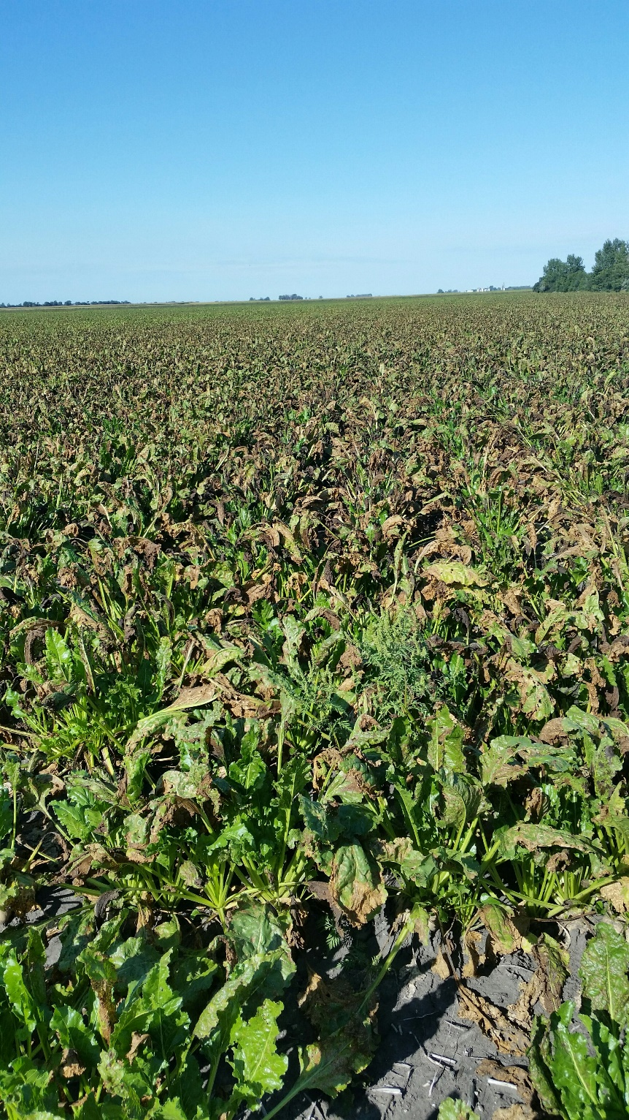
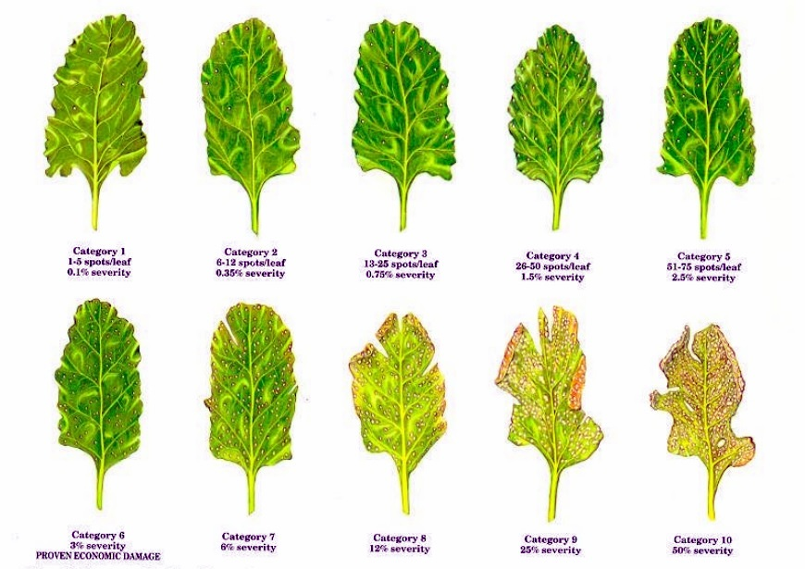
CLS Rating Scale

Slide 13
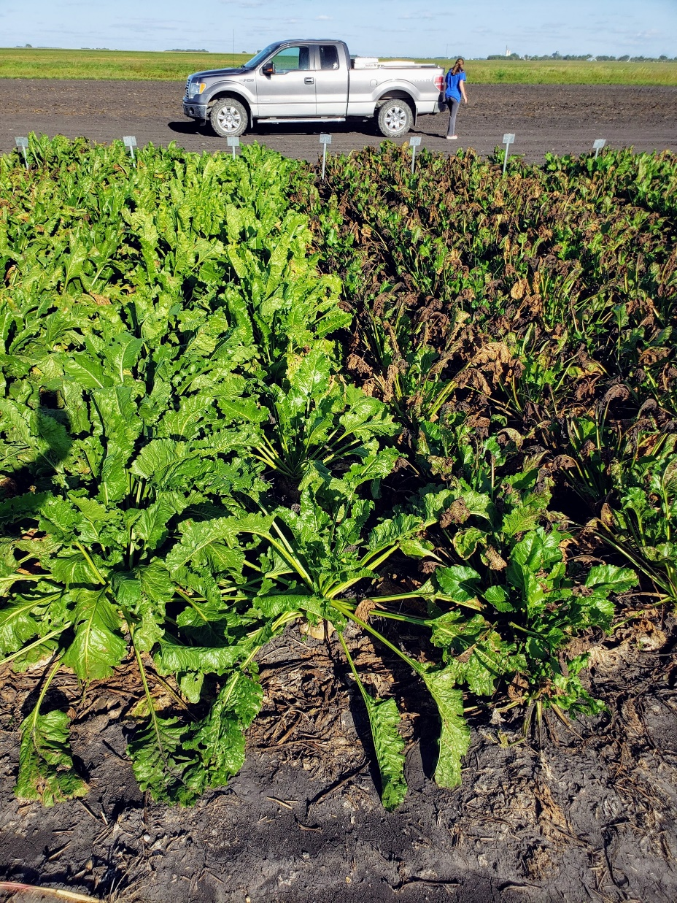
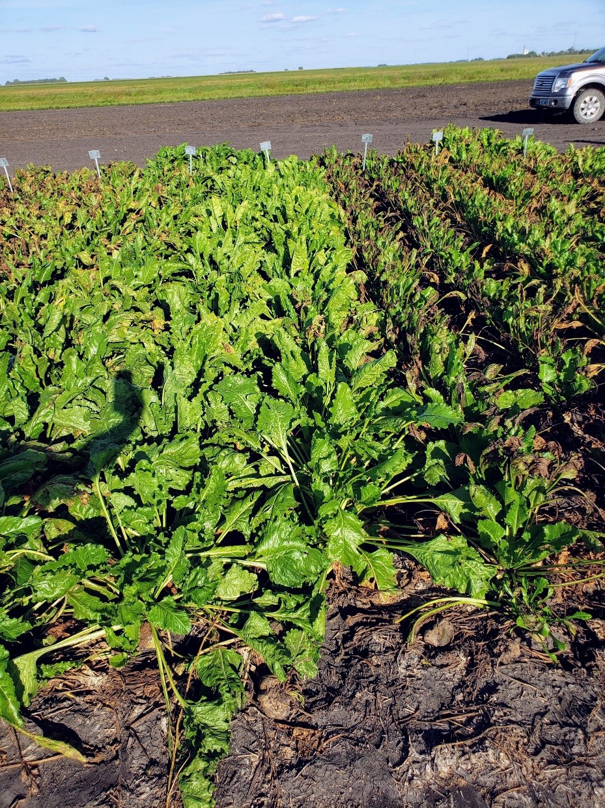


7996
973

Slide 14
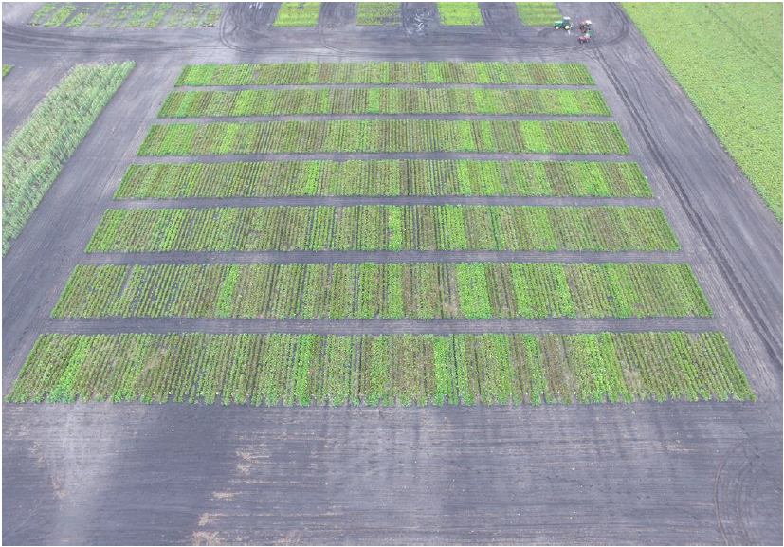
MDFC CLS Nursery – Foxhome, MN

Slide 15
2021 Grower Fields:
Top 3 Traditional vs. CR+
Ave: 17.51%
Ave: 16.70%

Slide 16
2021 Grower Fields:
Top 3 Traditional vs. CR+
Ave: 31.3 TPA
Ave: 29.4 TPA

Slide 17
2021 Grower Fields:
Top 3 Traditional vs. CR+
Ave: 300 lbs.
Ave: 285 lbs.

Slide 18
2021 Grower Fields:
Top 3 Traditional vs. CR+
Ave: 9,603 lbs.
Ave: 8,714 lbs.

Slide 19
What is the Relationship?

Slide 20
Why is Purity a Big Deal???
Non-Sugars
3%
Sugars

Slide 21
Two Different Worlds…
3%
Agriculture World
3% Decrease in Purity
Operations World
30% Increase in Non-Sugars
Notes:
1 lb non-sugars causes loss of 1.5 lbs sucrose to molasses

Slide 22
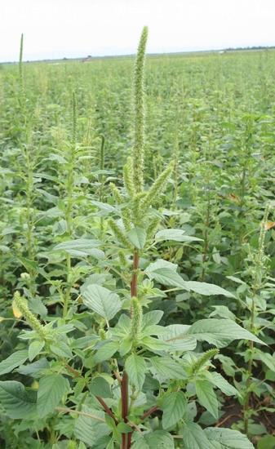
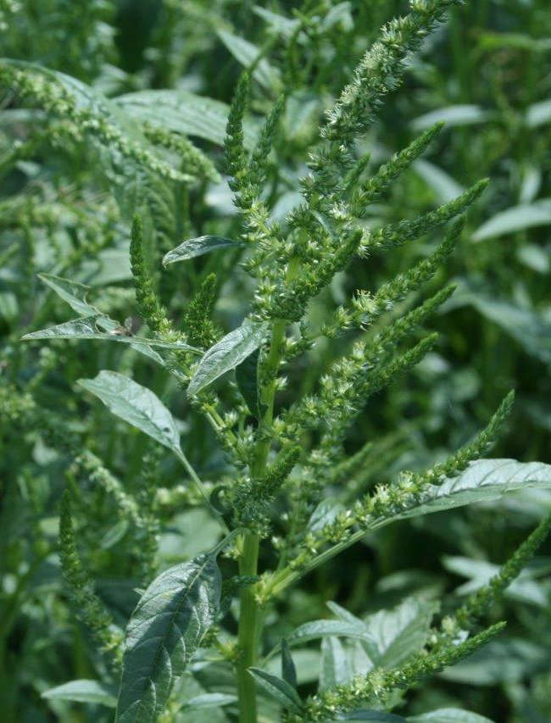
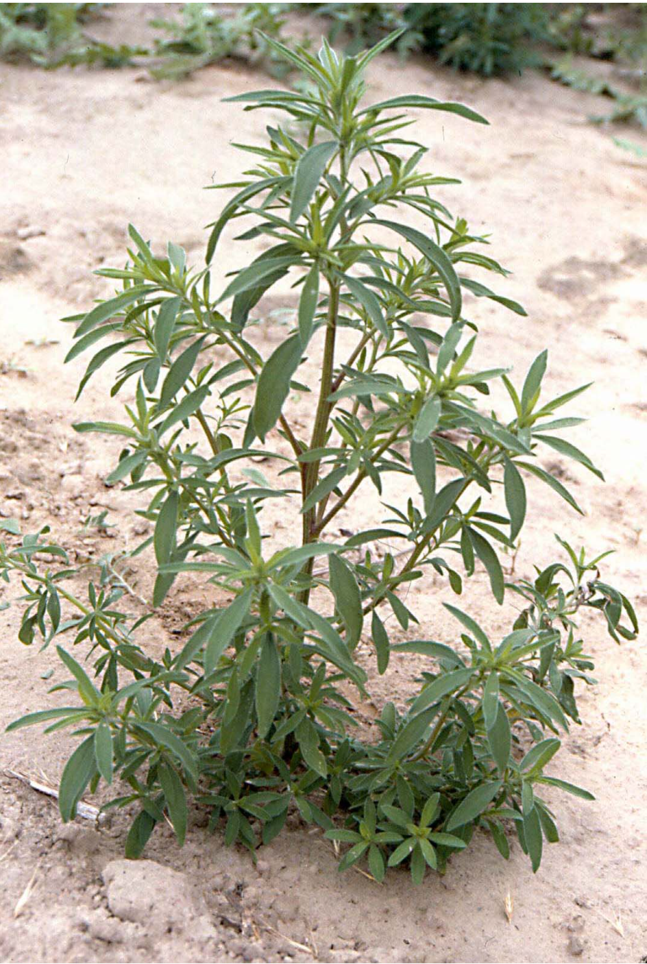
Palmer amaranth
Waterhemp
Kochia

Slide 23
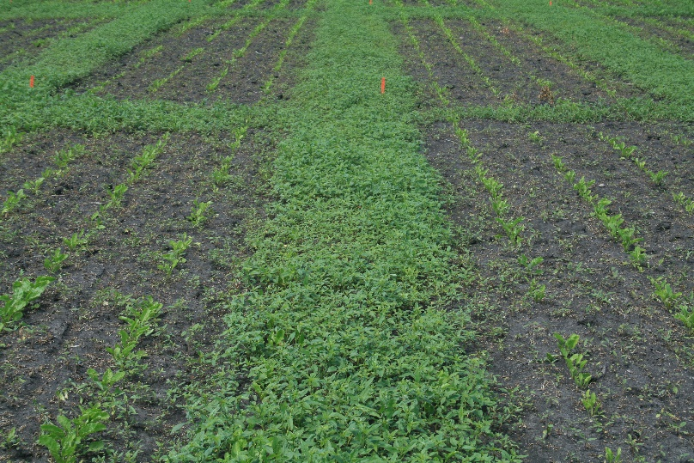
Pre-Emerge Herbicides at Work
(Start off With a Clean Slate)

Slide 24
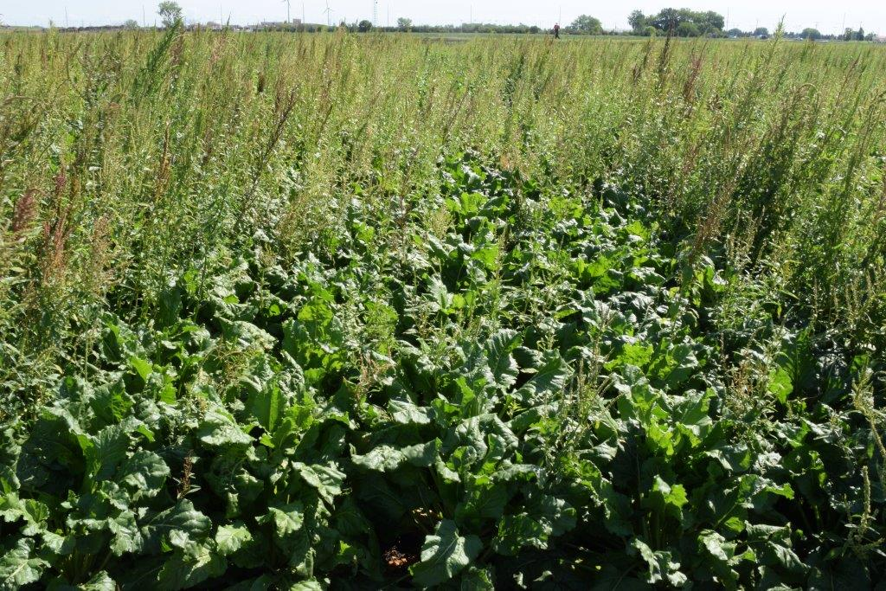

Slide 25
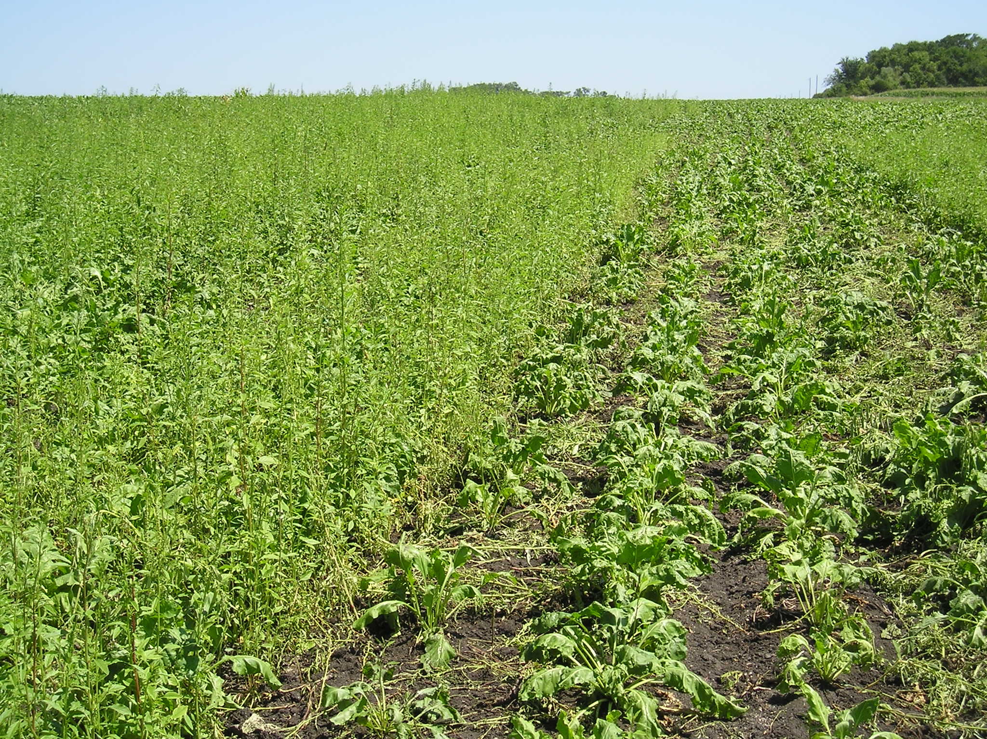

Slide 26
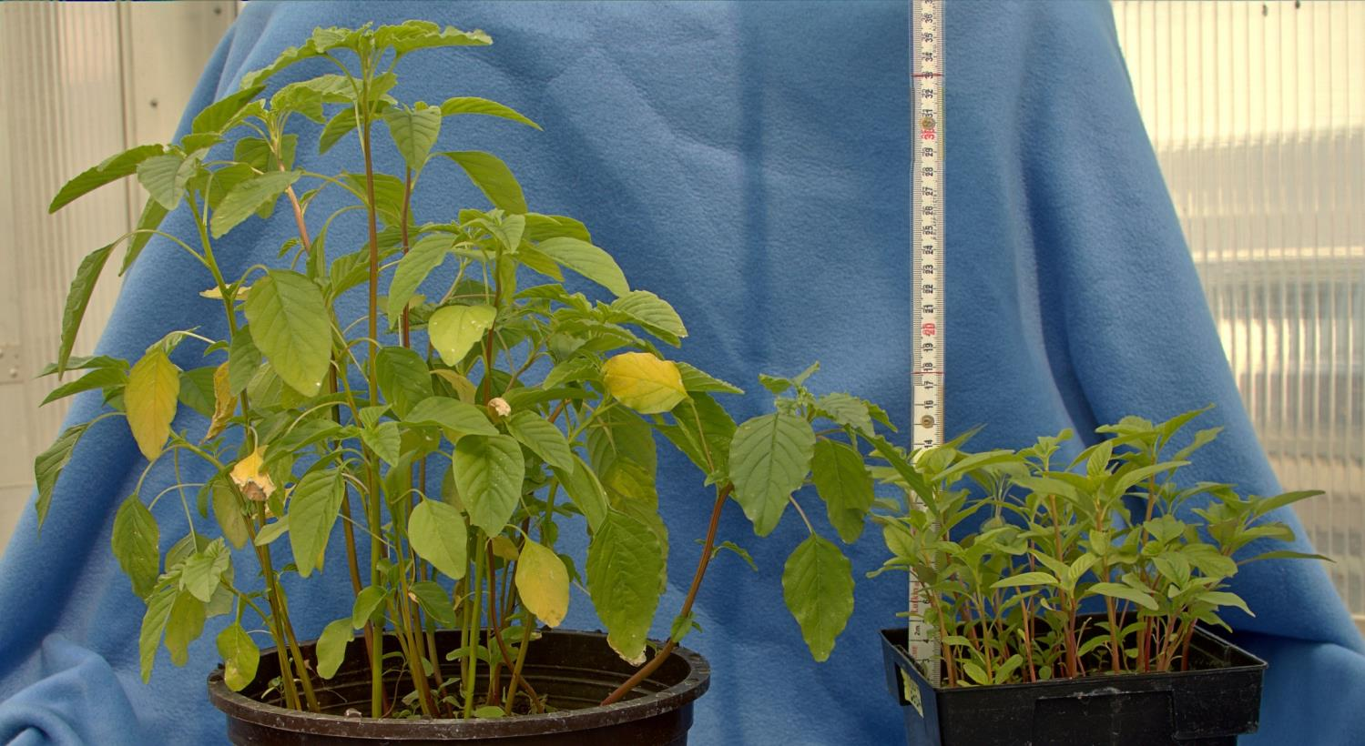
Palmer amaranth
Waterhemp
Notes:
Palmer Amaranth 31 days after emergence under greenhouse conditions.
Tall waterhemp 25 days after emergence under greenhouse conditions.
Note the difference in height between the two species.

Slide 27
Weed Control - Past and Present..
638,000 acres of sugarbeet in Minnesota and eastern North Dakota in 2021
Waterhemp was noted as the most important weed control challenge on 500,400 acres (78%) of the acreage according to an NDSU/U of MN survey
Glyphosate-resistant kochia is more common
We rely heavily on the herbicide portfolio in our rotational crops planted ahead of sugarbeet
  Corn, wheat, and soybean

Slide 28
Looking Ahead: Truvera®
A very versatile trait offering sugarbeet growers a complete weed management system with the flexibility of three modes of action
‘Triple-Stack’ Technology
  Dicamba
  Glufosinate
  Glyphosate

Slide 29
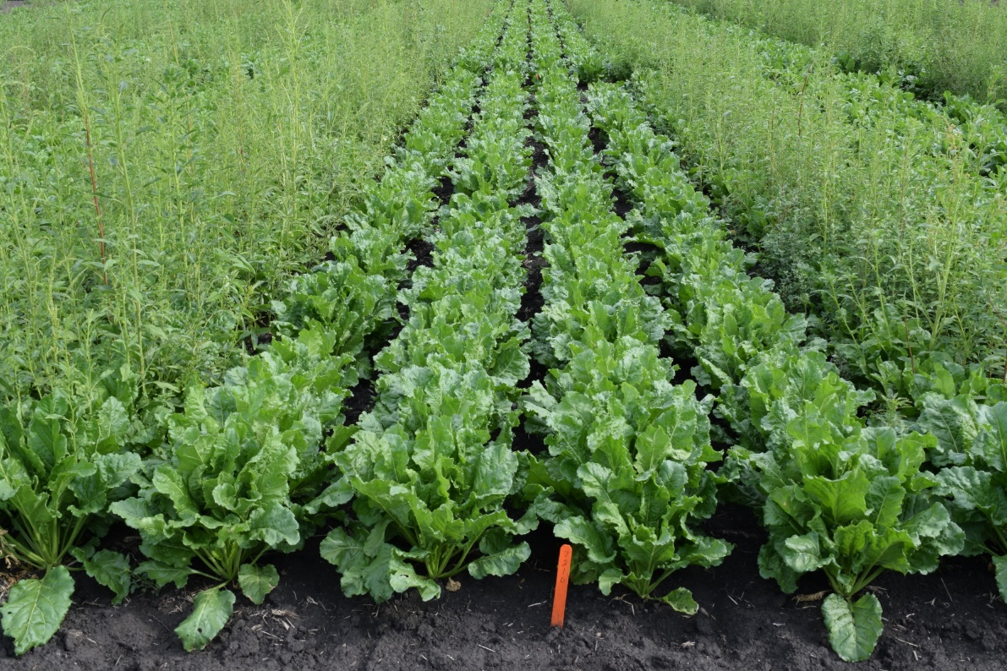
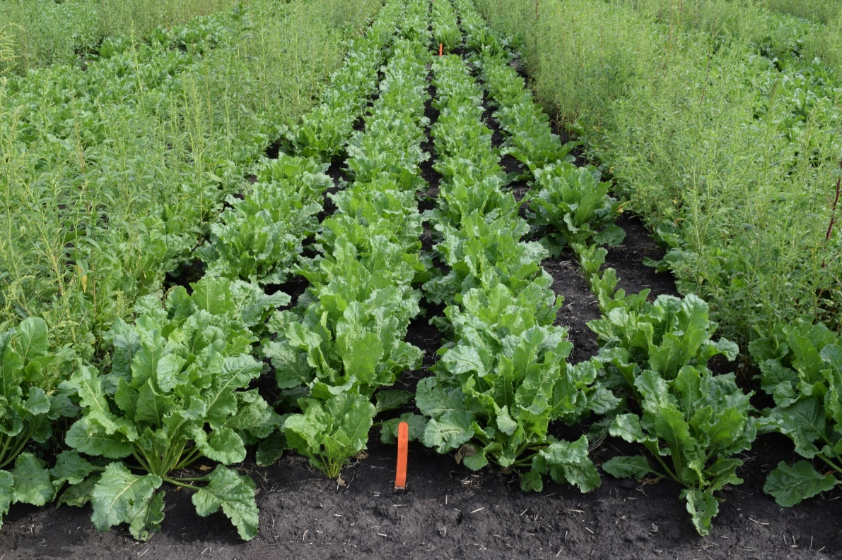
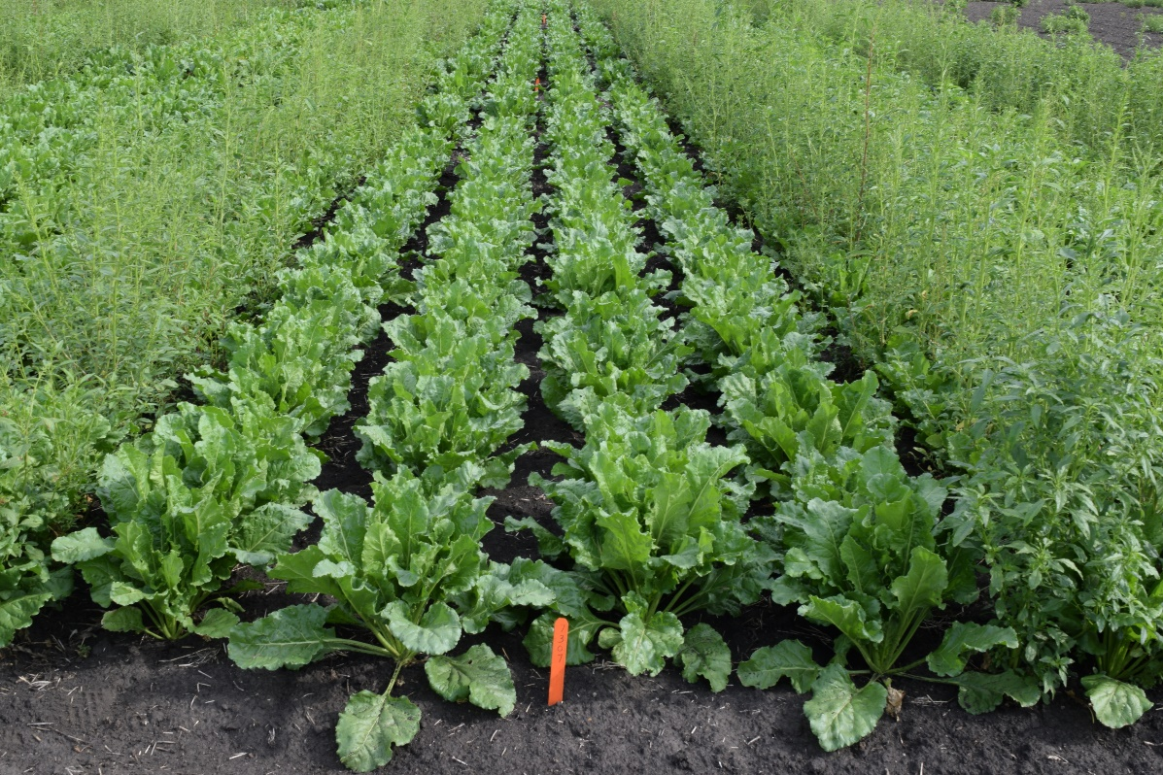
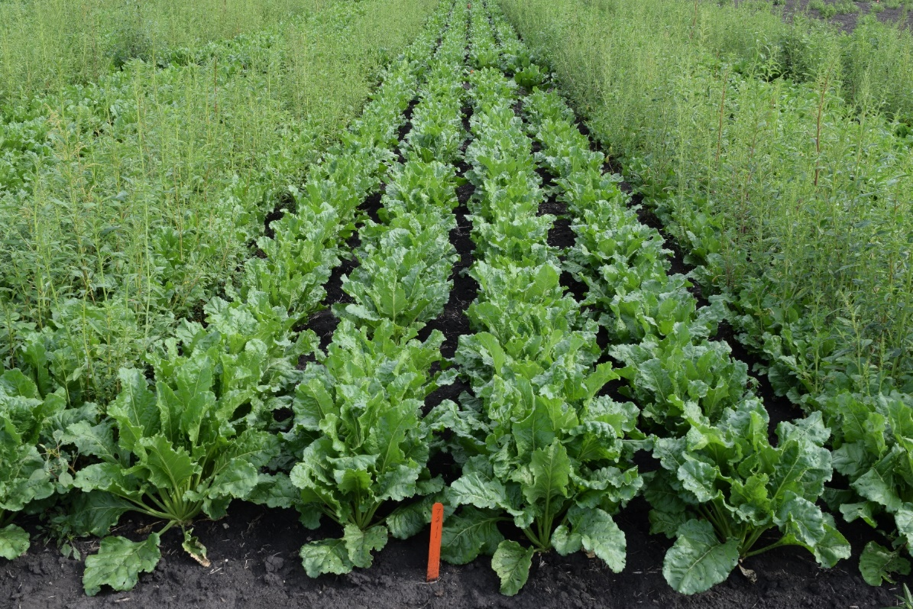

Slide 30
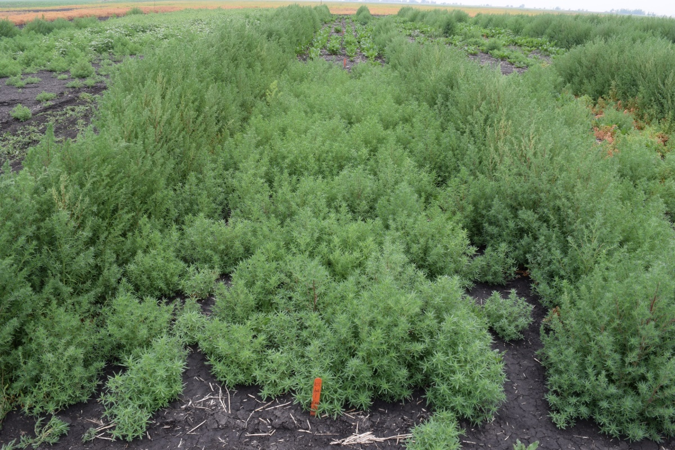
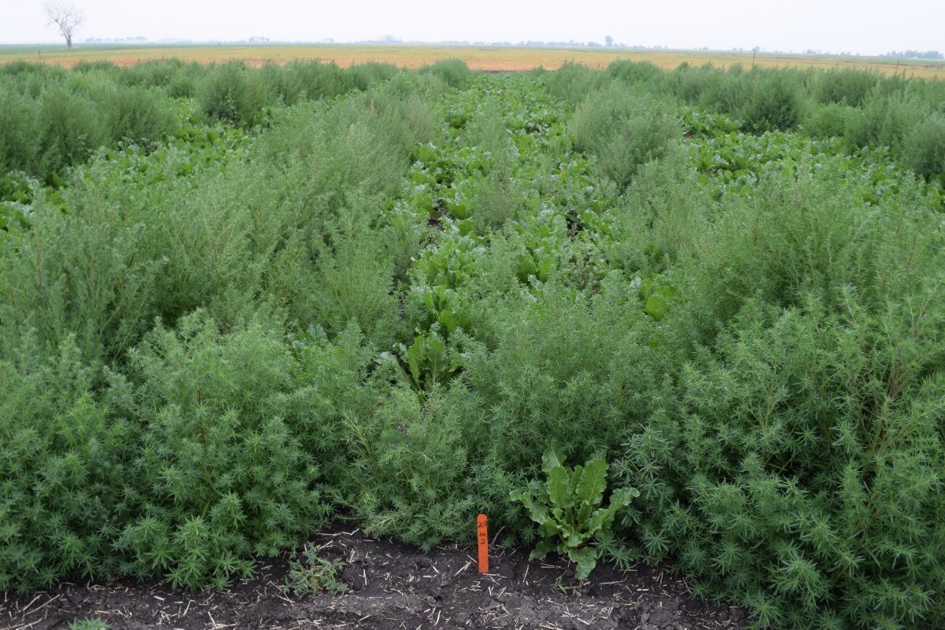
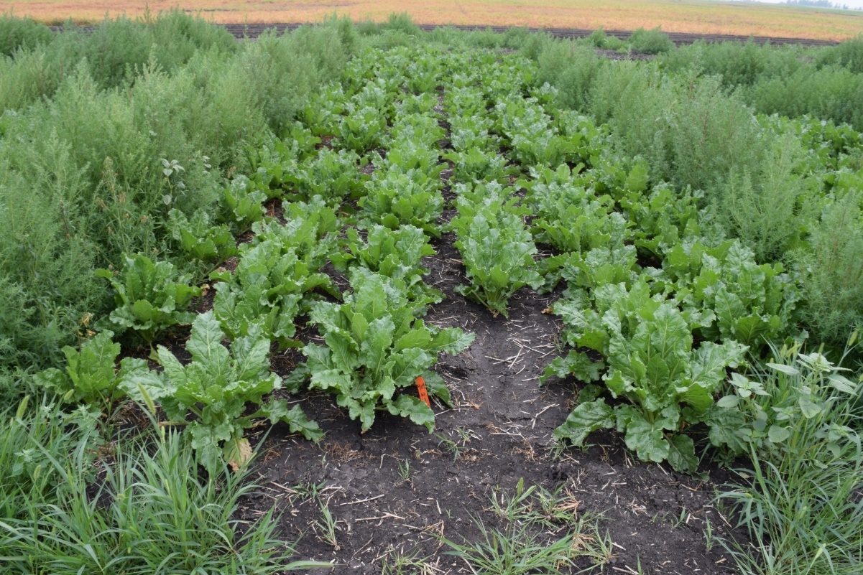
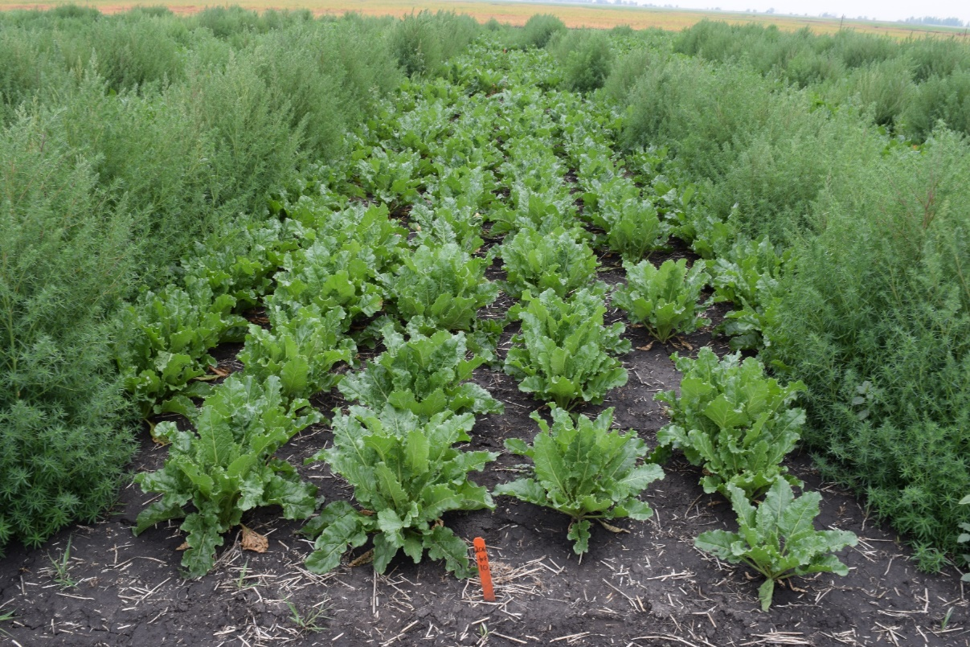

Slide 31
Summary & Key Take Aways…
The future is looking very bright
The beet sugar industry has been able to utilize these valuable technologies (among others) to beneficially enhance yield, quality and production
Current and future technology should stabilize yields and reduce variability from one year to the next
Our Cooperative is focused upon efficiency and economically-viabile sustainability initiatives
A balanced market provides for an optimistic outlook and supports domestically-grown beet sugar production

Slide 32
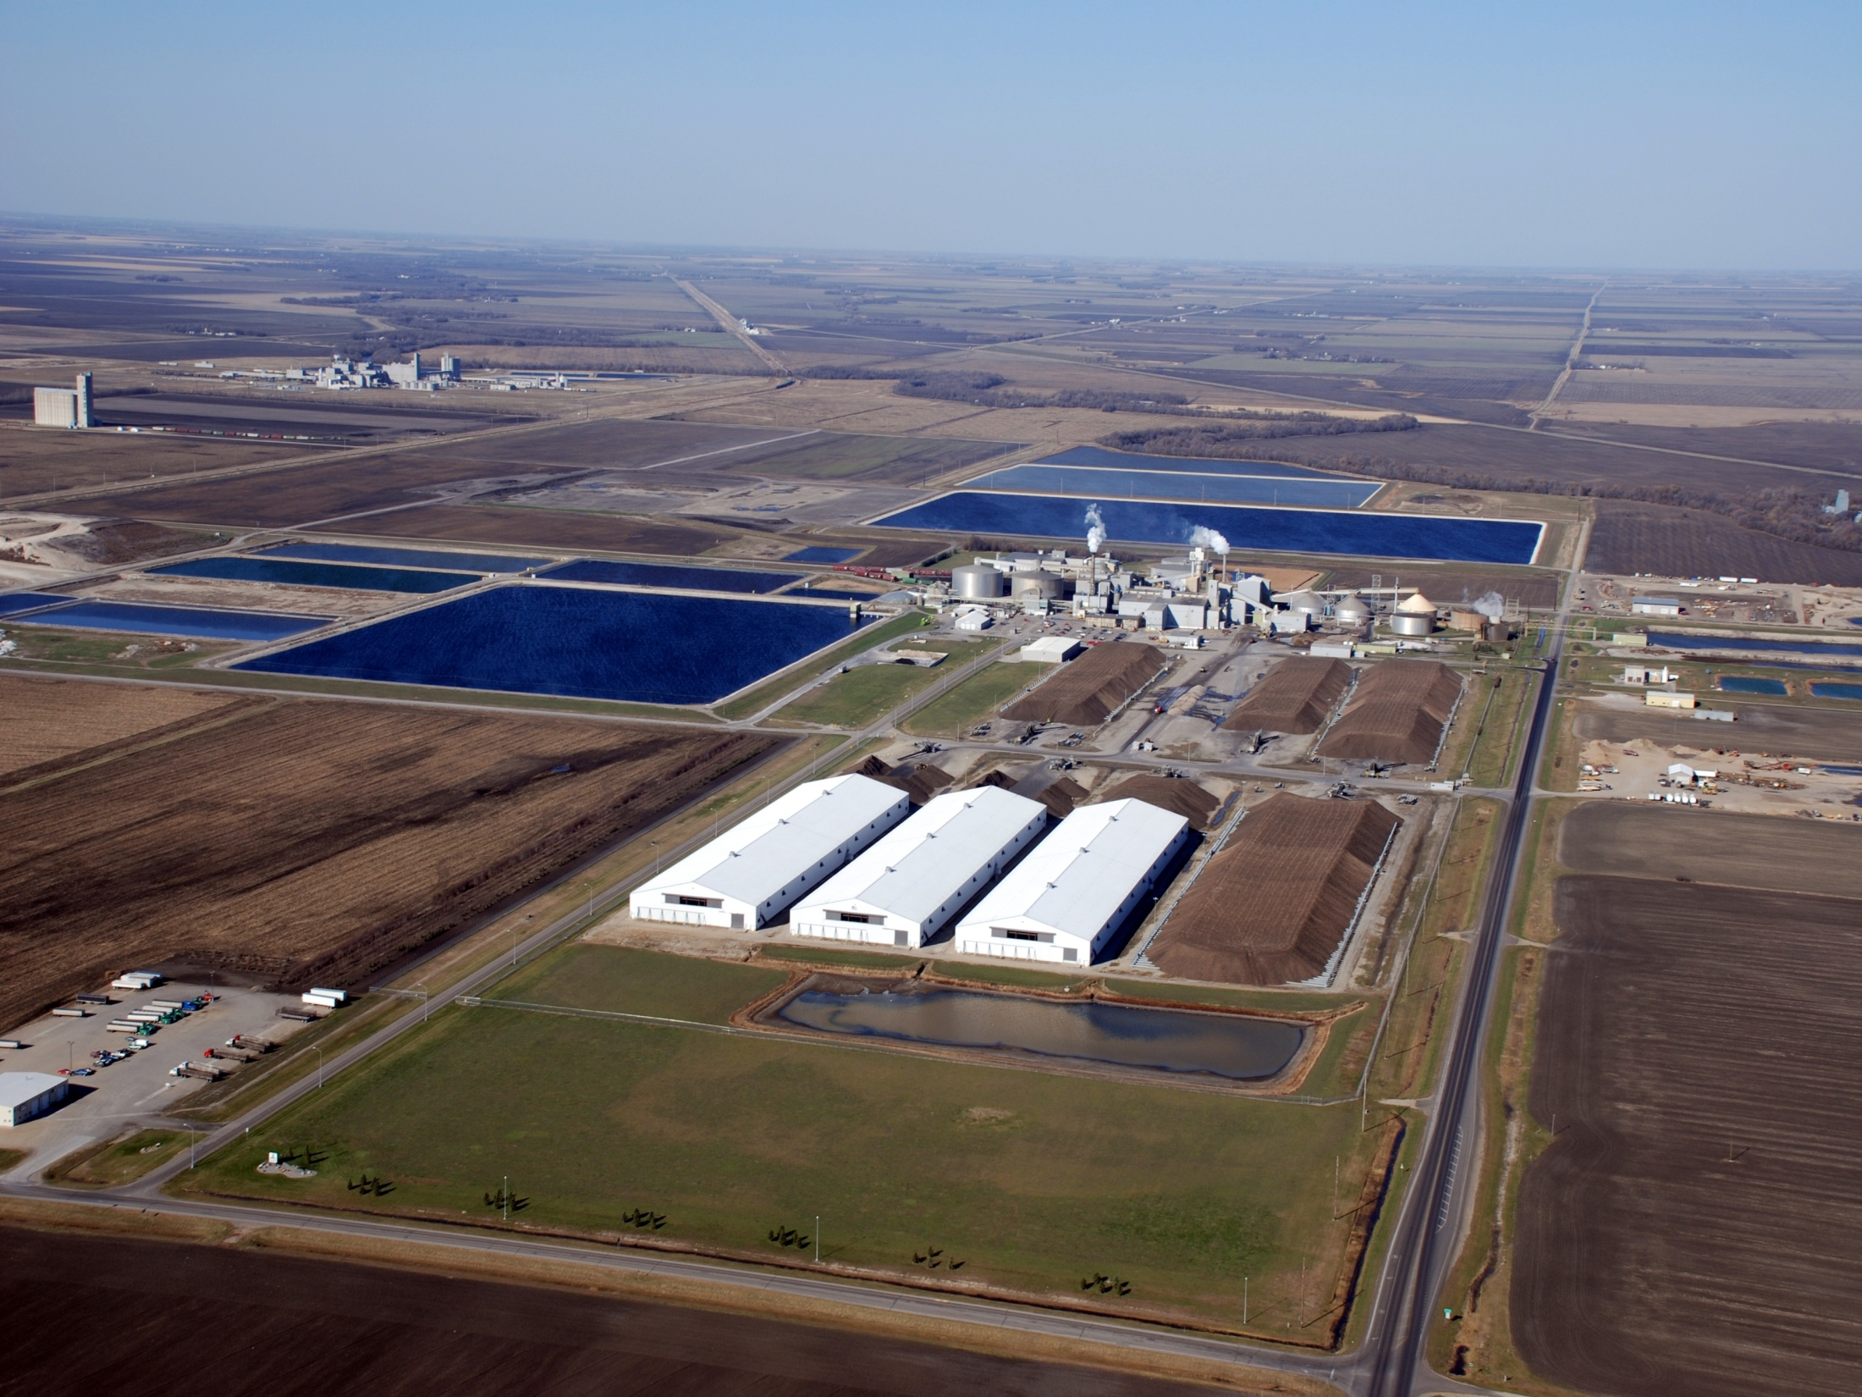


Mike Metzger, Ph.D.
Minn-Dak Farmers Coop.
Phone: 218-770-1535
Email: mmetzger@mdf.coop

