Slide 1
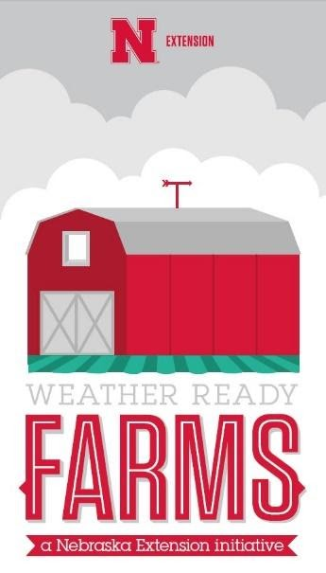



2022 USDA Agricultural Outlook Forum:
Building Resilience through Extreme Event Preparedness
Weather Ready Farms
Nathan Mueller Ph. D
Weather Ready Farms Coordinator & Project Mentor
Extension Educator: Water & Integrated Cropping Systems
Nebraska Extension
nathan.mueller@unl.edu
Melissa Bartels Ph. D
Weather Ready Farms Coordinator & Project Mentor
Extension Educator: Water & Integrated Cropping Systems
Nebraska Extension
melissa.bartels@unl.edu
Candace Hulbert
Disaster Education Weather Ready Agriculture VISTA
AmeriCorps VISTA
Nebraska Extension
candace.hulbert@unl.edu
Notes:
Hello welcome to the USDA Virtual Agricultural Outlook Forum regarding the topic of building resilience through extreme event preparedness. Today, we will be discussing the Weather Ready Farms program from Nebraska Extension. My name is Candace Hulbert, and I am an AmeriCorps VISTA serving with the Weather Ready Farms program. With me today is Nathan Mueller and Melissa Bartels, Water & Integrated Cropping Systems Educators and Weather Ready Farms Coordinators.

Slide 2
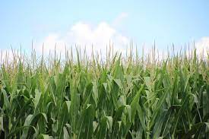
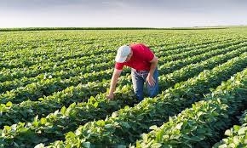
Agenda
Program overview
History
How designation works
Assessment
Education & Weather Ready projects
Verification
Designation
Current project status
Future goals
Notes:
As a quick agenda, today we explain a general overview of the program, offer a short background of how Weather Ready Farms was created, describe how the designation process works, and take a closer look at the education phase, the participant’s Weather Ready Projects, the verification process, and how participants earn Weather Ready designation status. We will also discuss the current project status and the projects future goals.

Slide 3


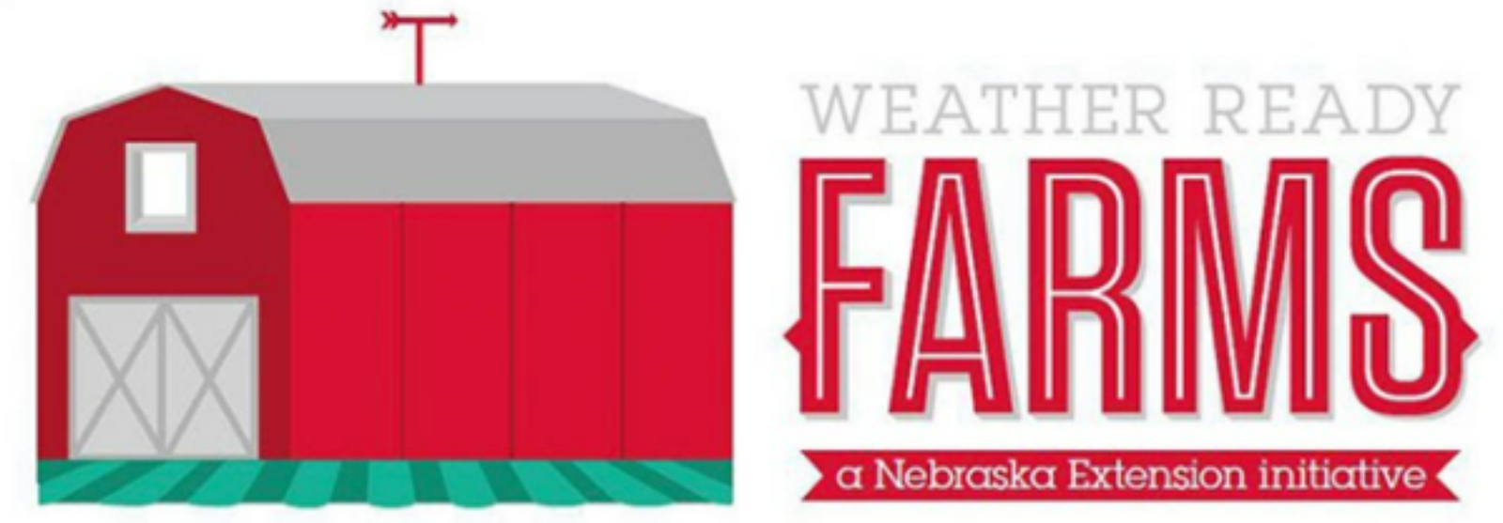




Program Overview
Nebraska Extension’s Weather Ready Farms designation program is a two-year agricultural education program aimed at offering farmers new strategies and technologies to prepare for extreme weather events and climate variation while simultaneously increasing overall farm resilience and sustainability.
Notes:
Nebraska Extension’s Weather Ready Farms designation program is an agricultural education program aimed at offering farmers new strategies and technologies to prepare for extreme weather events and climate variation while simultaneously increasing overall farm resilience and sustainability. By participating in the program farmers learn how to adapt their farms to extreme weather events like drought, flooding, strong wind, and hail to protect their crop yields. Simultaneously, our program educates producers about climate-smart agriculture and emphasizes the importance of conservation, natural resource management, and soil health. We emphasize peer learning and community. We work directly with farmers to curate the resources and projects that will be the most useful for their individual needs. Each WRF participant is starting at a different place and our team works with them to ensure that they meet their resiliency goals.

Slide 4
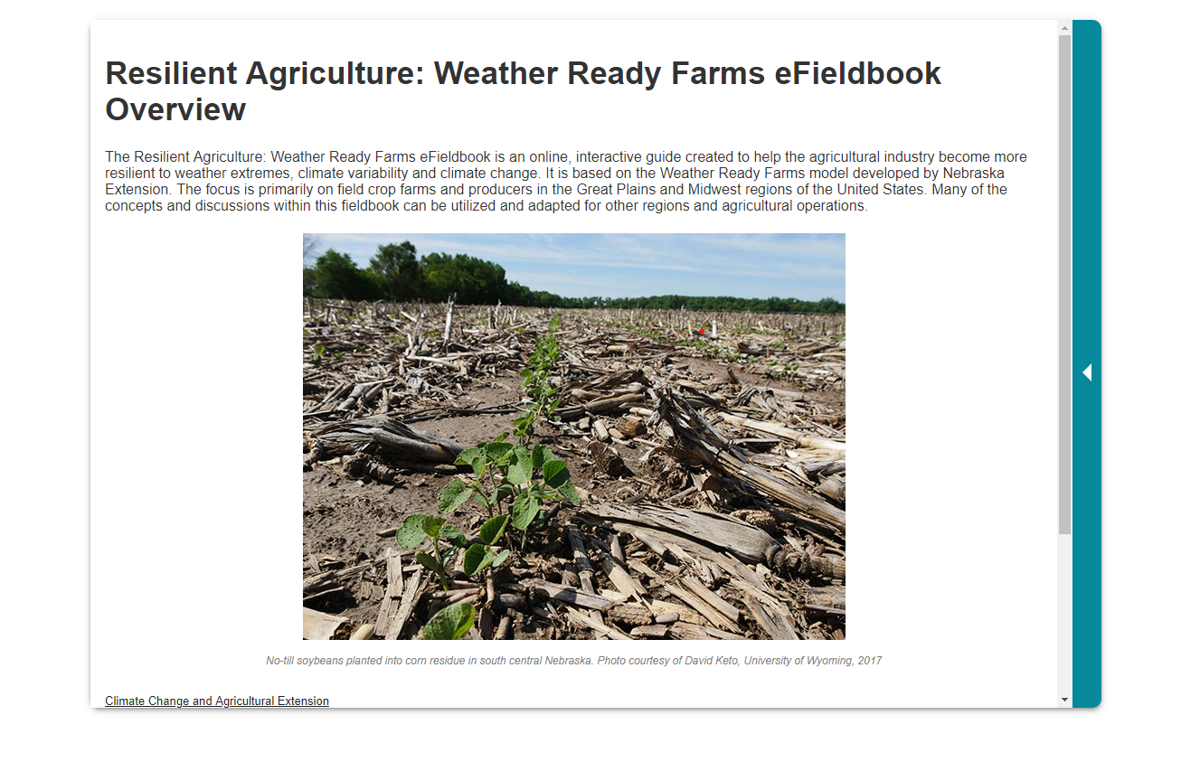

Origins
Weather Ready Farms was a collaborative project between Nebraska Extension, Purdue Extension, and the eXtension Foundation as a New Technologies for Ag Extension (NTAE) project in 2019. This collaboration resulted in the creation of the WRF eFieldbook.
Authors:
  Martha Shulski, Applied Climatologist, State Climatologist, Director, Nebraska State Climate Office, University of Nebraska-Lincoln
  Hans Schmitz, County Extension Director, Purdue University
  Tyler Williams, Former Water and Integrated Cropping System Extension Educator, University of Nebraska-Lincoln
Contributors:
  Ashley Mueller, Former Disaster Education Coordinator, University of Nebraska-Lincoln
  Dannele Peck, Director, USDA Northern Plains Climate Hub
  Dennis Todey, Director, Midwest Climate Hub
  Natalie Umphlett, Regional Climatologist, High Plains Regional Climate Center
Notes:
Weather Ready Farms was a collaborative project between Nebraska Extension, Purdue Extension, and the eXtension Foundation as a New Technologies for Ag Extension (NTAE) project in 2019. This collaboration resulted in the creation of the WRF eFieldbook. The Resilient Agriculture: Weather Ready Farms eFieldbook is an online, interactive guide created to help the agricultural industry become more resilient to weather extremes, climate variability and climate change.. The focus is primarily on field crop farms and producers in the Great Plains and Midwest regions of the United States. Many of the concepts and discussions within this fieldbook can be utilized and adapted for other regions and agricultural operations.

Slide 5
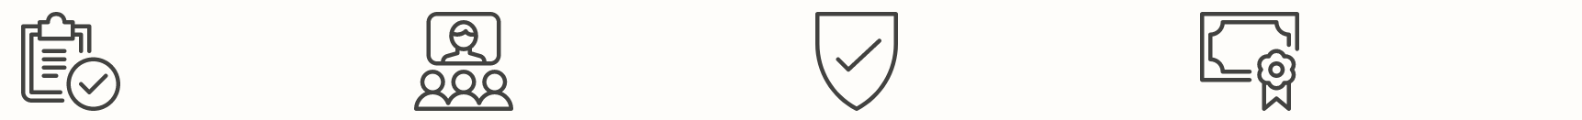
How Designation Works
There are four stages of the Weather Ready Farms designation program.
1.Assessment
2.Education
3.Verification
4.Designation
Participants begin the program by completing an online self-assessment to determine areas of vulnerability on their farms. Participants are then assigned two project mentors. Participants’ project mentors travel to the participants’ farms to complete an on-farm assessment. The WRF team then develops each participants’ educational plan.
Participants attend educational events where they learn about new research and strategies they can implement. Additionally, during the education phase, participants will start projects to improve their overall farm resiliency.
After participants finish their educational requirements and complete their projects, participants will begin the verification phase. The participants will have a final on-farm assessment to evaluate the changes they have made.
Participants who have completed all three phases will receive the Weather Ready Farms designation status.
Notes:
The Weather Ready Farms is divided into four phases: assessment, education, verification, and designation.
In the assessment phase, participants begin the program by completing an online self-assessment to determine areas of vulnerability on their farms. Participants are then assigned two project mentors who work with them throughout the program. After participant’s complete the online self-assessment, participants’ project mentors travel to the participants’ farms to complete an on-farm assessment. The WRF team develops each participants’ educational learning plan.
In the education phase, Participants attend educational events where they learn about new research and strategies they can implement related to weather readiness. Participants are expected to complete forty hours of education over eighteen months. Additionally, during the education phase, participants will start Weather Ready projects to improve their overall farm resiliency.
The verification phase begins, once participants finish their educational requirements and complete their on-farm projects. The participants will have a final on-farm assessment to evaluate the changes they have made throughout participating in the program.
The last phase of the program is designation. Designation recognizes the participants success after completing the first three phases of the program.

Slide 6

Assessment
The assessment asks participants about their current farm practices such as:
Do you use irrigation scheduling on a field-by-field basis?
Do you plant cover crops on targeted or all acres?
Have you developed an informal or a written comprehensive nutrient management plan?
Do you have a continuity of operations plan (COOP) that guides the business after an emergency or incident?
Note: The assessment is divided into 3 phases with increasing expectations
Notes:
Thanks Candace. Now I will take a deeper dive into the first three stages of the Weather Ready Farms Designation Program including the assessment, education, and verification phase. The Weather Ready Farms assessment asks participants about their current farm practices such as:
Do you use irrigation scheduling on a field-by-field basis?
Do you plant cover crops on targeted or all acres?
Have you developed an informal or a written comprehensive nutrient management plan?
Do you have a continuity of operations plan that guides the business after an emergency or incident?
The assessment is divided into three phases. Each phase in the assessment increases the expectations of having weather ready farm practices in place. For example, phase 1 focuses on erosion control through no-till, phase 2 on targeted placement of cover crops on critical acres, and phase 3 is growing cover crops on all acres
After participants complete the self-assessment, the Weather Ready Farm mentors conduct a 2 hour in-person farm visit to review the self-assessment with participants and to learn more about the participant, the farm, and their needs. This in-person meeting offers the Weather Ready Farms team the necessary information to help create the participants’ learning plan as the participant moves into the education phase.

Slide 7
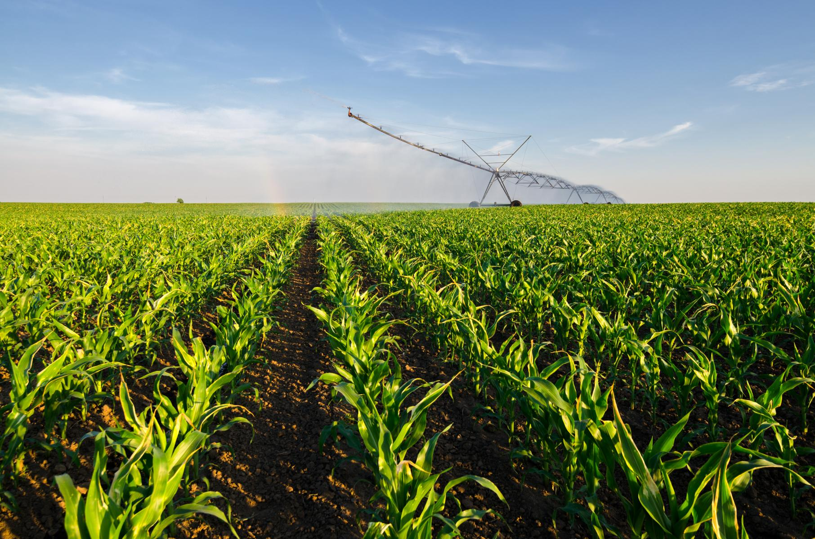
What Participants Learn
Farmers that participate in the two-year program learn about:
Climate-smart agriculture practices
Precision agriculture & on-farm research
Integrated pest management
Soil health management planning
Water and nitrogen management
Farm financial management
Farm safety and risk management
And many more topics
Notes:
We recognize that no two farms or participants are the same. Therefore, each learning plan is specific to the needs of their operation. The learning plans recommend specific workshops, field days, conferences, and webinars that a participant should attend and what educational topics participants should focus their educational hours on. The learning plans can help identify potential weather ready projects that participants can implement of their farms.
Farmers that participate the Weather Ready Farms program go through a 40-hour education phase over an 18-month time-frame. Education focuses on topics like:
Climate-smart agriculture practices,
Precision agriculture & on-farm research ,
Integrated pest management ,
Soil health management planning ,
Water and nitrogen management ,
Farm financial management ,
Farm safety and risk management ,
And other topics identified during the assessment

Slide 8


























Educational Providers
Throughout the designation program, participants attend free and/or lost cost in-person and online educational events delivered by Nebraska Extension and our educational partners.
Notes:
Throughout the 18-month education phase, participants attend free and/or lost cost in-person and online educational events delivered by Nebraska Extension and our educational partners.
Numerous education opportunities abound. The Weather Ready Farm Team helps broaden awareness of opportunities through University of Nebraska-Lincoln, but also those from neighboring land-grant institutions, USDA, American Society of Agronomy, National Weather Service, other federal, state, and local government entities, non-profit organizations, and private industry.
Participant’s learning plan start with education hours recommended by the Weather Ready Farms Team based on the on-farm assessment, but participants also have flexibility and input in proposing educational opportunities for approval in their plan.

Slide 9
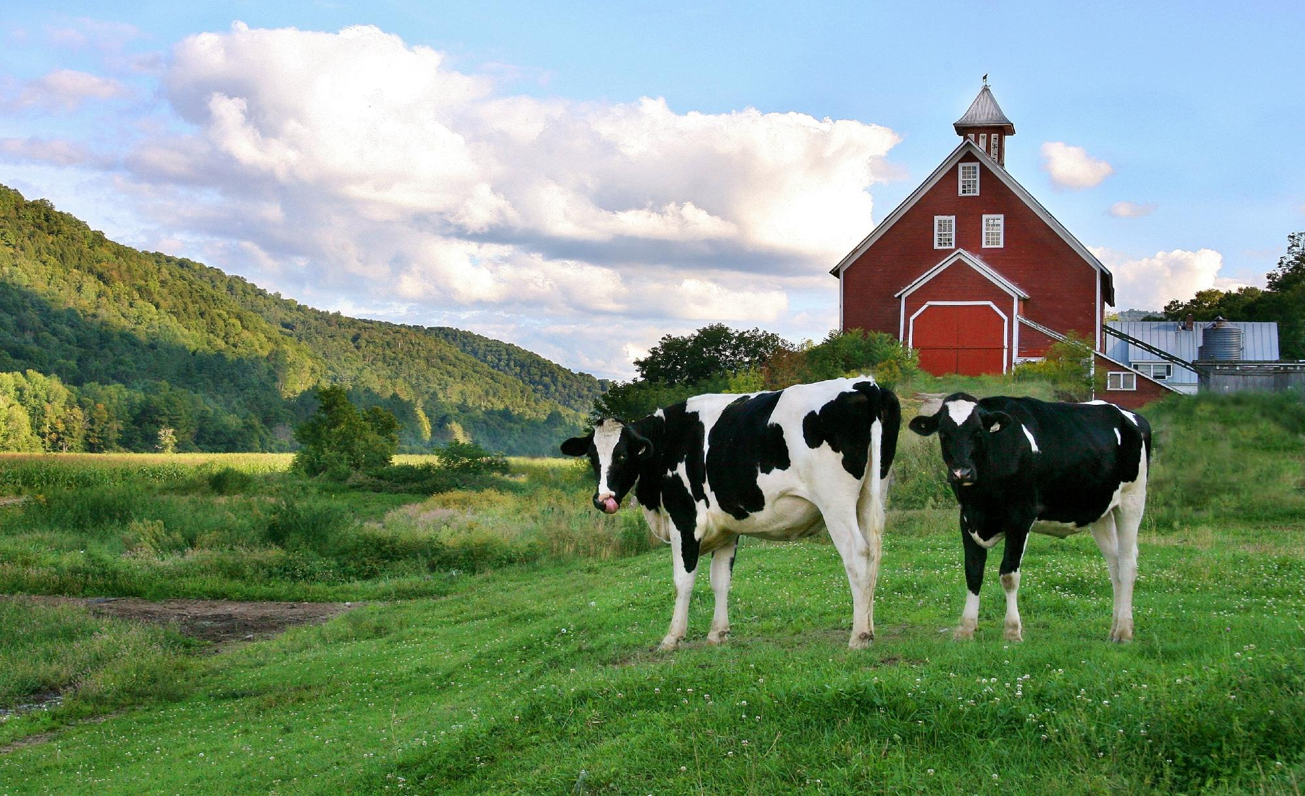
Weather Ready Projects
After participant’s learn new strategies from the education phase, participants will be provided with project funding to implement these strategies on their farms.
Projects include, but are not limited to:
On-farm research
Soil conservation practices (cover crops, small grains, waterways, prairie strips)
Windbreak establishment & renovation
Irrigation scheduling tools
Tile drainage water management
Farm data security & redundancy
First aid kits & CPR training
Notes:
After participant’s learn new strategies during the education phase, participants will be provided with some-limited project funding to put towards implementing weather ready farm practices.
It has been fun to discuss potential projects with participants already during the on-farm visits. Some of the projects initially discussed include:
On-farm research
Soil conservation practices like cover crops, small grains, waterways, prairie strips
Windbreak establishment & renovation
Irrigation scheduling tools like soil moisture sensors and weather stations
Tile drainage water management
Farm data security & redundancy
More first aid kits & CPR training

Slide 10

Verification
When participants have completed their 40 hours of education and projects, an on-farm verification will be scheduled.
To limit bias, other members of the WRF team will verify participants’ farms, not their project mentors.
The reviewers will come to each participants’ farm to assess the changes that participants have made according to their individualized learning plans.
If the reviewer finds that there is still work that needs to be done, they will offer recommendations for improvement and a follow-up assessment will be scheduled.
Notes:
When participants have completed their 40 hours of education and projects, an on-farm verification will be scheduled.
To limit bias, other members of the WRF team will verify participants’ farms, not their project mentors.
The reviewers will come to each participants’ farm to assess the changes that participants have made according to their individualized learning plan and projects.
If the reviewer finds that there is still work that needs to be done, they will offer recommendations for improvement and a follow-up assessment will be scheduled.
With that, I will turn it over to my colleague, Melissa Bartels to discuss the final designation phase.

Slide 11
Designation
After each participant has met the goals established in their individual learning plan, participants will earn their designation of Weather Ready Farms.
Designation Tier System
Designation
Tier 1
If the participant implements and completes the seven practices in phase 1.
Designation
Tier 2
If the participant completes phase 1 and the nine practices in phase 2.
Designation
Tier 3
If the participant
completes phase 1 & 2 and the eleven practices in phase 3.
Notes:
Transition to Melissa Bartels: Thanks Nathan, The final phase of WRF is designation. Designation occurs after each participant has met the goals established in their individual learning plan. Participants will then earn their designation of Weather Ready Farms. In the assessment phase of the program, our team determines which phase of the assessment each participant will likely complete. If the participant implements and completes the seven practices in phase 1 they earn Weather Ready Designation in Tier 1. If the participant completes phase 1 and the nine recommended practices in phase 2 they will receive designation in tier 2. If the participant completes phase 1 & 2 and the eleven recommended practices in phase 3 they will receive designation in tier 3. Each participant is honored with a designation status regardless of which tier they earn.

Slide 12
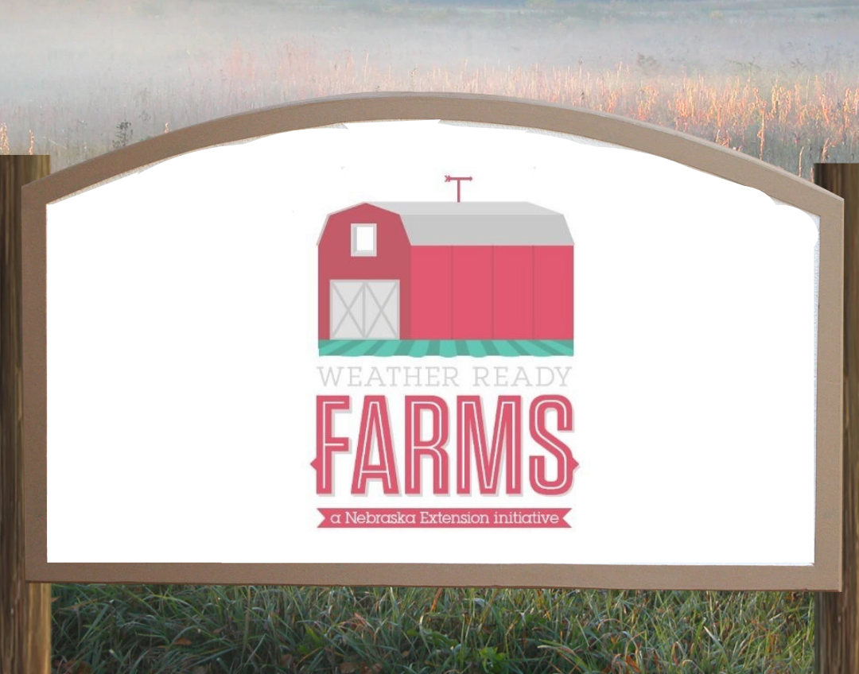
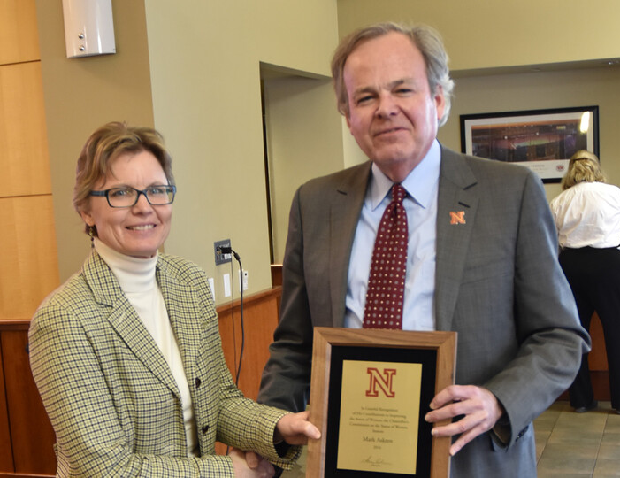
Honoring Weather Ready Farms Designation
Participant will be recognized for their accomplishments.
Means of recognition may include but are not limited to:
Farm sign
Featured in local or regional publications
Social media recognition
Awards banquet
Notes:
Each participant who receives the designation of Weather Ready Farms will be recognized for their accomplishments . We would like to recognize our participants by awarding them with a Farm Sign, featuring them in the local newspaper, recognizing them on our social media page and we also hope to have an awards banquet.
Farm sign
Feature in local or regional publications or media
Social media recognition
Reception or banquet

Slide 13
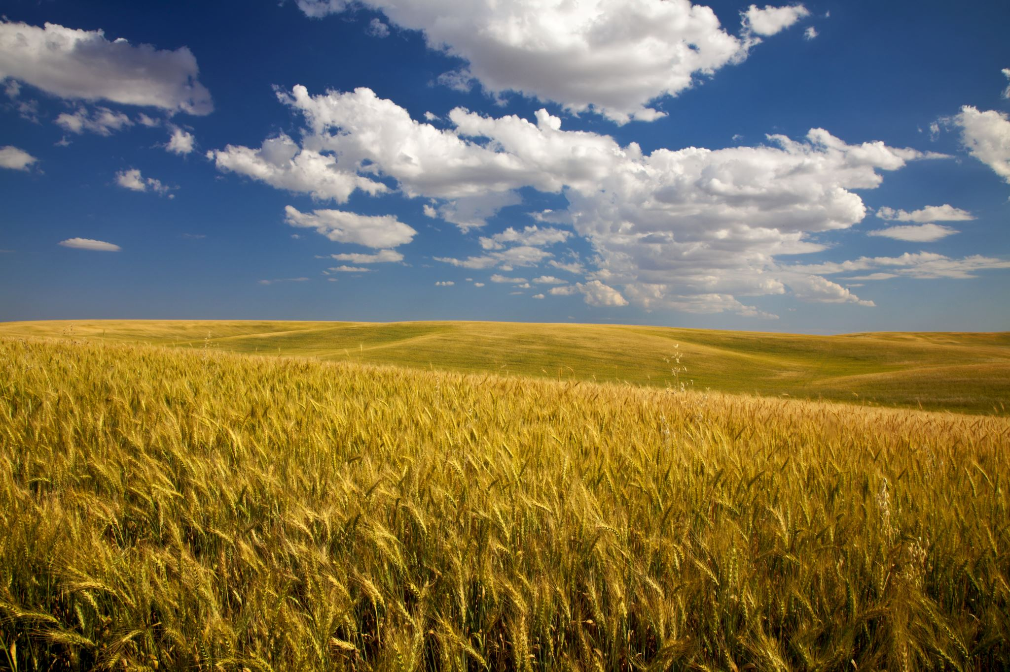
Current Project Status
Our 2021-2023 Weather Ready Farms cohort consists of nine farmers from Southeastern Nebraska.
We have completed the assessment phase of the program and the education phase started February 1, 2022.
We are currently working on developing partnerships to expand program capacity and outreach.
We will begin recruiting for the 2022-2024 cohort, in the next couple months.
Notes:
So what is the current status of our project? Our 2021-2023 Weather Ready Farms cohort consists of 9 farmers from Southeastern NE. These producers are early adapters with 3 of our participants being first generation farmers. We have completed the assessment phase of the program and the educational phase stated on February 1, 2022. We are currently working on developing partnerships to expand program capacity and outreach. We will begin recruiting for the 2022-2024 cohort, in the next couple months.

Slide 14

Purdue Extension’s Weather Ready farms Program
The Nebraska Extension WTF team, has been collaborating with Purdue Extension to assist their team to pilot Weather Ready Farms in Indiana.
Purdue is finalizing their participant recruitment process to create their 2022-2024 WRF cohort. They will begin the assessment phase of the program in February.
Hans Schmitz
Weather Ready Farms Coordinator
Purdue Extension Educator
Notes:
We want to acknowledge the efforts of the Weather Ready Farms program at Purdue. The Nebraska Extension WRF team, has been collaborating with Purdue Extension to assist their team to pilot Weather Ready Farms in Indiana. Purdue is finishing their recruitment process to create their 2022-2024 WRF cohort. They will begin the assessment phase of the program in the next month. We would like to give a special thanks to Hans Schmitz as he was a major contributor to the creation of the Weather Ready Farms program and currently serves as the WRF Coordinator at Purdue Extension.

Slide 15
Future Project Goals
Expand educational opportunities and partnerships
Farm safety, preparation for disaster, and reduction of on-farm hazards
Continue supporting the 2021-2023 WRF cohort with project funding, mentorship, community building, and education.
Crop production resources outside of commodity crops
Precision agriculture and conservation
Recruit and build support for the 2022-2024 WRF cohort to be ready to begin November 1, 2022
Integrate rural sociological research of participants to understand the social and psychological impact of the WRF program
Implement WRF within other universities
Notes:
We have several future goals for Weather Ready Farms,
We want to expand our educational opportunities and partnerships. Specifically develop education related to precision agriculture and conservation; farm safety and preparation for disaster; and expand to specialty crop production resources.
We are working to integrate rural sociological research to understand the social and psychological Impact of the program
We want to continue supporting the 2021-2023 WRF cohort thru project funding, mentorship, community building, and education
Another goal we have is to recruit and build for the next WRF cohort
And finally we would like to see WRF implemented within other Universities

Slide 16
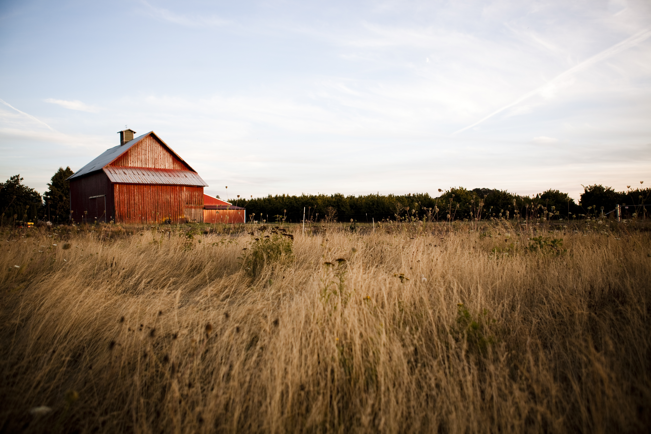



Interested in Collaborating or Setting up a Weather Ready Farms Program within your Organization?
Follow us
Check out our website
weather-ready.unl.edu/farms
Contact us
wravista@unl.edu
@UNL_WRF
@UNLWRF
@unl_wrf
Notes:
Thank you for the opportunity to talk about the Weather Ready Farm Program.
For more information please visit our website, weather-ready.unl.edu/farms, follow us on twitter, Facebook or Instagram
If you are interested in collaborating with weather ready farms or setting up a WRF pilot, please contact us at wravista@unl.edu

