Slide 1
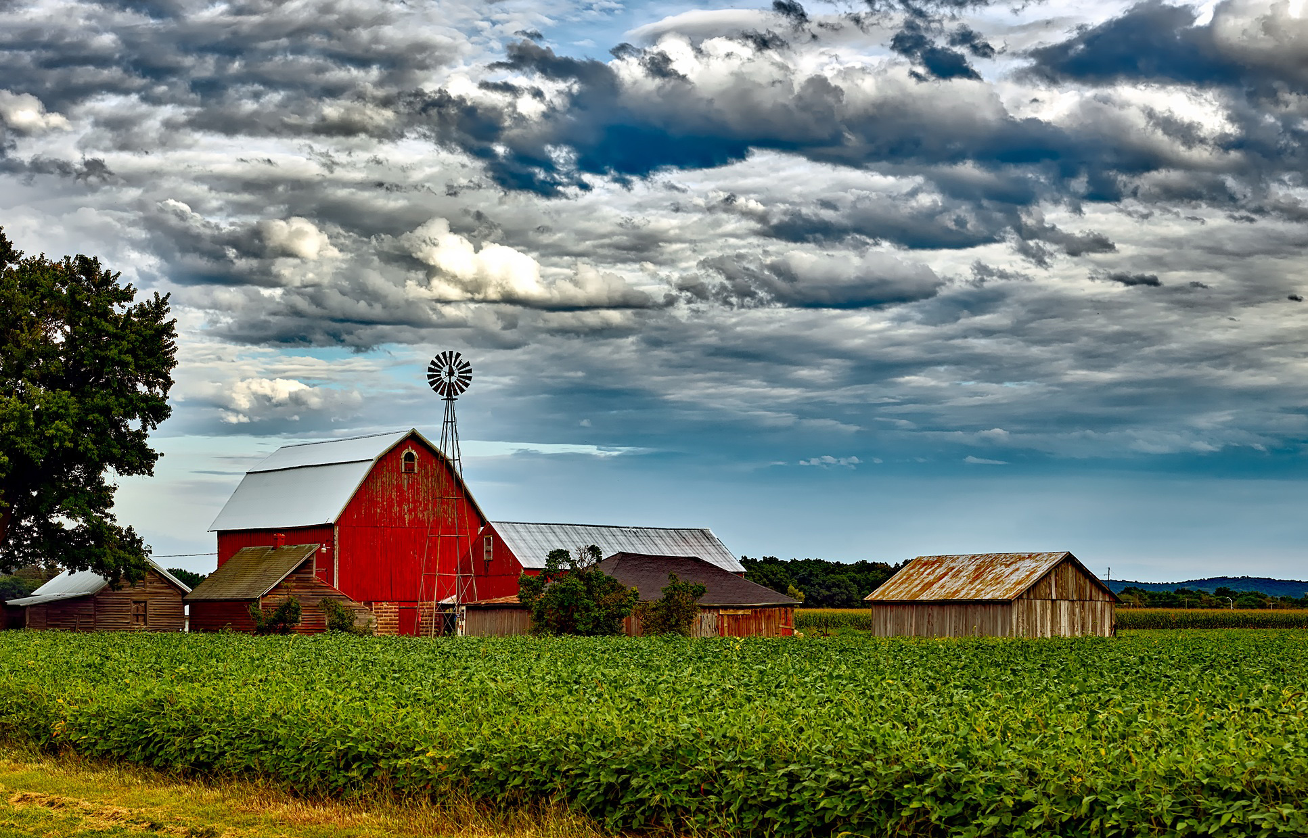

Dr. John Newton, Chief Economist, American Farm Bureau Federation

Slide 2

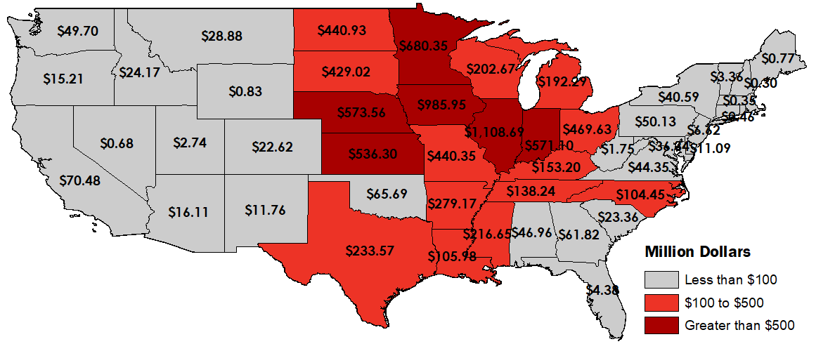
Total Trade Aid in Round One at $8.5+ Billion
As of May 13, 2019, Includes Corn, Cotton, Dairy, Sweet Cherries, Hogs, Shelled Almonds, Sorghum, Soybeans and Wheat
#MFP1
Direct payments to farmers based on production in 2018

Slide 3
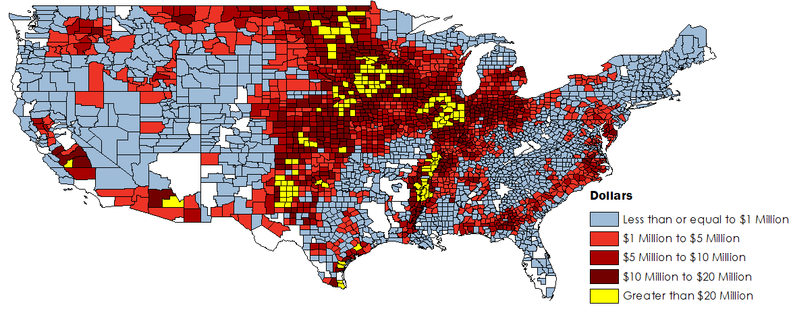
$14.5 Billion in Trade Assistance Dollars Flowed Into Corn & Cotton Belts in Round 2, Two-Year Total Close to $20B
Estimated MFP Payments for 2019, All 3 Tranches, Does Not Include Livestock or Specialty Crop Payments
MFP Payments
Direct payments to farmers based acreage planted in 2019, cover crops eligible to $15 per acre payment.
Source: USDA FSA, Farm Bureau Compilations

Slide 4

Midwest Growing Season
#NoPlant19

Slide 5
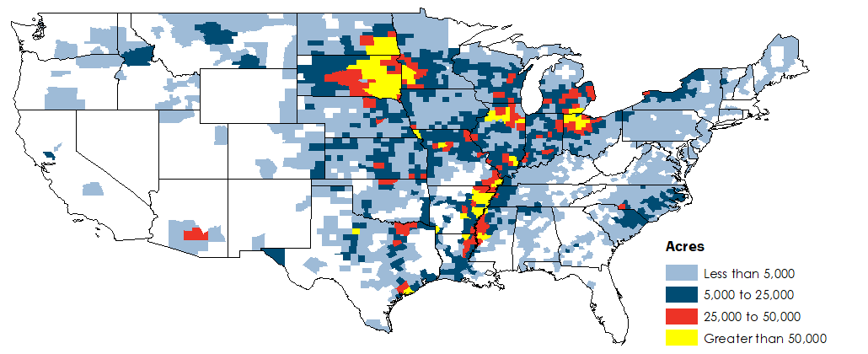
Nearly 20,000,000 Acres Unplanted in 2019 Due To Flooding
Prevent Plant
Prevented planting is a failure to plant an insured crop with the proper equipment by the final planting date.
Source: USDA FSA, Farm Bureau Calculations

Slide 6
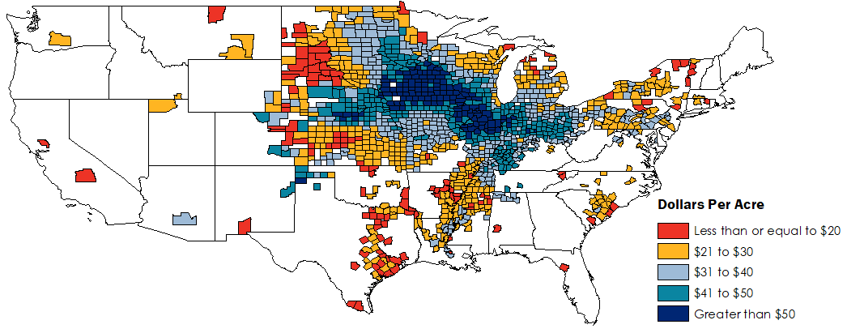
Disaster Aid Bonus Payment for #NoPlant19
$292/acre for Corn ($252 + $38) and $220/acre for Soybeans ($192 + $28)
#Top-Up
Bonus direct payment equal to 10%-15% of the prevent planting insurance indemnity
Source: USDA FSA, USDA RMA, Farm Bureau Calculations

Slide 7
Decline in Trade Assistance Creates a Big Hole in Net Cash Income, Down 11%, or $13 Billion in Inflation-Adjusted Dollars
U.S. Farm Sector Net Cash Income, 2020 inflation-Adjusted Dollars
$3.7B
Market Facilitation Program Payments Final Tranche Payment, Down 75%
$11.3B
Other Federal Support, +19%
$4.7B
Net Federal Insurance Indemnities, Down 27%
$89.9B
Farm-Related Net Cash Income from Crop and Livestock Sales Down 2% or $2B from 2019
Source: USDA ERS, Farm Bureau Calculations

Slide 8
We’re In The 8th Year of a Down Farm Economy
Duration Of Farm Economic Troughs
-29%
Current Downturn
Series Begins in 2012, 29% Decline in Net Cash Income Over 8 Years
-30%
Post WW2 Downturn
Series Begins in 1947, 30% Decline in Net Cash Income Over 8 Years
-45%
1980’s Farm Financial Crisis
Series Begins in 1973, 45% Decline in Net Cash Income Over 8 Years
Source: USDA ERS, Farm Bureau Calculations

Slide 9



Slide 10
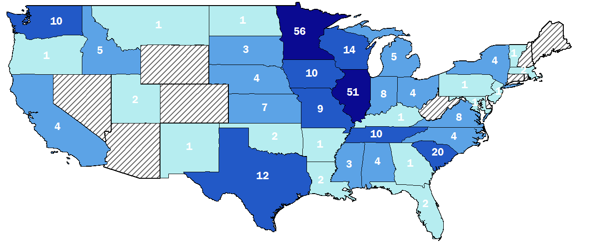
Nearly 300 Respondents and High Participation in Midwest
Source: Farm Bureau Survey

Slide 11
Most Respondents Were Engaged in Crop and Livestock Farming, Few Had Off-Farm Income
Occupation
Farming Activities
Source: Farm Bureau Survey, *Other includes agribusiness, government and trade association, retired and other affiliations

Slide 12
Less Than A Quarter of Producers Expect Higher Prices in 2020, Better Long-Term Outlook
Compared to today, what are your expectations for farm cash receipts and commodity prices in 2020?
Lower
About The Same
Higher
Over Next Five Years
USDA Forecasts 3% Increase in Crop and Livestock Receipts
Source: Farm Bureau Survey, USDA ERS

Slide 13
Most Producers Expect Higher Production Expenses in 2020, Long-Term Costs Certain to Rise
Compared to today, what are your expectations for farm production expenses in 2020?
Lower
About The Same
Higher
Over Next Five Years
USDA Forecasts 3% Increase in Cash & Total Expenses
Source: Farm Bureau Survey, USDA ERS

Slide 14
More Than 80% of Farmers Expect Profits to Be The Same or Lower in 2020, Slightly More Long-Run Optimism
Compared to today, what are your expectations for farm profitability in 2020?
Lower
About The Same
Higher
Over Next Five Years
USDA Forecasts 3% Increase in Net Farm Income, 9% Decrease in Net Cash Income
Source: Farm Bureau Survey, USDA ERS

Slide 15
Few Producers Expect Farmland Values or Cash Rents to Decline in 2020 & Likely to Hold Long-Term Value
Compared to today, what are your expectations for farmland values and cash rents in your area in 2020?
Lower
About The Same
Higher
Over Next Five Years
2019 Cash Rents Increased by 1.4%
Source: Farm Bureau Survey, USDA NASS

Slide 16
Majority of Farmers Expect Debt to Rise in 2020 & See No Major Change In Long-Run Debt Trends
Compared to today, what are your expectations for farm debt in 2020?
Lower
About The Same
Higher
Over Next Five Years
USDA Forecasts Farm Debt to Rise 2.3%, Real Estate Up 3.2%
Source: Farm Bureau Survey, USDA ERS

Slide 17
Farm Investments Expected to Slow in 2020, Hesitant to Make Long-Run Investments
Compared to today, what are your expectations for farm investments and capital purchases in 2020 (new buildings, equipment, technology, etc.)?
Lower
About The Same
Higher
Over Next Five Years
USDA Forecasts Capital Expenditures to Rise 0.7%, Down 35% Since 2014
Source: Farm Bureau Survey, USDA ERS

Slide 18





New AFBF Risk Management Partner
Know-Risk™
Crop Marketing
Futures/OTC
Trades
Market
Intelligence
Market Outlooks
& Education
20% Off
10 Free Trades
Up to 90% Off
40% Off
Learn More at FB.org/FCStone
Member benefits available in participating states. Details and restrictions apply.

Slide 19



AFBF Economics Team
Veronica Nigh
Economist
Issues: International Trade, Food Aid, Food Safety, Labor Markets, Tax Policy
Michael Nepveux
Economist
Issues: Renewable Fuels, Agricultural Data, Livestock and Dairy Markets, Hemp
Megan Nelson
Economic Analyst
Issues: Transportation, Rural Development, Global Development, Tax Policy
Shelby Myers
Economist
Issues: Crop & Specialty Crop Markets, Environment and Water, Federal Land Issues

Slide 20


