Slide 1

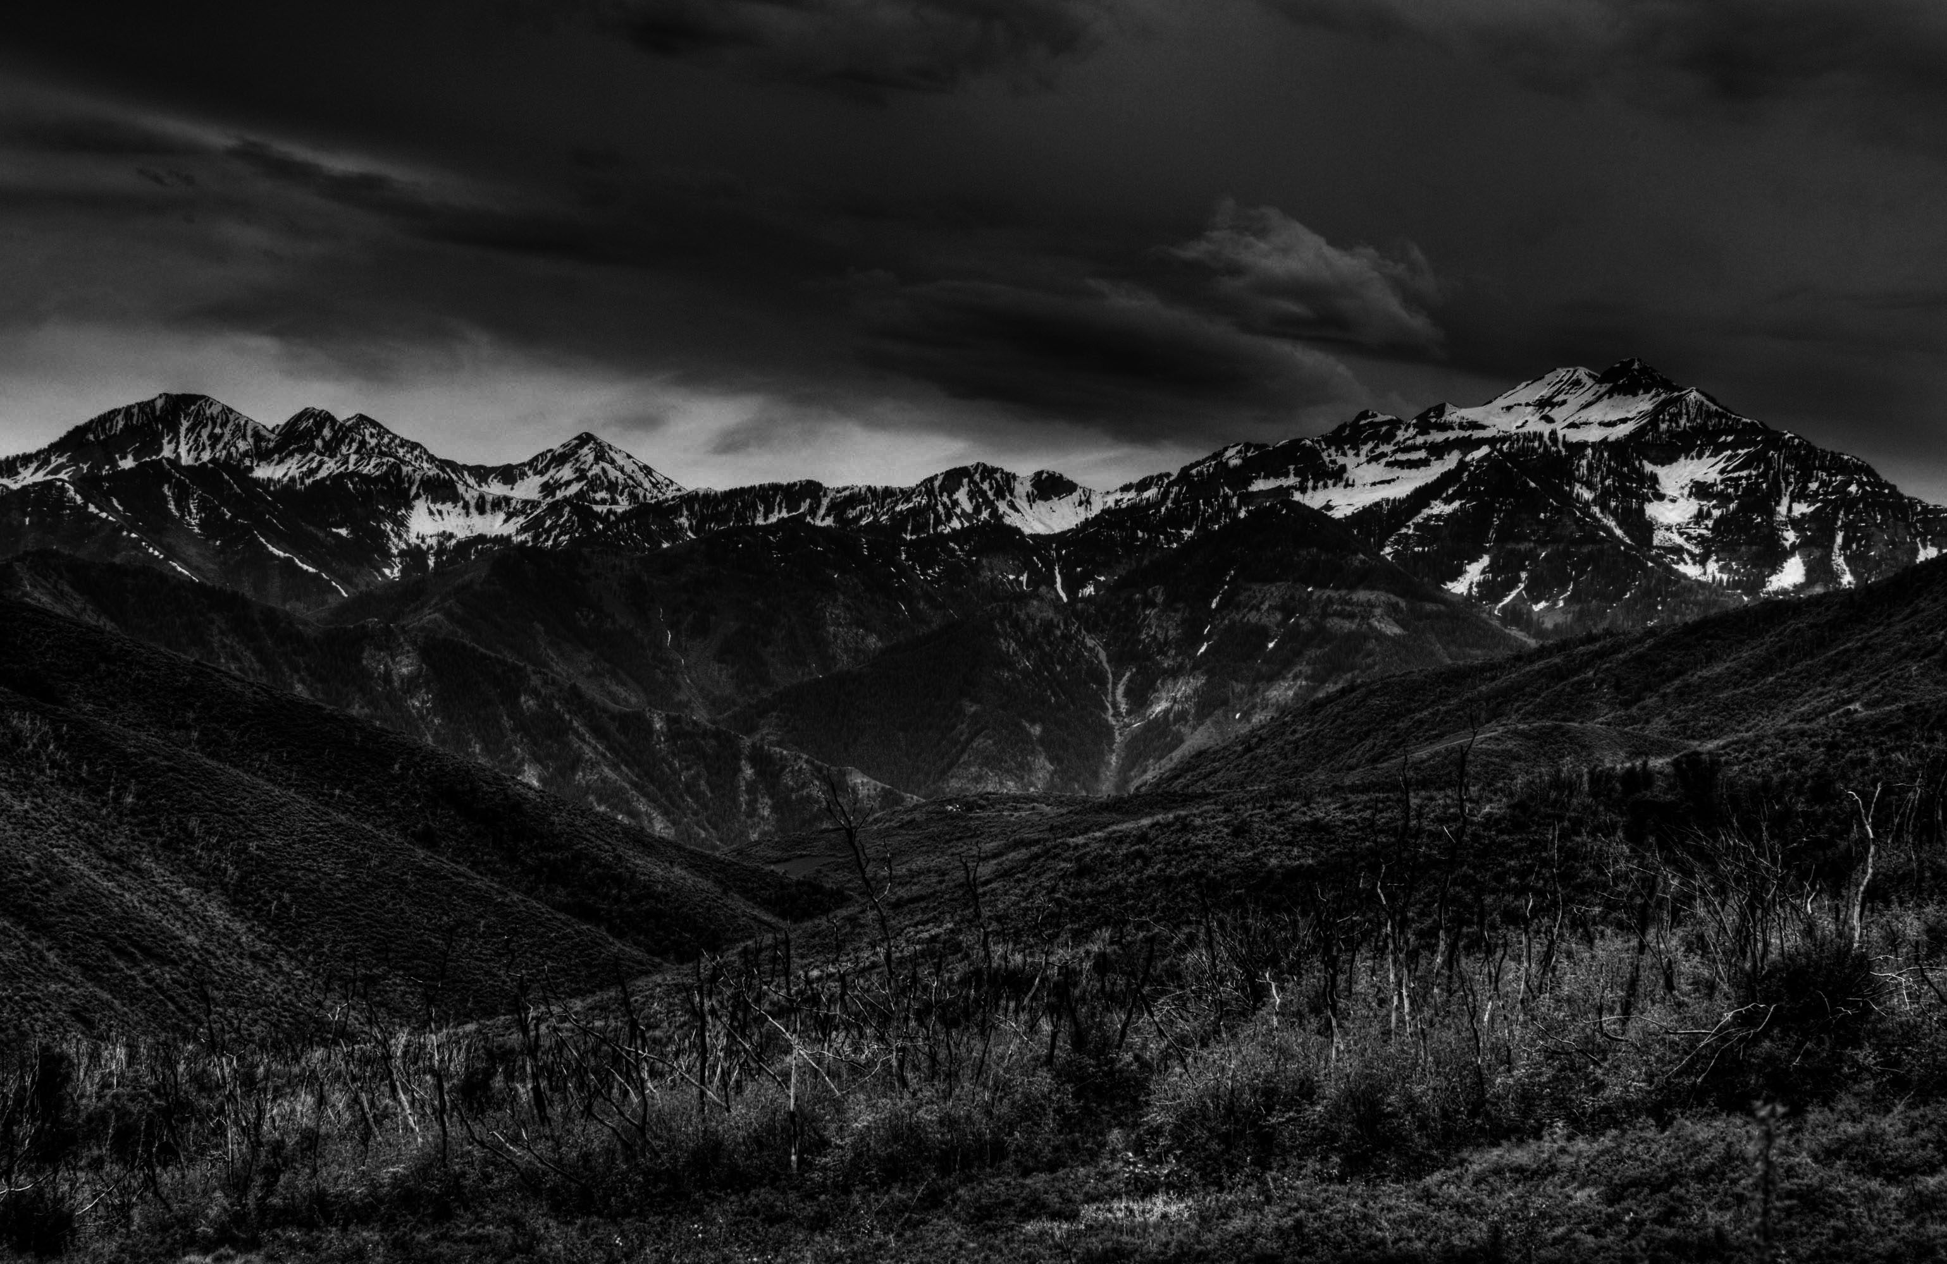

Building a better presidential Transition
JIM OGSBURY
Executive Director
JIM OGSBURY
Executive Director

Slide 2
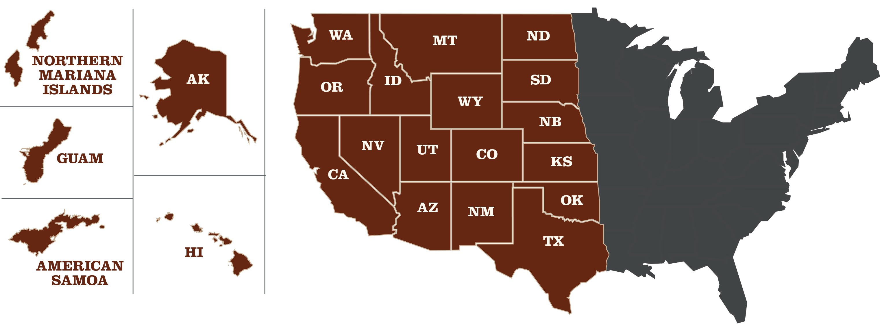
THE WGA REGION

Slide 3
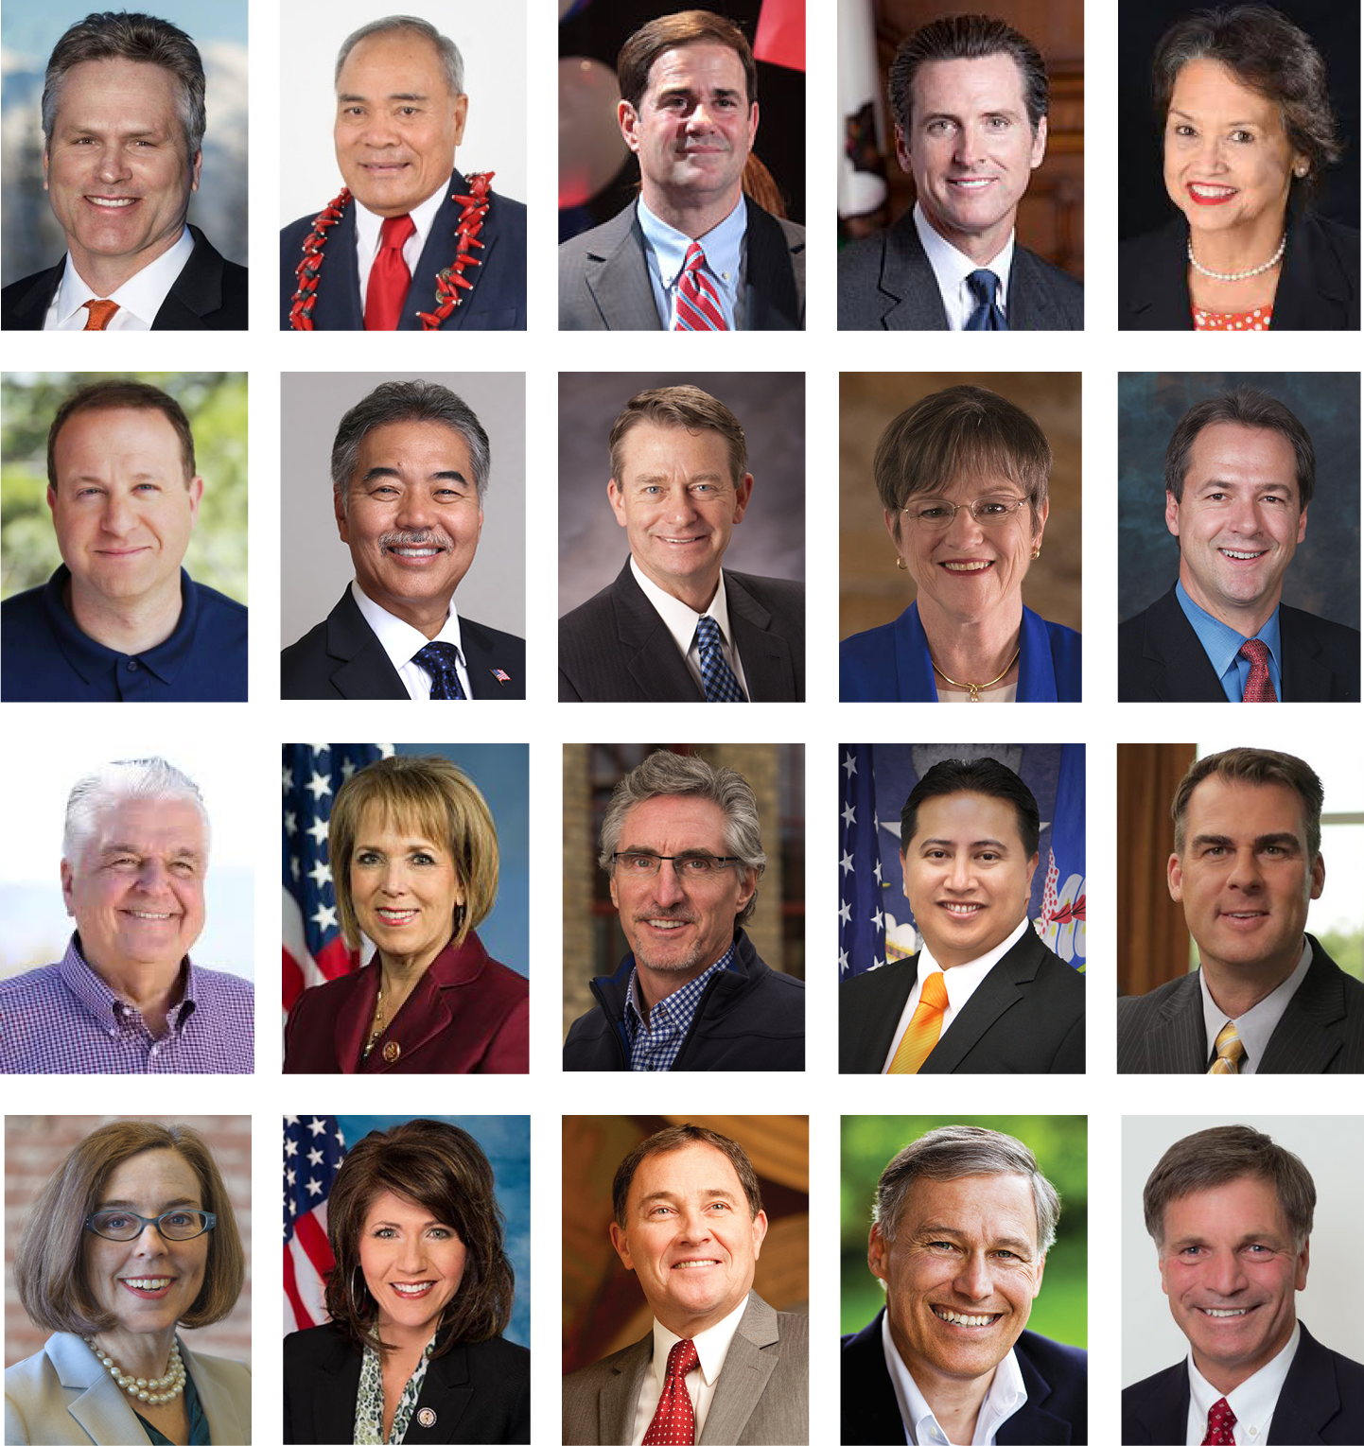
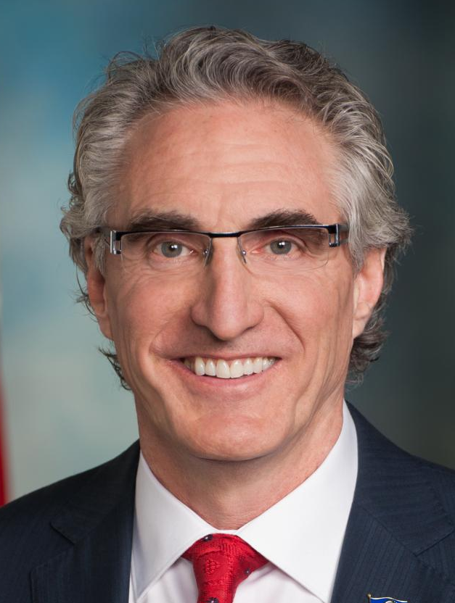
THE GOVERNORS
Gov. David Ige,
Hawai‘i
Gov. Doug Burgum,
North Dakota
Gov. Kate Brown,
Oregon

Slide 4



Slide 5



CHAIRS’ INITIATIVE

Slide 6



CHAIRS’ INITIATIVE

Slide 7
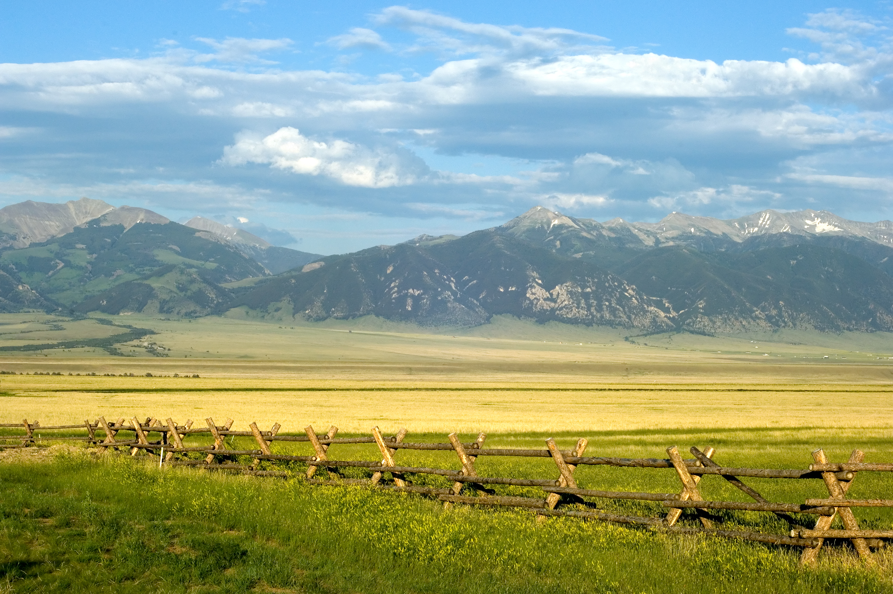

WORKING LANDS ROUNDTABLE

Slide 8
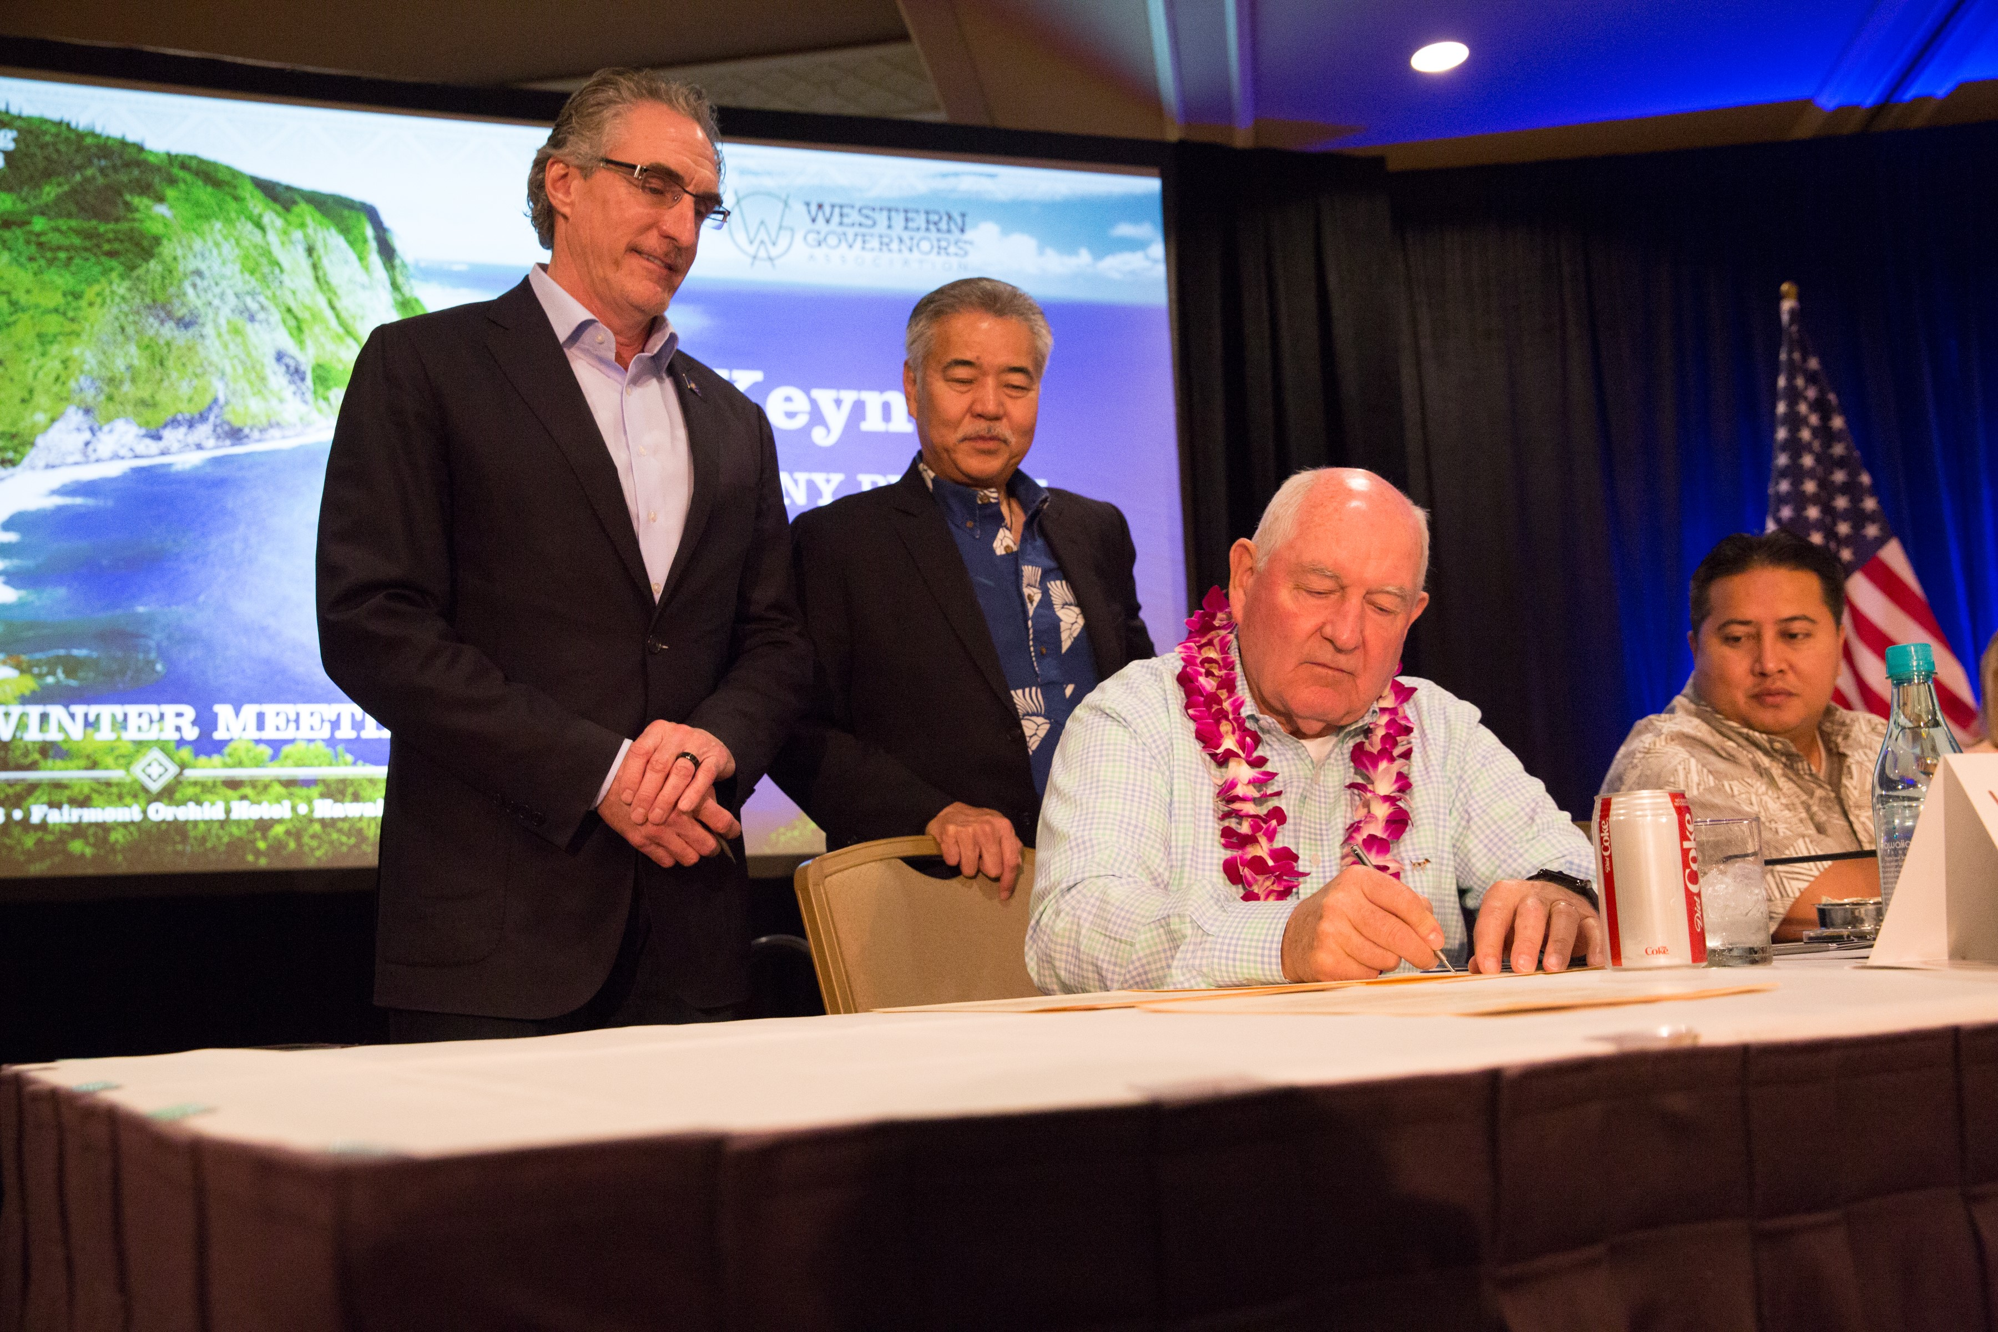
SHARED STEWARDSHIP

Slide 9
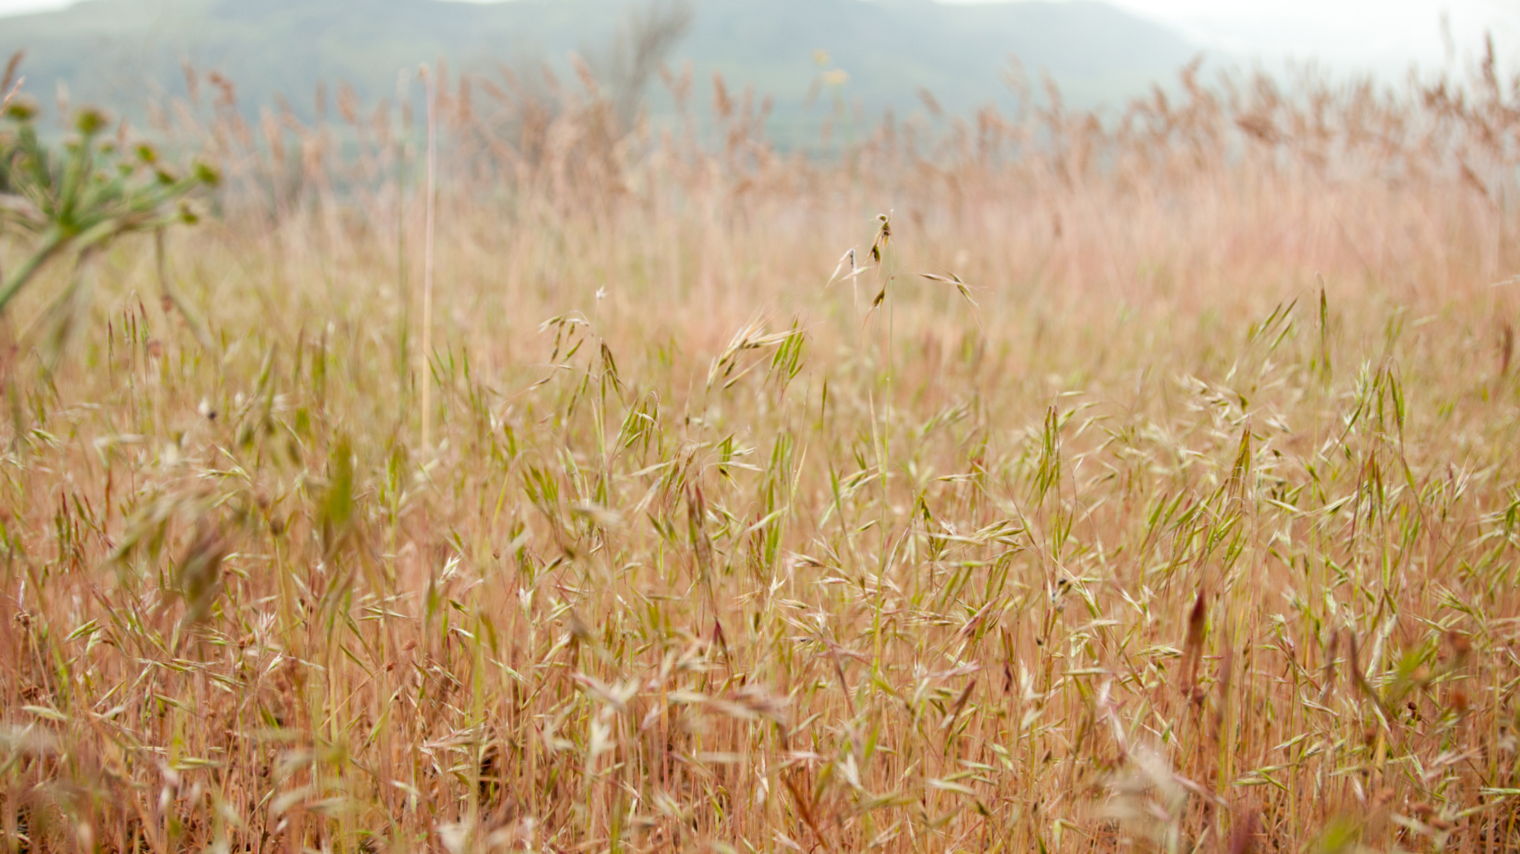
CHEATGRASS

Slide 10
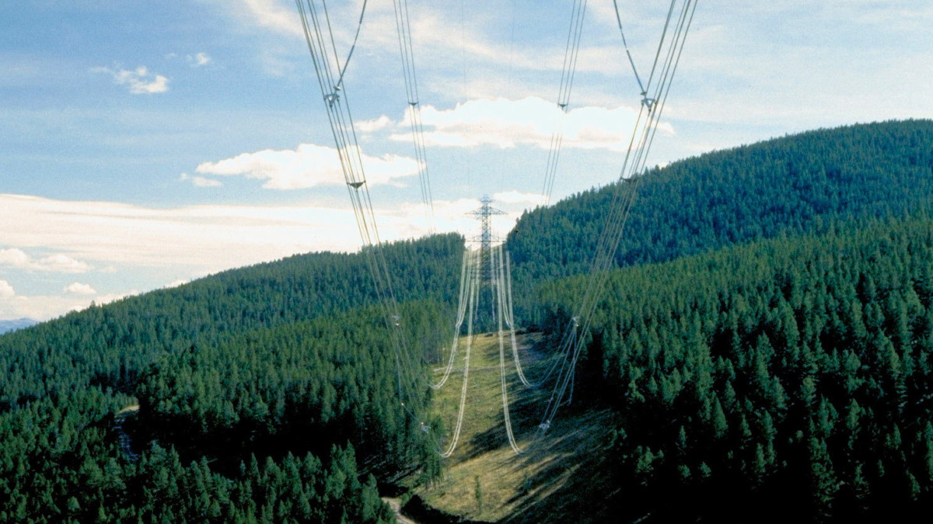
VEGETATION MANAGEMENT

Slide 11
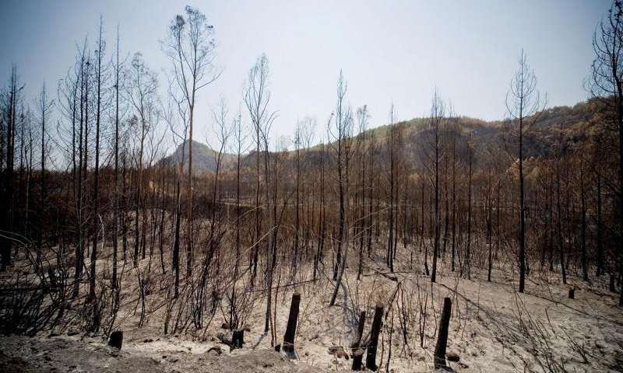
POST-DISASTER RECOVERY

Slide 12
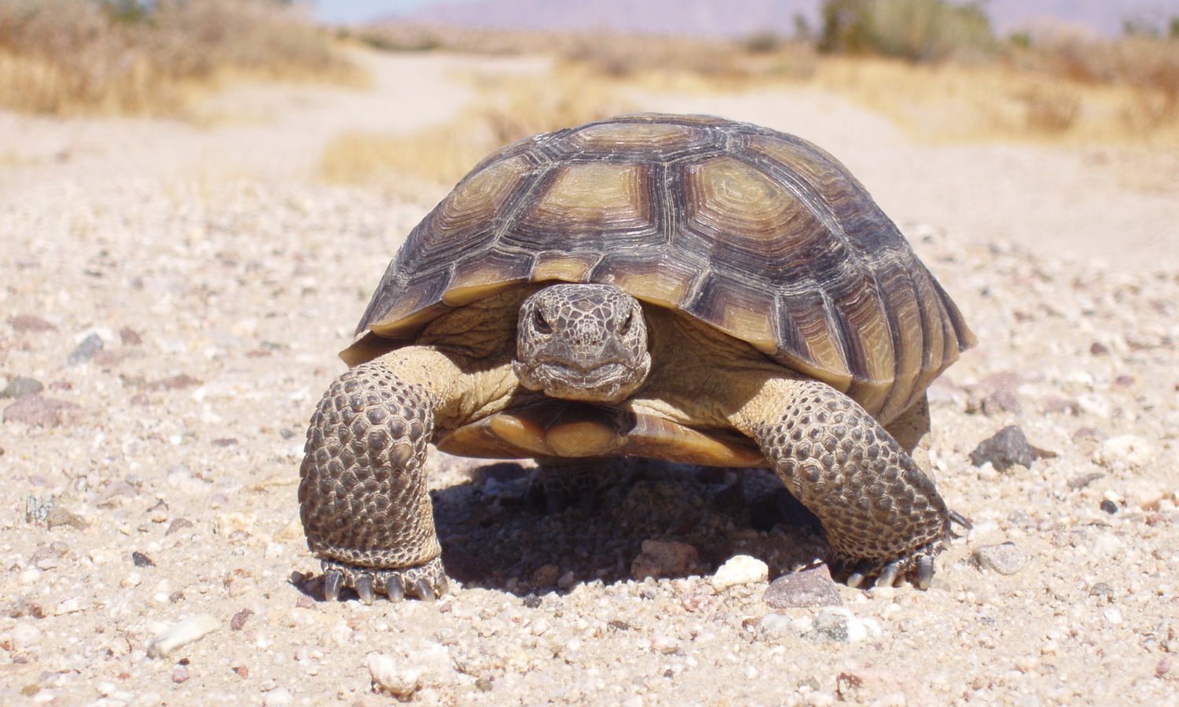
COLLABORATIVE CONSERVATION

Slide 13
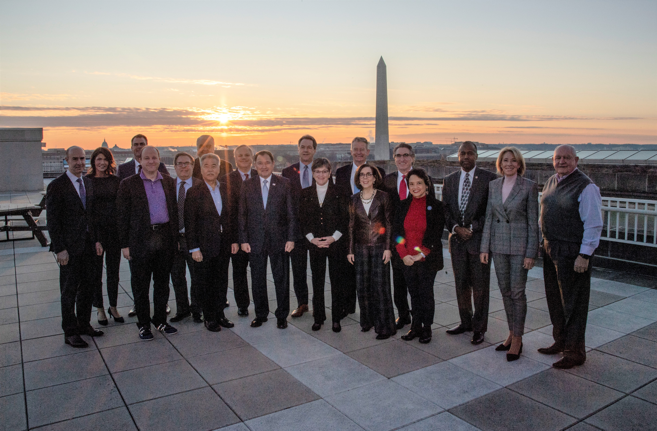
STATE-FEDERAL COLLABORATION
Notes:
State-Federal Collaboration

Slide 14


Westgov.org

